Slide 1
Introduction to Bioinformatics using NGS data
Martin Dahlö
2022-03-28

Slide 2
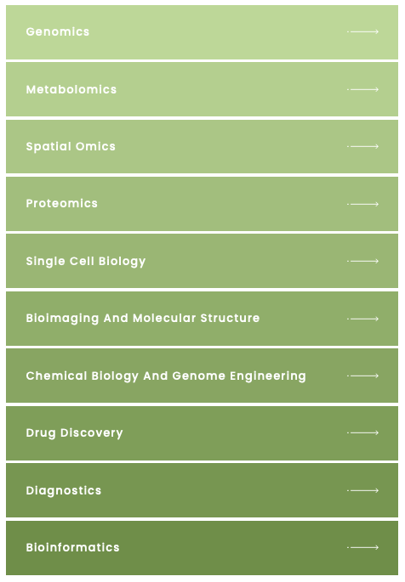
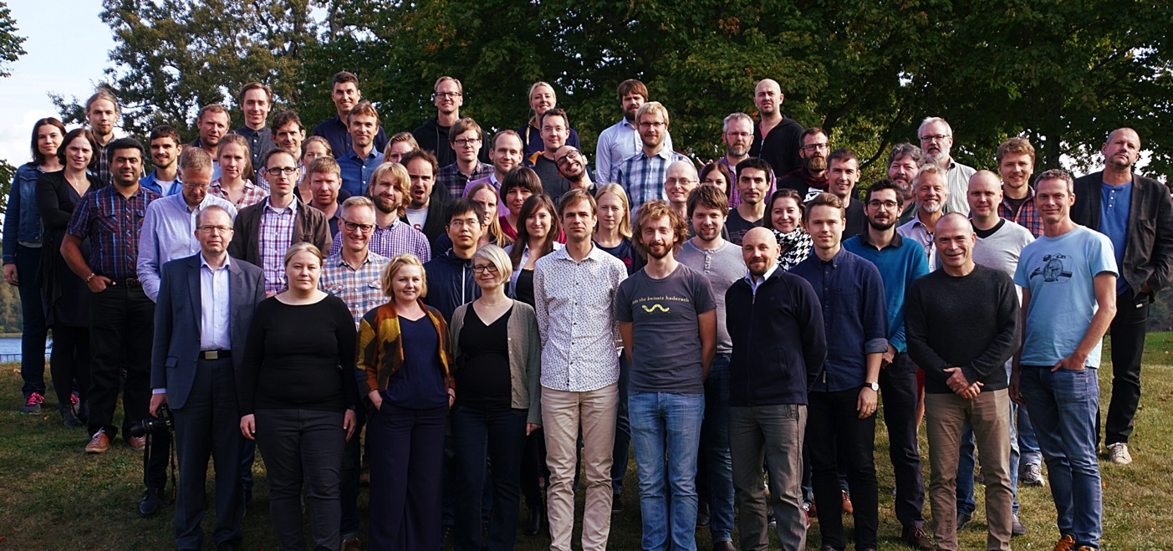


SciLifeLab, NBIS and NGI
SciLifeLab services
Umeå
Staff at six different sites across Sweden with expertise in many different omics-related areas
Uppsala
Stockholm
Linköping
Göteborg
Lund
Notes:
This workshop is organized by SciLifeLab: NGI (national genomics infrastructure) is part of the Genomics platform, NBIS is the bioinformatics platform.

Slide 3

Teachers on this workshop are from NBIS and NGI
Publication
Study design
Data generation
Standard analyses
Project-specific analyses
Notes:
Most teachers on this workshop work at NBIS. We are involved in planning of projects and project specific data analysis, and teaching. Teachers on Tuesday afternoon are from NGI; who are involved in producing data and implementing and running standard analyses.

Slide 4

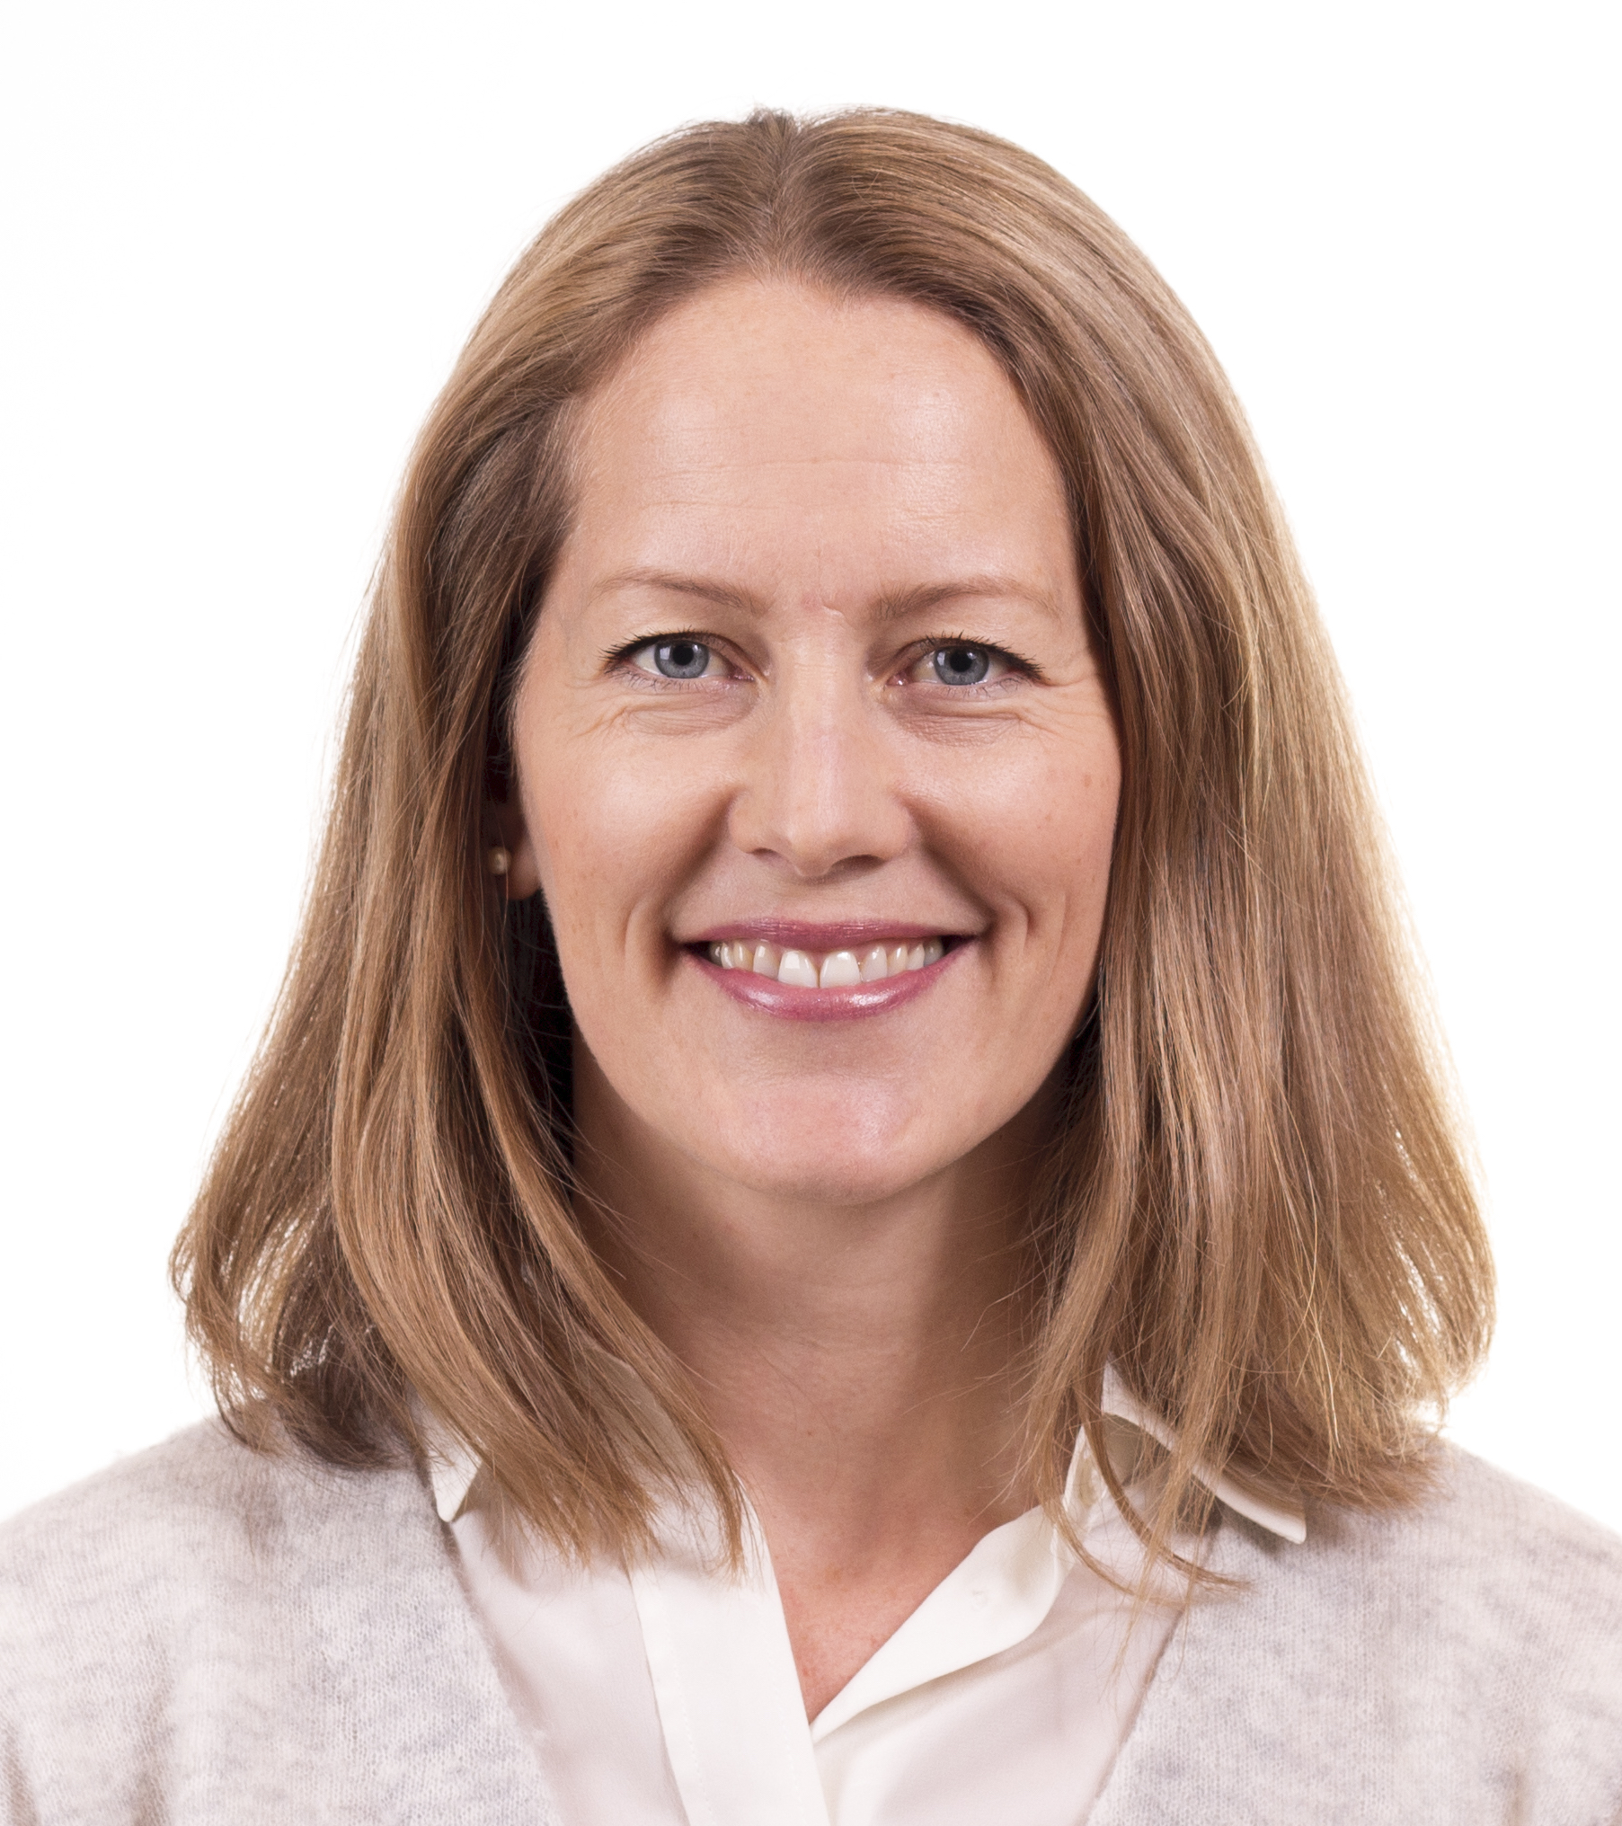

Workshop organizers
Roy Francis
Malin Larsson
Martin Dahlö

Slide 5
NBIS Bioinformatic Support
Drop-in sessions every week @ all 6 sites
Online (Zoom) Tuesdays at 14.00, for free
Study design and project consultation
Three hours per project, for free
Fee-for-service support
User fee 800 SEK per hour, however many hours you may need
No selection process, all project are welcome
Long-term support
Selection process based on scientific peer-review
A total of 500 hours, for free
Partner Projects
Full-cost model: utilize and pay for 50% of one NBIS FTE

Slide 6
NBIS Training
Some example NBIS courses
Introduction to bioinformatics using NGS data
Bulk and single-cell RNA-seq
Python and R programming
Tools for reproducible research
Omics integration and systems biology
Biostatistics and machine learning
Check out our training catalogue:
https://uppsala.instructure.com/courses/48087/pages/nbis-training-catalogue

Slide 7
More information about NBIS on Friday!

Slide 8
Practical information

Slide 9
Lectures
Live in zoom
Please have camera on during lectures
Have sound muted (except when asking questions)
Tuesday 13:15 – 15:15: We will watch a pre-recorded video. Questions can be asked in the main zoom window at 15:15.

Slide 10
Labs
Work in breakout rooms in zoom
Work in pairs because it improves the learning
New pair each day / module
When you need help: Type “Need help in room xx” in this document:
https://hackmd.io/KUSlRPLaRP2vvpyPC_QYyw
Then a teacher will come to you room and help out
Notes:
Show how to edit hackmd

Slide 11
Open session on Friday afternoon
Opportunity to discuss your research projects
Discussion topic servey: https://www.menti.com/qz4xgxnym3
We will try to arrange groups according to your preferred topics

Slide 12
Questions?
Please ask questions and take part in discussions trough out the workshop!

