Slide 1
Quality Control of NGS data
Malin Larsson
Malin.Larsson@nbis.se

Slide 2
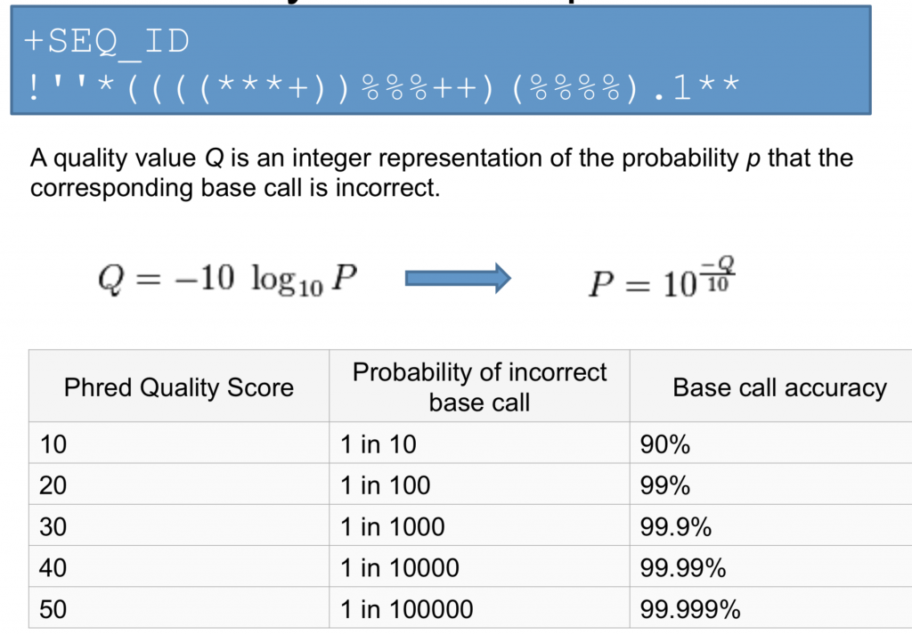
Phred Quality Scores

Slide 3
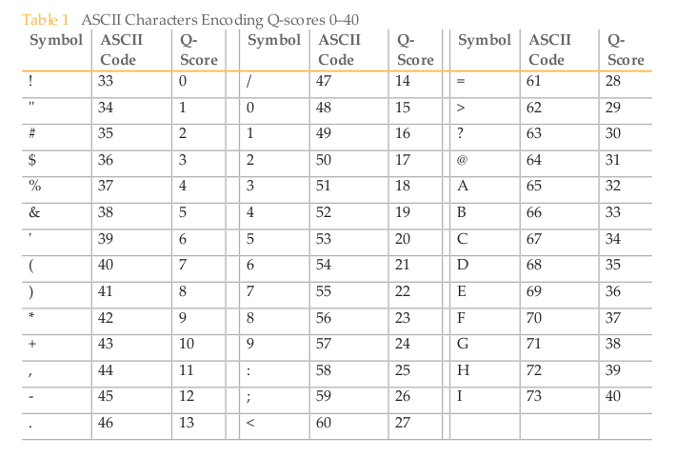
ASCII encoded quality scores

Slide 4
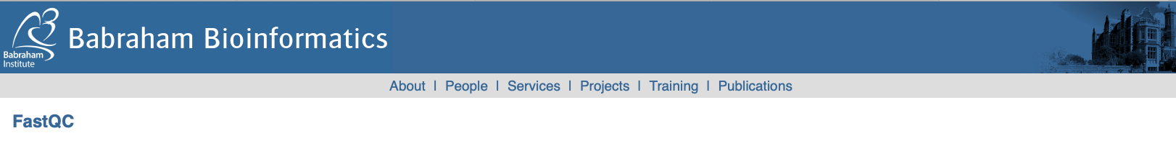
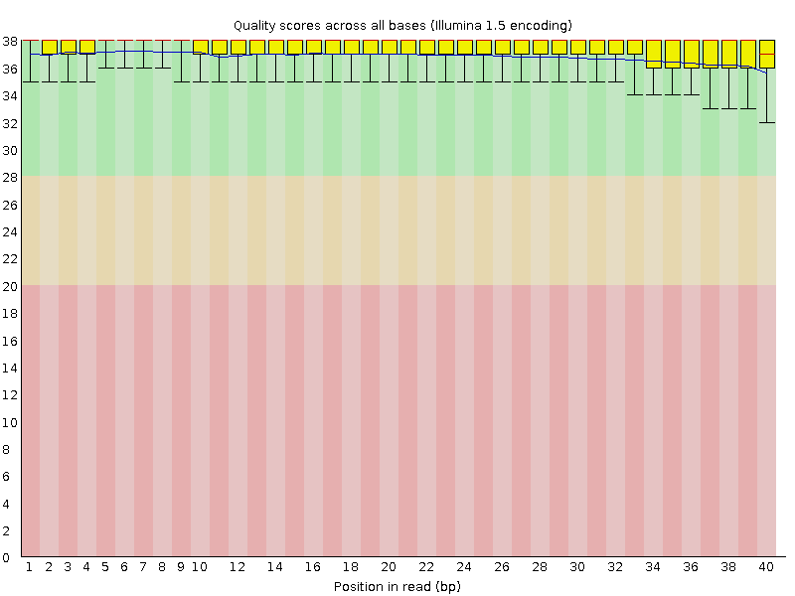
FastQC
Bad qualities: Good qualities:

