Slide 1
NGS workflow
Lab discussion

Slide 2
Annovar and gene information
Chr | Start | End | Ref | Alt | Func | Gene | GeneD. | ExonicFunc | AAchange | snp138 | 1000g2015aug_all | 1000g2015aug_eur | 100g2015aug_afr
2 | 136608646 | 136608646 | G | A | intronic | MCM6 |  |  |  | rs4988235
The variant site is within an intron of MCM6,
but acts as an enhancer of the neighboring gene LCT (according to Mattar, et. al., 2012)
It is common to look for variants in exons first, there are 7 exonic variants in LCT in these samples: “cat my_annovar.hg19_multianno.txt | grep LCT | grep exonic”

Slide 3
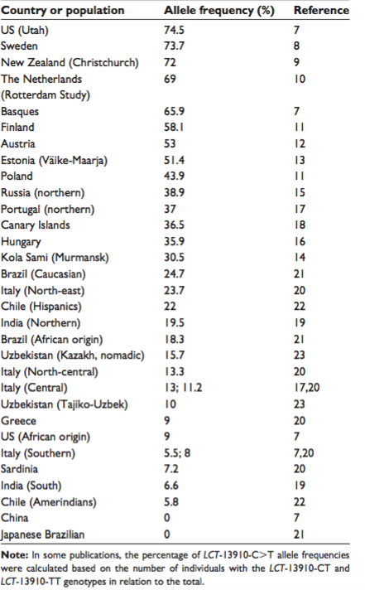
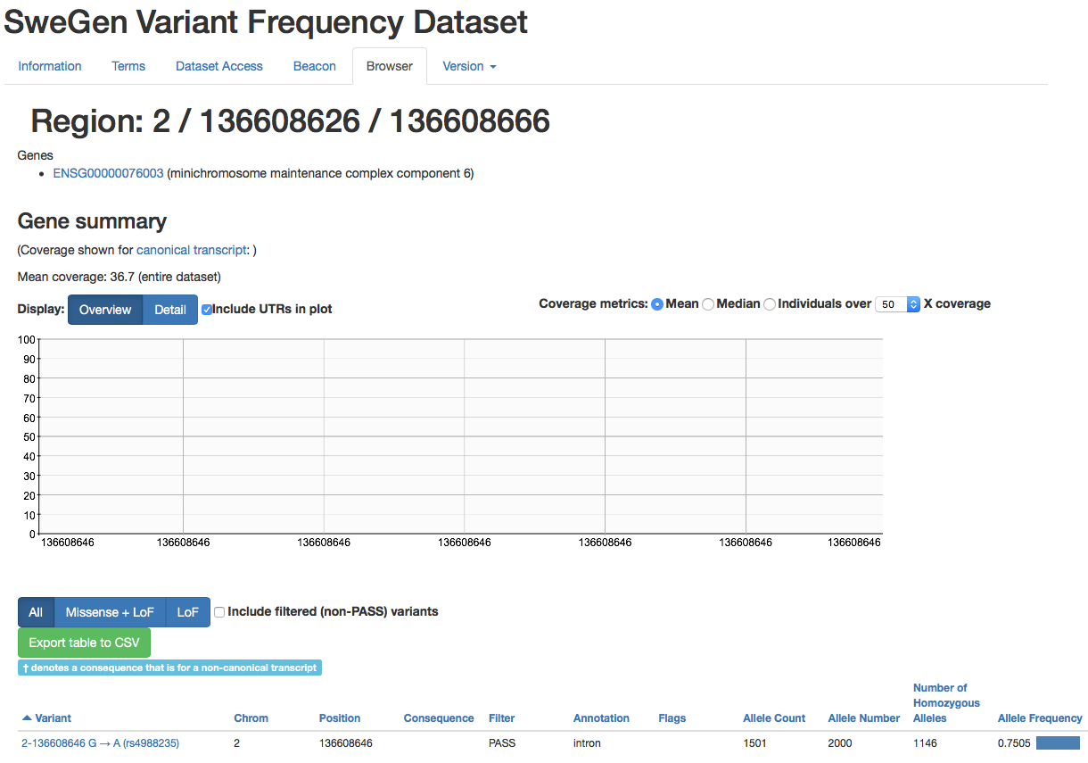
Annovar and allele frequency
Chr | Start | End | Ref | Alt | Func | Gene | GeneD. | ExonicFunc | AAchange | snp138 | 1000g2015aug_all | 1000g2015aug_eur | 100g2015aug_afr
2 | 136608646 | 136608646 | G | A | intronic | MCM6 |  |  |  | rs4988235 | 0.161 | 0.508 | 0.03
Mattar et al., 2012

Slide 4
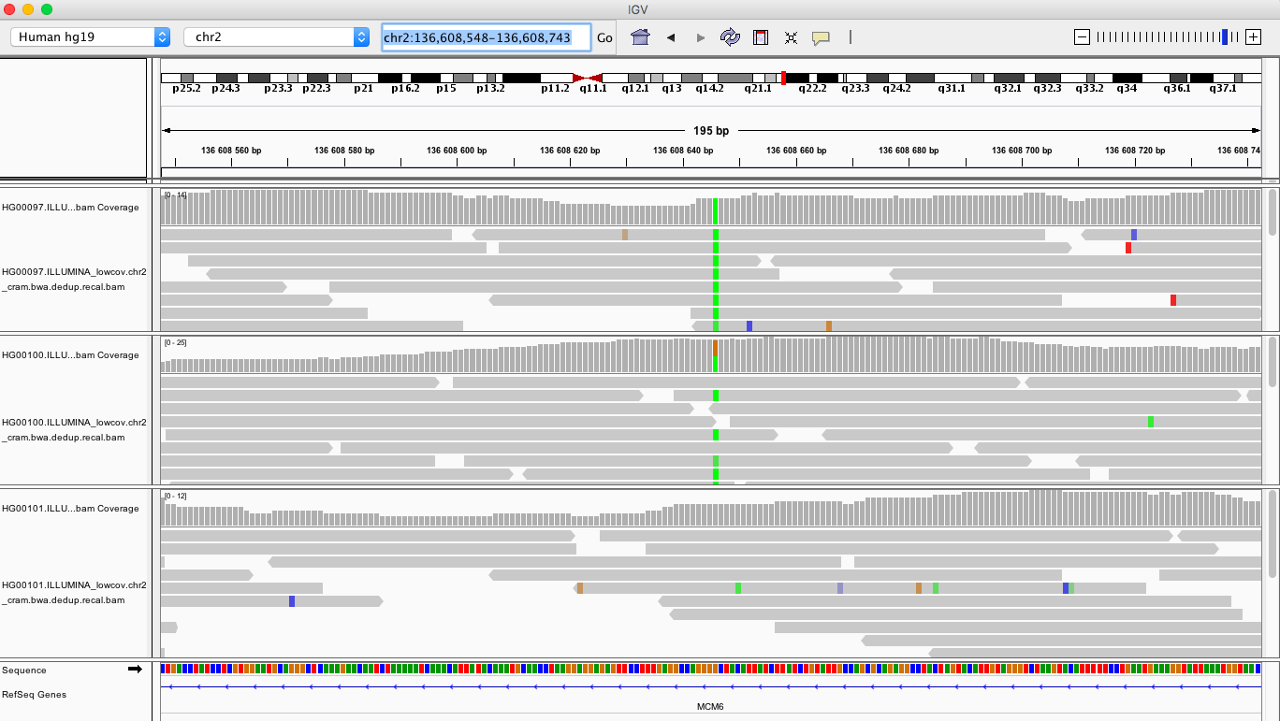
IGV
Read length?
Do we have decent coverage across the variant position?
Homozygotes/heterozygotes?
Who can drink milk?

Slide 5
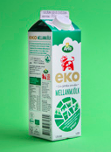
IGV

Slide 6
Vcf files
Descriptions of each field can be found in the header section (lines starting with '#')
CHROM POS ID REF ALT QUAL FILTER INFO FORMAT HG00097 HG00100 HG00101
2 136608646 . G A 628.02 PASS AC=3;AF=0.500;AN=6;BaseQRankSum=-3.410e-01;ClippingRankSum=0.00;DP=38;ExcessHet=1.5490;FS=3.211;MLEAC=3;MLEAF=0.500;MQ=60.00;MQRankSum=0.00;QD=20.26;ReadPosRankSum=-3.970e-01;SOR=1.037;set=snp
GT:AD:DP:GQ:PL 1/1:0,9:9:27:316,27,0 0/1:11,11:22:99:348,0,382 0/0:7,0:7:21:0,21,223

Slide 7
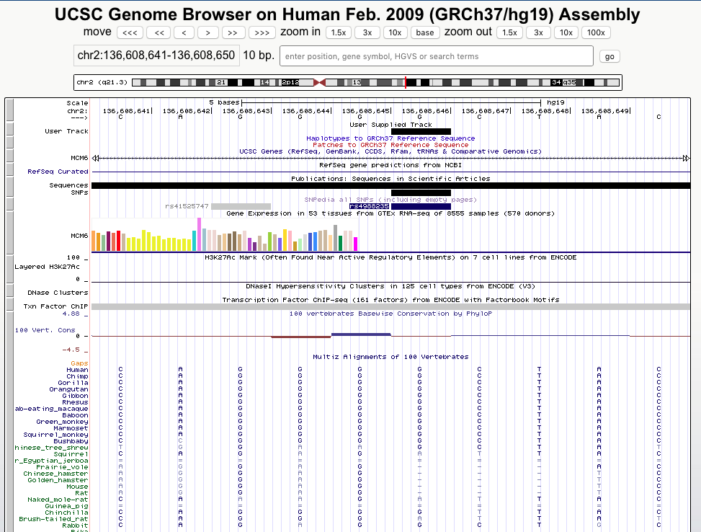
UCSC
Most species have the G allele, however squirrels and naked mole rat apparently have the A allele

Slide 8
Questions
MarkDuplicates: 588 duplicate reads
697 of the 711 variants passed the filters
108 variants are indels (use: --keep-only-indels)

Slide 9
Warnings
Warnings are common, google them if you are not sure what they mean
JointGenotyping: Some filters require heterozygote variants
You probably got a warning that optical duplicates were not discovered. This is because the read names are not properly formatted to be able to do this
Annovar: “1 invalid alternative alleles found in input file” (it is a '*', which is a symbol used by JointGenotyping when some samples have a SNP and others have an indel covering that site.

