Slide 1
Quality Control of NGS data
Notes:
QC is the first thing done after sequencing
Some QC is often already done by the sequencing facility
Need to know how to understand their report

Slide 2
FASTQ files
@HWUSI-EAS100R:6:73:941:1973#0/1
GATTTGGGGTTCAAAGCAGTATCGATCAAATAGTAAATCCATTTGTTCAACTCACAGTTT
+
!''*((((***+))%%%++)(%%%%).1***-+*''))**55CCF>>>>>>CCCCCCC65
Line 1: An “@” followed by a sequence identifier (machine ID, x-y coordinates, ...)
Line 2: The nucleotide sequence
Line 3: A “+” optionally followed by the sequence identifier again
Line 4: Encoded quality scores, one for each base in the read
Bad nucleotides are sometimes written as N (“unknown”, “any”)
Character “!” is quality zero
If you see an uppercase character, the quality is ok
Notes:
Raw sequences are stored in text files
Usually gzip-compressed (extension .gz) (not in the QC lab, though)
FASTQ format has four lines per record
Sequence itself can also be used for QC purposes. For example, by checking for adapter contamination
Here, focus on quality values
“A” represents quality 32

Slide 3
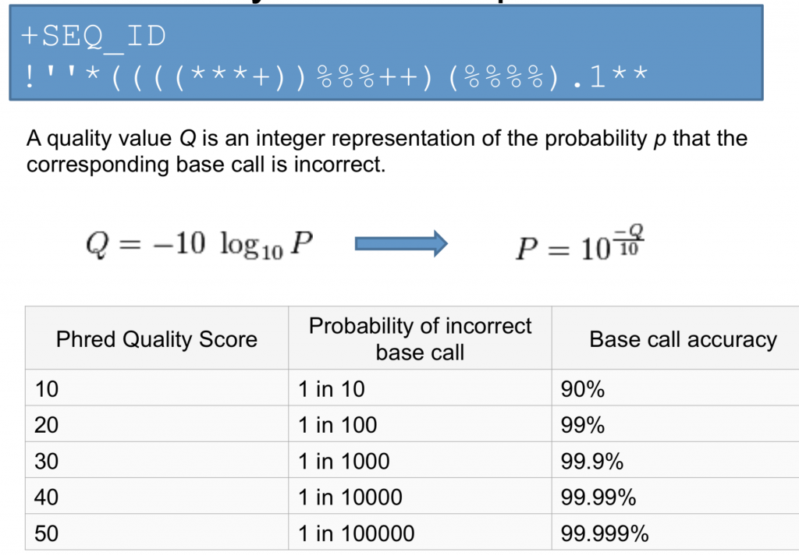
Phred quality scores
Notes:
Why does it not make much sense to have quality 0?

Slide 4
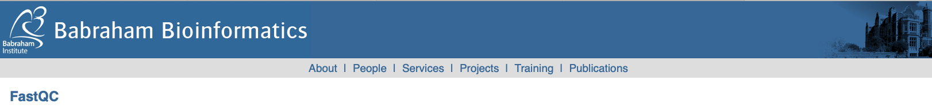
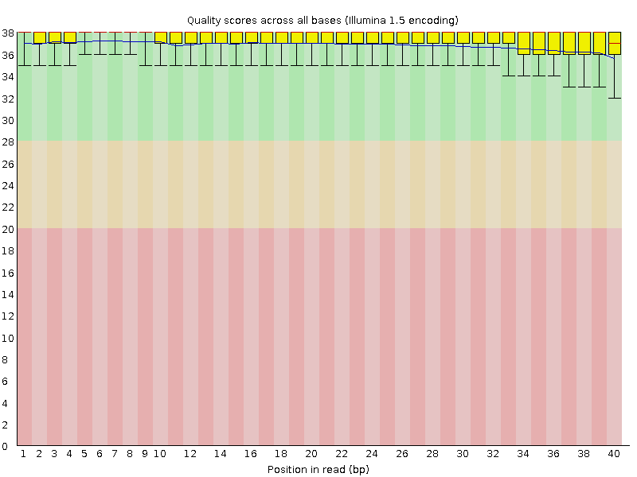
FastQC
Bad qualities: Good qualities:
Notes:
Very typical: Quality degrades over time
This module shows the distribution of the quality scores at each position in the reads. The quality scores are represented by a box-and-whisker plot with the following elements:
The central red line is the median value.
The yellow box represents the inter-quartile range (25-75%).
The upper and lower whiskers represent the 10% and 90% points
The blue line represents the mean quality

Slide 5
Quality trimming
Low-quality read ends may introduce spurious variant calls or other problems
A tool to trim these is Cutadapt. For 3' trimming, run: cutadapt -q 20 -o output.fastq.gz input.fastq.gz
Removes ends with quality less than 20 (you choose)
Often not needed because read aligners should handle it
(Cutadapt can also remove adapters and primers)
Notes:
-q 10 would be a bit more conservative; doesn’t remove as much

Slide 6
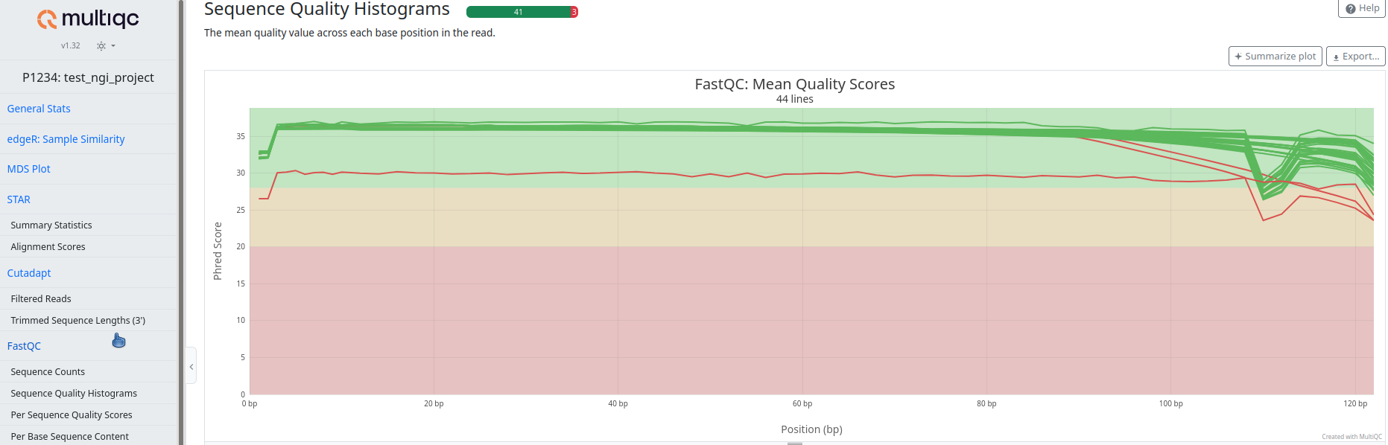
MultiQC
Gathers output from other bioinformatics tools and generates a single report for all samples
Example NGI report:
Notes:
All the blue lines (means) from the individual FastQC plots shown at once for all samples

Slide 7
What is QC?
Different NGS application have their own problem areas and require their own QC strategy
Today: Focus on QC for whole genome sequencing
For variant calling, it is important to look at quality score distribution, sequence length distribution and duplication levels.
Thursday: More details on QC for RNA-seq

Slide 8
Links
FastQC homepage
Explanation of FastQC’s sequence quality plot
MultiQC homepage
MultiQC example report

