Slide 1
Introduction to Bioinformatics using NGS data

Slide 2
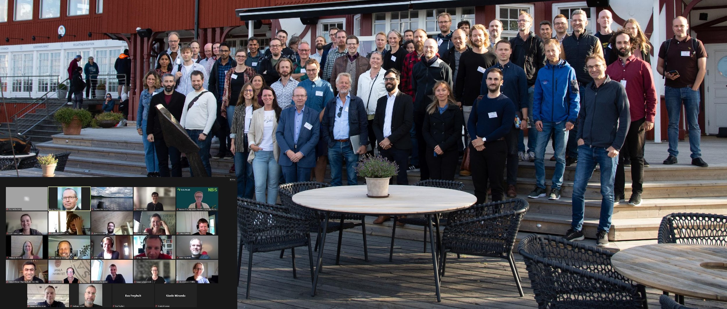
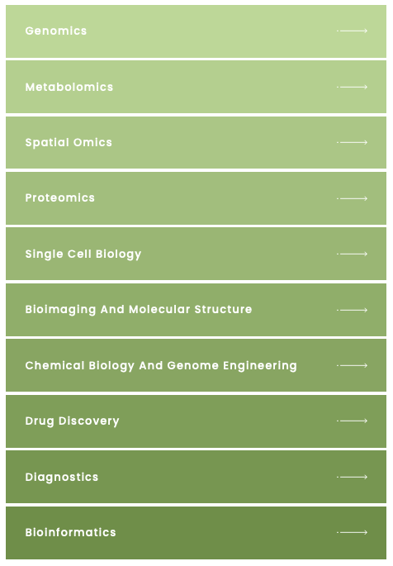
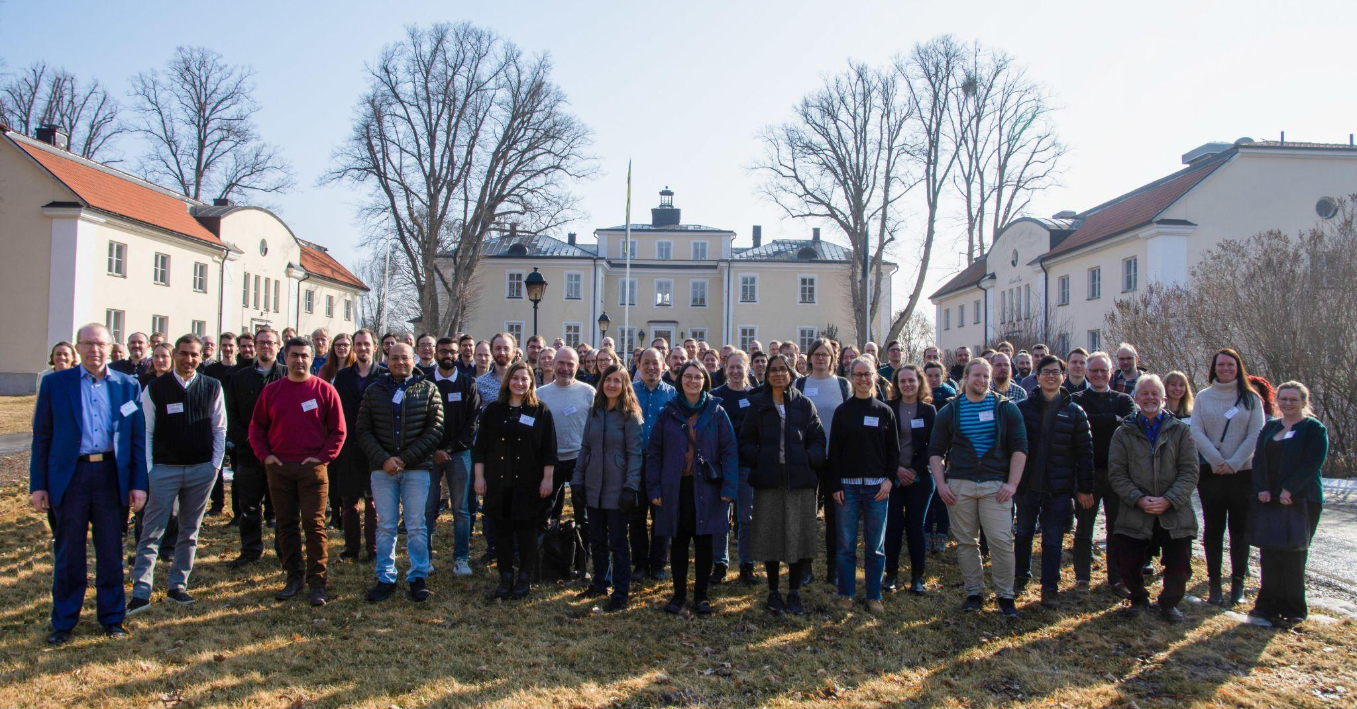


SciLifeLab, NBIS and NGI
SciLifeLab services
Umeå
Staff at six different sites across Sweden with expertise in many different omics-related areas
~120 staff at six different sites across Sweden with expertise in many different omics-related areas
Uppsala
Stockholm
Göteborg
Linköping
Lund
Notes:
This workshop is organized by SciLifeLab: NGI (national genomics infrastructure) is part of the Genomics platform, NBIS is the bioinformatics platform.

Slide 3

Teachers on this workshop are from NBIS and NGI
Publication
Study design
Data generation
Standard analyses
Project-specific analyses
Notes:
Most teachers on this workshop work at NBIS. We are involved in planning of projects and project specific data analysis, and teaching. Teachers on Tuesday afternoon are from NGI; who are involved in producing data and implementing and running standard analyses.

Slide 4
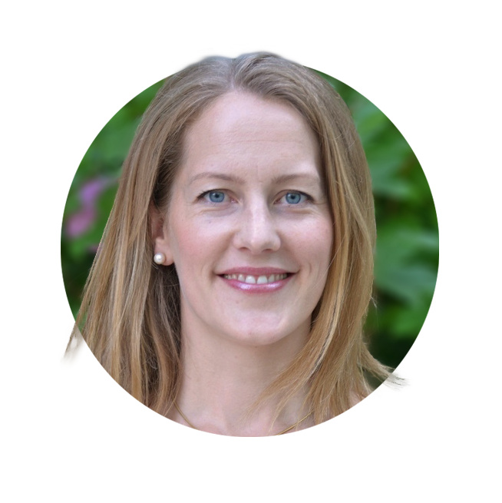
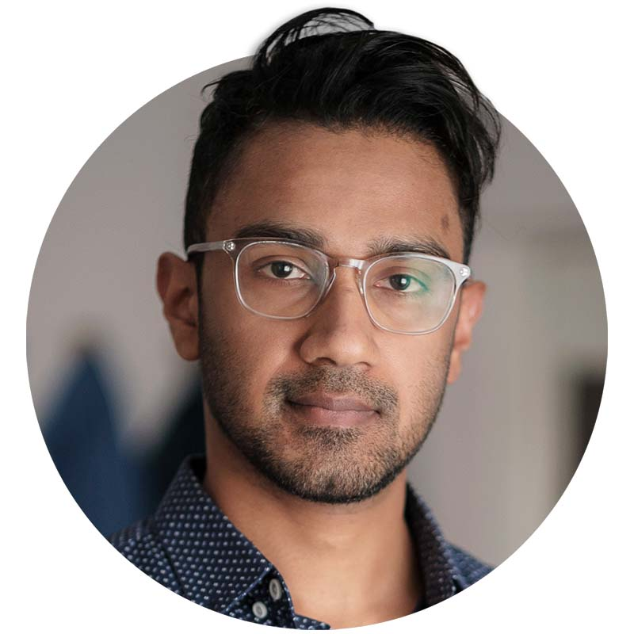
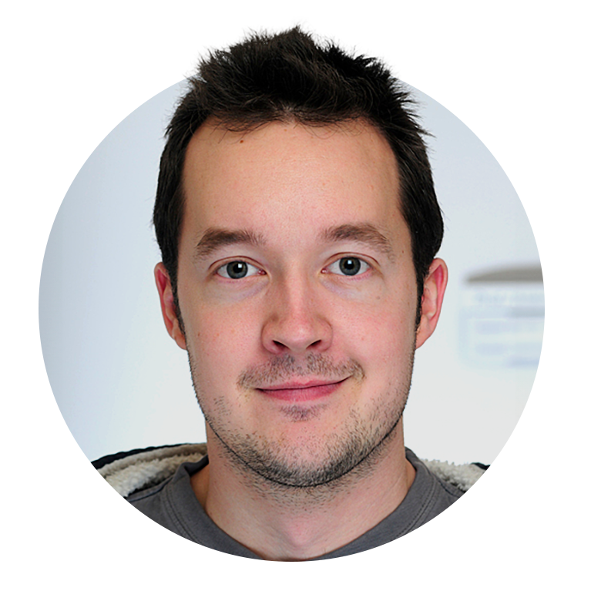
Workshop organizers
Roy Francis
Malin Larsson
Martin Dahlö

Slide 5
Practical information
Zoom: https://uu-se.zoom.us/j/61968741381?pwd=TUxTaysrWFc2RTloeWh4YkRQNUdNZz09
Course home page: https://uppsala.instructure.com/courses/91743
Lunch ~12:00 every day
Coffee breaks in the morning and afternoon (exact times decided per day)
Times in schedule may be adjusted slightly depending on breaks. Start time in the morning and after lunch is “fixed”.
Lectures in the main zoom room
Labs in breakout rooms
Please have cameras on

Slide 6
Labs
Instructions available in Canvas:
https://uppsala.instructure.com/courses/91743
All material linked from Modules/Workshop/Schedule
Work in breakout rooms
Four persons in each room
Help each other in the room because it improves the learning.
Breakout rooms will be announced in slack
Ask TAs when you have problems!
Use slack channel ngsintro_students to ask for help:
“Help needed in room 4”
Notes:
Show how to edit hackmd

Slide 7
Attendence and certificate
Those that attend the full workshop* will get a certificate.
*Attendence at all lectures and labs
*Labs done to the basic level
*Let us know if you need to miss a session
The certificate will not state number of credits. It will say that this was a full weeks workshop and what topics were covered.
We will mark your attendance during the workshop
Notes:
We can add that in case someone needs to miss a part of the workshop please talk with us beforehand. Then we will take note of this and tell you how to compensate for the absence i.e. by watching the prerecorded video and run the lab on your own.

Slide 8
Questions?
Please ask questions and take part in discussions trough out the workshop!

