Slide 1
Introduction to Bioinformatics using NGS data

Slide 2
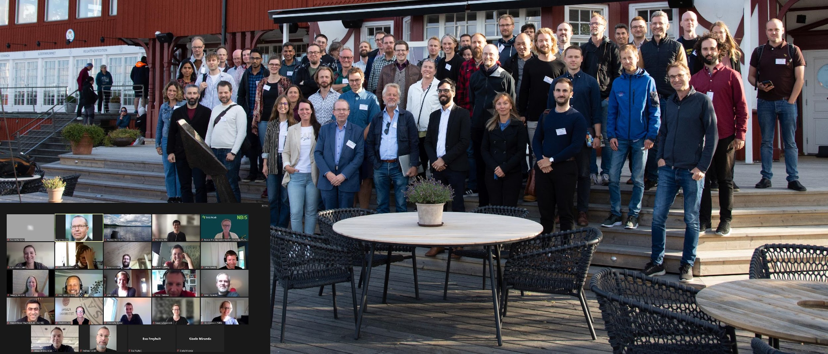
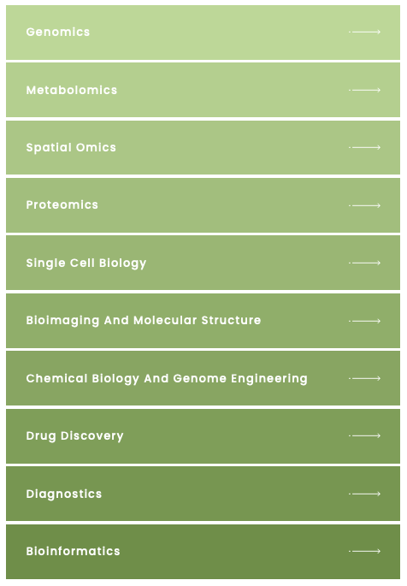
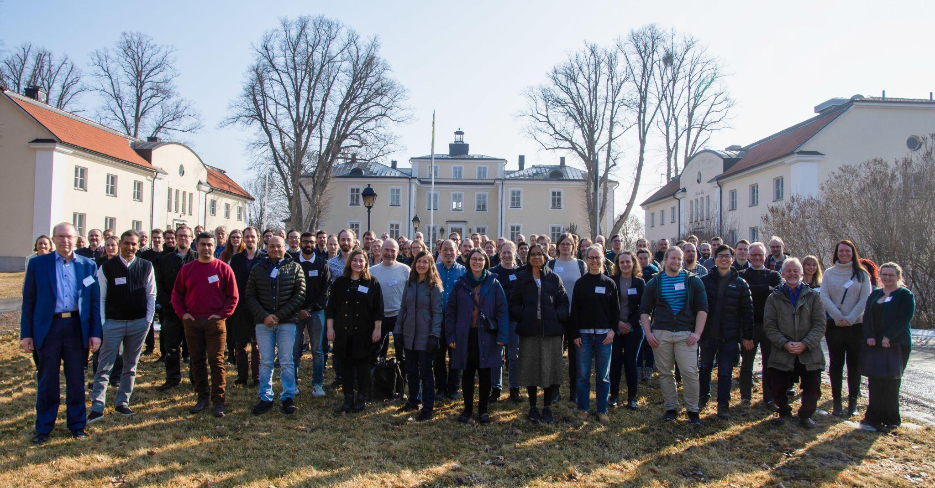
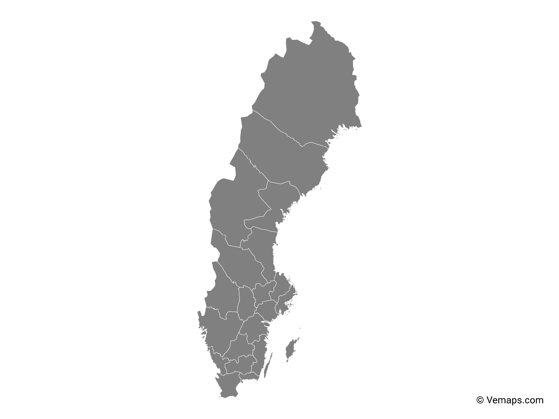

SciLifeLab, NBIS and NGI
SciLifeLab services
Umeå
Staff at six different sites across Sweden with expertise in many different omics-related areas
~120 staff at six different sites across Sweden with expertise in many different omics-related areas
Uppsala
Stockholm
Göteborg
Linköping
Lund
Notes:
This workshop is organized by SciLifeLab: NGI (national genomics infrastructure) is part of the Genomics platform, NBIS is the bioinformatics platform.

Slide 3

Teachers on this workshop are from NBIS and NGI
Publication
Study design
Data generation
Standard analyses
Project-specific analyses
Notes:
Most teachers on this workshop work at NBIS. We are involved in planning of projects and project specific data analysis, and teaching. Teachers on Tuesday afternoon are from NGI; who are involved in producing data and implementing and running standard analyses.

Slide 4
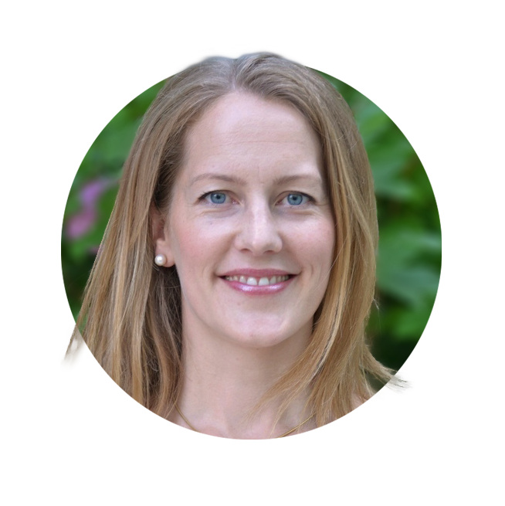
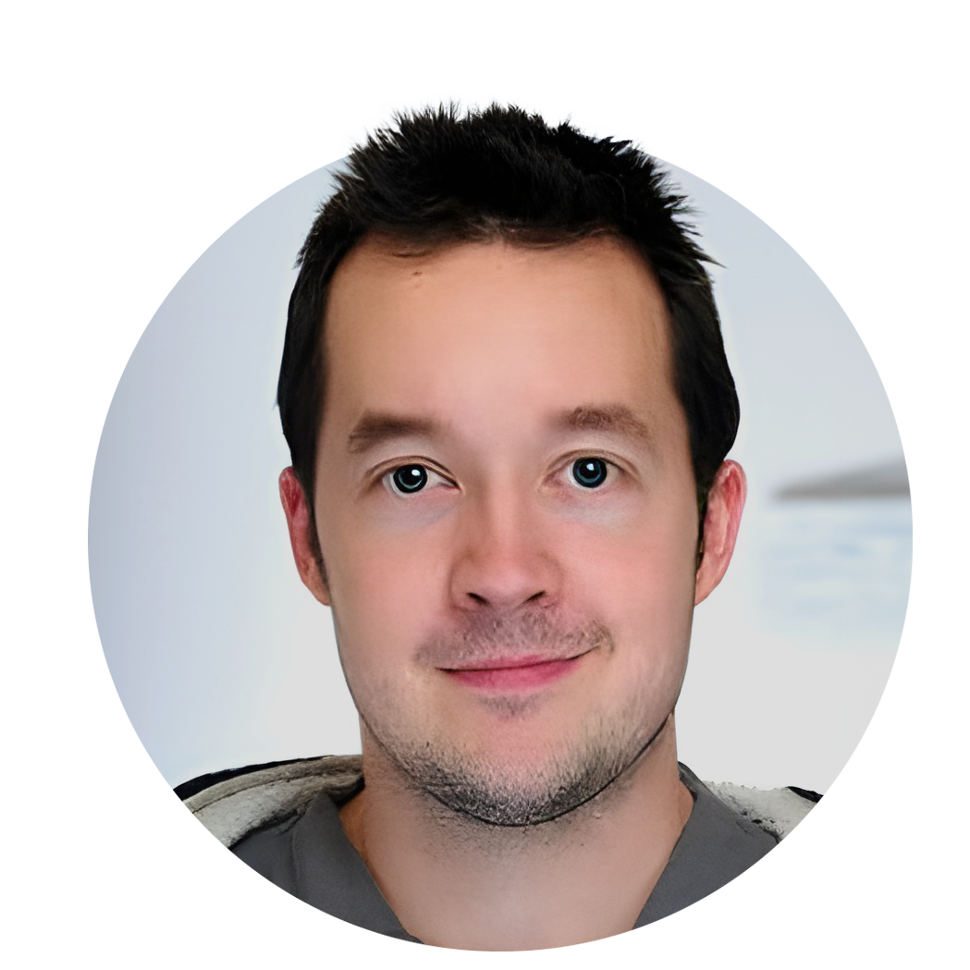
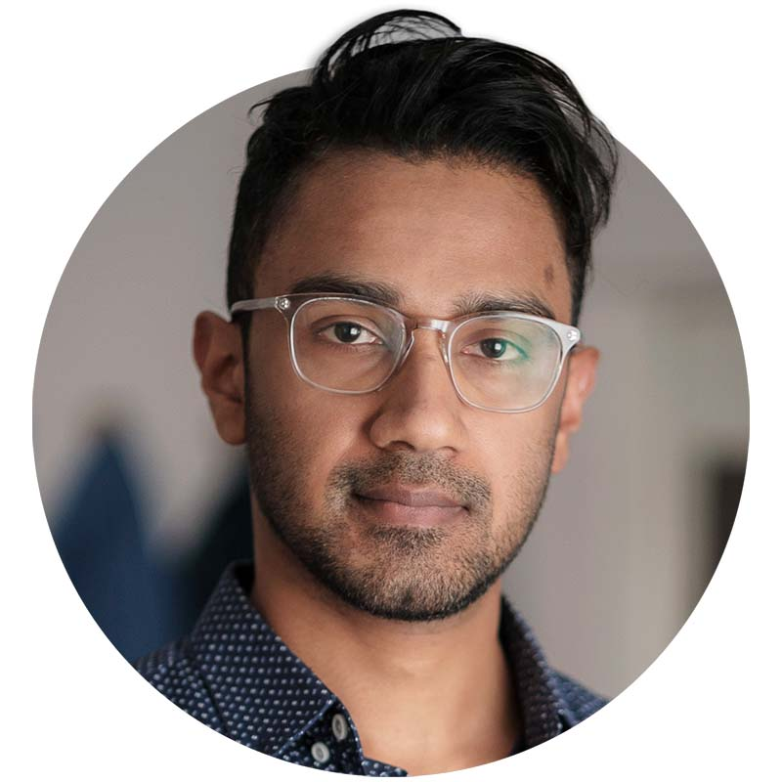
Workshop organizers
Roy Francis
Malin Larsson
Martin Dahlö

Slide 5
Practical information
Fire exits
Restrooms
Lunch is booked at 12:00 every day
Coffe is ordered for 10:00 and 14:30 every day. We may adjust times a bit depending on lectures
Course dinner: Wednesday 18:00, Koh Phangan, Fyristorg 2.
Please sign up on the list in the classroom on Monday!

Slide 6
Labs
Instructions available in Canvas:
https://uppsala.instructure.com/courses/85059
All material linked from Modules/Workshop/Schedule
Work in pairs because it improves the learning.
Ask TAs when you have problems!
Notes:
Show how to edit hackmd

Slide 7
Attendence and certificate
Those that attend the full workshop* will get a certificate.
*Attendence at all lectures and labs
*Labs done to the basic level
*Let us know if you need to miss a session
The certificate will not state number of credits. It will say that this was a full weeks workshop and what topics were covered.
Please fill in attendence sheets on the wall!
Notes:
We can add that in case someone needs to miss a part of the workshop please talk with us beforehand. Then we will take note of this and tell you how to compensate for the absence i.e. by watching the prerecorded video and run the lab on your own.

Slide 8
Course dinner
Wednesday 18:00
Uppsala: Koh Phangan, Fyristorg 2
Lund:
Umeå:
Please sign up on the list in the classroom on Monday!

Slide 9
Questions?
Please ask questions and take part in discussions trough out the workshop!

