Slide 1
Introduction to Bioinformatics using NGS data
Martin Dahlö
2023-02-06

Slide 2
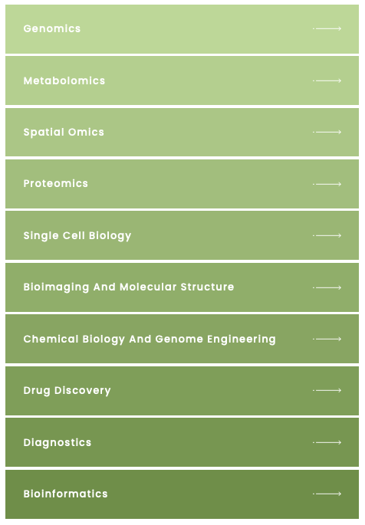
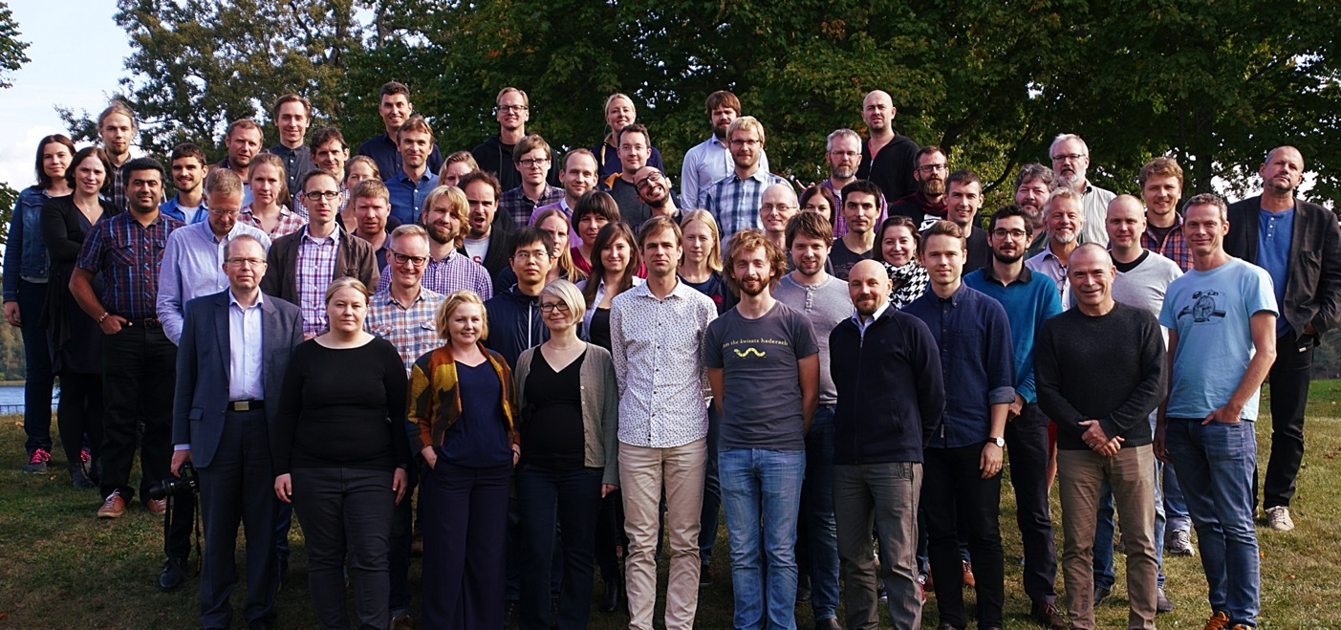


SciLifeLab, NBIS and NGI
SciLifeLab services
Umeå
Staff at six different sites across Sweden with expertise in many different omics-related areas
Uppsala
Stockholm
Linköping
Göteborg
Lund
Notes:
This workshop is organized by SciLifeLab: NGI (national genomics infrastructure) is part of the Genomics platform, NBIS is the bioinformatics platform.

Slide 3

Teachers on this workshop are from NBIS and NGI
Publication
Study design
Data generation
Standard analyses
Project-specific analyses
Notes:
Most teachers on this workshop work at NBIS. We are involved in planning of projects and project specific data analysis, and teaching. Teachers on Tuesday afternoon are from NGI; who are involved in producing data and implementing and running standard analyses.

Slide 4
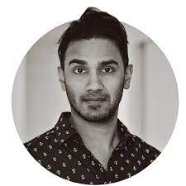
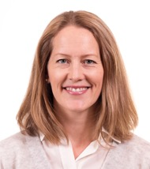
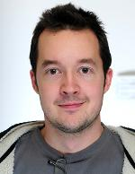
Workshop organizers
Roy Francis
Malin Larsson
Martin Dahlö

Slide 5
NBIS Bioinformatic Support
Drop-in sessions every week @ all 6 sites
Online (Zoom) Tuesdays at 14.00, for free
Study design and project consultation
Three hours per project, for free
Fee-for-service support
User fee 800 SEK per hour, however many hours you may need
No selection process, all project are welcome
Long-term support
Selection process based on scientific peer-review
A total of 500 hours, for free
Partner Projects
Full-cost model: utilize and pay for 50% of one NBIS FTE

Slide 6
NBIS Training
Some example NBIS courses
Introduction to bioinformatics using NGS data
Bulk and single-cell RNA-seq
Python and R programming
Tools for reproducible research
Omics integration and systems biology
Biostatistics and machine learning
Check out our training catalogue:
https://uppsala.instructure.com/courses/79097

Slide 7
More information about NBIS on Friday!

Slide 8
Practical information

Slide 9
Lectures
Mainly live in the classroom in Uppsala.
Streamed via zoom to Lund and Umeå.
Lets help out to make sure that questions are heard in all classrooms!

Slide 10
Labs
Instructions available in Canvas:
https://uppsala.instructure.com/courses/76870
All material listed under “Contents”
Work in pairs because it improves the learning.
TAs available in your classroom
Notes:
Show how to edit hackmd

Slide 11
Attendence and certificate
Those that attend the full workshop* will get a certificate.
*Attendence at all lectures and labs
*Labs done (to the basic level)
*Let us know if you need to miss a session
The certificate will not state number of credits. It will say that this was a full weeks workshop and what topics were covered.
Please fill in attendence sheets on the wall!
Notes:
We can add that in case someone needs to miss a part of the workshop please talk with us beforehand. Then we will take note of this and tell you how to compensate for the absence i.e. by watching the prerecorded video and run the lab on your own.

Slide 12
Breaks
Coffe is ordered for 10:00 and 14:30 every day
May adjust times a bit depending on lectures
Lunch booked at 12:00 every day
Uppsala:
Lund:
Umeå

Slide 13
Course dinner
Wednesday 18:00
Uppsala: Koh Phangan, Fyristorg 2
Lund:
Umeå:
Please sign up on the list in the classroom on Monday!

Slide 14
Questions?
Please ask questions and take part in discussions trough out the workshop!

