Slide 1
Variant calling
Notes:
NotebookAI used for inspiration

Slide 2
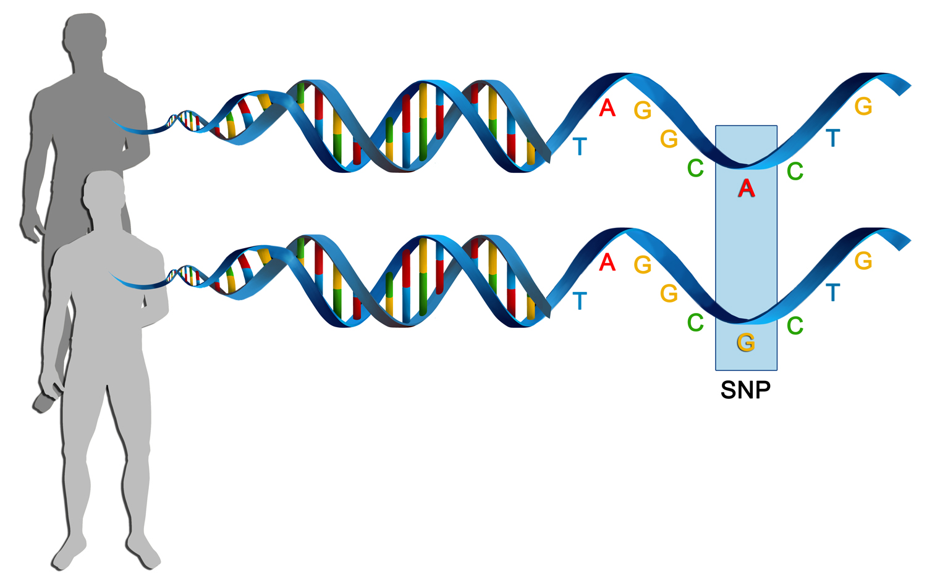
Genetic variation
Genetic variation
differences in DNA among individuals of the same species:
Single nucleotide variants (SNVs)
Small insertions and deletions (indels)
Structural variants (SVs)
Copy Number Variants (CNVs)
Variant calling
Identify genetic variations compared with a reference sequence in NGS data
SNV
Notes:
Genetic variation range in size from large chunks of the chromosome down to single nucleotides. We will focus on SNVs and short insertions and deletions in todays exercise.

Slide 3
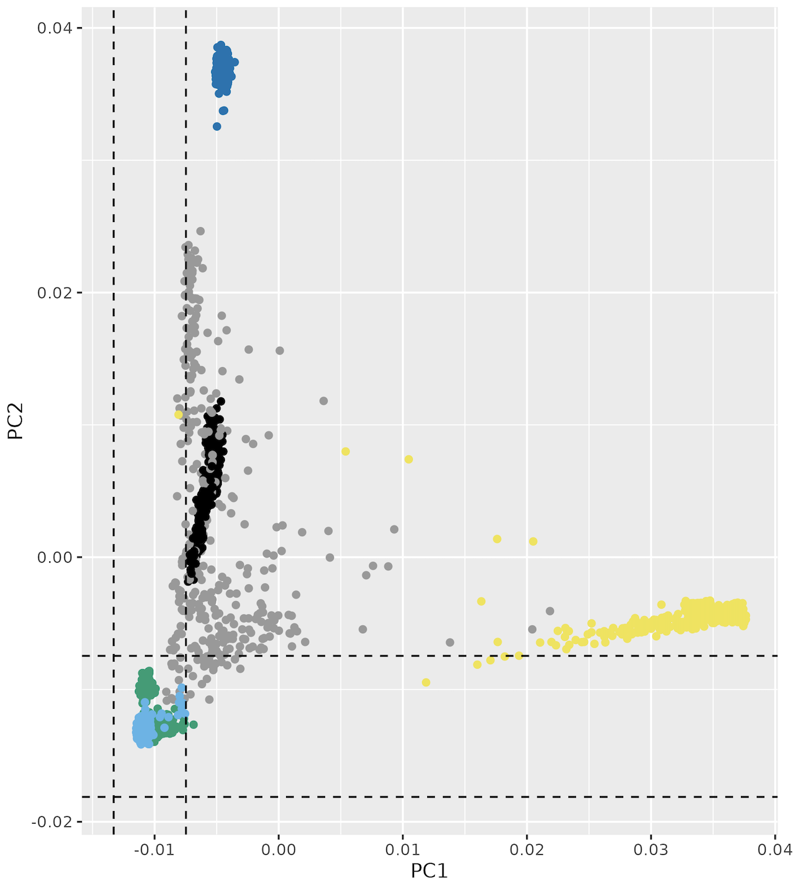
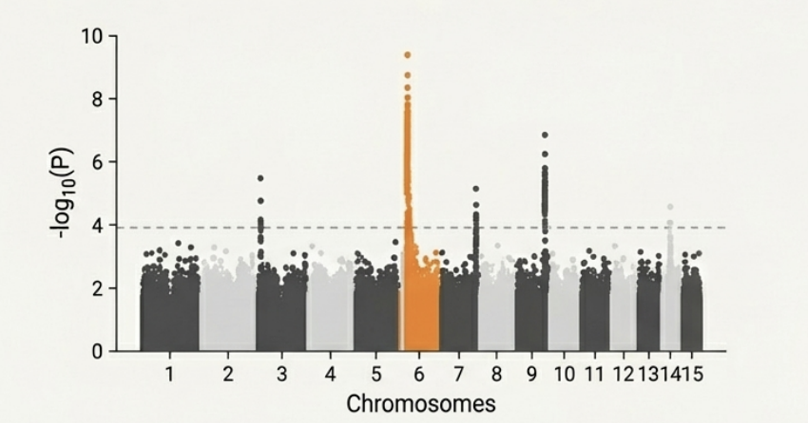
Variant calling applications
Finding variants allows us to connect genetics to biology,
from diagnosing disease to understanding population history
Disease & Trait association
Identify variants linked to mendelian or complex diseases, cancer (somatic variants), or favorable traits (e.g. in agriculture)
Evolution & Population Genomics
Uncover patterns of ancestry, migration and biodiversity
GWAS/manhattan plot
PCA/Ancestry

Slide 4
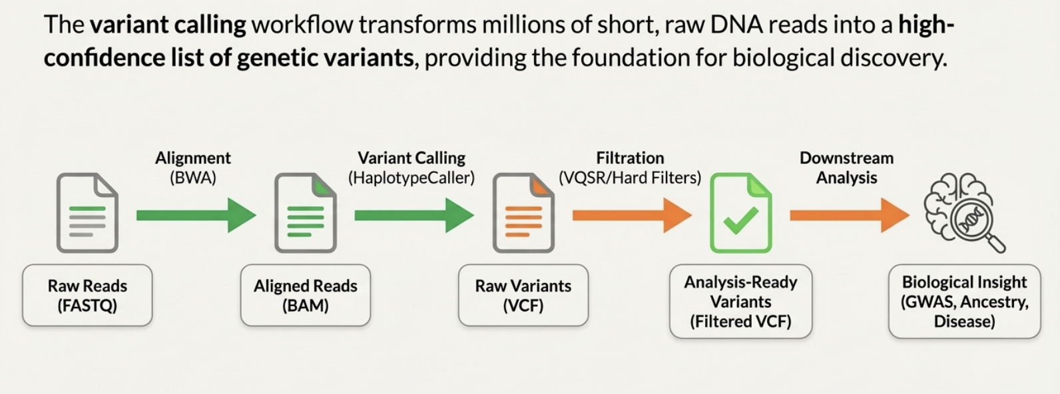
Variant calling workflow
The variant calling workflow transforms millions of short DNA reads into a list of genetic variants
Notes:
NotebookAI

Slide 5
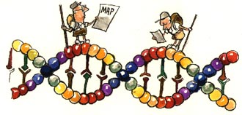
The reference genome
A reference genome is a haploid sequence that represents the genome of a species
Necessary to have a common reference so that loci and annotations can be compared between studies
Human genome created as a consensus of a number of individuals and has evolved from GRCh37 (hg19) with 250 gaps, to GRCh38 (hg38) and the “gapless” T2T (2022)
Choosing a reference version depends on available annotations and a need to be compatible with earlier studies, so the latest version is not always the best choice.
Important to keep track of which version of the reference genome your data was mapped to - the same version must be used in all downstream analyses

Slide 6
Read alignment to reference
Alignment (or mapping) is the process of finding the best matching location of the sequencing read in the reference genome
REFERENCE
CCCCGCTAGCTAGCTAGCTAGCTAGCTAGCTAGCTACCCTCTTCCTTAGGG
SEQUENCING READS
CCCGCTAGCTAGCTAG
GCTAGCTAGCTAGCTACC
TAGCTAGCTAGCTAGC
TAGCTACCCTCTTCCTT
Alignment tools: Mapping millions of reads requires specialized software, e.g. bwa mem, bowtie2 (short reads) or minimap2 (long reads)
Uniquely mapped reads align to one (best) location in the genome
Multi-mapping reads have many best matches (e.g. repeats)
Notes:
Typical read lengths 100-150 bp
Multi-mapping reads can be filtered out

Slide 7
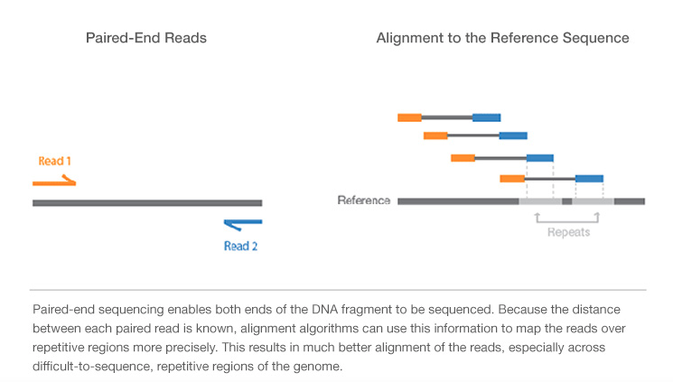
Paired-end reads
https://emea.illumina.com/science/technology/next-generation-sequencing/plan-experiments/paired-end-vs-single-read.html
Notes:
Maybe change image

Slide 8
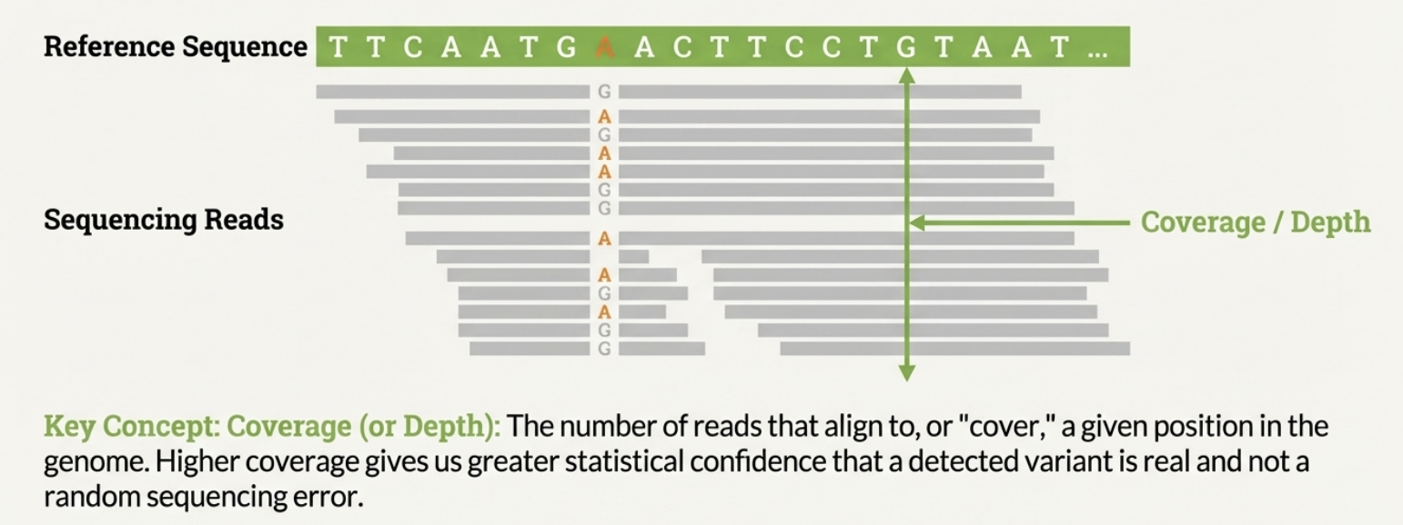
Read Depth (coverage)
Mapping millions of reads results in many reads covering the same position
The number of reads that align to (cover) a given position in the reference is called Coverage or Depth
A mean coverage of 30 (30X) is common in variant calling
Notes:
NotebookLM image

Slide 9
Mapping output - SAM format
HEADER SECTION
@HD VN:1.6 SO:coordinate
@SQ SN:2 LN:243199373
@PG ID:bwa PN:bwa VN:0.7.17-r1188 CL:bwa mem -t 1 human_g1k_v37_chr2.fasta HG00097_1.fq HG00097_2.fq
@PG ID:samtools PN:samtools PP:bwa VN:1.10 CL:samtools sort
@PG ID:samtools.1 PN:samtools PP:samtools VN:1.10 CL:samtools view -H HG00097.bam
ALIGNMENT SECTION
Read_001 99 2 3843448 0 101M = 3843625 278 TTTGGTTCCATATGAAC 0F<BFB<FFFBFBFFFB
Read_001 147 2 3843625 0 101M = 3843448 -278 TTATTTCATTGAGCAG FBBI7IIFIB<BBBB<B
Read_002 163 2 4210055 0 101M = 4210377 425 TGGTACCAAAACAGAGA 0IIFBFFFIIIFFIFFF
Start position
Read name
Sequence
Quality
Reference sequence name (chromosome/contig)
SAM: Sequence Alignment/Map format
BAM: binary SAM – used by most (all?) variant callers and many other tools
Notes:
Also covered in the ”Common file format” lecture earlier in the course
QNAME: the name of the read.
FLAG: a bitwise number describing information about the read such as mapped/unmapped read, pairing, etc.
RNAME: the reference sequence name. The value of this field is * for unmapped reads.
POS: the left most mapping position of the first matching base. It is set to zero for unmapped reads.
MAPQ: a number to indicate the mapping quality.
CIGAR: a string describing how the read aligns with the reference. It consists of one or more components. Each component comprises an operator and the number of bases which the operator applies to. Operators are: MIDNSHP=X. The following table gives an overview of these operators
MNAME: the name of the mate strand, if it is a paired read. ‘=’ means that the name is the same as RNAME.
MPOS: a number indicating the left most mapping position of the mate.
TLEN: a number set to 0 for single-segment. For paired-segments it is calculated as the number of bases from the left most mapped base to the right most mapped base.
SEQ: the read sequence as the reference. If not ‘*’ then the length of the sequence must be equal the sum of lengths of M/I/S/=/X operations in the CIGAR string.
QUAL: the read quality, same as the quality string in a fastaq format.

Slide 10
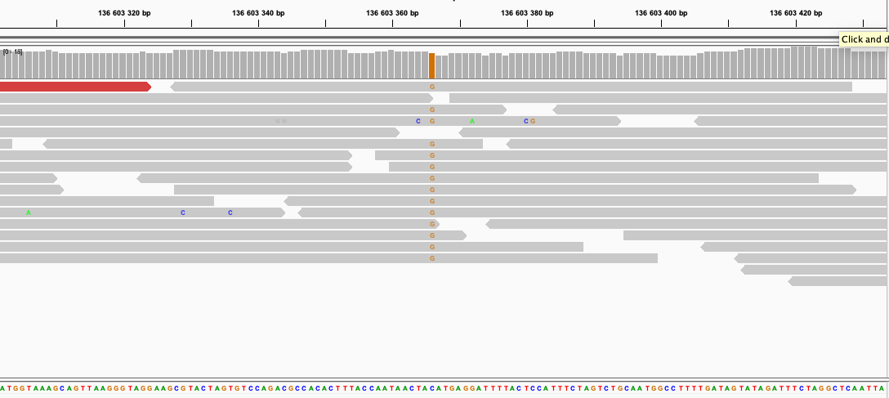
Detecting variants
Reference allele = the allele in the refence genome
Alternative allele = the allele NOT in the refence genome
Reference: GTAGACTGCTAGATCGA
Sample reads: TAGACTGATAGA
AGACTGATAGATC
GACTGCTAGATCG
TAGACTGCTAG
ACTGATAGAT
GACTGATAGATC
Reference allele (here C)
Alternative allele (here A): allele that differs from reference
A variant calling tool scans all reads for differences between the sequencing reads and the reference
Variant callers
Germline callers (for inherited variants): HaplotypeCaller, FreeBayes, Bcftools, Deepvariant
Somatic callers (for acquired variants, e.g. in tumors): Mutect2, Strelka2
Notes:
Variant calling is looking for positions where some number of reads disagree with the reference genome. Here for example the reference sample says the position should be a C whereas 6 of the reads say it is an A in the sample.
Reference allele = the allele in the refence genome
Alternative allele = the allele NOT in the refence genome
GATK HaplotypeCaller is used in the lab – commonly used for variant calling in human. Non-model organisms?

Slide 11
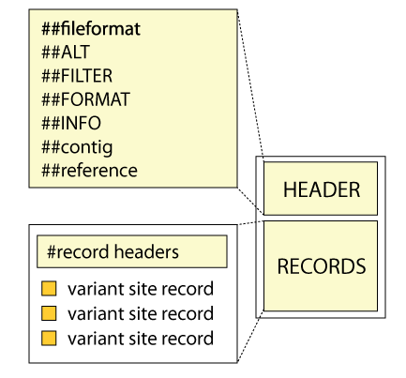
Variant Call Format (VCF)
Standard file format for storing genetic variants –
output from most variant callers and input to many downstream analysis tools
##fileformat=VCFv4.2
##FILTER=<ID=LowQual,Description="Low quality">
##FORMAT=<ID=AD,Number=R,Type=Integer,Description="Allelic depths for the ref and alt alleles">
##FORMAT=<ID=DP,Number=1,Type=Integer,Description="Approximate read depth">
##FORMAT=<ID=GT,Number=1,Type=String,Description="Genotype">
##INFO=<ID=AC,Number=A,Type=Integer,Description="Allele count in genotypes, for each ALT allele">
##INFO=<ID=AF,Number=A,Type=Float,Description="Allele Frequency, for each ALT allele">
##INFO=<ID=AN,Number=1,Type=Integer,Description="Total number of alleles in called genotypes">
##contig=<ID=2,length=243199373>
##source=HaplotypeCaller
#CHROM POS ID REF ALT QUAL FILTER INFO FORMAT HG00097
2 136220992 rs111 G T 30 PASS AC=1;AF=1.0;AN=2 GT:AD:DP 1/1:3,2:5
2 136226814 rs222 GAC G 44 . AC=1;AF=0.5;AN=2 GT:AD:DP 0/1:4,2:6
2 136234279 . C T 102 . AC=1;AF=0.5;AN=2 GT:AD:DP 0/1:3,4:7
Header section - Metadata defining the file content, including definitions of the INFO and FORMAT fields
Records (one line per variant) - Each line represents one genetic variant
Notes:
VCF files, or variant call format files, are divided into two main parts. The top, or head, of the file, with hashtag prefixed lines, is a descriptive part explaining the information given for each variant and each sample, if multiple samples exists. It also gives the date and some information from the variant caller used.
On this slide – go through meta data and columns 1-9

Slide 12
Multi-sample VCF
Multi-sample vcf files have one column per sample - necessary for downstream comparisons
##fileformat=VCFv4.2
##ALT=<ID=NON_REF,Description="Represents any possible alternative allele at this location">
##FILTER=<ID=LowQual,Description="Low quality">
##FORMAT=<ID=AD,Number=R,Type=Integer,Description="Allelic depths for the ref and alt alleles in the order listed">
##FORMAT=<ID=DP,Number=1,Type=Integer,Description="Approximate read depth (reads with MQ=255 or with bad mates are filtered)">
##FORMAT=<ID=GT,Number=1,Type=String,Description="Genotype">
##INFO=<ID=AC,Number=A,Type=Integer,Description="Allele count in genotypes, for each ALT allele, in the same order as listed">
##INFO=<ID=AF,Number=A,Type=Float,Description="Allele Frequency, for each ALT allele, in the same order as listed">
##INFO=<ID=AN,Number=1,Type=Integer,Description="Total number of alleles in called genotypes">
##contig=<ID=2,length=243199373>
##source=CombineGVCFs
##source=GenotypeGVCFs
##source=HaplotypeCaller
#CHROM POS ID REF ALT QUAL FILTER INFO FORMAT SAMPLE1 SAMPLE2 aSAMPLE
2 136045826 . G A 167 . AC=1;AF=0.167;AN=6 GT:AD:DP 0/0:8,0:8 0/0:13,0:13 0/1:1,5:6
2 136046443 . CG C 129 . AC=3;AF=0.500;AN=6 GT:AD:DP 0/0:8,0:8 0/1:3,1:4 1/1:0,4:4
2 136047387 . T C 186 . AC=1;AF=0.167;AN=6 GT:AD:DP 0/0:6,0:6 ./.:.,.:. 0/1:4,6:10
Limitation: Individual vcf files have information only for variant sites - not possible to distinguish non-variant (reference) positions and positions with missing information
Solution: Creating gVCF files and do joint variant calling in all samples (cohort) simultaneously

Slide 13
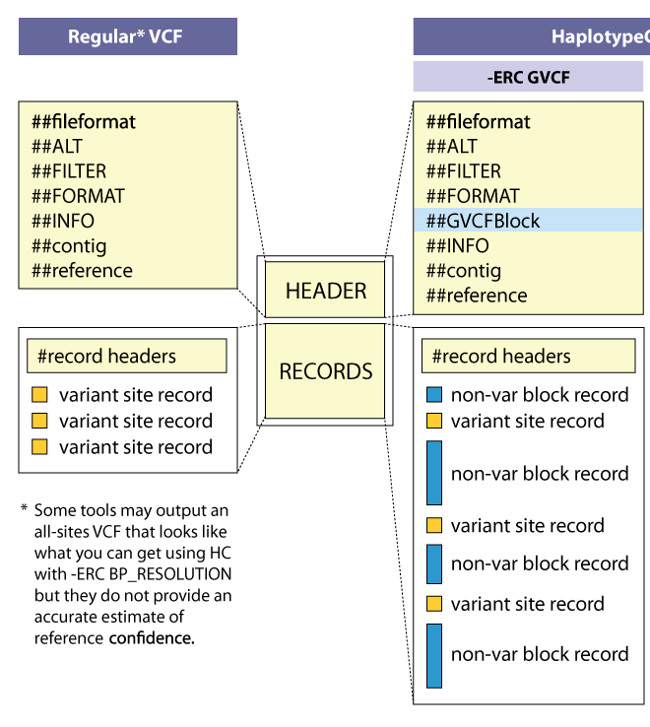
Genomic VCF (gVCF) Files
HaplotypeCaller GVCF
VCF files have information only about variant sites
gVCF files have records for all sites
Adjacent homozygous-reference sites are merged into blocks
The gVCF files can be used to generate a multi-sample VCF through joint genotyping without loss of information
Some tools can call variants from all samples simultaneously (outputting multi-sample VCFs directly)
Creating gVCF files first saves computation time in large cohorts or if samples are added at a later time
Notes:
For joint genotyping projects we use a different kind of VCF file.
A gVCF file has the same format as a VCF file but it has information for all sites, not just variants.
individual variant records for variant sites, but the non-variant sites are grouped together into non-variant block records that represent intervals of sites for which the genotype quality (GQ) is within a certain range or band.
http://gatkforums.broadinstitute.org/wdl/discussion/4017/what-is-a-gvcf-and-how-is-it-different-from-a-regular-vcf
In the so-called GVCF mode used for scalable variant calling in DNA sequence data, HaplotypeCaller runs per-sample to generate an intermediate genomic gVCF (gVCF), which can then be used for joint genotyping of multiple samples in a very efficient way, which enables rapid incremental processing of samples as they roll off the sequencer, as well as scaling to very large cohort sizes (e.g. the 92K exomes of ExAC).

Slide 14
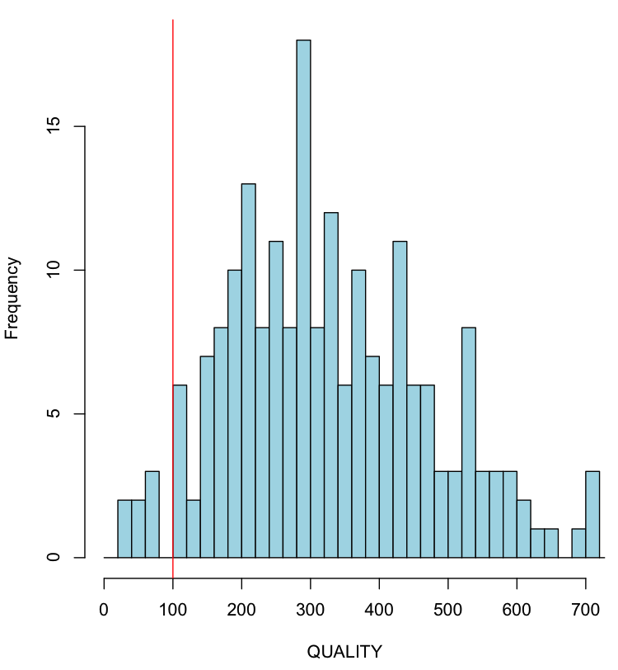
Variant filtration
Variant calling with HaplotypeCaller is designed to be sensitive –
Apply filters to limit false positives
Advanced filtration (VQSR)
Machine Learning approach
Need well-curated list of known variants
Requires large datasets
Hard filters
Select cutoffs, e.g. quality and depth
Cutoffs selected after viewing score distributions
Works for small datasets and
non-model organisms
Notes:
VQSR is a machine learning approach that learns the properties of true variants from a set of known, well-curated variants

Slide 15
Workflows
input_data.txt
Process 1
Intermediary_file_1.txt
Process 2
Intermediary_file_2.csv
Process 3
output.pdf
Notes:
An important part of bioinformatics work is creating workflows, i.e. putting tools together in the right order.

Slide 16
Example: Basic workflow, one sample
HG00097_1.fastq
HG00097_2.fastq
Reference.fasta
Alignment
Create a new output file in each process - Do not overwrite the input file
Use informative file names
Include information about the process + sample
Correct name extension (e.g. .bam, .vcf)
HG00097.bam
VariantCalling
HG00097.vcf

Slide 17
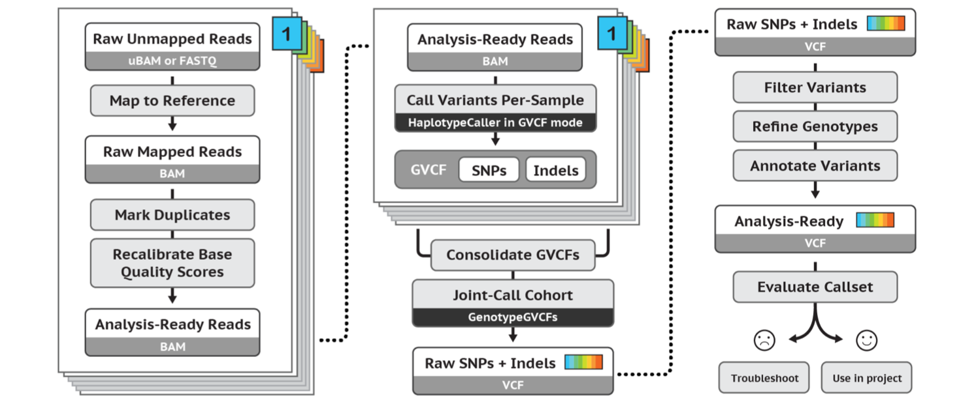
Refined workflow: GATK best practices workflow for germline short variant discovery
https://software.broadinstitute.org/gatk/best-practices/
Notes:
Recommendations in the Broad institute best practices. A guide that they have maintained pretty-well for several years where they recommend tools and setting to use for a standard analysis.

Slide 18
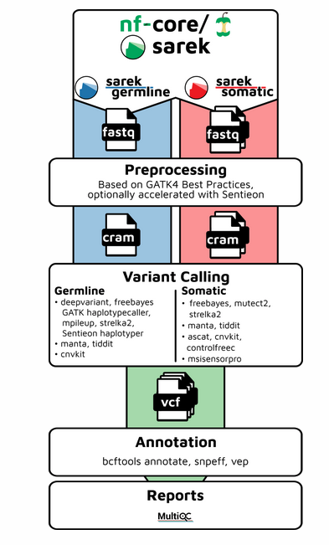
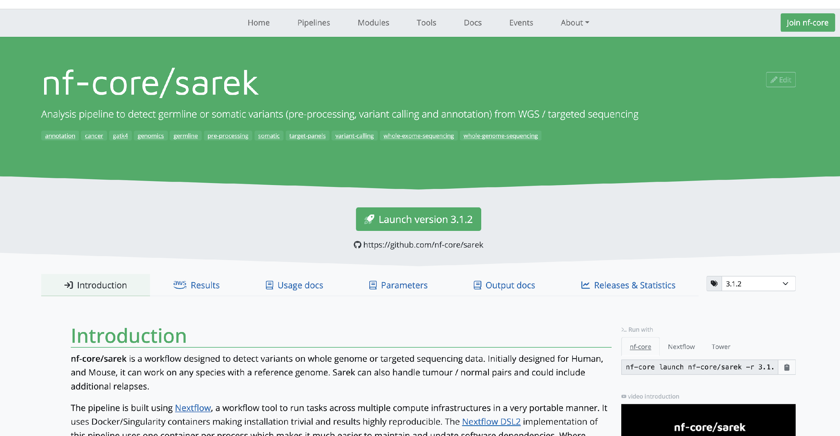
Nf-core variant calling workflow: Sarek
All steps in the GATK best-practises (germline variant calling) have been combined in the commonly used pipeline nf-core/sarek
Includes mapping, duplicate marking and quality recalibration
Variant caller(s) can be chosen
Annotations, e.g. gene, and dbSNP ID
https://nf-co.re/sarek/3.4.2/

Slide 19
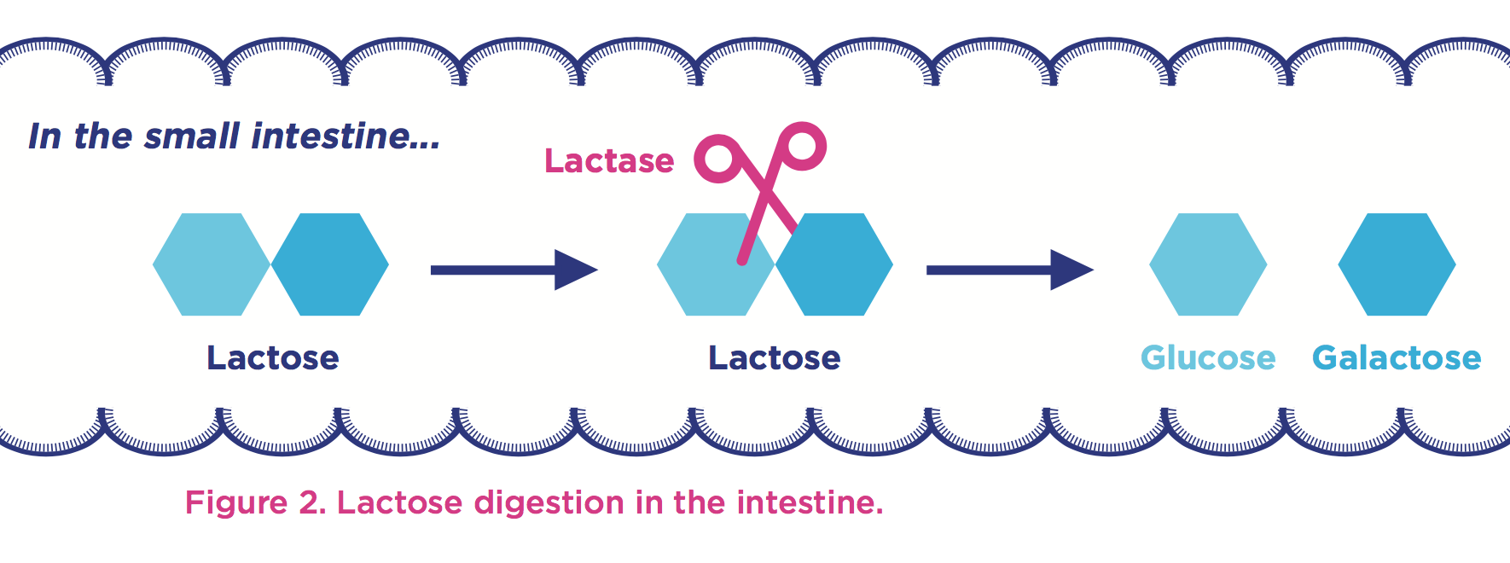
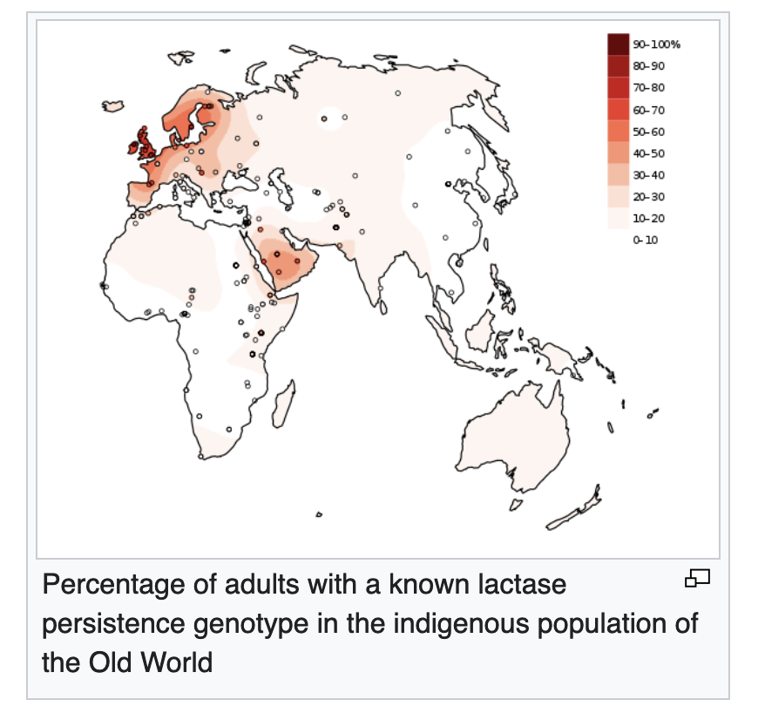
The lab: Lactose tolerance
All mammals produce lactase as infants, but some humans produce lactase also in adulthood
A genetic variant upstream of the LCT gene leads to the lactase persistent phenotype (lactose tolerance)
Notes:
Most people are born with the ability to digest lactose, the major carbohydrate in milk and the main source of nutrition until weaning.
Lactase is an enzyme expressed in the small intestine.
Cuts the lactose molecule into one glucose and one galactose molecule.
Lactase is encoded by the LCT gene, located on chromosome 2.

Slide 20

Data
3 samples (from 1000 genomes)
Low coverage WGS data
Small region on chromosome 2
About the samples:
https://www.internationalgenome.org/data-portal/sample

Slide 21
Overview of lab
Part1: Basic variant calling for one sample
Part2: Variant calling in cohort (multiple samples)
Part3: Write a bash script
Extra material (part4): GATK Best practices
Notes:
During the course of this talk I hope to explain some core concepts around NGS data such as the basics surrounding what the reference genome, variants and paired-end data is. This will be background information for the main point which is to cover the main concepts of a typical best practice workflow, or as some people call it a “pipeline”, where we take the raw reads in fastq format all the way to variants. I will dive a little deeper into the output from variant calling, the VCFs or Variant Call Format, what joint genotyping is and the principal of annotating and filtering the variants.
As with anything there is more to know about each of these subjects and I encourage you to go deeper as needed.

Slide 22
Part1: Basic Variant Calling in one sample
HG00097_1.fastq
HG00097_2.fastq
FASTQ files
BWA mem
Alignment
SAM file
HG00097.bam
BAM file
Variant calling
HaplotypeCaller
HG00097.vcf
VCF file

Slide 23
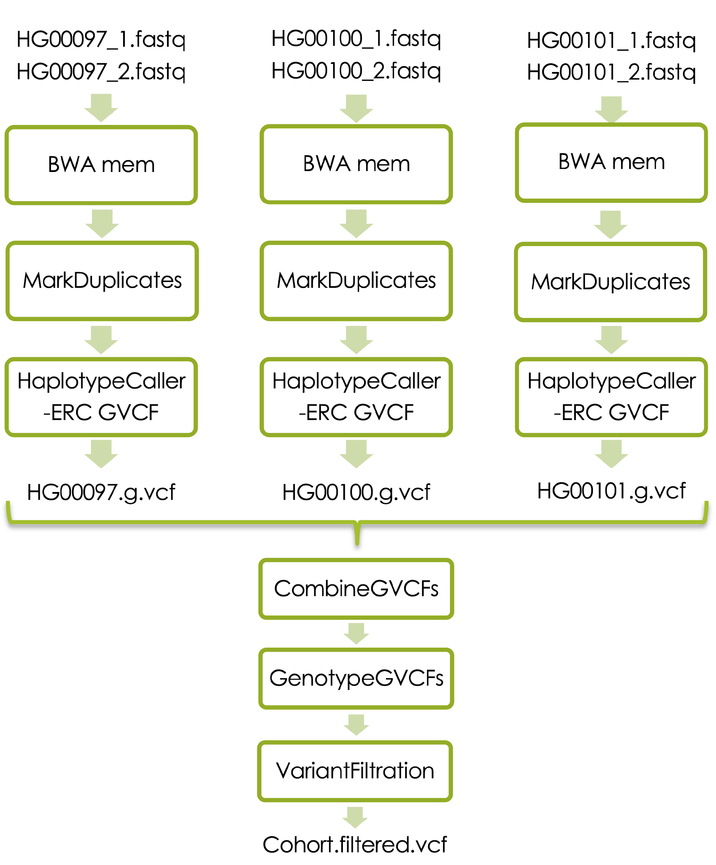
Part2: Basic variant calling in cohort

Slide 24
Basic variant calling in cohort
Mark duplicates
Joint genotyping
Variant filters
Notes:
Add marking of duplicate reads (PCR and optical)
Add variant calling in multiple samples and variant filtration

Slide 25
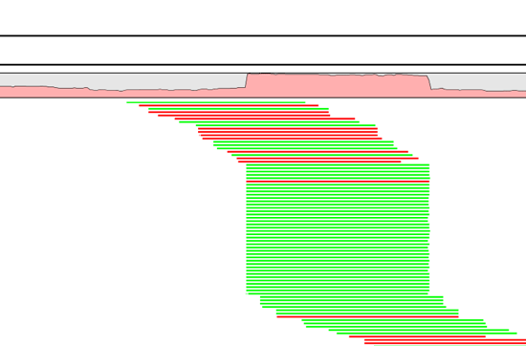
Duplicate reads
PCR duplicates - library preparation
Optical duplicates - sequencing
Can give false allelic ratios of variants
Should often be removed/marked
Picard MarkDuplicates
Samtools dedup
Notes:
One tool for this is picards MarkDuplicates.
Occur PCR
Copies same fragment goto different flowcells
High library complexity is good
Don’t add information
Optical duplicates
Less talked about
One flowcell cluster
Incorrectly identified on several cells
Amplicon
Duplicates typically arise during PCR amplification of the fragments with adapters. We are intentionally creating multiple copies of each original genomic DNA molecule so that you have enough of them. The PCR duplicates occur when two copies of the same original molecule get onto different areas of the flowcell. A greater amount of starting material, often termed as having a high complexity library, is a good indicator of not having a big problem with duplicates.
And duplicates don’t give any additional information, as you can see here, what we want is reads slightly off from eachother, so we know that they are adding new information. You can also choose to just mark the duplicates rather than remove them entirely as many variant callers can ignore reads marked as duplicates. This gives you the option later to perform variant calling with and without duplicates and compare the results.
Finally, during some kinds of sequencing, such as amplicon sequencing, you tend to recommend not removing duplicates as there will be many duplicates by design. So keep that in mind.
“optical duplicates are sequences from one flow cell cluster, that are (incorrectly) identified by software to be from multiple adjacent clusters. ”

Slide 26
File indices
Most large files that we work with need indices - Allows efficient access
Different indices for different file types
The index is stored in a file with specific ending
Most tools will find the index file automatically as long as the ending is correct
File endings
Reference genome (.fasta.fai/fasta.dict)
Aligned reads (.bam.bai)
Variants (.vcf.idx)

Slide 27
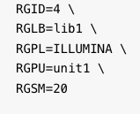
ReadGroups
Tags that mark which sample and sequencing run each read comes from
REQUIRED TAGS
RGID: unique identifier of sequencing run
RGLB: library id, used to get correct duplicate marking
RGPL: platform (here Illumina)
RGPU: platform unit
RGSM: sample name used in the vcf file

Slide 28
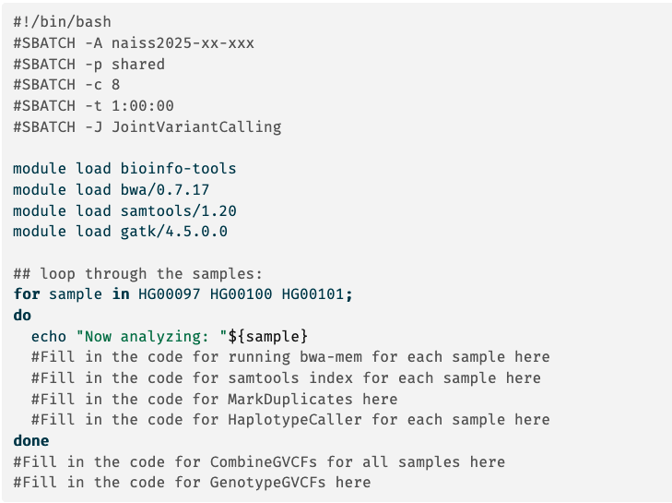
Part3: Bash script for variant calling

Slide 29
General advice
Copying commands to terminal can introduce errors
Type commands in terminal or
Copy and edit in text editor
Backslash “\”
the command continues on the next line, but should not be included when the command is copied
Pipe “|”
Bwa mem ref.fa fastq.fq | samtools sort > output.bam

Slide 30
Start practising!

Slide 31
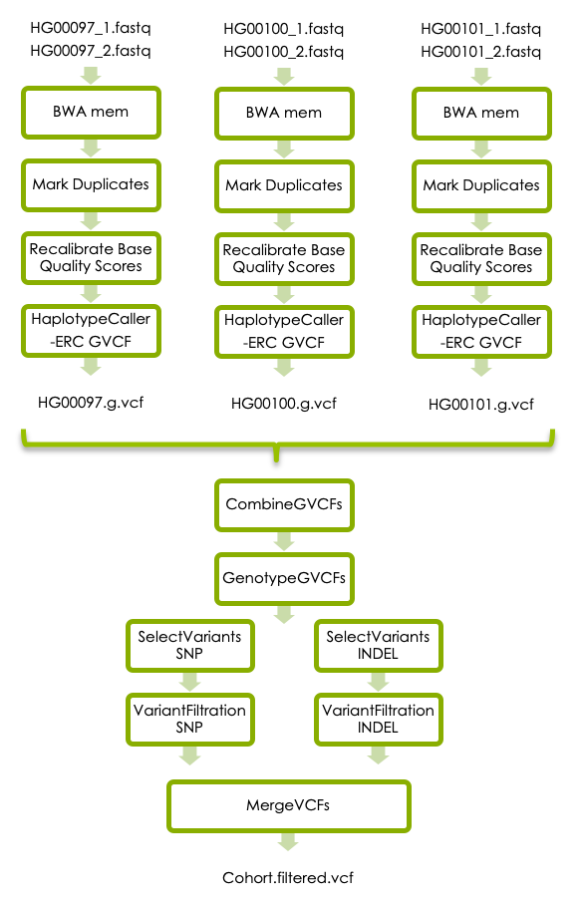
Extra lab (Part4): GATK’s best practises
Notes:
Day2 ?

Slide 32
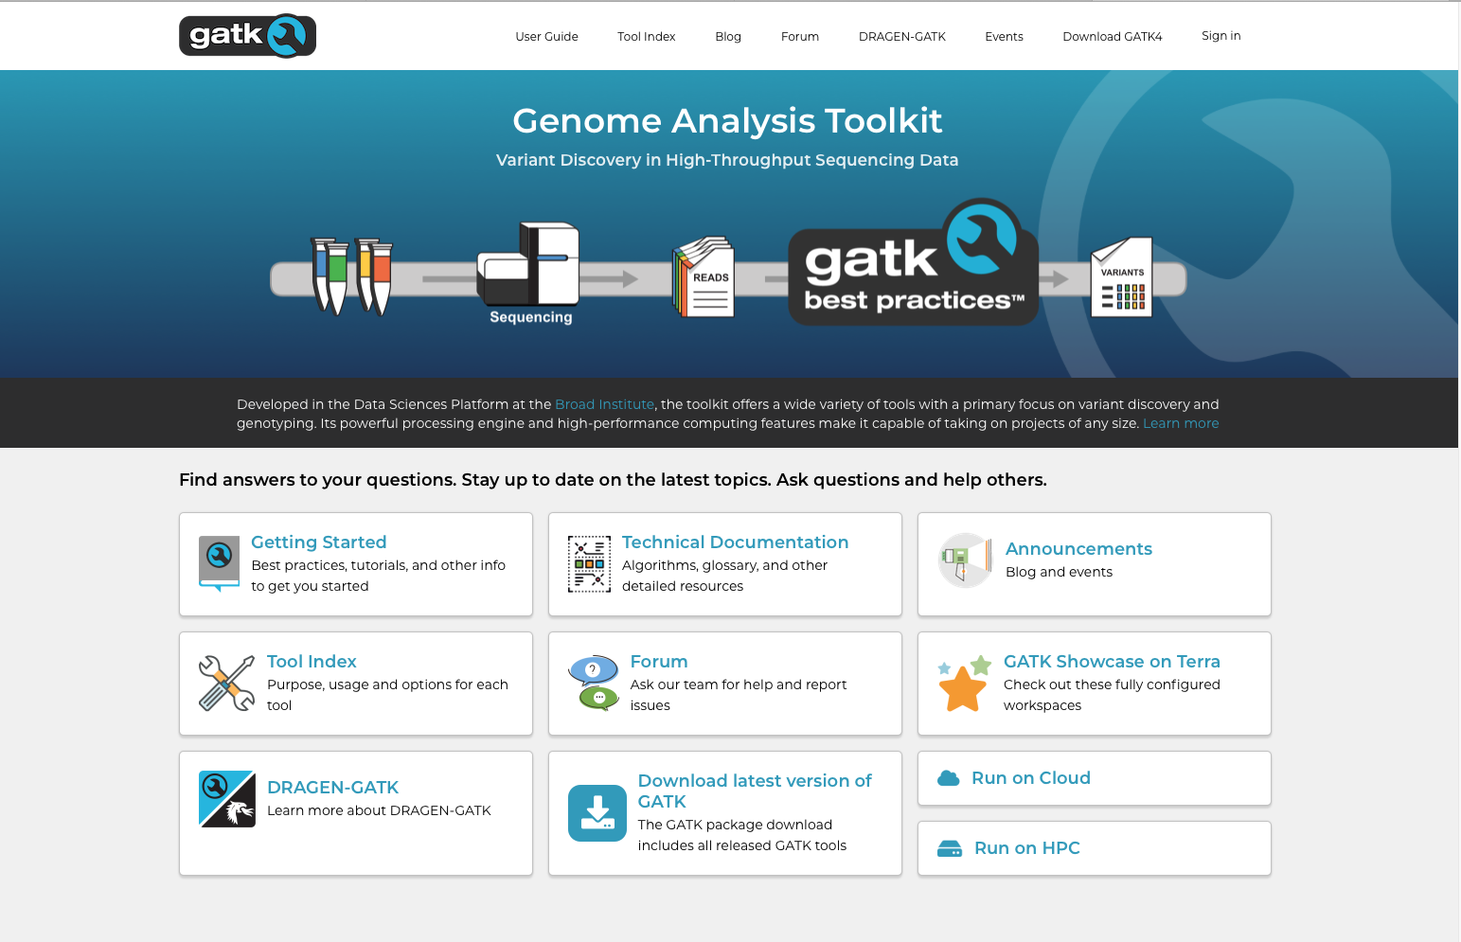
GATK best practices for short variant discovery
https://gatk.broadinstitute.org

Slide 33
GATK best practices
workflow for germline short variant discovery
https://software.broadinstitute.org/gatk/best-practices/
Notes:
this is where the recommendations of the Broad institute best practices start. A guide that they have maintained pretty-well for several years where they recommend tools and setting to use for a standard analysis. I recommend that someone setting up a bioinformatics workflow or wanting to compare what has been done with their data and what is currently considered best practice be intimately aware of these recommendations.
They no longer recommend indel realignment, as it is performed on the fly at the variant calling stage. It is good to note that this resource exists, as it is definitely something you should be looking at when running a different variant calling pipeline or when the bam files are needed for other purposes.

Slide 34
Base Quality Score Recalibration (BQSR)

Slide 35
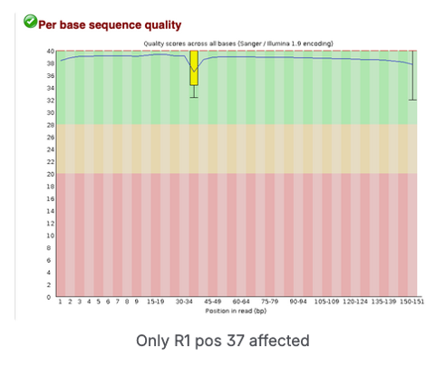
Base Quality Score Recalibration (BQSR)
During base calling, the sequencer estimates a quality score for each base. These are the quality scores present in the fastq files
Systematic (non-random) errors in base quality score estimation can occur due to for example
physics or chemistry of the sequencing reaction
manufacturing flaws in the equipment
Can cause biases in variant calling
Base Quality Score Recalibration helps to calibrate the scores so that they correspond to the real per-base sequencing error rate (phred scores)
Notes:
Base Quality Score Recalibration basically detects systematic errors made by the sequencer when it estimates the quality score of each base call, which is basically how confident the machine was that the called base is correct.
Some of these errors are due to the physics or the chemistry of how the sequencing reaction works, and some can be due to manufacturing flaws in the equipment.
The tool checks the covariation between Reported quality score, the position within the read and the preceding and current nucleotide observed by the sequencing machine to find non-random discrepancies that lead to the score being adjusted.
These systematic technical errors, leading to over- or under-estimated base quality scores in the data.

Slide 36
Filter variants
https://software.broadinstitute.org/gatk/best-practices/
Germline short variant discovery (SNPs + Indels)
Notes:
But before we dive in to alignment I will mention that this is where the recommendations of the Broad institute best practices start. A guide that they have maintained pretty-well for several years where they recommend tools and setting to use for a standard analysis. I recommend that someone setting up a bioinformatics workflow or wanting to compare what has been done with their data and what is currently considered best practice be intimately aware of these recommendations.
They no longer recommend indel realignment, as it is performed on the fly at the variant calling stage, but it is good to note that this resource exists, as it might be needed when working with other tools downstream.

Slide 37
Hard Filters
Small data set used in this lab
Filters on information in the VCF file using set cutoffs
SNPs and indels can have slightly different filter values
For example: Flag variants with
QD < 2.0 – Quality by Depth (variant QUAL divided by the depth of non-hom-ref samples)
FS > 60 – Fisher Strand Bias
Notes:
Strand Bias tells us whether the alternate allele was seen more or less often on the forward or reverse strand than the reference allele

