Slide 1
Project – Main Assignment

Slide 2
Practical information
Time: Every afternoon, from ~15:00 to 17:00
Duration: Throughout the entire week
Apply your knowledge to tackle a real-world problem at a larger scale than the exercises
Work on your own or in groups
TAs available for questions
Not mandatory but highly recommended
Solutions will be published on Friday after the lectures

Slide 3
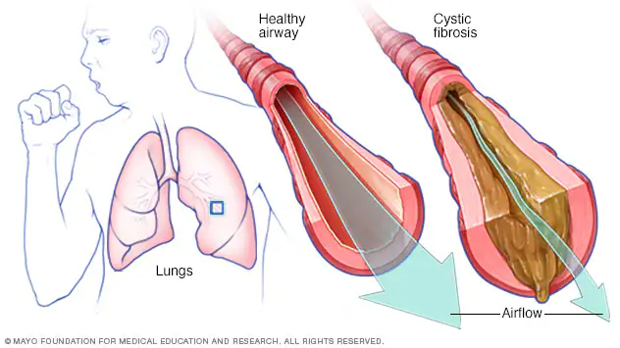
Background
Cystic fibrosis (CF)
Genetic inherited disease
Produces thick and sticky mucus in organs, including lungs and the pancreas
Clogs the airways of patients and makes them difficult to breathe
No cure available but only symptom management, such as airway clearance
source: mayoclinic.org

Slide 4
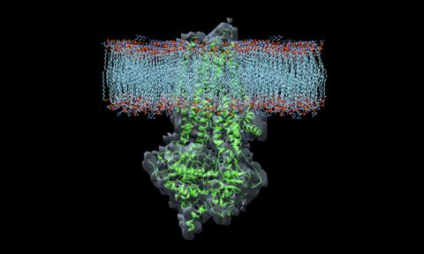
Genomic facts of Cystic Fibrosis
CF is caused by mutations in Cystic Fibrosis Transmembrane Conductance Regulator (CFTR).
The CFTR protein is an ion channel protein, acting like gates in a cell membrane that control the traffic of molecules through the membrane.
For regular people, CFTR acts as a gate for chloride ions. When chloride leaves the cell, it carries water with it, which makes mucus less thick.
For patients with CF, gene mutations in CFTR prevent this functionality, causing the mucus stays sticky and thick.
source: cff.org
Notes:
Cytoplasmic part is larger

Slide 5
More about the CFTR gene
CFTR gene is located on chromosome 7 of the human genome
Over 1,500 mutations known to cause CF
One type of mutations
Non-synonymous (with amino acid changing) mutations that generate a premature termination codon (PTC), that further leads to a truncated CFTR protein (shortened length).
Notes:
Stop codon: TAA, TAG or TGA

Slide 6
Goal of the project
Write a python program that:
Extract the correct CFTR transcript from the human genome
Translate it into its corresponding amino acid sequence
Determine if one or more patients have a premature stop codon
You will be guided step by step towards the final goal
For more details: Canvas -> Modules -> Project

Slide 7
Data
Filename | Description
Homo_sapiens.GRCh38.93.gtf | Human reference annotation file (GTF format)
Homo_sapiens.GRCh38.dna_sm.chromosome.7.fa | Human reference DNA sequence for chromosome 7 (fasta format)
Patient1.fa | DNA sequence data for Patient 1 (fasta format)
Patient2.fa | DNA sequence data for Patient 2 (fasta format)
Patient3.fa | DNA sequence data for Patient 3 (fasta format)
Patient4.fa | DNA sequence data for Patient 4 (fasta format)
Patient5.fa | DNA sequence data for Patient 5 (fasta format)

Slide 8
Fasta format
>MT dna:chromosome chromosome:GRCh38:MT:1:16569:1 REF
GATCACAGGTCTATCACCCTATTAACCACTCACGGGAGCTCTCCATGCATTTGGTATTTT
CGTCTGGGGGGTATGCACGCGATAGCATTGCGAGACGCTGGAGCCGGAGCACCCTATGTC
GCAGTATCTGTCTTTGATTCCTGCCTCATCCTATTATTTATCGCACCTACGTTCAATATT
ACAGGCGAACATACTTACTAAAGTGTGTTAATTAATTAATGCTTGTAGGACATAATAATA
ACAATTGAATGTCTGCACAGCCACTTTCCACACAGACATCATAACAAAAAATTTCCACCA
AACCCCCCCTCCCCCGCTTCTGGCCACAGCACTTAAACACATCTCTGCCAAACCCCAAAA
ACAAAGAACCCTAACACCAGCCTAACCAGATTTCAAATTTTATCTTTTGGCGGTATGCAC
TTTTAACAGTCACCCCCCAACTAACACATTATTTTCCCCTCCCACTCCCATACTACTAAT
CTCATCAATACAACCCCCGCCCATCCTACCCAGCACACACACACCGCTGCTAACCCCATA
CCCCGAACCAACCAAACCCCAAAGACACCCCCCACAGTTTATGTAGCTTACCTCCTCAAA

Slide 9
GTF format
GTF stands for Gene transfer format
Holds information about gene structure
Tab-delimited

Slide 10
Columns of GTF file
<seqname> <source> <feature> <start> <end> <score> <strand> <frame> [attributes]
1. <seqname>: The name of the sequence (typically a chromosome).
2. <source>: The source of the annotation (e.g., ENSEMBL).
3. <feature>: The type of feature (e.g., gene, transcript, exon).
4. <start>: The starting position of the feature in the sequence.
5. <end>: The ending position of the feature in the sequence.
6. <score>: A score between 0 and 1000, or . if not applicable (indicating the reliability of the annotation).
7. <strand>: The strand on which the feature is located (`+` for the forward strand, `-` for the reverse strand).
8. <frame>: The reading frame, one of '0', '1' or '2', or `.` if not applicable.
9. [attribute]: A list of key-value pairs providing additional information about the feature.

Slide 11
Attribute of GTF
A semicolon (;)-separated list of key-value pairs
For each key-value pair, key is one word, and the value is quoted by double quotes, which may contain multiple words
A key can be repeated multiple times.
Some attributes (always semi-colon separated key-value pairs):
gene_id: The stable identifier for the gene
gene_version: The stable identifier version for the gene
gene_name: The official symbol of this gene
gene_source: The annotation source for this gene
transcript_id: The stable identifier for this transcript
transcript_name: The symbold for this transcript derived from the gene name
exon_id: The stable identifier for this exon

Slide 12
GTF example
<seqname> <source> <feature> <start> <end> <score> <strand> <frame> [attributes]
1 havana gene 11869 14409 . + . gene_id "ENSG00000223972"; gene_version "5"; gene_name "DDX11L1"; gene_source "havana"; gene_biotype "transcribed_unprocessed_pseudogene";
1 havana transcript 11869 14409 . + . gene_id "ENSG00000223972"; gene_version "5"; transcript_id "ENST00000456328"; transcript_version "2"; gene_name "DDX11L1"; gene_source "havana"; gene_biotype "transcribed_unprocessed_pseudogene"; transcript_name "DDX11L1-202"; transcript_source "havana"; transcript_biotype "processed_transcript"; tag "basic"; transcript_support_level "1";
1 havana exon 11869 12227 . + . gene_id "ENSG00000223972"; gene_version "5"; transcript_id "ENST00000456328"; transcript_version "2"; exon_number "1"; gene_name "DDX11L1"; gene_source "havana"; gene_biotype "transcribed_unprocessed_pseudogene"; transcript_name "DDX11L1-202"; transcript_source "havana"; transcript_biotype "processed_transcript"; exon_id "ENSE00002234944"; exon_version "1"; tag "basic"; transcript_support_level "1";

Slide 13
Getting started
Create a folder called project
Download and extract the project files in this folder (download link is provided in the project page)
Work with Jupyter or any text editor (e.g., Spyder, Sublime)
Ask questions if something is unclear
Speak to a TA or discuss with your neighbour
Or use the discussion section in Canvas
Find out more info at Canvas -> Modules -> Project

