Slide 1
Project – main assignment
Every day from 15-17h

Slide 2
Practical information
Practical project
to use the knowledge you acquired
in a real world problem
bigger scale than the exercises
Work on your own (or in groups)
At the end of every day (usually from ~15:00)
TAs available for questions
Not mandatory but highly recommended
Solutions published on Friday the 13th of October
Questions through Canvas until Friday the 20st of October

Slide 3
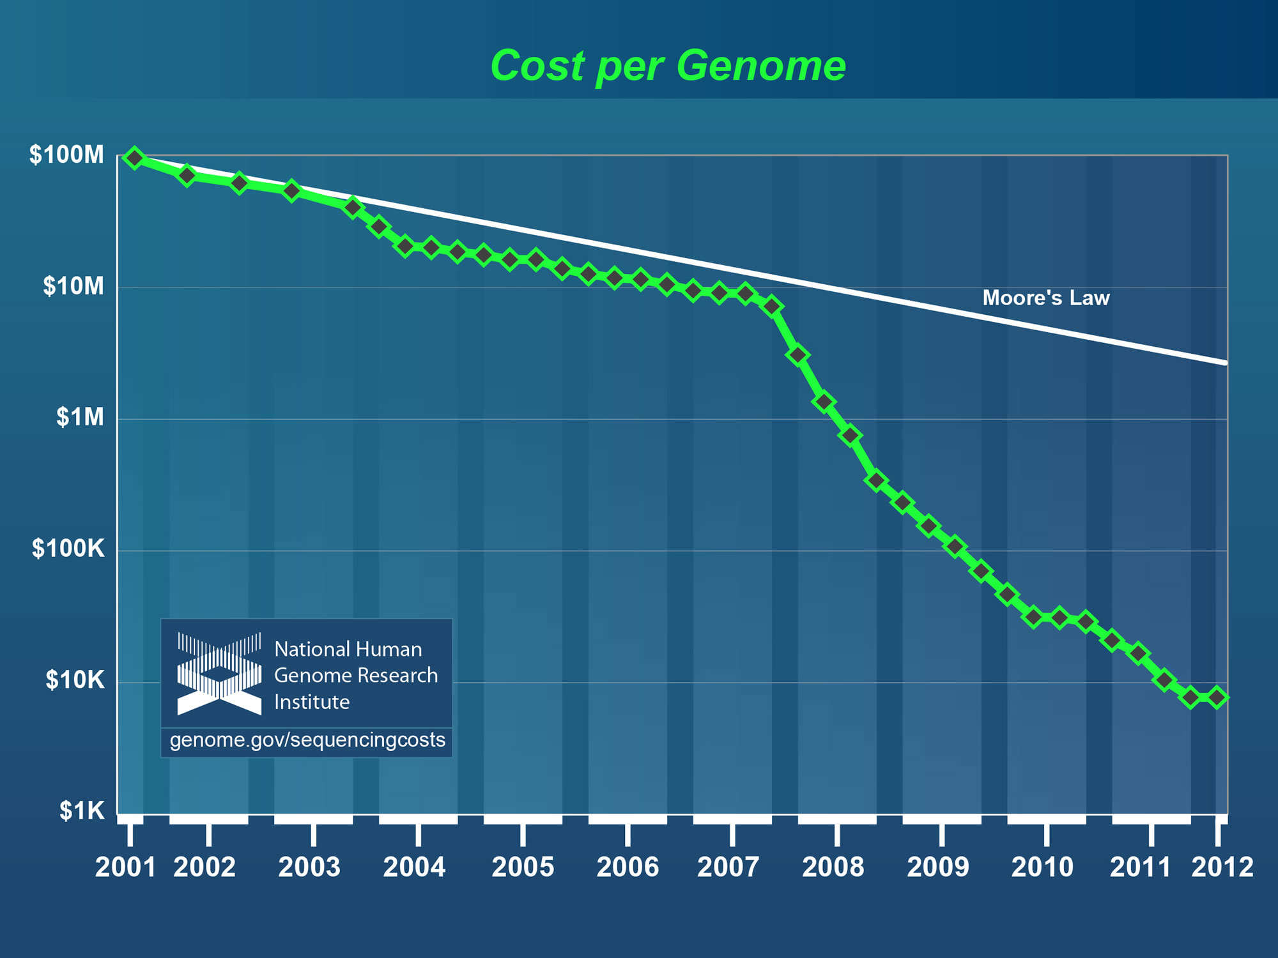
Project background
Whole genome sequencing in the clinic
Sequencing costs low
Screening for mutations causing diseases from whole genome sequencing data

Slide 4
Project background
Cystic fibrosis (CF)
Hereditary disease
Affects lungs and digestive system
Production of thick and sticky mucus
No cure but symptom management

Slide 5
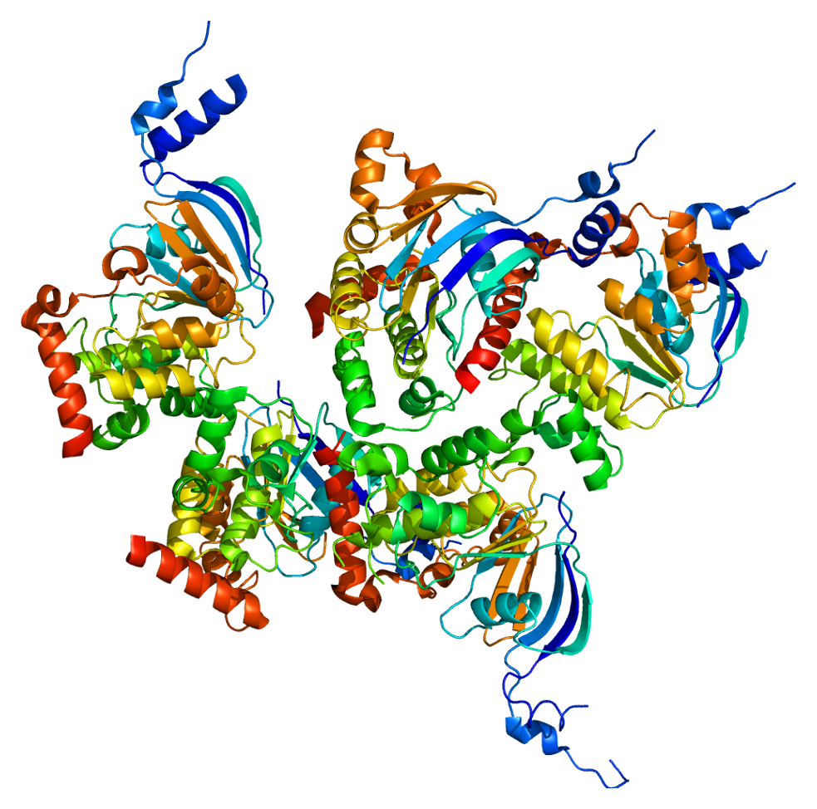
Project background
Cystic Fibrosis Transmembrane Conductance Regulator (CFTR)
Ion channel protein, acting in epithelial cells
CFTR gene located on chromosome 7 of the human genome
Over 1,500 mutations known to cause CF
Non-synonymous (amino acid changing) mutations → premature stop codons

Slide 6
Goal
Write a python program that:
Extracts the correct CFTR transcript from the human genome
Translates it into its corresponding amino acid sequence
Determines if one or more patients have a premature stop codon
→ You are guided step by step towards the final task

Slide 7
Available data
Human reference genome
Chromosome 7 in fasta format
Gene annotations in GTF format
Genome sequencing data from five patients
Chromosome 7 in fasta format

Slide 8
FASTA format
>MT dna:chromosome chromosome:GRCh38:MT:1:16569:1 REF
GATCACAGGTCTATCACCCTATTAACCACTCACGGGAGCTCTCCATGCATTTGGTATTTT
CGTCTGGGGGGTATGCACGCGATAGCATTGCGAGACGCTGGAGCCGGAGCACCCTATGTC
GCAGTATCTGTCTTTGATTCCTGCCTCATCCTATTATTTATCGCACCTACGTTCAATATT
ACAGGCGAACATACTTACTAAAGTGTGTTAATTAATTAATGCTTGTAGGACATAATAATA
ACAATTGAATGTCTGCACAGCCACTTTCCACACAGACATCATAACAAAAAATTTCCACCA
AACCCCCCCTCCCCCGCTTCTGGCCACAGCACTTAAACACATCTCTGCCAAACCCCAAAA
ACAAAGAACCCTAACACCAGCCTAACCAGATTTCAAATTTTATCTTTTGGCGGTATGCAC
TTTTAACAGTCACCCCCCAACTAACACATTATTTTCCCCTCCCACTCCCATACTACTAAT
CTCATCAATACAACCCCCGCCCATCCTACCCAGCACACACACACCGCTGCTAACCCCATA
CCCCGAACCAACCAAACCCCAAAGACACCCCCCACAGTTTATGTAGCTTACCTCCTCAAA

Slide 9
GTF format
Gene transfer format
Holds information about gene structure
Tab-delimited
Based on the general feature format (GFF), additional structure specific to genes

Slide 10
GTF format
Structure (per line):
<seqname> <source> <feature> <start> <end> <score> <strand> <frame> [attributes]

Slide 11
GTF format
Structure (per line):
<seqname> <source> <feature> <start> <end> <score> <strand> <frame> [attributes]
seqname - name of the chromosome or scaffold; chromosome names without a 'chr’
source - name of the program that generated this feature, or the data source (database or project name)
feature - feature type name. Current allowed features are {gene, transcript, exon, CDS, Selenocysteine, start_codon, stop_codon and UTR}.
start - start position of the feature, with sequence numbering starting at 1
end - end position of the feature, with sequence numbering starting at 1

Slide 12
GTF format
Structure (per line):
<seqname> <source> <feature> <start> <end> <score> <strand> <frame> [attributes]
score - a floating point value indiciating the score of a feature
strand - defined as + (forward) or - (reverse)
frame - reading frame, one of '0', '1' or '2'
attribute - a semicolon-separated list of tag-value pairs (separated by a space), providing additional information about each feature. A key can be repeated multiple times.

Slide 13
GTF format
Structure (per line):
<seqname> <source> <feature> <start> <end> <score> <strand> <frame> [attributes]
Some attributes (always semi-colon separated key-value pairs):
gene_id: The stable identifier for the gene
gene_version: The stable identifier version for the gene
gene_name: The official symbol of this gene
gene_source: The annotation source for this gene
transcript_id: The stable identifier for this transcript
transcript_name: The symbold for this transcript derived from the gene name
exon_id: The stable identifier for this exon

Slide 14
GTF format
Structure (per line):
<seqname> <source> <feature> <start> <end> <score> <strand> <frame> [attributes]
1 havana gene 11869 14409 . + . gene_id "ENSG00000223972"; gene_version "5"; gene_name "DDX11L1"; gene_source "havana"; gene_biotype "transcribed_unprocessed_pseudogene";
1 havana transcript 11869 14409 . + . gene_id "ENSG00000223972"; gene_version "5"; transcript_id "ENST00000456328"; transcript_version "2"; gene_name "DDX11L1"; gene_source "havana"; gene_biotype "transcribed_unprocessed_pseudogene"; transcript_name "DDX11L1-202"; transcript_source "havana"; transcript_biotype "processed_transcript"; tag "basic"; transcript_support_level "1";
1 havana exon 11869 12227 . + . gene_id "ENSG00000223972"; gene_version "5"; transcript_id "ENST00000456328"; transcript_version "2"; exon_number "1"; gene_name "DDX11L1"; gene_source "havana"; gene_biotype "transcribed_unprocessed_pseudogene"; transcript_name "DDX11L1-202"; transcript_source "havana"; transcript_biotype "processed_transcript"; exon_id "ENSE00002234944"; exon_version "1"; tag "basic"; transcript_support_level "1";

Slide 15
Getting started
Create a folder called project
Download and extract the files in this folder
Work with Jupyter or any text editor (e.g., Spyder, Sublime)
Ask questions if something is unclear
Speak to a TA
Or use the discussion section in Canvas

