Slide 1
Geometric Transformation

Slide 2
Agenda
3D geometric transformation
  Basic 3D transformation matrices
  3D reflection and shearing
  composite transformation implementation
  OpenGL transformation functions(P236-242)
Q&A

Slide 3
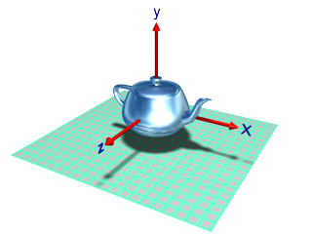
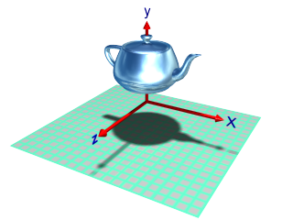
5.7.1 3D Translation
平移向量: t_{x}, t_{y}, t_{z}
矩阵表达
x’ 1 0 0 t_{x} x
y’ 0 1 0 t_{y} y
z’ 0 0 1 t_{z} z
1 0 0 0 1 1
Notes:
Parameters: tx, ty, tz
Matrix representation

Slide 4
5.7.2 3D Scale
针对原点变比
  变比因子: s_{x}, s_{y}, s_{z}
  矩阵表达
x’ s_{x} 0 0 0 x
y’ 0 s_{y} 0 0 y
z’ 0 0 s_{z} 0 z
1 0 0 0 1 1
Notes:
Scale From Origin
Parameters: Sx, Sy, Sz
Matrix Representation

Slide 5
5.7.3 3D Scale
针对固定点变比
  参数: s_{x}, s_{y}, s_{z}, (x_{f}, y_{f}, z_{f})
  变换矩阵
  M=T(x_{f}, y_{f}, z_{f})S(s_{x}, s_{y}, s_{z})T(-x_{f},-y_{f}, -z_{f})
Notes:
Scale From Fixed Position
Parameters: Sx, Sy, Sz, (X_{f}, Y_{f}, Z_{f})
Matrix Representation

Slide 6
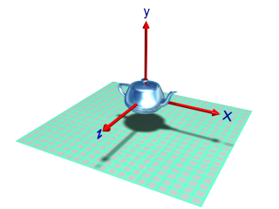
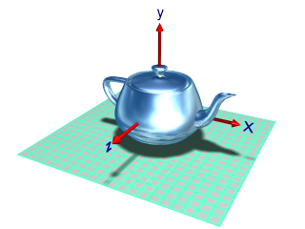
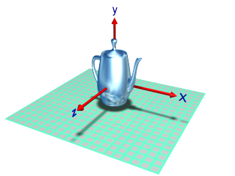
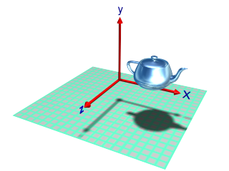
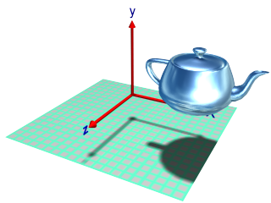
Original
scale all axes
scale Y axis
offset from origin
distance from origin also scales

Slide 7
5.7.3 3D Rotations
旋转参数
  指定旋转轴
  旋转角度以及方向
基本旋转变换类型
  Z-axis Rotation
  X-axis Rotation
  Y-axis Rotation
Notes:
Parameters
designate an axis
amount of angular rotation
Basic Rotations transformation types
Z-axis Rotation
X-axis Rotation
Y-axis Rotation

Slide 8
z-axis Rotation
代数方程
x’ = xcosθ - ysinθ
y’ = xsinθ + ycosθ
z’ = z

Slide 9
z-axis Rotation
矩阵表达 P’= R_{z}(θ)*P
x’ cosθ -sinθ 0 0 x
y’ sinθ cosθ 0 0 y
z’ 0 0 1 0 z
1 0 0 0 1 1

Slide 10
x-axis Rotation
x->y->z->x
代数方程
y’ = ycosθ - zsinθ
z’ = ysinθ + zcosθ
x’ = x

Slide 11
x-axis Rotation
矩阵表达 P’= R_{x}(θ)*P
x’ 1 0 0 0 x
y’ 0 cosθ -sinθ 0 y
z’ 0 sinθ cosθ 0 z
1 0 0 0 1 1

Slide 12
y-axis Rotation
x->y->z->x
代数方程
z‘ = zcosθ - xsinθ
x‘ = zsinθ + xcosθ
y‘ = y

Slide 13
y-axis Rotation
矩阵表达 P’= R_{y}(θ)*P
x‘ cosθ 0 sinθ 0 x
y‘ 0 1 0 0 y
z‘ -sinθ 0 cosθ 0 z
1 0 0 0 1 1

Slide 14
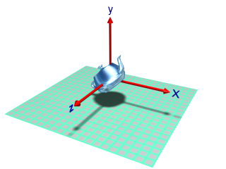
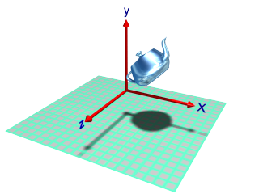
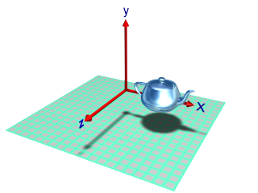
rotation of 45º about the Z axis
offset from origin rotation

Slide 15
General 3D Rotations
y
任意轴平行于坐标轴之一
  平移使任意轴与平行坐标轴重合
  完成指定旋转
  反向平移使回到原位置
Example
任意轴平行于X轴的变换矩阵M=T⁻¹ R_{X}(θ)T
L
x
z
Notes:
General axis parallel to one of the coordinate axes
Translate the object so that the rotation axis coincides with the parallel coordingate axis
Perform the specified rotation
Translate to move back to its original position

Slide 16
General 3D Rotations
任意轴不平行于任何坐标轴
  平移使任意轴过原点
  旋转使任意轴与坐标轴之一重合
  完成指定旋转
  反向旋转
  反向平移
y
L
x
z
Notes:
General axis not parallel to one of the coordinate axes
Translate
Rotate to make the axis coincides with one of the coordinate axes
Perform the specified rotation
Apply inverse rotations
Apply inverse translation

Slide 17
General 3D Rotations
Example (P221~225)
Other methods

Slide 18
M=T⁻¹Rx(-a)Ry(-b)Rz(θ)Ry(b)Rx(a)T
y
y
y
y
T
Rx(a)
Ry(b)
p2
u’
p1
u
u
x
x
x
x
u’’’
z
z
z
z
u’’
y
y
y
y
Rz(θ)
T⁻¹
Rx(-a)
Ry(-b)
u
u
x
x
x
x
z
z
z
u’’
u’’’
z

Slide 19
General 3D Rotations
旋转轴由两个坐标点确定
P₁(x₁, y₁, z₁) → P₂(x₂, y₂, z₂)
旋转轴矢量
  V = P₂－P₁ = (V_{x}, V_{y}, V_{z})
沿旋转轴的单位向量
  u=V/|V| =(a, b, c)
  a=(x₂-x₁)/|V|、b=(y₂-y₁)/|V|
  c=(z₂-z₁)/|V|
  |V| = sqrt(V_{x}² + V_{y}² + V_{z}²)
y
P₂
u
P₁
x
z

Slide 20
第一步：平移物体，使旋转轴通过原点
平移矢量
T₁ = T(t_{x}, t_{y}, t_{z})
= T(-x₁, -y₁, -z₁)
=
y
P₂'
1 0 0 -x₁
0 1 0 -y₁
0 0 1 -z₁
0 0 0 1
P₁'
x
z

Slide 21
第二步:旋转物体使旋转轴与z轴重合
旋转物体使旋转轴与z轴重合分两步
  将向量U绕x轴旋转到xz平面上: R_{x}(α)
  将向量U绕y轴旋转到z轴上: R_{y}(β)
y
y
u(a,b,c)
β
α
u_{z}(0,0,1)
x
x
u'' (a,0,d)
u'' (a,0,d)
z
z
Notes:
见下一张卡片

Slide 22
第二步的第一小步
  将向量U绕x轴旋转到xz平面上: R_{x}(α)
y
u'(0,b,c)
u(a,b,c)
α
α
x
u_{z}(0,0,1)
u'' (a,0,d)
z
u'为u在yz平面上的投影
Notes:
d是u的长度,

Slide 23
将向量U绕x轴旋转到xz平面上: R_{x}(α)
cos(α)，sin(α)求解
利用向量的点乘运算确定余弦项
cos(α)=u'.u_{z}/(|u'|.|u_{z}|)=c/d
  |u_{z}|=1 及 |u'|=d=sqrt(b²+c²)
利用向量的叉乘运算确定正弦项u'×u_{z}=u_{x}|u'|.|u_{z}|sin(α)=b.u_{x}
  sin(α)=b/d

Slide 24
将向量U绕x轴旋转到xz平面上：R_{x}(α)
1 0 0 0
0 c/d -b/d 0
0 b/d c/d 0
0 0 0 1
R_{x}(α)=

Slide 25
第二步的第二小步
  将向量U绕y轴旋转到z轴上: Ry(β)
y
β
u_{z}(0,0,1)
x
u'' (a,0,d)
z

Slide 26
将向量U绕y轴旋转到z轴上：Ry(β)
cos(β)，sin(β)求解
利用向量的点乘运算确定余弦项cos(β)=u''.u_{z}/(|u''|.|u_{z}|)=d
  |u_{z}|=1 及 |u''| = sqrt(d² + a²) = |u| = 1
利用向量的叉乘运算确定正弦项u''×u_{z}=u_{y}|u''||u_{z}|sin(β)=-a.u_{y}
  sin(β)=-a

Slide 27
将向量U绕y轴旋转到z轴上：Ry(β)
R_{y}(β)=
d 0 -a 0
0 1 0 0
a 0 d 0
0 0 0 1

Slide 28
第三步：完成指定旋转 R_{z}(θ)
Rz(θ)=
cosθ -sinθ 0 0
sinθ cosθ 0 0
0 0 1 0
0 0 0 1

Slide 29
第四步：反向旋转使旋转轴回到原始方向
R_{y}(-β)= R_{y}⁻¹ (β)
R_{x}(-α)= R_{x}⁻¹ (α)

Slide 30
第五步：反向平移使旋转轴回到原始位置
1 0 0 x1
0 1 0 y1
0 0 1 z1
0 0 0 1
T₂=
=T₁⁻¹

Slide 31
M=T⁻¹Rx(-a)Ry(-b)Rz(θ)Ry(b)Rx(a)T
y
y
y
y
T
Rx(a)
Ry(b)
p2
u’
p1
u
u
x
x
x
x
u’’’
z
z
z
z
u’’
y
y
y
y
Rz(θ)
T⁻¹
Rx(-a)
Ry(-b)
u
u
x
x
x
x
z
z
z
u’’
u’’’
z

Slide 32
5.8 3D Reflection & Shearing
变换矩阵
  XOY 平面反射
  XOZ 平面反射
  YOZ 平面反射
  1 0 0 0
0 1 0 0
0 0 -1 0
0 0 0 1
RFz =
y
y
z
x
x
z
Notes:
Matrix Representation
XOY Plane Reflection
XOZ Plane Reflection
YOZ Plane Reflection

Slide 33
5.8 3D Reflection & Shearing
变换矩阵
  Z-axis 错切
  X-axis 错切
  Y-axis 错切
  1 0 a 0
0 1 b 0
0 0 1 0
0 0 0 1
SHz =
Notes:
Matrix Representation
Z-axis Shearing
X-axis Shearing
Y-axis Shearing

Slide 34

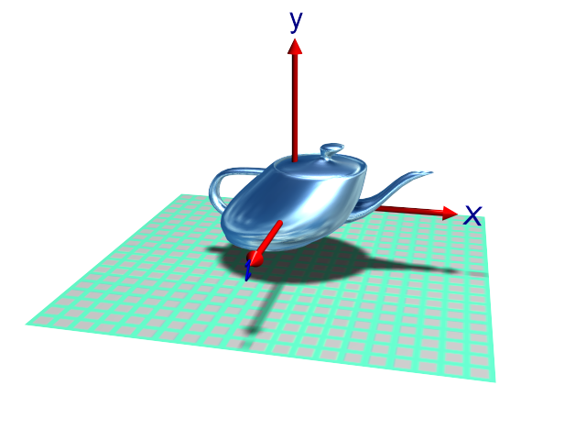
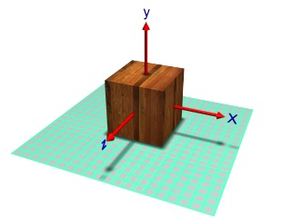
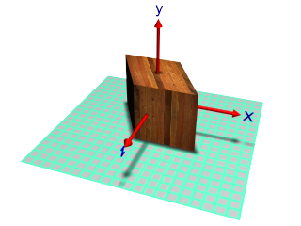
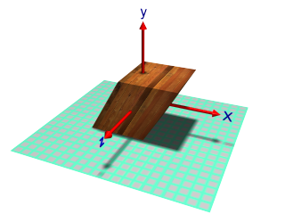
original

Slide 35
5.9 Composite Transformations
Implementation(P231~P234)

