Slide 1
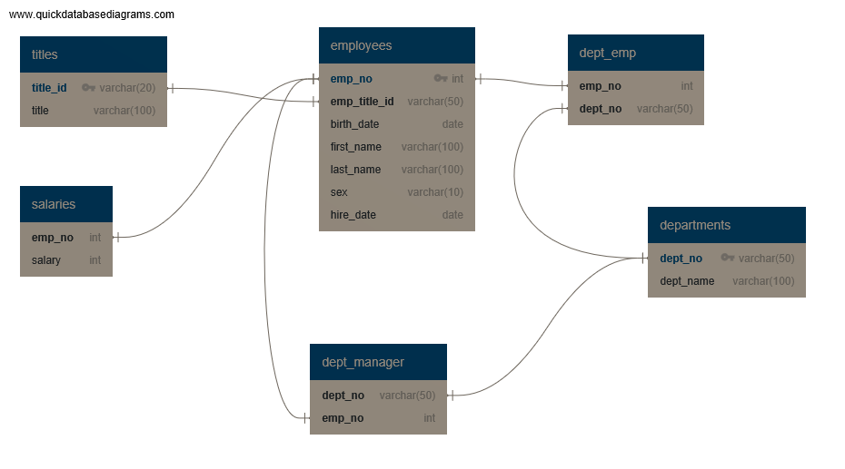
ERD – sql-challenge

