Slide 1
Smart Dustbin
Team _3744
Nachiket Patil
Prathamesh Posa
Email_Id:- nachiketpatil4642@gmail.com
S.S.Agrawal Institute of Engineering and Technology.

Slide 2
AGENDA
To provide a hands-free and efficient way of disposing of waste by automating the opening and closing of the bin lid based on the presence of a user or object.
To enable real-time monitoring of the garbage level inside the bin using ultrasonic sensors and display the information on an LCD screen.
To alert the user when the garbage level reaches a certain threshold using a buzzer and servo motor to rotate a flag, indicating that the bin needs to be emptied.

Slide 3
PROBLEM STATEMENT
The problem of waste management is a global concern that affects the environment and public health. The current waste management system is time-consuming and inefficient, leading to littering and environmental problems. The smart bin project aims to address these challenges by automating the waste disposal process, providing real-time monitoring of the garbage level, and alerting the user when the bin needs to be emptied. This project is a practical application of sensors and electronics to solve a pressing environmental and public health issue.

Slide 4
PROJECT OVERVIEW
The smart bin project is an innovative application of electronics and sensors to automate waste disposal and improve waste management. The project uses two ultrasonic sensors to detect the presence of a user or object and measure the garbage level in the bin. The garbage level is displayed on an LCD screen, and a buzzer and servo motor rotate a flag to alert the user when the bin is full. The project aims to provide a hands-free and efficient way of disposing of waste while reducing environmental and public health concerns.

Slide 5
WHO ARE THE END USERS?
The end-users of the smart bin project could be any individuals, households, or organizations that generate waste and want to improve their waste management practices. The project can be used in public places such as parks, streets, or bus stations, where there is a high volume of waste generated. The project can also be used in households, apartments, or offices, where there is a need for efficient and hands-free waste disposal systems. The project is designed to benefit anyone who wants to improve their waste management practices and reduce environmental and public health concerns.

Slide 6
THE WOW FACTOR IN OUR SOLUTION
The smart bin project has several "wow" factors that make it a unique and innovative solution to waste management. Firstly, the project uses two ultrasonic sensors to detect the presence of a user or object and measure the garbage level in the bin, providing real-time monitoring of the waste disposal process. Secondly, the project uses a servo motor to open the bin lid automatically when a user or object is detected, providing a hands-free and hygienic way of disposing of waste. Finally, the project uses a buzzer and servo motor to rotate a flag when the garbage level reaches a certain threshold, providing a visual and audible alert to the user to empty the bin. The combination of these features makes the smart bin project an efficient, practical, and user-friendly solution to waste management.

Slide 7
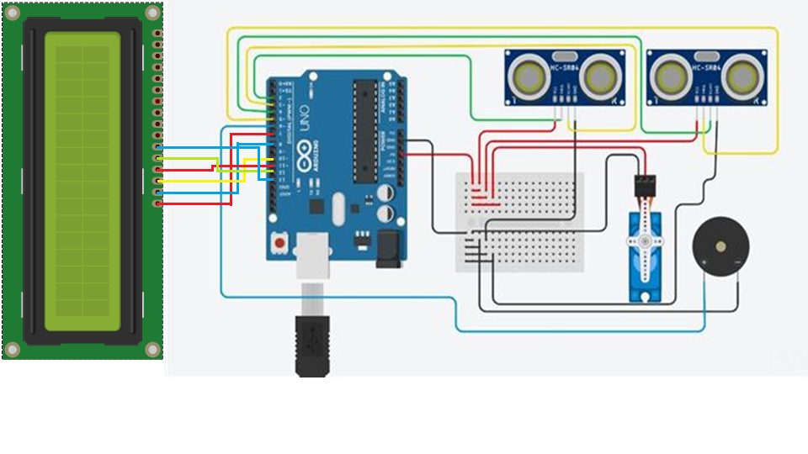
MODELLING

Slide 8
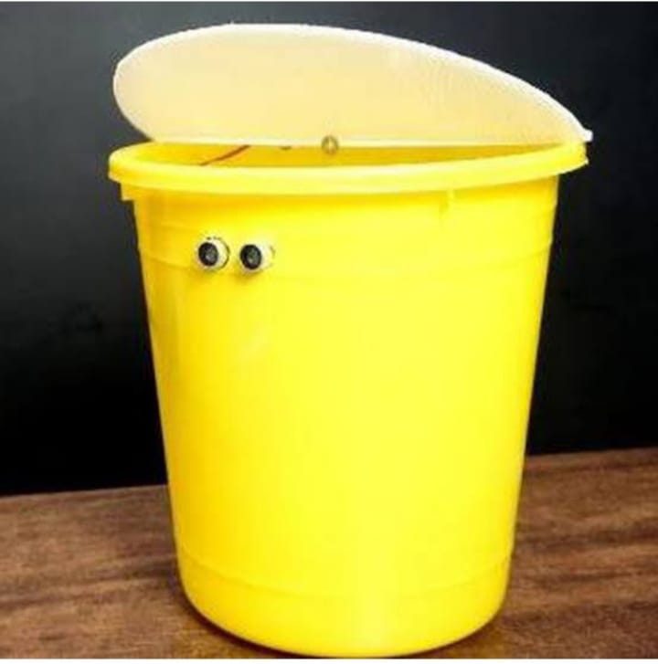
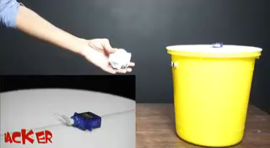
RESULTS

Slide 9
CONCLUSION
The smart bin project is an innovative solution that combines multiple technologies to create an intelligent waste management system. By using ultrasonic sensors, a servo motor, a buzzer, and an LCD display, the system can detect the presence of waste and open the bin accordingly, measure the level of waste in the bin and alert users when it's full. The project has the potential to improve waste management practices, reduce littering, and increase the efficiency of waste collection processes. This project is an excellent example of how technology can be used to address real-world problems and make a positive impact on society.

Slide 10


MEET OUR TEAM
Nachiket Patil
Prathamesh Posa

Slide 11
Thank You

