Slide 1
Nigeria Labour Force Survey 2023
Employed Persons by Occupation (ISCO) umar siyudi

Slide 2
 | sector | percent
0 | Services and sales workers | 33.8
1 | Skilled agricultural forestry and fishery workers | 28.1
2 | Craft and related trades workers | 14.4
3 | Elementary occupations | 7.0
4 | Plant and machine operators and assemblers | 6.4

Slide 3
Please note: the following text and data are drawn from p.26 of the Nigeria Labour Force Survey Annual Report 2023 published by the NBS.

Slide 4
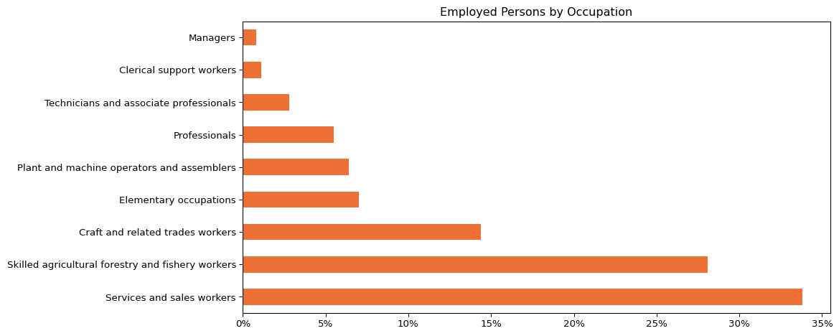
EMPLOYED PERSONS BY OCCUPATION
The International Standard Classification of Occupations (ISCO) is a system developed by the International Labour Organisation (ILO) to classify and categorize occupations worldwide. It provides a standardized framework for organizing and comparing information about occupations across different countries and regions.
Figure 1: Employed Persons by Occupation

Slide 5
The proportion of Services and sales workers was 33.8%, skilled agricultural, forestry, and fishery was 28.1%, and clerical support workers represented 1.1% of the workforce (see Figure 1 and Table 1)

