Slide 1
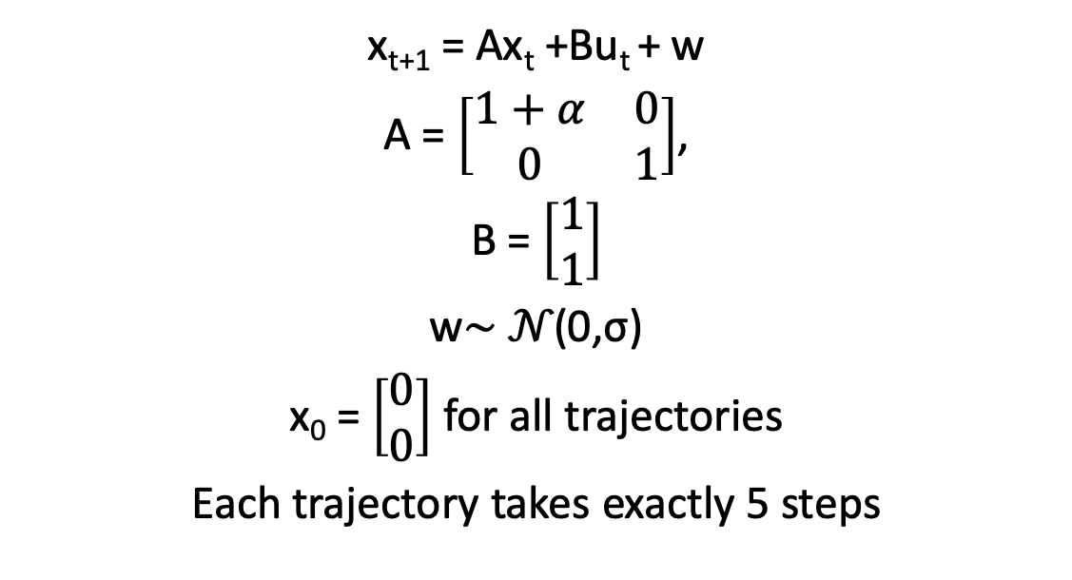
RL outputs on
x_{t+1} = Ax_{t} +Bu_{t} + w
A = $\left[\begin{matrix}1+α & 0 \\ 0 & 1\end{matrix}\right]$,
B = $\left[\begin{matrix}1 \\ 1\end{matrix}\right]$
w∼ 𝒩(0,σ)
x₀ = $\left[\begin{matrix}0 \\ 0\end{matrix}\right]$ for all trajectories
Each trajectory takes exactly 5 steps

Slide 2
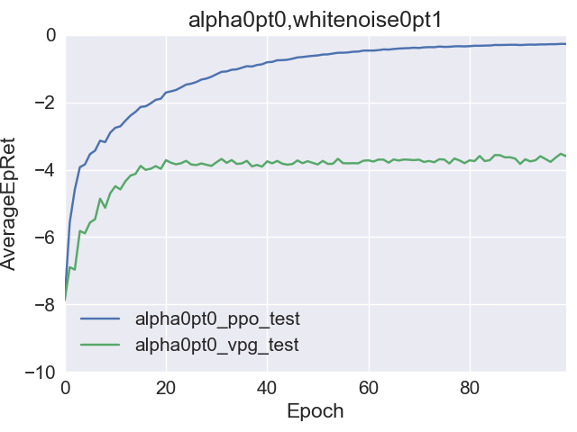
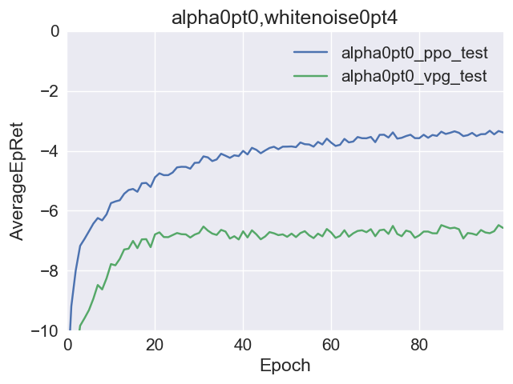
Generally…
(for actual presentation, these should be replaced with ylim=15)
It does not seem like there is enough learning signal in this short of experiment
Rather, it might just be realizing that it’s never really that bad so it should just do nothing
It might just be that the regularization parameter is now too high for the scale of the signal coming in through a trajectory’s rewards…

Slide 3
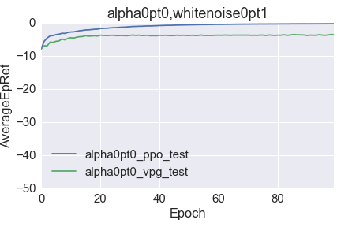
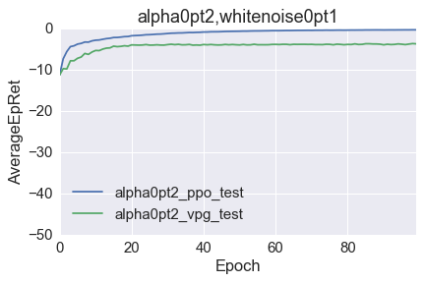
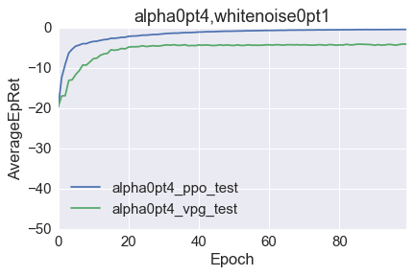

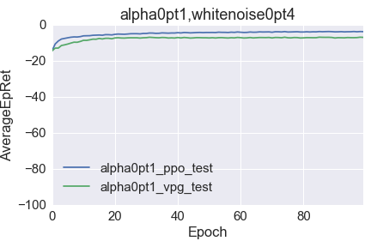
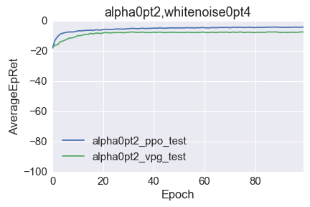
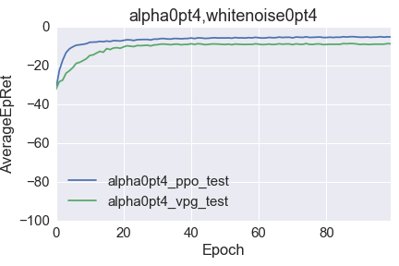
𝝰 increasing ⟶
(for actual presentation, these should be replaced with ylim=15)
⟵ σ increasing

Slide 4
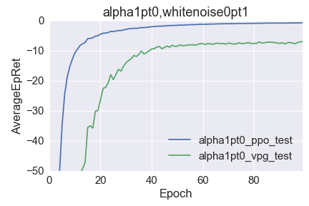
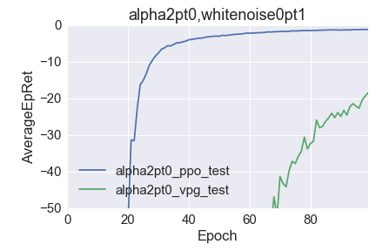
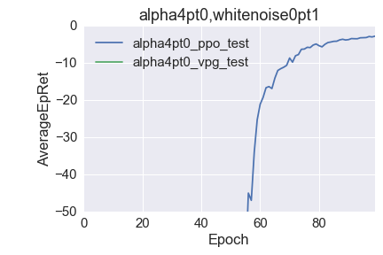
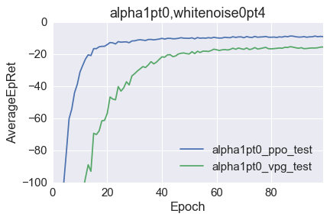
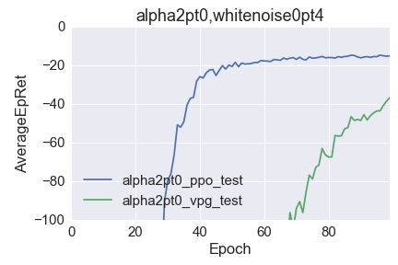
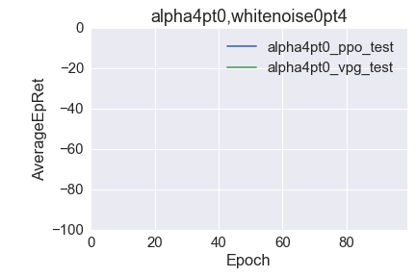
𝝰 increasing ⟶
(for actual presentation, these should be replaced with ylim=15)
⟵ σ increasing

