Slide 1




Bhasha Bandhu Hackathon
Innovating for a Multilingual Judiciary
Innovating for a Multilingual Judiciary
Team/Individual Name:BhashaNyaya Team/Individual bio: Mohammed Sohail, N Bhanu Prakash
Supported by

Slide 2
Problem Statement
Many Indian citizens face challenges in filing legal applications due to:
Complex Legal Forms: Legal terminology is difficult to understand.
Language Barriers: Most legal forms are in English or Hindi, excluding regional speakers.
Fear of Mistakes: Errors in applications can cause delays or rejections.
Illiteracy & Accessibility Issues: Rural citizens struggle due to lack of literacy skills.
Lack of Legal Guidance: Without legal experts, people don't know how to complete forms correctly.
This project aims to bridge these gaps by providing a multilingual, AI-powered legal assistant.
Notes:
Idea Submissions Form – Details of the form Topic
Thesis Abstract Concept Note What is the solution Build? Business use case (Less than 100 – 200 words) Judge and filter becomes easy

Slide 3
Solution
Our solution leverages the BHASHINI API to create a multilingual legal support platform focusing on three key areas:
Mediation Awareness Platform
Chatbots providing multilingual legal assistance.
User-friendly resources explaining mediation benefits.
Community forums for experience sharing.
Legal Literacy Ecosystem
Digital legal education platform with quizzes and scenarios.
Tailored content for students, professionals, and senior citizens.
Real-time updates on legal aid services.
Speech-Enabled Legal Application System
BHASHINI API-powered speech recognition for legal form-filling.
Secure electronic submission and real-time tracking.
Notes:
Idea Submissions Form – Details of the form Topic
Thesis Abstract Concept Note What is the solution Build? Business use case (Less than 100 – 200 words) Judge and filter becomes easy

Slide 4
Use of Azure OpenAI & Bhashini API
Key Features:
Feature | Functionality
AI-Powered Case Analysis | Uses NLP to analyze user’s case details & determine case type.
Legal Department Identification | AI suggests the correct government office & officer to approach.
Speech-to-Text (Bhashini API) | Converts user’s regional language speech into text for form filling.
Text-to-Speech | Reads form instructions & legal terms aloud for accessibility.
Legal Terminology Explanation | AI provides simple explanations of legal terms to users.
Facial Recognition & Fingerprint Authentication | Secure form submission using biometric verification.
Submission & Tracking System | Users receive SMS/email notifications with case status updates.
Notes:
Idea Submissions Form – Details of the form Topic
Thesis Abstract Concept Note What is the solution Build? Business use case (Less than 100 – 200 words) Judge and filter becomes easy

Slide 5
Techstack/Technology Used
Our solution is powered by cutting-edge technologies:
Frontend: React with Tailwind CSS for a smooth user experience.
Backend: Flask/Django for efficient API interactions and data handling.
Speech Processing: BHASHINI API + Google Speech-to-Text for language recognition.
Database: PostgreSQL/MySQL for storing user data and case tracking.
AI/NLP: Hugging Face Transformers / BERT for understanding legal terminology.
Notes:
Idea Submissions Form – Details of the form Topic
Thesis Abstract Concept Note What is the solution Build? Business use case (Less than 100 – 200 words) Judge and filter becomes easy

Slide 6
Unique Selling Proposition
What makes our solution unique?
AI-Powered Legal Assistance: Analyzes cases and guides users.
Multilingual Voice-Based Support: Speech recognition breaks language barriers.
Secure Biometric Authentication: Ensures verified application submissions.
Real-Time Tracking & Notifications: Keeps users updated on case progress.
Notes:
Idea Submissions Form – Details of the form Topic
Thesis Abstract Concept Note What is the solution Build? Business use case (Less than 100 – 200 words) Judge and filter becomes easy

Slide 7
Business Potential
Our solution has a strong market and social impact potential:
Empowers Citizens: Allows people to file legal applications independently.
Eliminates Language Barriers: Voice-based support improves accessibility.
Saves Time & Reduces Errors: AI-driven guidance prevents mistakes.
Promotes Legal Accessibility: Ensures justice for rural and underprivileged communities.
Notes:
Idea Submissions Form – Details of the form Topic
Thesis Abstract Concept Note What is the solution Build? Business use case (Less than 100 – 200 words) Judge and filter becomes easy

Slide 8
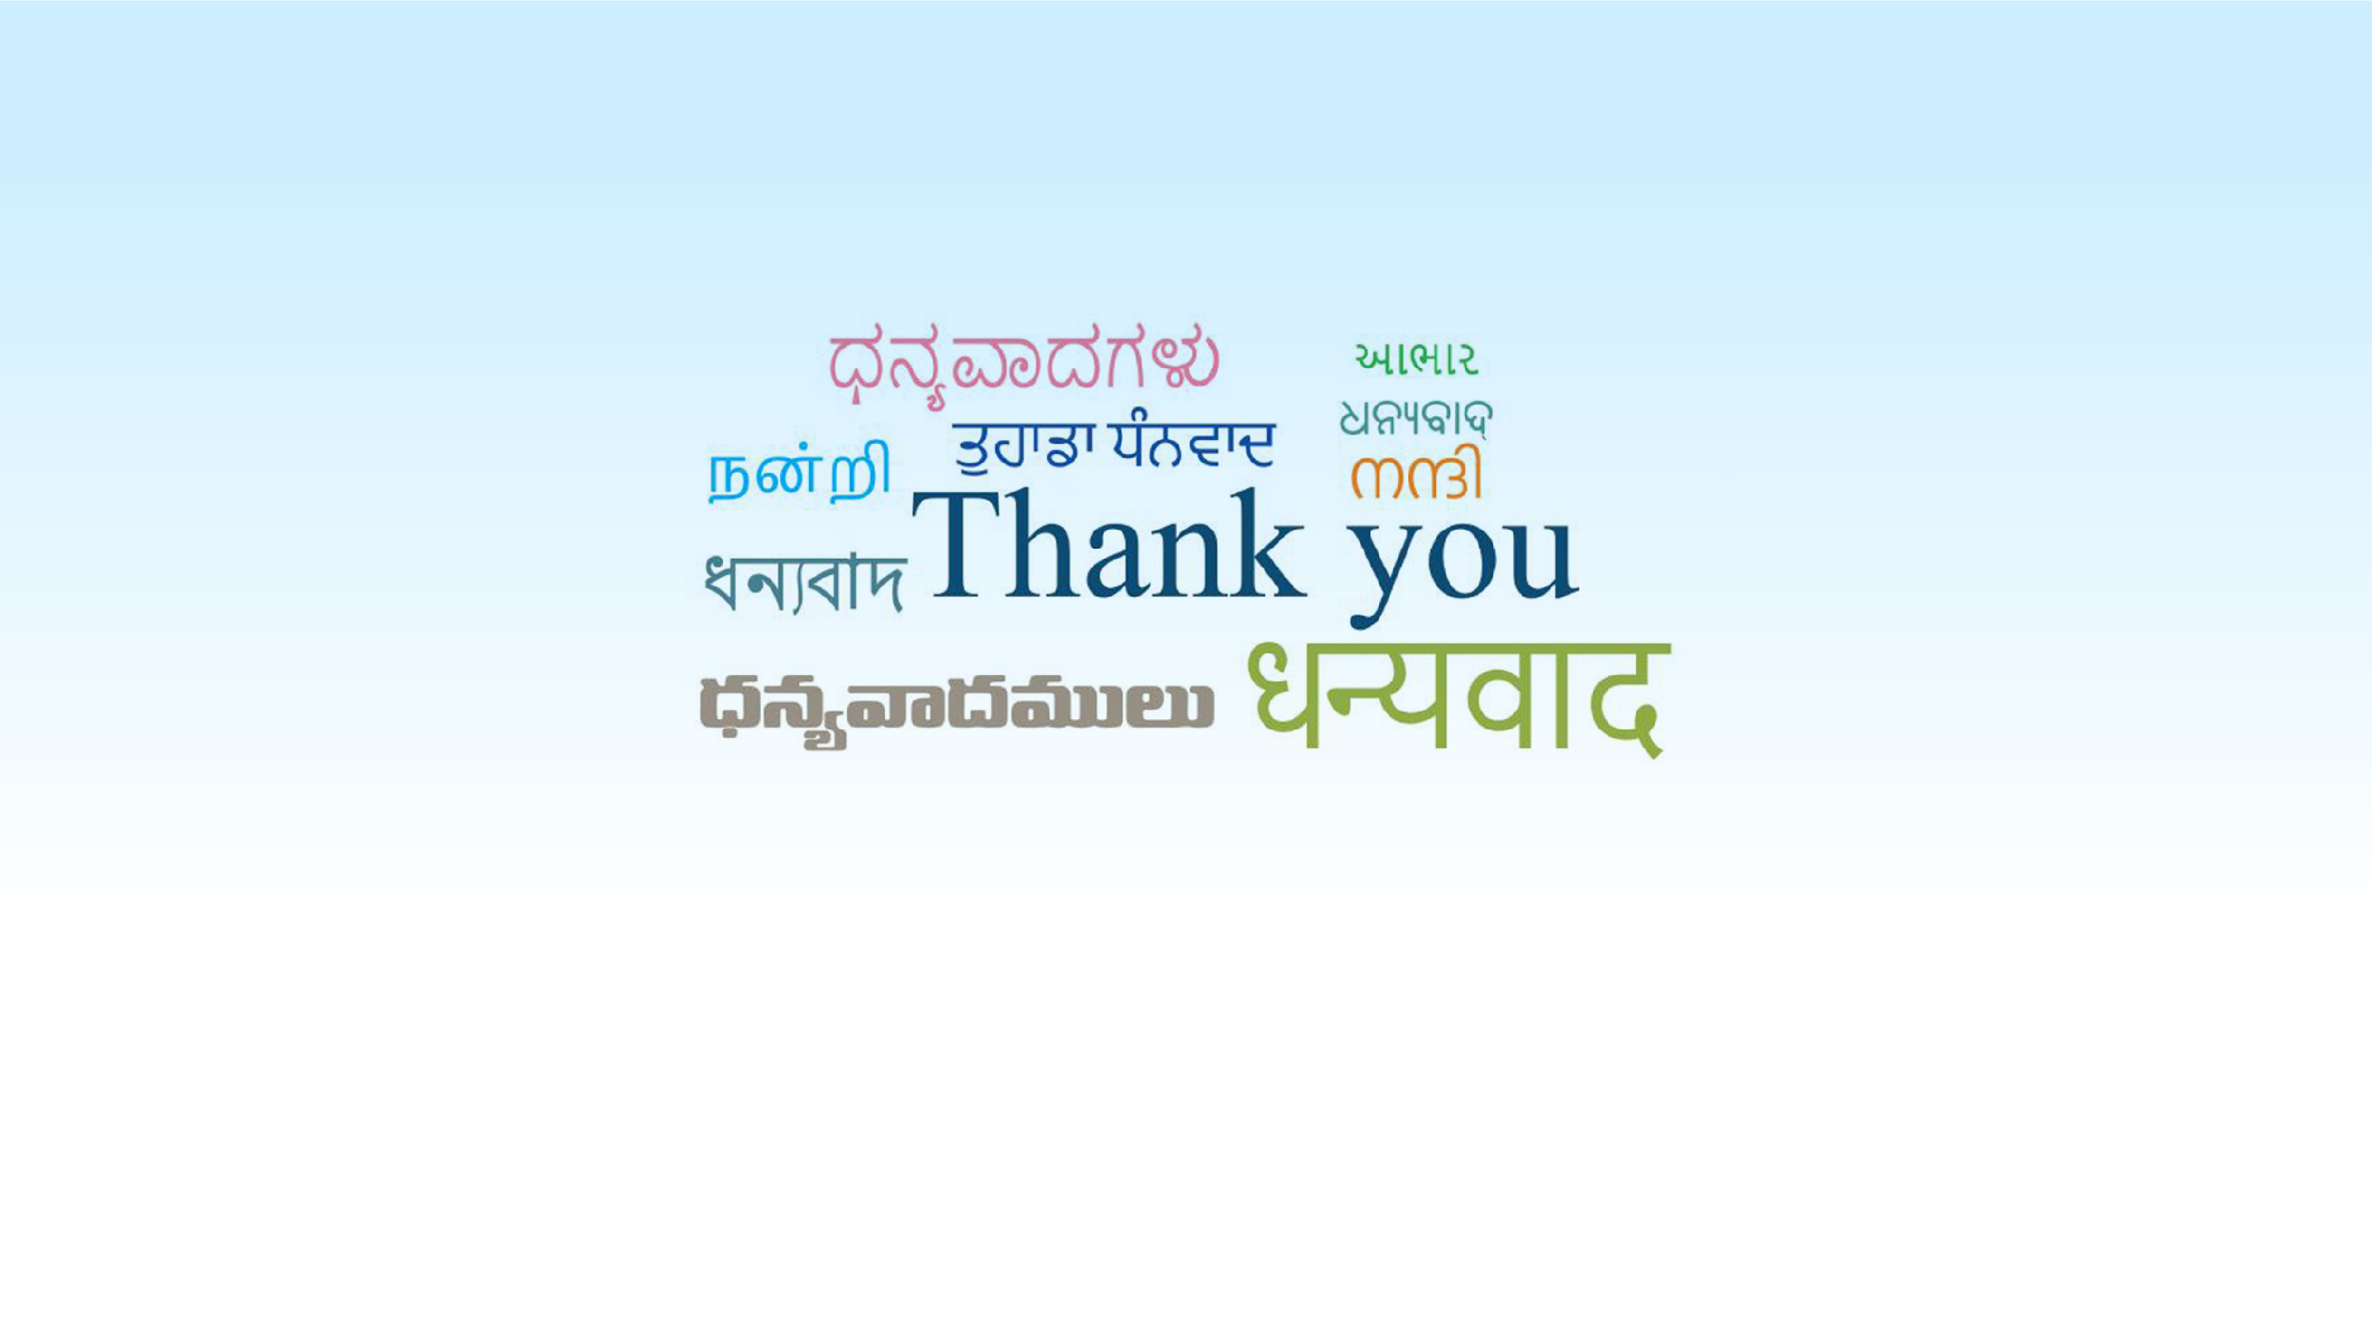
Innovating for a Multilingual Judiciary
Supported by

