Slide 1


SMART INDIA HACKATHON 2024
TRUTHLENS
Problem Statement ID –1683
Problem Statement Title-Development of AI/ML based solution for detection of face-swap based deep fake videos
Theme-Miscellaneous
PS Category- Software
Team ID-
Team Name (TRUTHLENS)

Slide 2
TRUTH LENS
TEAM
TRUTH
LENS
Web-based AI-Powered System for Detecting Face-Swap Deepfakes and AI-Generated Audio in Videos
The solution leverages AI to analyze faces, and detect deepfake morphing/swapping in images and videos . It also assesses audio for AI-generated elements.
Truth Lens detects deepfakes by dual analysis of video frames and audio, improving accuracy, and countering misinformation effectively
Our innovation lies in our dual-analysis approach, combining real-time visual and audio deepfake detection, offering superior accuracy, scalability, and a Reliable defence against misinformation.

Slide 3

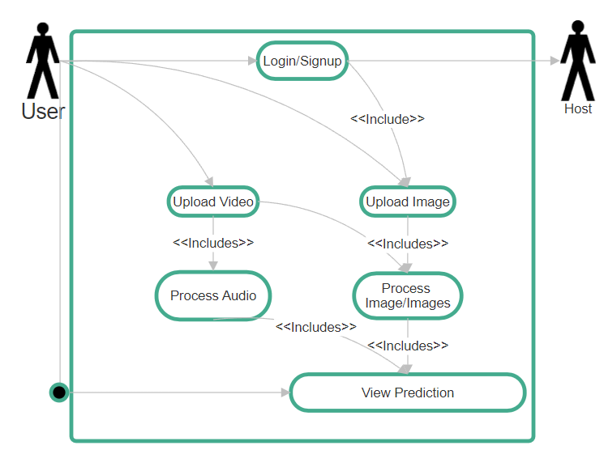
TECHNICAL APPROACH
TEAM
TRUTH
LENS
Tensorflow, OpenCV, Dlib, Keras, ML, librosa, matplotlib, Numpy, React, MongoDB, CSS, HTML, Flutter, Dart
Flowchart:

Slide 4
FEASIBILITY AND VIABILITY
TEAM
TRUTH
LENS
TruthLens applies AI/ML technologies for face and voice recognition, which are mature and widely researched. Integrating these into a comprehensive deepfake detection system is technically feasible.
With the increasing prevalence of deepfakes, there's a growing demand for reliable detection tools, providing a solid market opportunity on a subscription model
Potential challenges and risks: High Computation cost and Data Privacy concerns
Solutions: Cloud-Based Scaling, Continuous Model Training,Privacy Protocols

Slide 5
IMPACT AND BENEFITS
TEAM
TRUTH
LENS
Impact on Audience: Public Awareness, Ethical and Legal Considerations
Reduction of fraud, Improved Media Quality, Digital Footprint

Slide 6
RESEARCH AND REFERENCES
TEAM
TRUTH
LENS
https://www.tensorflow.org/api_docs
https://keras.io/api/
https://www.mongodb.com/docs/
https://devdocs.io/react/

