Slide 1

Release 2.1 – The NBility model
Netbeheer Business Capability Model
march 2023

Slide 2
Content presentation: the NBility model
Description parts of the NBility model
This presentation contains the NBility model with the Business capabilities, the Value streams and the Business objects of a Grid operator.
This presentation contains animations.
The English descriptions of the business capabilities are in column F of excel file ‘NBility 2.1’
2

Slide 3
Business capabilities
Level 1
C. Core Capabilities
Serve
customers
Transport energy
Manage development and maintenance of energy grids
Measure energy flows and energy grids
Perform work on
energy grids
Facilitate the energy market
E. Enterprise capabilities: Guide and support the company

Slide 4
Business capabilities
Level 2
C. Core Capabilities
1. Serve
customers
2 Transport energy
3. Manage development and maintenance of energy grids
4. Measure energy flows and energy grids
5. Perform work on
energy grids
6. Facilitate the energy market
.1. Serve customers and maintain relations
.1. Realise energy transport
.1. Expand, replace and renew energy grids
.1. Obtain measurements
.1. Create and maintain work portfolio
.1. Serve market parties and maintain relations
.2. Acquire and manage contracts
.2. Restore energy transport
.2. Maintain energy grids
.2. Direct work execution
.2. Manage market data
.3. Invoice and collect
.3. Create transport and switching plans
.3. Establish energy grid guidelines and patterns
.2. Distribute measurements
.3. Execute work
.3. Perform/facilitate market processes
.4. Limit revenue loss
.4. Support work
.4. Enable market data distribution
E. Enterprise capabilities: Guide and support the company

Slide 5
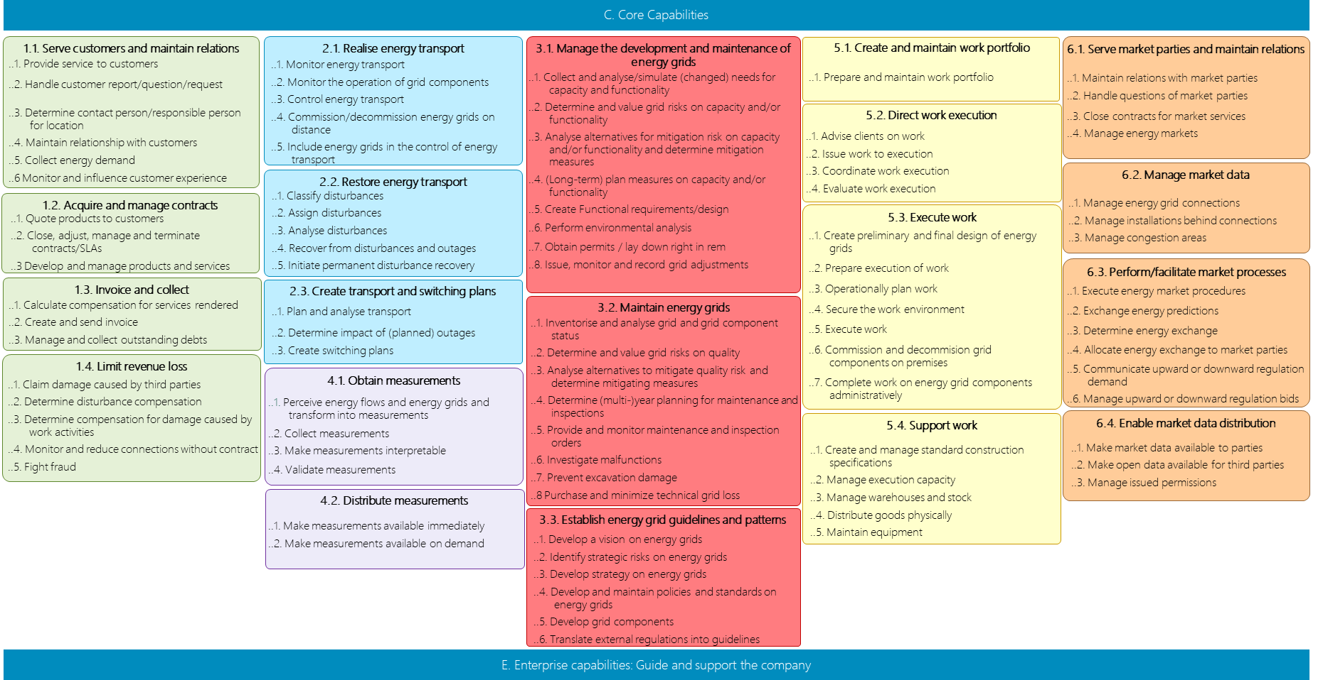
Business capabilities
C. Core Capabilities
Level 3
1.1. Serve customers and maintain relations
2.1. Realise energy transport
3.1. Manage the development and maintenance of energy grids
5.1. Create and maintain work portfolio
6.1. Serve market parties and maintain relations
..1. Provide service to customers
..2. Handle customer report/question/request
..3. Determine contact person/responsible person for location
..4. Maintain relationship with customers
..5. Collect energy demand
..6 Monitor and influence customer experience
..1. Monitor energy transport
..2. Monitor the operation of grid components
..3. Control energy transport
..4. Commission/decommission energy grids on distance
..5. Include energy grids in the control of energy transport
..1. Prepare and maintain work portfolio
..1. Collect and analyse/simulate (changed) needs for capacity and functionality
..2. Determine and value grid risks on capacity and/or functionality
..3. Analyse alternatives for mitigation risk on capacity and/or functionality and determine mitigation measures
..4. (Long-term) plan measures on capacity and/or functionality
..5. Create Functional requirements/design
..6. Perform environmental analysis
..7. Obtain permits / lay down right in rem
..8. Issue, monitor and record grid adjustments
..1. Maintain relations with market parties
..2. Handle questions of market parties
..3. Close contracts for market services
..4. Manage energy markets
5.2. Direct work execution
..1. Advise clients on work
..2. Issue work to execution
..3. Coordinate work execution
..4. Evaluate work execution
2.2. Restore energy transport
6.2. Manage market data
1.2. Acquire and manage contracts
..1. Classify disturbances
..2. Assign disturbances
..3. Analyse disturbances
..4. Recover from disturbances and outages
..5. Initiate permanent disturbance recovery
..1. Manage energy grid connections
..2. Manage installations behind connections
..3. Manage congestion areas
..1. Quote products to customers
..2. Close, adjust, manage and terminate contracts/SLAs
..3 Develop and manage products and services
5.3. Execute work
..1. Create preliminary and final design of energy grids
..2. Prepare execution of work
..3. Operationally plan work
..4. Secure the work environment
..5. Execute work
..6. Commission and decommision grid components on premises
..7. Complete work on energy grid components administratively
6.3. Perform/facilitate market processes
1.3. Invoice and collect
2.3. Create transport and switching plans
..1. Execute energy market procedures
..2. Exchange energy predictions
..3. Determine energy exchange
..4. Allocate energy exchange to market parties
..5. Communicate upward or downward regulation demand
..6. Manage upward or downward regulation bids
..1. Calculate compensation for services rendered
..2. Create and send invoice
..3. Manage and collect outstanding debts
..1. Plan and analyse transport
..2. Determine impact of (planned) outages
..3. Create switching plans
3.2. Maintain energy grids
..1. Inventorise and analyse grid and grid component status
..2. Determine and value grid risks on quality
..3. Analyse alternatives to mitigate quality risk and determine mitigating measures
..4. Determine (multi-)year planning for maintenance and inspections
..5. Provide and monitor maintenance and inspection orders
..6. Investigate malfunctions
..7. Prevent excavation damage
..8 Purchase and minimize technical grid loss
1.4. Limit revenue loss
..1. Claim damage caused by third parties
..2. Determine disturbance compensation
..3. Determine compensation for damage caused by work activities
..4. Monitor and reduce connections without contract
..5. Fight fraud
4.1. Obtain measurements
..1. Perceive energy flows and energy grids and transform into measurements
..2. Collect measurements
..3. Make measurements interpretable
..4. Validate measurements
5.4. Support work
6.4. Enable market data distribution
..1. Create and manage standard construction specifications
..2. Manage execution capacity
..3. Manage warehouses and stock
..4. Distribute goods physically
..5. Maintain equipment
..1. Make market data available to parties
..2. Make open data available for third parties
..3. Manage issued permissions
4.2. Distribute measurements
..1. Make measurements available immediately
..2. Make measurements available on demand
3.3. Establish energy grid guidelines and patterns
..1. Develop a vision on energy grids
..2. Identify strategic risks on energy grids
..3. Develop strategy on energy grids
..4. Develop and maintain policies and standards on energy grids
..5. Develop grid components
..6. Translate external regulations into guidelines
E. Enterprise capabilities: Guide and support the company

Slide 6
Business capabilities per domein
Enterprise capabilities: Het bedrijf richting geven en ondersteunen – Niveau 2
C. Core capabilities
E. Enterprise capabilities: Guide and support the company
E..1. Develop and control business direction
E.2. Develop and manage processes and data
E.3. Recruit and manage human capital
E.4. Develop and maintain digital technology
E.5. Obtain goods and services
E.6. Manage office buildings and facilities
E.7. Manage finance
.1. Formulate strategy
.1. Manage processes
.1. Develop and manage employee strategy and plans
.1. Develop digital technology strategy and manage digital product portfolio
.1. Develop and manage goods and services strategy and plans
.1. Manage real estate
.1. Create and monitor finance strategy and plans and financial justification
.2. Align stakeholders
.2. Manage data
.2. Recruite and exit employees
.2. Develop Digital Products
.2. Close and monitor contracts with suppliers
.2. Manage facilities
.2. Acquire and Manage financing
.3. Manage enterprise transformation
.3. Retain employees
.3. Deliver digital products
.3. Manage financial transactions and ledger
.4. Ensure business continuity and compliance
.4. Develop employees
.4. Assure Digital products
6

Slide 7
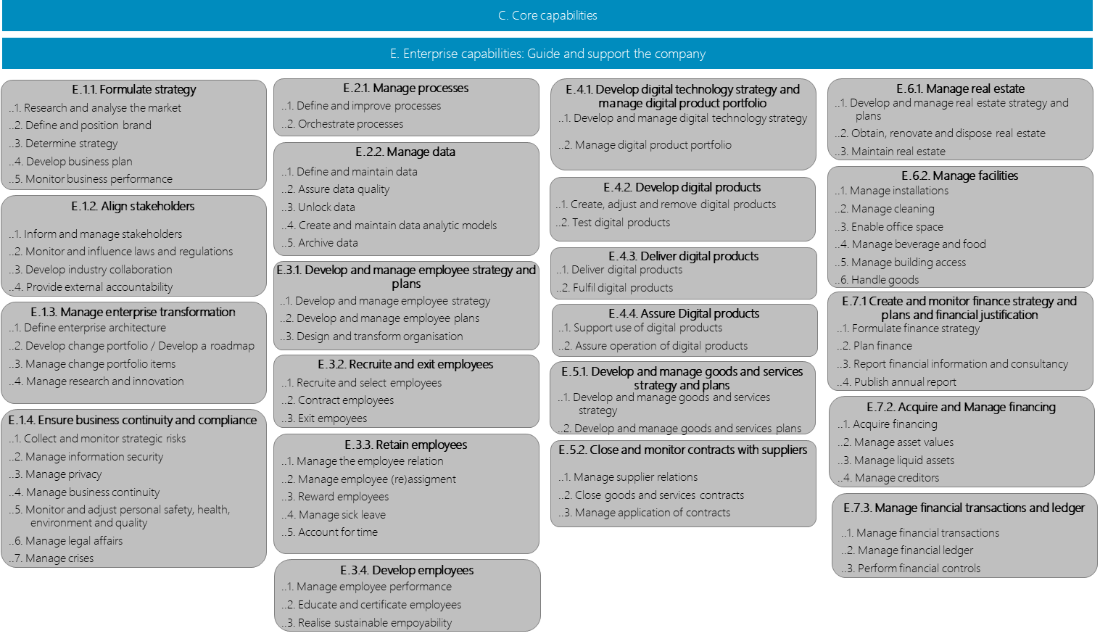
C. Core capabilities
Business capabilities per domein
E. Enterprise capabilities: Guide and support the company
Enterprise capabilities: Het bedrijf richting geven en ondersteunen – Niveau 3
E.1.1. Formulate strategy
E.2.1. Manage processes
E.4.1. Develop digital technology strategy and manage digital product portfolio
E.6.1. Manage real estate
..1. Research and analyse the market
..2. Define and position brand
..3. Determine strategy
..4. Develop business plan
..5. Monitor business performance
..1. Define and improve processes
..2. Orchestrate processes
..1. Develop and manage real estate strategy and plans
..2. Obtain, renovate and dispose real estate
..3. Maintain real estate
..1. Develop and manage digital technology strategy
..2. Manage digital product portfolio
E.2.2. Manage data
..1. Define and maintain data
..2. Assure data quality
..3. Unlock data
..4. Create and maintain data analytic models
..5. Archive data
E.6.2. Manage facilities
E.4.2. Develop digital products
..1. Manage installations
..2. Manage cleaning
..3. Enable office space
..4. Manage beverage and food
..5. Manage building access
..6. Handle goods
E.1.2. Align stakeholders
..1. Create, adjust and remove digital products
..2. Test digital products
..1. Inform and manage stakeholders
..2. Monitor and influence laws and regulations
..3. Develop industry collaboration
..4. Provide external accountability
E.4.3. Deliver digital products
E.3.1. Develop and manage employee strategy and plans
..1. Deliver digital products
..2. Fulfil digital products
E.1.3. Manage enterprise transformation
..1. Develop and manage employee strategy
..2. Develop and manage employee plans
..3. Design and transform organisation
E.7.1 Create and monitor finance strategy and plans and financial justification
E.4.4. Assure Digital products
..1. Define enterprise architecture
..2. Develop change portfolio / Develop a roadmap
..3. Manage change portfolio items
..4. Manage research and innovation
..1. Support use of digital products
..2. Assure operation of digital products
..1. Formulate finance strategy
..2. Plan finance
..3. Report financial information and consultancy
..4. Publish annual report
E.3.2. Recruite and exit employees
E.5.1. Develop and manage goods and services strategy and plans
..1. Recruite and select employees
..2. Contract employees
..3. Exit empoyees
..1. Develop and manage goods and services strategy
..2. Develop and manage goods and services plans
E.7.2. Acquire and Manage financing
E.1.4. Ensure business continuity and compliance
..1. Acquire financing
..2. Manage asset values
..3. Manage liquid assets
..4. Manage creditors
..1. Collect and monitor strategic risks
..2. Manage information security
..3. Manage privacy
..4. Manage business continuity
..5. Monitor and adjust personal safety, health, environment and quality
..6. Manage legal affairs
..7. Manage crises
E.3.3. Retain employees
E.5.2. Close and monitor contracts with suppliers
..1. Manage the employee relation
..2. Manage employee (re)assigment
..3. Reward employees
..4. Manage sick leave
..5. Account for time
..1. Manage supplier relations
..2. Close goods and services contracts
..3. Manage application of contracts
E.7.3. Manage financial transactions and ledger
..1. Manage financial transactions
..2. Manage financial ledger
..3. Perform financial controls
E.3.4. Develop employees
7
..1. Manage employee performance
..2. Educate and certificate employees
..3. Realise sustainable empoyability

Slide 8
External (Primary) Value streams
Value streams, Products and Markets
Value stream
Agree, connect and disconnect energy users
Reconstruct energy grids
Adjust energy grid plan driven
Maintain energy grids (maintenance + disturbance recovery)
Manage available energy grid capacity (near real time)
Transport energy (real time)
Allocate energy exchange to market parties
Distribute grid operator data
Product
Connection
Reconstructed energy grid
Future proof energy grid
Reliable energy grid
Transport capacity
Transported energy
Allocated energy exchange
Grid operator data
Market
Customer
Government, Customer
Society
Society, Customer
Society
Customer
Market party
Market party, Society
P.A.
P.B.
P.C.
P.D.
P.E.
P.F.
P.G.
P.H.
Notes:
Waardestromen

Slide 9
Business capabilities per value stream
Overview
7
2
1
.1. Serve customers and maintain relations
6
2
1
3
10
9
8
7
1
1
1
4
3
4
4
4
1
1
.3. Perform/facilitate market processes
.2. Manage market data
.1. Serve market parties and maintain relations
.3. Establish energy grid guidelines and patterns
1
1
.4. Enable market data distribution
1
5
4
6
5
.2. Acquire and manage contracts
7
6
5
1
1
Station
Preparation and planning
6
.2. Maintain energy grids
2
2
2
Station
Outages
Station
Execution
.1. Expand, replace and renew energy grids
.1. Create and maintain work portfolio
.2. Direct work execution
.3. Execute work
4
6
6
3
4
5
6
5
5
3
4
5
6
3
4
5
2
4
6
7
8
2
3
4
5
6
.1. Realise energy transport
.3. Create transport and switching plans
.2. Restore energy transport
.2. Maintain energy grids
.4. Support work
4
3
4
4
3
2
2
7
5
7
4
8
4
.4. Limit revenue loss
7
.2. Distribute measurements
4
7
6
2
Value streams
Agree, connect and disconnect energy users
Reconstruct energy grids
Adjust energy grid plan driven
Maintain energy grids (maintenance + disturbance recovery)
Manage available energy grid capacity (near real time)
Transport energy (real time)
Allocate energy exchange to market parties
Distribute grid operator data
6
5
.1. Obtain measurements
4
5
1
4
3
3
.3. Invoice and collect

Slide 10
Internal (secondary) valuestreams
Valuestreams and products
Product
Business Strategy, Business Plan en Reports
Company structure
Compliant organisation
Employable employees (incl. fysical and digitale workspace)
Executed process and/or available data
Available goods and services
Available financial assets and information
Value stream
Determine and monitor strategy and plans
Change company structure
Ensure business continuity and compliance
Getting and keeping employees employable
Realizing information provisioning
Making goods and services available
Making financial assets and information available
I.A.
I.B.
I.C.
I.D.
I.E.
I.F.
I.G.
Notes:
Waardestromen

Slide 11
Internal value streams
Change business and production factors
2
2
1
C.1.2 Acquire and manage contracts
C.3.3 Establish energy grid guidelines and patterns
E.7.1. Create and monitor finance strategy and plans and financial justification
3
1
2
2
2
E.7.2. Acquire and Manage financing
E.5.2. Close and monitor contracts with suppliers
2
2
3
E.7.3. Manage financial transactions and ledger
3
E.2.1. Manage processes
2
2
E.6.1. Manage real estate
E.7.1. Financiële strategie en -plannen opstellen, bewaken en rapporteren
3
2
4
2
2
3
E.1.1. Formulate strategy
2
2
2
3
4
5
2
2
E.5.1. Develop and manage goods and services strategy and plans
E.4.2. Develop Digital Products
E.4.3. Deliver digital products
E.4.4. Assure Digital products
E.1.2. Align stakeholders
1
E.3.1. Develop and manage employee strategy and plans
E.4.1. Develop digital technology strategy and manage digital product portfolio
E.2.2. Manage data
2
3
4
1
2
1
E.3.3. Retain employees
1
E.1.3. Manage enterprise transformation
1
2
E.6.2. Manage facilities
3
E.3.4. Develop employees
2
E.1.4. Ensure business continuity and compliance
Value streams
Determine and monitor strategy and plans
Change company structure
Ensure business continuity and compliance
Getting and keeping employees employable
Realizing information provisioning
Making goods and services available
Making financial assets and information available
3
1

Slide 12
Business objects
Level 1
Customer
Energy market
demander in
realization of connection service offered on
realization of transport service offered on
Work
Energy grid
Energy transport
on
over
of
of
Measurement

Slide 13
Business objects
All levels
Customer
Energy transport
Energy grid
Measurement
Work
Energy market
Customer
Transport control
Energy grid
Measurement
Work portfolio
Market party
Customer
Energy transport
Grid component
Measurement
Market party
Customer interaction
Switching situation
Grid function
Work order
Market case
Customer request
Switching step
Grid component configuration
Work order
Energy market
Transport demand
Upward or downward regulation
Environmental analysis
Work activity
Market agreement
Customer interaction
Grid component performance
Right in rem or route permit
Preliminary or final design
Connection
Customer notification
Transport deviation
Grid change
Work plan
Connection
Customer experience
Disturbance
Functional design
Employee deployment
Connection location
Customer case
Transport planning
Grid calculation
Work activity
Facility
Customer agreement
Transport calculation
Capacity bottleneck
Work resource
Congestion area
Customer quote
Switching plan
Grid modification order
Standard work product
Market process
Customer agreement
Non-availability
Investment plan
Execution capacity
Market request
Product
Outage
Grid quality
Material
Energy schedule or forecast
Customer settlement
Grid component condition
Work tool
Energy exchange
Customer invoice
Quality bottleneck
Goods movement
Upward or downward regulation demand
Maintenance or inspection plan
Execution permit
Upward or downward regulation offer
Maintenance or inspection order
Market data provision
Digging message
Consent from system user
Grid policy
Technical business standard

Slide 14
Relations can be read in natural language by inserting articles and a conjugation of ‘(can) be’. For example:
A customer can be the submitter of a customer request
A customer request is the request for a customer quote
Etcetera
Business objects
Level 3
Customer
submitter of
by
to
with
of
concerning
Customer request
Product
Transport demand
Customer notification
Customer interaction
Customer experience
Customer case
Claim case
Compensation case
Missing contract case
Energy fraud case
Complaint case
Damage case
request for
offered in
Customer quote
Connection location
Facility
Consent from system user
Congestion area
Market request
Market case
acceptance of
of
of
for
in
submitter of
concerning
Customer agreement
about
Connection
active on
Market party
counterparty in
Market agreement
basis for
basis for
on
assigned to
agreement about
or acceptance of
Customer invoice
Energy exchange
Upward or downward regulation demand
request for
Upward or downward regulation offer
traded on
planned in
of
basis for
callout of
Energy market
Energy schedule or forecast
Measurement
Transport calculation
Switching situation
Upward or downward regulation
Energy transport
Grid component performance
at
realization of
of or using
on the basis of
of
over
at
Outage
Grid function
cause of
of
cause of
cause of
deployed on
on the basis of
for
in area of
for
in digging polygon of
Standard work product
Non-availability
Investment plan
Quality bottleneck
Capacity bottleneck
Grid component
Grid calculation
Technical business standard
Environmental analysis
Right in rem or route permit
Digging message
Primary grid component
of
Grid component configuration
based on
start or end of
cause of
planned in
mitigation of
mitigation of
Secondary grid component
Work plan
planned in
Switching step
Disturbance
Grid modification order
Meter
of
Grid component condition
planned in
basis for
for
basis for
Tertiary grid component
Switching plan
Functional design
Maintenance or inspection plan
Telecom component
deployed as
Material
Execution capacity
in accordance with
planned in
for
of
from
Preliminary or final design
Maintenance or inspection order
Execution permit
Goods movement
Employee deployment
Work tool
for the execution
for the execution of
basis for
for
for
for
for
Work order
authorization for
Work activity

