Slide 1

Release 2.4 – The NBility model
Netbeheer Business Capability Model
May 2026

Slide 2
Content presentation: the NBility model
Description parts of the NBility model
This presentation contains the NBility model with the Business capabilities, the Value streams and the Business objects of a Grid operator.
This presentation contains animations.
The English descriptions of the business capabilities are in column F of excel file `NBility 2.4`
2

Slide 3
Business capabilities
Level 1
C. Core Capabilities
Serve
customers
Transport energy
Manage development and maintenance of energy grids
Measure energy flows and energy grids
Perform work on
energy grids
Facilitate the energy market
E. Enterprise capabilities: Guide and support the company

Slide 4
Business capabilities
Level 2
C. Core Capabilities
C.1. Serve
customers
C.2. Transport energy
C.3. Manage development and maintenance of energy grids
C.4. Measure energy flows and energy grids
C.5. Perform work on
energy grids
C.6. Facilitate the energy market
.1. Serve customers and maintain relations
.1. Realise energy transport
.1. Expand, replace and renew energy grids
.1. Obtain measurements
.1. Create and maintain work portfolio
.1. Serve market parties and maintain relations
.2. Acquire and manage customer agreements
.2. Restore energy transport
.2. Maintain energy grids
.2. Direct work execution
.2. Manage market data
.3. Invoice and collect
.3. Create transport and switching plans
.3. Establish energy grid guidelines and patterns
.2. Distribute measurements
.3. Execute work
.3. Perform/facilitate market processes
.4. Limit revenue loss
.4. Support work
.4. Enable grid operator data distribution
E. Enterprise capabilities: Guide and support the company

Slide 5
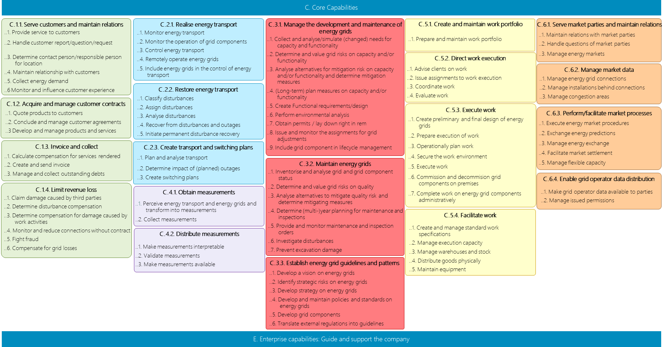
Business capabilities
C. Core Capabilities
Level 3
C.1.1. Serve customers and maintain relations
C.2.1. Realise energy transport
C.3.1. Manage the development and maintenance of energy grids
C.5.1. Create and maintain work portfolio
C.6.1. Serve market parties and maintain relations
..1. Provide service to customers
..2. Handle customer report/question/request
..3. Determine contact person/responsible person for location
..4. Maintain relationship with customers
..5. Collect energy demand
..6 Monitor and influence customer experience
..1. Monitor energy transport
..2. Monitor the operation of grid components
..3. Control energy transport
..4. Remotely operate energy grids
..5. Include energy grids in the control of energy transport
..1. Prepare and maintain work portfolio
..1. Maintain relations with market parties
..2. Handle questions of market parties
..3. Manage energy markets
..1. Collect and analyse/simulate (changed) needs for capacity and functionality
..2. Determine and value grid risks on capacity and/or functionality
..3. Analyse alternatives for mitigation risk on capacity and/or functionality and determine mitigation measures
..4. (Long-term) plan measures on capacity and/or functionality
..5. Create Functional requirements/design
..6. Perform environmental analysis
..7. Obtain permits / lay down right in rem
..8. Issue and monitor the assignments for grid adjustments
..9. Include grid component in lifecycle management
C.5.2. Direct work execution
..1. Advise clients on work
..2. Issue assignments to work execution
..3. Coordinate work
..4. Evaluate work
C.6.2. Manage market data
..1. Manage energy grid connections
..2. Manage installations behind connections
..3. Manage congestion areas
C.2.2. Restore energy transport
C.1.2. Acquire and manage customer contracts
..1. Classify disturbances
..2. Assign disturbances
..3. Analyse disturbances
..4. Recover from disturbances and outages
..5. Initiate permanent disturbance recovery
..1. Quote products to customers
..2. Conclude and manage customer agreements
..3 Develop and manage products and services
C.5.3. Execute work
C.6.3. Perform/facilitate market processes
..1. Create preliminary and final design of energy grids
..2. Prepare execution of work
..3. Operationally plan work
..4. Secure the work environment
..5. Execute work
..6. Commission and decommision grid components on premises
..7. Complete work on energy grid components administratively
..1. Execute energy market procedures
..2. Exchange energy predictions
..3. Manage energy exchange
..4. Facilitate market settlement
..5. Manage flexible capacity
C.1.3. Invoice and collect
C.2.3. Create transport and switching plans
..1. Calculate compensation for services rendered
..2. Create and send invoice
..3. Manage and collect outstanding debts
..1. Plan and analyse transport
..2. Determine impact of (planned) outages
..3. Create switching plans
C.3.2. Maintain energy grids
..1. Inventorise and analyse grid and grid component status
..2. Determine and value grid risks on quality
..3. Analyse alternatives to mitigate quality risk and determine mitigating measures
..4. Determine (multi-)year planning for maintenance and inspections
..5. Provide and monitor maintenance and inspection orders
..6. Investigate disturbances
..7. Prevent excavation damage
C.6.4. Enable grid operator data distribution
C.1.4. Limit revenue loss
C.4.1. Obtain measurements
..1. Make grid operator data available to parties
..2. Manage issued permissions
..1. Claim damage caused by third parties
..2. Determine disturbance compensation
..3. Determine compensation for damage caused by work activities
..4. Monitor and reduce connections without contract
..5. Fight fraud
..6. Compensate for grid losses
..1. Perceive energy transport and energy grids and transform into measurements
..2. Collect measurements
C.5.4. Facilitate work
C.4.2. Distribute measurements
..1. Create and manage standard work specifications
..2. Manage execution capacity
..3. Manage warehouses and stock
..4. Distribute goods physically
..5. Maintain equipment
..1. Make measurements interpretable
..2. Validate measurements
..3. Make measurements available
C.3.3. Establish energy grid guidelines and patterns
..1. Develop a vision on energy grids
..2. Identify strategic risks on energy grids
..3. Develop strategy on energy grids
..4. Develop and maintain policies and standards on energy grids
..5. Develop grid components
..6. Translate external regulations into guidelines
E. Enterprise capabilities: Guide and support the company

Slide 6
Business capabilities per domain
Enterprise capabilities: Guide and support the company – Level 2
C. Core capabilities
E. Enterprise capabilities: Guide and support the company
E..1. Develop and control business direction
E.2. Develop and manage processes and data
E.3. Recruit and manage human capital
E.4. Develop and maintain digital technology
E.5. Obtain goods and services
E.6. Manage office buildings and facilities
E.7. Manage finance
.1. Formulate strategy
.1. Manage processes
.1. Develop and manage employee strategy and plans
.1. Develop digital technology strategy and manage digital product portfolio
.1. Develop and manage goods and services strategy and plans
.1. Manage real estate
.1. Create and monitor finance strategy and plans and financial justification
.2. Align stakeholders
.2. Manage data
.2. Recruite and exit employees
.2. Develop Digital Products
.2. Close and monitor contracts with suppliers
.2. Manage facilities
.2. Acquire and Manage financing
.3. Manage enterprise transformation
.3. Retain employees
.3. Deliver digital products
.3. Manage financial transactions and ledger
.4. Ensure business continuity and compliance
.4. Develop employees
.4. Assure Digital products
6

Slide 7
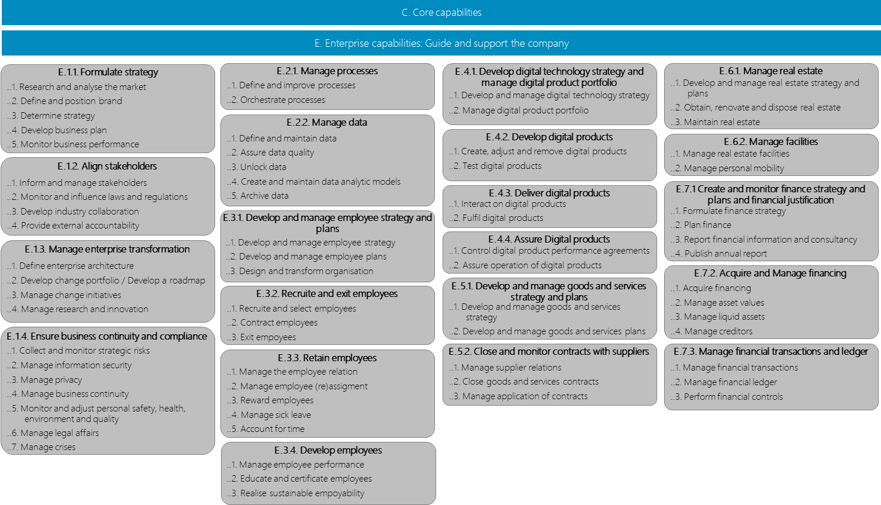
C. Core capabilities
Business capabilities per domain
E. Enterprise capabilities: Guide and support the company
Enterprise capabilities: Guide en support the company – Level 3
E.1.1. Formulate strategy
E.2.1. Manage processes
E.4.1. Develop digital technology strategy and manage digital product portfolio
E.6.1. Manage real estate
..1. Research and analyse the market
..2. Define and position brand
..3. Determine strategy
..4. Develop business plan
..5. Monitor business performance
..1. Define and improve processes
..2. Orchestrate processes
..1. Develop and manage real estate strategy and plans
..2. Obtain, renovate and dispose real estate
..3. Maintain real estate
..1. Develop and manage digital technology strategy
..2. Manage digital product portfolio
E.2.2. Manage data
..1. Define and maintain data
..2. Assure data quality
..3. Unlock data
..4. Create and maintain data analytic models
..5. Archive data
E.4.2. Develop digital products
E.6.2. Manage facilities
..1. Create, adjust and remove digital products
..2. Test digital products
..1. Manage real estate facilities
..2. Manage personal mobility
E.1.2. Align stakeholders
..1. Inform and manage stakeholders
..2. Monitor and influence laws and regulations
..3. Develop industry collaboration
..4. Provide external accountability
E.7.1 Create and monitor finance strategy and plans and financial justification
E.4.3. Deliver digital products
..1. Interact on digital products
..2. Fulfil digital products
..1. Formulate finance strategy
..2. Plan finance
..3. Report financial information and consultancy
..4. Publish annual report
E.3.1. Develop and manage employee strategy and plans
E.1.3. Manage enterprise transformation
..1. Develop and manage employee strategy
..2. Develop and manage employee plans
..3. Design and transform organisation
E.4.4. Assure Digital products
..1. Control digital product performance agreements
..2. Assure operation of digital products
..1. Define enterprise architecture
..2. Develop change portfolio / Develop a roadmap
..3. Manage change initiatives
..4. Manage research and innovation
E.7.2. Acquire and Manage financing
E.3.2. Recruite and exit employees
E.5.1. Develop and manage goods and services strategy and plans
..1. Acquire financing
..2. Manage asset values
..3. Manage liquid assets
..4. Manage creditors
..1. Recruite and select employees
..2. Contract employees
..3. Exit empoyees
..1. Develop and manage goods and services strategy
..2. Develop and manage goods and services plans
E.1.4. Ensure business continuity and compliance
..1. Collect and monitor strategic risks
..2. Manage information security
..3. Manage privacy
..4. Manage business continuity
..5. Monitor and adjust personal safety, health, environment and quality
..6. Manage legal affairs
..7. Manage crises
E.3.3. Retain employees
E.5.2. Close and monitor contracts with suppliers
E.7.3. Manage financial transactions and ledger
..1. Manage the employee relation
..2. Manage employee (re)assigment
..3. Reward employees
..4. Manage sick leave
..5. Account for time
..1. Manage supplier relations
..2. Close goods and services contracts
..3. Manage application of contracts
..1. Manage financial transactions
..2. Manage financial ledger
..3. Perform financial controls
E.3.4. Develop employees
..1. Manage employee performance
..2. Educate and certificate employees
..3. Realise sustainable empoyability
7

Slide 8
External (primary/core) value streams
Value streams, Products and Markets
Value stream
Install and change connections
Reconstruct energy grids
Adjust energy grid plan driven
Maintain energy grids (maintenance)
Maintain energy grids (disturbance recovery)
Coordinate desired and available transport capacity
Transport energy
Allocate energy exchange
Distribute grid operator data
Productgroup
Connection
Reconstructed energy grid
Future proof energy grid
Reliable energy grid
Reliable energy grid
Transport capacity
Energy transport
Energy attribution
Grid operator data product
Stakeholder
Klant
Grid user
Infrastructure / sub surface manager
Asset owner (on behalf of society)
Asset owner (on behalf of society)
Grid user
Maatschappij
Grid user
Grid user
Market party
Data consumer
Transport ready energy grid
C.A.
C.B.
C.C.
C.D1.
C.D2.
Energy transport
C.E.
C.F.
C.G.
Data about energy grid en -transport
C.H.
Notes:
Waardestromen

Slide 9
Core capabilities per primary/core value stream
Overview
C.1.1.2
C.1.3.3
C.1.3.2
Handle customer report/question/ request
Manage and collect outstanding claims
Create and send invoice
C.2.1.5
Include energy grids in the control of energy transport
C.1.1.2
C.1.4.6
C.6.2.1
Manage energy grid connections / allocation points
C.6.2.2
C.3.2.6
C.2.2.5
C.1.1.1
Compensate for grid losses
Manage installations behind connections
Investigate disturbances
Initiate permanent disturbance recovery
Provide service to customers using channels
C.1.2.1
C.6.4.1
Make grid operator data available for third parties
Quote products to customers
C.6.1.2
Handle questions of market parties
C.3.1.8
C.5.2.2
C.3.1.9
C.6.2.3
Issue and monitor the assignments for grid adjustments
Issue assignments to work execution
C.5.3.5
Include grid component in lifecycle management
Manage congestion areas
Execute work
C.6.3.4
C.1.2.2
C.1.2.2
Facilitate market settlement
Conclude and manage customer agreements
C.3.1.3
C.6.3.3
C.6.3.5
Analyse alternatives for mitigation of risk on capacity and/or functionality and determine mitigating measures
Manage energy exchange
Manage flexible capacity
C.3.2.7
C.4.2.3
C.2.1.1
C.1.1.5
Prevent excavation damage
Make measurements available
Monitor energy transport
Collect energy transport demand
C.3.1.2
C.3.2.5
Determine and value grid risks on capacity and/or functionality
Provide and monitor assignments for maintenance and inspection orders
C.2.2.1
C.2.3.1
C.2.1.3
Classify disturbances
Plan and analyse energy transport
Control energy transport
C.3.2.3
C.3.2.2
Analyse alternatives to mitigate quality risk and determine mitigating measures
Determine and value grid risks based on quality
C.2.2.2
C.2.2.3
C.2.2.4
C.2.1.4
Assign disturbances
Analyse disturbances
Recover from disturbances and outages
Remotely operate energy grids
Value streams
C.A Install and change connections
C.B Reconstruct energy grids
C.C Adjust energy grid plan driven
C.D1 Maintain energy grids (maintenance)
C.D2 Maintain energy grids (disturbance recovery)
C.E Coordinate desired and available transport capacity
C.F Transport energy
C.G Allocate energy exchange
C.H Distribute grid operator data
C.6.3.1
Execute energy market procedures

Slide 10
Internal (secondary/enterprise) value streams
Value streams and products
Value stream
Determine and monitor strategy and plans
Change business resources
Ensure business continuity and compliance
Getting and keeping employees employable
Providing information
Making goods and services available
Making financial assets and information available
Product
Business direction
Business resources
Compliant business
Employable employees (incl. fysical and digitale workspace)
Executed process and/or available data
Available goods and services
Available financial assets and information
E.A.
E.B.
E.C.
E.D.
E.E.
E.F.
E.G.
Notes:
Waardestromen

Slide 11
Enterprise capabilities per internal/enterprise value stream
Overview
2
2
1
C.1.2 Acquire and manage contracts
C.3.3 Establish energy grid guidelines and patterns
E.7.1. Create and monitor finance strategy and plans and financial justification
3
1
2
2
2
E.7.2. Acquire and Manage financing
E.5.2. Close and monitor contracts with suppliers
2
2
3
E.7.3. Manage financial transactions and ledger
3
E.2.1. Manage processes
2
2
E.6.1. Manage real estate
E.7.1. Financiële strategie en -plannen opstellen, bewaken en rapporteren
3
2
4
2
2
3
E.1.1. Formulate strategy
2
2
2
3
4
5
2
2
E.5.1. Develop and manage goods and services strategy and plans
E.4.2. Develop Digital Products
E.4.3. Deliver digital products
E.4.4. Assure Digital products
E.1.2. Align stakeholders
1
E.3.1. Develop and manage employee strategy and plans
E.4.1. Develop digital technology strategy and manage digital product portfolio
E.2.2. Manage data
2
3
4
1
2
1
E.3.3. Retain employees
1
E.1.3. Manage enterprise transformation
1
2
E.6.2. Manage facilities
3
E.3.4. Develop employees
2
E.1.4. Ensure business continuity and compliance
Value streams
E.A Determine and monitor strategy and plans
E.B Change business resources
E.C Ensure business continuity and compliance
E.D Getting and keeping employees employable
E.E Providing information
E.F Making goods and services available
E.G Making financial assets and information available
3
1

Slide 12
Business objects
Core – Level 1
Customer
Energy market
demander in
for use on
for use on
Work
Energy grid
Energy transport
on
over
of
of
Measurement

Slide 13
Business objects
Core – All levels
Customer
Energy transport
Energy grid
Measurement
Work
Energy market
Customer
Energy transport
Energy grid
Measurement
Work portfolio
Market participant
Customer
Energy transport
Grid calculation
Measurement
Work portfolio
Market participant
Transport demand
Switching situation
Capacity bottleneck
Work order
Market request
Customer interaction
Operating instruction
Capacity measure
Work order
Energy market
Customer request
Capacity deployment decision
Investment plan
Customer notification
Grid component performance
Grid design
Work activity
Connection
Customer experience
Grid component configuration
Grid function
Preliminary or final design
Connection
Environmental analysis
Work plan
Facility
Customer agreement
Disturbance
Execution permit
Congestion area
Customer quote
Disturbance
Right in rem or route permit
Customer agreement
Grid modification order
Worker deployment
Market process
Customer product
Transport planning
Grid component
Work activity
Market activity
Transport analysis
Grid revision or finding
Energy prediction
Customer invoice
Non-availability
Grid quality
Energy exchange
Customer invoice
Outage
Grid component condition
Work resource
Energy attribution
Switching plan
Quality bottleneck
Standard work product
Capacity service
Revenue loss
Quality measure
Execution capacity
Damage recovery
Maintenance or inspection plan
Material
Transport release
Disturbance compensation
Maintenance or inspection order
Goods movement
Grid operator data provision
Damage compensation
Digging message
Work resource
Grid operator data provision
Contractless situation
Disturbance root cause
Consent from system user
Energy theft
Grid loss procurement
Grid strategy
Grid strategy
Technical business standard

