Slide 1


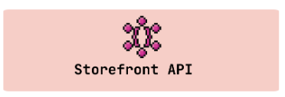







Customer
Shopify Web
Admin
Shopify Admin
Install
Review Server
Shopify App
Recommend Server

