Slide 1
Density of States for Titan Relevant Molecules in GROMACS

Slide 2
Molecules of Interest
Modeled Molecules
Methane
Water-Ice (Ice-Ih) and Heay Water-Ice (D2O)
Ammonia
Experimental Comparison
Melamine
Future molecules of interest
Ethane, Butane, Ethylene + other hydrocarbons
Hydrogen Cyanide + other Nitriles and complex organics

Slide 3
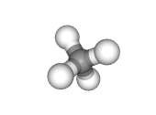
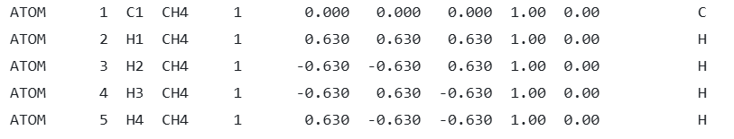
Setup
Setup required knowledge of molecule structure and other parameters
Atoms: mass – charge – positions
Bonds: atoms bonded, bond length, strength (kJ/mol/nm2)
Bonds: atoms bonded, bond angle, bond strength
GROMACS Equilibration Production and DOS DOS Results

Slide 4
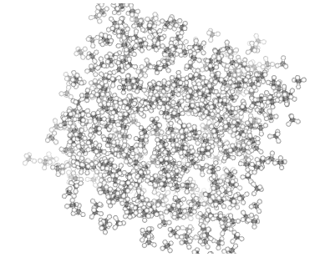
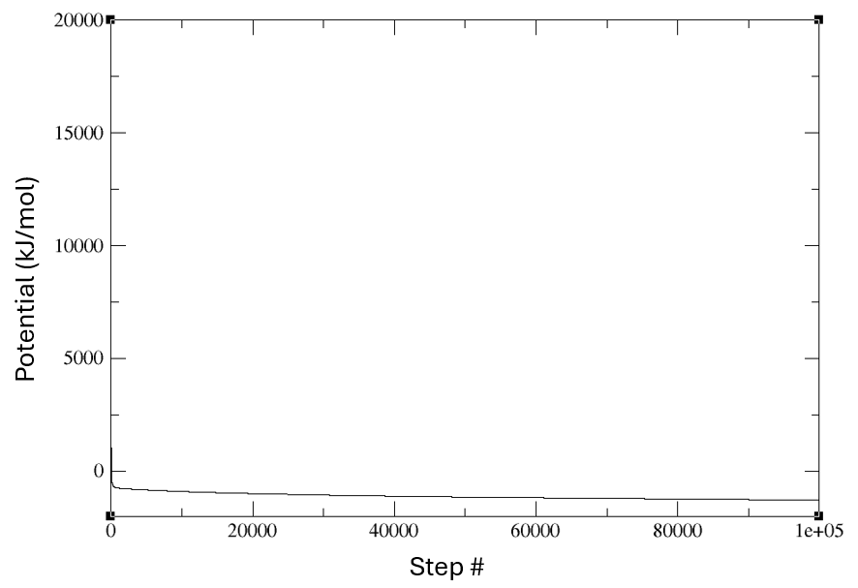
Energy Minimization
Spaces out molecules to minimize forces on each one
Prevents strong repulsive forces at beginning of simulation (avoids errors)
Avoids overlapping molecules and atom shells
GROMACS Equilibration Production and DOS DOS Results

Slide 5
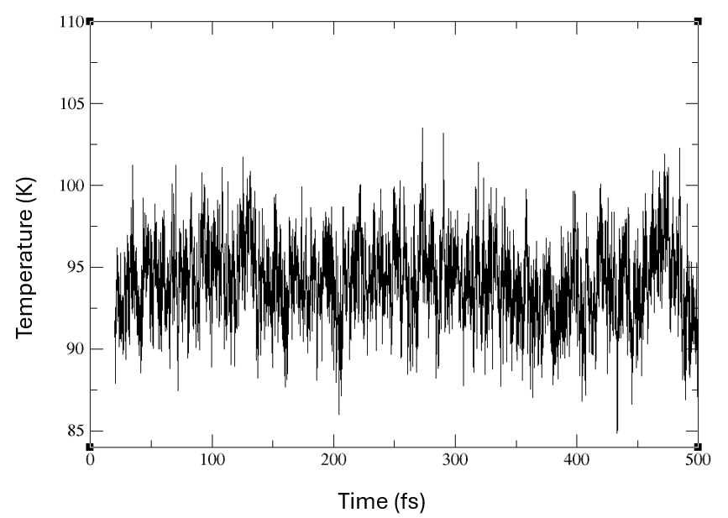
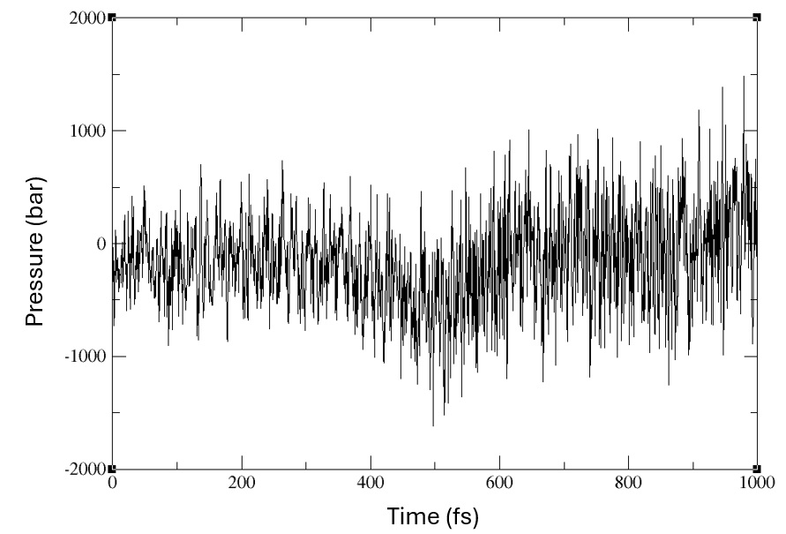
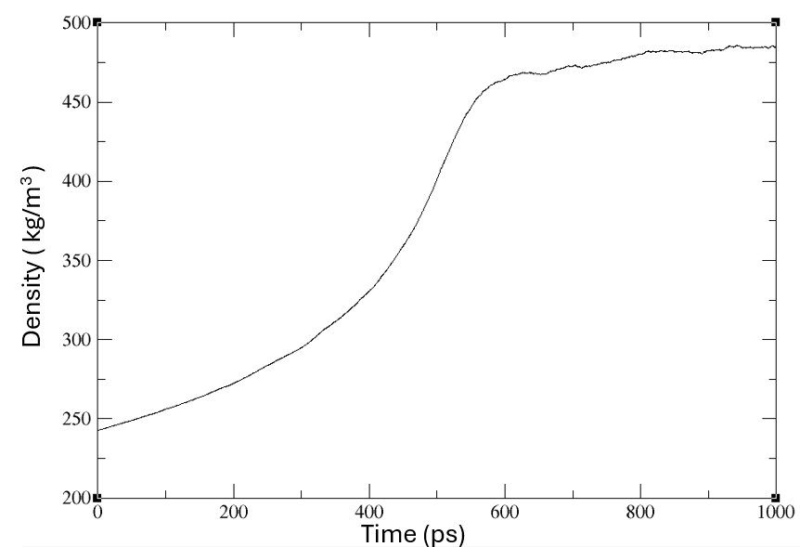
Equilibration Runs
Equilibrate the system at desired T and P
NVT: closed system, heat transfer → Adjust atom velocities
NPT: closed system, heat and work transfer → Adjust atom positions/density
Uses different thermostats and barostats
GROMACS Equilibration Production and DOS DOS Results

Slide 6


Notes on Pressure Equilibration
Pressure fluctuates and the simulation box size changes
Instantaneous pressure is calculated from the virial:
Standard deviation scales with size of simulation:
Pressure is acceptable as long as the average is on the same order of magnitude of the target pressure
Important to make sure density is at target and does not fluctuate
GROMACS Equilibration Production and DOS DOS Results

Slide 7
Production Run
Simulations (typically 1 – 5 ns) let molecules interact with each other
Outputs trajectory files tracking vibrations and rotations of atoms and molecules + bond bending/stretching
GROMACS Equilibration Production and DOS DOS Results

Slide 8
DOS Calculation
gmx velacc: computes the velocity autocorrelation function
gmx dos: computes the Density of States from a simulations
Both need trajectory files (output from production)
Contains all the coordinates, velocities, forces and energies
GROMACS Equilibration Production and DOS DOS Results

Slide 9
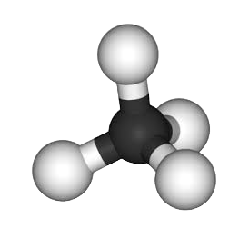
METHANE
200 Molecules (800 atoms)
T = 94K
Pressure = 1.5 bar
Density = 480 kg/m3
GROMACS Equilibration Production and DOS DOS Results

Slide 10
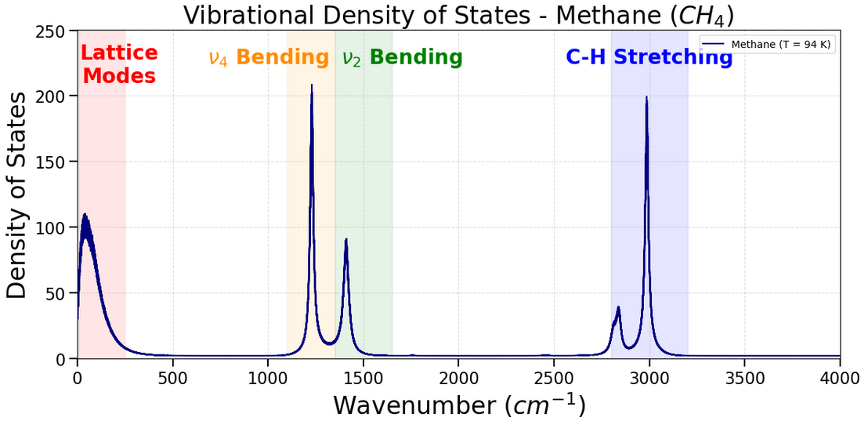
METHANE
GROMACS Equilibration Production and DOS DOS Results

Slide 11
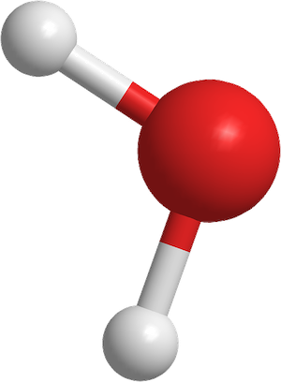
ICE - Ih
632 Molecules (1896 atoms)
T = 94K
Pressure = 1.5 bar
Density = 980 kg/m3
GROMACS Equilibration Production and DOS DOS Results

Slide 12
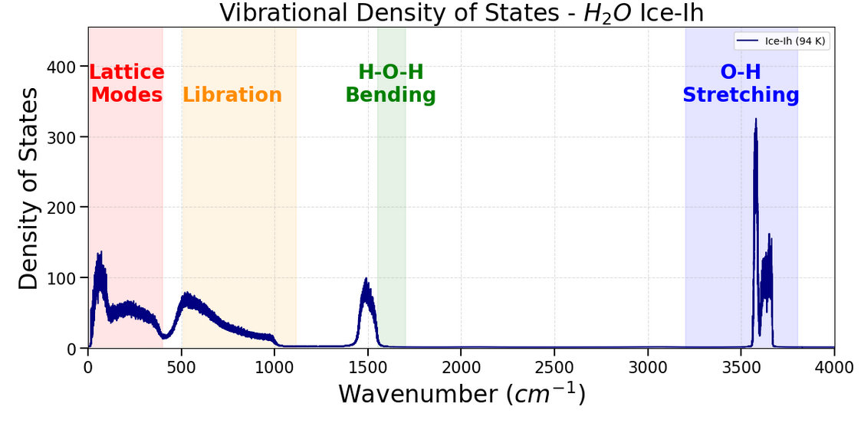
ICE - Ih
GROMACS Equilibration Production and DOS DOS Results

Slide 13
D2O ICE
632 Molecules (1896 atoms)
T = 94K
Pressure = 1.5 bar
Density = 1,100 kg/m3
GROMACS Equilibration Production and DOS DOS Results

Slide 14
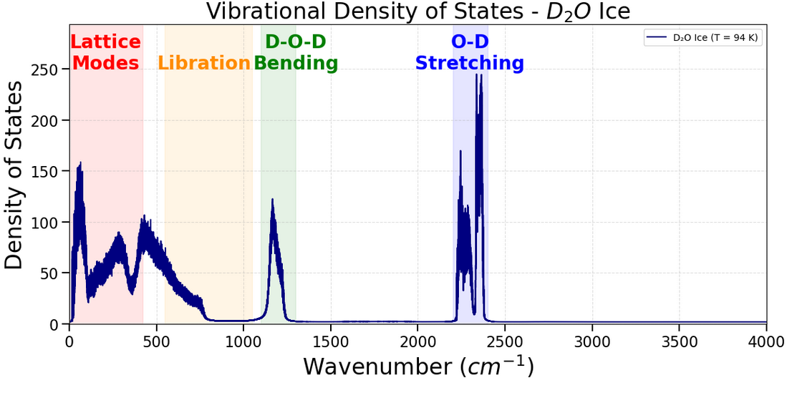
D2O ICE
GROMACS Equilibration Production and DOS DOS Results

Slide 15
GROMACS Equilibration Production and DOS DOS Results

Slide 16
GROMACS Equilibration Production and DOS DOS Results

