Slide 1
GROMACS
GROMACS formulations
Computation
Input Files
Setup
Equilibration
Production
DOS Calculation

Slide 2
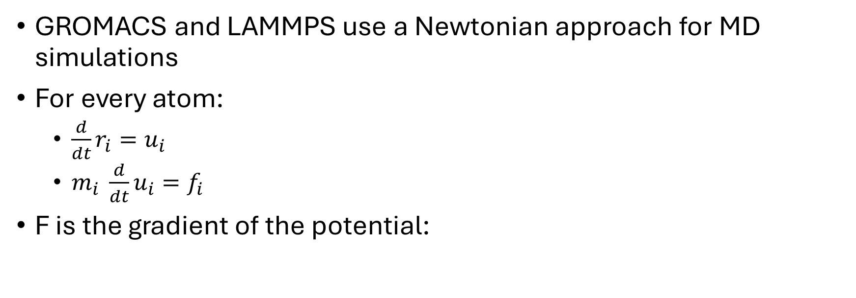
GROMACS Formulation
GROMACS and LAMMPS use a Newtonian approach for MD simulations
For every atom:
$\frac{d}{dt}r_{i}=u_{i}$
$m_{i} \frac{d}{dt}u_{i}=f_{i}$
F is the gradient of the potential:
Formulation Computation Files and structure DOS calculation

Slide 3
GROMACS Formulation
Different Potentials GROMACS uses:
Inter- and intra- molecular interactions
Lennard Jones (Vander Waals, repulsion) and Coulomb (charges)
Stretching and bending vibrations, Internal rotation
Force fields: OPLS-AA, AMBER, CHARMM, GROMOS
Set of functions to govern how atoms interact (bonded and non-bonded interactions)
Formulation Computation Files and structure DOS calculation
Notes:
AMBER (Assisted Model Building and Energy Refinement) refers both to a set of molecular mechanical force fields for the simulation of biomolecules and a package of molecular simulation programs.

Slide 4
Computational Aspects
Periodic boundary condition:
Avoids “wall” effects of larger systems
Atoms can interact through walls too
Atoms pass through the wall and appear at other side of the box
Formulation Computation Files and structure DOS calculation

Slide 5
Computational Aspects - Integrators
Time-stepping algorithms
Verlet, Leap-frog, Trotter
Neighbor searching
All non-bonded interactions between particles are computed out to a cut-off distance (typically set to 1nm)
Cut-off distance needs to be > ½ smallest box dimension
Formulation Computation Files and structure DOS calculation

Slide 6
Computational Aspects - Scales
Molecular interactions occur on small length scales and fast time scales
Length scales is nanometers (nm)
Time scale is femtoseconds (fs)
Number of atoms (and molecules)
Too few: Low quality data
Too many: Long simulations + Large files
Formulation Computation Files and structure DOS calculation

Slide 7
Files and Structure – DOS Workflow
Energy Minimization
Coordinate File
Topology File
Temperature Equilibration
Pressure Equilibration
Production Run
Simulation Box
VACF
DOS
Formulation Computation Files and structure DOS calculation

Slide 8
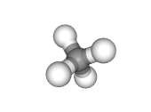
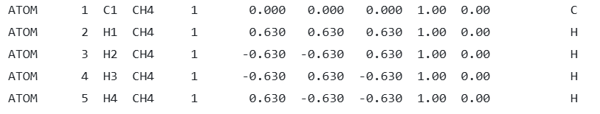
Coordinate File
Coordinates of every atom within a molecule
Pure simulations would require only 1 molecule defined – not true for more complex simulations
Formulation Computation Files and structure DOS calculation

Slide 9
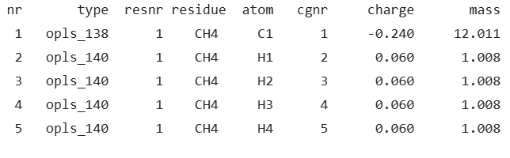
Topology File
Includes molecular information:
Bond lengths, bond angles
Force fields
System information
Number of molecules
Formulation Computation Files and structure DOS calculation

Slide 10
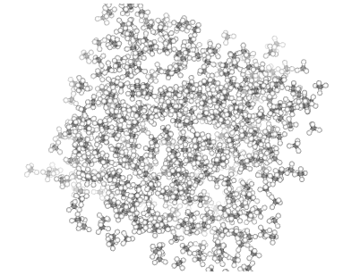
Simulation Box
Defines initial simulation size
Used in EM and NVT
Altered in NPT
Can manually add a specific number of molecules
GROMACS will warn you if it cannot fit all molecules
Can choose to solvate
(and specify how many molecules of each type you want)
500 methane molecules
(2,500 atoms)
3x3x3 nm box
Final Density: 490 kg/m^3
Formulation Computation Files and structure DOS calculation

Slide 11
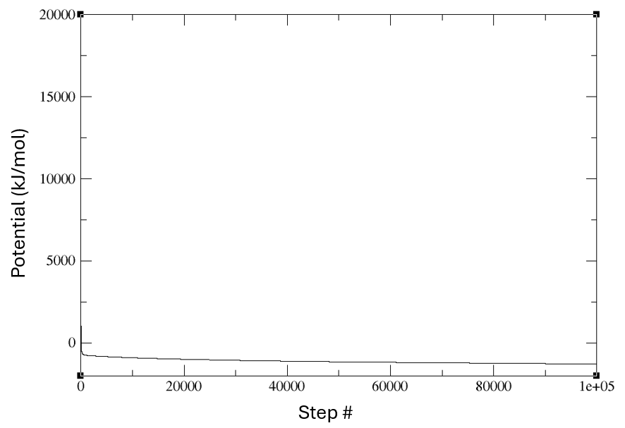
Energy Minimization
Spaces out molecules to minimize forces on each one
Prevents strong repulsive forces at beginning of simulation (avoids errors)
Avoids overlapping molecules and atom shells
Formulation Computation Files and structure DOS calculation

Slide 12
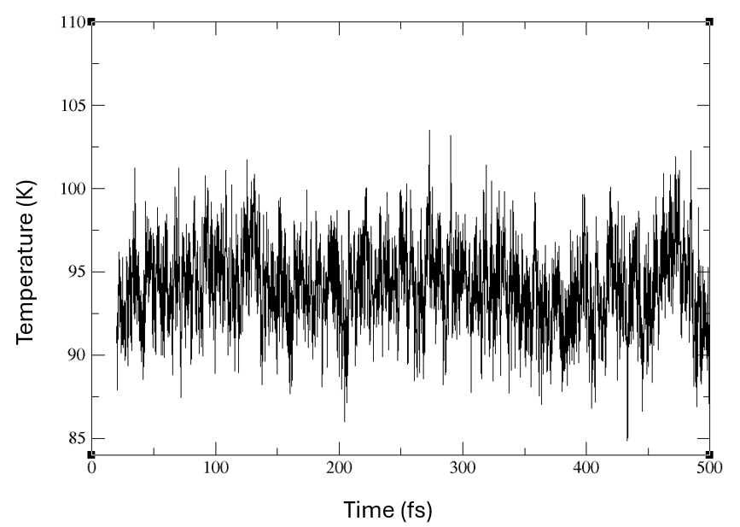
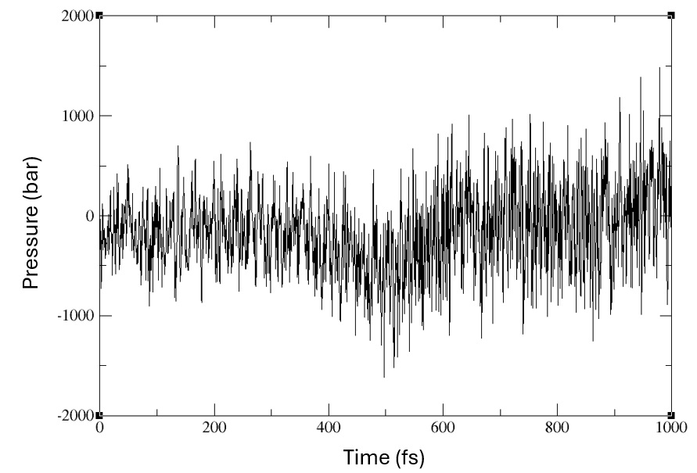
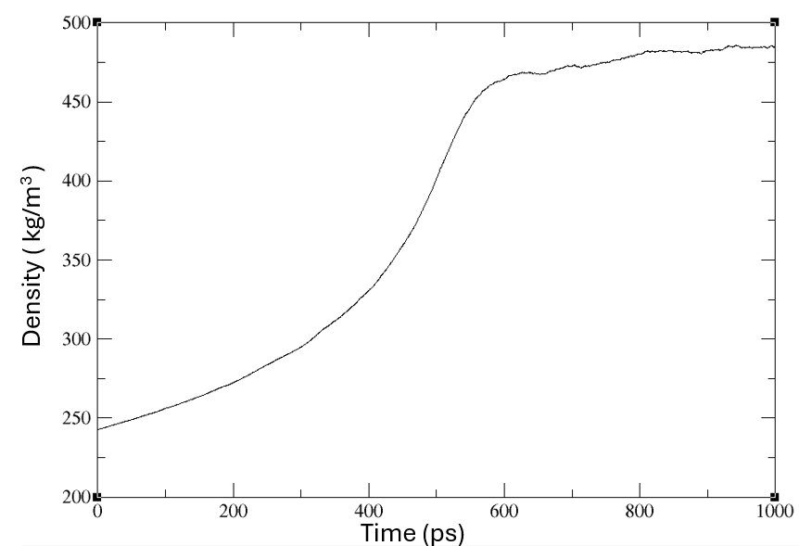
Equilibration Runs
Equilibrate the system at desired T and P
NVT: closed system, heat transfer → Adjust atom velocities
NPT: closed system, heat and work transfer → Adjust atom positions/density
Uses different Thermostats and Barostats
Formulation Computation Files and structure DOS calculation
Notes:
NVT: Rescales atom velocities to keep temperature constant (adjust kinetic energy).
NPT: Rescales atom positions (box volume) to keep pressure constant (adjust potential energy).

Slide 13
Production Run
Simulations (typically 1 – 5 ns) let molecules interact with each other
Outputs trajectory files tracking vibrations and rotations and bond bending/stretching
Formulation Computation Files and structure DOS calculation

Slide 14
VACF + DOS
gmx velacc: computes the velocity autocorrelation function
gmx dos: computes the Density of States from a simulations
Both need trajectory files (output from production)
Contains all the coordinates, velocities, forces and energies
Formulation Computation Files and structure DOS calculation

Slide 15
DOS
“The density of states is calculated from the mass-weighted autocorrelation
by default only from the square of the real component rather than absolute value”
“This means the shape can differ substantially from the plain vibrational power spectrum you can calculate with gmx velacc”
This program needs a lot of memory: total usage equals the number of atoms times 3 times number of frames times 4
Formulation Computation Files and structure DOS calculation

Slide 16
DOS
Does not need to have gmx velacc run beforehand
Outputs vacf and dos files
Option to normalize the DoS such that it adds up to 3N
Formulation Computation Files and structure DOS calculation

Slide 17
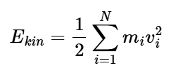

Thermostats
Temperature = total kinetic energy of system
Berendsen, Andersen, Nose-Hoover, V-rescale (velocity rescaling)
Formulation Computation Files and structure DOS calculation

Slide 18
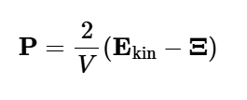
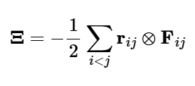

Barostats
Pressure is calculated as difference btwn KE and the virial, Ξ
Scalar pressure is used for isotropic systems
Berendsen, Parrinello-Rahman, Martyna-Tuckerman-Tobias-Klein (MTTK), and C-rescale,
Formulation Computation Files and structure DOS calculation

Slide 19
OPLS-AA - Optimized Potential for Liquid Simulations (All Atom)
https://pubs.acs.org/doi/10.1021/ja9621760
Formulation Computation Files and structure DOS calculation

Slide 20
AMBER - Assisted Model Building and Energy Refinement
Uses partial charges centered on atoms
http://ffamber.cnsm.csulb.edu/ffamber.php
https://ambermd.org/doc12/Amber24.pdf
Formulation Computation Files and structure DOS calculation

Slide 21
CHARM - Chemistry at HARvard Macromolecular Mechanics
Used for biologic systems (peptides, proteins, lipids, nucleic acids etc…)
https://academiccharmm.org/
Formulation Computation Files and structure DOS calculation

Slide 22
GROMOS - GROningen MOlecular Simulation
A general-purpose molecular dynamics computer simulation package for the study of biomolecular systems
Chemical and physical systems ranging from glasses and liquid crystals, to polymers and crystals
B-version to simulate gas phase isolated moleculesand solutions of biomolecules
https://www.gromos.net/
Formulation Computation Files and structure DOS calculation

Slide 23
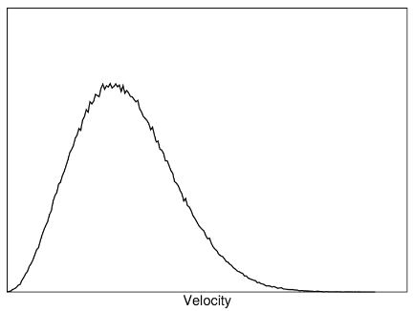
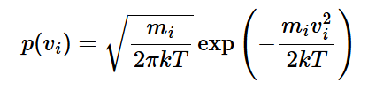
https://manual.gromacs.org/2025.0/reference-manual/algorithms/molecular-dynamics.html#fig-maxwell
Formulation Computation Files and structure DOS calculation

Slide 24
Links
https://manual.gromacs.org/2025.0/reference-manual/functions/functions.html#ff
https://manual.gromacs.org/2025.0/reference-manual/algorithms/molecular-dynamics.html#fig-maxwell

Slide 25
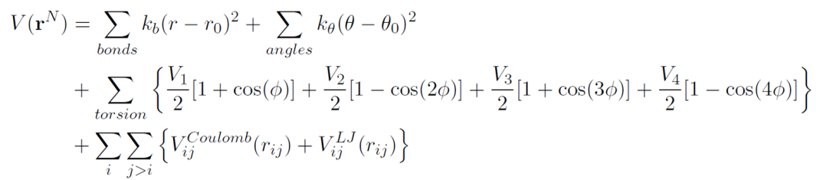
OPLS-AA - Optimized Potential for Liquid Simulations (All Atom)
https://pubs.acs.org/doi/10.1021/ja9621760
Formulation Computation Files and structure DOS calculation

