Slide 1

Draft.js

Slide 2
简介
Draft.js 是 Facebook 发布的一个用于构建富文本编辑器的 JavaScript 框架，它基于 React 进行开发。需要注意的是，Draft.js 不是一个开箱即可用的编辑器，需要对它进行进一步的编码才能使用。

Slide 3
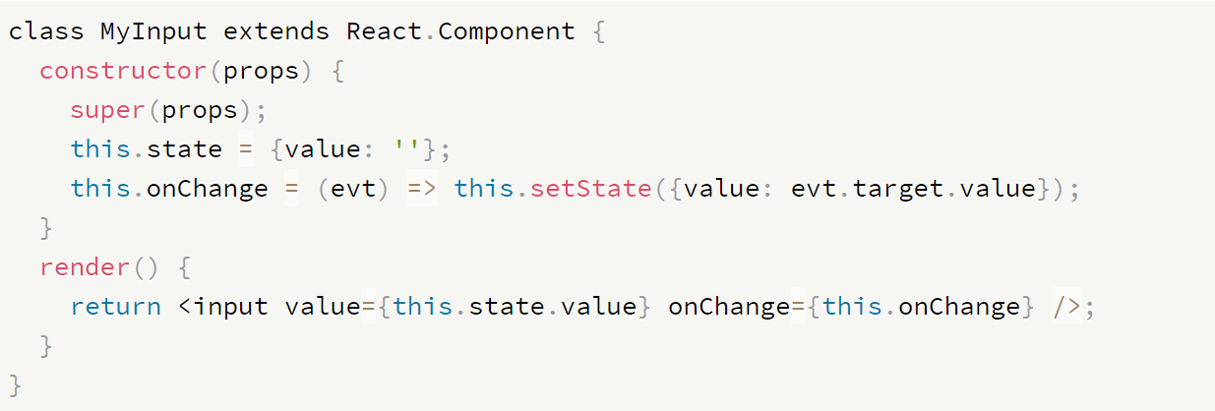
简介
controlled inputs involve two key pieces:
1.value: a value to represent the state of the input
2.onChange: an onChange prop function to receive updates to the input

Slide 4
简介
In a React rich text scenario, however, there are two clear problems:
1.A string of plaintext is insufficient to represent the complex state of a rich editor.
2.There is no such onChange event available for a ContentEditable element
Draft.js
EditorState <-------- > value
onChane <--------- > onChane

Slide 5
简介
EditorState is the top-level state object for the editor.
It is an Immutable Record that represents the entire state of a Draft editor, including:
The current text content state
The current selection state
The fully decorated representation of the contents
Undo/redo stacks
The most recent type of change made to the contents

Slide 6
简介
EditorState Static Methods:
EditorState .createEmpty()
EditorState . createWithContent()

Slide 7
环境搭建
Draft.js 是基于 React 的，所以首先需要创建一个 React 的工作环境
https://github.com/facebookincubator/create-react-app
npm install --save darft-js
引入Draft.css

Slide 8
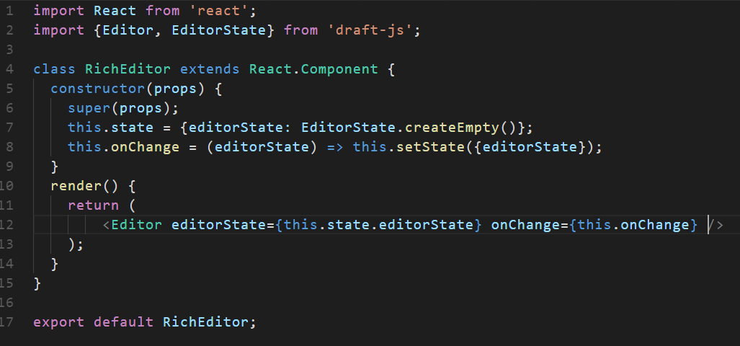
环境搭建
新建一个 React 组件

Slide 9
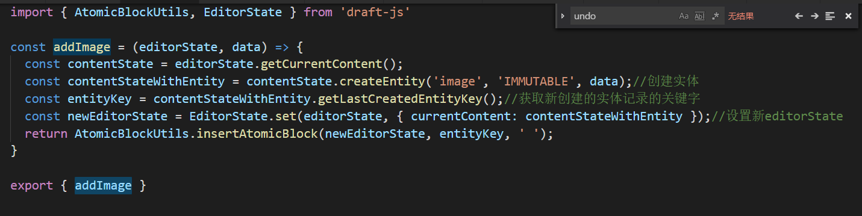
entity ： An entity is an object that represents metadata for a range of text within a Draft editor.

Slide 10
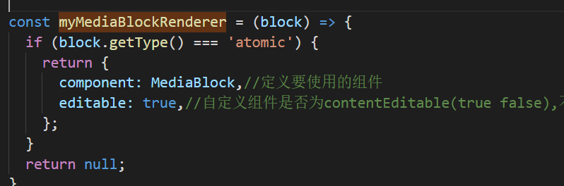
自定义块渲染：没有返回自定义渲染器对象，则编辑器将呈现默认的草稿编辑器块文本块组件。

Slide 11
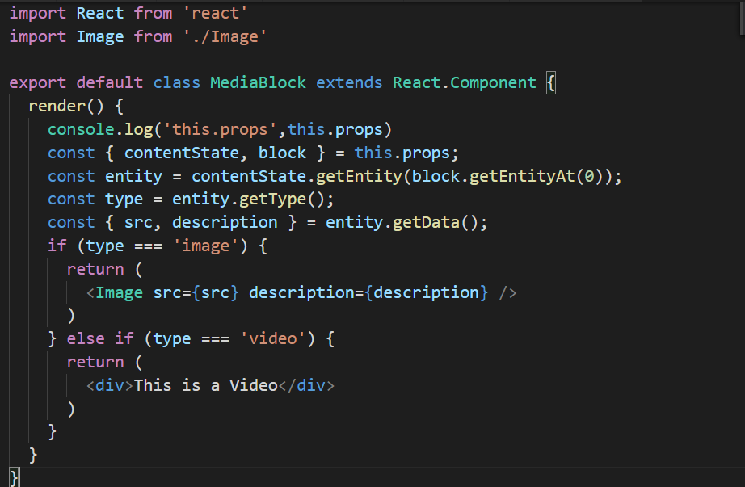
自定义块组件

Slide 12
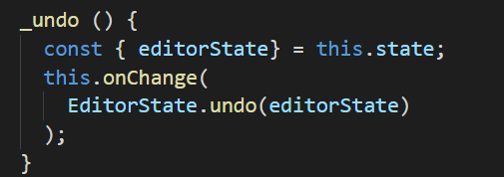
undo:
static undo(editorState: EditorState): EditorState
Returns a new EditorState object with the top of the undo stack applied as the new currentContent.
The existing currentContent is pushed onto the redo stack.

Slide 13
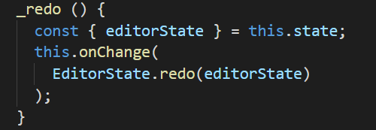
redo:
static redo(editorState: EditorState): EditorState
Returns a new EditorState object with the top of the redo stack applied as the new currentContent.
The existing currentContent is pushed onto the undo stack.

Slide 14
保存—转化成HTML
const {editorState} = this.state;
2. const contentState = editorState.getCurrentContent();//当前文本内容状态
3. convertToRaw(contentState);
//covertToRaw 方法来将 ContentState 对象转换成 plain JavaScript 对象，从而可以以 JSON 的格式进行存取
4. convertToHTML()

Slide 15
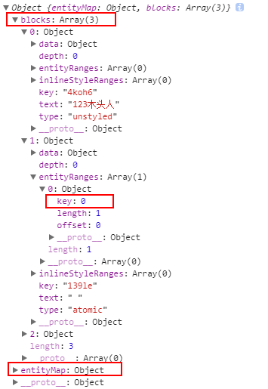
经过 covertToRaw 转换的 JSON 输出有两部分组成：
blocks 和 entityMap
blocks 是一个数组，每一项代表当前内容中的一个块级元素（比如标题、段落、列表等）。其中 text 表示该块级元素中的纯文本，type 表示该块级元素的类型（header-one 表示一级标题、unstyled 表示普通段落、atomic 表示多媒体类的块级元素）。

Slide 16
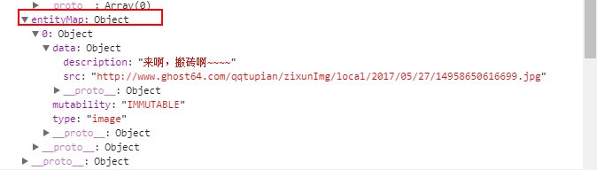
在 Draft.js 中，超链接、图片、视频等多媒体元素的数据通过 Entity 对象来表示，而 Entity 的位置信息存储于 entityRanges 数组中，其元数据可以通过 key 值，可以在 entityMap 中索引到。

Slide 17
感谢聆听
PPT模板下载：www.1ppt.com/moban/ 行业PPT模板：www.1ppt.com/hangye/
节日PPT模板：www.1ppt.com/jieri/ PPT素材下载：www.1ppt.com/sucai/
PPT背景图片：www.1ppt.com/beijing/ PPT图表下载：www.1ppt.com/tubiao/
优秀PPT下载：www.1ppt.com/xiazai/ PPT教程： www.1ppt.com/powerpoint/
Word教程： www.1ppt.com/word/ Excel教程：www.1ppt.com/excel/
资料下载：www.1ppt.com/ziliao/ PPT课件下载：www.1ppt.com/kejian/
范文下载：www.1ppt.com/fanwen/ 试卷下载：www.1ppt.com/shiti/
教案下载：www.1ppt.com/jiaoan/ PPT论坛：www.1ppt.cn

