Slide 1
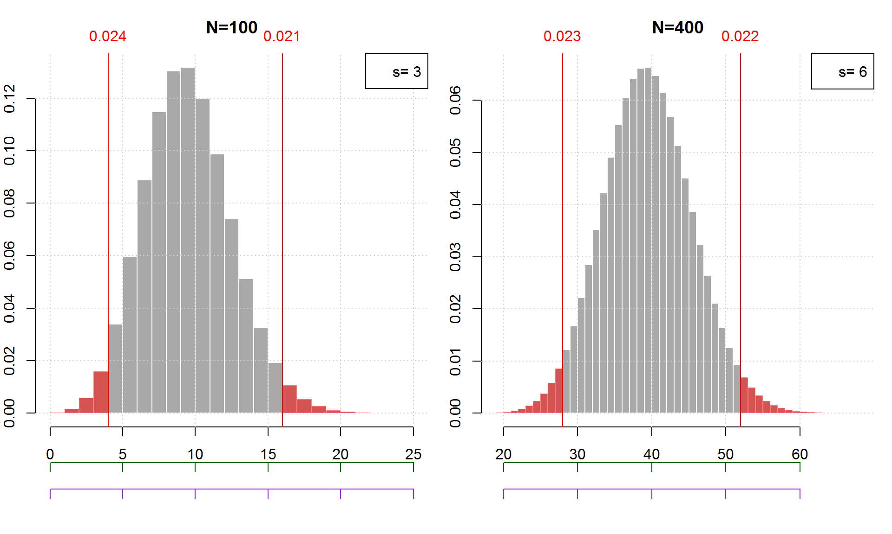
Complete the labeling of the two axis:
Green (1st) axis: difference in proportion to mean
Purple (2nd) axis: z-score (multiples of stdev)

