Slide 1
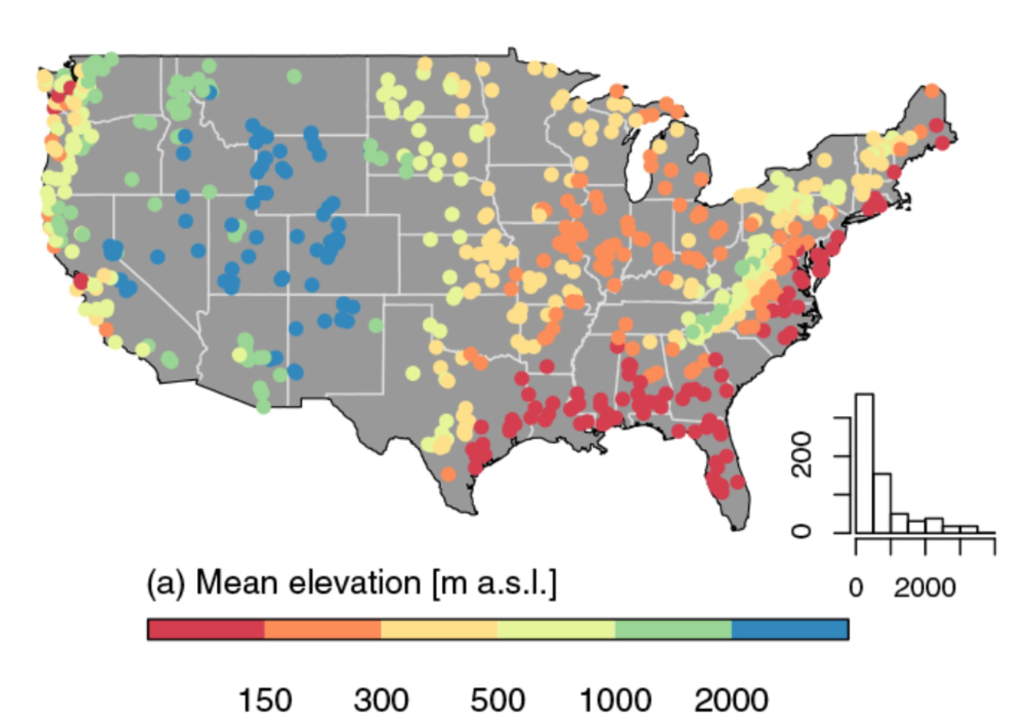
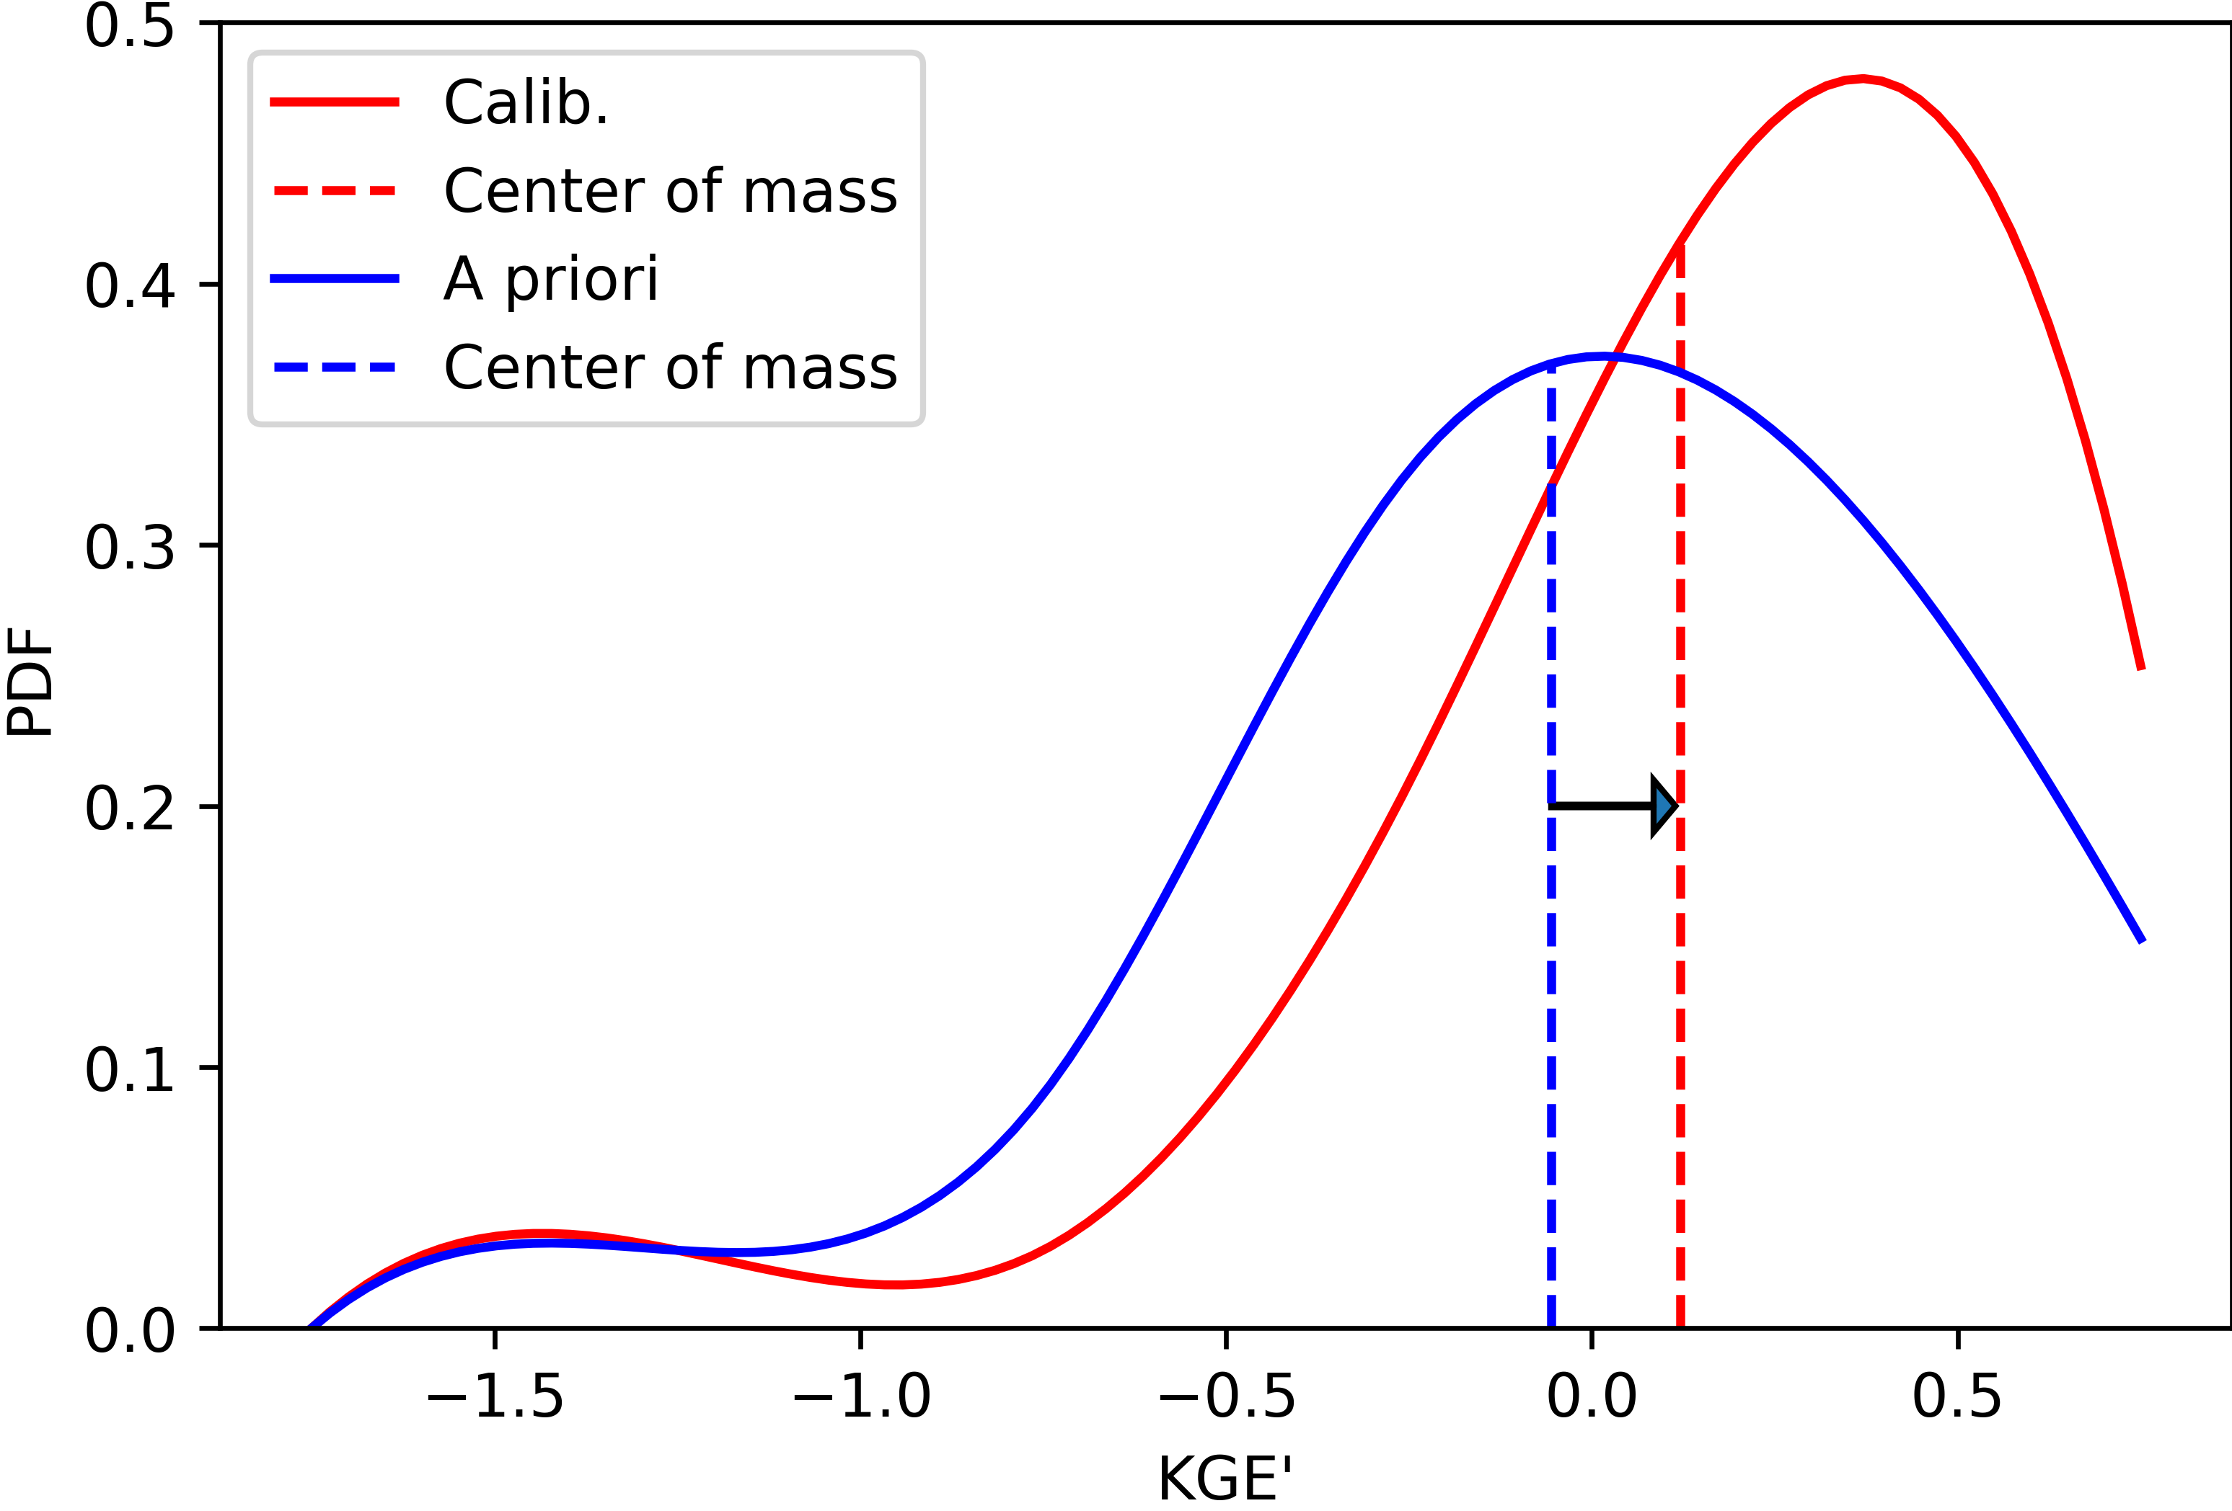
CTSM performance improvement using large-sample watershed modeling
CTSM model implementation
(with focus on hydrological components)
CAMELS (Catchment Attributes and Meteorology for Large-sample Studies) is a widely used dataset of hydrometeorological observations and model results for 671 US catchments.
Large-sample watershed dataset
(e.g., CAMELS and global datasets)
Feedback
Newman et al., 2015; Addor et al., 2017
CTSM performance improvement
(e.g., hydrology metrics, model configuration, parameter optimization, forcing analysis, multi-variate evaluation)
Experimental calibration of CTSM parameters using 10% of CAMELS basins show accuracy improvement of simulated runoff. Efforts are ongoing to improve the performance through multiple model implementation choices.
Global parameter optimization
Hydrology robustness analysis
Tang, Wood, and Swenson
Support: USACE

