Slide 1
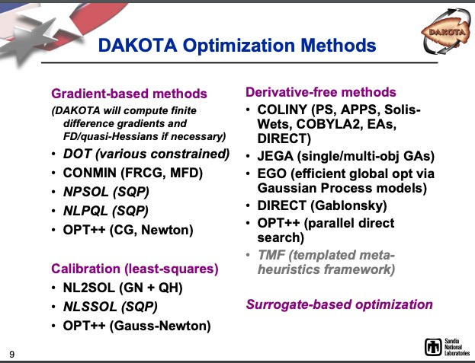
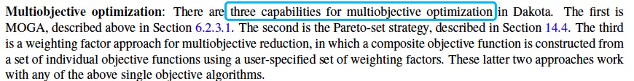
Dakota
https://dakota.sandia.gov/
It seems Dakota is not widely used in hydrological model calibration
The method is not common in hydrological model calibration (https://www.osti.gov/servlets/purl/1696903). Section 6.2 Optimizing with Dakota: Choosing a Method in User Manual.
Parallel is supported

Slide 2
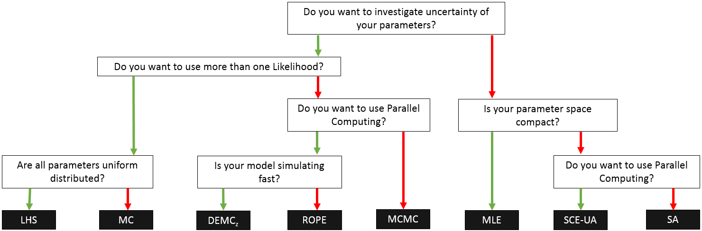
Spotpy
https://spotpy.readthedocs.io/en/latest/
If you have more than one series of observations, or simulation or objectivefunction: You can include them into your analysis, if you use 'MC', 'LHS' or 'FAST'
Parallel is supported

Slide 3
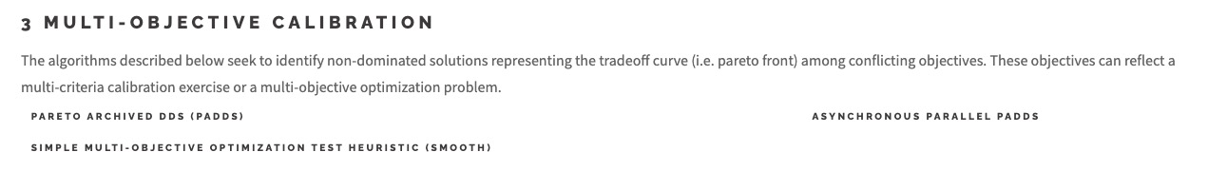
Ostrich
https://usbr.github.io/ostrich/index.html

