Slide 1




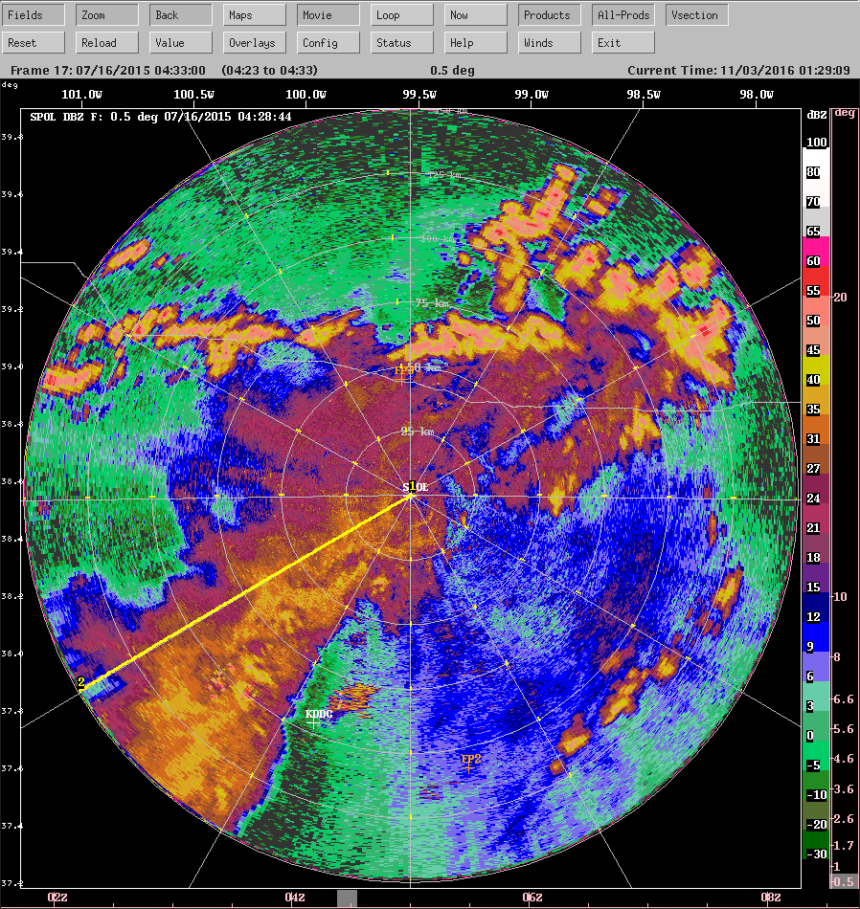
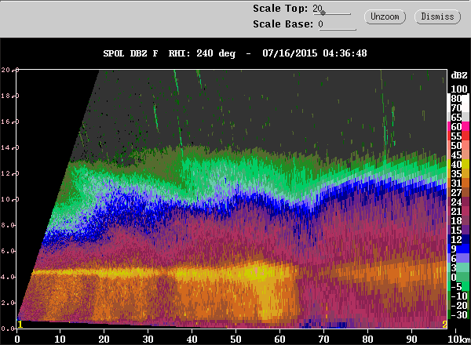
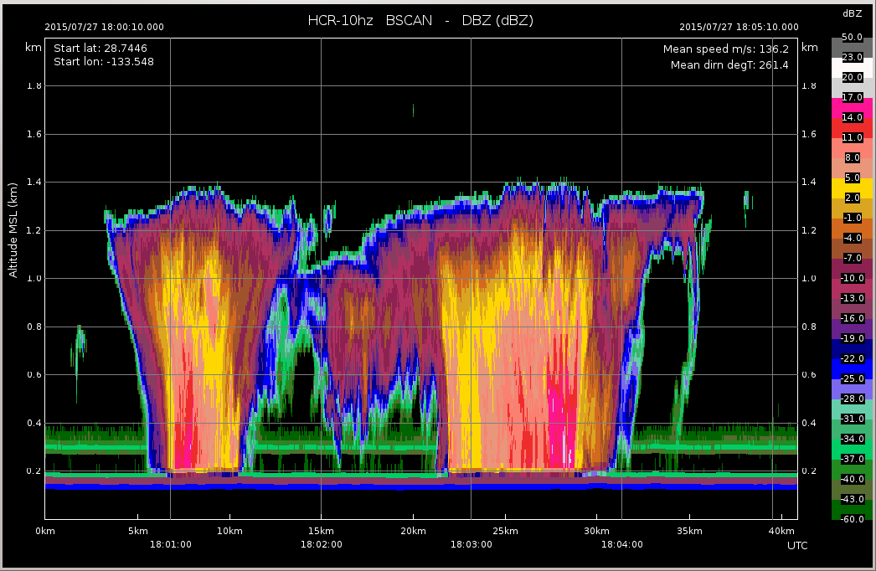
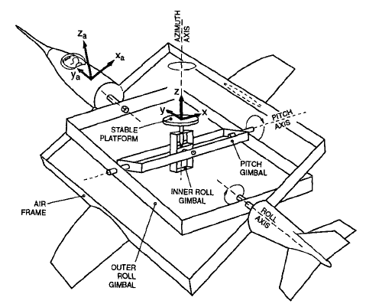
CfRadial - CF NetCDF for Radar and Lidar Data in Polar Coordinates
Mike Dixon¹ (dixon@ucar.edu), Wen-Chau Lee¹, Daniel Michelson², Mark Curtiss³ 1: Earth Observing Laboratory, NCAR, Boulder, Colorado 2: Environment Canada 3: Bureau of Meteorology Australia
AGU Fall Meeting 2016
Poster IN23A-1761
CfRadial is a CF-compliant NetCDF convention for RADAR and LIDAR data in polar coordinates.
The conventions for CF (Climate and Forecast) metadata are designed to promote the processing and sharing of files created with the NetCDF API.
The current CF conventions are documented at:
http://cfconventions.org/
http://cfconventions.org/cf-conventions/v1.6.0/cf-conventions.html
The nature of RADAR/LIDAR data – Polar coordinates
See: https://github.com/NCAR/CfRadial/tree/master/docs
CfRadial 2 – NetCDF4 with groups
NetCDF4, which is based on HDF5, introduced the concept of groups.
This allows us to create a data tree structure, in which data for different logical components are stored at different conceptual locations, or levels, within the file.
This is analogous to storing data files on your computed in a tree of folders or directories. This leads to a better organization of the data in a logical structure.
Scanning instruments – such as RADARS and LIDARS – operate natively in polar coordinates.
The intention with CfRadial is to save the data in the native coordinate system without any loss of information.
PPI scanning mode – the antenna moves predominantly in azimuth.
Sweeps contain rays at a constant elevation angle.
HISTORY of CfRadial versions
Date | Version | Remarks
2011/02/01 | 1.1 | First operational version – NetCDF3 Uses a volume-oriented flat structure
2011/06/07 | 1.2 | Minor changes / additions
2013/07/01 | 1.3 | Major changes / additions
2016/05/31 | 1.4 | Adding support for spectra and data quality fields
2017 | 2.0 | Upgrade to use NetCDF4 groups Change to sweep-oriented structure
As shown in the center panel (left), it makes sense to separate a radar volume into logical components called sweeps.
A sweep is defined as a series of rays for which certain characteristics are constant. In a PPI sweep, the elevation angle is held constant. In an RHI sweep, the azimuth angle is constant.
In CfRadial 2, the number of gates is in a sweep is always constant. This allows us to store the data set in a simple rectangular 2-D array, with dimensions time and range.
Sweep 3
Sweep 2
Sweep 1
CfRadial 1 – based on the classic NetCDF 3 design
CfRadial versions 1.1 to 1.4 are based on the classic NetCDF 3 model, in which the data structure is inherently flat.
All of the metadata variables, and the actual data set arrays, are stored at the same (top) level.
This is analogous to storing all of your computer files in a single folder – e.g. your home directory.
The logical structure of CfRadial2 is shown in the examples below
VOL1
0.5°
130°
...
32.0°
Volume
Sweep
Ray
Range Bin
Dataset
0.5km
180km
DBZH
VRADH
DBZH
VRADH
129°
...
...
VOL1
0.5°
DBZH [time][range]
VRADH [time][range]
...
DBZH [time][range]
Volume
Sweep
Dataset
32.0°
VRADH [time][range]
RHI scanning mode – the antenna moves predominantly in elevation.
Sweeps contain rays at a constant azimuth angle.
Some radar/lidar data contains rays with a constant number of gates. In CfRadial 1, this type of data can be stored in 2-D rectangular arrays where the primary dimension is time and the secondary dimension is range. See the figure below left.
As an alternative, to store the data more efficiently, some data sets have a variable number of gates per ray. This allows us to discard gates beyond the range at which useful data exists for that ray. In this case the field data is stored in a so-called 1-D ‘ragged’ array, in which the primary dimension is npoints – the length of the array. The location of the data for a specific ray is found via the ray_start_index and ray_n_gates metadata arrays. This structure is shown in the figure below right.
Sweep 3
sweep attributes dimensions: time, range, spectrum_group
metadata variables:
spectrum_group_names(spectrum_group)
time(time) range(range) elevation(time) azimuth(time) etc.
Sweep 2
group: root
dimension: sweep (can be unlimited) global attributes global variables sweep_group_names[sweep] sweep_fixed_angles[sweep]
group: sweep_name
Sweep 1
group: sweep_name1
sweep attributes dimensions: time, range
metadata variables:
time(time) range(range) elevation(time) azimuth(time) etc.
field variables: e.g.
dbz(time, range)
vel(time, range)
------
fieldn(time, range)
Vertically-pointing mode. Antenna is stationary.
Sweeps contain rays within a given time interval.
field variables: e.g.
dbz(time, range)
vel(time, range)
------
fieldn(time, range)
field attributes
field attributes
field attributes
field attributes
group: spectra
field attributes
Sweep 1
Sweep 2
Sweep 3
field attributes
dimensions: index, sample
spectrum_index(time, range)
spectrum field variables: e.g.
spectrum_hco(index, sample)
spectrum_vco(index, sample)
attributes
group: root
dimension: sweep global attributes global variables
attributes
group: sweep_nnnn
sweep attributes dimensions: time, range
metadata variables:
time(time) range(range) elevation(time) azimuth(time) etc.
field variables: e.g.
dbz(time, range)
vel(time, range)
------
fieldn(time, range)
group: georeference
latitude(time) longitude(time) altitude(time) heading(time) roll(time) pitch(time) etc.
attributes
sweep_name1 group sweep_name2 group
sweep_nnnn group radar_parameters group lidar_parameters group radar_calibration group lidar_calibration group georeference_correction group
field attributes
group: monitoring
transmit_power(time) noise_power(time) etc.
field attributes
Time
field attributes
Group structure showing top-level dimensions,
attributes, variables and sweep groups
Sweep group structure in more detail, showing support for geo-reference metadata for moving platforms, spectra, and monitoring data
Optional metadata groups (highlighted in yellow) in the root group
RADARs and LIDARs are pulsed instruments, which sample the atmosphere at a series of range gates, generally at constant spacing, in the direction at which the antenna or telescope is pointing.
The gates are grouped into rays, or beams.
Rays are grouped into sweeps, which are logical divisions in the scanning strategy. For example, as a radar scans in PPI mode, a sweep comprises all of the rays at a given elevation angle.
In CfRadial, a Volume comprises all of the rays in the file.
Standard name | Short name | Units | Already in CF?
equivalent_reflectivity_factor | DBZ | dBZ | yes
linear_equivalent_reflectivity_factor | Z | Z | no
radial_velocity_of_scatterers_ away_from_instrument | VEL | m/s | yes
doppler_spectrum_width | WIDTH | m/s | no
log_differential_reflectivity_hv | ZDR | dB | no
log_linear_depolarization_ratio_hv | LDR | dB | no
log_linear_depolarization_ratio_h | LDRH | dB | no
log_linear_depolarization_ratio_v | LDRV | dB | no
differential_phase_hv | PHIDP | degrees | no
specific_differential_phase_hv | KDP | degrees/km | no
cross_correlation_ratio_hv | RHOHV |  | no
log_power | DBM | dBm | no
log_power_co_polar_h | DBMHC | dBm | no
log_power_co_polar_v | DBMVC | dBm | no
linear_power | PWR | mW | no
linear_power_co_polar_h | PWRHC | mW | no
linear_power_co_polar_v | PWRVC | mW | no
signal_to_noise_ratio | SNR | dB | no
signal_to_noise_ratio_co_polar_h | SNRHC | dB | no
signal_to_noise_ratio_co_polar_v | SNRVC | dB | no
normalized_coherent_power | NCP |  | no
radar_estimated_rain_rate | RRR | mm/hr | no
rain_rate | RR | kg/m2/s | yes
radar_echo_classification (should be used for PID, HCA, HID etc) | REC | legend | no
2-D rectangular dataset array
1-D ragged dataset array
In both of these cases, the metadata variables such as time, elevation angle and azimuth angle are stored as 1-D arrays.
As mentioned earlier, all of these arrays are stored at the top level in the NetCDF file – NetCDF3 has only a single level.
References
Axford, D. N., 1968: On the accuracy of wind measurements using an inertial platform in an aircraft, and an example of a measurement of the vertical structure of the atmosphere. J. Appl. Meteor., 7, 645-666.
Dixon M., Lee, W-C., Rilling B., Burghart C., and Van Andel J., 2013: CfRadial Data File Format. Proposed CF-compliant netCDF Format for Moments Data for RADAR and LIDAR in Radial Coordinates. Version 1.3. EOL, NCAR. 66 pp.
Lee, W., P. Dodge, F. D. Marks Jr. and P. Hildebrand, 1994: Mapping of Airborne Doppler Radar Data. Journal of Oceanic and Atmospheric Technology, 11, 572 – 578.
Michelson D.B., Lewandowski R., Szewczykowski M., Beekhuis H., and Haase G., 2014: EUMETNET OPERA weather radar information model for implementation with the HDF5 file format. Version 2.2. EUMETNET OPERA Output O4. 38 pp.
Standard Names: Only 2 radar fields are currently included in the CF standard name list.
This table shows examples of field names that will be requested for addition to the standard name list.
Moving platforms (e.g. aircraft) are supported in CfRadial. Axis definitions and reference frame (reproduced from Lee et al., 1994,originally from Axford, 1968) ©American Meteorological Society. Reprinted with permission.

