Slide 1
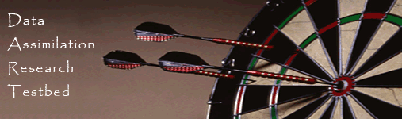
Data Assimilation Research Testbed Tutorial
Section 2: How should observations of a state variable impact an unobserved state variable? Multivariate assimilation.

Slide 2
Single observed variable, single unobserved variable
So far, we have a known observation likelihood for single variable.
Now, suppose the prior has an additional variable.
We will examine how ensemble members update the additional variable.
Basic method generalizes to any number of additional variables.
DART-LAB Tutorial -- June 09

Slide 3
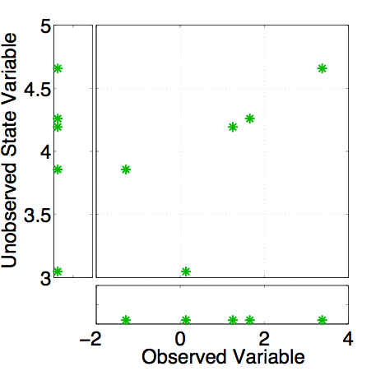
Ensemble filters: Updating additional prior state variables
Assume that all we know is prior joint distribution.
One variable is observed.
What should happen to the unobserved variable?
DART-LAB Tutorial -- June 09

Slide 4
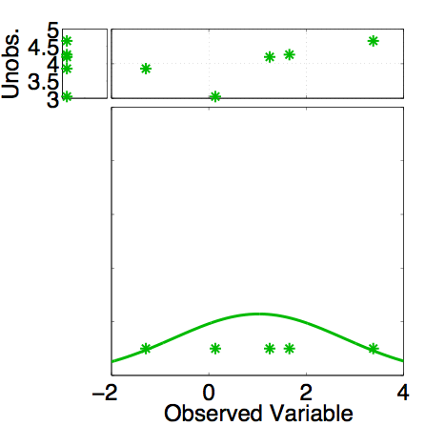
Ensemble filters: Updating additional prior state variables
Assume that all we know is prior joint distribution.
One variable is observed.
Update observed variable with one of previous methods.
DART-LAB Tutorial -- June 09

Slide 5
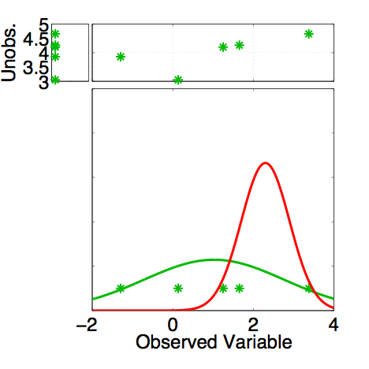
Ensemble filters: Updating additional prior state variables
Assume that all we know is prior joint distribution.
One variable is observed.
Update observed variable with one of previous methods.
DART-LAB Tutorial -- June 09

Slide 6
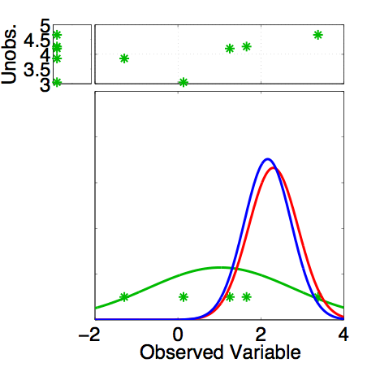
Ensemble filters: Updating additional prior state variables
Assume that all we know is prior joint distribution.
One variable is observed.
Update observed variable with one of previous methods.
DART-LAB Tutorial -- June 09

Slide 7
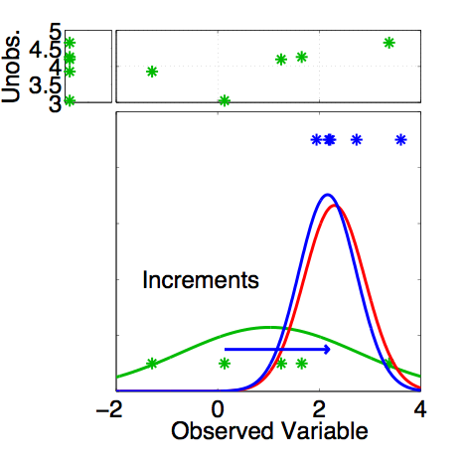
Ensemble filters: Updating additional prior state variables
Assume that all we know is prior joint distribution.
One variable is observed.
Compute increments for prior ensemble members of observed variable.
DART-LAB Tutorial -- June 09

Slide 8
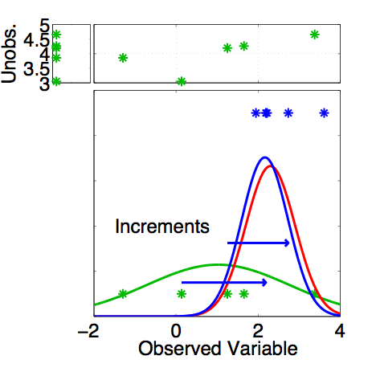
Ensemble filters: Updating additional prior state variables
Assume that all we know is prior joint distribution.
One variable is observed.
Compute increments for prior ensemble members of observed variable.
DART-LAB Tutorial -- June 09

Slide 9

Ensemble filters: Updating additional prior state variables
Assume that all we know is prior joint distribution.
One variable is observed.
Compute increments for prior ensemble members of observed variable.
DART-LAB Tutorial -- June 09

Slide 10
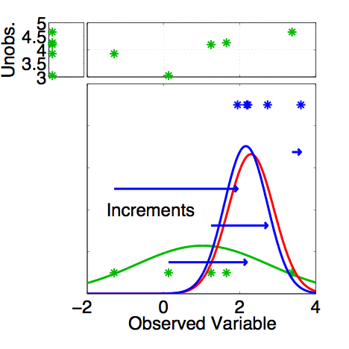
Ensemble filters: Updating additional prior state variables
Assume that all we know is prior joint distribution.
One variable is observed.
Compute increments for prior ensemble members of observed variable.
DART-LAB Tutorial -- June 09

Slide 11
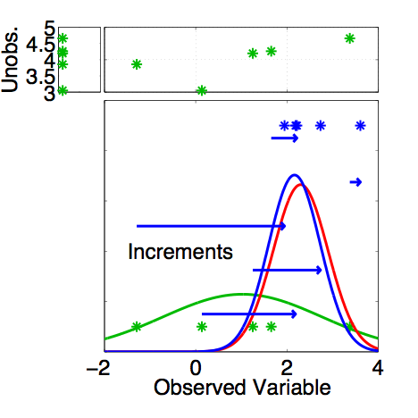
Ensemble filters: Updating additional prior state variables
Assume that all we know is prior joint distribution.
One variable is observed.
Compute increments for prior ensemble members of observed variable.
DART-LAB Tutorial -- June 09

Slide 12
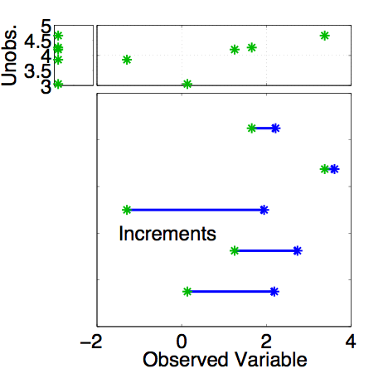
Ensemble filters: Updating additional prior state variables
Assume that all we know is prior joint distribution.
One variable is observed.
Using only increments guarantees that if observation had no impact on observed variable, unobserved variable is unchanged (highly desirable).
DART-LAB Tutorial -- June 09

Slide 13
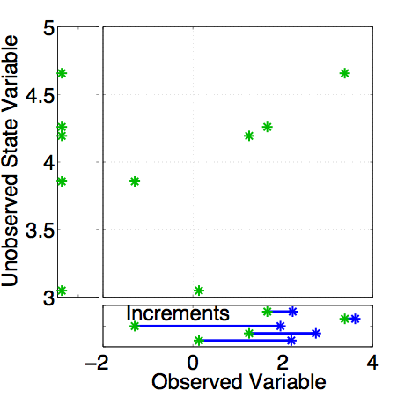
Ensemble filters: Updating additional prior state variables
Assume that all we know is prior joint distribution.
How should the unobserved variable be impacted?
First choice: least squares.
Equivalent to linear regression.
Same as assuming binormal prior.
DART-LAB Tutorial -- June 09

Slide 14
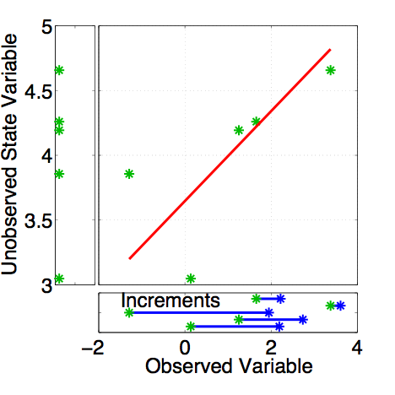
Ensemble filters: Updating additional prior state variables
Have joint prior distribution of two variables.
How should the unobserved variable be impacted?
First choice: least squares.
Begin by finding least squares fit.
DART-LAB Tutorial -- June 09

Slide 15
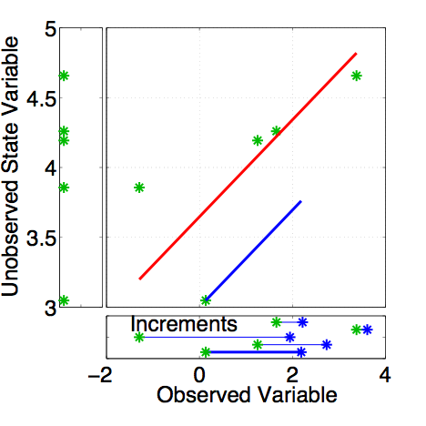
Ensemble filters: Updating additional prior state variables
Have joint prior distribution of two variables.
Next, regress the observed variable increments onto increments for the unobserved variable.
Equivalent to first finding image of increment in joint space.
DART-LAB Tutorial -- June 09

Slide 16
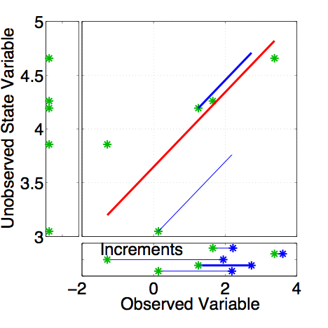
Ensemble filters: Updating additional prior state variables
Have joint prior distribution of two variables.
Next, regress the observed variable increments onto increments for the unobserved variable.
Equivalent to first finding image of increment in joint space.
DART-LAB Tutorial -- June 09

Slide 17
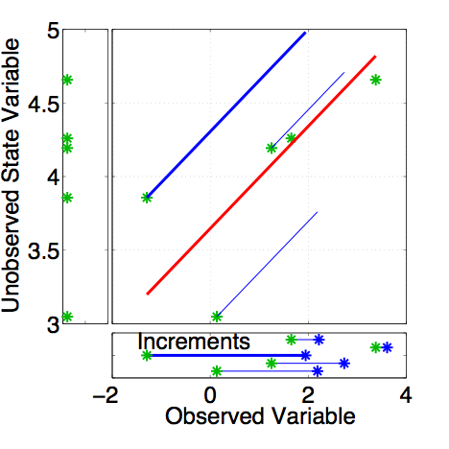
Ensemble filters: Updating additional prior state variables
Have joint prior distribution of two variables.
Next, regress the observed variable increments onto increments for the unobserved variable.
Equivalent to first finding image of increment in joint space.
DART-LAB Tutorial -- June 09

Slide 18
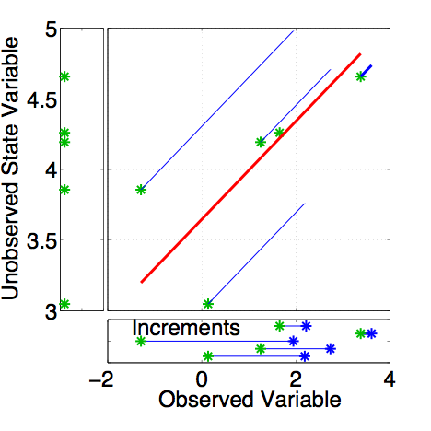
Ensemble filters: Updating additional prior state variables
Have joint prior distribution of two variables.
Next, regress the observed variable increments onto increments for the unobserved variable.
Equivalent to first finding image of increment in joint space.
DART-LAB Tutorial -- June 09

Slide 19
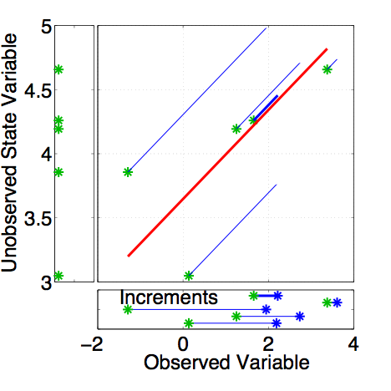
Ensemble filters: Updating additional prior state variables
Have joint prior distribution of two variables.
Next, regress the observed variable increments onto increments for the unobserved variable.
Equivalent to first finding image of increment in joint space.
DART-LAB Tutorial -- June 09

Slide 20
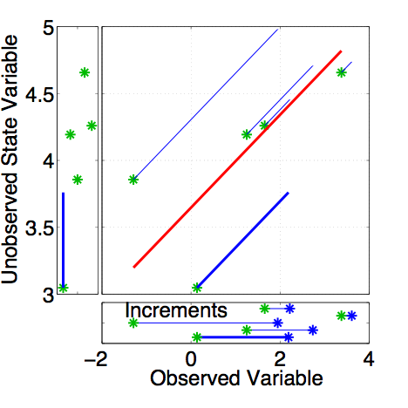
Ensemble filters: Updating additional prior state variables
Have joint prior distribution of two variables.
Regression: Equivalent to first finding image of increment in joint space.
Then projecting from joint space onto unobserved priors.
DART-LAB Tutorial -- June 09

Slide 21
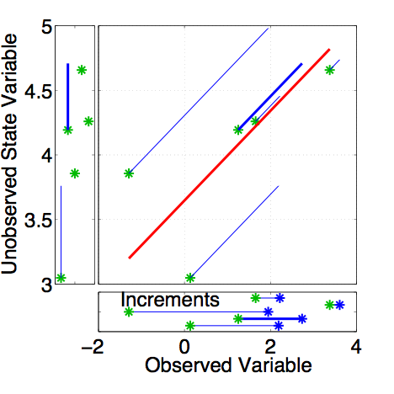
Ensemble filters: Updating additional prior state variables
Have joint prior distribution of two variables.
Regression: Equivalent to first finding image of increment in joint space.
Then projecting from joint space onto unobserved priors.
DART-LAB Tutorial -- June 09

Slide 22
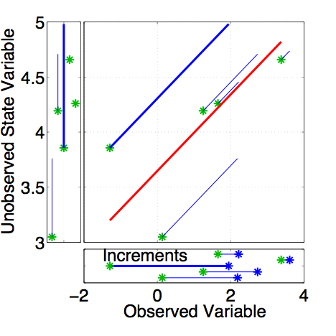
Ensemble filters: Updating additional prior state variables
Have joint prior distribution of two variables.
Regression: Equivalent to first finding image of increment in joint space.
Then projecting from joint space onto unobserved priors.
DART-LAB Tutorial -- June 09

Slide 23
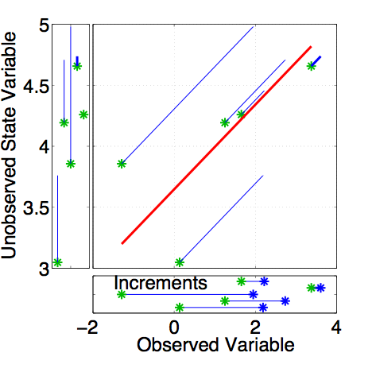
Ensemble filters: Updating additional prior state variables
Have joint prior distribution of two variables.
Regression: Equivalent to first finding image of increment in joint space.
Then projecting from joint space onto unobserved priors.
DART-LAB Tutorial -- June 09

Slide 24
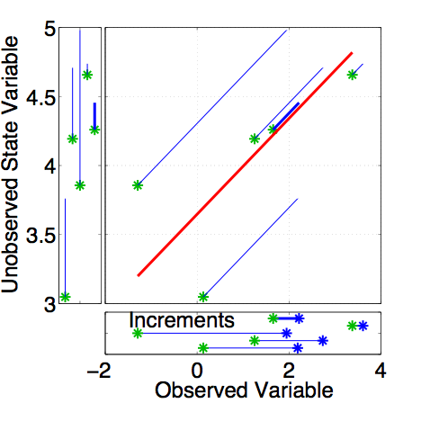
Ensemble filters: Updating additional prior state variables
Have joint prior distribution of two variables.
Regression: Equivalent to first finding image of increment in joint space.
Then projecting from joint space onto unobserved priors.
DART-LAB Tutorial -- June 09

Slide 25
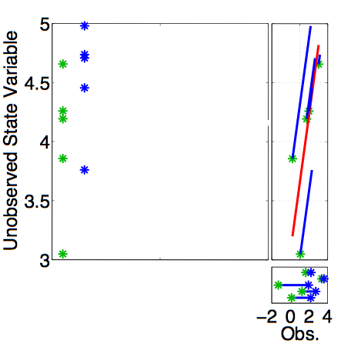
Ensemble filters: Updating additional prior state variables
Now have an updated (posterior) ensemble for the unobserved variable.
DART-LAB Tutorial -- June 09

Slide 26
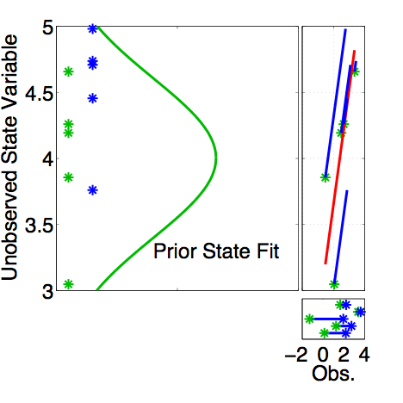
Ensemble filters: Updating additional prior state variables
Now have an updated (posterior) ensemble for the unobserved variable.
Fitting Gaussians shows that mean and variance have changed.
DART-LAB Tutorial -- June 09

Slide 27
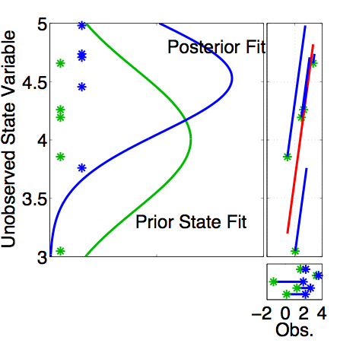
Ensemble filters: Updating additional prior state variables
Now have an updated (posterior) ensemble for the unobserved variable.
Fitting Gaussians shows that mean and variance have changed.
Other features of the prior distribution may also have changed.
DART-LAB Tutorial -- June 09

Slide 28
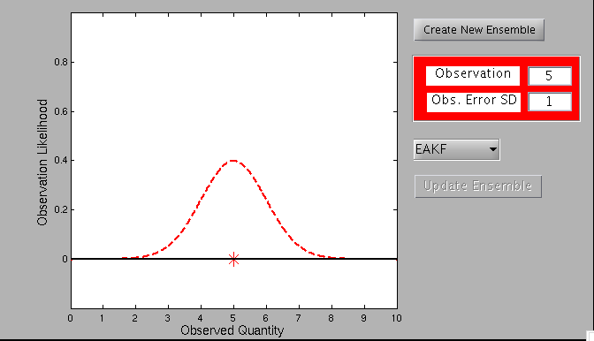
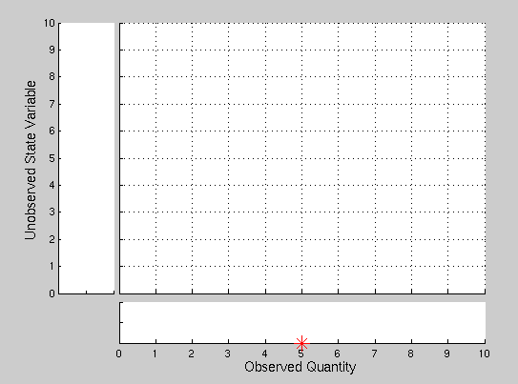
Matlab Hands-On: twod_ensemble
Purpose:
Explore how an unobserved state variable is updated by an observation of another state variable.
DART-LAB Tutorial -- June 09

Slide 29
Matlab Hands-On: twod_ensemble
Procedure:
This script opens two windows: a menu window and a diagnostic window.
Use the red dialog boxes to set the observation likelihood mean and standard deviation.
To create a prior ensemble:
  Select Create New Ensemble .
  Click on large white area in the diagnostic window to create an ensemble member. The horizontal coordinate is the value of the observed state variable and the vertical coordinate is the corresponding unobserved variable. Repeat a few times.
  Click on a gray area of the diagnostic window to finish ensemble.
Select Update Ensemble to see the updated ensemble.
The pull-down menu allows you to select different ensemble filter algorithms (we’ll talk about these later).
DART-LAB Tutorial -- June 09

Slide 30
Matlab Hands-On: twod_ensemble
What do I see?
The GUI window displays the prior, observation, and posterior for the observed variable only.
The diagnostic window has three panels. The large central panel is a plot of the joint distribution of the unobserved and observed state variable. The lower panel is the marginal distribution for just the observed variable and corresponds to part of what is shown in the GUI window. The left panel is the marginal for the unobserved variable. It shows how the unobserved variable is updated by the observation.
DART-LAB Tutorial -- June 09

Slide 31
Matlab Hands-On: twod_ensemble
Explorations:
Create ensemble members that are nearly on a line. Explore how the unobserved variable is updated.
2. What happens for nearly uncorrelated observed and unobserved variables? Create a roundish cloud of points for the prior.
3. What happens with a two-dimensional bimodal distribution?
4. Try prior ensembles with various types of outliers.
DART-LAB Tutorial -- June 09

Slide 32
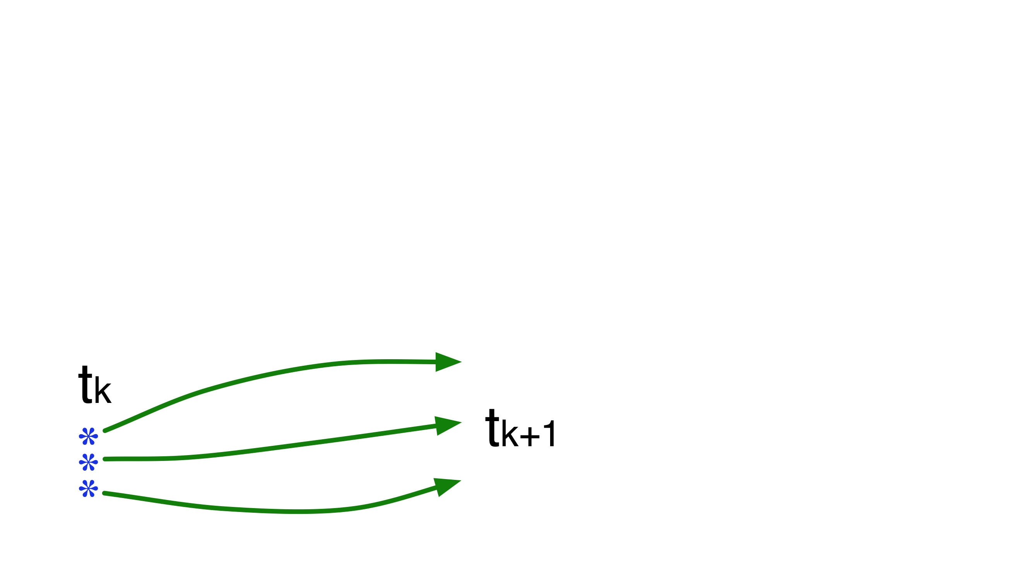
Ensemble Kalman Filter for Geophysical Data Assimilation
1. Use model to advance ensemble (3 members here) to time at which next observation becomes available.
DART-LAB Tutorial -- June 09

Slide 33
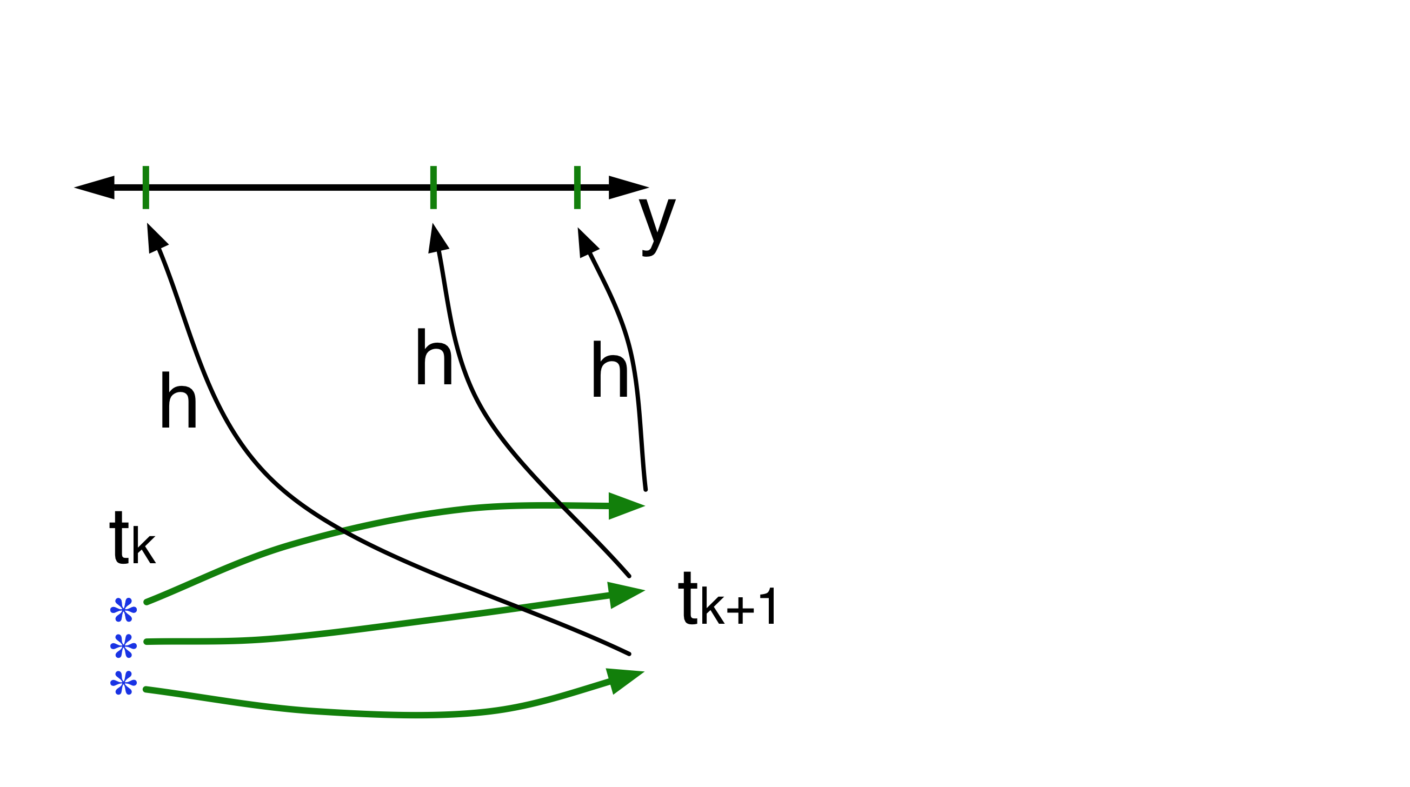
Ensemble Kalman Filter for Geophysical Data Assimilation
2. Get prior ensemble sample of observation, y=h(x), by applying forward operator h to each ensemble member.
DART-LAB Tutorial -- June 09

Slide 34
Ensemble Kalman Filter for Geophysical Data Assimilation
2. Get prior ensemble sample of observation, y=h(x), by applying forward operator h to each ensemble member.
Theory: observations from instruments with uncorrelated errors can be done sequentially.
DART-LAB Tutorial -- June 09

Slide 35
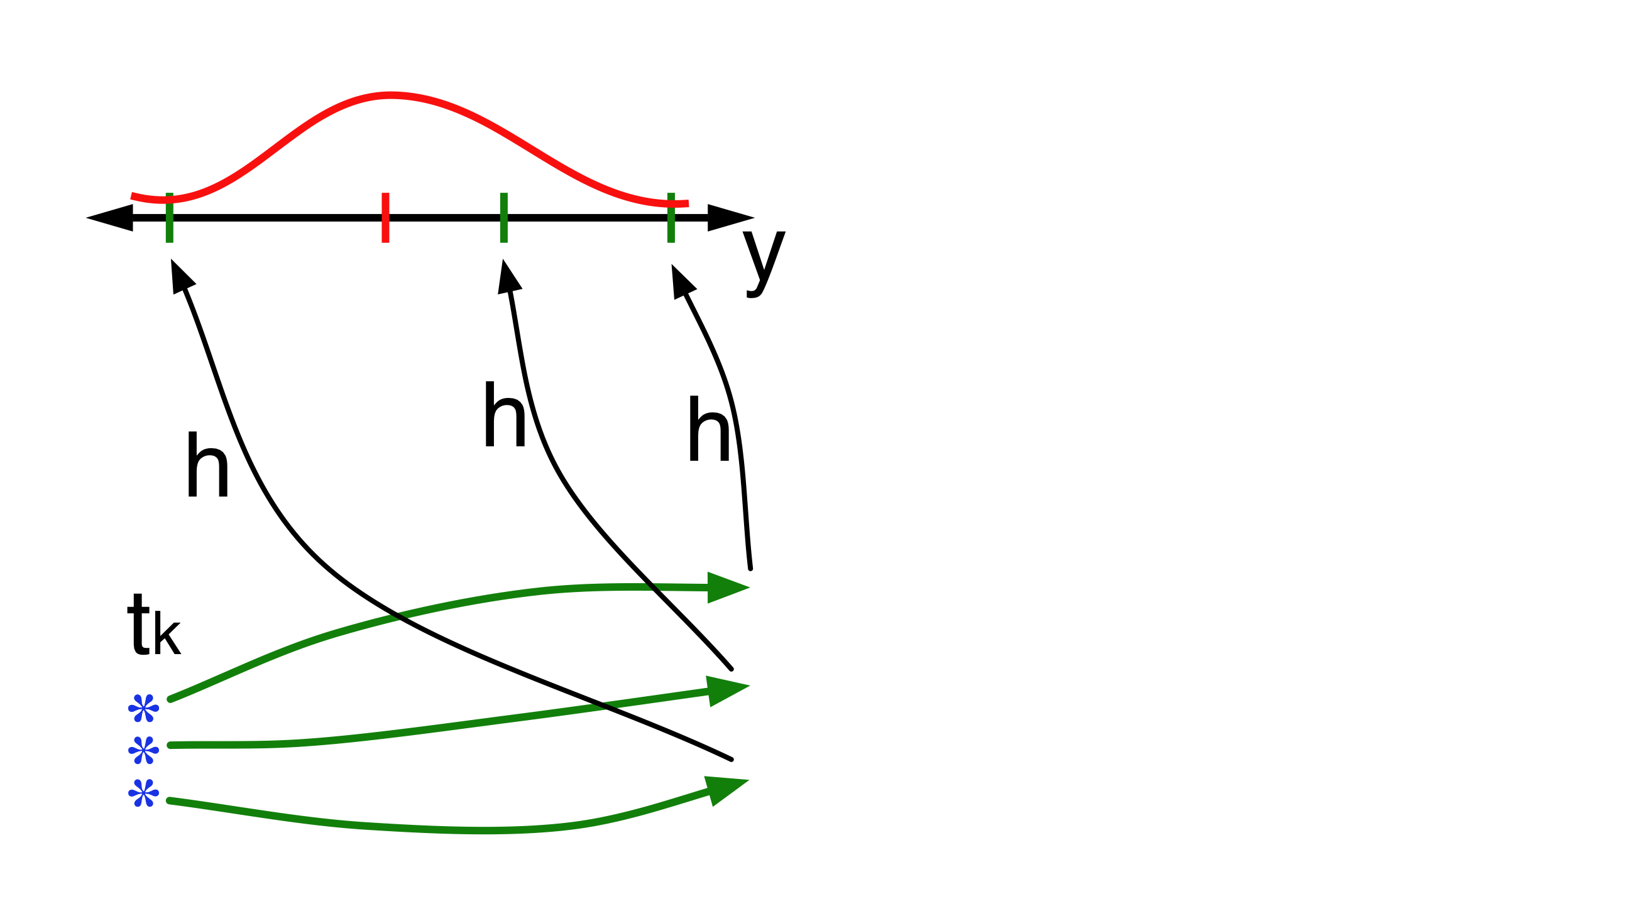
Ensemble Kalman Filter for Geophysical Data Assimilation
3. Get observed value and observational error distribution from observing system.
DART-LAB Tutorial -- June 09

Slide 36
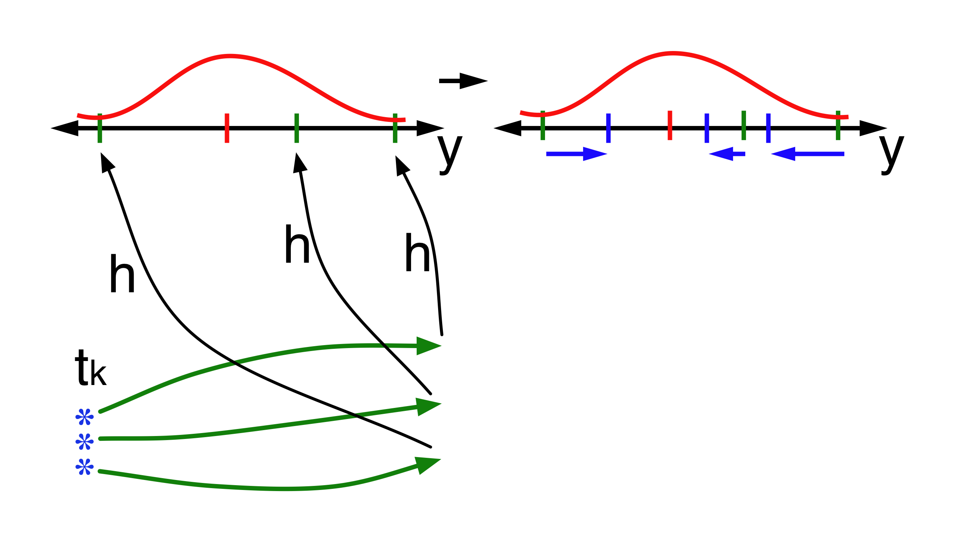
Ensemble Kalman Filter for Geophysical Data Assimilation
4. Find increment for each prior observation ensemble (this is a scalar problem for uncorrelated observation errors).
DART-LAB Tutorial -- June 09

Slide 37
Ensemble Kalman Filter for Geophysical Data Assimilation
4. Find increment for each prior observation ensemble (this is a scalar problem for uncorrelated observation errors).
Note: Difference between different flavors of ensemble filters is primarily in observation increment.
DART-LAB Tutorial -- June 09

Slide 38
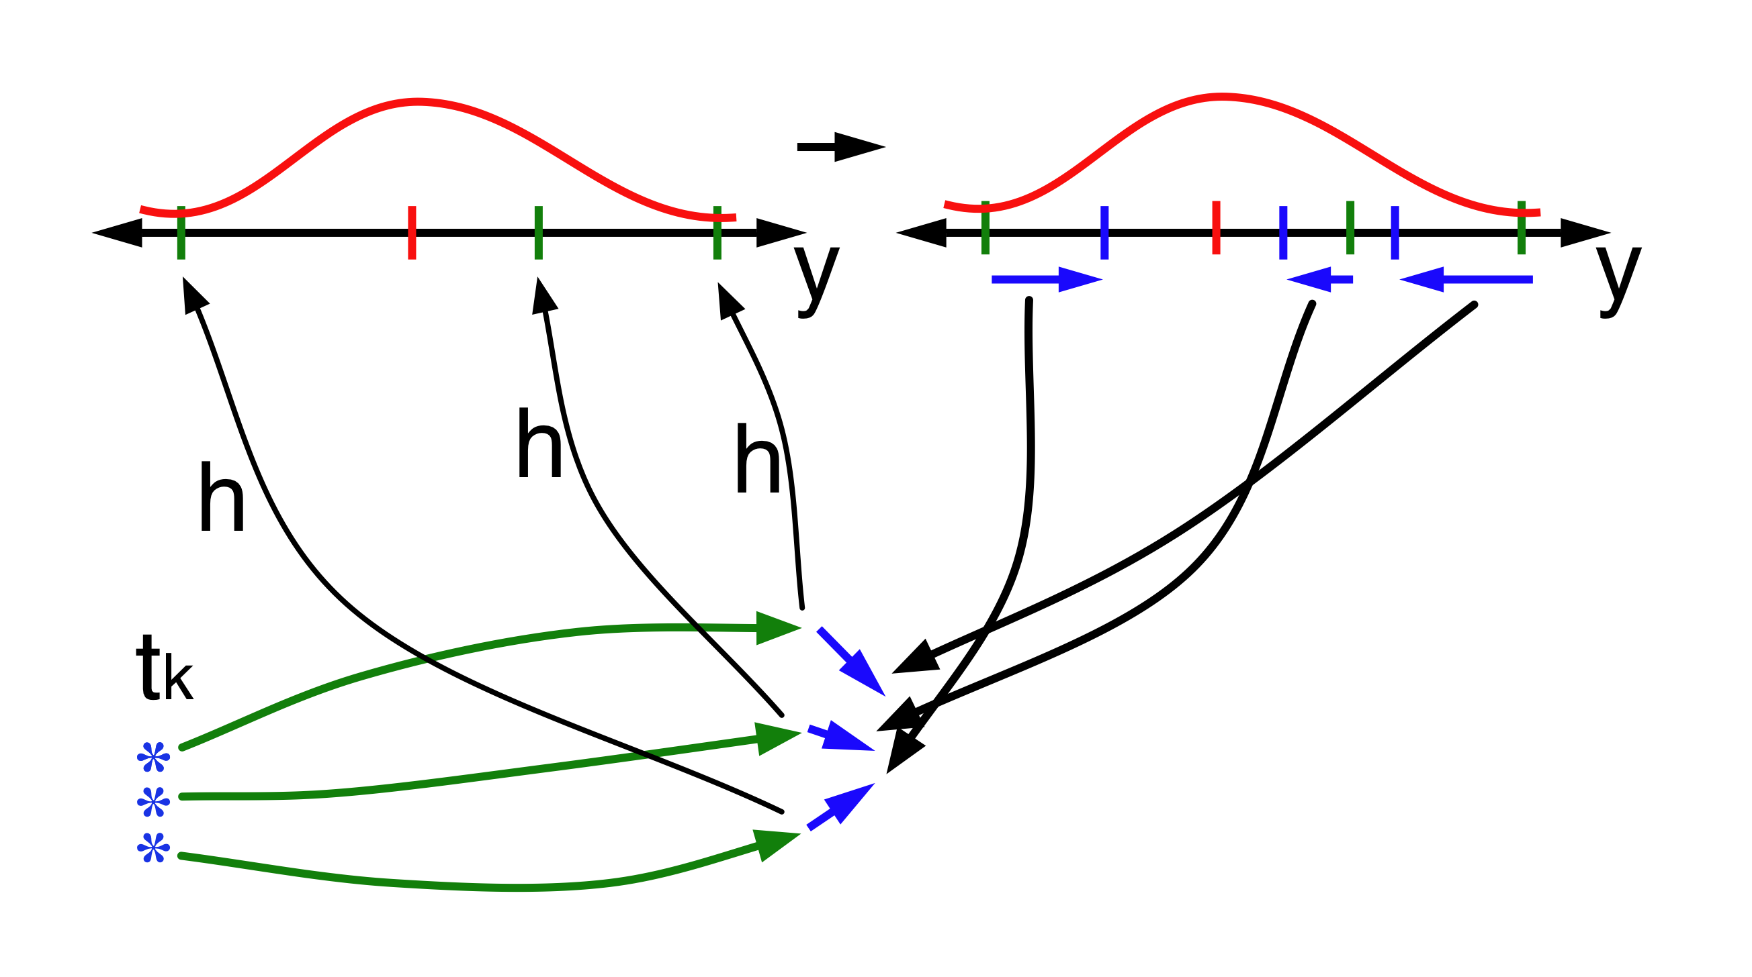
Ensemble Kalman Filter for Geophysical Data Assimilation
5. Use ensemble samples of y and each state variable to linearly regress observation increments onto state variable increments.
DART-LAB Tutorial -- June 09

Slide 39
Ensemble Kalman Filter for Geophysical Data Assimilation
5. Use ensemble samples of y and each state variable to linearly regress observation increments onto state variable increments.
Theory: Impact of observation increments on each state variable can be handled independently!
DART-LAB Tutorial -- June 09

Slide 40
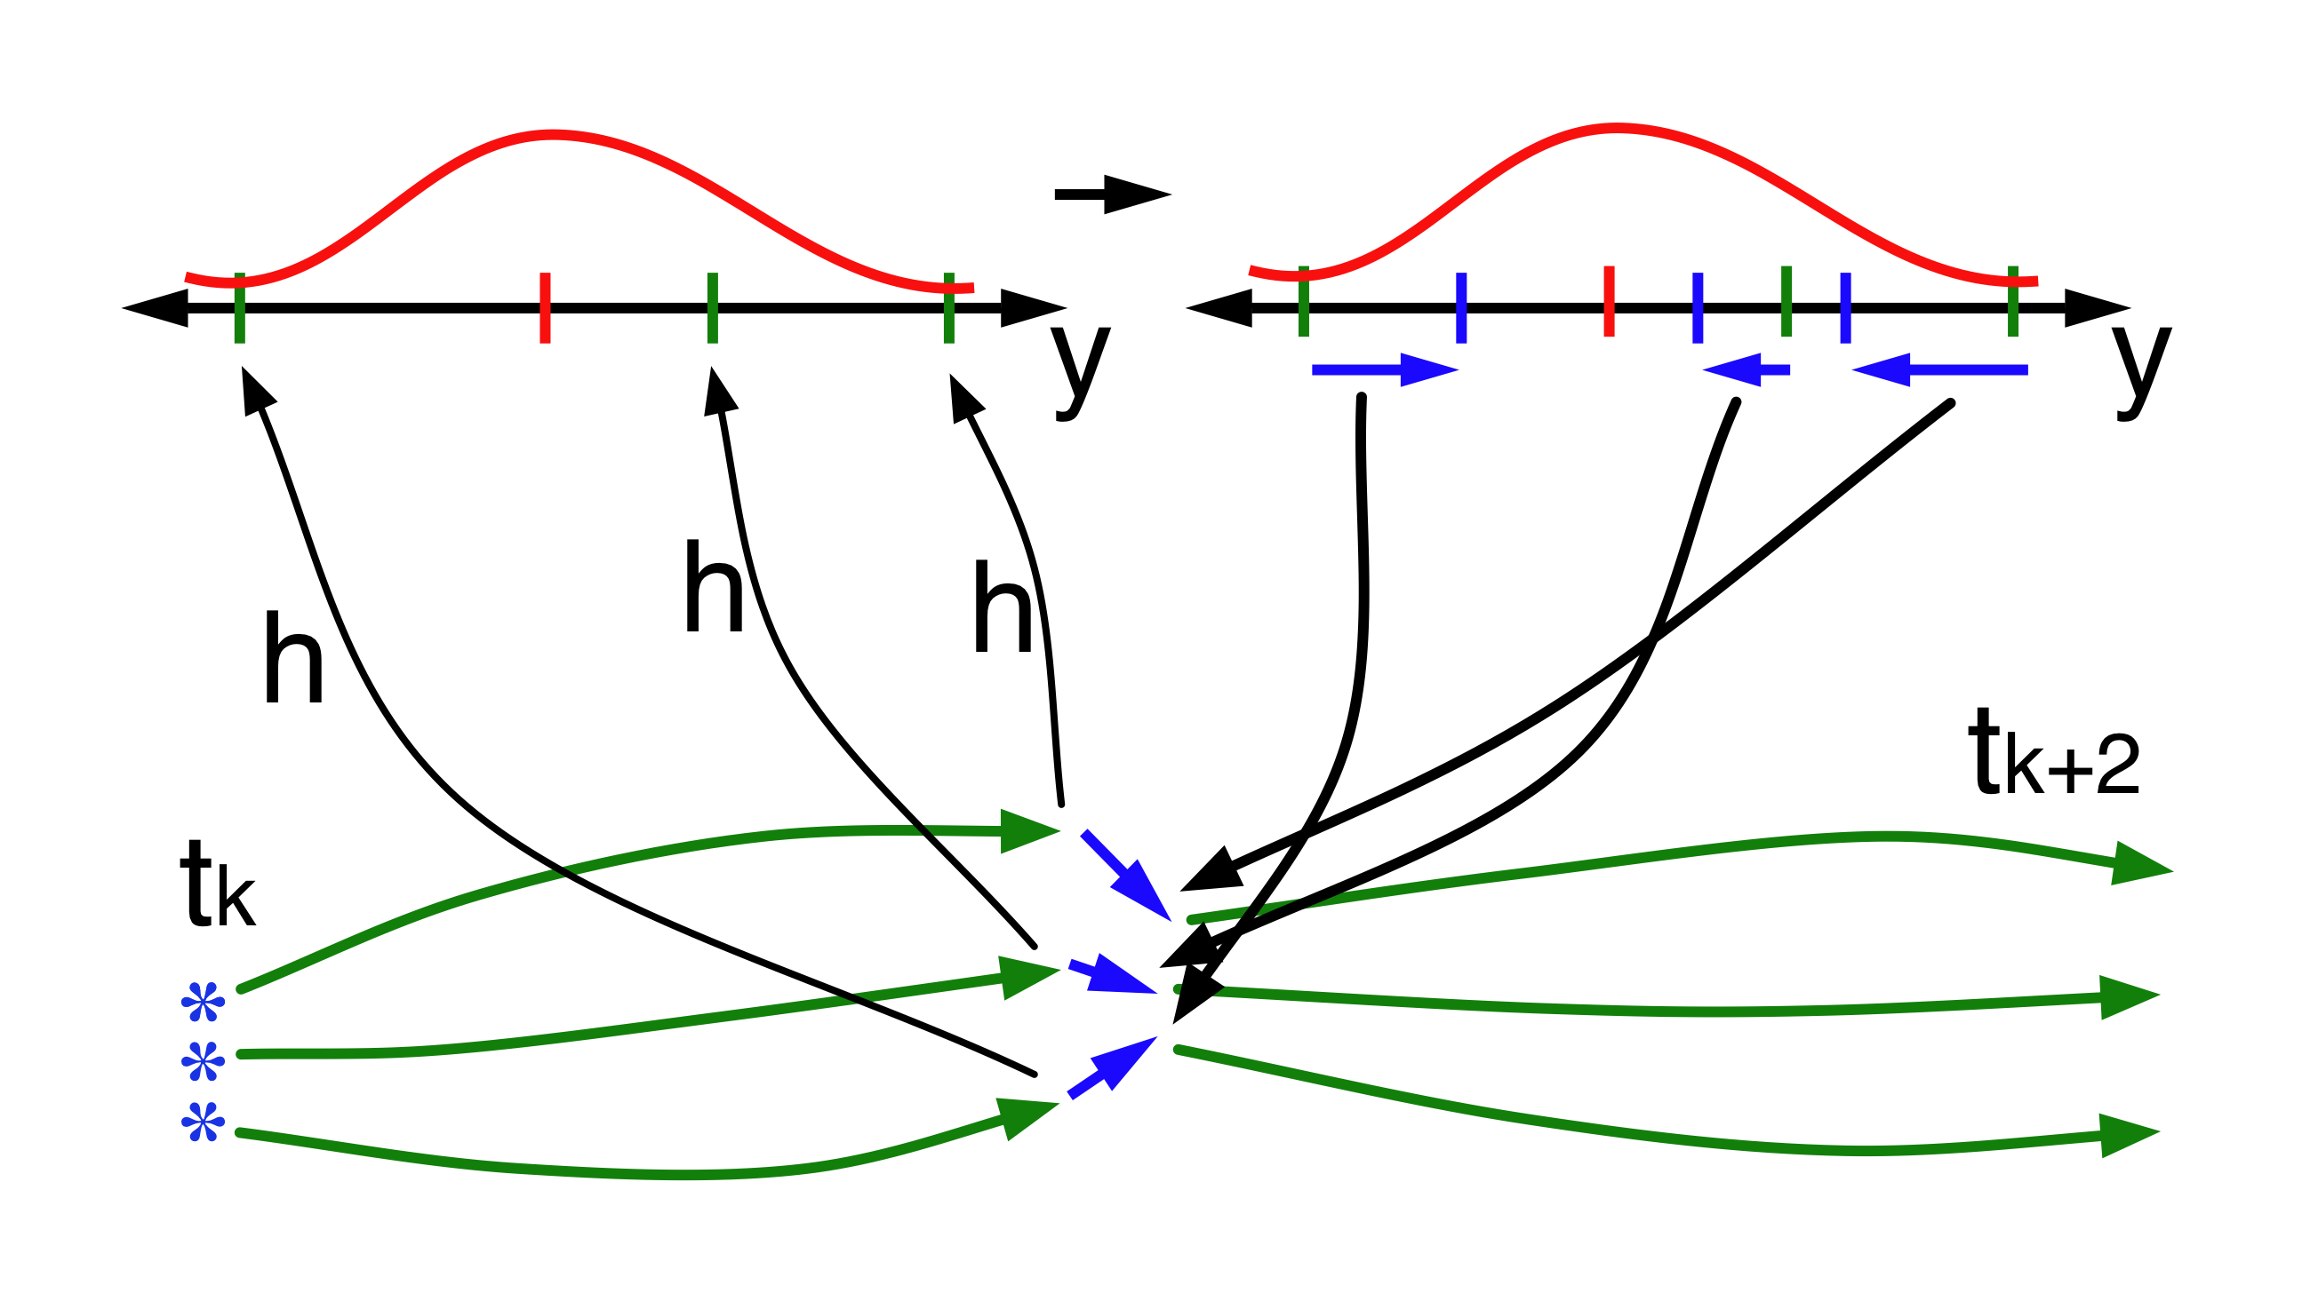
Ensemble Kalman Filter for Geophysical Data Assimilation
6. When all ensemble members for each state variable are updated, have a new analysis. Advance model to time of next observation...
DART-LAB Tutorial -- June 09

Slide 41
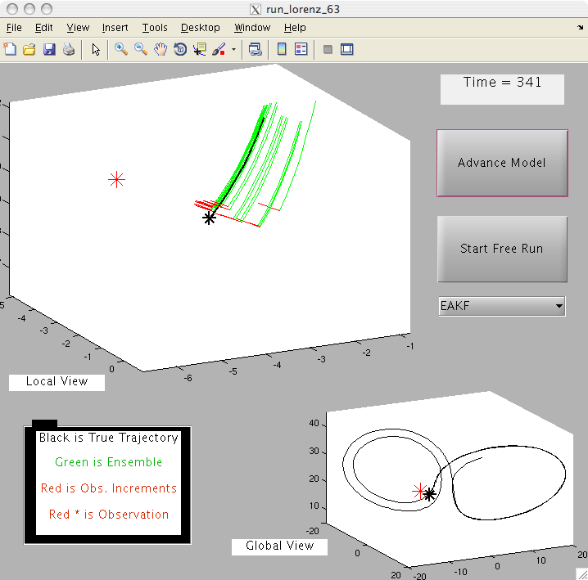
Matlab Hands-On: run_lorenz_63
Purpose: Explore behavior of ensemble Kalman filters in a low-order, chaotic dynamical system, the 3-variable Lorenz 1963 model.
DART-LAB Tutorial -- June 09

Slide 42
Matlab Hands-On: run_lorenz_63
Procedure:
To see individual model advance and assimilation steps, select the top button on the menu window (it will alternate between Advance Model and Assimilate Obs ).
Selecting Start Free Run starts a sequence of advance and assimilation steps.
Selecting Stop Free Run stops the sequence of steps.
The ensemble filter algorithm is changed with the pull-down.
No Assimilation runs the truth and model without assimilation.
EAKF uses the deterministic ensemble Kalman filter.
DART-LAB Tutorial -- June 09

Slide 43
Matlab Hands-On: run_lorenz_63
What do I see?
Both panels show the time evolution of the true state (black). 20 ensemble members (green) are shown in the top window.
Red asterisks mark the observation and red segments show the increments for the ensemble members.
The smaller panel shows a global view of the true trajectory.
The larger window shows a magnified view of the recent evolution of the truth and the ensemble.
At each observation time, the three components of the truth are 'observed’ by adding a random draw from a standard normal distribution to the true value.
DART-LAB Tutorial -- June 09

Slide 44
Matlab Hands-On: run_lorenz_63
Explorations:
Select Start Free Run and watch the evolution of the ensemble. Try to understand how the ensemble spreads out.
2. Restart the GUI and select EAKF. Do individual advances and assimilations and observe the behavior.
3. Do some free runs with assimilation turned on.
4. Explore how different areas of the attractor have different assimilation behavior.
DART-LAB Tutorial -- June 09

Slide 45
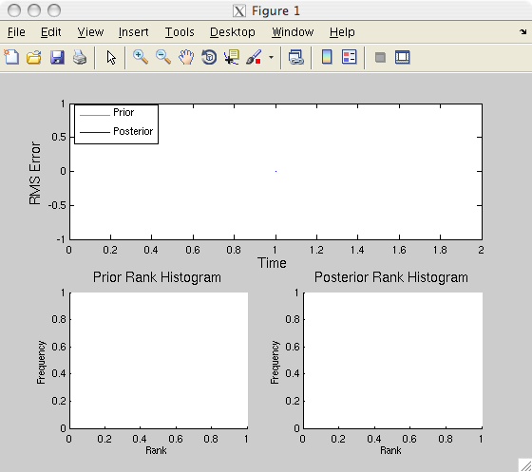
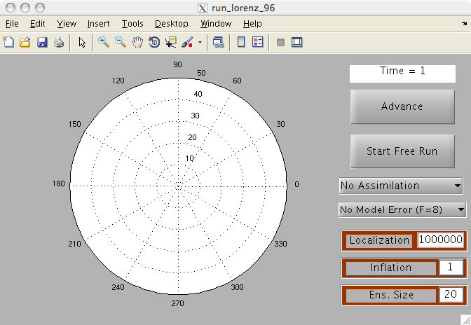
Matlab Hands-On: run_lorenz_96
Purpose: Explore the behavior of ensemble filters in a 40-variable chaotic dynamical system; the Lorenz 1996 model.
DART-LAB Tutorial -- June 09

Slide 46
Matlab Hands-On: run_lorenz_96
Procedure:
To see individual model advance and assimilation steps, select the top button on the menu window (it will alternate between Advance Model and Assimilate Obs ).
Selecting Start Free Run starts a sequence of advance and assimilation steps.
Selecting Stop Free Run stops the sequence of steps.
Selecting No Assimilation runs truth and ensemble without assimilation. Selecting EAKF uses deterministic ensemble Kalman filter.
Inflation and ensemble size can be set with dialogue boxes.
More about localization and model error later.
DART-LAB Tutorial -- June 09

Slide 47
Matlab Hands-On: run_lorenz_96
What do I see?
The control panel shows the time evolution of the true state (black) and ensemble members (green).
At each observation time, the 40 observations are marked by red asterisks.
RMS error for the prior and posterior ensemble mean are in the top panel of figure 1.
Rank histograms for prior and posterior are in the lower panels.
Notes: All 40 state variables are observed. Error standard deviation is 4.
DART-LAB Tutorial -- June 09

Slide 48
Matlab Hands-On: run_lorenz_96
Explorations:
Do an extended free run to see error growth in the ensemble. How long does it take to saturate?
Select EAKF and explore how the assimilation works.
Try adding inflation (maybe 1.4) and repeat.
DART-LAB Tutorial -- June 09

