Slide 1
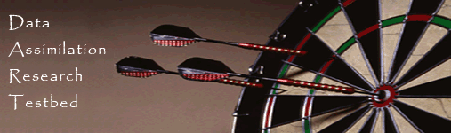
Data Assimilation Research Testbed Tutorial
Section 1: Introduction

Slide 2


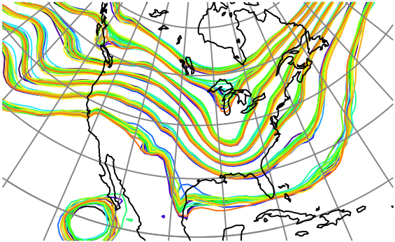
What is Data Assimilation?
Observations
Observations combined with a Model forecast…
+
…to produce an analysis
(best possible estimate).
DART-LAB Tutorial -- June 09

Slide 3
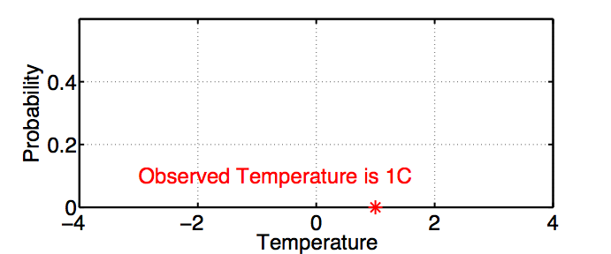
Example: Estimating the Temperature Outside
An observation has a value ( ∗ ),
DART-LAB Tutorial -- June 09

Slide 4
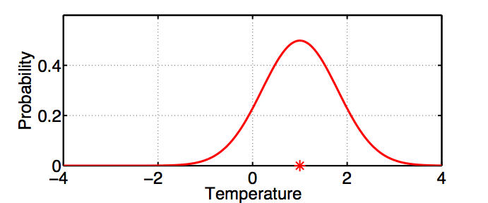
Example: Estimating the Temperature Outside
An observation has a value ( ∗ ),
and an error distribution (red curve) that is associated with the instrument.
DART-LAB Tutorial -- June 09

Slide 5
Example: Estimating the Temperature Outside
Thermometer outside measures 1C.
Instrument builder says thermometer is unbiased with +/- 0.8C gaussian error.
DART-LAB Tutorial -- June 09

Slide 6
Example: Estimating the Temperature Outside
Thermometer outside measures 1C.
The red plot is , probability of temperature given that T_{o} was observed.
DART-LAB Tutorial -- June 09

Slide 7
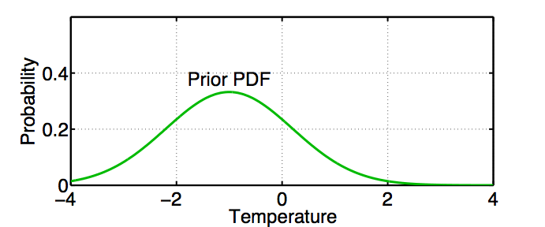
Example: Estimating the Temperature Outside
We also have a prior estimate of temperature.
The green curve is ; probability of temperature given all available prior information .
DART-LAB Tutorial -- June 09

Slide 8
Example: Estimating the Temperature Outside
Prior information can include:
Observations of things besides T;
Model forecast made using observations at earlier times;
A priori physical constraints ( T > -273.15C );
Climatological constraints ( -30C < T < 40C ).
DART-LAB Tutorial -- June 09

Slide 9
Combining the Prior Estimate and Observation
Bayes Theorem:
Prior
Posterior: Probability of T given observations and Prior. Also called update or analysis.
Likelihood: Probability that T_{o} is observed if T is true value and given prior information C.
DART-LAB Tutorial -- June 09

Slide 10
Combining the Prior Estimate and Observation
Rewrite Bayes as:
Denominator normalizes so Posterior is PDF.
DART-LAB Tutorial -- June 09

Slide 11
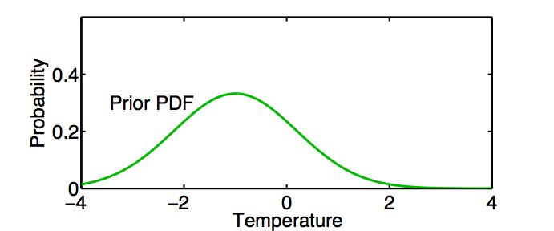
Combining the Prior Estimate and Observation
P
(
T
|
T
,
C
)
P
(
T
|
C
)
P
(
T
|
T
,
C
)
=
o
o
normalization
DART-LAB Tutorial -- June 09

Slide 12
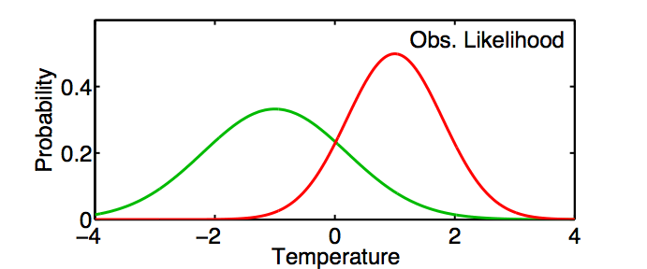
Combining the Prior Estimate and Observation
P
(
T
|
T
,
C
)
P
(
T
|
C
)
P
(
T
|
T
,
C
)
=
o
o
normalization
DART-LAB Tutorial -- June 09

Slide 13
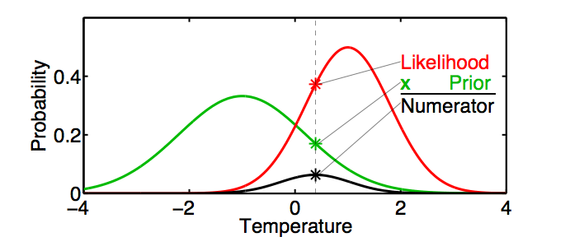
Combining the Prior Estimate and Observation
P
(
T
|
T
,
C
)
P
(
T
|
C
)
P
(
T
|
T
,
C
)
=
o
o
normalization
DART-LAB Tutorial -- June 09

Slide 14
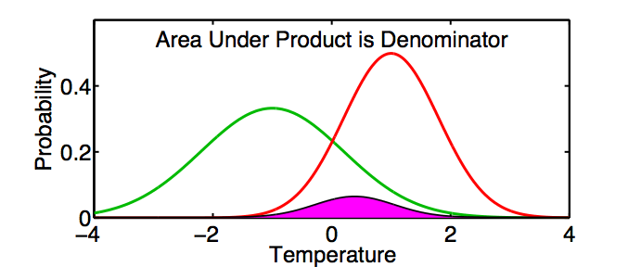
Combining the Prior Estimate and Observation
P
(
T
|
T
,
C
)
P
(
T
|
C
)
P
(
T
|
T
,
C
)
=
o
o
normalization
DART-LAB Tutorial -- June 09

Slide 15
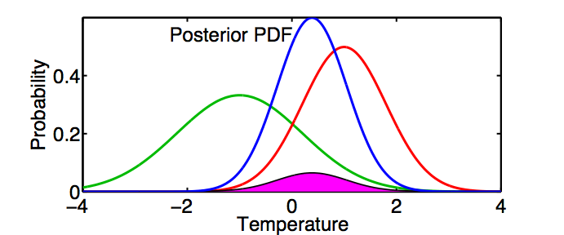
Combining the Prior Estimate and Observation
P
(
T
|
T
,
C
)
P
(
T
|
C
)
P
(
T
|
T
,
C
)
=
o
o
normalization
DART-LAB Tutorial -- June 09

Slide 16
Consistent Color Scheme Throughout Tutorial
Green = Prior
Red = Observation
Blue = Posterior
Black = Truth
(truth available only for ‘perfect model’ examples)
DART-LAB Tutorial -- June 09

Slide 17
Combining the Prior Estimate and Observation
P
(
T
|
T
,
C
)
P
(
T
|
C
)
P
(
T
|
T
,
C
)
=
o
o
normalization
Generally no analytic solution for Posterior.
DART-LAB Tutorial -- June 09

Slide 18
Combining the Prior Estimate and Observation
P
(
T
|
T
,
C
)
P
(
T
|
C
)
P
(
T
|
T
,
C
)
=
o
o
normalization
Gaussian Prior and Likelihood -> Gaussian Posterior
DART-LAB Tutorial -- June 09

Slide 19
Combining the Prior Estimate and Observation
For Gaussian prior and likelihood…
Prior
Likelihood
Then, Posterior
With
DART-LAB Tutorial -- June 09

Slide 20
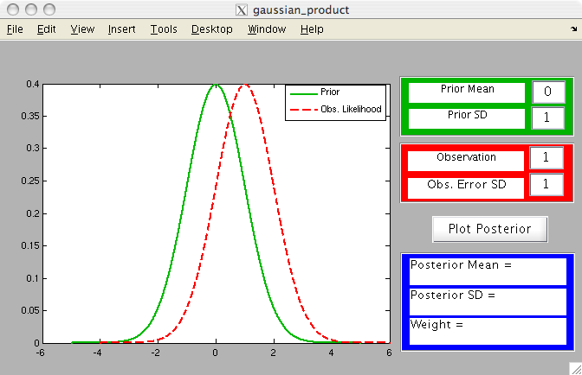
Matlab Hands-On: gaussian_product
Purpose: Explore the gaussian posterior that results from taking the product of a gaussian prior and a gaussian likelihood.
DART-LAB Tutorial -- June 09

Slide 21
Matlab Hands-On: gaussian_product
Procedure:
Use the green dialog boxes to set the prior mean and standard deviation.
Use the red dialog boxes to set the observation likelihood mean and standard deviation.
Select Plot Posterior to plot the posterior.
The blue boxes show the posterior mean and standard deviation and the weight for the product.
DART-LAB Tutorial -- June 09

Slide 22
Matlab Hands-On: gaussian_product
Explorations:
Change the mean values of the prior and likelihood.
Change the standard deviation of the prior.
What is always true for the mean of the posterior?
What is always true for the standard deviation of the posterior?
DART-LAB Tutorial -- June 09

Slide 23
The One-Dimensional Kalman Filter
Suppose we have a linear forecast model L
  If temperature at time t₁ = T_{1,} then
  temperature at t₂ = t₁ + Δt is T₂ = L(T₁)
  Example: T₂ = T₁ + ΔtT₁
DART-LAB Tutorial -- June 09

Slide 24
The One-Dimensional Kalman Filter
Suppose we have a linear forecast model L.
  If temperature at time t₁ = T_{1,} then
  temperature at t₂ = t₁ + Δt is T₂ = L(T₁).
  Example: T₂ = T₁ + ΔtT₁ .
If posterior estimate at time t₁ is Normal(T_{u,1}, σ_{u,1}) then
prior at t₂ is Normal(T_{p,2}, σ_{p,2}).
  T_{p,2} = T_{u,1},+ ΔtT_{u,1}
  σ_{p,2} = (Δt + 1) σ_{u,1}
DART-LAB Tutorial -- June 09

Slide 25
The One-Dimensional Kalman Filter
Suppose we have a linear forecast model L.
  If temperature at time t₁ = T_{1,} then
  temperature at t₂ = t₁ + Δt is T₂ = L(T₁).
  Example: T₂ = T₁ + ΔtT₁ .
If posterior estimate at time t₁ is Normal(T_{u,1}, σ_{u,1}) then
prior at t₂ is Normal(T_{p,2}, σ_{p,2}).
Given an observation at t₂ with distribution Normal(t_{o}, σ_{o})
the likelihood is also Normal(t_{o}, σ_{o}).
DART-LAB Tutorial -- June 09

Slide 26
The One-Dimensional Kalman Filter
Suppose we have a linear forecast model L.
  If temperature at time t₁ = T_{1,} then
  temperature at t₂ = t₁ + Δt is T₂ = L(T₁).
  Example: T₂ = T₁ + ΔtT₁ .
If posterior estimate at time t₁ is Normal(T_{u,1}, σ_{u,1}) then
prior at t₂ is Normal(T_{p,2}, σ_{p,2}).
Given an observation at t₂ with distribution Normal(t_{o}, σ_{o})
the likelihood is also Normal(t_{o}, σ_{o}).
The posterior at t₂ is Normal(T_{u,2}, σ_{u,2}) where T_{u,2} and σ_{u,2} come from page 19.
DART-LAB Tutorial -- June 09

Slide 27
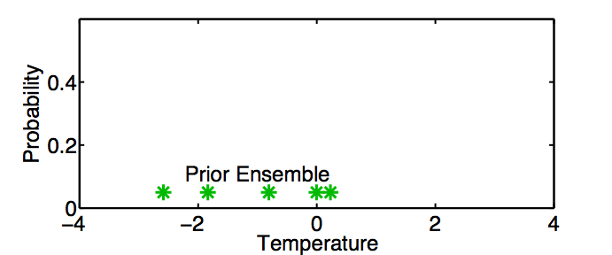
A One-Dimensional Ensemble Kalman Filter
Represent a prior pdf by a sample (ensemble) of N values:
DART-LAB Tutorial -- June 09

Slide 28
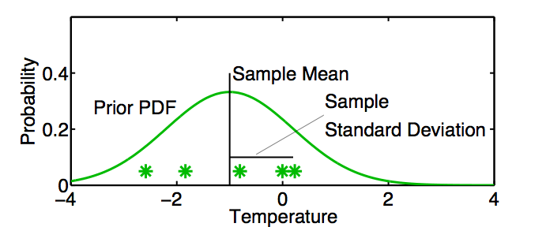
A One-Dimensional Ensemble Kalman Filter
Represent a prior pdf by a sample (ensemble) of N values:
Use sample mean
and sample standard deviation
to determine a corresponding continuous distribution
DART-LAB Tutorial -- June 09

Slide 29
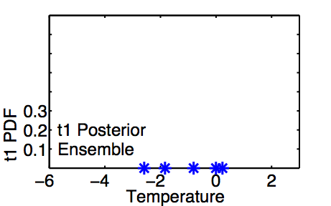
A One-Dimensional Ensemble Kalman Filter:
Model Advance
If posterior ensemble at time t₁ is T_{1,n}, n = 1, …, N
DART-LAB Tutorial -- June 09

Slide 30
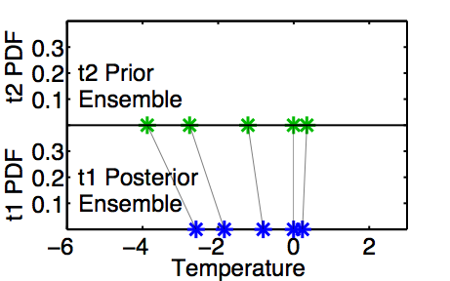
A One-Dimensional Ensemble Kalman Filter:
Model Advance
If posterior ensemble at time t₁ is T_{1,n}, n = 1, …, N ,
advance each member to time t₂ with model, T_{2,n} = L(T_{1, n}) n = 1, …,N .
DART-LAB Tutorial -- June 09

Slide 31
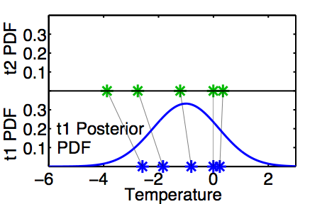
A One-Dimensional Ensemble Kalman Filter:
Model Advance
Same as advancing continuous pdf at time t₁ …
DART-LAB Tutorial -- June 09

Slide 32
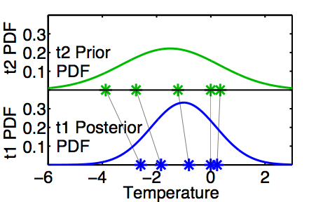
A One-Dimensional Ensemble Kalman Filter:
Model Advance
Same as advancing continuous pdf at time t₁
to time t₂ with model L.
DART-LAB Tutorial -- June 09

Slide 33
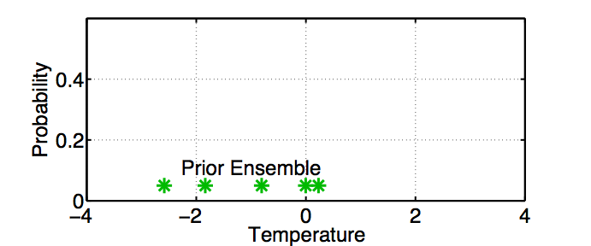
A One-Dimensional Ensemble Kalman Filter:
Assimilating an Observation
DART-LAB Tutorial -- June 09

Slide 34
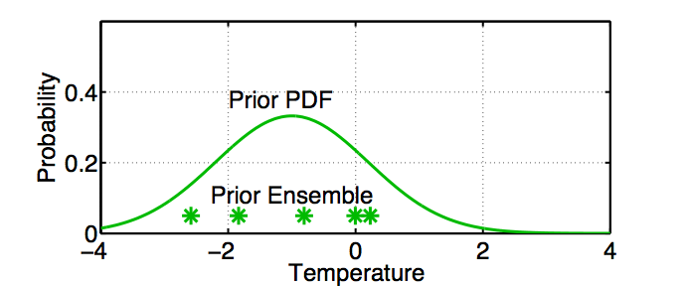
A One-Dimensional Ensemble Kalman Filter:
Assimilating an Observation
Fit a Gaussian to the sample.
DART-LAB Tutorial -- June 09

Slide 35
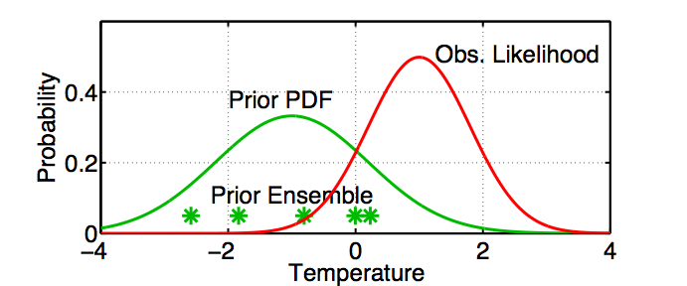
A One-Dimensional Ensemble Kalman Filter:
Assimilating an Observation
Get the observation likelihood.
DART-LAB Tutorial -- June 09

Slide 36
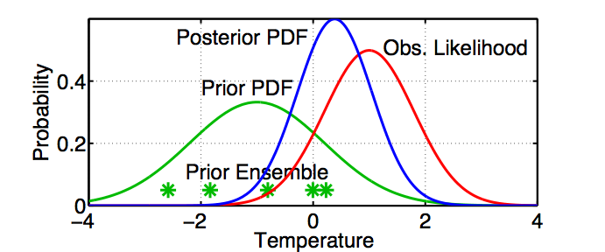
A One-Dimensional Ensemble Kalman Filter:
Assimilating an Observation
Compute the continuous posterior PDF.
DART-LAB Tutorial -- June 09

Slide 37
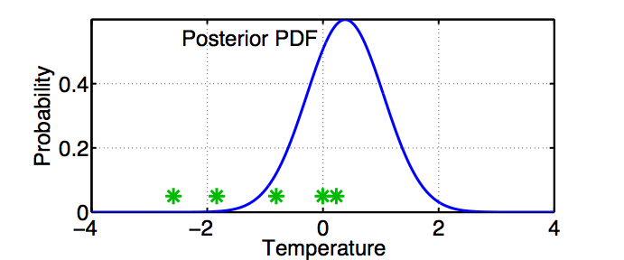
A One-Dimensional Ensemble Kalman Filter:
Assimilating an Observation
Use a deterministic algorithm to ‘adjust’ the ensemble.
DART-LAB Tutorial -- June 09

Slide 38
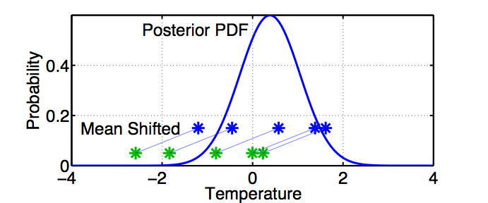
A One-Dimensional Ensemble Kalman Filter:
Assimilating an Observation
First, ‘shift’ the ensemble to have the exact mean of the posterior.
DART-LAB Tutorial -- June 09

Slide 39
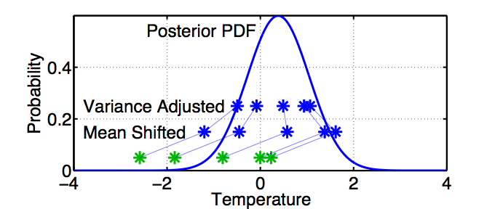
A One-Dimensional Ensemble Kalman Filter:
Assimilating an Observation
First, ‘shift’ the ensemble to have the exact mean of the posterior.
Second, linearly contract to have the exact variance of the posterior.
Sample statistics are identical to Kalman filter.
DART-LAB Tutorial -- June 09

Slide 40
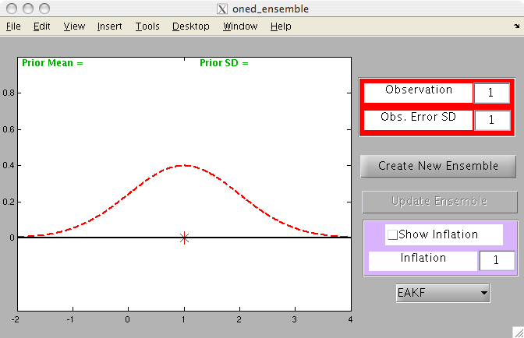
Matlab Hands-On: oned_ensemble
Purpose: Explore how ensemble filters update a prior ensemble.
DART-LAB Tutorial -- June 09

Slide 41
Matlab Hands-On: oned_ensemble
Procedure:
The observation likelihood mean and standard deviation can be changed with the red dialog boxes.
To create a prior ensemble:
  Select Create New Ensemble .
  Click on the axis in the figure to create an ensemble member. Repeat a few times.
  Click on a gray area of the figure to finish ensemble.
  Select Update Ensemble to see the updated ensemble.
Ignore the inflation box and EAKF pulldown for now.
DART-LAB Tutorial -- June 09

Slide 42
Matlab Hands-On: oned_ensemble
Procedure (cont):
The pull-down menu allows you to select different ensemble filter algorithms.
DART-LAB Tutorial -- June 09

Slide 43
Matlab Hands-On: oned_ensemble
Procedure (cont):
The pull-down menu allows you to select different ensemble filter algorithms.
  The EAKF (Ensemble Adjustment KF) is the update method described here.
  The EnKF (Ensemble KF) is a stochastic update method that approximates the KF.
  The RHF (Rank Histogram Filter) is a non-gaussian update method.
DART-LAB Tutorial -- June 09

Slide 44
Matlab Hands-On: oned_ensemble
Explorations:
Keep your ensembles small, less than 10, for easy viewing.
Create a nearly uniformly spaced ensemble. Examine the update.
What happens with an ensemble that is confined to one side of the likelihood?
What happens with a bimodal ensemble (two clusters of members on either side)?
What happens with a single outlier in the ensemble?
DART-LAB Tutorial -- June 09

Slide 45
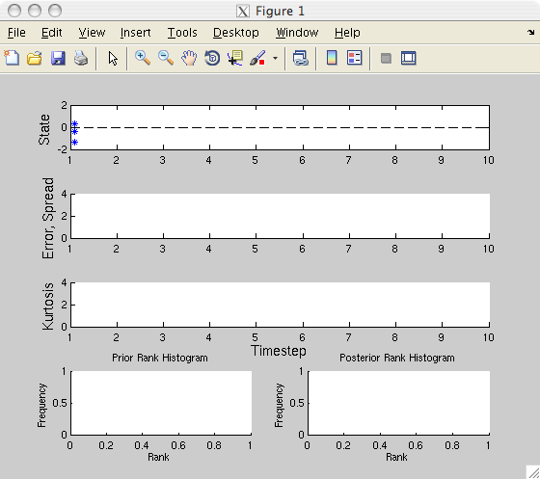
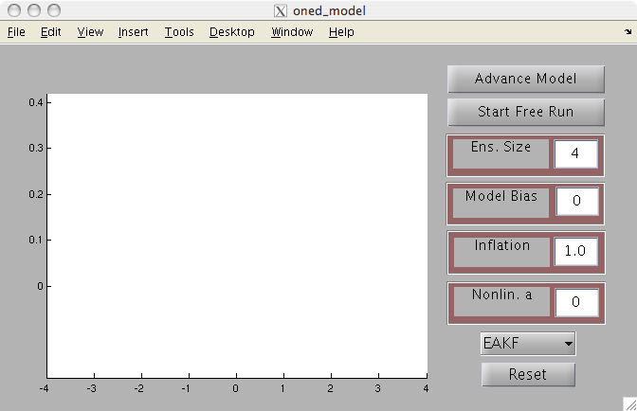
Matlab Hands-On: oned_model
Purpose: Explore the behavior of a complete 1-dimensional ensemble filter for a linear system.
Look at the behavior of different ensemble sizes.
DART-LAB Tutorial -- June 09

Slide 46
Matlab Hands-On: oned_model
Procedure:
This script opens two windows: the menu window and a diagnostic window.
To see individual model advance and assimilation steps, select the top button on the menu window (it will alternate between Advance Model and Assimilate Obs ).
Selecting Start Free Run starts a sequence of advance and assimilation steps.
Selecting Stop Free Run stops the sequence of steps.
The ensemble size can be changed with a dialog box.
Selecting Reset restarts the exercise.
Notes: This uses the simple linear model dx/dt = x.
The ‘truth’ is always 0.
Observation noise is a draw from a unit normal.
DART-LAB Tutorial -- June 09

Slide 47
Matlab Hands-On: oned_model
What do I see?
The graphics window on the GUI window displays details of the latest assimilation step. The prior and posterior ensemble, the observation, and the truth are plotted.
The diagnostic window has 5 panels. The top panel shows the evolution of the ensemble with posteriors in blue, model advances in green, and observations in red. The second panel shows the error (absolute value of the difference between the ensemble mean and the truth) in blue and the ensemble spread (standard deviation) in red.
The third panel displays the ensemble kurtosis (more on this later).
The two bottom panels have rank histograms (details later).
DART-LAB Tutorial -- June 09

Slide 48
Matlab Hands-On: oned_model
Explorations:
Step through a sequence of advances and assimilations with the top button. Watch the evolution of the ensemble, the error and spread.
How does a larger ensemble size ( < 10 is easiest to see) act?
Compare the error and spread for different ensemble sizes.
Note the time behavior of the error and spread.
3. Let the model run freely using the second button.
DART-LAB Tutorial -- June 09

Slide 49
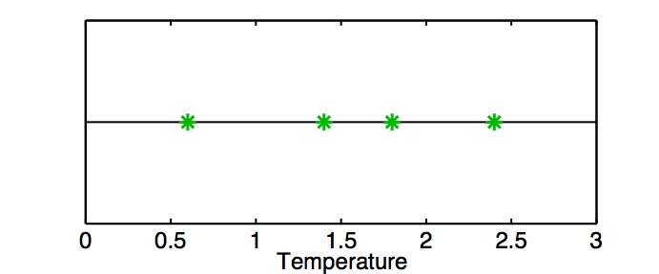
The Rank Histogram: Evaluating Ensemble Performance
Draw 5 values from a real-valued distribution.
Call the first 4 ‘ensemble members’.
DART-LAB Tutorial -- June 09

Slide 50
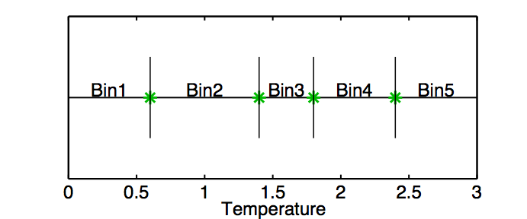
The Rank Histogram: Evaluating Ensemble Performance
These partition the real line into 5 bins.
DART-LAB Tutorial -- June 09

Slide 51
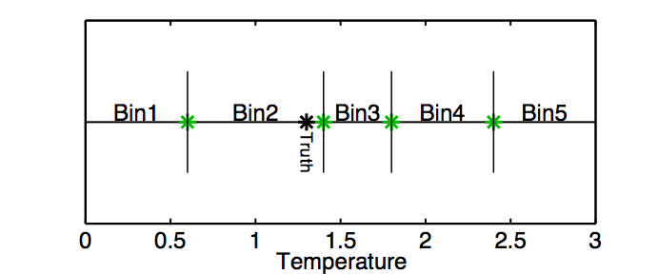
The Rank Histogram: Evaluating Ensemble Performance
Call the 5th draw the ‘truth’.
1/5 chance that this is in any given bin.
DART-LAB Tutorial -- June 09

Slide 52
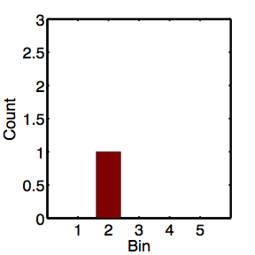
The Rank Histogram: Evaluating Ensemble Performance
Rank histogram shows the frequency of the truth in each bin over many assimilations.
DART-LAB Tutorial -- June 09

Slide 53
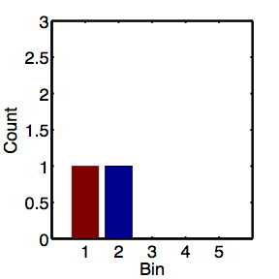
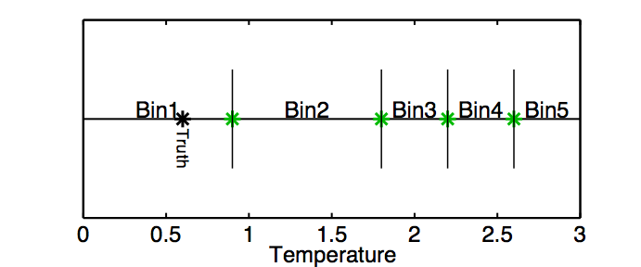
The Rank Histogram: Evaluating Ensemble Performance
Rank histogram shows the frequency of the truth in each bin over many assimilations.
DART-LAB Tutorial -- June 09

Slide 54
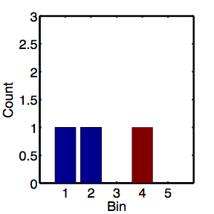
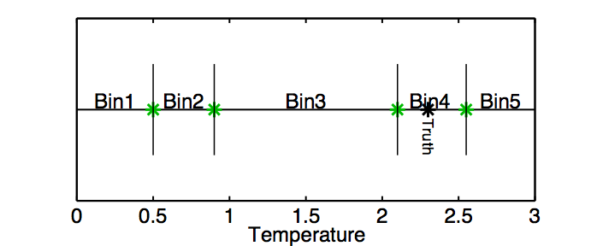
The Rank Histogram: Evaluating Ensemble Performance
Rank histogram shows the frequency of the truth in each bin over many assimilations.
DART-LAB Tutorial -- June 09

Slide 55
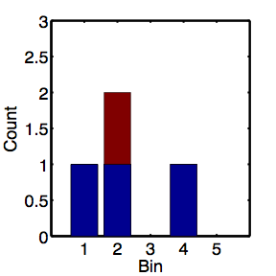
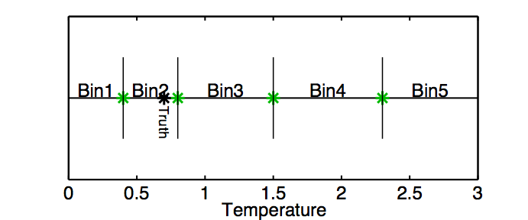
The Rank Histogram: Evaluating Ensemble Performance
Rank histogram shows the frequency of the truth in each bin over many assimilations.
DART-LAB Tutorial -- June 09

Slide 56
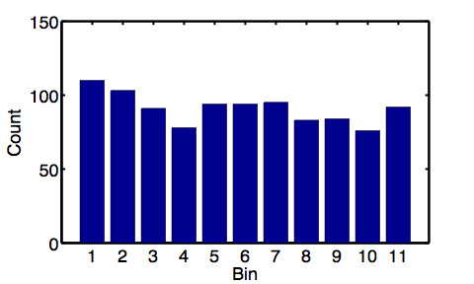
The Rank Histogram: Evaluating Ensemble Performance
Rank histograms for good ensembles should be uniform (caveat sampling noise).
Want truth to look like random draw from ensemble.
DART-LAB Tutorial -- June 09

Slide 57
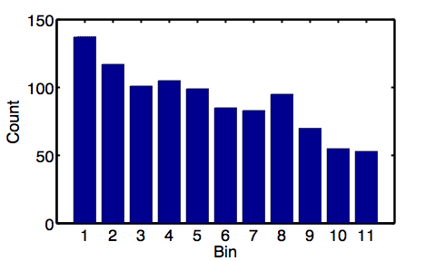
The Rank Histogram: Evaluating Ensemble Performance
A biased ensemble leads to skewed histograms.
DART-LAB Tutorial -- June 09

Slide 58
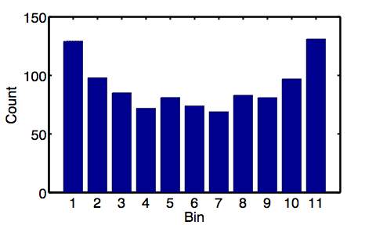
The Rank Histogram: Evaluating Ensemble Performance
An ensemble with too little spread gives a u-shape.
This is the most common behavior for geophysics.
DART-LAB Tutorial -- June 09

Slide 59
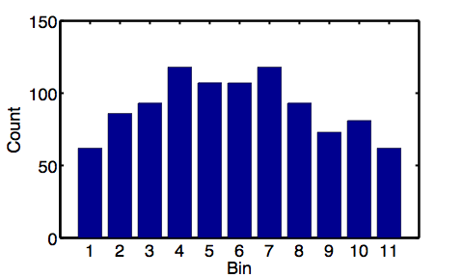
The Rank Histogram: Evaluating Ensemble Performance
An ensemble with too much spread is peaked in the center.
DART-LAB Tutorial -- June 09

Slide 60
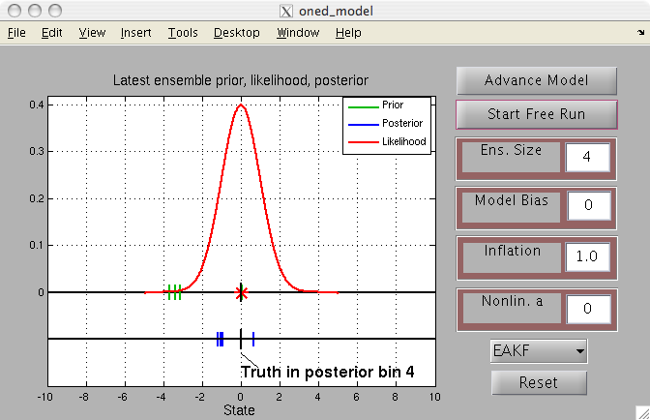
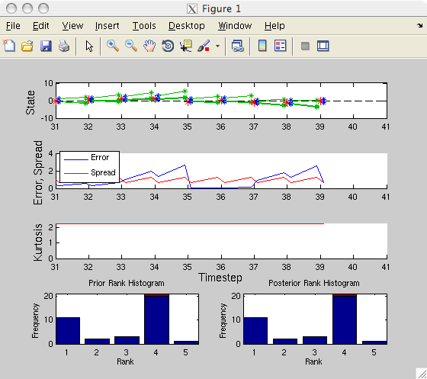
Matlab Hands-On: oned_model (2)
Purpose: Understand rank historgram diagnostics.
Explore the impact of a biased model.
Explore the impact of a nonlinear model.
DART-LAB Tutorial -- June 09

Slide 61
Matlab Hands-On: oned_model (2)
Procedure:
This script opens two windows: the menu window and a diagnostic window.
To see individual model advance and assimilation steps, select the top button on the menu window (it will alternate between Advance Model and Assimilate Obs ).
The ensemble size can be changed with a dialog box.
A model bias can be set with a dialog box.
An additional non-linear term can be added to the model with a dialog box.
Notes: Model bias is dx/dt = x + bias.
Non-linear model is dx/dt = x + a x |x|. Super-exponential growth.
Truth is still always 0.
See matlab script advance_oned.m for details.
DART-LAB Tutorial -- June 09

Slide 62
Matlab Hands-On: oned_model (2)
What do I see?
The graphics window on the GUI window displays details of the latest assimilation step. Note the rank histogram bin for the truth is labeled.
The diagnostic window has 5 panels. The two bottom panels have rank histograms for the prior and posterior ensembles. The entry for the most recent observation is in red.
DART-LAB Tutorial -- June 09

Slide 63
Matlab Hands-On: oned_model (2)
Explorations:
Step through a sequence of advances and assimilations with the top button. Watch the evolution of the rank histogram bins.
2. Add some model bias (less than 1 to start) and see how the filter responds.
3. Add some nonlinearity ( < 1 ) to the model. How do the different filters respond?
4. Can you break the filter (find setting so that the ensemble moves away from zero) with the options explore so far?
DART-LAB Tutorial -- June 09

Slide 64
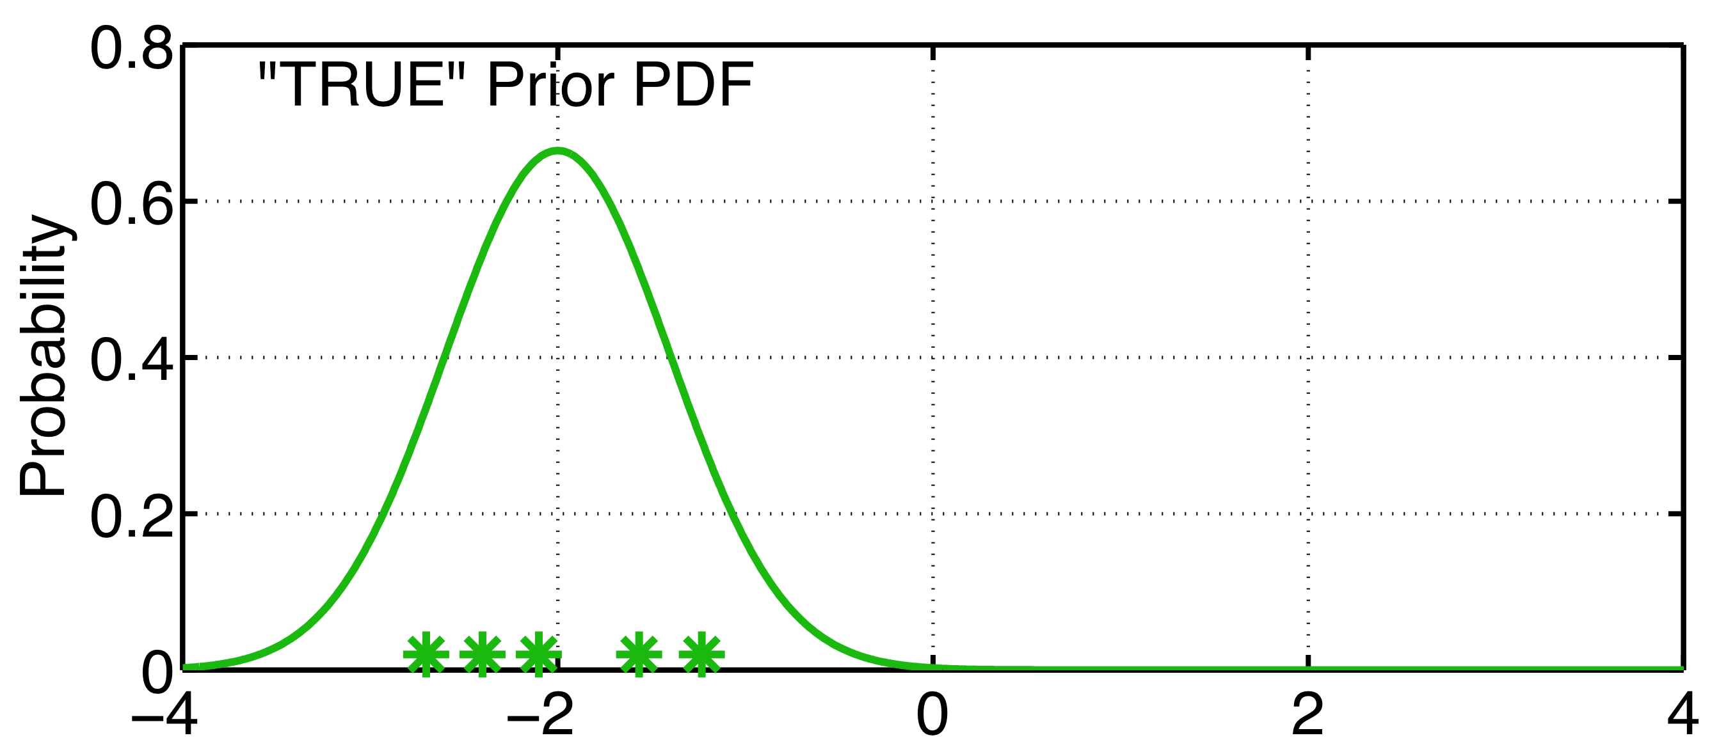
Dealing with systematic error: Variance Inflation
Observations + physical system => ‘true’ distribution.
DART-LAB Tutorial -- June 09

Slide 65
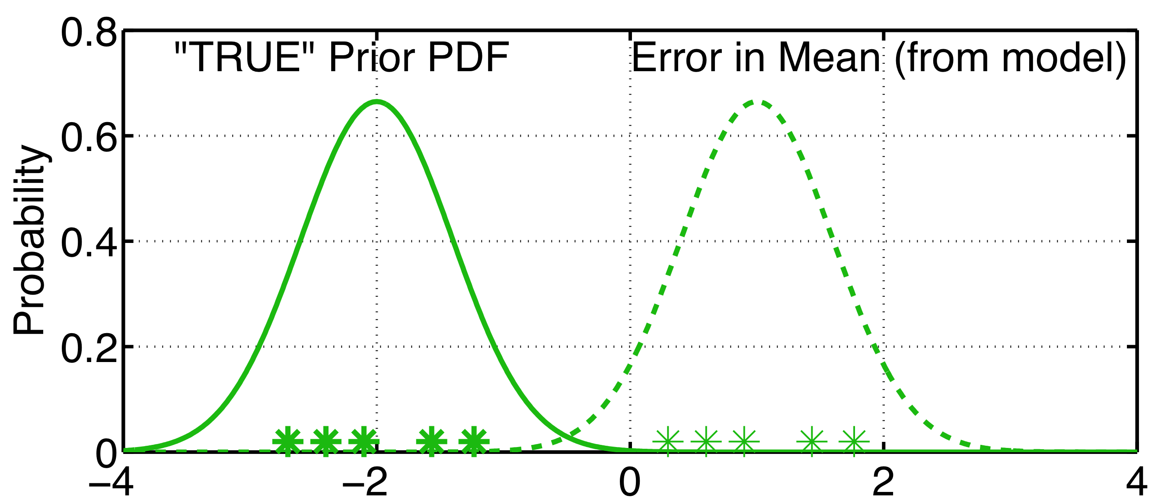
Dealing with systematic error: Variance Inflation
Observations + physical system => ‘true’ distribution.
Model bias (and other errors) can shift actual prior.
Prior ensemble is too certain (needs more spread).
DART-LAB Tutorial -- June 09

Slide 66
Dealing with systematic error: Variance Inflation
Could correct error if we knew what it was.
With large models, can’t know error precisely.
DART-LAB Tutorial -- June 09

Slide 67
Dealing with systematic error: Variance Inflation
Taking no action can cause observations to be ignored.
DART-LAB Tutorial -- June 09

Slide 68
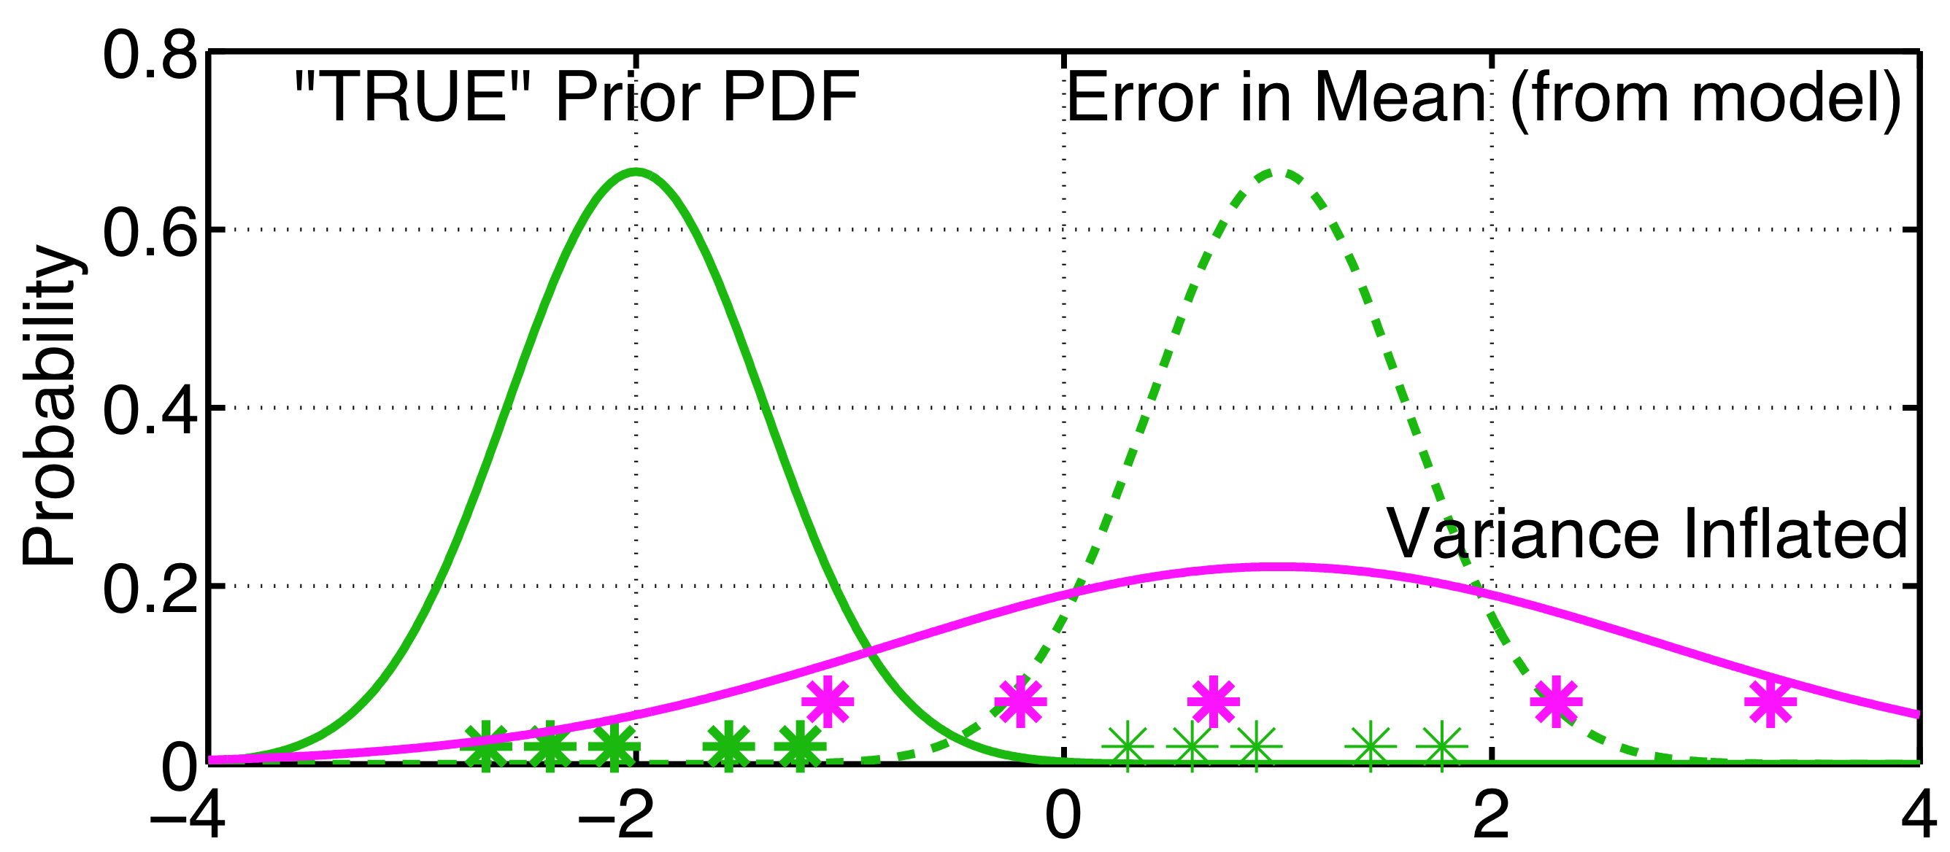
Dealing with systematic error: Variance Inflation
Naïve solution: increase the spread in the prior.
Give more weight to the observation, less to prior.
DART-LAB Tutorial -- June 09

Slide 69
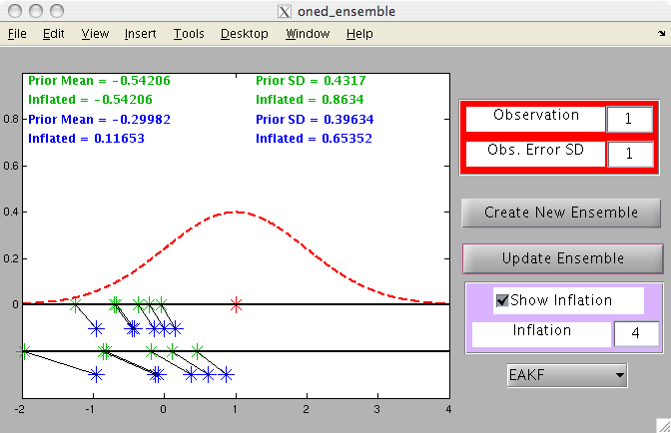
Matlab Hands-On: oned_ensemble (2)
Purpose: Explore how inflating the prior ensemble impacts the posterior ensemble.
DART-LAB Tutorial -- June 09

Slide 70
Matlab Hands-On: oned_ensemble (2)
Procedure:
To create a prior ensemble:
  Select Create New Ensemble .
  Click on the axis in the figure to create an ensemble member. Repeat a few times.
  Click on a gray area of the figure to finish ensemble.
  Select Update Ensemble to see the updated ensemble.
Select Show Inflation before Update Ensemble to see inflated prior and posterior and statistics.
DART-LAB Tutorial -- June 09

Slide 71
Matlab Hands-On: oned_ensemble (2)
Procedure:
To create a prior ensemble:
  Select Create New Ensemble .
  Click on the axis in the figure to create an ensemble member. Repeat a few times.
  Click on a gray area of the figure to finish ensemble.
  Select Update Ensemble to see the updated ensemble.
Select Show Inflation before Update Ensemble to see inflated prior and posterior and statistics.
DART-LAB Tutorial -- June 09

Slide 72
Matlab Hands-On: oned_ensemble (2)
Explorations:
See how increasing inflation (> 1) changes the posterior mean and standard deviation.
Look at priors that are not shifted but have small spread compared to the observation error distribution.
Look at priors that are shifted from the observation.
DART-LAB Tutorial -- June 09

Slide 73
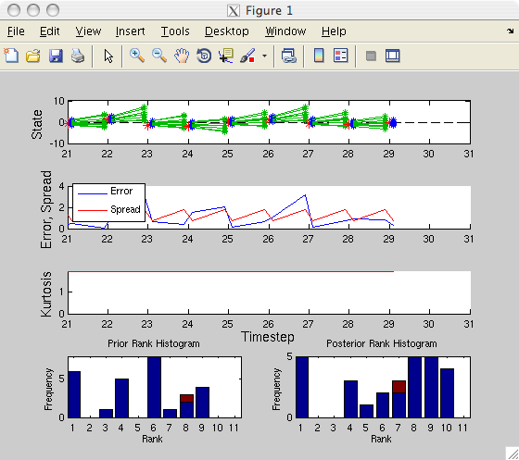

Matlab Hands-On: oned_model (3)
Purpose: Explore the use of inflation to deal with model systematic error.
DART-LAB Tutorial -- June 09

Slide 74
Matlab Hands-On: oned_model (3)
Procedure:
This script opens two windows: the menu window and a diagnostic window.
Set the Model Bias to some value like 1.
Run an assimilation and observe the error, spread, and rank histograms.
Add some Inflation (try starting with 1.5) and observe how behavior changes.
What happens with too much inflation?
Remember: This uses the simple linear model dx/dt = x.
The ‘truth’ is always 0.
Observation noise is a draw from a unit normal.
The spread is increased by the square root of the inflation.
DART-LAB Tutorial -- June 09

Slide 75
Matlab Hands-On: oned_model (3)
What do I see?
The graphics window on the GUI window displays details of the latest assimilation step. The prior and posterior ensemble, the observation, and the truth are plotted.
The diagnostic window has 5 panels. The top panel shows the evolution of the ensemble with posteriors in blue, model advances in green, and observations in red. The second panel shows the error (absolute value of the difference between the ensemble mean and the truth) in blue and the ensemble spread (standard deviation) in red.
The third panel displays the ensemble kurtosis (more on this later).
The two bottom panels have rank histograms (details later).
DART-LAB Tutorial -- June 09

Slide 76
Matlab Hands-On: oned_model (3)
Explorations:
Step through a sequence of advances and assimilations with the top button. Watch the evolution of the ensemble, the error and spread.
How does a larger ensemble size ( < 10 is easiest to see) act?
Compare the error and spread for different ensemble sizes.
Note the time behavior of the error and spread.
3. Let the model run freely using the second button.
DART-LAB Tutorial -- June 09

