Slide 1
SST Differences Between Old and New ¼ degree, Daily AVHRR data sets

Slide 2
Intro
This analysis concerns RDA ds277.7.
We discovered that the old version described the time variable as being valid at noon,
but also “days since 1978-01-01 00Z” and the times were whole numbers.
Those files have names like avhrr-only-v2.YYYYMMDD.nc.
Those now live in /gpfs/fs1/collections/rda/decsdata/ds277.7/V/avhrr/YYYY.
They end in mid 2020.
Discussion with the NOAA folks led to the conclusion that the “days since” metadata was wrong, so they generated a new replacement data set with “days since 1978-01-01 12Z”, and still having times that are whole numbers.
File names: oisst-avhrr-v02r01.YYYYMMDD.nc.
Location: /gpfs/fs1/collections/rda/data/ds277.7/avhrr_v2.1/YYYY
That should have been the only difference between the old and new data sets,
but it isn’t. The fields themselves are different, and they could never explain why.
Ben has discovered that there’s a paper about the differences.

Slide 3
2 Timelines
Old; avhrr-only-v2
12Z “data valid here”
1978-01-01
00Z
time 0.0
inconsistent with 00Z reference time
time 1.0 = 1.5 days later than the reference time
We checked that CAM picked the
right time slots. We can’t say
for sure that the data was truly valid
at those times.
New; oisst-avhrr—v02r01
Mitigating factor; data at a time slot
is smoothed with the previous
and next days’ data.
12Z data valid here
1978-01-01
12Z
time 0.0
time 1.0 = 1 day later than the reference time

Slide 4
NCAR_v02r01-v2.20191231; difference of supposedly the same time from the old and new datasets. Range is -6...+6

Slide 5
Is the data shifted by a day? NCAR_v02r01-v2.20191230-31; 12/30 from new - 12/31 old Range is -6...+8

Slide 6
Is the data shifted by a day? NCAR_v02r01-v2.20200101-31; Range is -4...+6

Slide 7
For comparison, the difference between successive days of the new dataset; smaller maxes than the previous 3 diffs. NCAR_oisst-avhrr-v02r01.20200101-191231; Range is -4...+5

Slide 8
For context; the old SST field. NCAR_avhrr-only-v2.20191231; Range is -1... 32

Slide 9
Deciding How to Proceed
The data sets are different.
We need to use the new one.
We may as well start at a clean boundary; the beginning of 2020.
But do we start from the old ICs (which used the old, 0Z, SST data set,
or ICs that have been spun up using the new, 12Z set?
Using the old ICs provides continuity in the state and forcing files, but includes a spinup period while they adjust to the new SSTs. How much noise is generated in the first 6 hours?
Using new ICs removes that spinup because the ICs are consistent with the new SSTs, but this makes a discontinuity in the state and forcing, which could cause problems in the surface model assims. How noticable is this in the forced files?
Investigate by using the 12Z SSTs in a 2019-12 spinup.
Look at the noise in the first 6 hours of that.
Then start 2020 using the spun up, 12Z SST, ICs and feed the results to the surface models.

Slide 10
The 2019-12, 12Z SST Spinup
Starts from the Reanalysis 2019-12-02-00000 restart set, including inflation files.
Extensive checks to make the case (Rean_SST12Z_2020) the same as the Reanalysis.
The only difference from the Rean. should be the SSTs, and I expected those to be largest near the surface, especially over the ocean, and maybe mostly in T.
But the largest diffs are in the wind fields in the middle troposphere.
Similar from 688-150 hPa

Slide 11
Is any of the lack of spinup due to the small number of obs?
313hPa is the only layer to show a notable spinup.

Slide 12
Source of the Spinup?
Differences are apparent in the ensemble mean of the first hindcast,
so it’s not due to the assimilation. Here’s the lowest level T difference
of the 12Z case relative to the Reanalysis.

Slide 13
Back 1 More Step; Recreate the Reanalysis, but Start on 2019-12-02-00000 (same SST file, same offset)
sign is opposite the previous figure due to different order of ncdiff args
Notable;
Diffs very small over ocean
Large diffs in coastal grid boxes
large diffs over many deserts, esp. SH (summer)
Not shown; very noisy U, V diffs over Scan- dinavia

Slide 14
Experiments
Reanalysis: f.e21.FHIST_BGC.f09_025.CAM6assim.011
New SST Dec Spinup: Rean_SST12Z_2020
Old SST Dec Spinup: Rean_SST0Z_2020 Mistaken attempt to reproduce 1; offset = 12 h should have been 0. I converted this $rundir to do the assimilation-only tests, starting from the Reanalysis “forecast” ensemble, so the SST offset is irrelevant to the results in here after the first ones.
Old SST Dec Spinup: Rean_SST0Z_nooffset. Offset consistent with what 1. used. Nov 29
Old SST Dec Spinup: Rean_SST0Z_fxd_clm_nml; all nml consistent w. 1. Dec 2
All experiments before 5. had very large (1000 Pa) differences which we saw 2+ months ago.
Experiments after 4. were mostly assimilation-only and showed small ( 3 Pa) diffs.
We did see large diffs after running the best setup (like 5. fxd_clm_nml) for a week, but the first cycle of that run showed O(3 Pa) differences. Details below.
# If a new case must be started exactly from an existing case,
# then 'hybrid' must be replaced by 'branch’,
# and the cam_####.r. files must be staged in RUNDIR.
# This will fix the CLM start, but may cause CAM to start differently than during
# an assimilation, since it's using(?) the restart file instead of the initial file.
Luckily, NO, the ‘forecast’ ens. mean file of the test is identical to the Reanalysis!

Slide 15
The forecast means are identical. On to the assimilation.
Things that I’ve made consistent between the Reanalysis and the Branch:
the same filter, built Jul 3 2019 (Reanalysis was run Aug 2020)
obs_seq.out file has not changed between Reanalysis and Branch
input.nml was copied from Reanalysis into Branch
same SST file (from old ds277.7)
assimilate.csh is the same except for
update of the file date string
different diagnostic statements and comments
more robust link of an initial file to cam_phis.nc
more careful purging of CESM’s restart history files (irrelevant)
The Reanalysis output mean file was extracted from the RDA archive. It was never compressed. Neither was the Branch output mean file.
Setups that are not consistent:
MPI_COMM_MAX = 16383 in the Reanalysis, but default (256?) in the Branch
MPI_GROUP_MAX = 1024 in the Reanalysis, but default (?) in the Branch.
env_batch.xml: 'submit_args: arg_flag=-k name=eod’ in the Reanalysis.
Cheyenne ...?

Slide 16
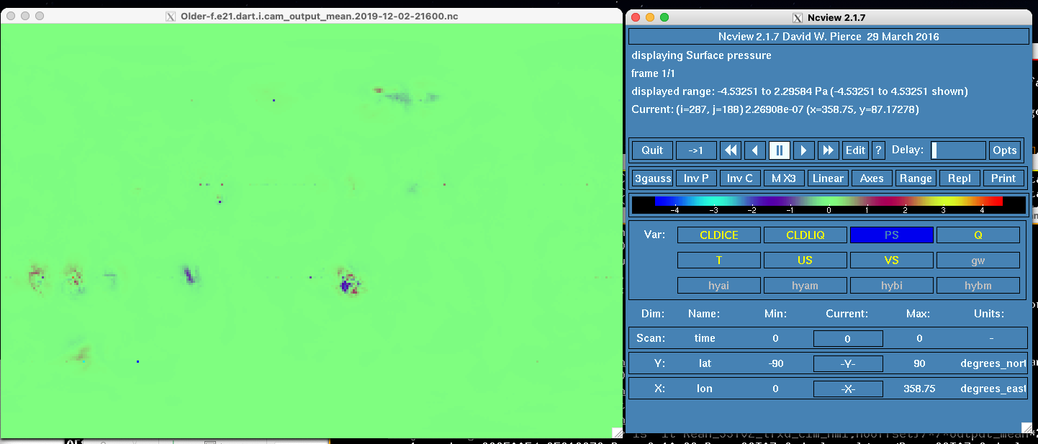
Diffs at 12-2 6Z; oldest filter exec. in _fxd_clm_nml
A full cycle, starting from 12-2 0Z Reanalysis restart files.
Hindcast reproduced b4b.
Assimilation used the oldest filter executable, which was likely (caveats) used in the Rean.
Run Dec 2, 2021

Slide 17
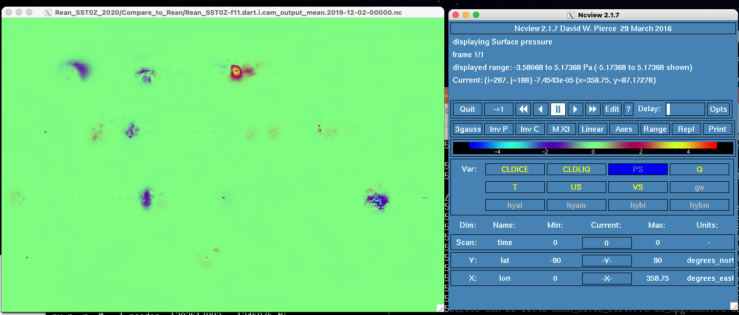
Assimilation-only tests at 12-2 0Z
Started from Reanalysis “forecast” ensemble (no hindcast here)
Ran it a 2nd time with no changes; it reproduced identically.
Run ~Jan 15

Slide 18
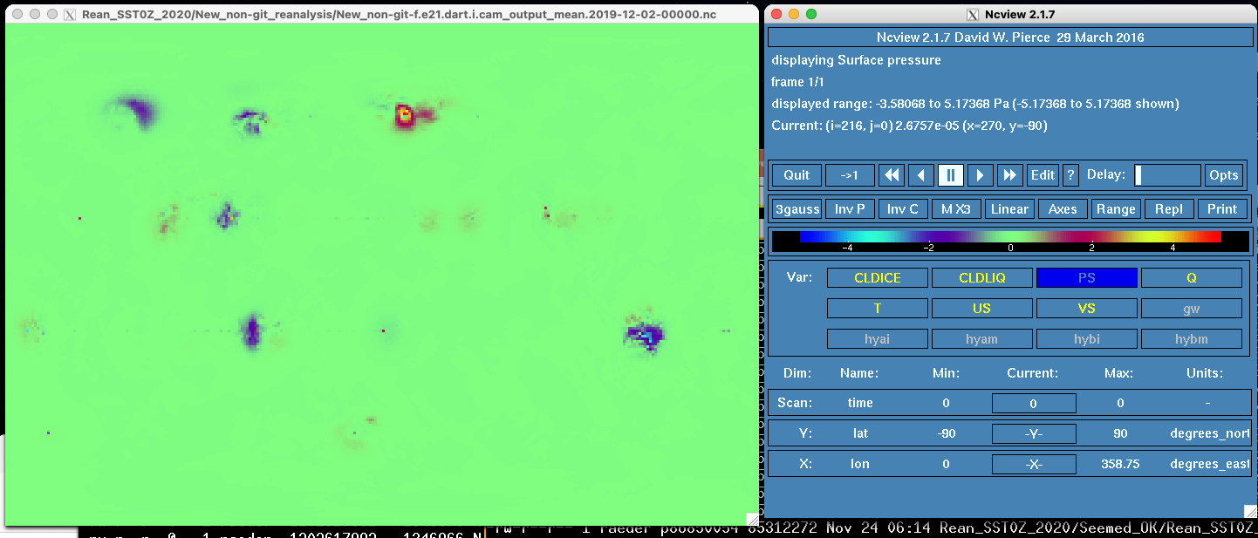
Assimilation-only; a new filter built in the SVN reanalysis directory
Run in the same $rundir as the previous experiment
with the filter executable replaced (I’ve checked several times).
Yes, it’s identical. Several other filters give the same results.
Run Jan 25

Slide 19
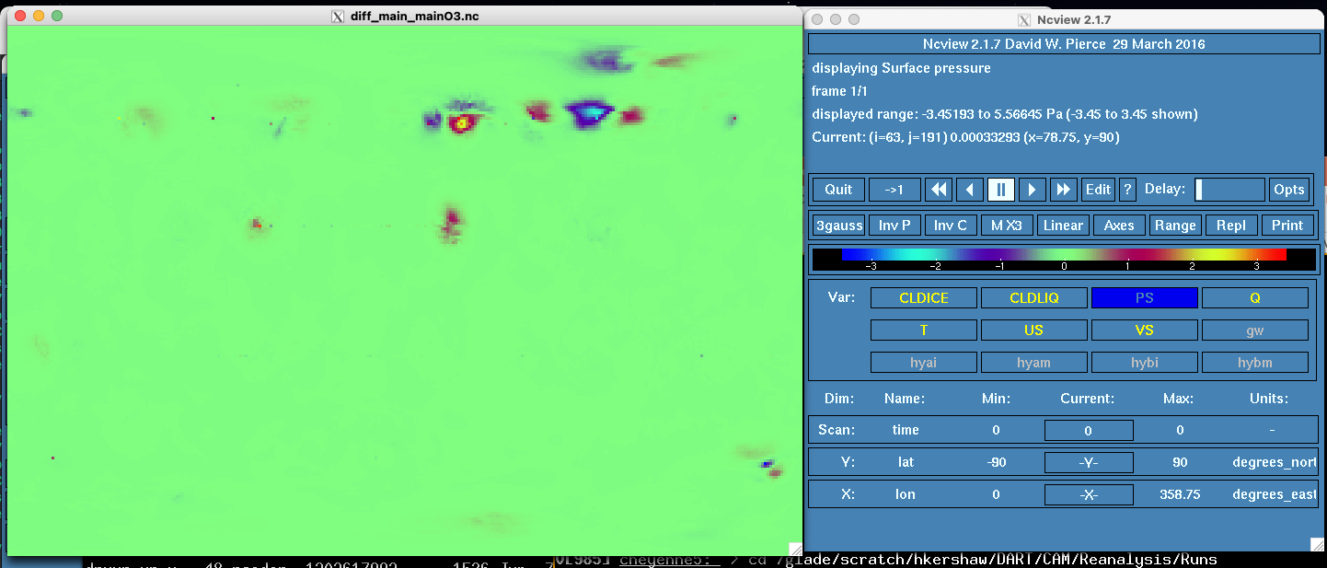
Helen’s comparison of filter compiler options
Same (but infl?) setup as my assimilation-only tests
-O2 –xHost vs -O3 - axavx
ncdiff Feb15.main/output_mean.nc Feb15.main.O3/output_mean.nc \
diff_main_mainO3.nc
If the filter used for Reanalysis were compiled with the “O3” options used here,
then this picture should be equivalent to my assim-only pictures.
The picture from the same experiment on the reanalysis branch is identical (flipped diff order)

Slide 20
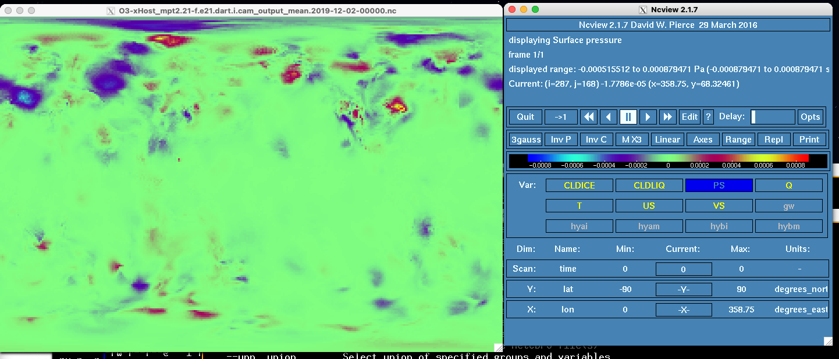
Closer! -O3 -xHost
This is the difference from the Reanalysis.
I don’t see the single point diffs along latitude lines
The diffs are more than 1000x smaller
The other assim-only experiments used –O2 –axavx,
mpt ?

Slide 21
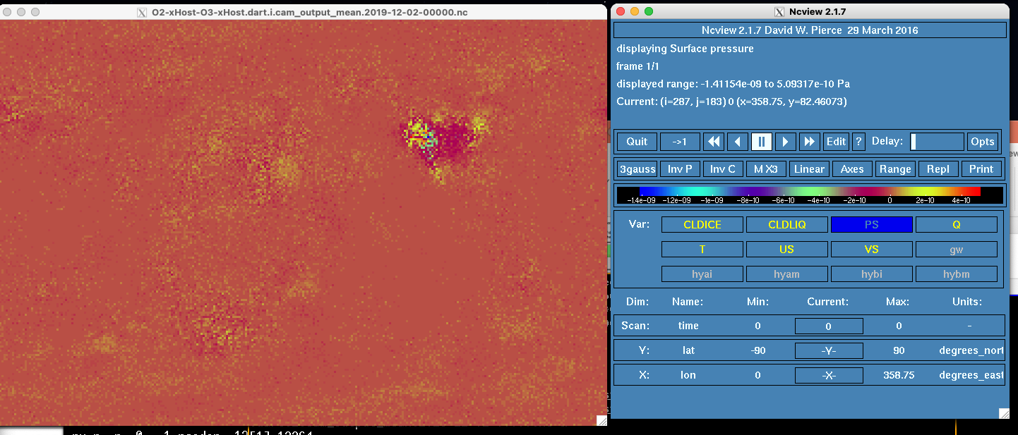
O2-xHost - O3-xHost

Slide 22
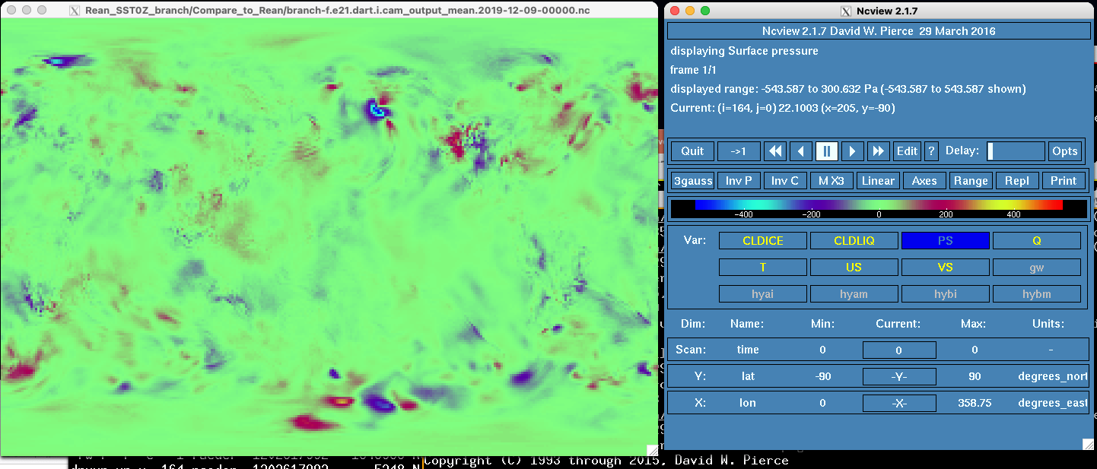
A week-long test
Used the oldest filter executable (but it seems to not matter much) and old SSTs (0Z)
Started from the Reanalysis restart files (not “forecast” ensemble) enabled by the b4b hindcast.
The first cycle PS diffs are just like the previous few slides.
Here’s 12-9 0Z (one week later)
Run Jan 29 (These are the largest diffs I generated since early Dec 2021)

Slide 23
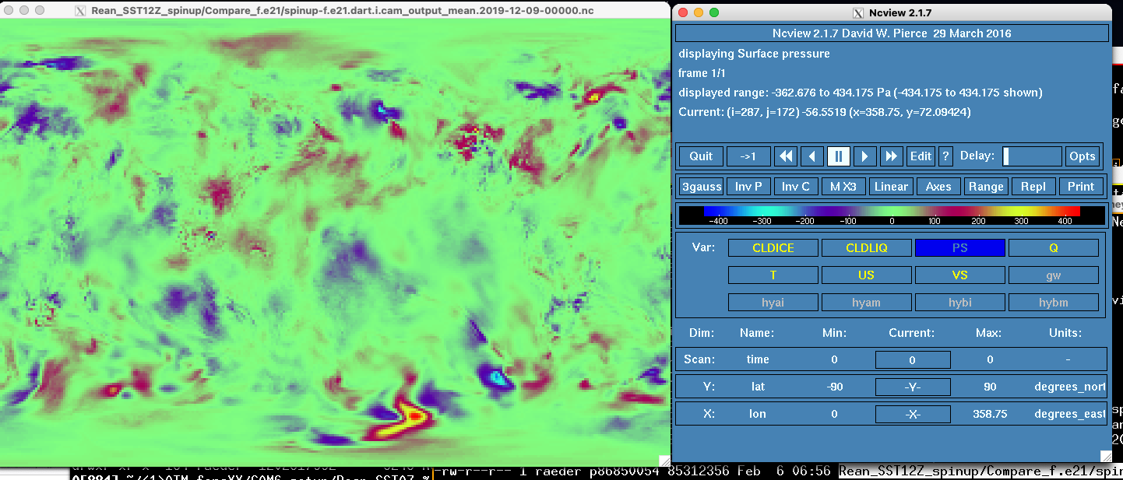
Another week-long test; New SSTs (12Z)
filter built with current system default modules, libraries.
Started the same as the previous week-long test.
Max diffs (compared to Reanalysis) are smaller than using the old SSTs and filter!
But the RMS differences may be essentially the same.
Run Feb 5

Slide 24
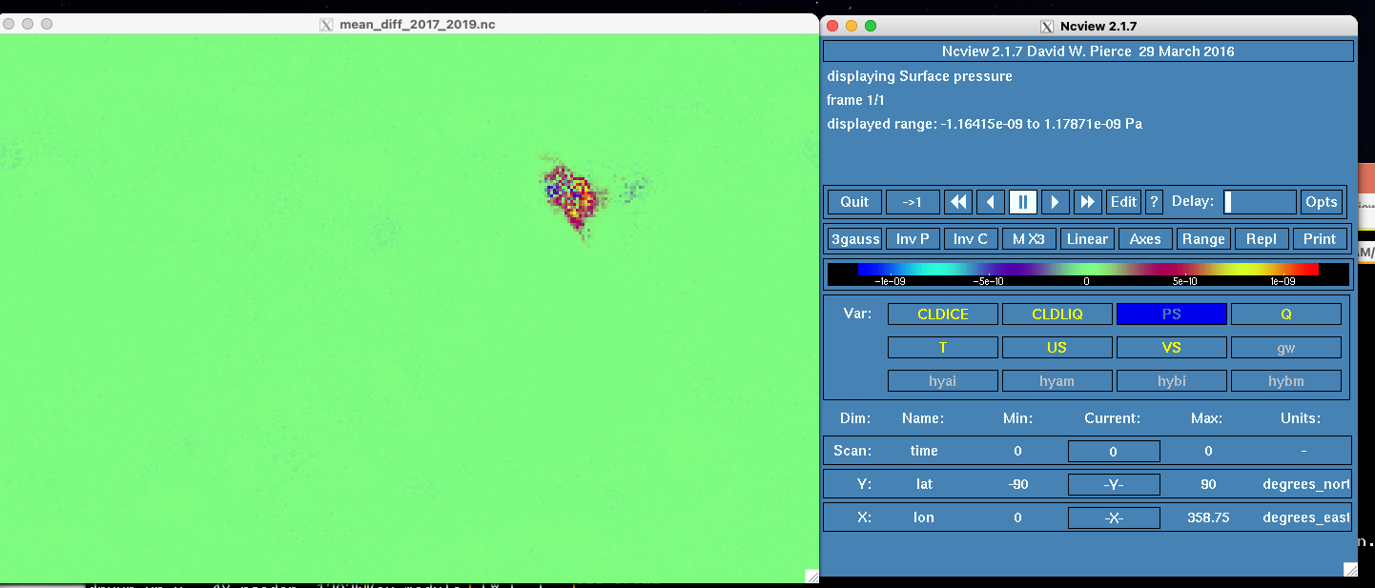
Helen’s comparison of filter compiler versions
Same (but infl?) setup as my assimilation-only tests.
Same compiler options, but different ifort versions; 2017, 2019.
Max diffs O(10⁻⁹ Pa).

Slide 25
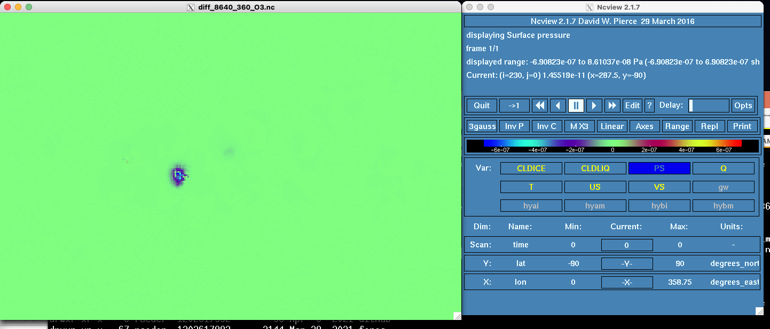
Helen’s comparison of filter core counts
Same (but infl?) setup as my assimilation-only tests.
Same compiler options (-O3 –axavx?) and ifort version, but 8640 vs 360 cores
Max diffs O(10⁻⁷ Pa).

Slide 26
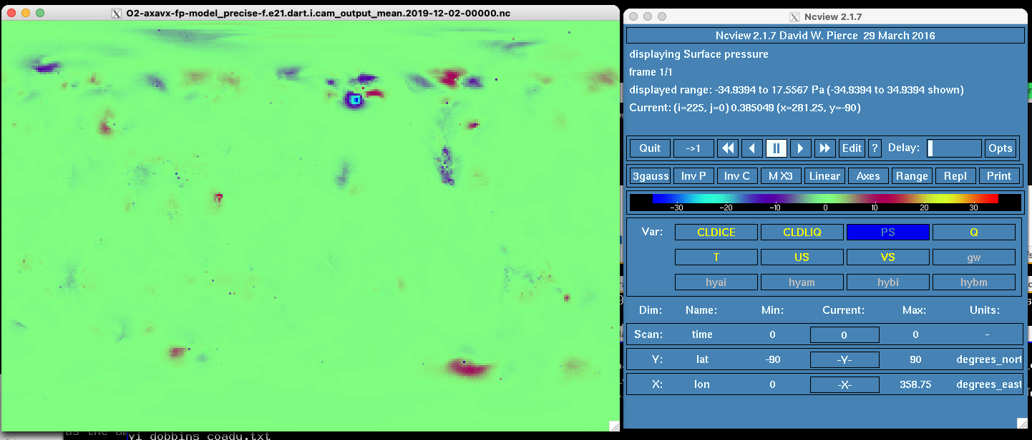
O2-axavx-fp-model_precise
Lots single point differences (from the Reanalysis), but not clustered on latitudes.
Note max diffs are 10x the -O2 –axavx assims with no fp-model precise.

Slide 27
Summary
Very large differences (esp. over land) seen in Nov 2021 were fixed by:
branch mode
consistent offset of SST
fixing CLM namelists
These yielded b4b hindcasts.
Single assimilation tests by Kevin and Helen consistently yield O(3 Pa) diffs when only compiler options are changed.
Changing compiler versions or core counts yields O(10⁻⁷ Pa) diffs.
Running an assimilation for a week, either with old SSTs + old filter, or new SST + new filter, yields diffs O(300 Pa).
There are no other recent tests that yield diffs that large.

