Slide 1
Function numbers
1-19 is from Simon’s functions as shown above.
20 is Box-Cox.
21 is Box-Cox with fixed parameters for the whole study area.
Period: 2016

Slide 2
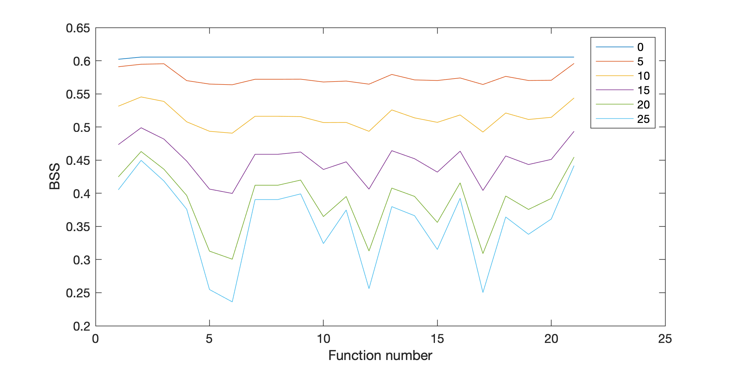
Box-Cox (21) with a fixed parameter is the best one based on the two figures.
Reasons why optimized parameters are sometimes worse:
Zero precipitation is excluded, resulting in a largely reduced number of stations that can be used to calculate errors. Thus, gridded error estimation can only rely on a smaller number of stations.
Error is estimated at stations and then interpolated to grids, but the transformation parameters between grids and stations could be different.
Other unknown reasons.

