Slide 1
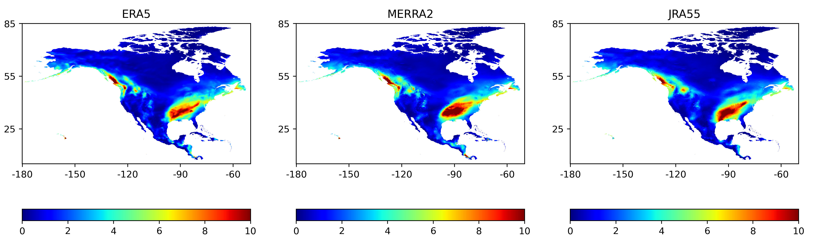
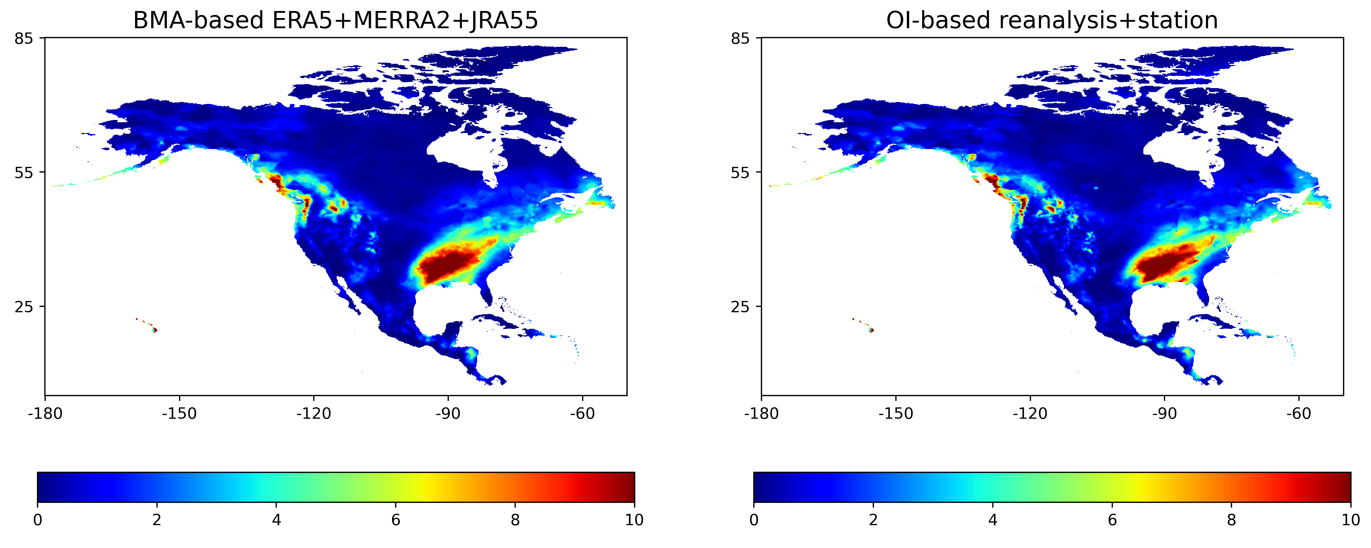
Precipitation in February 2018
Downscaled reanalysis data
Quantile Mapping-based correction
Bayesian Model Averaging-based merging
Optimal Interpolation-based reanalysis + station
Probabilistic estimation
Future work: probabilistic estimates

Slide 2
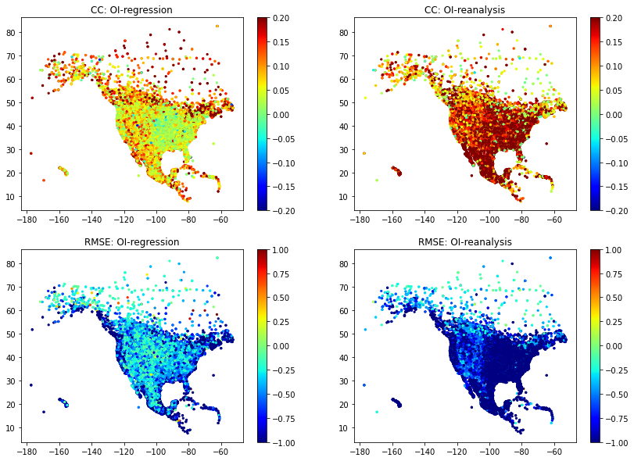
Optimal Interpolation (OI) obtains better precipitation estimates than station regression-only data or reanalysis-only data
Notes:
CC: correlation coefficient
RMSE: root mean square error

