Slide 1
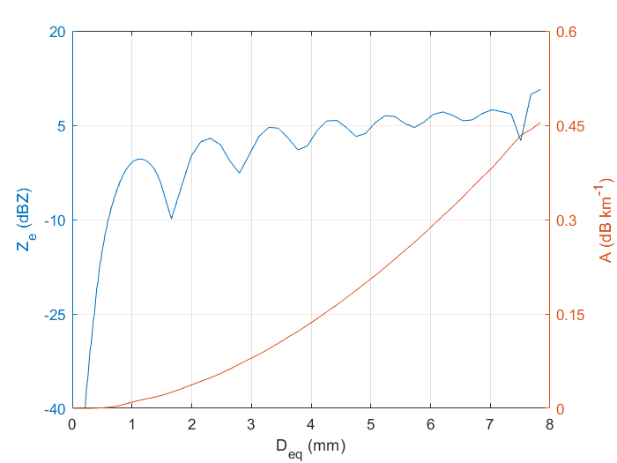
Scattering of Single Particle
The W-band (94.4 GHz) radar reflectivity factor (Z_{e} ; blue line) shows that D_{eq} < 0.5 mm is Rayleigh scattering. The first peak of Mie Scattering is at D_{eq} = ~ 1mm and the first dip at ~ 1.6 mm. On the other hand, the A (red line) increases for whole possible size range of water drops. It means that we can estimate RES based on Xres up to 1.6 mm or little bit higher because both Z_{e} and A need to integrate over the size. If DSD has sufficient large drops (> 1mm), the Xres will reduce when RES increases. For cloud droplet, the maximum size ~0.05 mm (50 mm), the RES can be estimated by Rayleigh method. The drizzle drop size is up to 1.5 mm. The RES must estimate by R&M method.

Slide 2
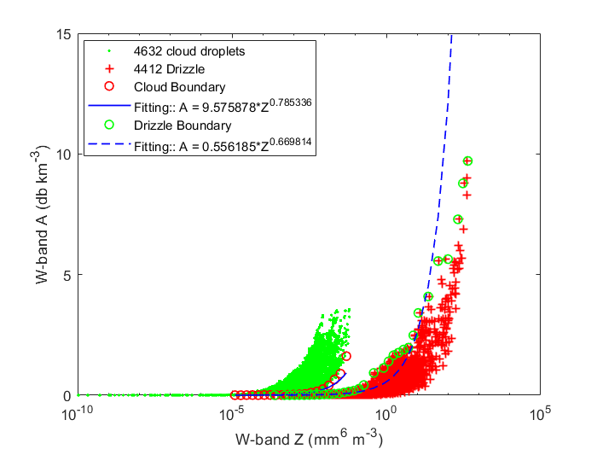
Cloud or Drizzle
The A versus Z_{e} base on 4632 measured cloud DSD and 4412 measured drizzle DSD and T-matrix method. The maximum cloud Z_{e} is -11.98 dBZ and the minimum drizzle Z_{e} is -36.85 dBZ. There are ~ 25 dB overlap of Z_{e}. So, we can not distinguish between cloud and drizzle only based on Z_{e}.

Slide 3
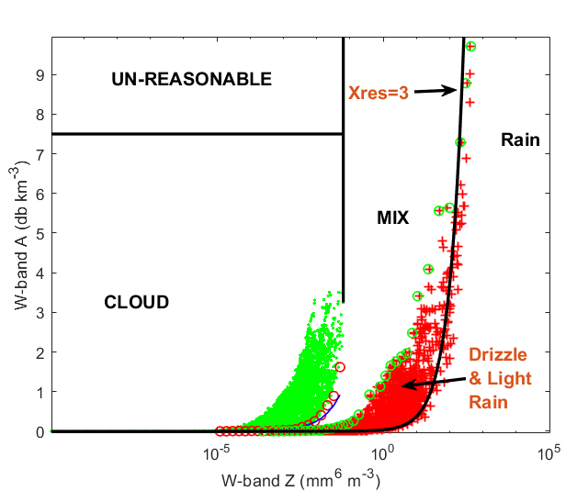
Precipitation Particle Classification
To classify precipitation type, we use surface reference technique (SRT) to obtain the PIA on sea surface, and then, apply ZPHI method to compute specific attenuation (A) and corrected radar reflectivity (Ze) at each radar gates. Mapping these Ze-A pair to the simulation data (see left figure) to decide the PID on each gate.

Slide 4
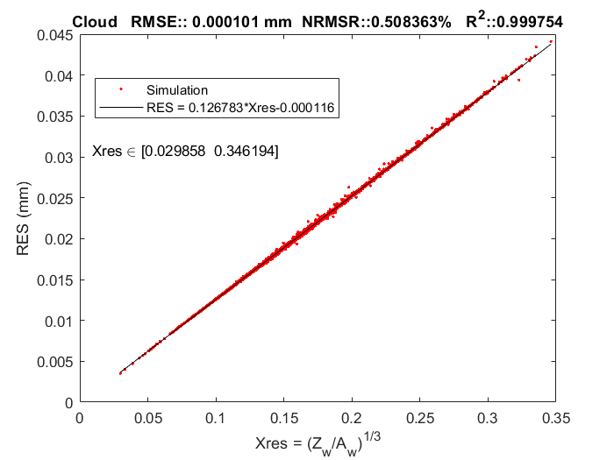
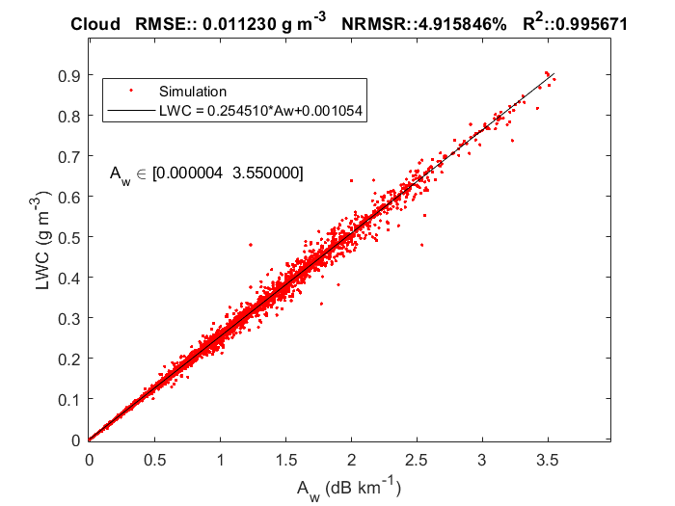
Cloud

Slide 5
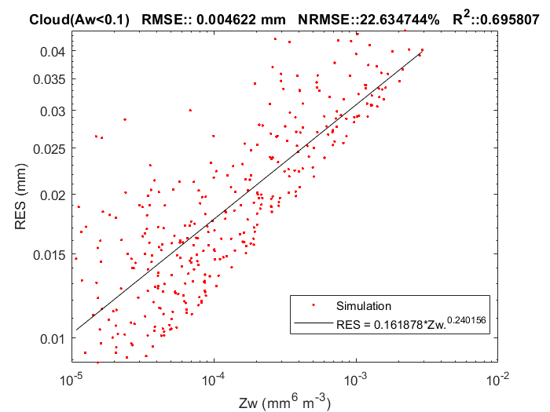
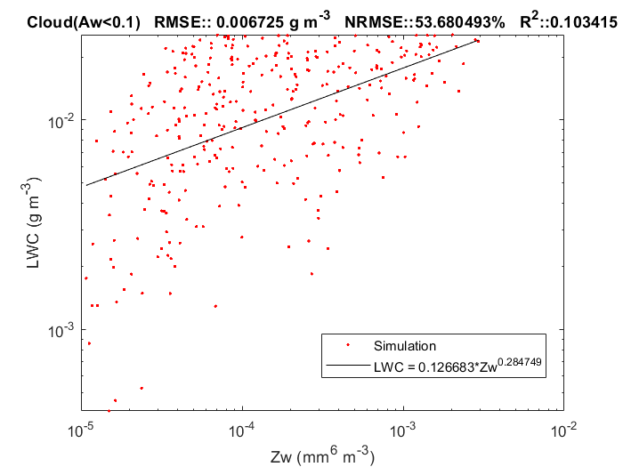
Cloud (A<0.1 dB km⁻¹)
Since the sea surface reflectivity has natural fluctuation (± 1 dB), a small amount of surface PIA may not be measured. For a gate with reliable Ze but A = 0, we will estimate RES and LWC based on Ze.

Slide 6
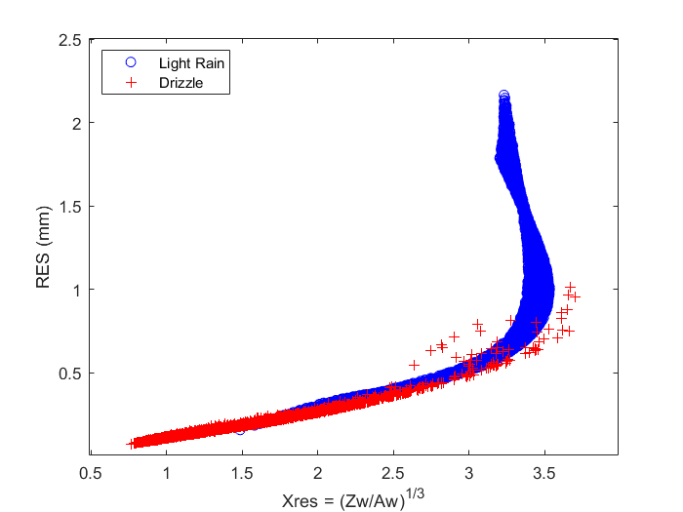
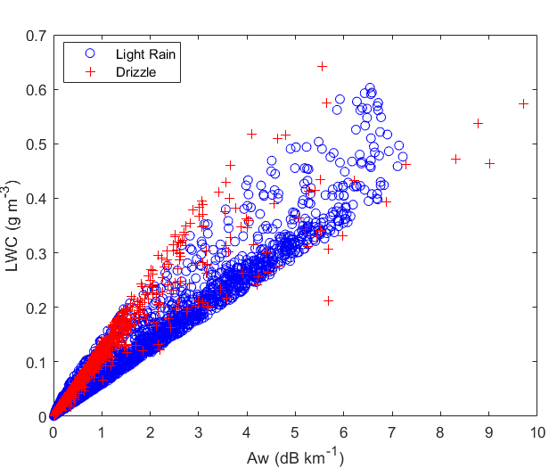
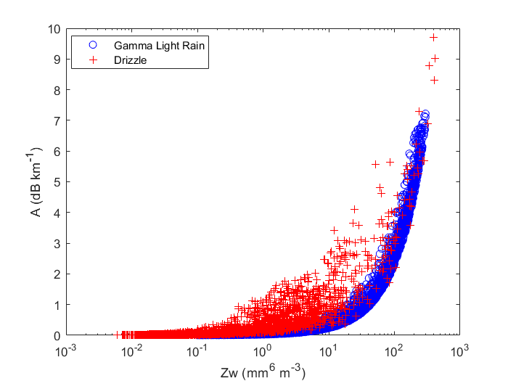
Drizzle or Light Rain (R< 5 mm/hr)
We simulate 7135 gamma DSD. The criteria of DSD are similar as we did for SPOLKa. The light rain is defined as the gamma rain rate less than 5 mm/hr. There are 5360 DSD set satisfy light rain. Although the slope of LWC versus A shows the difference, the LWC can not be measured by radar. We are not able to separate drizzle and light rain based only reflectivity and attenuation.

Slide 7
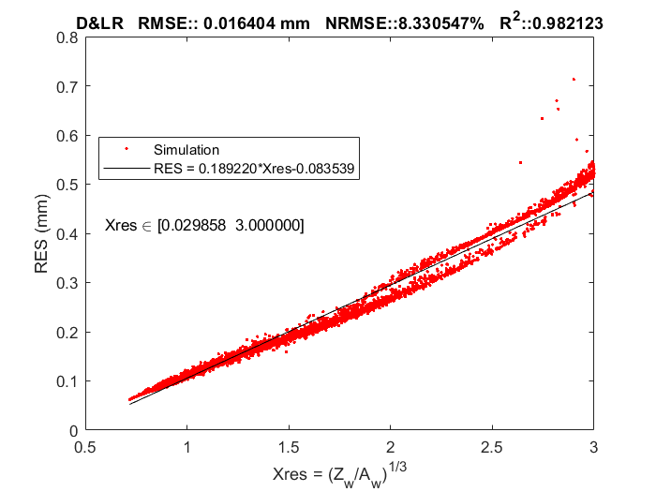
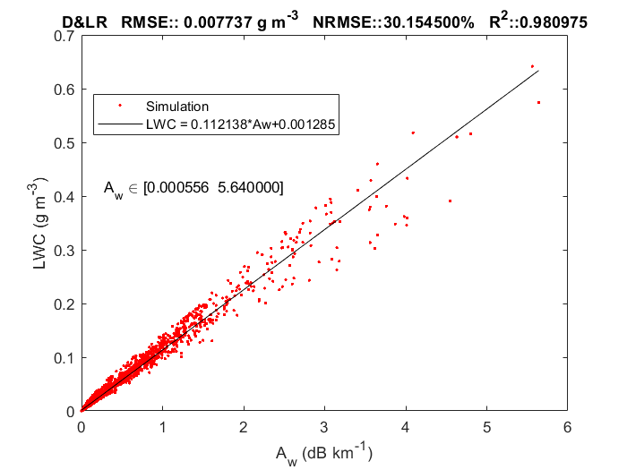
Drizzle and Light Rain with Xres≤3

Slide 8
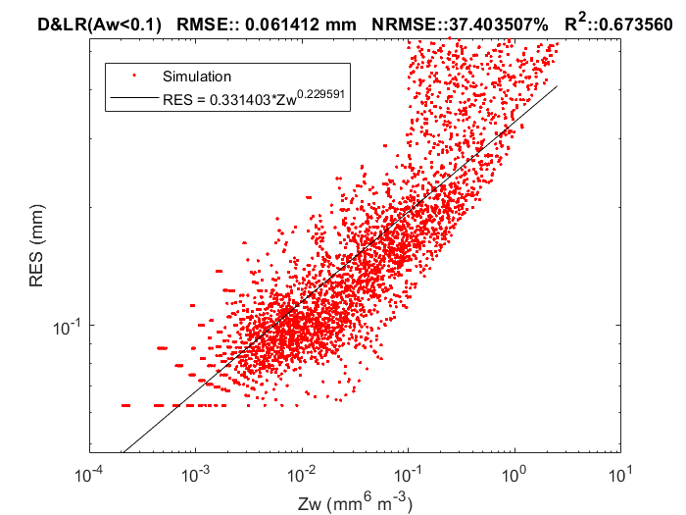
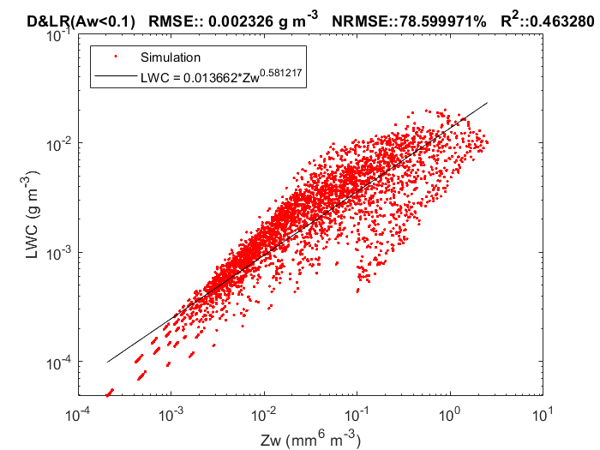
Drizzle & Light Rain (A<0.1)

Slide 9
Based on Simulation
 | Cloud | Drizzle | Drizzle and Light Rain (Xres≤3) | Drizzle and Light Rain (Xres>3)
Min. Z (dBZ) | -99.76 | -36.85 | -36.85 | -9.98
Max. Z (dBZ) | -11.98 | 26.18 | 20.45 | 27.66
Min. A (dB km⁻¹) | 3.97e-6 | 5.56e-4 | 5.56e-4 | 0.0027
Max. A (dB km⁻¹) | 3.55 | 9.71 | 5.64 | 13.9
Min. Xres | 0.030 | 0.718 | 0.718 | 3
Max. Xres | 0.346 | 3.827 | 3 | 3.827
Min. RES (mm) | 0.0035 | 0.063 | 0.063 | 0.482
Max. RES (mm) | 0.044 | 1.019 | 0.713 | 2.184
Min. LWC (g m⁻³) | 9.703e-7 | 4.844e-5 | 4.844e-5 | 1.990e-4
Max. LWC (g m⁻³) | 0.906 | 0.642 | 0.642 | 1.113

Slide 10
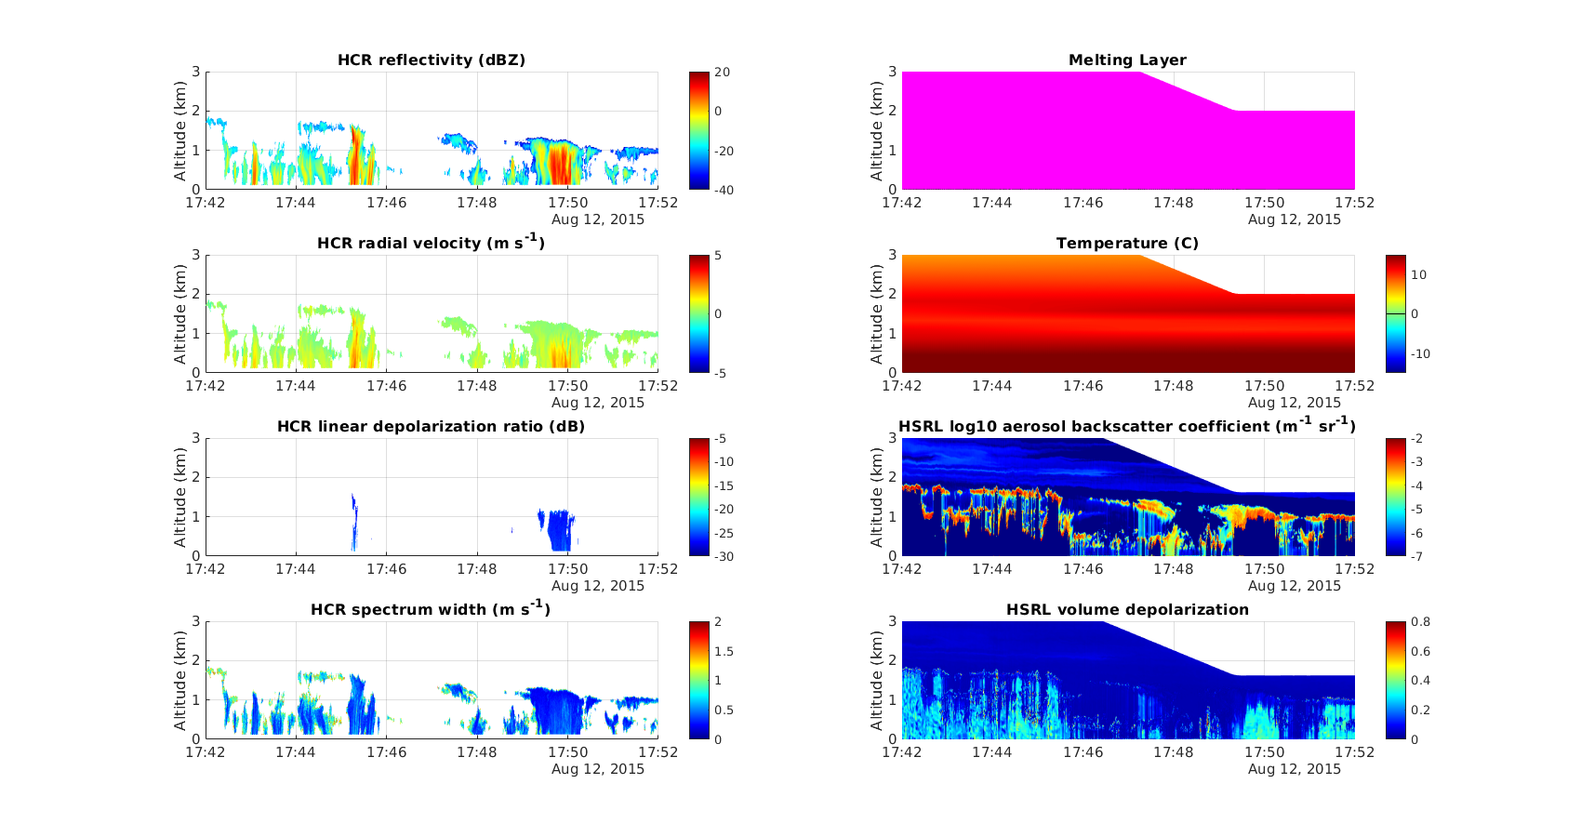

Slide 11
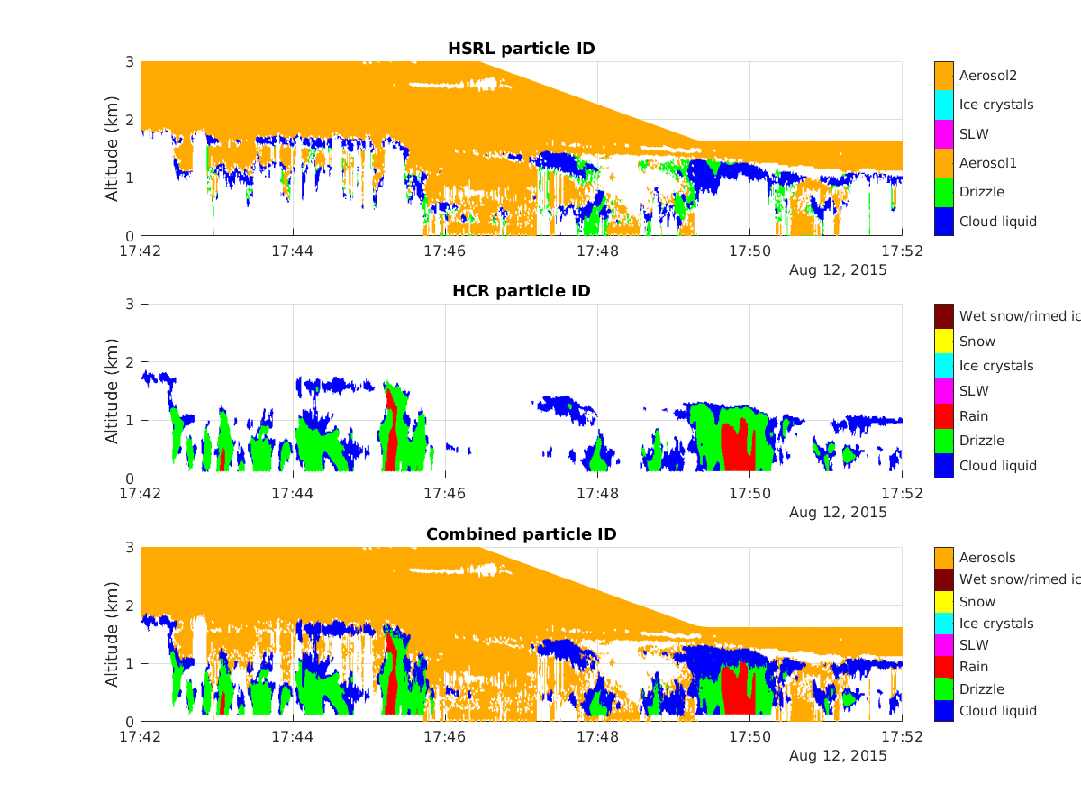

Slide 12
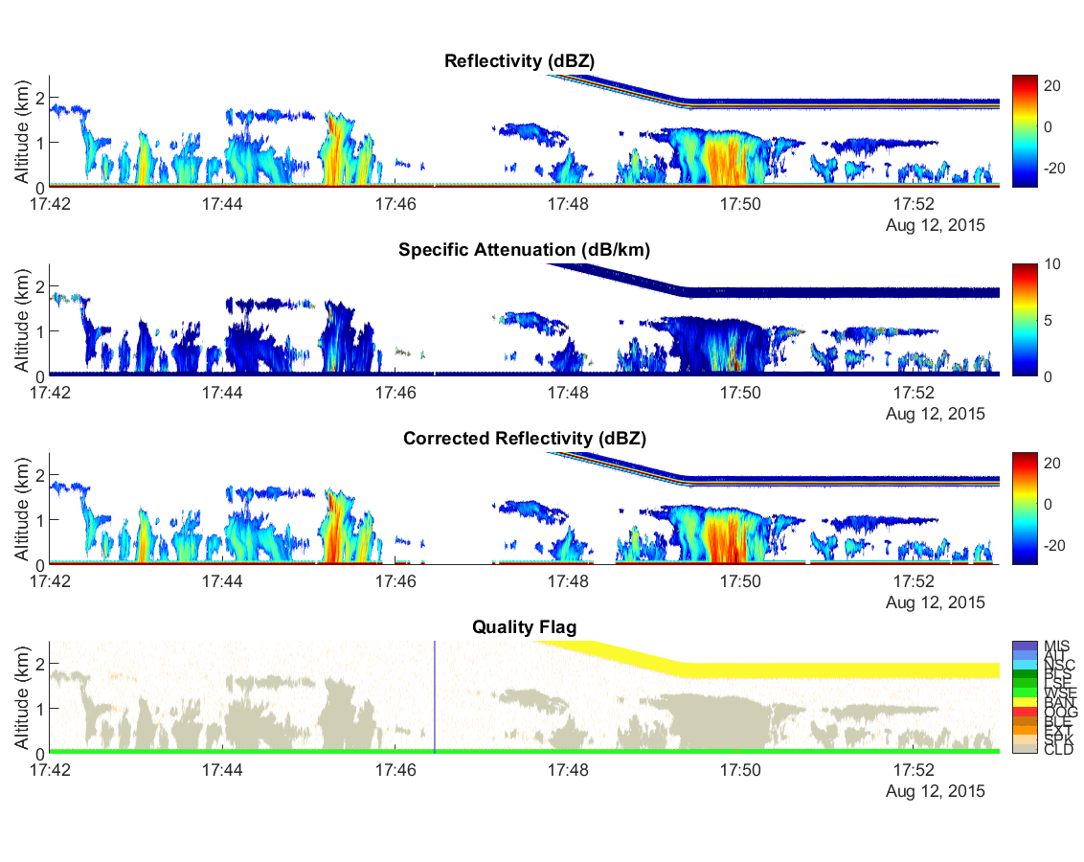
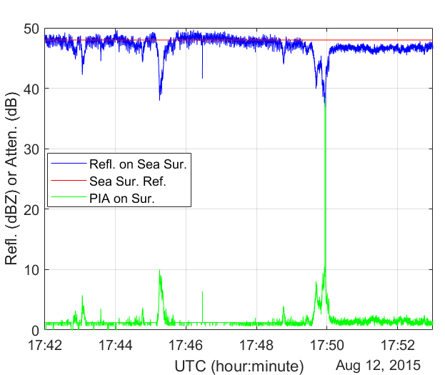
CSET 2015-08-12 17:42:00-17:53:00

Slide 13
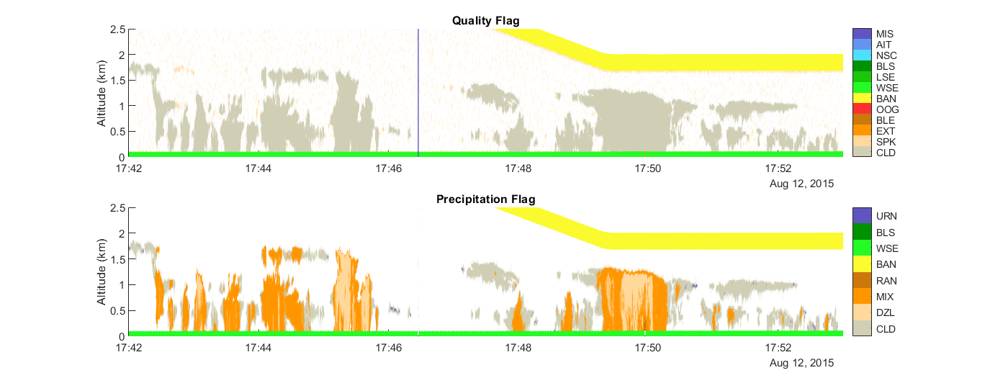
Continue

Slide 14
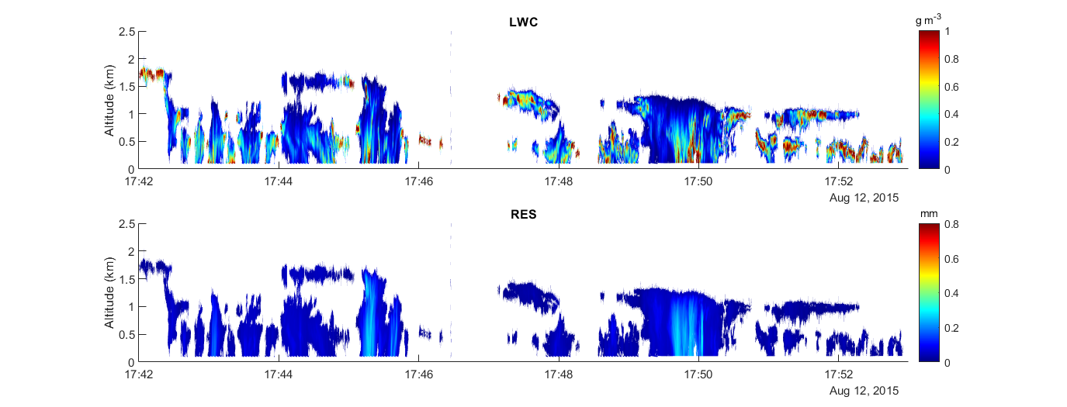
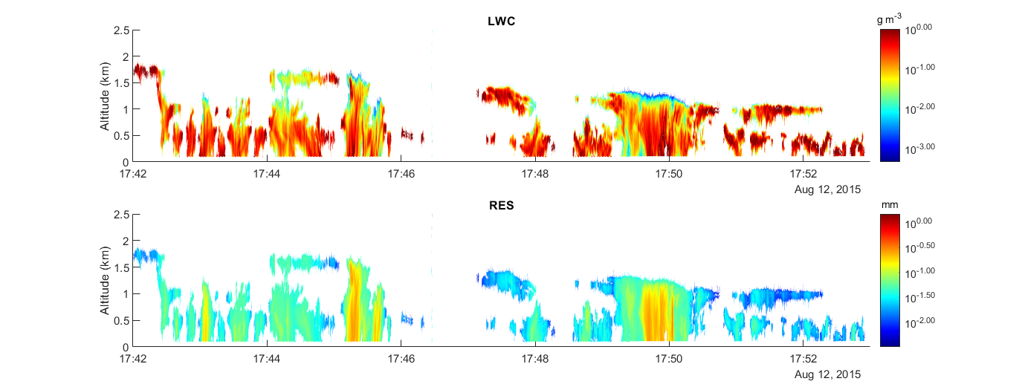
LWC and RES

Slide 15
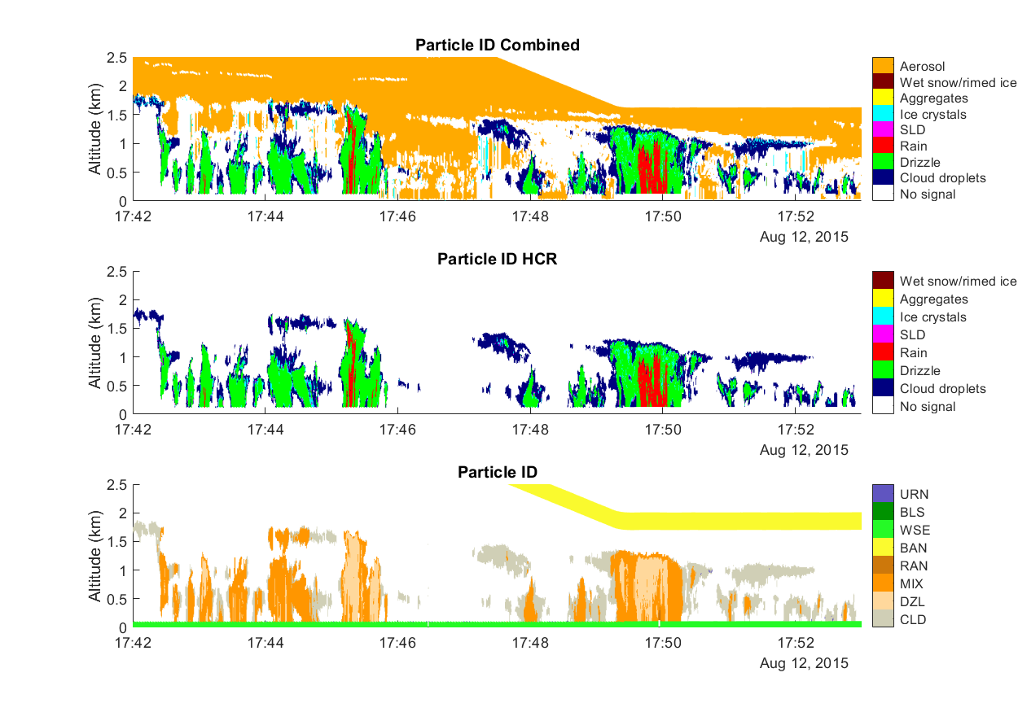
Compare SRT with HCR-HSRL Merged Method

Slide 16
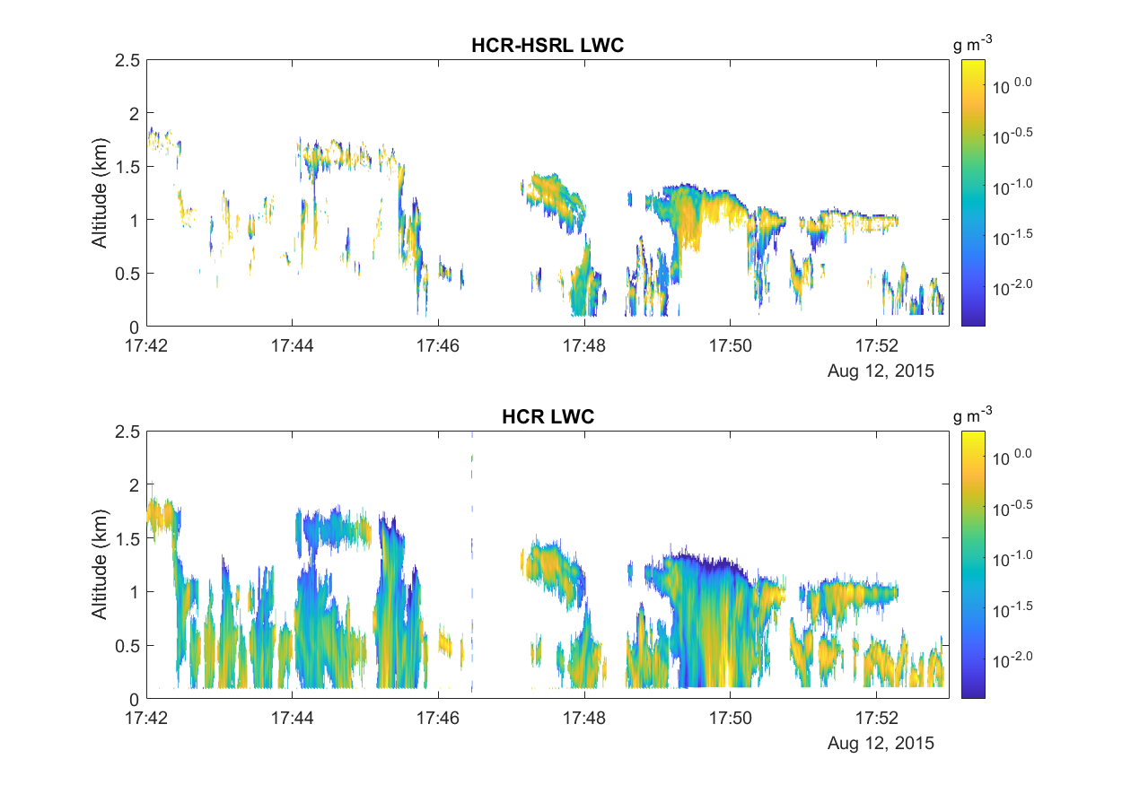
LWC

Slide 17
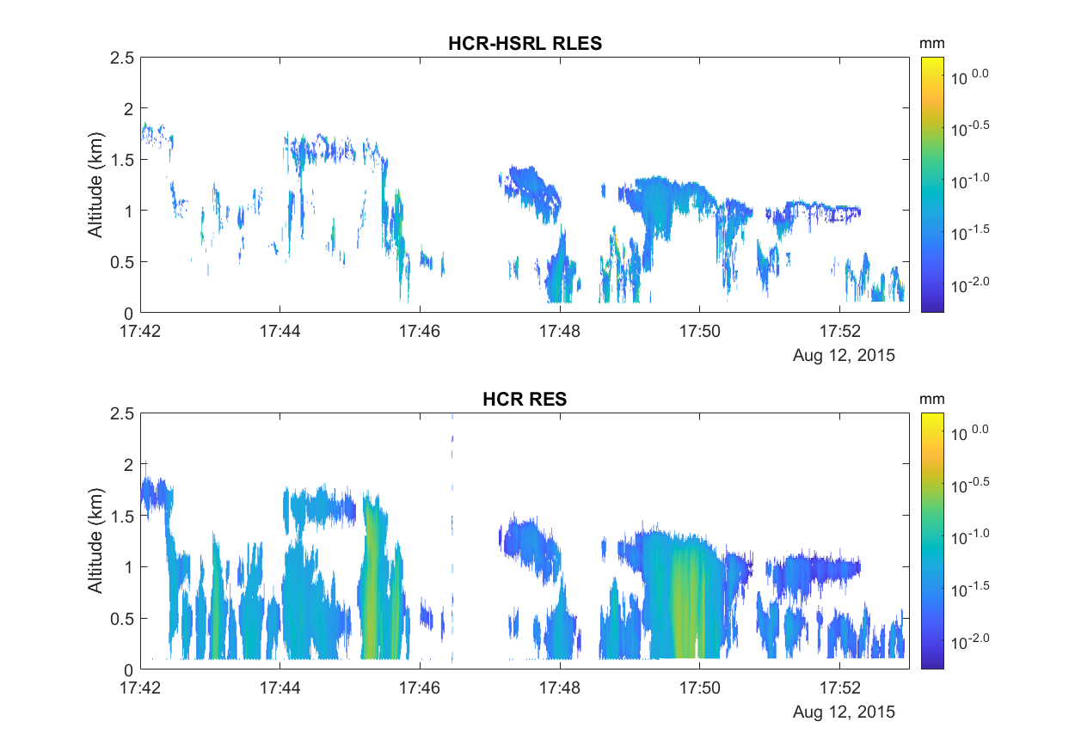
RES

Slide 18
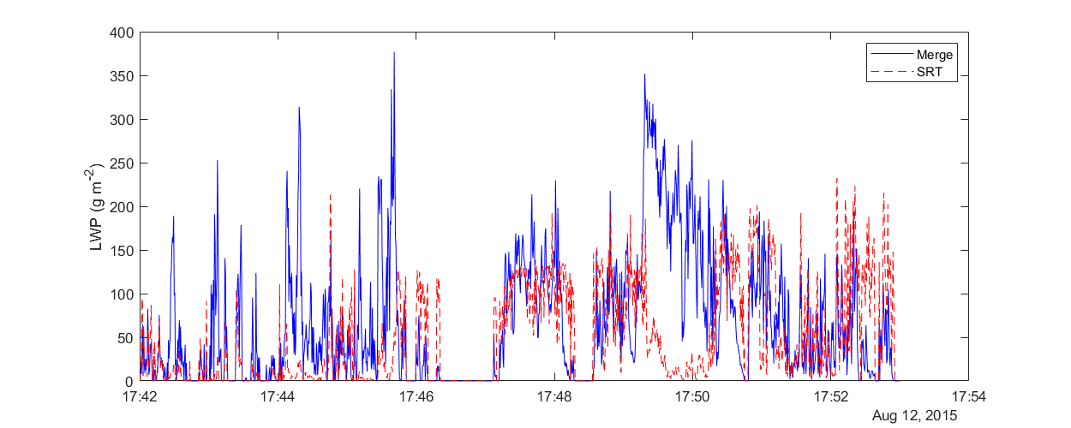
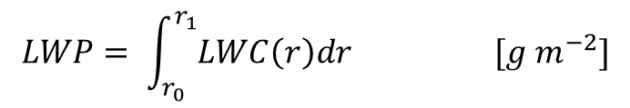
LWP
$$LWP= \int_{r_{0}}^{r_{1}}{LWC\left(r\right)dr} [g m^{−2}]$$
In order to compare, we compute those gates which merged LWC exist.

Slide 19
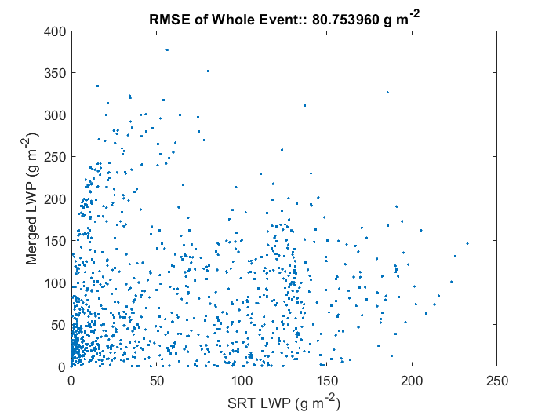
Continue

Slide 20
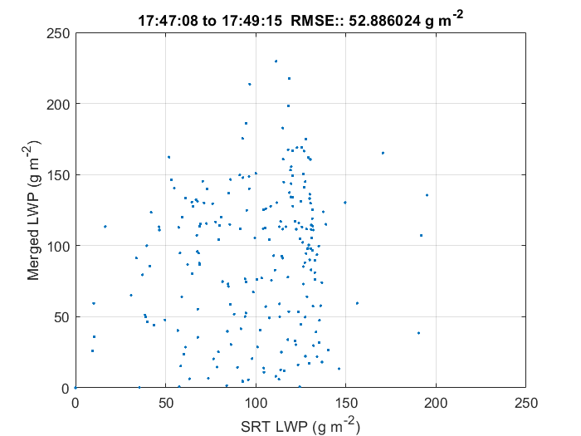
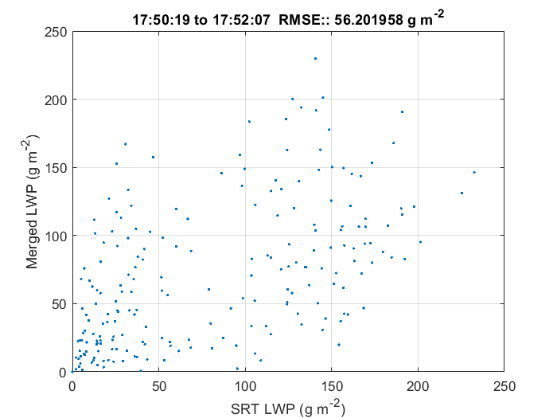
Continue

