Slide 1
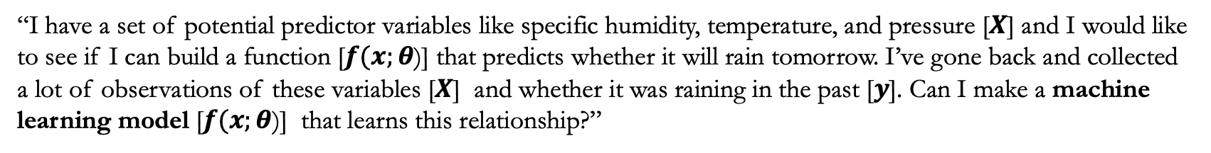

Supervised Machine Learning: Minimize the Loss
My definition: Any optimized/optimizable statistical linking function that maps input predictors to a desired (or target) output.
Problem Setup / Notation:
$y:$ target output (we want a function to describe this)
$X:$ predictor variables (inputs) [x₁, x₂, x₃,…, x_{n}]
$\hat{y}/f(x;θ):$ estimated/learned predictions
$θ:$ A set of weights which define the function
$w^{i}:$ an individual weight $w^{i}⊆$ $θ$
$b^{i}:$ an individual bias $b^{i}⊆$ $θ$
$L$: Loss (defines how good you / distance between $\hat{y}$ and $y$
“I have a set of potential predictor variables like specific humidity, temperature, and pressure [$X$] and I would like to see if I can build a function [$f(x;θ$)] that predicts whether it will rain tomorrow. I’ve gone back and collected a lot of observations of these variables [$X$] and whether it was raining in the past [$y$]. Can I make a machine learning model [$f(x;θ$)] that learns this relationship?”
$\hat{y}=x_{1}w_{1}+x_{2}w_{2}$+ $x_{3}w_{3}+ …+x_{n}w_{n}+b$; Task is to optimize $θ=\{w,b\}$ by minimizing $L$

Slide 2
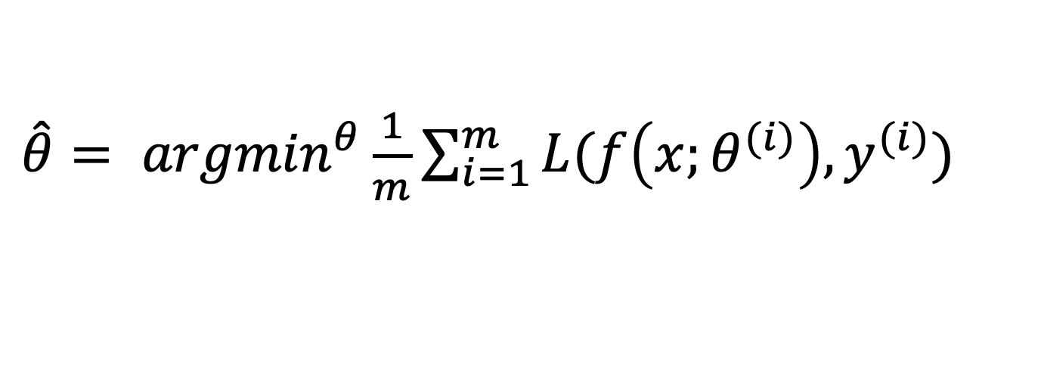

Our Goal: Minimize the Loss
Let’s make explicit that the loss function is parameterized by weights (and bias terms; think: $y=wx+b$): $θ=\left(w,b\right)$
We will represent $\hat{y}$ as $f(x;θ)$ [where $x$ are our input features, $\hat{y}$ is our learned output, and $y$ is our target], we define this relationship to make the dependence on $θ$ more obvious.
We want the weights that minimize the loss, averaged over all the training examples:
$\hat{θ}= {argmin}^{θ}\frac{1}{m}\sum_{i=1}^{m}{L(f\left(x;θ^{(i)}\right),y^{(i)})}$
Slide inspired from Stanford’s CS124

Slide 3
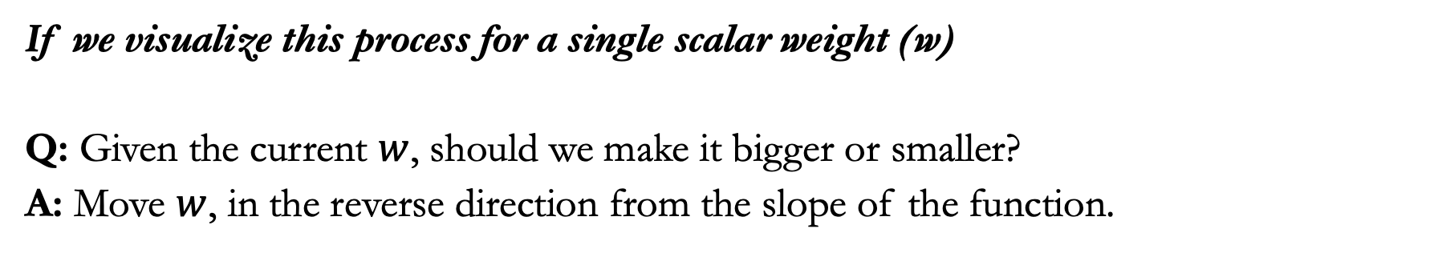
If we visualize this process for a single scalar weight (w)
Q: Given the current $w$, should we make it bigger or smaller?
A: Move $w$, in the reverse direction from the slope of the function.
Should we move weight (w) left or right?
Loss
Slope of Loss at w₁ is negative. So we’ll move positive
w₁
w_{min}
w
Slide inspired from Stanford’s CS124

Slide 4
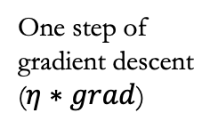
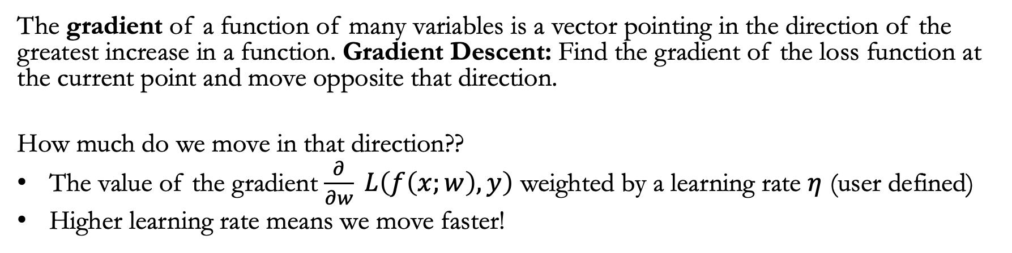
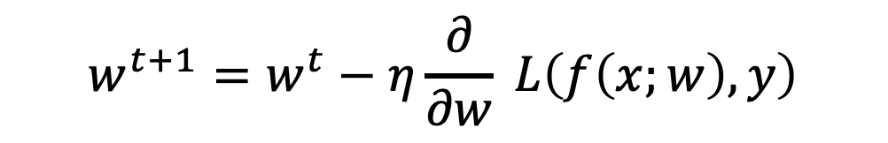
The gradient of a function of many variables is a vector pointing in the direction of the greatest increase in a function. Gradient Descent: Find the gradient of the loss function at the current point and move opposite that direction.
How much do we move in that direction??
The value of the gradient $\frac{∂}{∂w} L\left(f\left(x;w\right),y\right)$ weighted by a learning rate $η$ (user defined)
Higher learning rate means we move faster!
Loss
One step of gradient descent ($η∗grad$)
Our update function:
$$w^{t+1}=w^{t}−η\frac{∂}{∂w} L\left(f\left(x;w\right),y\right)$$
w₁
w_{min}
w
Slide inspired from Stanford’s CS124

Slide 5
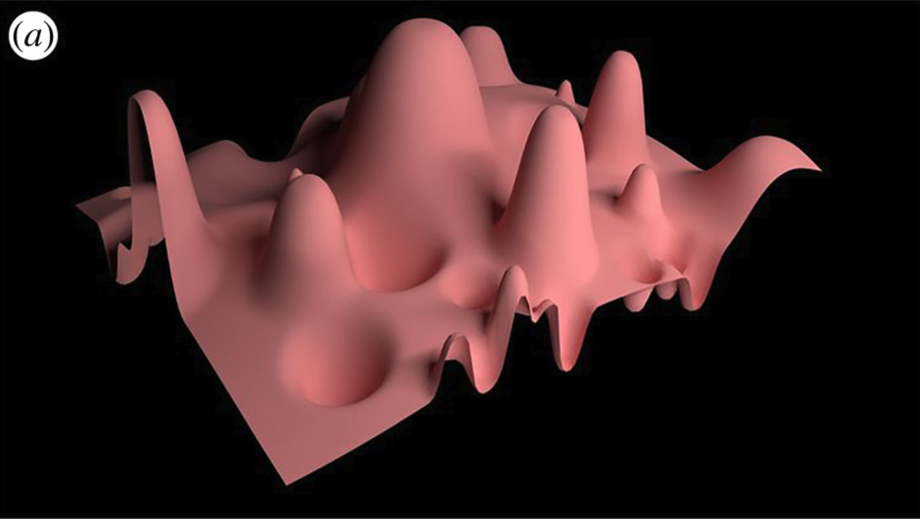



In the context of a multidimensional problem, we aim to determine our optimal direction within the N-dimensional space defined by the N parameters in 𝜃. The gradient represents this vector, signifying the directional components along each of the N dimensions corresponding to the steepest slope.
Most ML functions are quite complex with (lots and lots of weights), for each dimension $w^{i}$ the gradient component $i$ tells us the slope w.r.t. that variable.
“How much would a small change in $w^{i}$ influence the total loss function $L$?”
We express the slope as a partial derivative $∂$ of the loss $∂w^{i}$; the gradient is then defined as a vector of these partial derivatives.
$$w^{2}$$
$$w^{1}$$
Credit: Big data: the end of the scientific method? Succi & Coveney
Slide inspired from Stanford’s CS124

Slide 6

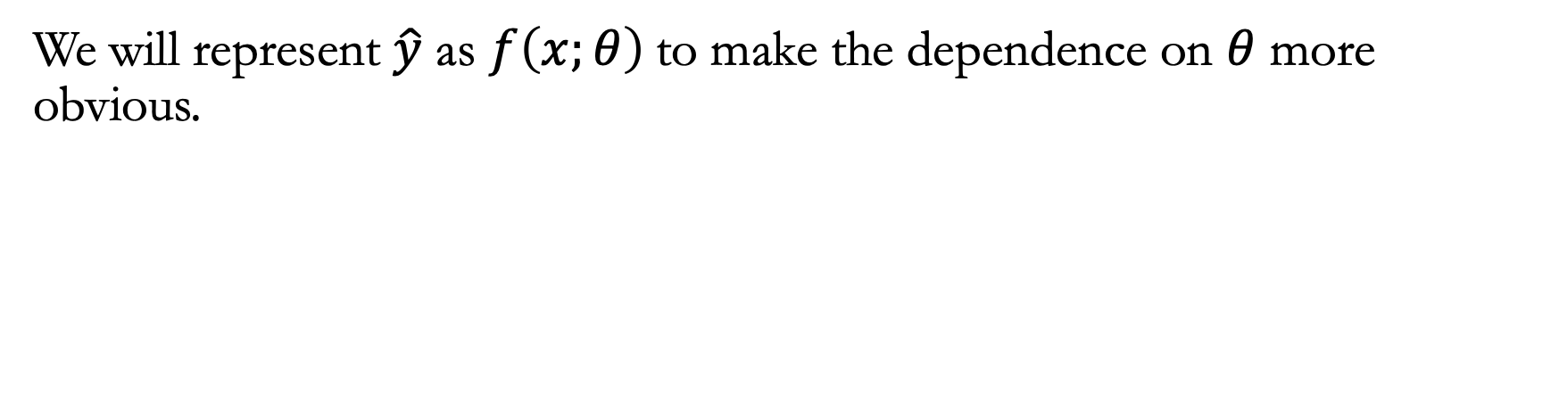
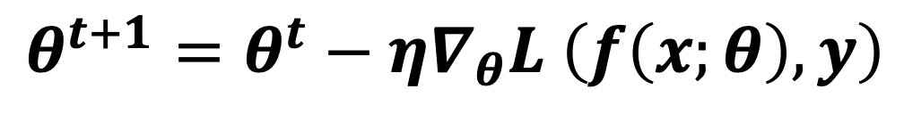
We will represent $\hat{y}$ as $f\left(x;θ\right)$to make the dependence on $θ$ more obvious.
$∇_{θ}L \left(f\left(x;θ\right),y\right)= \left[\begin{matrix}\frac{∂}{∂w_{1}}L \left(f\left(x;θ\right),y\right) \\ \frac{∂}{∂w_{1}}L \left(f\left(x;θ\right),y\right) \\ . \\ . \\ . \\ \frac{∂}{∂w_{n}}L \left(f\left(x;θ\right),y\right)\end{matrix}\right]$
Our update function for multidimensional functions:
$$θ^{t+1}=θ^{t}−η∇_{θ}L \left(f\left(x;θ\right),y\right)$$
Slide inspired from Stanford’s CS124

Slide 7

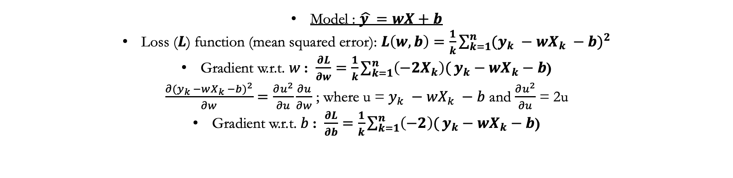
Let’s bring this into the real world with an example: Linear regression.
Model : $\hat{y }=wX+b$
Loss ($L$) function (mean squared error): $L\left(w,b\right)=\frac{1}{k}\sum_{k=1}^{n}{{(y_{k} −wX_{k} −b)}^{2}}$
Gradient w.r.t. $w$: $\frac{∂L}{∂w}=\frac{1}{k}\sum_{k=1}^{n}{\left(−2X_{k}\right)(}y_{k}−wX_{k}−b$)
$\frac{∂{(y_{k} −wX_{k} −b)}^{2}}{∂w}=\frac{∂u^{2}}{∂u}\frac{∂u}{∂w}$ ; where u = $y_{k} −wX_{k} −b$ and $\frac{∂u^{2}}{∂u}$ = 2u
Gradient w.r.t. $b$: $\frac{∂L}{∂b}=\frac{1}{k}\sum_{k=1}^{n}{\left(−2\right)(}y_{k}−wX_{k}−b\text{)}$
Algorithm:
select $η$
Initialize w’s (random weights)
Initialize b (random bias)
Repeat til done
For each training pair (x^{k} y^{k})
1. Optional (for reporting):
compute $\hat{y_{k}}=wX_{k}+b,$
compute the loss $L \left(\hat{y_{k}},y_{k}\right)$
2. dw = $\frac{1}{k} \left(−2X_{k}\right)∙(y_{k}−wX_{k}−b$)
3. db = $\frac{1}{k} (−2)∙(y_{k}−wX_{k}−b\text{)}$
4. $w$ ← w $−$ $(η)(dw)$
5. b ← b $−(η)(db)$

Slide 8
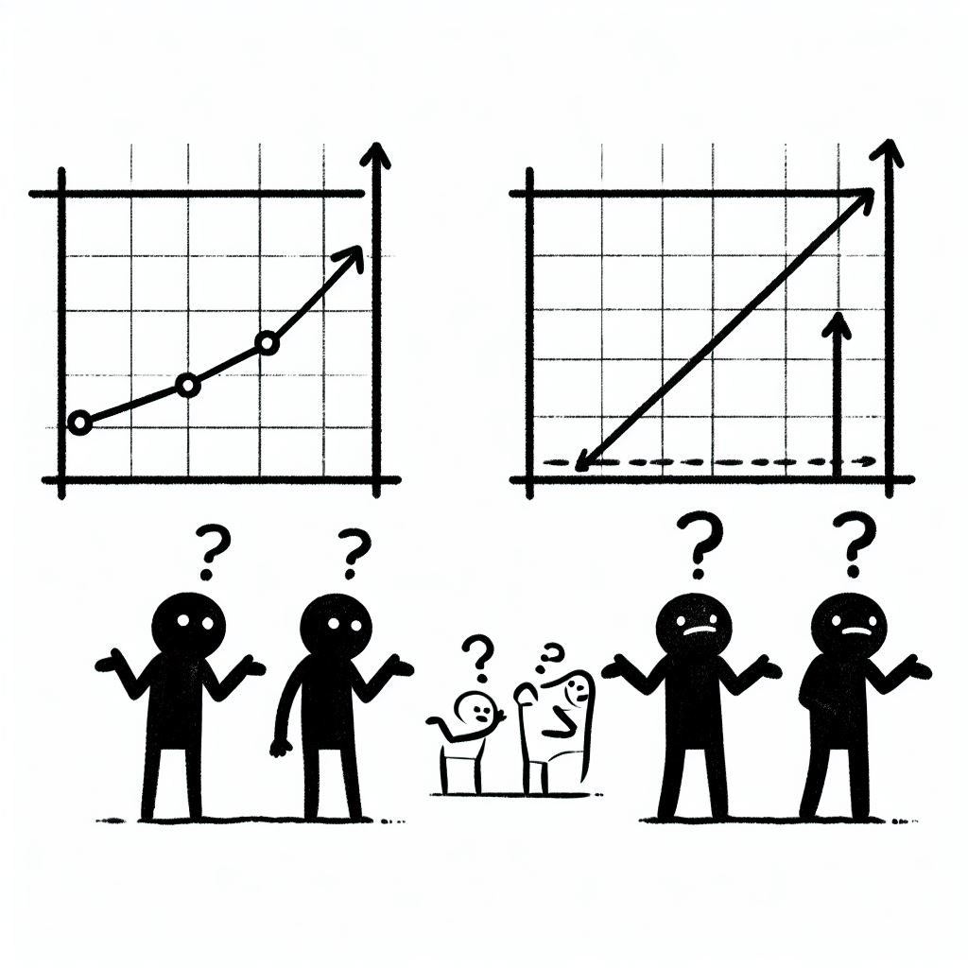

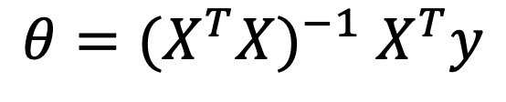
YOU SHOULD BE SAYING “SO WHAT?!?!”
There is an closed form solution to solve linear regression:
$θ={{(X}^{T}X)}^{−1}$ $X^{T}y$
ADDITIONALLY! There is nothing stochastic about it…. It gives the absolute best optimization by minimizing the residuals of the prediction. So what the heck are we doing here….
DALL·E generated images: for this course

Slide 9



Why is SGD a powerful idea?
ENTER NON-LINEAR FUNCTIONS, Logistic Regression, and ALLL of the fun stuff.
We will start with Logistic regression as an example.
For logistic regression, there is no longer a closed-form solution, due to the nonlinearity of the logistic sigmoid function.
Images: DALLE-3 request: “can you make me a stochastic gradient descent logo please? black and white and 2d”

Slide 10
Logistic Regression is a Discriminator/Categorizer:
Linear Probability model
Y=1
Logistic Regression Model
Y=0
X
Logistic regression is used to describe data and to explain the relationship between one dependent binary variable and one or more nominal, ordinal, interval or ratio-level independent variables. There is no closed form solution but it is CONVEX!!!

Slide 11
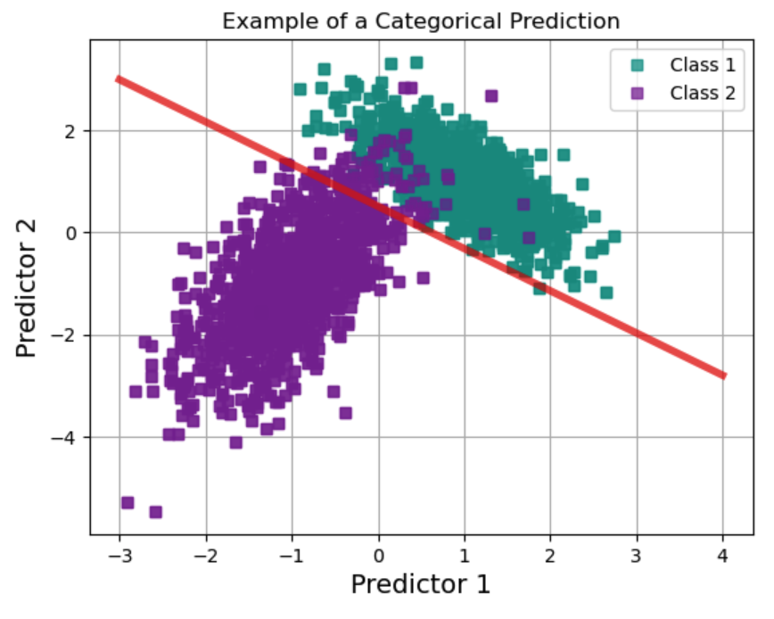
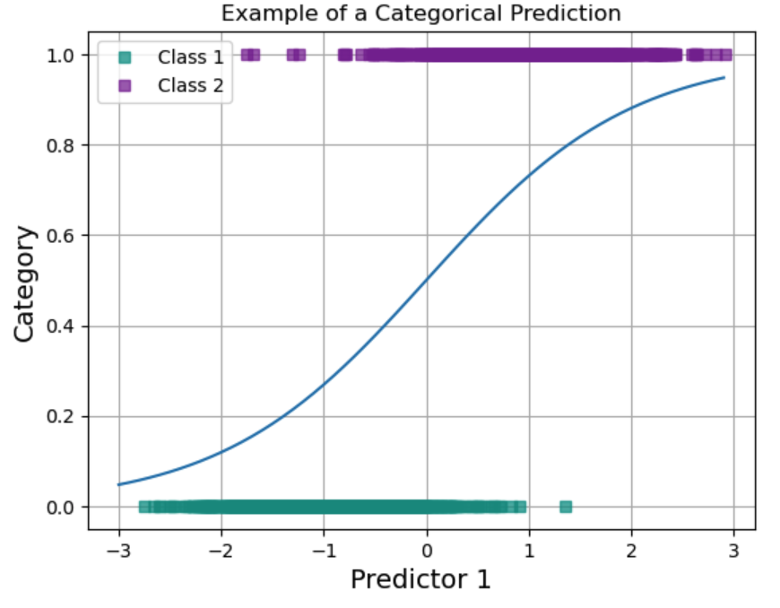
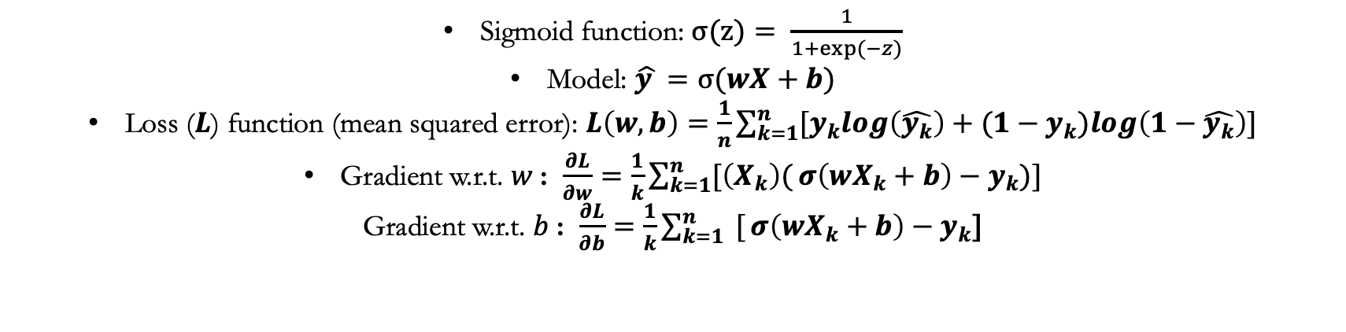
https://towardsdatascience.com/logistic-regression-from-scratch-in-python-ec66603592e2
Let’s bring this into the real world with an example: Logistic Regression
Sigmoid function: $σ(z)= \frac{1}{1+exp⁡(−z)}$
Model: $\hat{y }=σ(wX+b)$
Loss ($L$) function (mean squared error): $L\left(w,b\right)=\frac{1}{n}\sum_{k=1}^{n}{[y_{k}log\left(\hat{y_{k}}\right)+{(1−y}_{k})log\left(1−\hat{y_{k}}\right)]}$
Gradient w.r.t. $w$: $\frac{∂L}{∂w}=\frac{1}{k}\sum_{k=1}^{n}{[\left(X_{k}\right)(}σ\left(wX_{k}+b\right)−y_{k})]$
Gradient w.r.t. $b$: $\frac{∂L}{∂b}=\frac{1}{k}\sum_{k=1}^{n}{ [}σ\left(wX_{k}+b\right)−y_{k}\text{]}$

Slide 12
Slide inspired from Stanford’s CS124

Slide 13
Slide inspired from Stanford’s CS124

