Slide 1
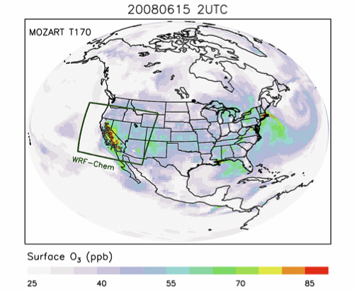
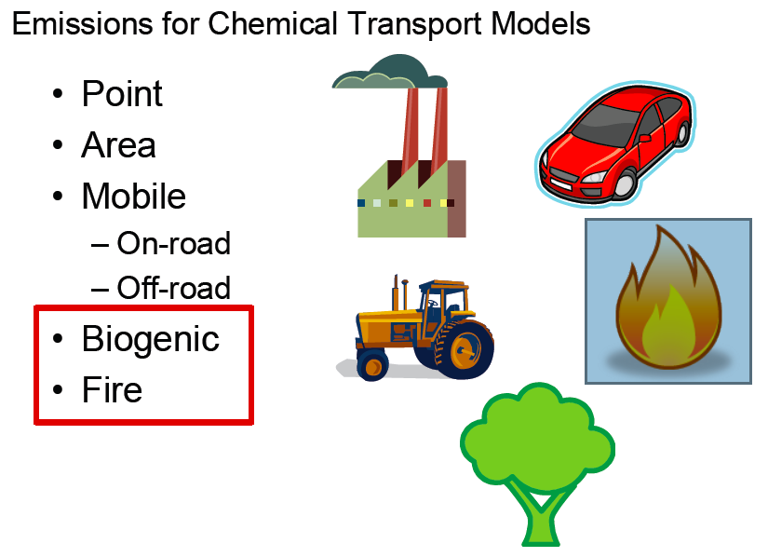
Chemical Boundary Conditions, MEGAN and FINN data in WRF-Chem
Gabriele Pfister, Stacy Walters, Christine Wiedinmyer,
Alex Guenther, Mary Barth, Louisa Emmons, Tiffany Duhl
October 2012

Slide 2
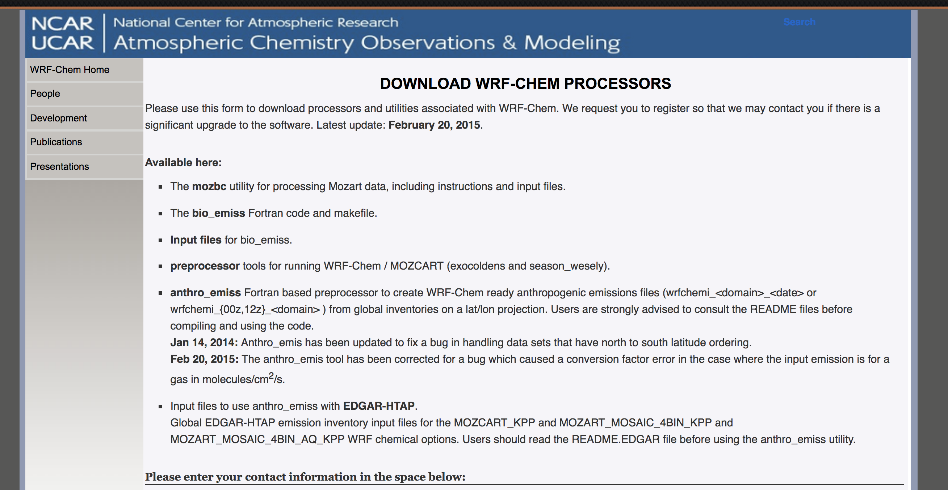
Preprocessors available from: https://www2.acom.ucar.edu/wrf-chem
Preprocessors are in FORTRAN and come with a README detailing compilation and execution.
Require netcdf libraries; work on Portland Group or IBM fortran 90 compiler.
Domain information derived from wrfinput_d<domain>

Slide 3
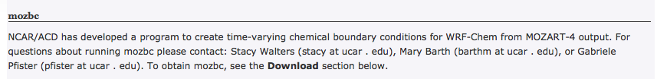
Chemical Boundary Conditions
mozbc – set chemical initial and lateral boundary conditions
chemical initial and boundary conditions are needed to account for initial concentrations and inflow
fills the chemical fields in wrfinput_d<domain> and wrfbdy_d<domain> with global model output
set-up for MOZART-4 and CAM-Chem global model output
controlled by namelist file (e.g. define species mapping; mappings available for MOZART to RACM, RADM, CBMZ, MADE/Sorgam, MOZAIC, GOCART)
Interpolation in time and space
MOZART-4 output for past years and forecasts available on Web

Slide 4
Chemical Boundary Conditions
mozbc – set chemical initial and lateral boundary conditions
mozbc operates on the most common map projections in WRF (Lambert, Mercator, Polar, Lat/Lon)
To compile: make_mozbc -> will create the executable mozbc
Package includes example namelist files (“mozbc.inp”)
To run: mozbc < mozbc.inp > mozbc.out
to enable chemical IC and BC when running WRF-Chem set in namelist.input: have_bcs_chem = .true

Slide 5
Chemical Boundary Conditions
Example namelist file for mozbc:
&control
do_bc = .true. defines if BC are set (default: .false.)
do_ic = .true. defines if IC are set (default: .false.)
domain = 2 number of domains to work on (default: 1);
e.g. d=2 sets BC for d01 and IC for d01 and d02
dir_wrf = '/ptmp/me/WRF_chem/’ path to WRF-Chem files (met_em*, wrfinp*, wrfbdy*)
dir_moz = '/ptmp/me/MOZBC/’ path to MOZART/CAM-Chem input files
fn_moz = ’h0040.nc’ initial MOZART/CAM-Chem file; mozbc increments filenames, filenames must be of the form prefix<nnn>.nc
moz_var_suffix = ‘_VMR_avrg’ suffix string for MOZART/CAM-Chem variables (default: ‘_VMR_inst’)
met_file_prefix = 'met_em’ prefix string for the WRF meterological files (default: ‘met_em’) {standard WRF names: met_em.d<nn>.<yyyy-mm-dd_hh:mm:ss>.nc }
met_file_suffix = '.nc’ suffix string for the WRF meterological files (default:’nc’)
met_file_separator = '.’ separator character for WRF meterological files (default: ’.’)
spc_map = 'o3 -> O3', 'o -> O', 'o1d_cb4 -> O1D', 'n2o -> N2O', 'no -> NO',
...
'DUST_4 -> .2348*[DUST3]+.5869*[DUST4];1.e9', 'DUST_5 -> .5869*[DUST4];1.e9'
/

Slide 6
Chemical Boundary Conditions
ubc - upper chemical boundary conditions
WRF-Chem does not have a stratosphere –possible issues when looking at UTLS or comparing to some satellite products (e.g. trop. O₃ retrievals)
o3,no,no2,hno3,ch4,co,n2o, n2o5 are set to climatology above certain pressure level and relaxed to tropopause level below
Same scheme as used in MOZART-4 and CAM-Chem
Climatologies available for present and future times
download climatologies from Web
namelist.input (&chem):
have_bcs_upper = .true.
fixed_upper_bc = 50.
fixed_ubc_inname = "ubvals_b40.20th.track1_1996-2005.nc”

Slide 7
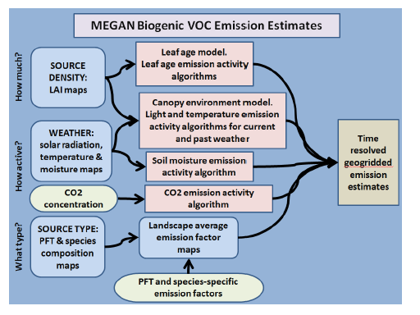
MEGAN online biogenic emissions
Model of Emissions of Gases and Aerosols from Nature
Estimate emissions of VOCs, NOx and CO from vegetation
Driving variables include landcover, weather, and atmospheric chemical composition
Reference: Guenther et al., GMD 2012 MEGAN v2.1
Note: as of current land cover used in MEGAN differs from that used within WRF-Chem
Planned:
Update to latest MEGAN (2.04 in WRF-Chem)
link to WRF-Chem land cover/CLM
from Guenther et al., 2012

Slide 8
MEGAN preprocessor
Static input fields needed to run with online MEGAN biogenic emissions: Isoprene Emissions Factors, monthly LAI, Solar Radiation & Temperature, Fractional coverage of broadleaf and needeleaf trees, shrubs and herbaceous
Compatible with MOZART, CBMZ, RADM, RACM, SAPRC (see module_data_mgn2mech.F for species mapping)
Download source code (megan_bio_emiss.tar) and global input data (megan.data.tar.gz)
megan_bio_emiss is a single cpu code, which
reads global MEGAN input data
maps them on the WRF-Chem domain
creates wrfbiochemi_d<domain> file

Slide 9
MEGAN preprocessor
To compile: make_util megan_bio_emis - creates the executable megan_bio_emiss
megan_bio_emiss is controlled by a namelist file (e.g. megan_bio_emiss.inp)
To run : megan_bio_emiss < megan_bio_emiss.inp > megan_bio_emiss.out
&control
domains = 3, creates wrfbiochemi_dnn for three domains (default: 1)
start_lai_mnth = 4, starting month for the monthly LAI (default: 1)
end_lai_mnth = 6, ending month for the monthly LAI (default: 12)
wrf_dir = '/home/me/megan/wrf_files', path to wrfinput_dnn (default: current)
megan_dir = '/home/me/megan/30sec’ path to MEGAN input files (default: current)
/

Slide 10
Running WRF-Chem with MEGAN
WRF-Chem output variables: EBIO_<species>
namelist.input:
&time_control (activate settings only either during real.exe or initial wrf.exe)
auxinput6_interval_h = 24
auxinput6_inname = 'wrfbiochemi_d01',
io_form_auxinput6 = 2,
&chem
bio_emiss_opt = 3
bioemdt = your choice (minutes)

Slide 11
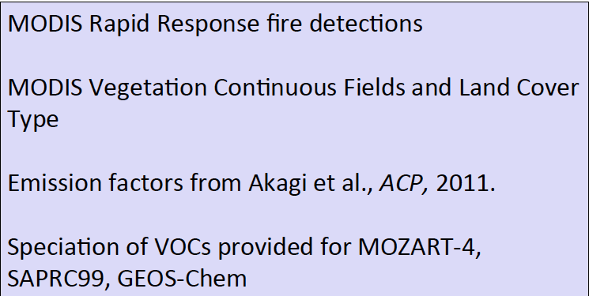
FINN Fire Emissions
FINN: Fire INventory from NCAR (Wiedinmyer et al., GMD, 2011)
Daily, 1 km resolution, global estimates of the trace gas and particle emissions from open burning of biomass
Uses satellite observations of active fires and land cover, together with emission factors and estimated fuel loadings

Slide 12

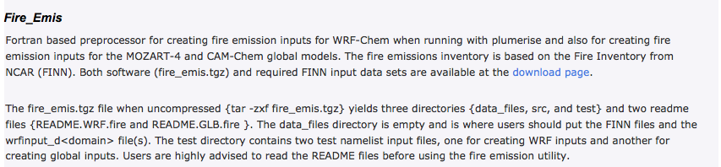
FINN Fire Emissions Preprocessor
create WRF-Chem ready fire emissions from FINN inventory - wrffirechemi_d<domain>_<date> for use with online plume rise (can also be merged into wrfchemi files) note: fire_emis also works to create global emission files for MOZART-4/CAM-Chem
Works for different chemical schemes (namelist controlled)
WRAP diurnal emission profile applied
Processor and FINN inputs available on Web
FINN inputs in MOZART-4, SAPRC99, and GEOS-Chem speciation

Slide 13
FINN Fire Emissions Preprocessor
To compile: make_fire_emis
To run: fire_emis < fire_emis.inp > fire_emis.out
Example namelist “fire_emis.inp” for MOZCART
&control
domains = 1,
fire_directory = '',
fire_filename = 'GLOB2012a_MOZ4_07242012.txt',
wrf_directory = '',
start_date = '2012-06-01',
end_date = '2012-06-10',
diag_level = 1,
wrf2fire_map = 'co -> CO', 'no -> NO', 'so2 -> SO2', 'bigalk -> BIGALK’, 'bigene -> BIGENE', 'c2h4 -> C2H4',
'c2h5oh - C2H5OH’, 'c2h6 -> C2H6', 'c3h8 -> C3H8','c3h6 -> C3H6','ch2o -> CH2O',
'ch3cho -> CH3CHO’, 'ch3coch3 -> CH3COCH3','ch3oh -> CH3OH','mek -> MEK',
'toluene -> TOLUENE’,’nh3 -> NH3','no2 -> NO2','open -> BIGALD','c10h16 -> C10H16',
'ch3cooh -> CH3COOH','cres -> CRESOL','glyald -> GLYALD','mgly -> CH3COCHO',
'gly -> CH3COCHO','acetol -> HYAC','isop -> ISOP','macr -> MACR’,'mvk -> MVK',
'oc -> 0.24*PM25 + 0.3*PM10;aerosol', 'bc -> 0.01*PM25 + 0.08*PM10;aerosol',
'pm10_raw -> PM10;aerosol','pm25_raw -> PM25;aerosol',
'sulf -> -0.01*PM25 + 0.02*PM10;aerosol',
'pm25 -> 0.36*PM25;aerosol','pm10 -> -0.61*PM25 + 0.61*PM10;aerosol’
/

Slide 14
FINN Fire Emissions Preprocessor
Running WRF-Chem with FINN emissions and plumerise:
&time_control
auxinput7_inname = 'wrffirechemi_d<domain>_<date>',
auxinput7_interval_m = 60, 60, 60,
io_form_auxinput7 = 2,
frames_per_auxinput7 = 1, 1, 1,
&chem
biomass_burn_opt = your choice
plumerisefire_frq = your choice
scale_fire_emiss = .true.

Slide 15
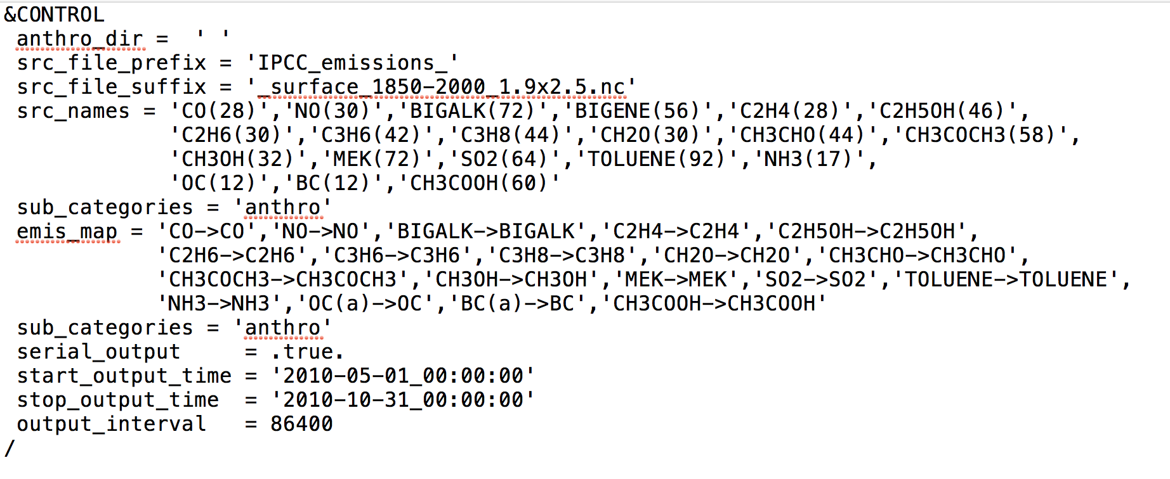
Global Anthropogenic Emissions
Create anthropogenic emissions files from global emission inventories
For CESM emissions and EDGAR-HTAP; other inventories are at the moment not supported
Examples for Mappings to MOZART chemical options
Controlled by namelist:

Slide 16
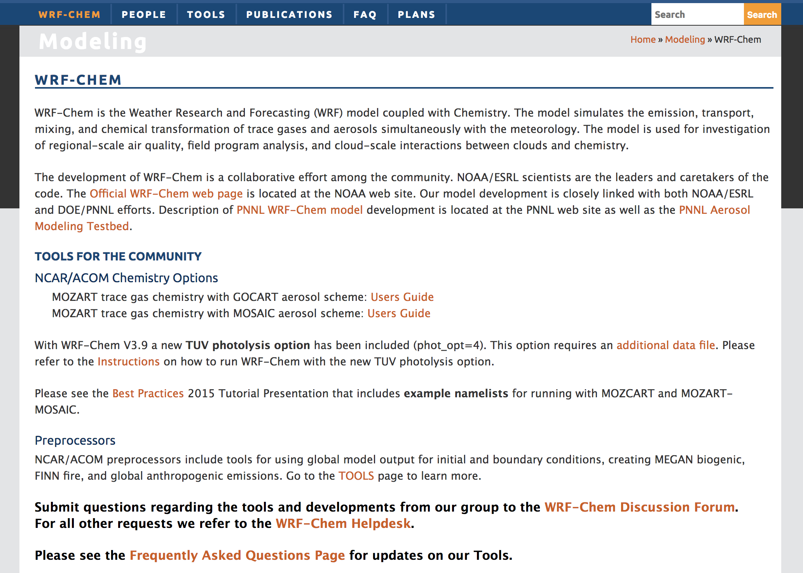
Further Information

Slide 17
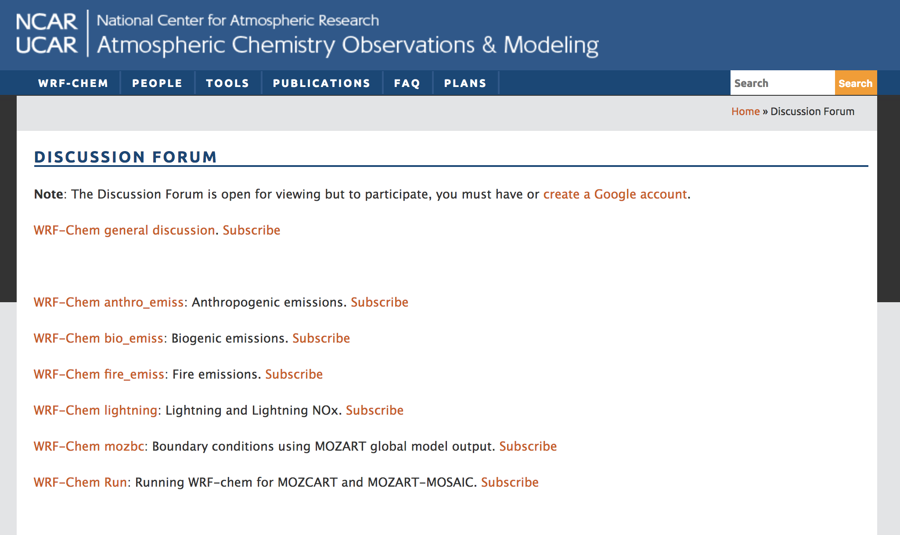
For Questions:
ACOM WRF-Chem Discussion Forum:

Slide 18
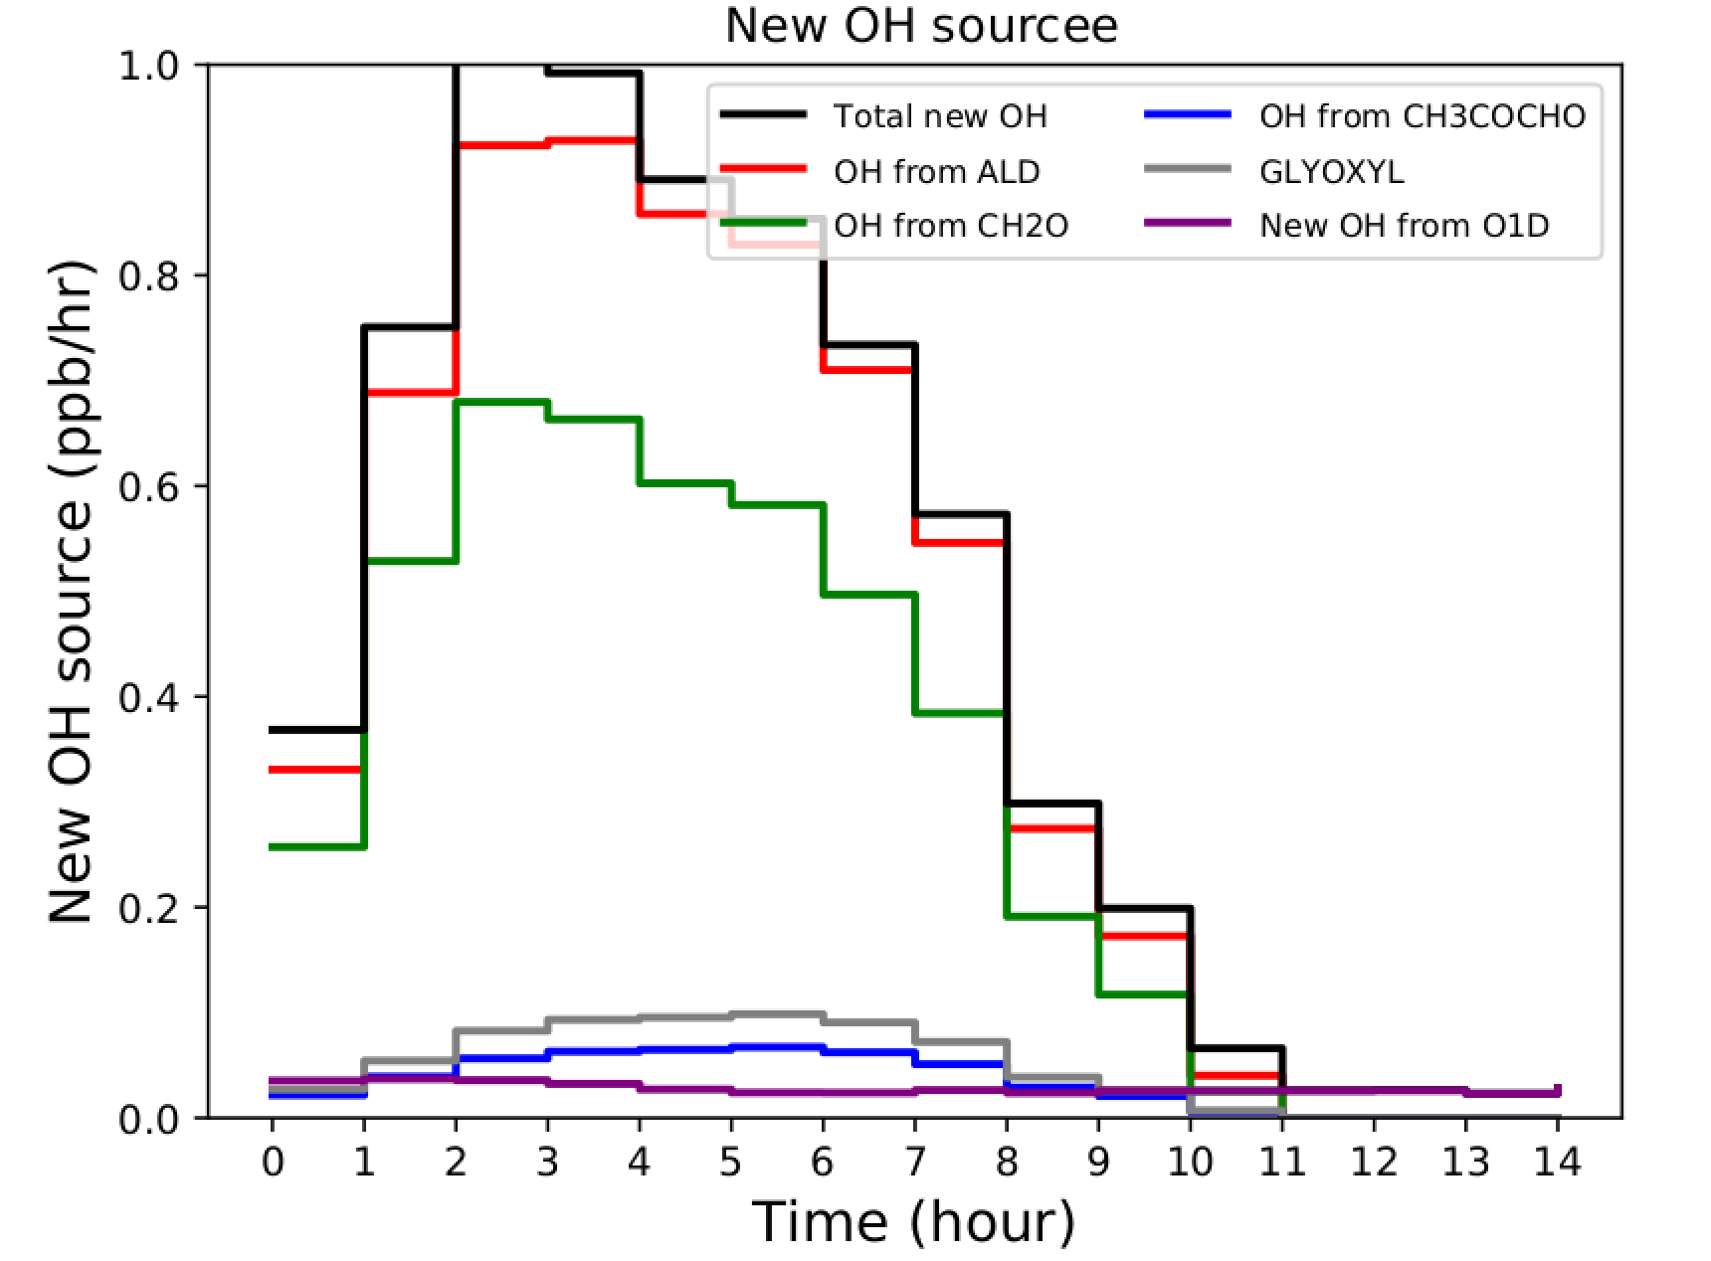
New Features in the Coming Release
Integrated Reaction Rates (IRR)
Similar to IRR in CMAQ
Output controlled by namelist
Analysis with Process Analysis tool PERMM (Will Vizuete, UNC) No scripts yet in place to share with community
MOZCART_T1 chem_opt = 114
Update to MOZART-4 chemical gas phase mechanism in chem_opt 112 (MOZCART)
142 gas phase species compared to 81 in MOZCART.
Motivated by improved understanding of VOC oxidation & need to better represent precursors of SOA.
More explicit monoterpenes, 1st generation HYAC/ MGLY/ GLYOXAL/ GLYALD formation, Two ‘lumped’ peroxy radicals from OH + isoprene, “Lumped” isoprene nitrate formation and chemistry , ……….
MOZCART_T1-MOCART
20140723 0 UTC

