Slide 1
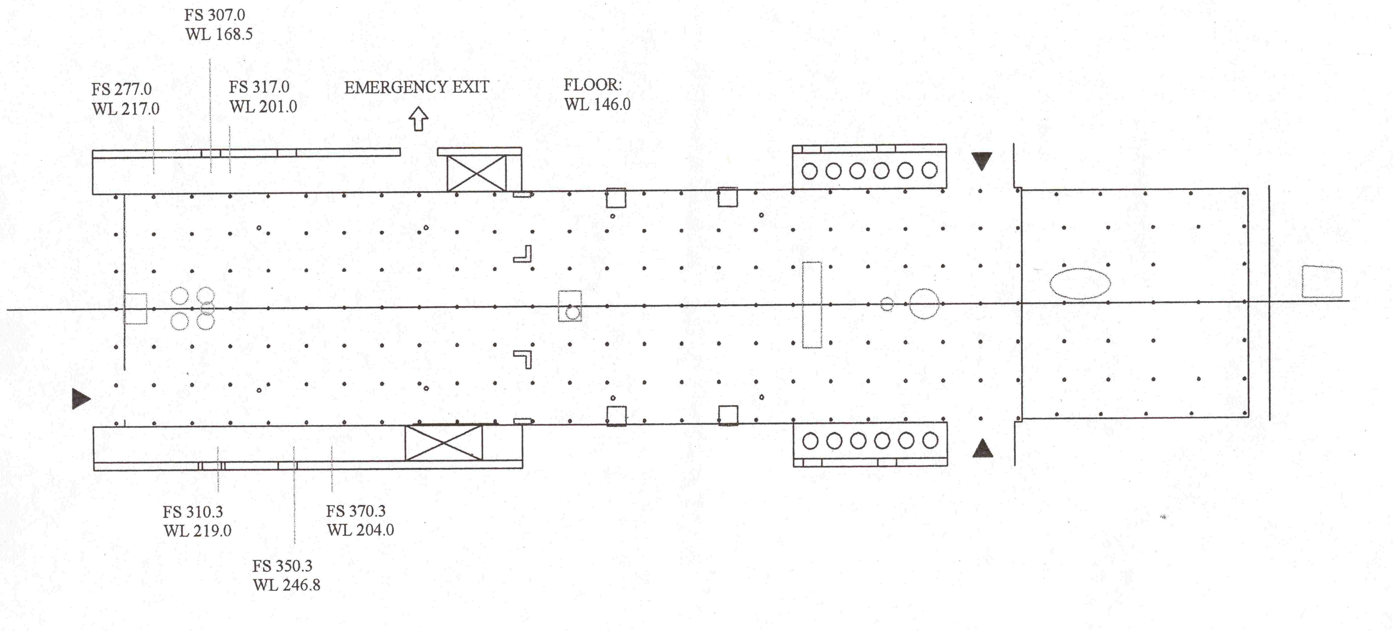
FINAL DRAFT C-130 LAYOUT FOR MIRAGE
NOTE: PAYLOAD NOT YET APPROVED BY NSF
Autonomous instruments:
NO, NOy, O3
TOTAL RONO2
CO, CO2
PANs
PILS
WAS
SAFS
SO2
Needed: CN from RAF
Per-
oxides
SAFS
Seat
Clarke1
SPII
PASS
CCN
Seat
Clarke2
TDMA/
HTDMA
WAS
PTR
MS
SO2
Buseck
PILS
PANs
NO, NO2, NOy
O3
Seat
Seat
Seat
SICIMS
Seat
CH2O
2
G-V
Seat
SABL
CO CO2
AMS
2
G-V
Seat
Fast
GCMS
Seat
Seat
RAF
Seat
Seat
Seat
Add’l:
pump for SPII,CCN, PASS, floor mounted
AMS pump, floor mounted or under bench
seats

