Slide 1

INDOEX LWC Analysis
and Cloud Data QA:
C-130 External OPCs
Darrel Baumgardner
Research Aviation Facility
National Center for Atmospheric Research
September 1999
INDOEX Data Analysis Meeting
Utrecht, Netherlands

Slide 2
Instruments Evaluated
FSSP - 100 (2) 2 μm - 60 μm
260-X 30 μm - 600 μm
Hot-wire LWC (2) 0.02 - 3 gm⁻³
PVM-100 0.02 - 3 gm-³
Trend Analysis
For all cloud passes during each flight, LWC derived from each sensor was correlated with every other LWC measurement and least-squares fits calculated. The magnitude of correlation coefficients and trends in the linear-fit slopes are indicators of data quality and changes in instrumment performance.

Slide 3
Sources of Uncertainty
FSSP - No recording of housekeeping variables
increased the uncertainties to > 20% in
concentration and > 40% in LWC. Normally
these uncertainties are ≈ 15% and 35%,
respectively
PVM - Underestimates water content in droplet
sizes larger than 40 μm. The PVM also
appears to have zero drifts that are a result
of aerosol sensitivity and possible
alignment shifts. These have been taken
out of the data in the processing.
Hotwire - Under-estimates water content in droplet
sizes larger than 40 μm. Proximity to wing
distorts airflow. Correction factors that
have been applied are semi-empirical. Flow
modeling studies are underway to compare
with empirically derived flowrates.

Slide 4
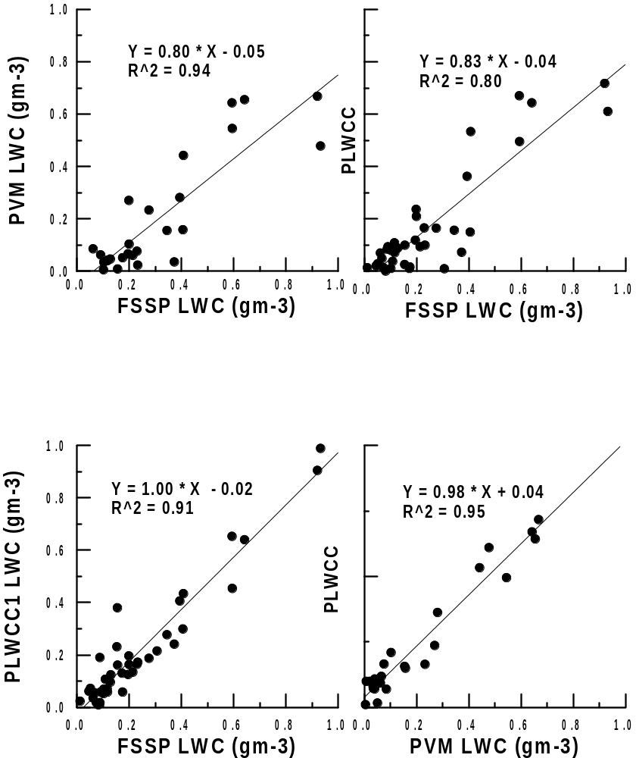

Slide 5
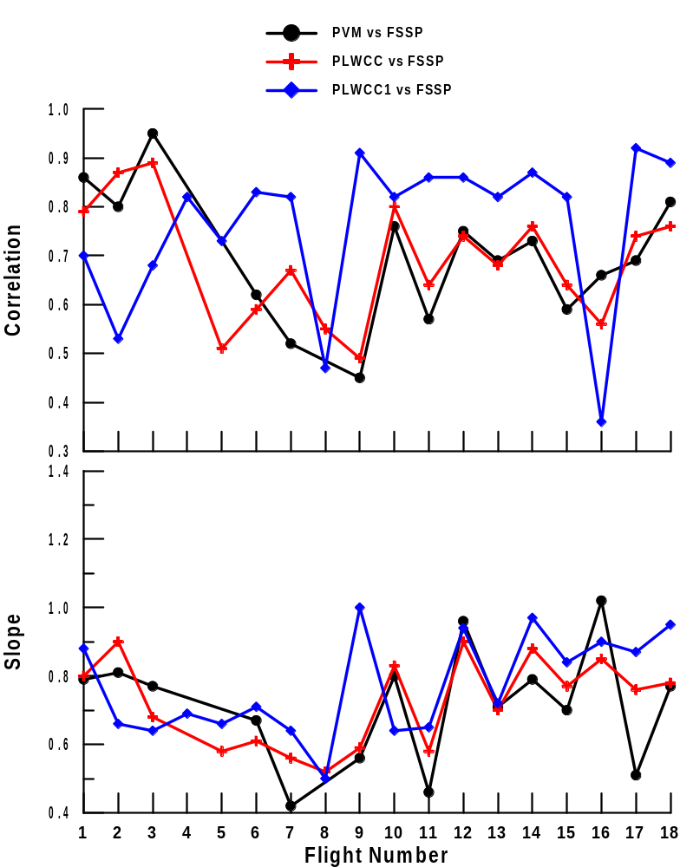
PLWCC and PVM on left wing
PLWC1 on right wing
Right FSSP
Left FSSP

Slide 6
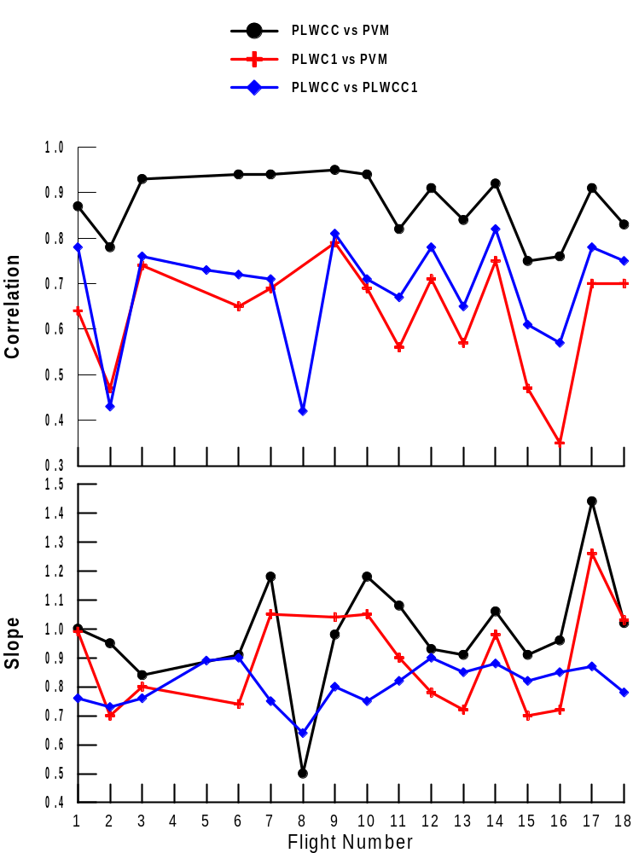
PLWCC and PVM on left wing
PLWC1 on right wing

Slide 7
Assessment
of LWC Data Quality
The correlations between LWC measurements made on the same wing are excellent, i.e.
PLWCC Vs PVM
PLWCC Vs Left Wing FSSP (Flights 1-3)
PLWCC1 Vs Right Wing FSSP (Flights 4-18)
with R² > 0.80 during most flights.
Trend in the slopes between the FSSP and other
sensors indicates possible change in FSSP
optics, but changes in cloud types can not be
ruled out, i.e. in polluted clouds with small droplets the FSSP is in better agreement with the other probes, while in the less polluted clouds with larger droplets, there is less agreement.
A comparison of correlations between sensors on the same and opposite wings provides a measure of the scale of cloud structure, i.e. separating sensors by approximately 30 m decreases correlatiions from > 0.90 (PLWCC vs PVM) to < 0.70 ( PLWC1 vs PVM).

Slide 8
Data Products
Cloud Statistics*
Flight Date = 21699 Research Flight # 1
Cloud Pass # 1 From 12:46:38 To 12:46:41
Latitude = 9.9333 Longitude = 8.8143
Altitude = 768.m, Cloud Width = 328.m
Temperature (C) Avg. = 20.922 Min. = 20.843 Max. = 21.06
Pressure (mb) Avg. = 928.22 Min. = 928.14 Max. = 928.31
Wind Speed (m/s) Avg. = 4.292 Min. = 3.861 Max. = 4.56
Wind Direction(deg) Avg. = 10.393 Min. = 8.374 Max. = 12.79
Vertical Wind (m/s) Avg. = 0.438 Min. = 0.209 Max. = 0.85
FSSP Conc. (cm-3) Avg. = 195.61 Min. = 54.165 Max. = 414.9
260X Conc. (/l) Avg. = 0.000 Min. = 0.000 Max. = 0.00
Med.Vol.Diam (um) Avg. = 13.187 Min. = 12.829 Max. = 13.85
FSSP LWC (g m-3) Avg. = 0.122 Min. = 0.008 Max. = 0.24
King LWC#1 (g m-3) Avg. = 0.090 Min. = 0.021 Max. = 0.14
King LWC#2 (g m-3) Avg. = 0.064 Min. = 0.036 Max. = 0.10
Gerber LWC (g m-3) Avg. = 0.056 Min. = -0.022 Max. = 0.15
* Flight by flight files can be ftp'd
anonymously from:
raf.atd.ucar.edu,
in directory:
pub/darrel/indoex
Filename convention:
102rfxxCloudStats.dat
xx = flight #, e.g.,rf05,rf13, etc.

