Slide 1
Aerosol Characteristics and Cloud-Nucleating Abilities
Cynthia Twohy,
Lynn Russell, James Anderson,
Monica Rivera
Acknowledgements:
Errol Korn, Chuck Brock

Slide 2
Scientific Questions to be Explored
What are the components of the atmospheric aerosol and which particle types and sizes are incorporated into clouds? (relative roles of sulfate, carbonaceous, sea-salt particles)
What kind of organic material is present and how does it affect cloud nucleation?
Are aerosol chemical and size characteristics consistent with CCN characteristics? (Do the measurements of real atmospheric aerosols deviate from simple growth theory for pure soluble substances?)
Can we see differences in pristine and non-pristine environments?

Slide 3
Possible Aerosol Particle Types at High RH
Simple Solution Particle Embedded Insoluble Material Surface Active Organic Film
Embedded Partly Soluble Material Soluble Trace Gases Aggregates

Slide 4
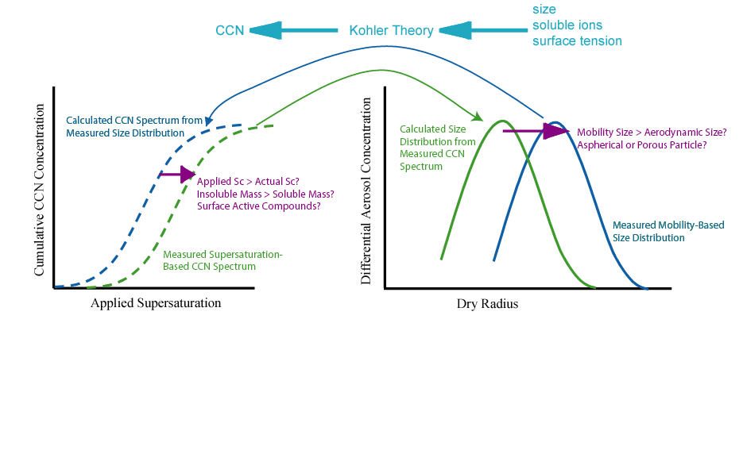

Size + Composition = CCN?

Slide 5
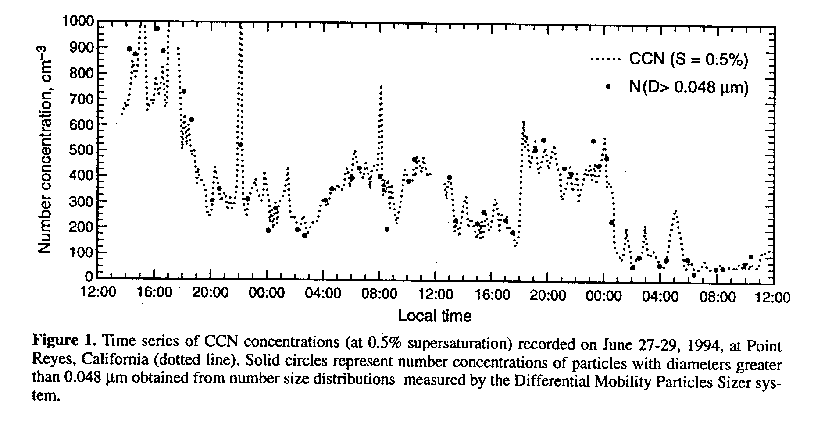
Do organics act as CCN?
Rivera-Carpio et al., 1996

Slide 6
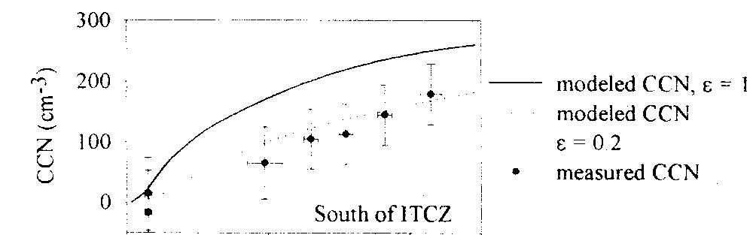
“Clean” particles may not act like sulfate
0.0 0.2 0.4 0.6 0.8 1.0
Supersaturation, %
Cantrell et al., 2000

Slide 7
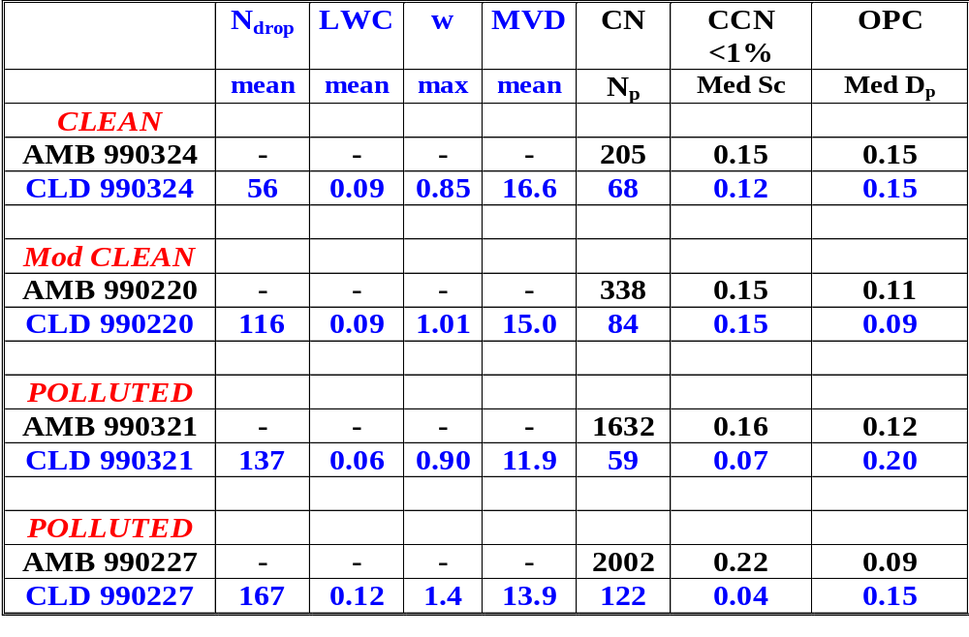
INDOEX Results

Slide 8
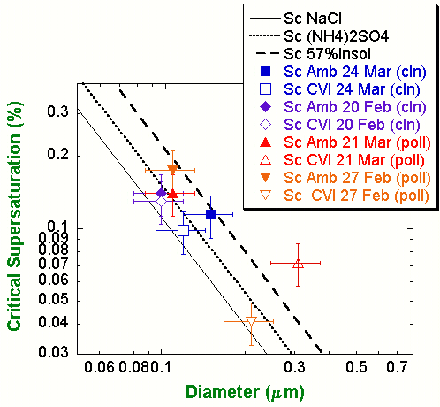
Measured Diameter vs Critical Supersaturation
Median Values Only
Median values presented before—wide variation but generally as expected
Median Sc of droplet residuals (hollow) always lower than that of ambient, greater difference in polluted clouds (higher N, lower S)

Slide 9
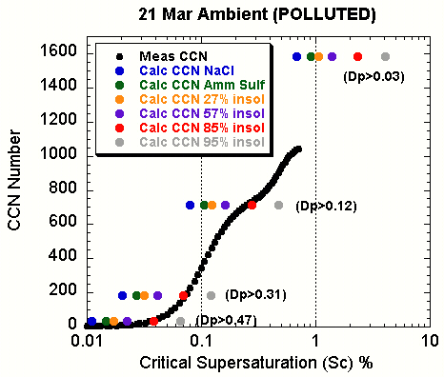
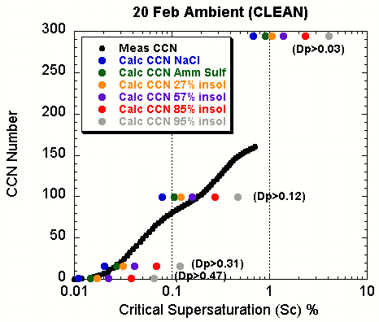
Measured vs. Predicted Spectra
Polluted Clean

Slide 10
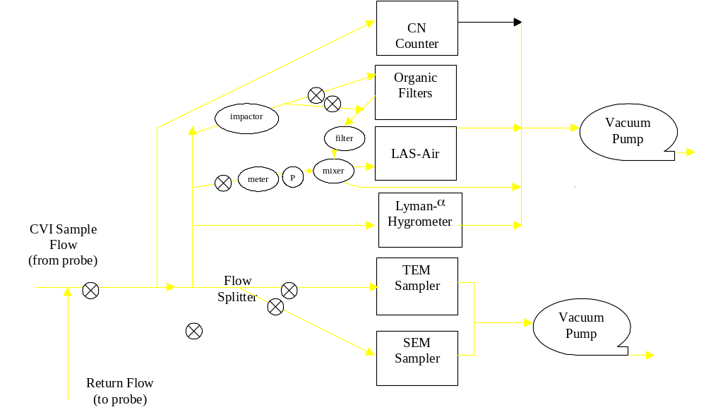
DYCOMS Counterflow Virtual Impactor

Slide 11


DYCOMS Progress to-Date
Calibrated two OPCs
Calibrated impactor
Calibrated losses in portions of system
Processing CVI CN, Lyman, LASAIR
Processing SDI (ambient) LASAIR
Above data to archive by end of April
SEM samples R3 and R5
All filter samples analyzed (LR, MR)
Interesting stuff still to come

Slide 12
DYCOMS issues
Data system problems
Trying to match impactor characteristics between SDI and CVI systems (RH, flows, bounce)
Ubiquitous drizzle causes breakup of drops & spurious CN counts

Slide 13
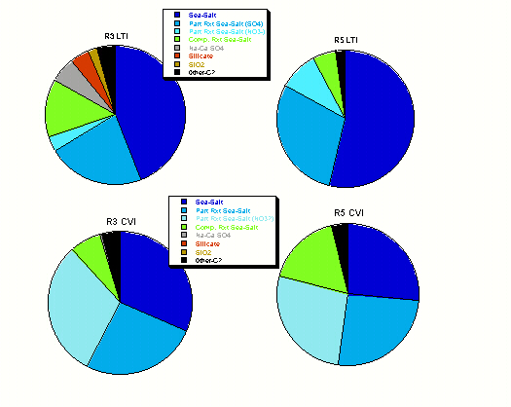
Preliminary SEM Results (% by N; D_{p}>0.2 μm)
        Sea-salt predominates in most particles
        CVI samples have more reacted sea-salt than below cloud
        CVI samples have less mineral components than below cloud

Slide 14

Future Work
Compare LAS-AIR to other sizing instruments
Compare aerosol chemistry and size to CCN measurements—closure?
Examine relative importance/speciation of organics vs. inorganics, effect on CCN?
Compare ambient aerosol to CVI (bulk and single particle chemistry, size distribution)

Slide 15
Conclusions
Measured vs predicted CCN # similar to values found by others
Generally, particles do not behave as pure sulfates, but like ammonium sulfate with 57%-85% insoluble material
With bulk composition (57% insoluble + organics), suggests organics inert or possibly inhibiting activation (uncertainty)
Solubility characteristics of “clean” clouds So. of ITCZ similar to polluted ones. Unknown if due to pollution crossing ITCZ or natural substances with low solubilities or surface effects

