Slide 1
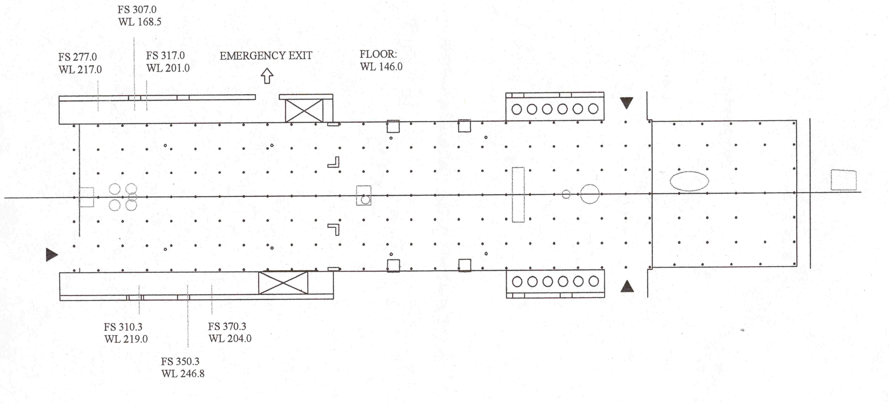
FINAL C-130 LAYOUT FOR PASE
7/13/07
SDI
LTI
All 6 slots in use
Hudson
CCN
CCN
Neph
U of H
Aerosol
MOUDI
AEROS
Seat
U of H
AMS
2 GV
racks
APIMS
2
Seat
RAF
Chem
2 GV
racks
Seat
RAF
Aerosol
&
storage
Seat
Seat
Seat
Seat
Heikes
TAS
CIMS
cylinders
Seat
LTI
Pump &
controls
TAS
Pump
SICIMS
Seat
APIMS
3
Seat
APIMS
4
Seat
Seat
ADS
Seat
Seat
Seat
CIM
All 6 slots in use
TAS
H2O
H2O2

