Slide 1



CoMP L2 Data Guide
Scott McIntosh (mscott@ucar.edu)
Christian Bethge
Hui Tian
Steve Tomczyk (tomczyk@ucar.edu)
Leonard Sitongia
Last Update: 5/16/2012

Slide 2
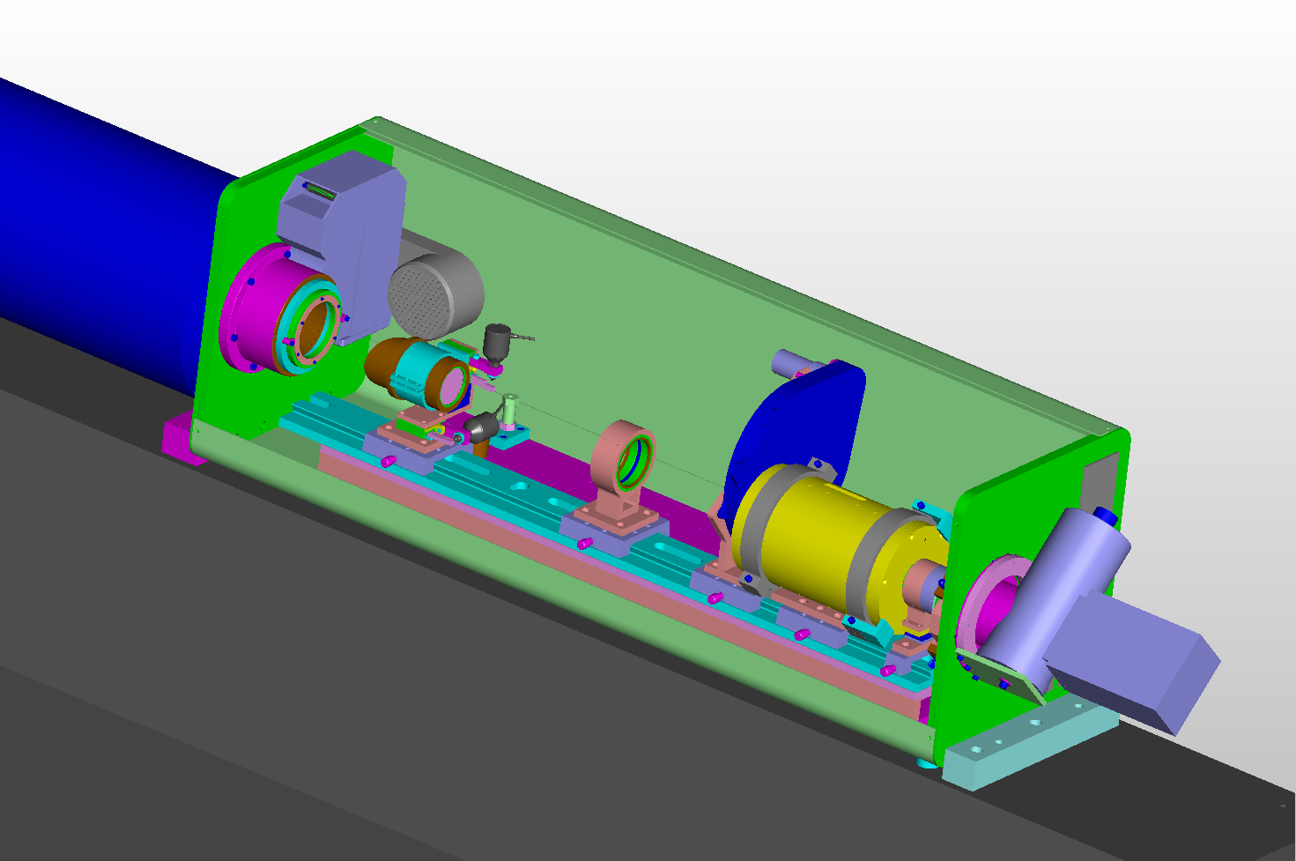
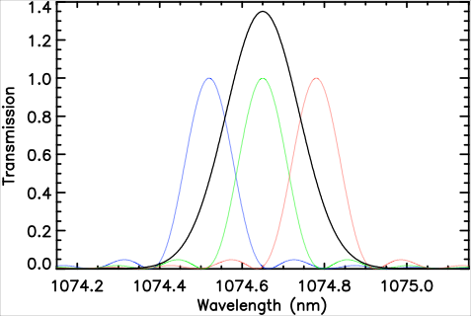
CoMP Instrument
CoMP L2 Data Guide
Calibration Polarizer Stage
Light Trap
Occulting Disk
Collimating Lens
Pre-Filter Wheel
Filter/Polarimeter
Re-Imaging Lens
Detector
CoMP Using three Lyot filter settings to measure Stokes I of the Fe XIII 1074.7nm line
CoMP Pre-filter Set:
FeXIII 1074.7nm
Fe XIII 1079.8 nm
HeI 1083.0 nm
Measures Stokes I, Q, U, V
0.14 nm bandpass
2.8 R_{sun} Full Field-of-View
4.5 arcsec/pixel
Linear Polarization → POS Magnetic Field Direction
Circular Polarization → LOS Magnetic Field Strength
Doppler Shift → Velocity
For more information about CoMP see the instrument paper:
http://adsabs.harvard.edu/abs/2008SoPh..247..411T

Slide 3
CoMP L2 Data Guide
Level 2 CoMP FITS files come in two flavors:
The “Dynamics” Dataset
[One FITS file per observation]
[Each of the below is a binary extension in the FITS file]
1. Line Peak Intensity
2. Edge Enhanced Line Peak Intensity
3. Doppler Velocity
4. Line Width
The “Polarization” Dataset
[One FITS file per observation]
[Each of the above is a binary extension in the FITS file]
1. Line Peak Intensity
2. Edge Enhanced Line Peak Intensity
3. Integrated Stokes Q
4. Integrated Stokes U
5 Total Linear Polarization LTOT (= √(Q²+U²) )
Note that the Field Azimuth (=1/2 tan⁻¹(U/Q)) is not provided but can be easily computed.
This file contains information on those measurements and the steps taken to produce the FITS files.
CoMP FITS files should be readable by all standard FITS reading software.
FITS Name Format: YYYYMMDD.HHMMSS.comp.wavelength.flavor.N.fts
N is the # of filter positions

Slide 4
CoMP L2 Data Guide
Current CoMP L2 Data Caveats & Notes
This is an evolving list and will be edited as factors change/develop.
At present (5/16/12) CoMP is only taking measurements in the Fe XIII 1074nm line. As our experience with the CoMP setup improves we will expand to Fe XIII 1079nm and He I 1083nm observations.
Users are pointed to http://adsabs.harvard.edu//abs/2007ApJ...662..677J for a complete discussion of the issues relating to CoMP-like measurements of coronal polarization (and http://adsabs.harvard.edu/abs/1972SoPh...23..103H)
In addition to movies and daily average sample images the daily CoMP data web page provides two means for the user to access CoMP data:
Two gzipped tar archives containing collected FITS files for the observations taken that day in the “dynamics” and “polarization” data sets. These FITS files should be readable by standard FITS software.
An ASCII file listing so that users can use “wget” or “sock_copy” command line functions.
Three and Five filter position CoMP data are available. The complete file listing for the day is available on the web interface. At present (5/16/12) the five position data is treated like three position data (the five position measurements have systematically higher line width values because of longer exposure times). In the daily file listing these measurements are easily identified in the file naming structure (see previous slide).
The enhanced intensity images use unsharp masking to bring out the coronal structures. We will release the IDL code that enhances our peak line intensity images
Values lower than 2 millionths of the sky brightness (intensity) are not fitted (and are omitted from the files). Users are reminded to be careful with the determined velocities where the intensities weak (<5 millionths)
Field azimuth calculations are subject to the 90˚ “Van Vleck Ambiguity” which is an effect resulting from atomic polarization in certain circumstances. We are exploring means of “resolving” this ambiguity (see the linked articles above for more information).

Slide 5
CoMP L2 Data Guide
“Dynamics” Extension One: Peak Intensity
Line Intensity
A measure of the amount of visible plasma along the line of sight

Slide 6
CoMP L2 Data Guide
“Dynamics” Extension Two: (Enhanced) Peak Intensity
Line Intensity
A measure of the amount of visible plasma along the line of sight
A “radial intensity filter” developed by Blake Forland is used to enhance the coronal structure observed by CoMP.

Slide 7
CoMP L2 Data Guide
“Dynamics” Extension Three: (Corrected) Doppler Velocity
Toward
Away
Doppler Shift
A measure of the flow velocity of visible plasma

Slide 8
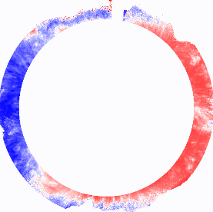
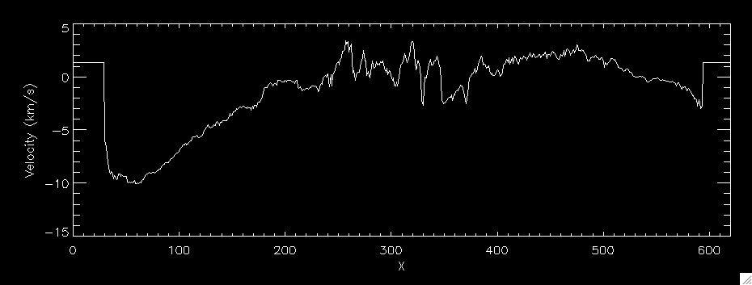
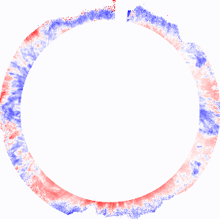
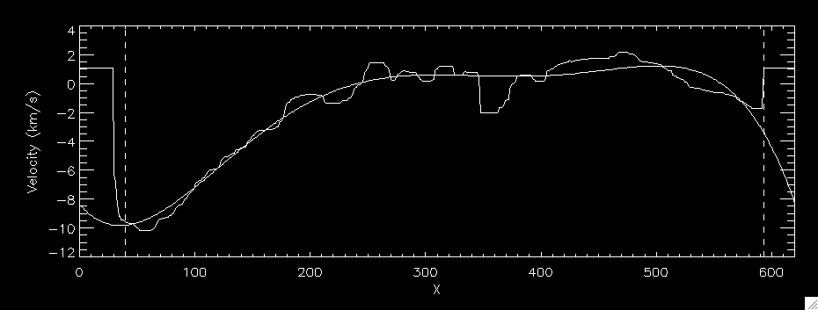
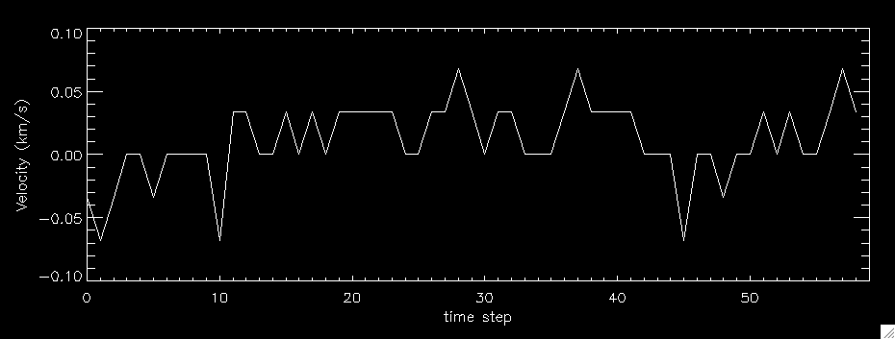

CoMP L2 Data Guide
“Dynamics” Extension Three: (Corrected) Doppler Velocity
(East-West = the intensity-weighted coronal rotation profile)
Uncorrected
CoMP 1074nm Doppler Image
1. Median filter of the East-West trend: eliminate possible abnormal values
Text
Subtract the East-West and Time-varying Doppler Velocity Trends
East-West
Trend Removed
2. 5th order polynomial fit to the filtered trend
Assume the median value of the Doppler shift is zero for each frame
Corrected CoMP
Doppler Image

Slide 9
CoMP L2 Data Guide
“Dynamics” Extension Four: Line Width
Doppler Width
A measure of the plasma velocities too close together to be detected individually.

Slide 10
CoMP L2 Data Guide
“Polarization” Extension Three: Integrated Stokes Q

Slide 11
CoMP L2 Data Guide
“Polarization” Extension Four: Integrated Stokes U

Slide 12
CoMP L2 Data Guide
“Polarization” Extension Five: Total Linear Polarization

Slide 13
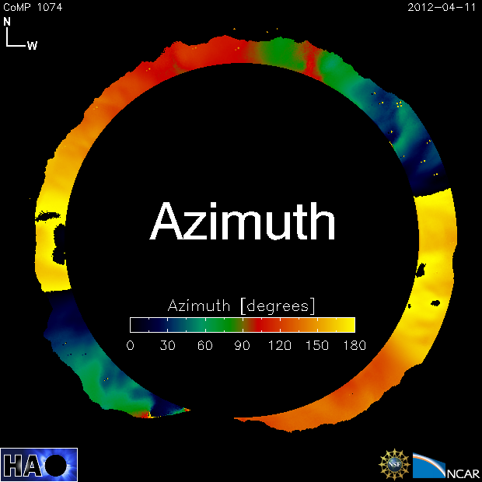
CoMP L2 Data Guide
Derived Field Azimuth
Field Azimuth (=1/2 tan⁻¹(U/Q))

Slide 14
CoMP L2 Data Guide

