Slide 1

METplus: Continuous integration with GitHub Actions for reproducible results and reduced software vulnerabilities
John Halley Gotway*, George McCabe, Michelle Harrold, Minna Win-Gildenmeister, Julie Prestopnik, Howard Soh
6 November 2025 | *johnhg@ucar.edu
Notes:
Good afternoon. My name is John Halley Gotway. I’m a software engineer in the NCAR’s Research Applications Lab and also work for the Developmental Testbed Center.
I’d especially like to acknowledge my co-authors. Michelle Harrold leads the METplus project team, and she gave a great overview of the purpose and functionality of the METplus software. The rest of us are engineers who work on the METplus software components. And in particular, I’d like to acknowledge George McCabe who’s really led the way on our teams adoption of GitHub actions.
I’ve been working on the Model Evaluation Tools, or MET, software since I joined NCAR in 2004. And in that time, I’ve learned a lot about community software, some aspects of which I’ll discuss today.

Slide 2
Community Software Considerations
more than new features
Funding for functionality and New Features
Version control (cvs, svn, git)
Continuous integration (regression testing and test coverage)
Continuous deployment (containers, conda)
Code quality (Fortify, SonarQube static code analysis and optimization)
Security scanning (CVEs and STIGs)
Development and release workflows (new features and bugfixes)
Internal communication (email, meetings, Slack)
Project management (Jira, GitHub issues, PRs, and projects)
Documentation (Users, Contributors, and Developers, DOIs)
User training (online tutorial, pre-recorded videos, live sessions)
User support for sponsors and community (email, GitHub discussions)
User outreach and marketing (proposals, presentations, social media)
Notes:
When it comes to community software in general, folks are most excited about the functionality of that software and, in particular, new features that could be added. And usually proposals for new funding are heavily focused on adding those new features.
But there’s a whole lot to work required to do a great job developing and supporting community software. And I’ve listed many of those things here.
TALK THROUGH THE BULLETS <CLICK><CLICK><CLICK>
I’m sure this list is not exhaustive.
And I could spend this entire talk on any one of these bullets.
So while the funding is usually focused on new features, the challenge is in leveraging that funding to make progress in all of these areas.
And I’ll note that I really appreciate our USAF funding since they do prioritize improvements in code quality in particular.

Slide 3
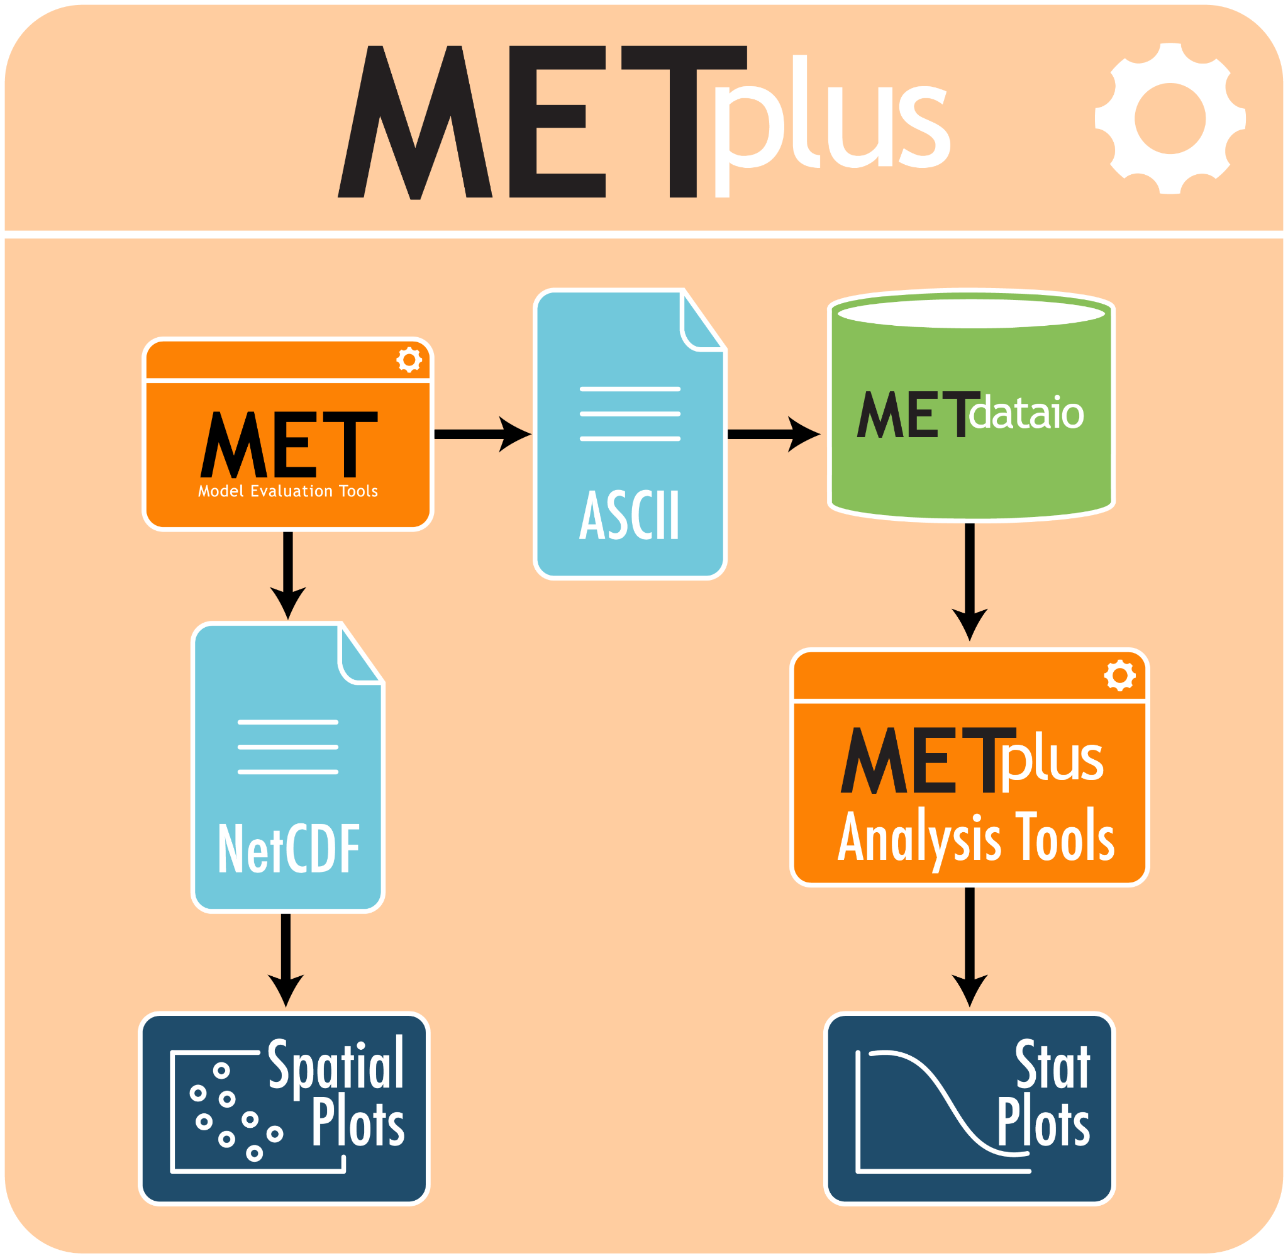
Functionality through Time
growth and expansion
Notes:
Michelle already gave a great overview of the purpose and functionality of METplus. So I don’t need to spend any time on that.
Here, we see a flowchart showing the software components of the METplus system. And the little box for MET in there is where we started.
<CLICK>
MET is a series of command line tools written mostly in C++, but with some FORTRAN and Python baked in. This wire diagram illustrates the evolution of MET functionality through time, from the first version in 2008 to the most recent 12.2 version being released this week. The gray boxes represent file I/O and the colored ovals represent the applications.
I’ve given plenty of presentations over the years about what each application does and how you can configure them and string them together to answer questions about your data. In fact, that’s really what each METplus use case does.
But this animation illustrates that the number and functionality of these tools have grown significantly over the years.

Slide 4
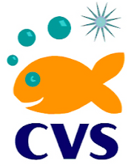

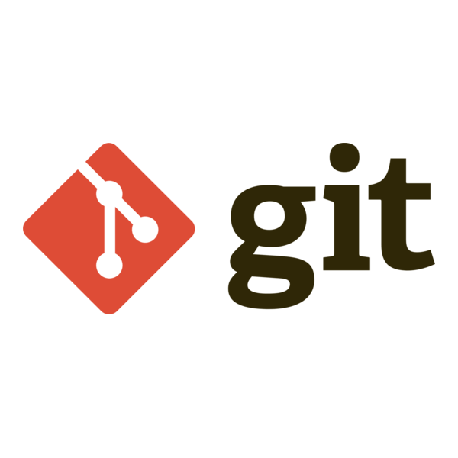





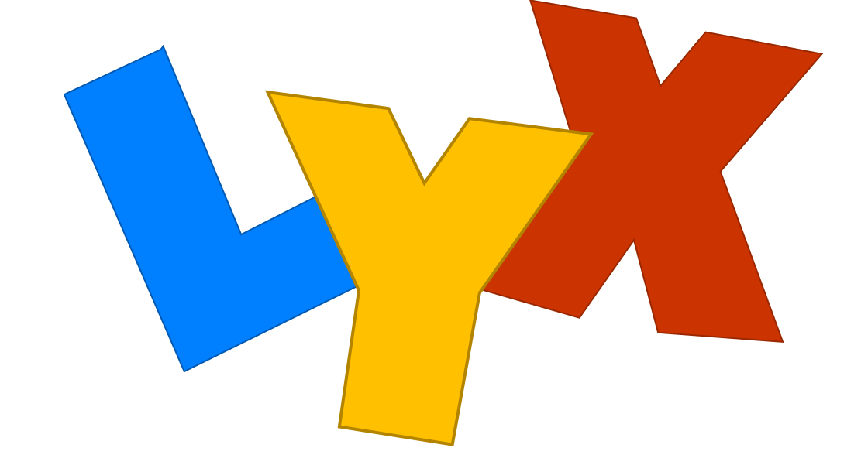




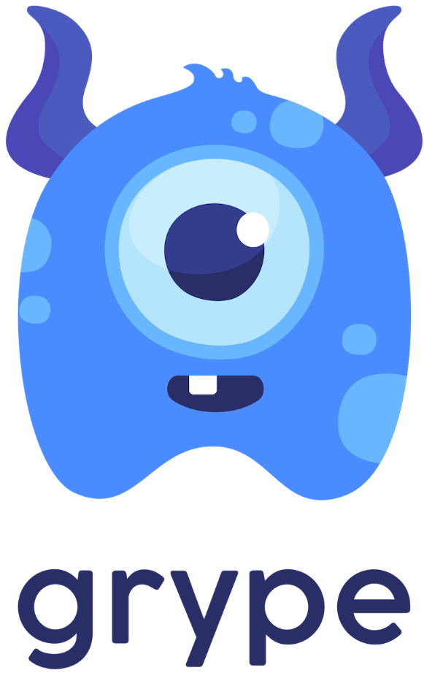
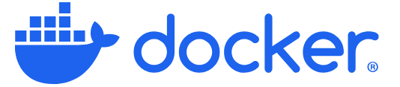
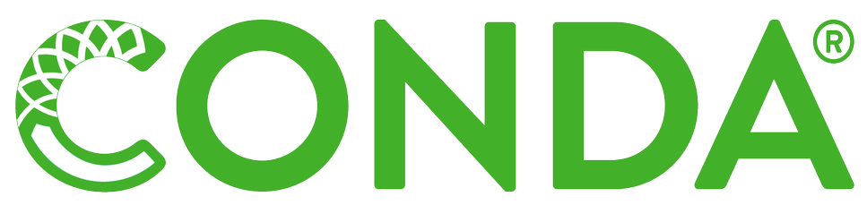
Support Tools through Time
evolution
VCS
TEST
PROJ
2010 2015 2020 2025
DOC
SCAN
DIST
Notes:
Just as the functionality of the software has grown, the tools we leverage to support it have evolved as well.
<CLICK>
Version Control: cvs (2008) > svn (2009) > git (2019)
<CLICK>
Testing: started with shell scripts for local nightly build testing (v4.0 in 2012) > migrated to GitHub actions (2019)
<CLICK>
Project Management: Jira (<2019) > GitHub Projects (2019) and we’ve refined our use significantly since
<CLICK>
Docs: Word > Lyx based on LaTeX (v5.1 in 2015) > RTD (v9.1 in 2020), Zenodo for DOI’s (v10.1 in 2022)
<CLICK>
Scan: Fortify (v8.1.1 in 2019) > was replaced by SonarQube (2021) > added Grype to scan for CVEs (2025)
<CLICK>
Code Distribution: Docker (v8.0 in 2018) > added Conda (2025)
Not shown here, but in terms of user support:
Started with email
Quickly began using an internal ticketing system named “RT” in conjunction with the UCAR Mailman
In 2021, migrated over to using GitHub discussions
The real benefit is making previously answered questions fully public and searchable.

Slide 5






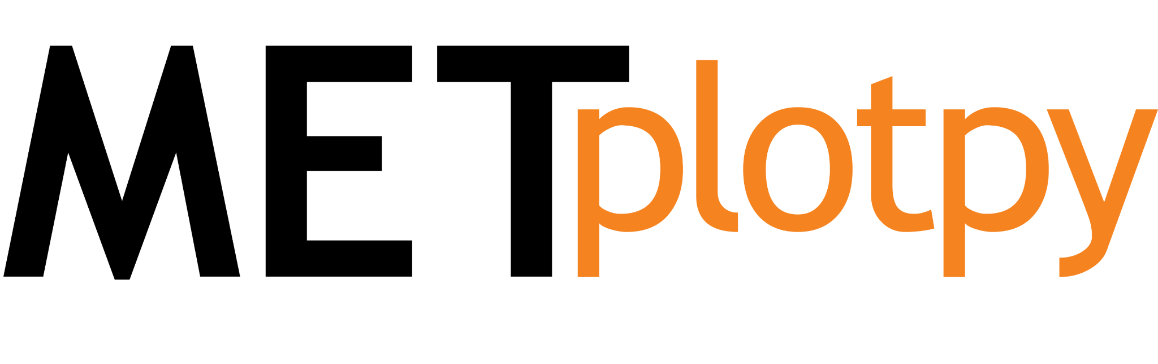
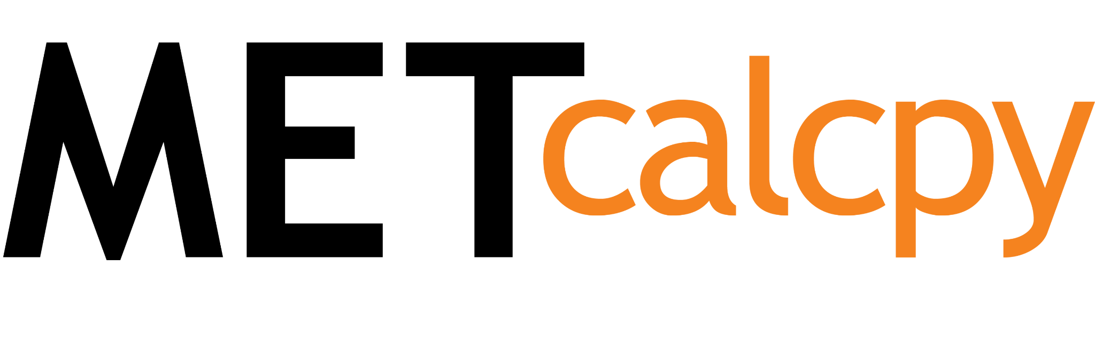

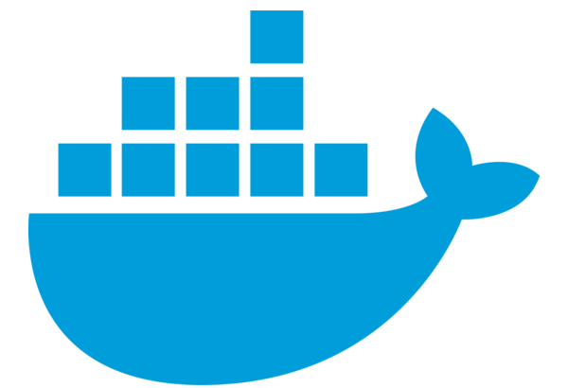
DTCenter GitHub Organization
Nonprofit Status
GitHub Teams
77 users ($3.7K)
Actions ($6K)
Docker Hub DSOS
10 users ($2K)
Slack Pro
23 Users ($2K)
repository hierarchy
metplus-action-...
scan-docker-images, free-disk-space,
data-update, trigger-use-case,
release-checksum, sonarqube,
build-documentation
METbaseimage
Notes:
In 2019, one upside of working fully remotely is that it prompted our team to adopt all things GitHub.
However, the Developmental Testbed Center is an organization sponsored by USAF, NCAR, and NOAA. So rather than hosting our code repositories in one of those GitHub organizations, we created a new one for the DTC.
It houses a total of 42 repositories, many used by METplus, plus those for other DTC activities.
So we have the top-level umbrella METplus repository here which houses all the use-case examples that Michelle described.
<CLICK>
METbaseimage is a small repository that provides Docker images in which the METplus components are built, tested, and distributed.
<CLICK>
One base image provides the build environment and dependent libraries for MET, and then METplus is layered on top of that.
<CLICK>
Another base image provides the build environment and dependencies for METviewer, including the other METplus-Analysis components.
<CLICK>
And separately, the METexpress display system only partially depends on the METplus-Analysis repositories.
<CLICK>
The DTCenter organization also includes 7 repositories for re-usable GitHub actions. George McCabe has created these, and I’ll talk more about them later. Rather than reimplementing the same functionality in multiple repositories, we store each custom action in its own repository and then reference it in the GitHub actions workflows from multiple places.
<CLICK>
Lastly, I’ll note that the DTCenter qualifying for non-profit status gets us a lot of benefits we otherwise would not enjoy.
Our free access to GitHub teams and actions saves us nearly $10K per year.
Being part of the Docker Sponsored Open Source program is a benefit of about $2K per year.
And our free use of Slack Pro is another $2K per year.
I see these tools as essential to our workflows anc communication. They are certainly worth the $14K/year we’d otherwise be paying.

Slide 6
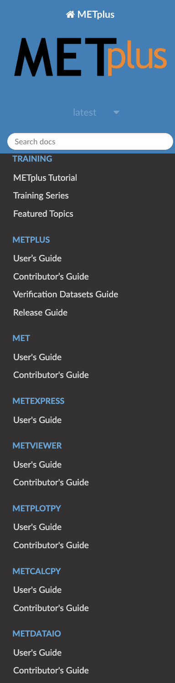
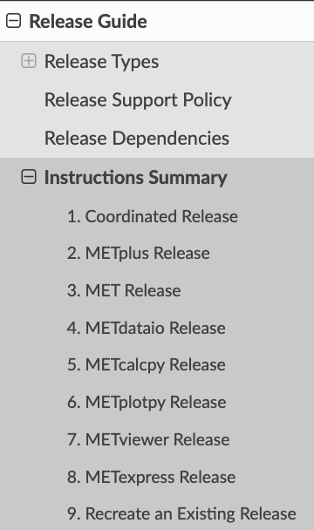
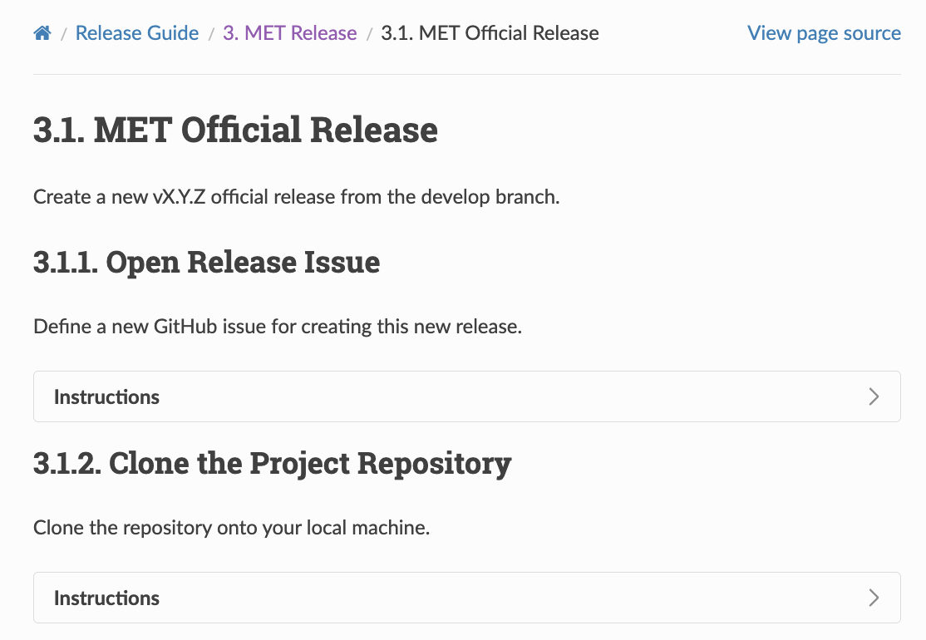
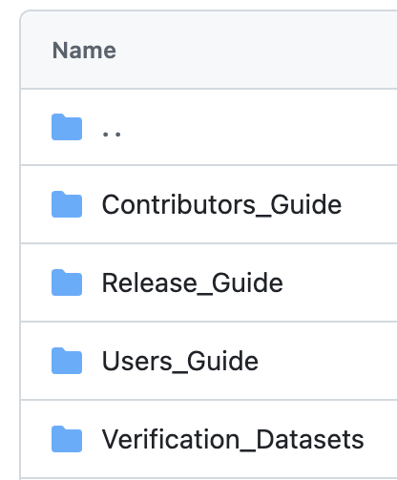
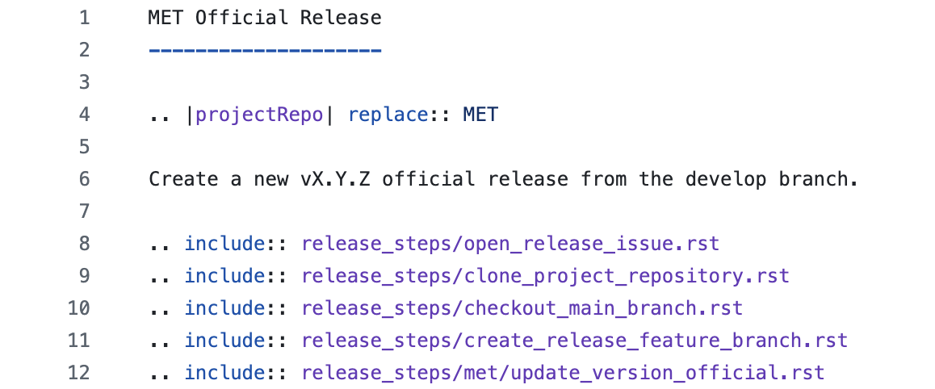

METplus Release Guide (RTD)
metplus.rtfd.io
Notes:
Our transition to Read-The-Docs in 2019 was significant. Here we see the doc directory in the METplus repository.
This enables the docs to live right next to the code, which dramatically improves the accuracy of the docs.
<CLICK>
In fact, our Pull Request template includes this standard question for the reviewer to ensure that the docs have really been updated for these changes, if needed.
<CLICK>
These docs from the METplus repository are combined with docs from all the other METplus repositories and served up through a single landing page.
This is a change that Julie Prestopnik handled last year. Collecting all the docs in one spot makes this much easier for the user.
<CLICK>
But I’d actually like to highlight the “Release Guide” whose content is used by developers, not users.
It starts by defining the different types of releases we create, ones for development, official releases, and then bugfixes.
And for each, we document the release steps. At first I was skeptical, thinking this isn’t really needed, but I’m now a believer. If you want to make something repeatable, WRITE IT DOWN.
<CLICK>
For example, we’re cutting an official MET release this week, and I’ll follow these instructions in section 3.1 to do so. It makes the results so much more repeatable and also make its realistic for us to backfill for each other.
<CLICK>
I’ll also point out that we do NOT just have the same content duplicated. Instead, we store details about each step in the “release_steps” directory and then include them in the correct order. In this list, the first 4 steps are common to all the repositories, but the 5th step about updating the version number, contains specific instructions that only apply to the MET repository.
So even when it feels over the top and pedantic, I’d recommend erring on the side of taking the time to write down your procedures. That’s how you get reproducible results.

Slide 7
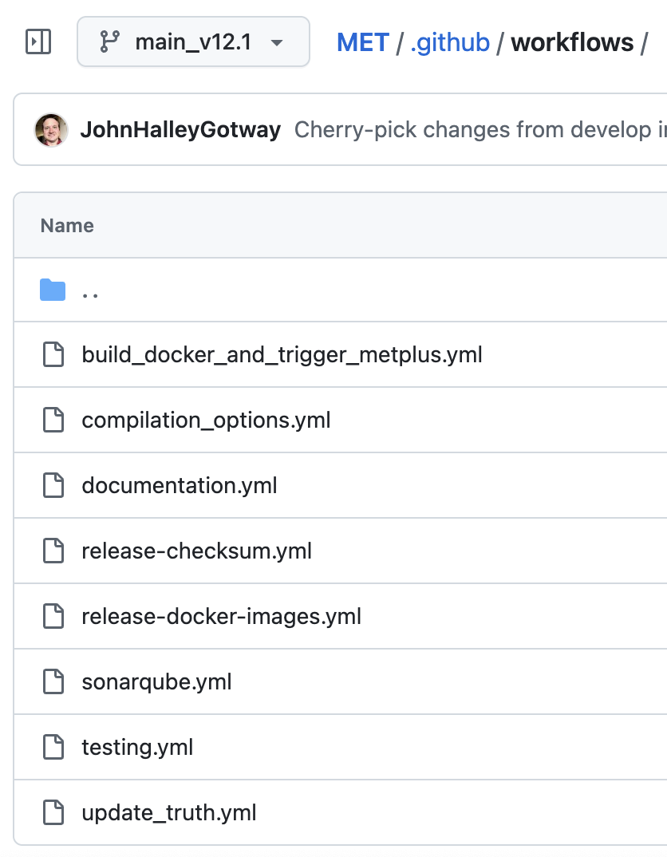
GitHub Actions Overview
workflow automation
METplus (9)
MET (8)
METexpress (9)
METviewer (7)
METplotpy (6)
METcalcpy (8)
METdataio (9)
METbaseimage (3)
Notes:
I’d like to spend my remaining time discussing GitHub actions, whose use has been a significant investment for us but has provided huge dividends.
Here you see the number of workflows in each METplus component repositories.
<CLICK>
In each repository, workflows are housed in the standard “.github/workflows” location.
And each workflow is defined by a YAML file. Here we see the 8 workflows defined in the MET repository.
And I want to give another huge shout out to George McCabe, who’s been instrumental in defining consistent functionality.
I won’t give a primer on how to define GitHub actions workflows, or even a comprehensive description of the ones we use, but I will highlight a few of them.
<CLICK>

Slide 8
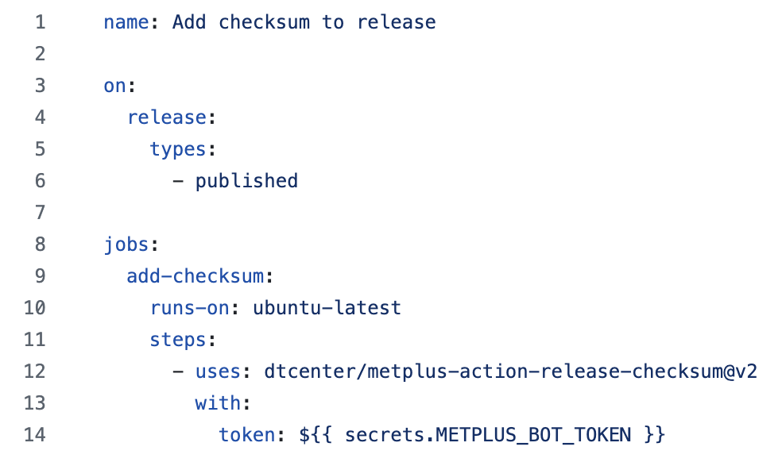
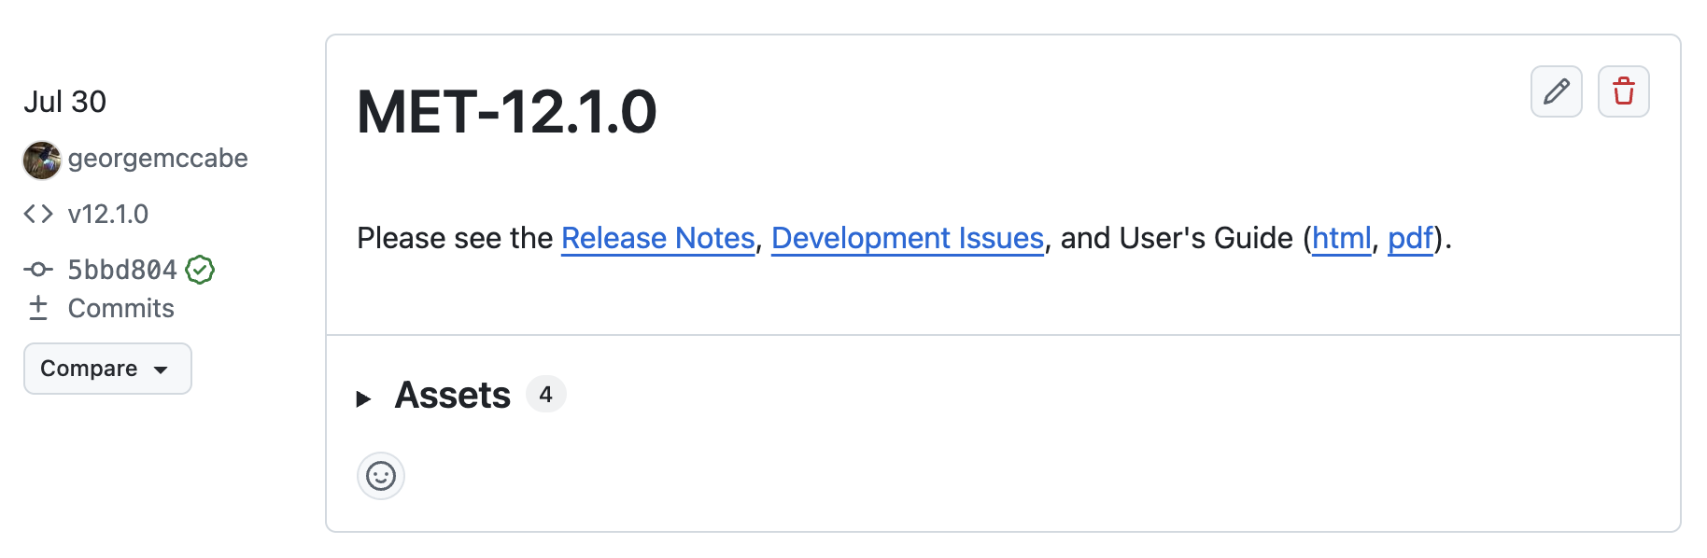
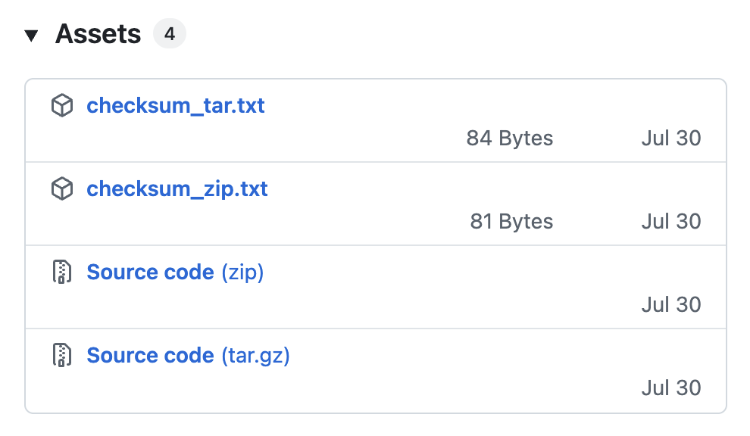
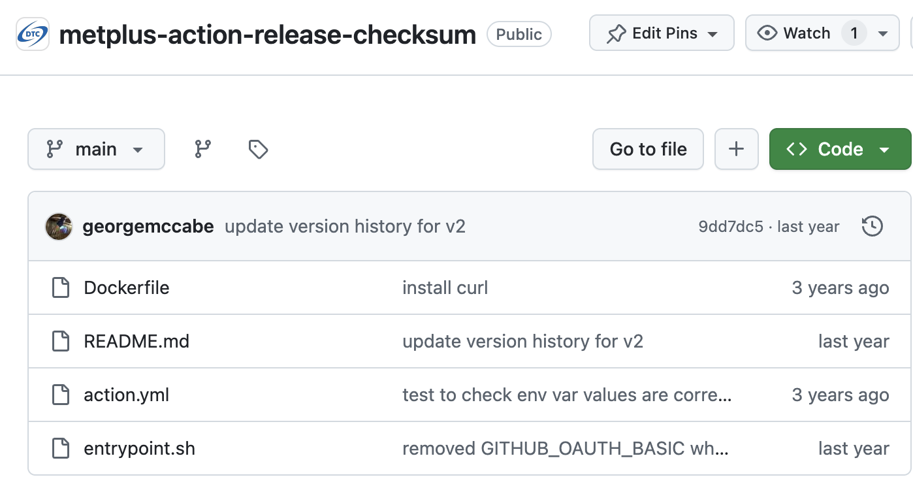
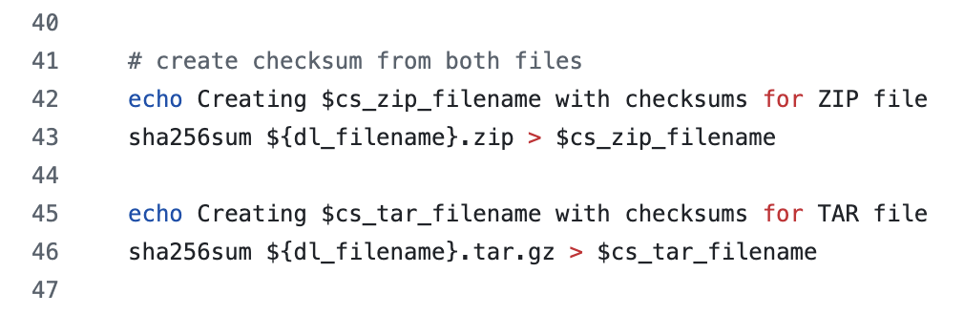
GHA: Release Checksums
release-checksum.yml
add md5 checksums
Notes:
I’ll note that our team had a requirement from the Air Force to add md5 checksums to software releases so that they verify the file they’re downloading is genuine and has not been tampered with. This is one of the requirements from the STIGs… which is short for Security Technical Implementation Guides.
Here, we see the MET version 12.1.0 release created on July 30th.
And I’ll note that it was George who cut that release. And I’ll bet he had the confidence to do because the steps were so clearly defined in our release guide.
<CLICK>
If you expand the release assets button, you’ll find these 4 files. The Source Code, in both .zip and .tar.gz format, and automatically added by GitHub, but the checksum files are not.
<CLICK>
These were added by the release-checksum.yml workflow, which is very simple. You see that the triggering event is when a release is published. Then it just runs the version 2 of this custom action.
<CLICK>
And here’s the contents of that metplus-action-release-checksum repository. A Dockerfile defines a very lightweight environment in which the commands are run. While there’s now a simpler way to accomplish this in GitHub actions that avoids the use of a Docker container, this original implementation still works fine.
<CLICK>
And ultimately the entrypoint.sh shell script is run, and around line 42 it generates the checksum files and later on, adds them as release assets.
The punchline is that rather than one of the developers needing to take action every time we create a release, we just let this automated workflow run, and we get consistent and reproducible results.

Slide 9
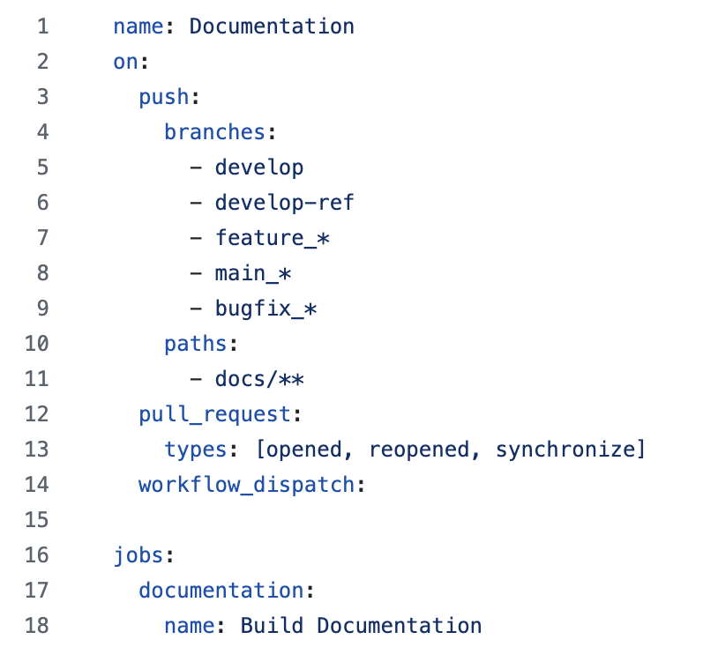
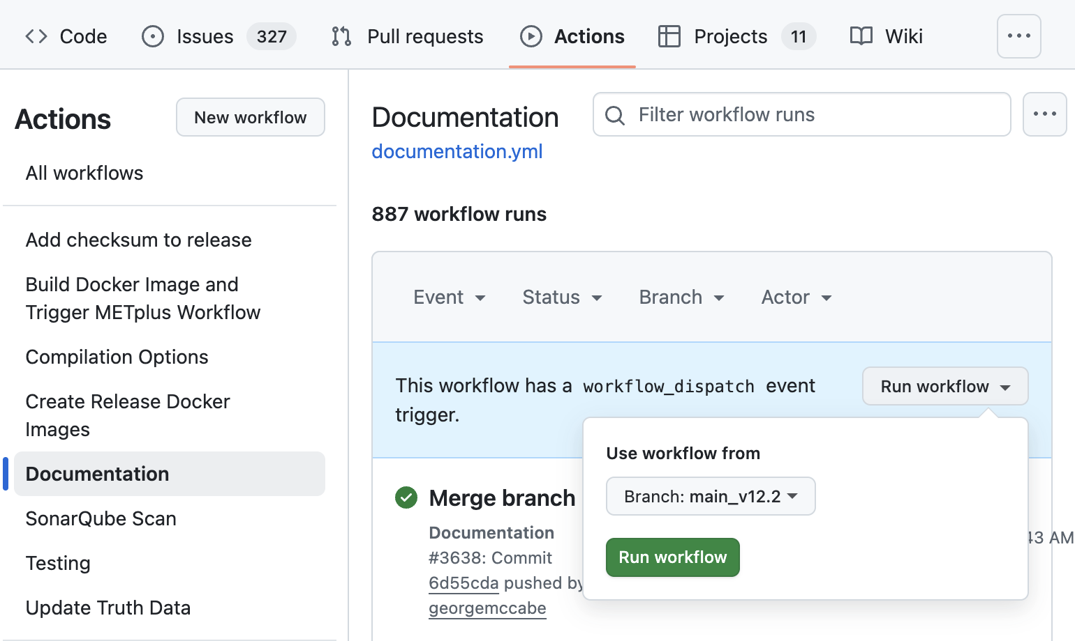
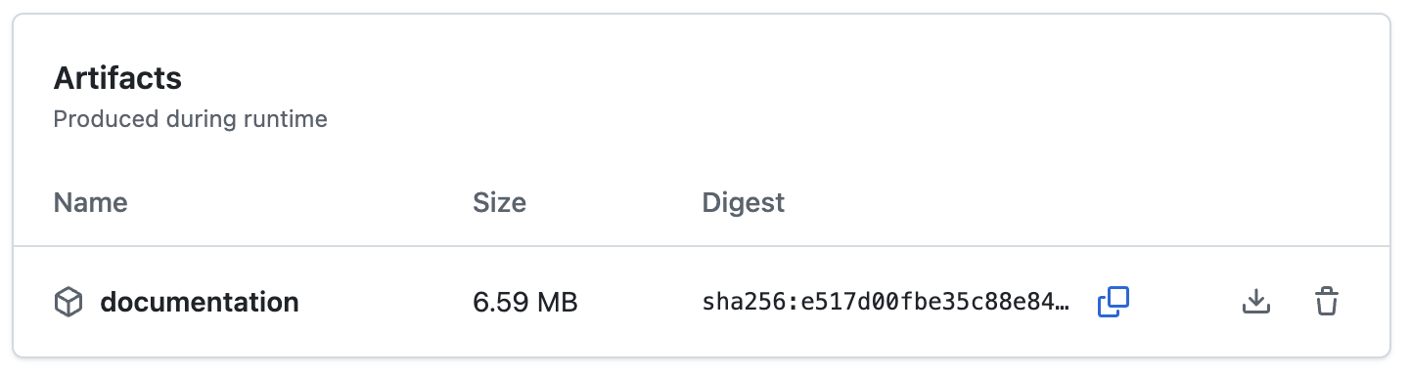
GHA: Documentation
documentation.yml
check for warnings
Notes:
Let me discuss the documentation workflow next. Note that this is NOT what drives Read-The-Docs. Instead, RTD is integrated directly with our repositories and the docs are built and rendered for each new branch, pull request, or release that gets created.
This workflow just runs a Python package called Sphinx to build the docs locally, check for any warning or error messages, and fail if any are present.
While the syntax for Restructured Text isn’t difficult, it’s pretty easy to trigger warnings. We want to know as soon as we introduce problems in the docs.
<CLICK>
Make note of all the triggering logic for this workflow.
It runs any time changes are pushed to branches that match these naming conventions.
And it’s also triggered by new or updated pull requests.
But only if changes occur within the “docs” sub-directory.
And lastly, we see “workflow_dispatch”, which means that a manual trigger is supported.
<CLICK>
On the actions tab of the repository, you’ll find a list of workflows from the default branch of that repository. Here I’ve selected the Documentation workflow and used the “Run workflow” option to manually trigger a build of the docs for the main_v12.2 branch.
<CLICK>
That workflow runs on one of the GitHub machines for about a minute.
<CLICK>
And this green checkmark means that the workflow returned good status.
<CLICK>
This job produces a documentation artifact. It’s a tar file that contains the rendered HTML for the documentation. Since we use RTD, we almost never use this documentation artifact, but it’s always there if you need it.

Slide 10
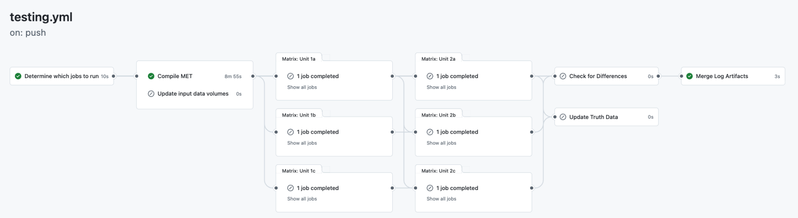
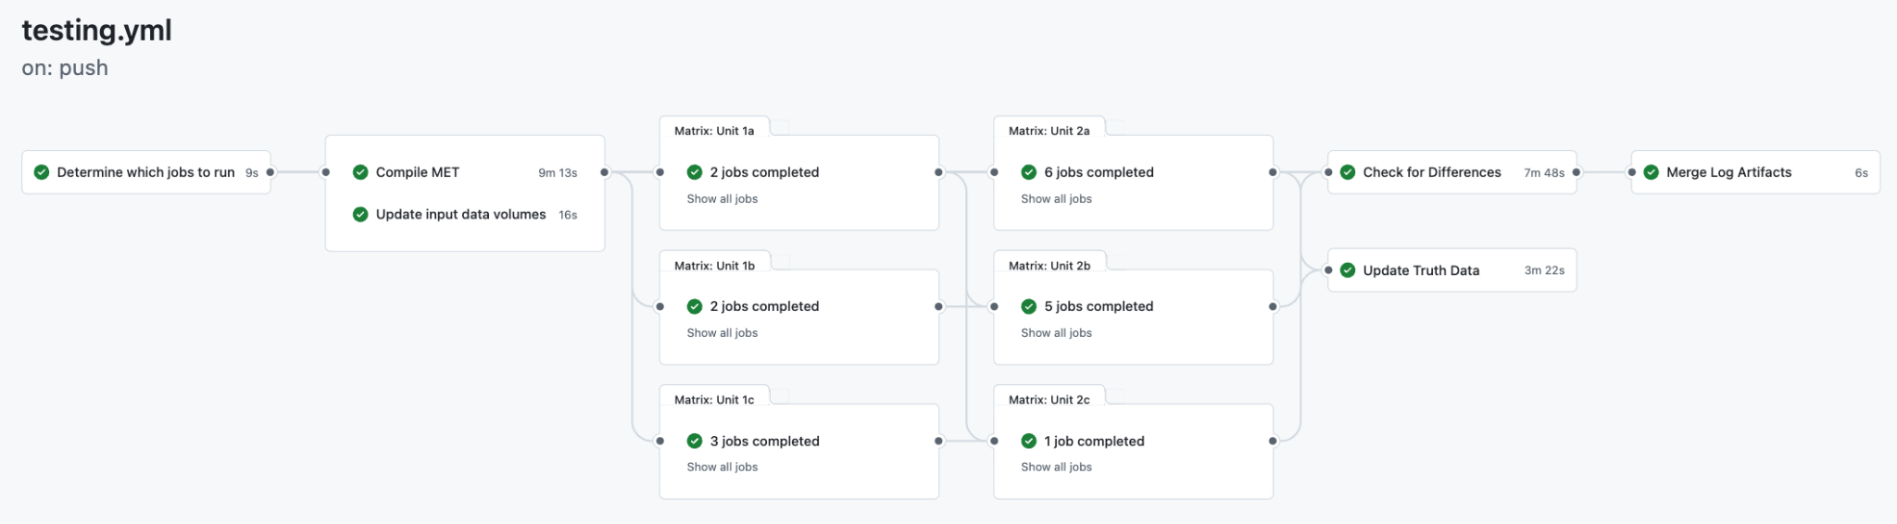
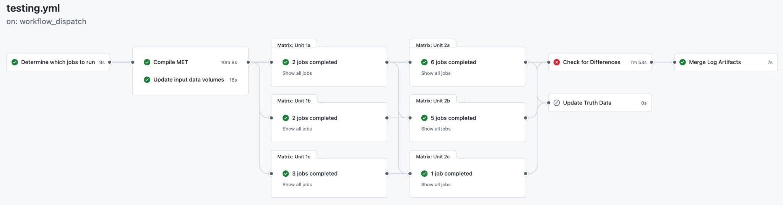
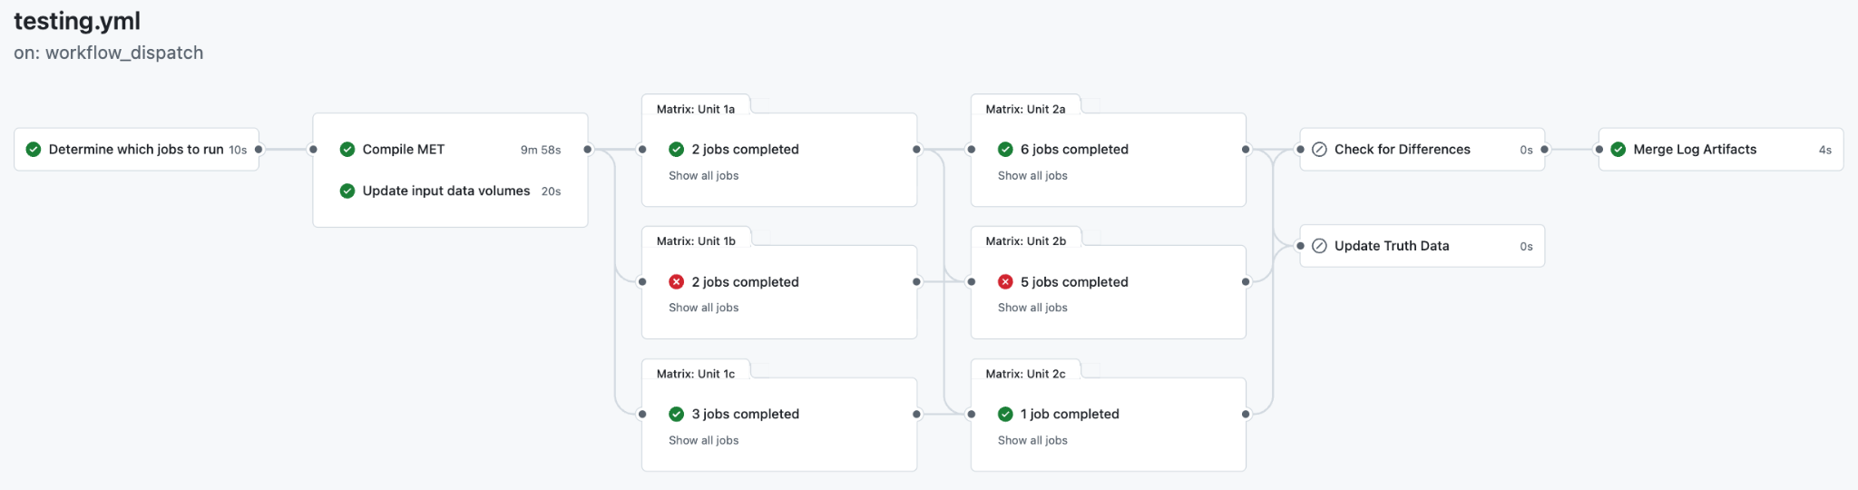
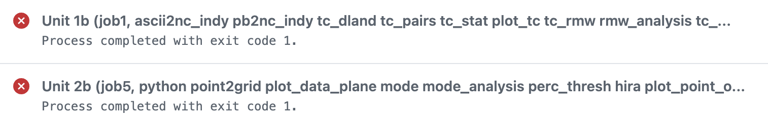
GHA: Testing Workflow
regression testing
Code Compiles
Tests Run, No Diffs
Tests Run, Diffs Found
Tests Failed
Notes:
The testing workflows can get rather complex, but are really the cornerstone of ensuring reliable results from the METplus software. They have caught many bugs and integration issues prior to the code being released, which has saved many, many hours of headaches and debugging down the line.
I’ll note that George McCabe gave a very detailed overview of the METplus testing workflow at the 2022 NCAR SEA Conference (https://www.youtube.com/watch?v=yi5ZRm5KvfQ&t=1888s).
Rather than stepping through the hundreds of lines of the YAML file which defines the MET testing workflow, let me show you some possible outcomes.
<CLICK>
When you click on a Workflow run, GitHub serves up this wire diagram of jobs which comprise that workflow.
So this workflow compiles the MET code and optionally runs a bunch of a tests and compares the output against a truth dataset.
In this first run for a push to a branch, it’s only checking that the code compiles, and all the other jobs are skipped.
<CLICK>
In this second run, the code is compiled, all the tests run, and no differences are found when compared against a truth dataset.
<CLICK>
In this third run, the code is compiled, all the test run, and differences are found. Now these diffs may be expected or not. It’s the job of GitHub to tell me if there’s any diffs. It’s my job as the developer to determine whether those diffs are expected based on my changes to the code.
<CLICK>
In this fourth run, some of the tests fail, and from my perspective, that’s always bad.
<CLICK>
Here’s the list of jobs that failed. And I, as the developer need to go figure out why and fix the problem.
There’s a whole lot of other details we could talk about, but in practice, this is how I use this workflow.

Slide 11
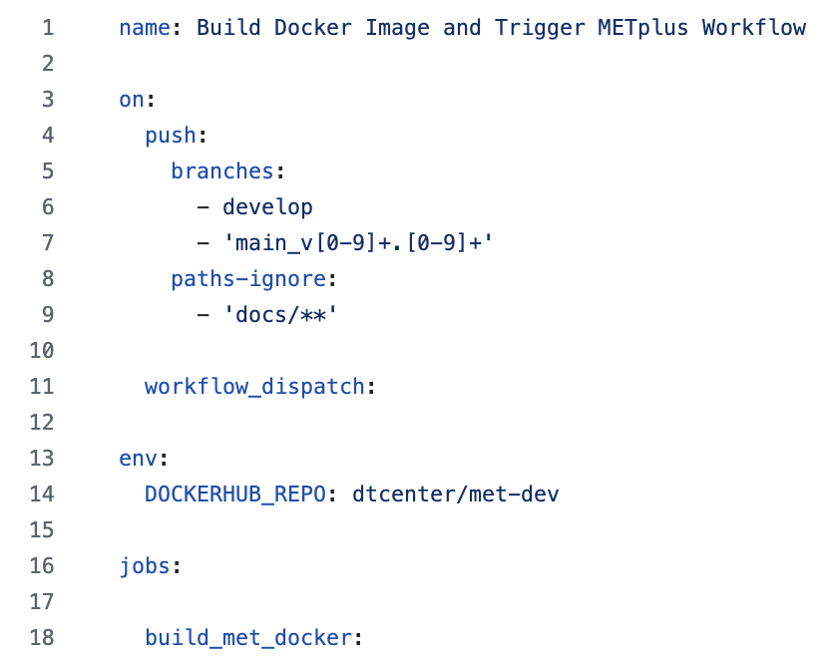
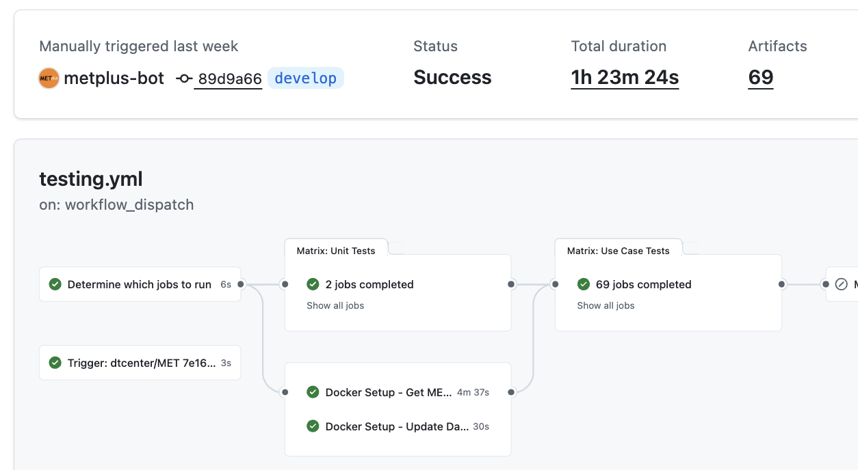
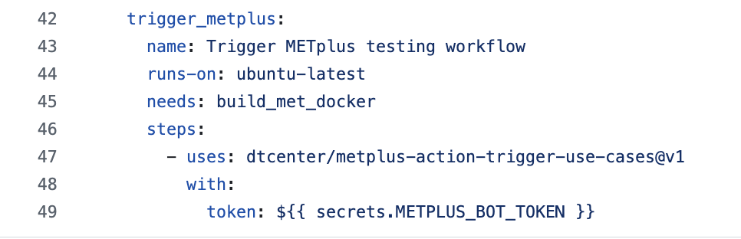
GHA: Trigger METplus
build_docker_and_trigger_metplus.yml
integration testing
Notes:
METplus consists of multiple software components. The regression testing in any given component makes sure that new changes don’t break existing functionality.
But it’s certainly possible for changes in one component to have unintended consequences on others.
<CLICK>
This workflow is triggered by changes to the develop branch or any branch named main_vX.Y, although doc-only changes are ignored.
The workflow builds a MET docker image and pushes the result up to DockerHub.
<CLICK>
Then it calls a custom action to trigger METplus to run it’s testing workflow using the updated version of the component.
<CLICK>
Buried down in the entrypoint script for that custom repository, you’ll find these lines, where the METplus testing workflow is triggered using the “gh” command line interface.
<CLICK>
This METplus GHA testing workflow usually takes about 45 minutes to complete, but run times vary based on resource availability. All of the METplus use cases are split into 69 different groups. This is run by METplus-bot account. All of the use cases completed successfully and no differences were flagged.
If you’re thinking that this is a whole lot of testing, I fully agree. And it has been incredibly useful in finding bugs early and preventing us from having to debug them later. Erroring on the side of robust and thorough testing builds confidence in users.

Slide 12
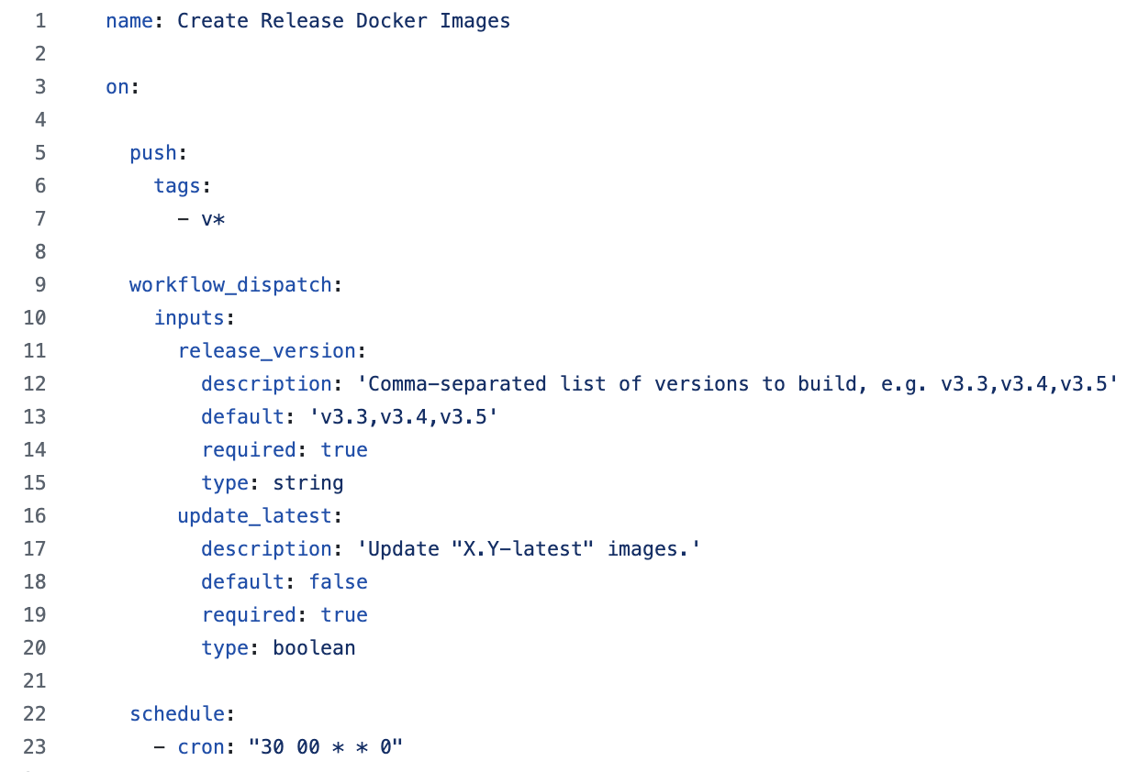
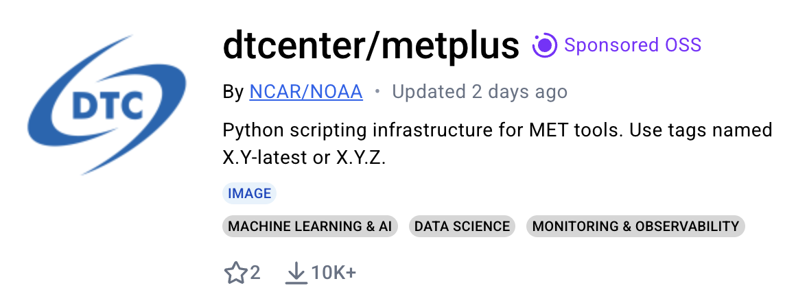
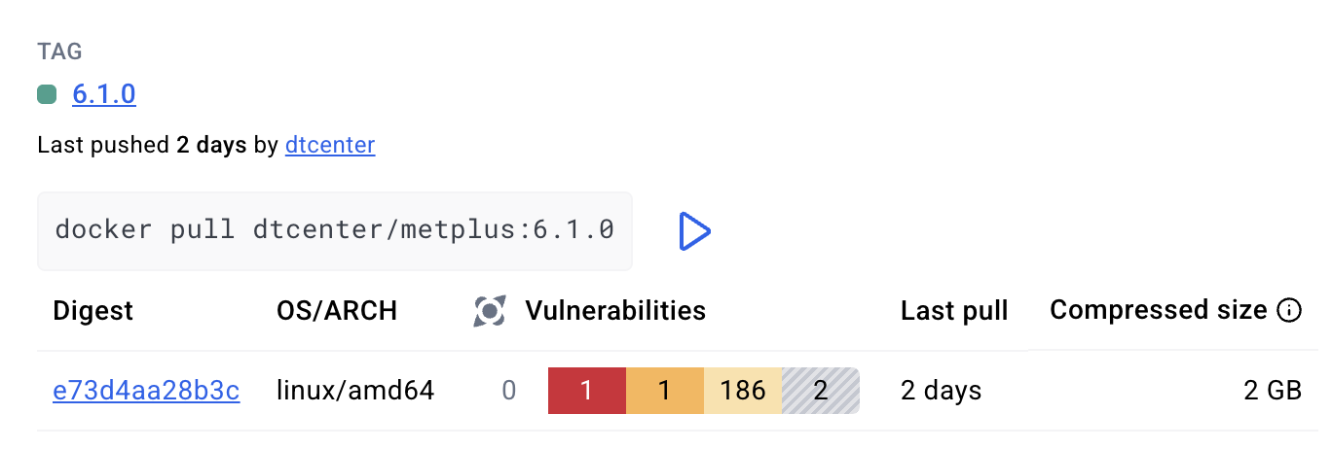
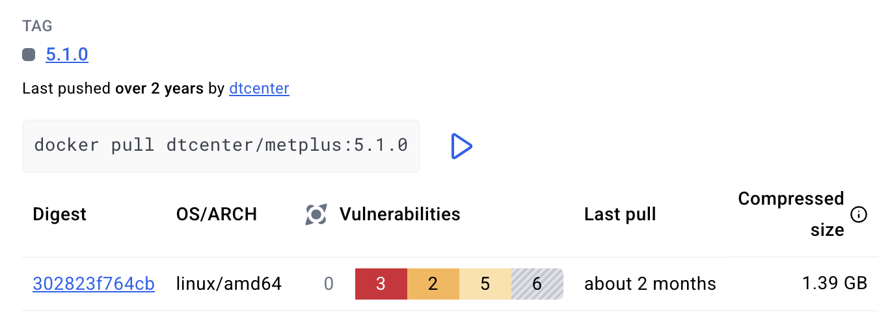
GHA: Release Docker Images
rebuild images weekly
Rebuild Supported Versions Weekly
METbaseimage @ 00:30
MET + METviewer @ 03:30
METplus @ 06:30
Notes:
We distributes our software via DockerHub. We use DockerHub repositories for both published official releases and our development images. In general, the DockerHub repos ending with “-dev” are for development, and those without are for public releases.
<CLICK>
Here we see the METplus version 6.1.0 tag. Notice that this release was created about 3 months ago, and yet this image was last pushed up to DockerHub 2 days ago.
<CLICK>
Compare that to the METplus version 5.1.0 tag. That release was created over 2 years ago and the image was last pushed 2 years ago.
<CLICK>
In the last few months, our team has learned a lot about vulnerabilities in Docker images. When images are created, the version of the OS and dependent libraries are frozen. And often, as time passes, security vulnerabilities are identified in those packages.
These counts, listed next to each image, are the result of Docker Scout, which automatically scans images for vulnerabilities. And time passes more of them are likely to be identified and the counts can creep up.
<CLICK>
This Create Release Docker Images workflow is run via a Cron schedule. Here, we see the METbaseimage workflow since that’s where we have the most control over package versions.
<CLICK>
METbaseimage images are rebuilt weekly at 00:30 UTC. The MET images are built 3 hours later. And the METplus images are built 3 hours after that.

Slide 13
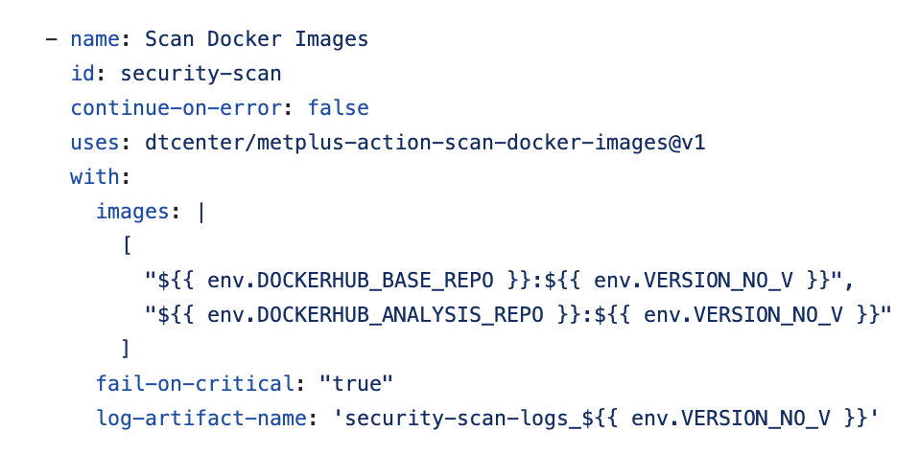
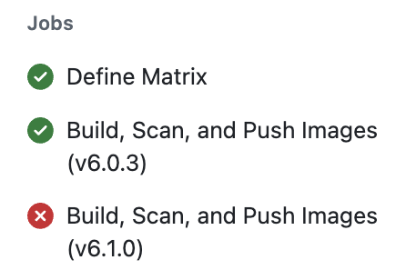
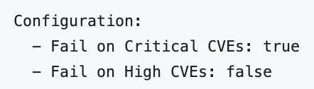

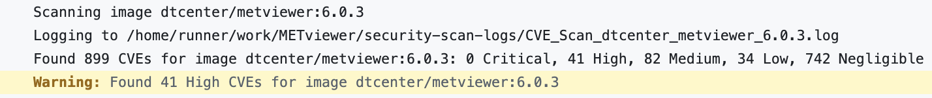
GHA: CVE Scanning
release-docker-images.yml (development-docker-images.yml)
vulnerabilities
METviewer
Notes:
CVE stands for “Common Vulnerabilities and Exposures”. The USAF prioritizes running secure containers in the cloud.
In the last few months, they’ve directed us to address all Critical and High CVEs from our images.
Docker Scout provides an assessment of CVEs, but we’ve found some variability in scan results.
Different tools pull CVEs from different databases. We did incorporate a free tool named Grype into a relatively new GitHub actions workflow.
<CLICK>
You’ll notice that this calls a custom action as well, and in that action, you’ll find this simple call to grype to scan a named Docker image.
<CLICK>
Here’s a scan from a recent weekly run of METviewer. You’ll notice that we’ve scanning the latest bugfix versions 6.0 and 6.1.
<CLICK>
And we’ve configured this scan to fail on criticals, but succeed on highs.
<CLICK>
Here we see that 6.0.3 passed, but did have 41 highs.
<CLICK>
Although version 6.1.0 failed with 5 criticals present.
We actually do have fixes ready for these CVEs and will patch them shortly. But this demonstrates the functionality of this workflow well.
Since these are run weekly, we can be notify when new CVEs are flagged that require our attention.

Slide 14
Thank You
Docs | https://metplus.readthedocs.io
Web | https://dtcenter.org/community-code/metplus
Help | https://github.com/dtcenter/METplus/discussions

