Slide 1


Rigor and Reasoning in Research Software (R3Sw)
Abstraction, Decomposition & Specification
Alper Altuntas
NSF National Center for Atmospheric Research (NCAR)
Nov 5-7, 2025
This work was supported by the Better Scientific Software Fellowship Program, a collaborative effort of the U.S. Department of Energy (DOE), Office of Advanced Scientific Computing Research via ANL under Contract DE-AC02-06CH11357 and the National Nuclear Security Administration Advanced Simulation and Computing Program via LLNL under Contract DE-AC52-07NA27344; and by the National Science Foundation (NSF) via SHI under Grant No. 2435328.
Notes:
NOTE: Background image can be used as is or changed for a particular presentation in the “Slide Master” button found under the “View” tab.

Slide 2
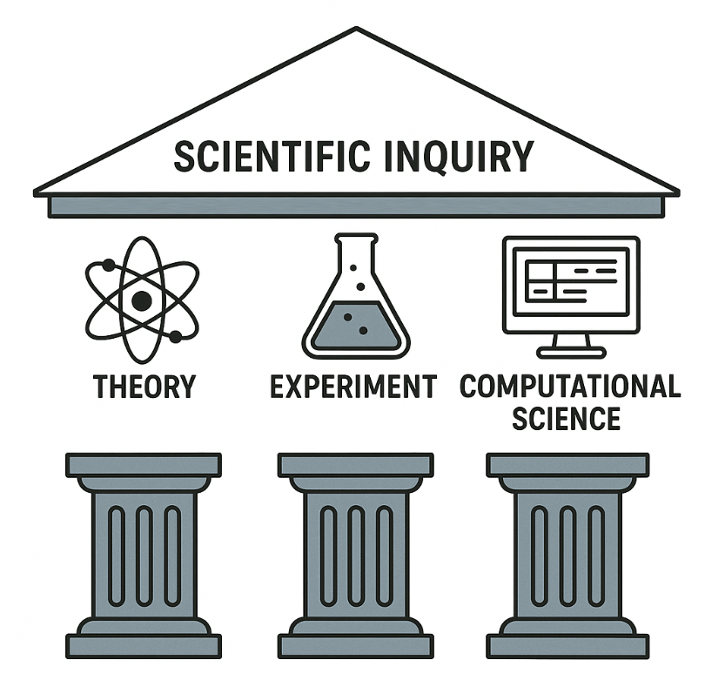
Why this matters?
“Computational science now constitutes the third pillar of scientific inquiry.” (Presidential Information Technology Advisory Committee Report, 2005)

Slide 3
The Goal
Explore how to make scientific software more reliable, understandable, and robust.
We’ll aim to do so without losing the creativity and speed that make research exciting.

Slide 4
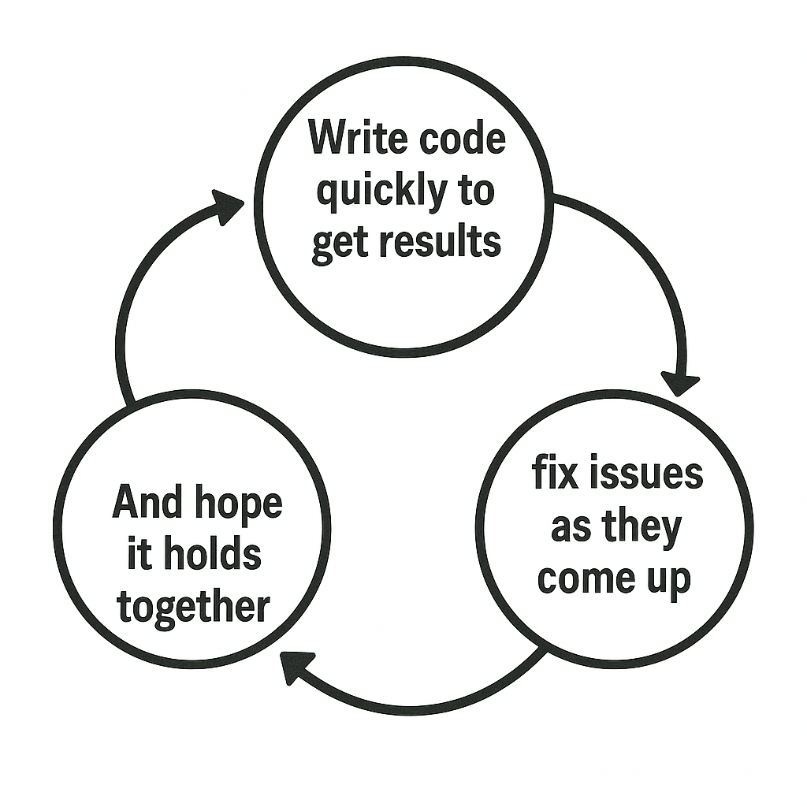
The code-and-fix style
• write code quickly to get results, • fix issues as they appear, • and hope it holds together.
The result? Code that works… most of the time. But is fragile, hard to test, and tricky to extend.
The code-and-fix style

Slide 5
A scientific mindset
A theory is scientific if it’s refutable.
Similarly, a software can be scientific, if its testable / verifiable.
So, we’ll go over practical techniques to:
hypothesize: specify intent
refute: test / verification
refine code & understanding

Slide 6
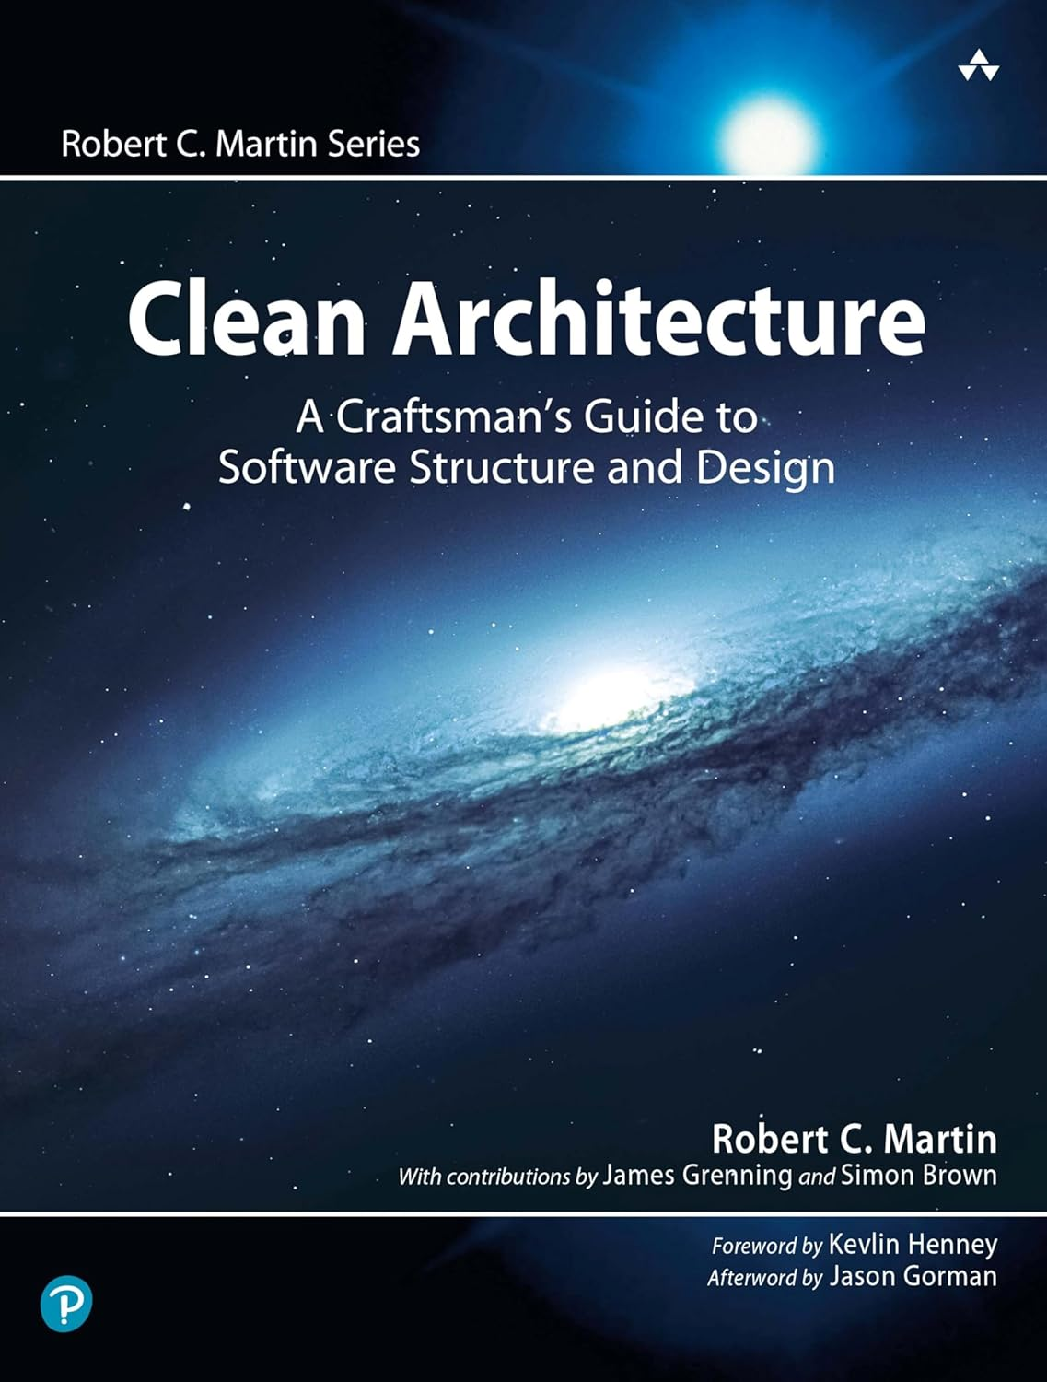
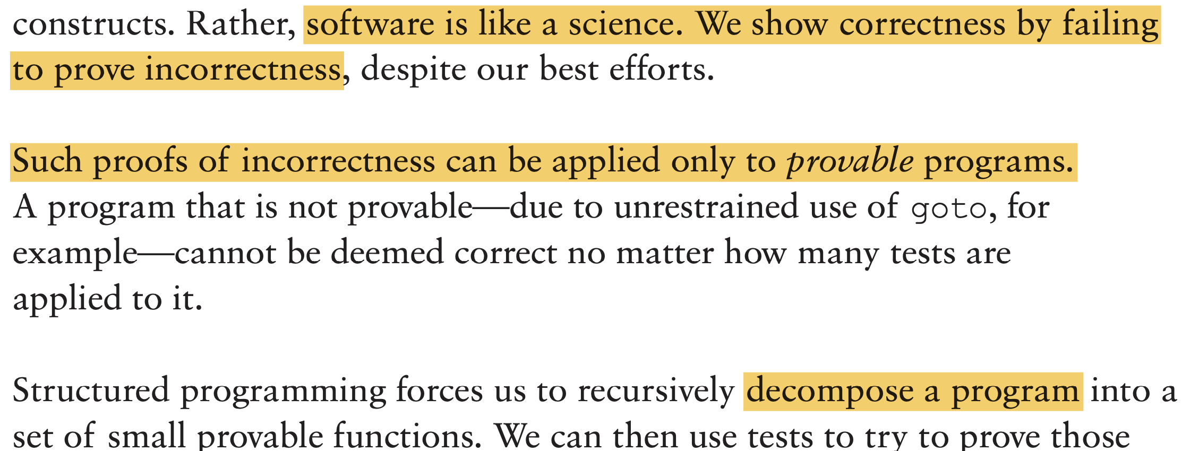
Robert C. Martin
Agile Manifesto, SOLID principles
“Provable” here doesn’t refer to a mathematical proof, but to scientific reasoning: something that can be falsified through experiments, or testing.

Slide 7

Decomposition
Based on abstractions, i.e., the key structures, relations, features, etc.
Decompose the code, into modules, classes, methods, functions, …
Such that each part
has an isolated, clear purpose.
exposes well-defined interfaces.
is refutable, i.e., testable.

Slide 8
Decomposition is the central software design task. (J. Ousterhout)
One we can’t capture fully in a one-day tutorial, or in a few slides.
Here, we focus on a few key principles for decomposing a large, monolithic routine into smaller functions that facilitate testing and reasoning:
Single purpose: each procedure should do one thing and do it clearly.
General: avoid hard-coded values or hidden assumptions
Explicit, narrow interfaces: small, coherent APIs that express intent
Dependency injection: pass in policies or strategies, don’t grab globals.

Slide 9
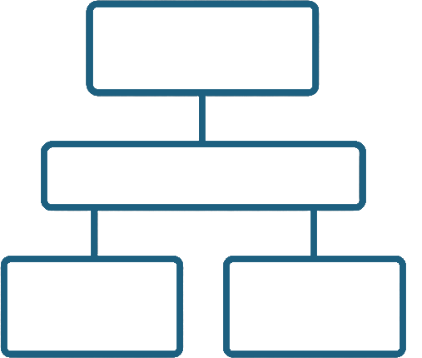
Specification
Once we have modular pieces, we need to say what each one should do:
A specification is a precise, refutable statement that defines:
What properties, conditions, and constraints are expected to hold.
What behaviors and outputs should result from given inputs.
Levels of specification:
System-level.
Module/class/function level.
{P} {Q}
{P} {Q}
{P} {Q}
{P} {Q}

Slide 10
What to specify?
Assumptions: background facts we take as given (e.g., valid b.c.)
Contracts: function preconditions and postconditions.
Properties: logical, computational, or physical/scientific.

Slide 11
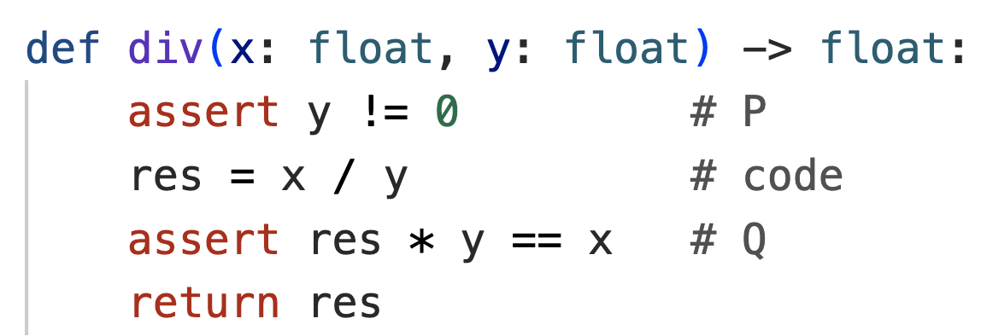
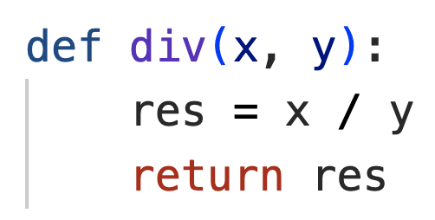
What to specify?
Assumptions: background facts we take as given (e.g., valid b.c.)
Contracts: function preconditions and postconditions.
Properties: logical, computational, or physical/scientific.
Contract
Specification

Slide 12
How to specify?
In this tutorial, our main focus is function-level specification. As such, we use a lightweight, practical style of specification that combines:
Type annotations
Assertions
Both pytest and hypothesis libraries rely on assertions.

Slide 13
Why specify?
Testing: Reasoning artifacts (e.g., assertions) ease testing efforts.
Change: To safely evolve or replace implementations.
Reasoning and Understanding: To think rigorously about intent.
“Writing is Nature's way of showing you how sloppy your thinking is.” (Dick Guindon)

Slide 14

Implementation
With abstractions identified, pieces decomposed, and specifications written:
implement code that satisfies them.
This shifts our mindset:
Instead of starting with lines of code and hoping they work, we start with clear expectations and then fill in implementations that must meet them.
{P} {Q}
{P} {Q}
{P} {Q}
{P} {Q}
{P} {Q}
{P} {Q}
{P} {Q}
{P} {Q}

Slide 15

Testing & verification (i.e., refutation)
This is the final step. The majority of this tutorial is devoted to practical testing and verification techniques. We’ll cover:
Unit testing: for this input, expect this output
Property-based testing: for all inputs satisfying preconditions, expect this relation to hold
Bounded Formal Verification: prove that properties hold for all possible inputs
Functional ”off-offline” testing: real-world applications
{P} {Q}
{P} {Q}
{P} {Q}
{P} {Q}

Slide 16
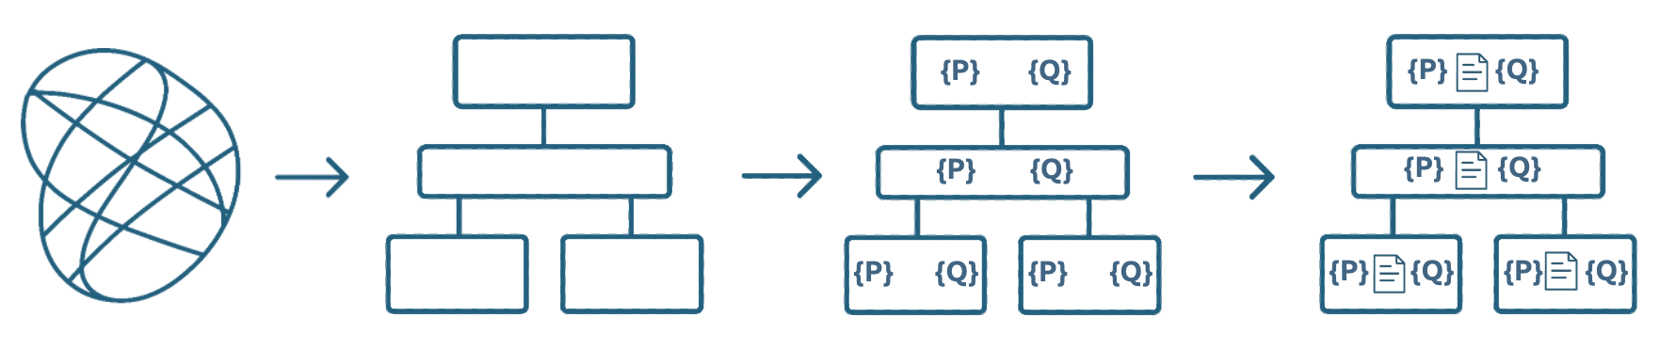

In summary
Abstraction &
Decomposition

Slide 17
In summary
Abstraction &
Decomposition
Specification

Slide 18
In summary
Abstraction &
Decomposition
Specification
Implementation

Slide 19
In summary
Abstraction &
Decomposition
Testing &
Verification
Specification
Implementation

Slide 20
Waterfall?
“The initial design for a system or component is almost never the best one; experience inevitably shows better ways to do things.” (J. Ousterhout, 2022)
Abstraction &
Decomposition
Testing &
Verification
Specification
Implementation

Slide 21
Waterfall Incremental
Abstraction &
Decomposition
Testing &
Verification
Specification
Implementation

Slide 22
Waterfall Incremental
To enable incremental design & development:
Tight feedback loops: Later work (impl/tests) can challenge and refine earlier choices.
Move in small slices: specify just enough, implement a bit, test and revise.
How this works:
Clear abstractions → easy to change parts without ripple.
Clear, stable interfaces → refactor internals freely.
Specs/contracts → instant oracles
Fast unit/property tests → quick checks

Slide 23
A running example

Slide 24
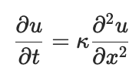
A running example: The 1-D Heat equation

Slide 25
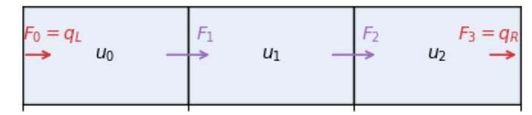
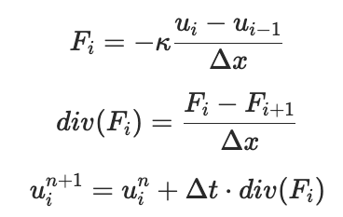
A running example: The 1-D Heat equation

Slide 26
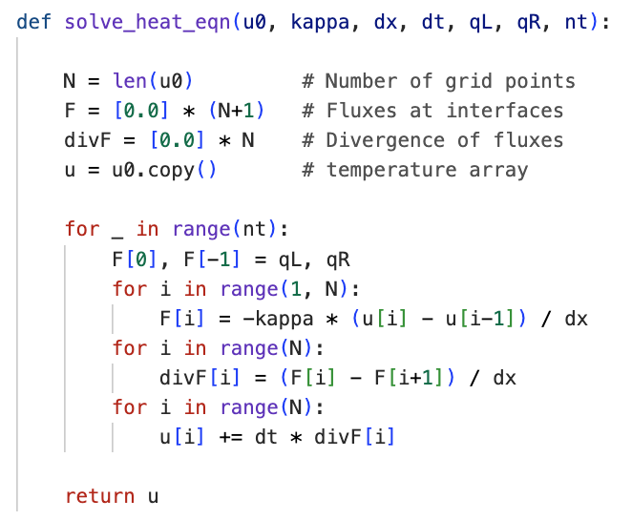
A quick implementation
Notes:
An ad-hoc, monolithic prototype, just like the quick scripts many of us have written

Slide 27
A quick implementation
Quite straightforward and manageable, but allows us to observe and generalize some issues regarding testing/reasoning:
Unclear abstractions: data structures and relations not explicit.
No reasoning artifacts: no assertions, property specifications, or contracts.
Mixed concerns: one function handling multiple responsibilities.
Opaque state: hard to inspect intermediate results.
No reuse or substitution: computations tightly coupled.

Slide 28
Monolithic Code - Observations
For only ~10 lines of code, these issues may not seem significant.
Our aim is to discuss strategies and techniques generalizable to real applications:
The same patterns/issues appear in routines with 100s of lines.
There, these design flaws become real barriers to understanding and testing.

Slide 29
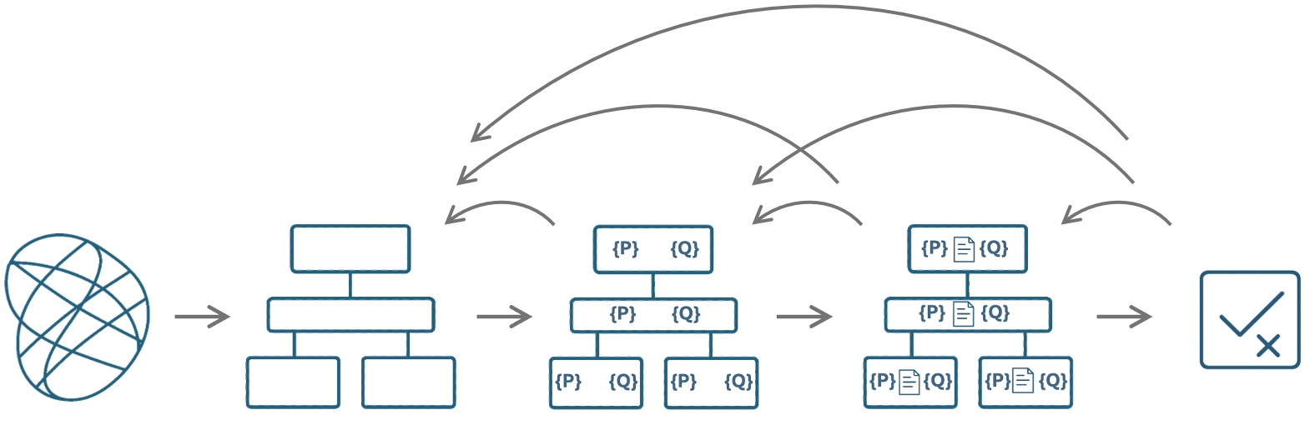
Design for Reasoning
What we had:
monolithic
mixed concerns
hard to test or extend
lack explicit reasoning
What we want:
separation of concerns
explicit expectations
A structure we can understand, test, extend

Slide 30
Abstraction – Deciding What Matters
Goal: Identify the key concepts that define the system.
Focus on what we represent, not how we compute it.
Concepts in Heat Equation Solver:
Mesh → domain geometry. A collection of cells.
Cell fields → quantities stored at cell centers (or cell avg.d)
Face fields → quantities incident on cell interfaces
Computations

Slide 31
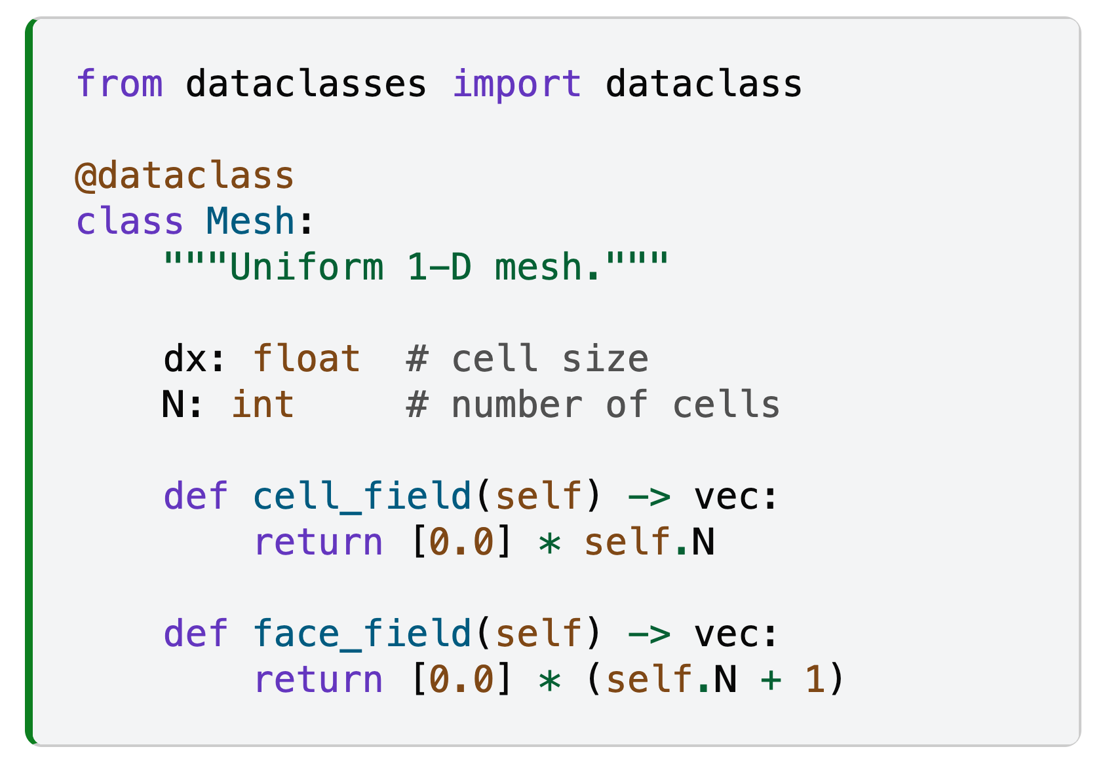
Abstraction – Deciding What Matters

Slide 32
Abstraction – Deciding What Matters
Note that our approach is mainly based on procedural abstraction. We won’t rely much on OOP features beyond this simple data class.

Slide 33
Decomposition – Organizing the code
Goal: Split computation along abstractions.
Each procedure should have a single, clear purpose.
Procedures should be general. Avoid hard-coded assumptions.
Keep them simple but composable.

Slide 34
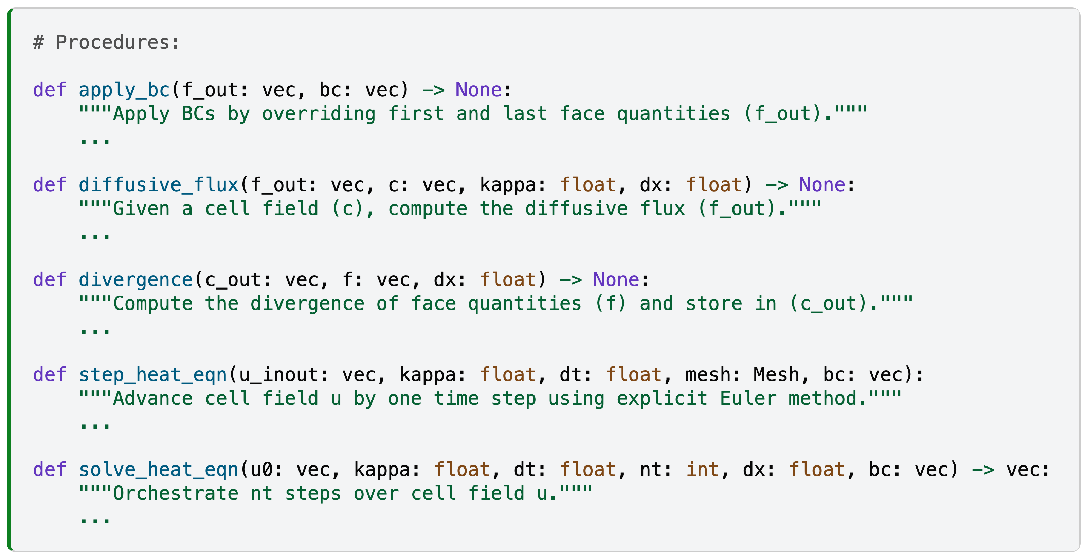
Decomposition – The core API

Slide 35
Decomposition – The core API
Argument naming convention:
c: cell field
f: face field
_out suffix: output argument
_inout suffix: input/output argument
These general argument names make the
procedures reusable (in line with
abstraction by parameterization.)

Slide 36
Program to an interface, not an implementation
- Gamma et al. Design Patterns, 1995
Design each function around what it promises to do, not how it does it.
By depending only on clear, minimal interfaces (inputs, outputs, and contracts)
other parts of the code remain unaffected when internals change.

Slide 37
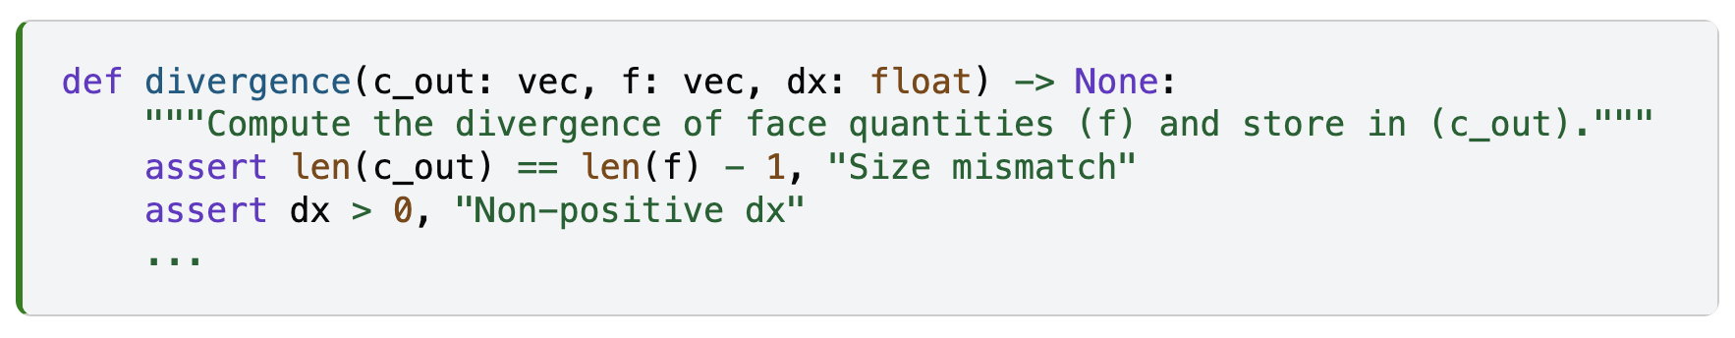
Specification
In addition to type annotations in core API, we can specify contracts:
{P} {Q}
{P} {Q}
{P} {Q}
{P} {Q}
{P} {Q}
{P} {Q}
{P} {Q}
{P} {Q}

Slide 38
Specification
Beyond contracts and structural correctness, we can express:
logical, computational, or physical/scientific properties
For the heat equation solver, examples include:
Telescoping: sum of divergences equals boundary flux difference
Conservation: total heat remains constant
Symmetry: symmetric initial conditions stay symmetric
Monotonicity: No new extrema

Slide 39
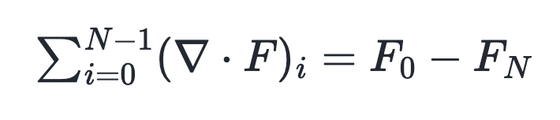
Specifying the Telescoping Property
The sum of the divergence over all cells equals the net flux through the boundaries.

Slide 40
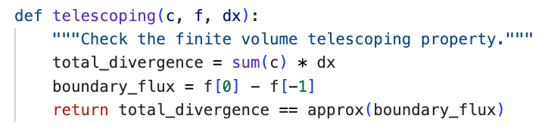
Specifying the Telescoping Property
The sum of the divergence over all cells equals the net flux through the boundaries.
Isolation of concerns and having well defined APIs
facilitate specification and testing of such properties:

Slide 41
Implementation
With abstractions identified, pieces decomposed, and specifications written:
implement code that satisfies them.
{P} {Q}
{P} {Q}
{P} {Q}
{P} {Q}

Slide 42
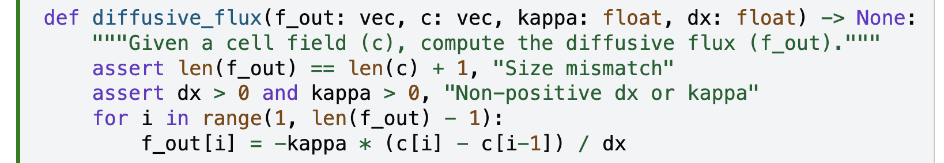
Implementation

Slide 43
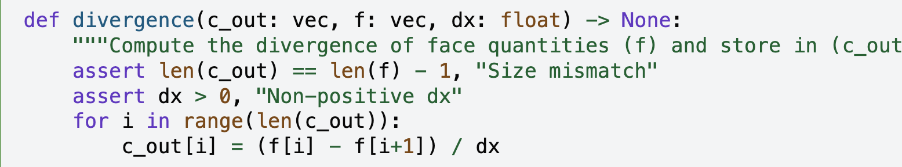
Implementation

Slide 44
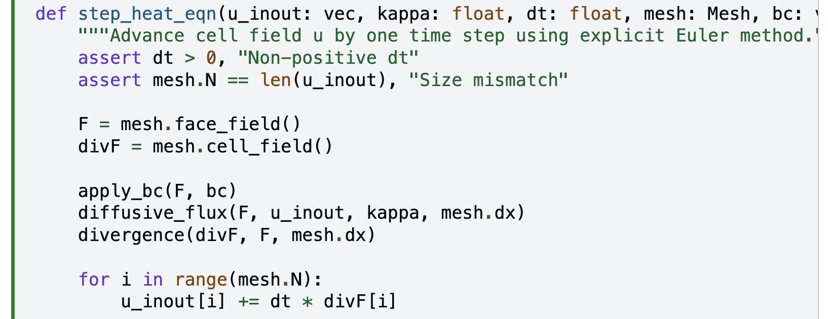
Implementation

Slide 45
Testing
In the remainder of this tutorial, we’ll cover several testing and verification techniques in detail with and with hands-on exercises:
Unit Testing
Property-base testing
Bounded formal verification
Functional Testing
{P} {Q}
{P} {Q}
{P} {Q}
{P} {Q}
{P} {Q}
{P} {Q}
{P} {Q}
{P} {Q}

Slide 46
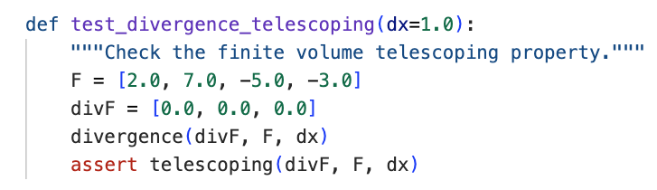

Unit Testing
Manish Venumuddula
(NSF NCAR)

Slide 47
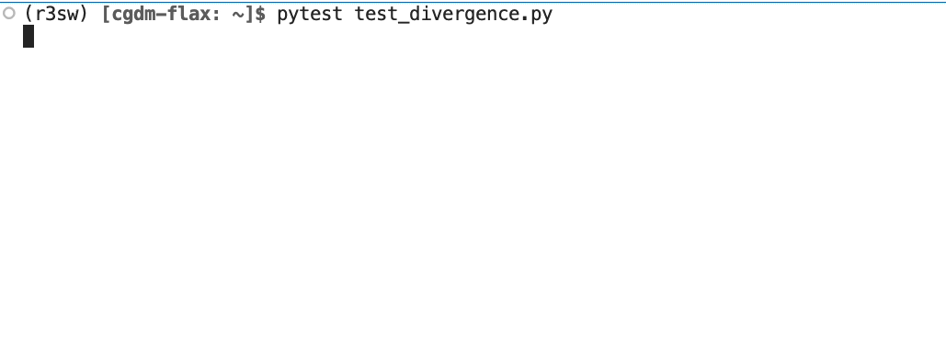
Unit Testing

Slide 48
Unit Testing
Unit tests are practical and useful.
They are great for quick, focused feedback.
But they only test the examples we think to write.

Slide 49

Property-Based Testing
For all inputs satisfying preconditions, check specified relations/properties.
Auto-generate many random inputs: explore cases we might never think to test.
The randomness is smart:
guided by strategies and constraints.
target edge cases.
shrink counterexamples.
Deepak Cherian
(Earthmover)

Slide 50
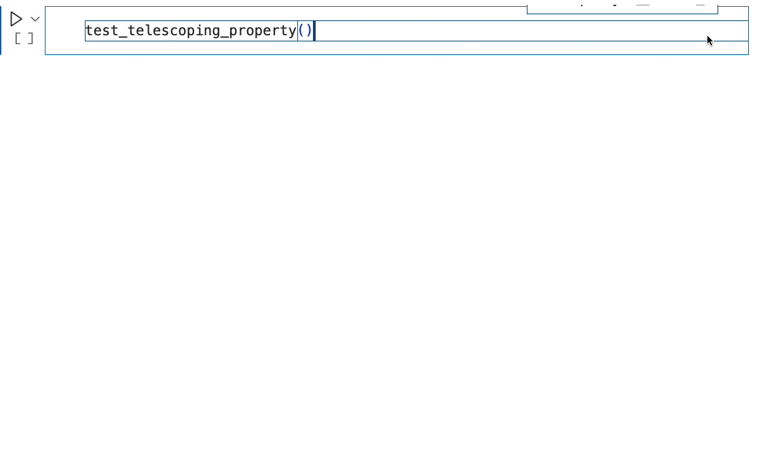
Property-Based Testing

Slide 51

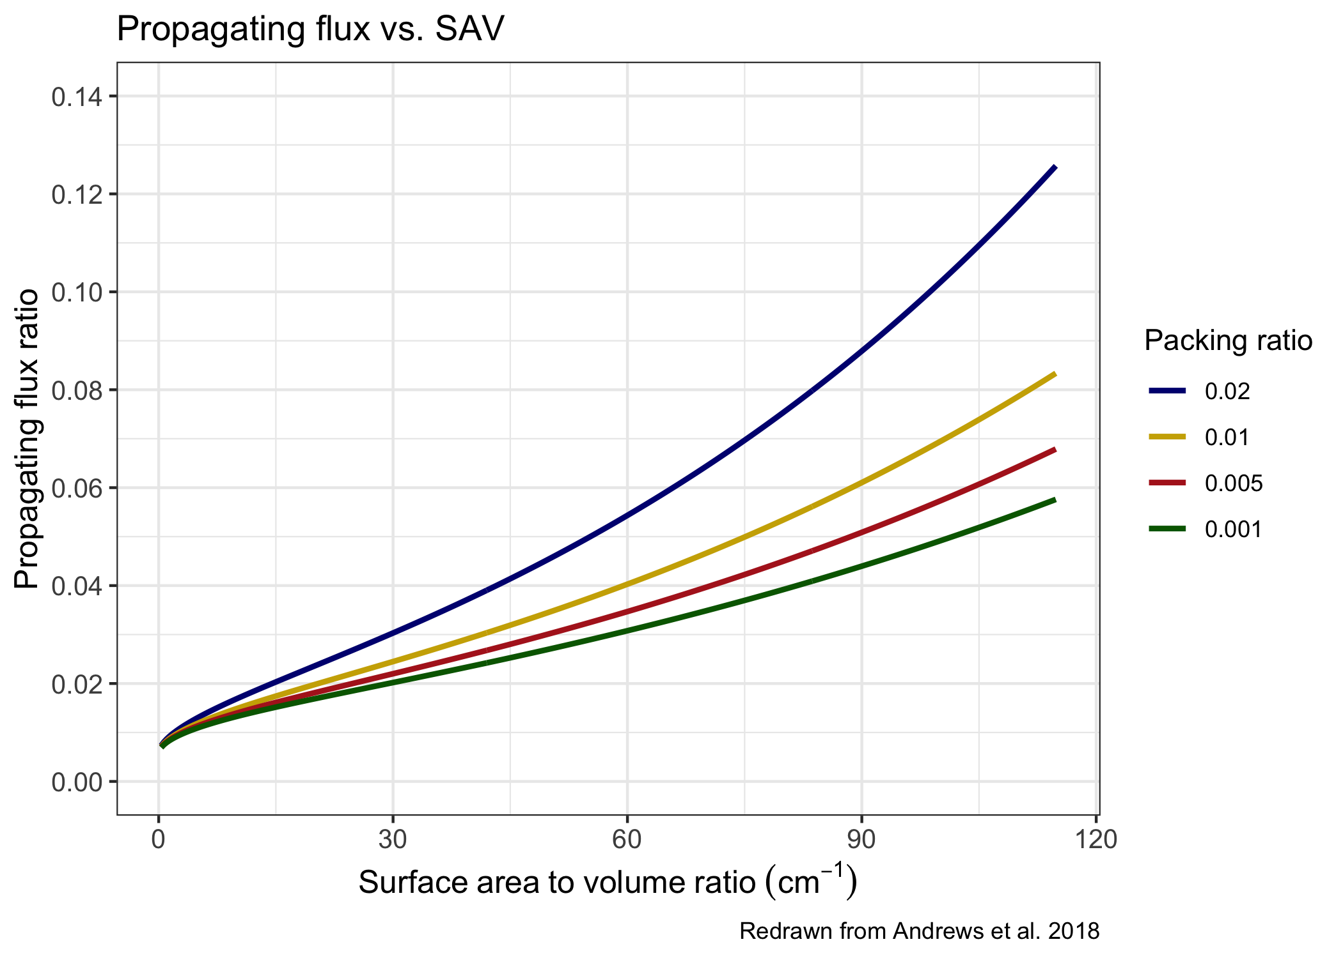
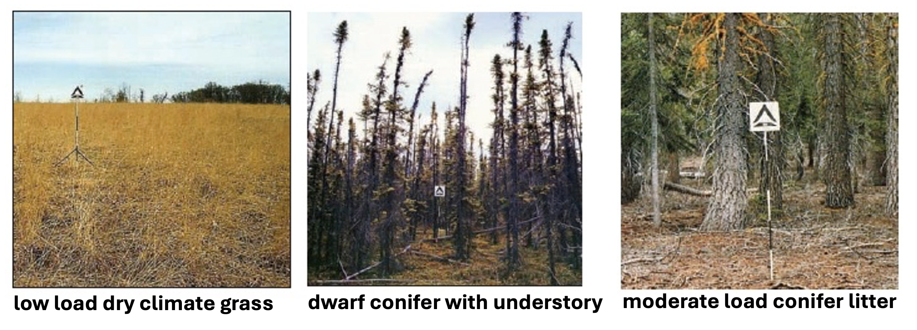
Functional Testing
Apply this mindset to a Python version of a production code that simulates wildfire behavior (translated from Fortran).
Explore scientific representations:
using synthetic fuels and comparing to observational data.
Adrianna Foster
(NSF NCAR)
“Functional testing”

Slide 52
“Testing can be used to show the presence of bugs,
but never to show their absence.”
- Edsger W. Dijkstra

Slide 53
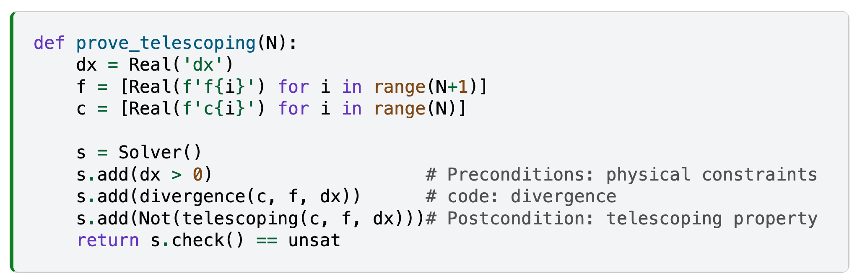
Bounded Formal Verification
Symbolically check whether properties hold for all possible inputs within specified ranges.
Less practical, but still achievable when we have the right abstractions and decompositions.

Slide 54
Bounded Formal Verification
By reasoning symbolically:
we move from testing some cases to proving properties for all cases within a defined scope.
This gives scope completeness:
The solver explores every combination of inputs allowed by the specification.
And thanks to the small scope hypothesis:
A high proportion of bugs can be found by checking the program for all inputs within some small scope. (D. Jackson, 2006)

Slide 55
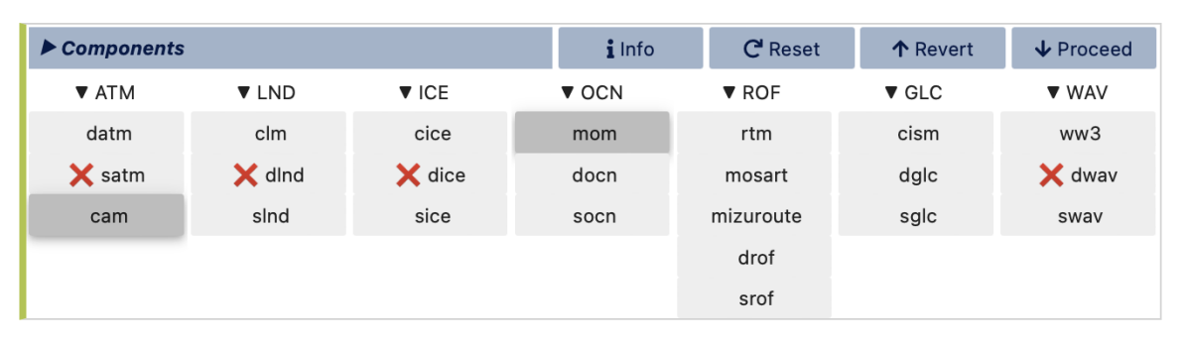
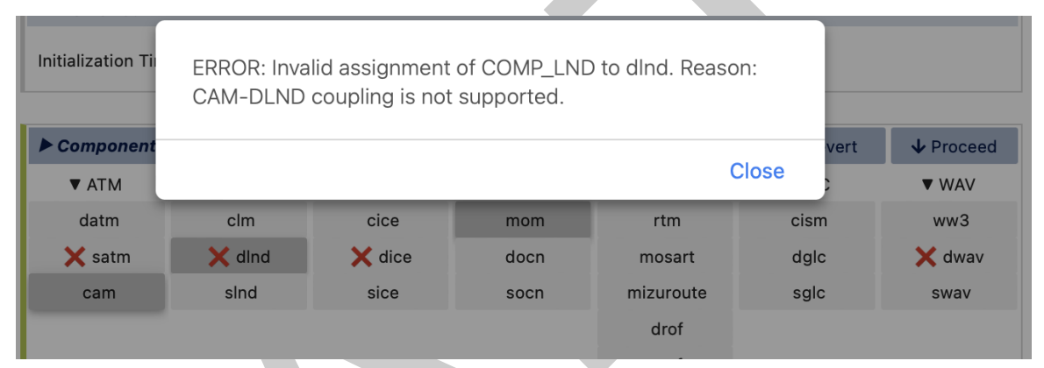
The Z3 Solver
We’ll introduce the Z3 Solver, a popular formal methods tool used across many domains.
Bug finding & verification: powers symbolic execution and static-analysis tools
Constraint solving: finds configurations or schedules that satisfy complex interdependent rules
Compilers & optimizers: LLVM-based tools to check that optimized code.
Tool development:
We’ve used Z3 in visualCaseGen, a custom CESM case configurator: Z3 validates setting in real time by analyzing dependencies, detecting conflicts, and explaining incompatibilities.

Slide 56


Formal Reasoning and AI
Tomorrow’s Keynote: “Lean into Verifiable Intelligence”
A talk about Lean, another formal verification tool, and how AI and formal reasoning are coming together to make systems both smarter and more trustworthy.
Soonho Kong
(Amazon)

Slide 57
Final Words

Slide 58
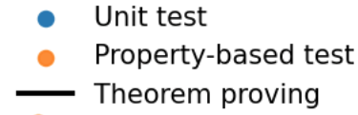
Coverage and Problem Sizes

Slide 59
Coverage and Problem Sizes

Slide 60
Coverage and Problem Sizes

Slide 61
No One-Size-Fits-All Solution
Each technique brings its own tradeoffs in effort, scope, and assurance.
Unit testing: fast, focused, and essential
Property-based testing: broad and exploratory
Formal Verification: deep and exhaustive, but less practical
Choose based on your project’s needs and practical constraints.

Slide 62
Beyond Tools: A Scientific Mindset
Start by thinking about the abstractions and properties your code should hold.
Hypothesize about these properties through reasoning and specification.
Attempt to refute your hypothesis through tests / verification.
Incrementally refine your code and your understanding based on the results.

Slide 63
Does the extra work slow us down?
Yes, for one-off applications.
But for code that lives beyond a few versions, the effort pays back:
It enables quick inquiries, changes, and exploration of new ideas.

Slide 64
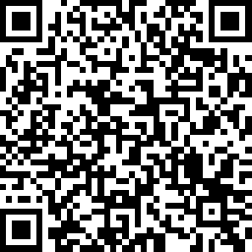
Thanks! altuntas@ucar.edu
Link to survey:
https://www.surveymonkey.com/r/RFQYLG6

