Slide 1
Why I love property testing
Success & Failure & Fun
Deepak Cherian, Ph.D

Slide 2






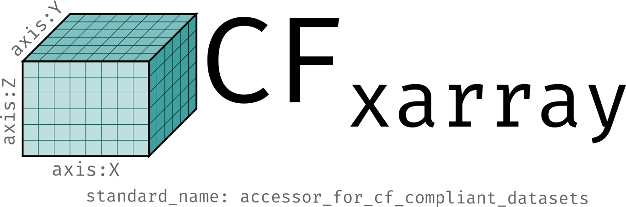
Building cloud-native data infrastructure at Earthmover PBC
Deepak Cherian
Icechunk
FORWARD ENGINEER OCEANOGRAPHER OSS MAINTAINER
FORMERLY AT NCAR, CGD OCEAN SECTION

Slide 3
What is property testing?
Write test case generators that sample the input space.
A property testing library usually provides helpers for these.
The helpers are “smart” : check NaN, Inf, INT_MAX, INT_MIN etc.
For each test case, assert that a property holds for the output of the tested function.
When a failing case is detected, a good property testing library will shrink the failing case to a much simpler case (defined somehow).
My take:
Unit test: I generate complexity → test specific examples
I am the “oracle” → I write out the correct answer to test against
Property test: I describe how to generate complexity → test abstract properties are satisfied
Sidestep the “oracle” problem

Slide 4
Over the past 18 months, I have built property testing suites for these open-source projects
Icechunk
xpublish-tiles
flox
Chunked, compressed N-D Arrays
Transactional Storage Engine for Zarr
From Zarr to web map
Grouped aggregations for arrays
Data format
Stores data in any key/value store : {“a”: 0}
Cannot lose or misrepresent data
Emphasis on safety & correctness over vanilla Zarr
Cannot lose or misrepresent data
Given any dataset, render a region of the globe as an image.
Must faithfully represent data
Computation executed in many ways (serial ,parallel, compiled)
Supports broad range of data types & operations

Slide 5
Why?
The stakes are high — data formats cannot lose data.
We want to move fast, with confidence.
I am on the hook if this breaks.
The input space is large. Covering it with unit tests is hard!
This is fun! (more fun than unit tests ;); and elegant! And a tool for thought!

Slide 6
Agenda
01
Where I have used property testing?
02
Examples of properties tested
03
Hands-on exercises!
04
Beware!
05
Lessons learned

Slide 7
Choosing properties
A flavor of what property tests test

Slide 8
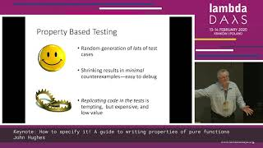
Sources
John Hughes - How to specify it!
“DO NOT THINK, let QuickCheck [hypothesis] do your thinking for you.”
Sean Wlaschin series on property testing
Hillel Wayne on choosing properties

Slide 9

Validity testing or invariants: xpublish-tiles
Property: For a dataset with global coverage, no tile should have a transparent pixel.
Test over
Latitude: increasing or decreasing;
Longitude: -180° →180°, 0°→360°
Arbitrary data shapes (or grid spacings)
Arbitrary zoom levels
This should never happen

Slide 10
Validity testing or invariants: Zarr
Property: we read what we write
Generate an arbitrary in-memory array
Arbitrary data types (ints, floats, chars, datetimes etc.)
Arbitrary shapes
Arbitrary values
Write to disk and read back
Over arbitrary store types (in-memory, object store, file storage, etc.)
Arbitrary folders
Arbitrary compression
Arbitrary “chunking”
And more…
Must be identical to what was written (simple property)

Slide 11
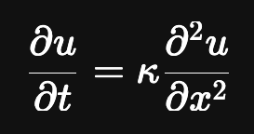
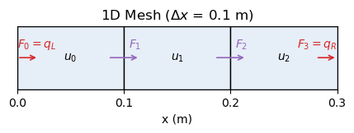
Validity testing or “invariants”: heat equation
With prescribed boundary fluxes
Conservation of heat
Symmetry preservation: symmetric initial condition + symmetric boundary conditions == symmetric solution.
Monotonicity: non-decreasing initial states remain non-decreasing
We will look at how to implement these later in this session.

Slide 12
2. What is the postcondition?
“Construct inputs whose output is easy to predict.”
Property: Aggregating an array A after grouping by an array B of constant values is identical to aggregating the array A.
Example:
Consider A: array of arbitrary data type & shape e.g. [0, 1, 2];
B: array to group “by” of arbitrary data type but constant values e.g. [1, 1, 1], [‘a’, ‘a’, ‘a’]
A.groupby(B).mean() is identical to A.mean() - tests handling of inf, Nan
- tests datatype casting rules etc.

Slide 13
2. What is the postcondition?
“Construct inputs whose output is easy to predict.”
With prescribed boundary fluxes
u = arbitrary constant + 0 fluxes; ⇒ u = arbitrary constant
u = arbitrary linear function + 0 fluxes; ⇒ u = arbitrary initial function
u = constant + both boundary fluxes heat (or cool) ⇒ du/dt >0 (<0)

Slide 14
3. Metamorphic tests: “related calls yield related results”
No oracle needed!
Spotify example (doi:10.1109/TSE.2017.2764464):
Property: Search for “word1 word2” must have fewer results than the search for “word1”.
Flox example:
Property: forward filling and backward filling are inverse operations.
Consider array A = [1, 2, np.nan, 3] ffill(A) == reversed(bfill(reversed(A))) == [1, 2, 2, 3] bfill(A) == reversed(ffill(reversed(A))) == [1, 2, 3, 3]

Slide 15
3. Metamorphic tests: xpublish-tiles “Different paths; same destination”
Property: The same data on a uniformly spaced grid should render as an equivalent tile regardless of how underlying coordinates are specified.
2
1
11 | 12
13 | 14
11 | 12
13 | 14
2 | 2
1 | 1
11 | 12
13 | 14
y
y
GeoTransform: [-0.5, 1, 0, -0.5, 0, 1]
Shape: 2 x 2
1 | 2
1 | 2
1 | 2
x
x
(a) Affine transform + shape
(b) Rectilinear mesh 1D x, y coordinates
(c) Curvilinear mesh 2D x, y coordinates

Slide 16
3. Metamorphic tests: heat equation
With prescribed boundary fluxes
Symmetry about the center
Solution is unchanged upon shifting x coordinate; generalizes to dimensional consistency & non-dimensionalization
Add an arbitrary constant to the initial condition; solution must be unchanged
Solution with time step Δt and spacing Δx should be approx equal to that with Δt/N (assuming stability condition etc….). Similar for N * Δx (given Δt)

Slide 17
4. Model-based properties
Test against a simpler model (“implement a simple oracle”)
This only works if the model is simpler to implement.
Example:
Indexing an array is identical to indexing that array after writing to disk in Zarr format
numpy_array[0, slice(10), 3] == zarr_array[0, slice(10), 3]
The heat equation could be a model for a different system (e.g. ocean model vertical mixing scheme).

Slide 18


Notebook
Explore the hypothesis library in a notebook.
Hypothesis is a great (opinionated) property testing library!
Open-source!
Integrated with pytest
Used by an estimated 5% of python developers
Very UX focused
Docs are great! https://hypothesis.readthedocs.io/en/latest/
Releases every day or two!
Easy integration with CI.

Slide 19
Metamorphic testing
See test_metamorphic.py

Slide 20
(maybe) stateful testing
A variant of model-based property testing

Slide 21
A failure
Property testing can lead to overconfidence

Slide 22
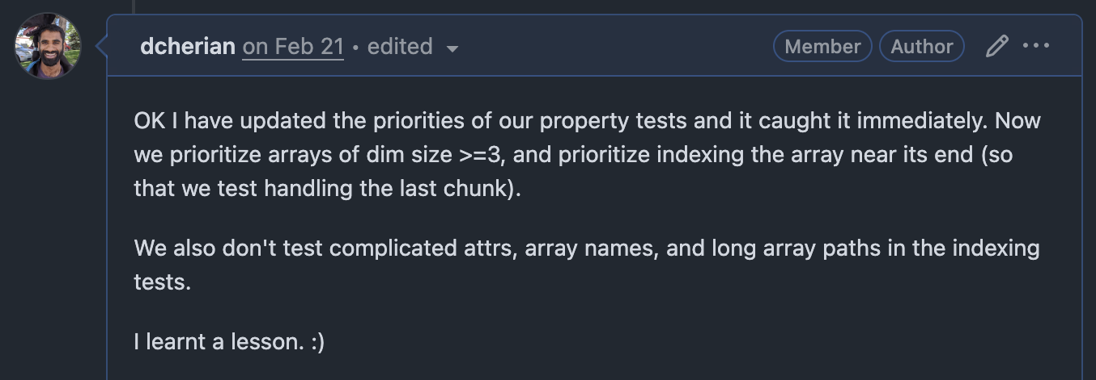
Lesson learned: examine your strategies!
I made a complex change to improve performance. Unit tests passed, thought property test coverage was good.
Then a user reports data loss!
Zarr cuts an array in to “chunks” of uniform size; the last chunk can be smaller e.g. [2, 2, 1]
I introduced a bug when overwriting the last chunk when it is smaller.
Why? We spent all our effort testing parts of parameter space that weren’t relevant to most users or irrelevant to the read/write operation being tested
arrays of shape (0,) and (1,); complicated unicode attributes etc.
And almost no effort testing the most common “complex” case (a smaller last chunk).
Pull Request

Slide 23
Lessons learned

Slide 24
01.
Property tests don’t replace other testing strategies.
They are meant to help you increase coverage (and think through the problem).

Slide 25
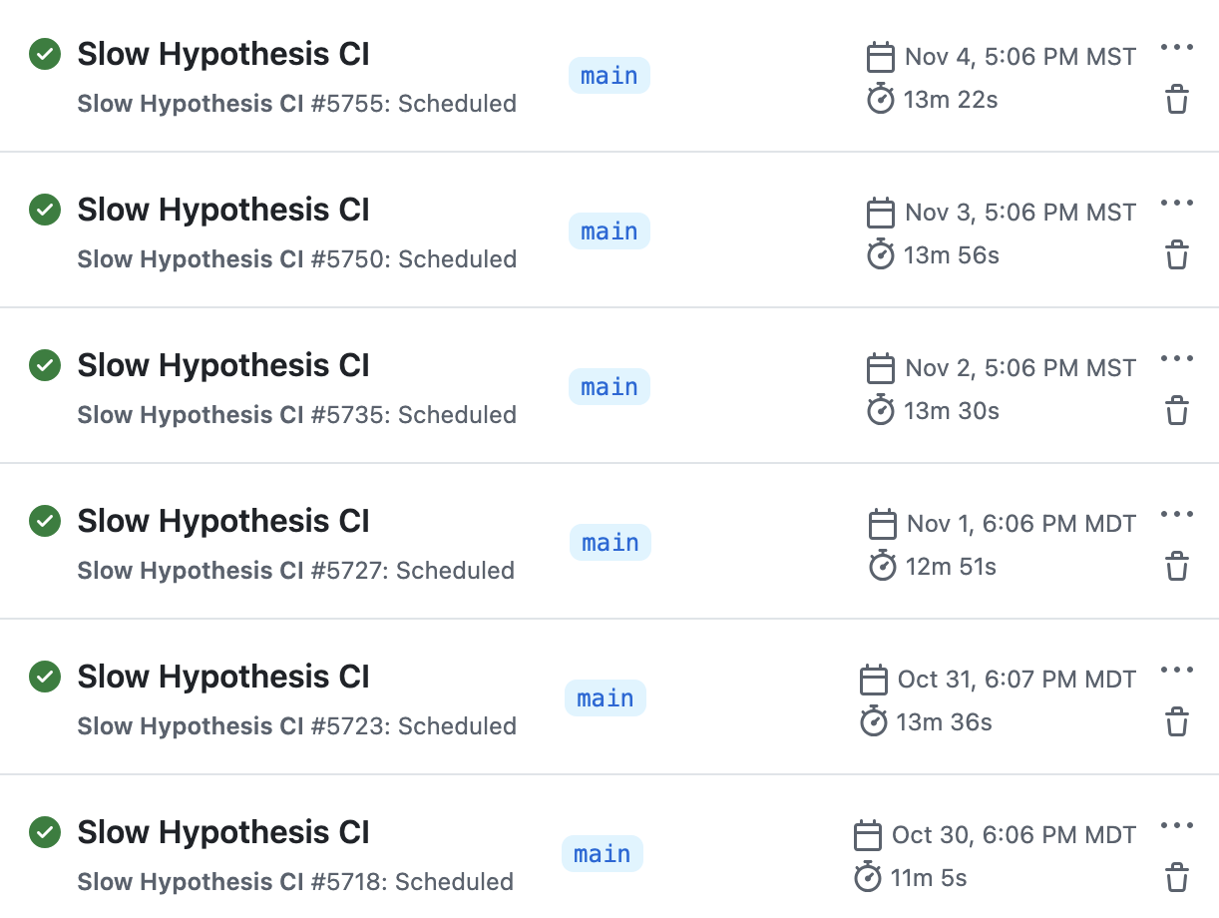
02.
Zarr nightly CI
Property tests pseudo-randomly sample the input search space.
This means it is upon you to narrow the search space to “interesting” regions. Hypothesis can help.
Minimize the search space along dimensions that are unimportant for the property you are testing. A successful test doesn’t prove anything! Use CI.

Slide 26
03.
Simple properties are really effective and very elegant.
Explore complexity in input generation (explore the input space).
Think of this as a thinking tool.

Slide 27
04.
Property testing suites are effectively an empirical specification of your program’s behaviour.
If you don’t like it; time to fix it!

Slide 28
05.
Your unit test is most likely a property test in disguise.
Generalize it!
rewrite @parametrize to a combination of @given & @example

Slide 29
06.
When you find a bug, construct a property test to catch it!
But beware, property tests can lead to overconfidence.
They don’t replace other testing strategies!

Slide 30

Thank you!
deepak@cherian.net

