Slide 1

Formal Guarantees of Error-bounded Lossy Compression
Tripti Agarwal, Ganesh Gopalakrishnan
Notes:
Good morning everyone, I’m Tripti Agarwal, and today I’ll be talking about our work and some of the initial ideas that we on Formal Guarantees of Error-Bounded Lossy Compression. This work going to explore
how we can formally verify correctness and determinism in lossy compressors, while maintaining topological and numerical integrity.

Slide 2
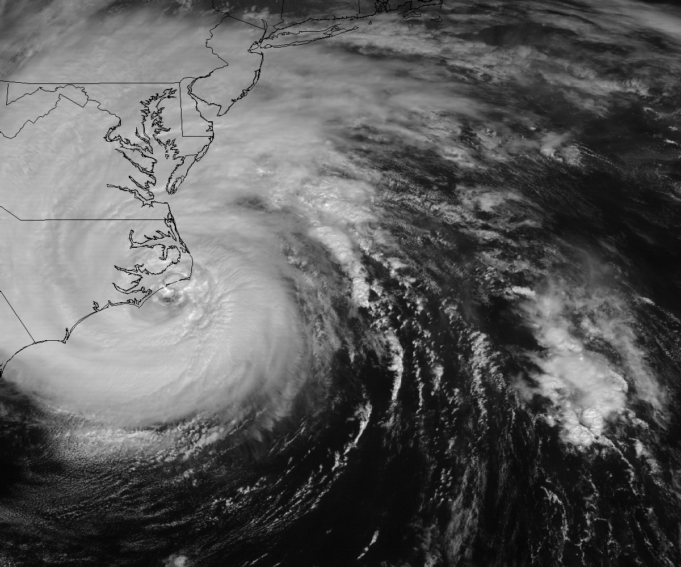

Large Scientific Data
Today's scientific research relies on simulations and instruments that generate extremely large datasets for processing and analysis.
Image source: https://szcompressor.org/tabs/application/#weather
Notes:
So lets have quick understanding of why we are working with lossy compressors, first. Scientific discovery today heavily depends on large-scale simulations and high-resolution instruments.

Slide 3
Large Scientific Data
Today's scientific research relies on simulations and instruments that generate extremely large datasets for processing and analysis.
Climate Simulation
High resolution CESM simulation
1 TB of data generated per compute day
Current NCAR platform (2017) : ~50% of hardware budget
Image source: https://szcompressor.org/tabs/application/#climate
Notes:
For instance, a single CESM climate simulation can generate 1 terabyte per compute day, that can consume nearly half of NCAR’s hardware budget.

Slide 4
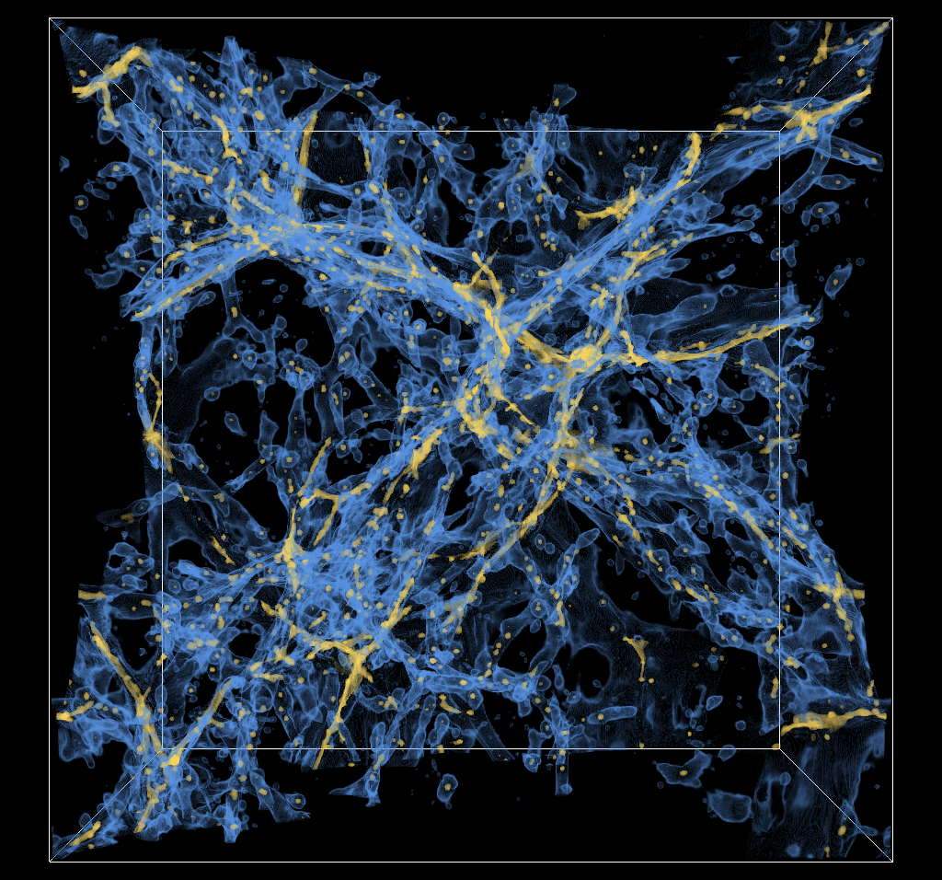
Large Scientific Data
Today's scientific research relies on simulations and instruments that generate extremely large datasets for processing and analysis.
Climate Simulation
High resolution CESM simulation
1 TB of data generated per compute day
Current NCAR platform (2017) : ~50% of hardware budget
Other datasets :
Cosmology Simulation: a total of >20PB of data when simulating trillion of particles
High energy x-ray beams experiments: 1TB/s of streaming intensity
Image source: https://szcompressor.org/tabs/application/#cosmology
Notes:
Similarly, Cosmology simulation produces a total of more than 20 PB of data and X-ray experiments can reach terabytes per second. So clearly, the scale of data in modern scientific simulations is staggering — from climate and cosmology to X-ray facilities, we’re generating large amount of data.

Slide 5
Large Scientific Data
Today's scientific research relies on simulations and instruments that generate extremely large datasets for processing and analysis.
Climate Simulation
High resolution CESM simulation
1 TB of data generated per compute day
Current NCAR platform (2017) : ~50% of hardware budget
Other datasets :
Cosmology Simulation: a total of >20PB of data when simulating trillion of particles
High energy x-ray beams experiments: 1TB/s of streaming intensity
How to reduce the data without losing important information?
Image source: https://szcompressor.org/tabs/application/#cosmology
Notes:
But storing, moving, and analyzing this data becomes infeasible unless we reduce it efficiently. This brings us to the next key question — how can we actually reduce this data size without losing important information?

Slide 6
How to reduce data: Lossless
We exploit the fact that data has redundancy
Similarities, Autocorrelation, Smoothness
Notes:
The first approach we typically use is lossless compression.
Lossless compression relies on redundancy i.e. repeated patterns or correlations in the data — to shrink the storage footprint without changing any values.

Slide 7
How to reduce data: Lossless
We exploit the fact that data has redundancy
Similarities, Autocorrelation, Smoothness
Preprocess
(Transform, Prediction, Decomposition, etc.)
Entropy encoding
Output
(Compressed data)
Input data
Lossless
Huffman Encoding
Lz77
Snappy
Zlib
Notes:
Here is a simple workflow of lossless compression. We take the input data, then preprocess it using techniques like LZ77, Snappy, and Zlib so that we can remove redundancy in our data and then apply entropy encoding such as huffman encoding on the data to store the compressed output in form of smaller bits and bytes.

Slide 8
How to reduce data: Lossless
We exploit the fact that data has redundancy
Similarities, Autocorrelation, Smoothness
Preprocess
(Transform, Prediction, Decomposition, etc.)
Entropy encoding
Lossless
Output
(Compressed data)
Input data
Lossless
Lossless
Huffman Encoding
Lz77
Snappy
Zlib
Lossless compression is limited to a ratio of 2 for scientific data
Notes:
But for scientific floating-point data, the ratio rarely exceeds by more than 2. So, To increase the ratio by more than 2, we must trade a bit of accuracy for much higher compression.

Slide 9
Lossy compression
Reducing data by more than ratio of 2
Preprocess
(Transform, Prediction, Decomposition, etc.)
Entropy encoding
Lossless
Output
(Compressed data)
Input data
Lossless
Lossless
Huffman Encoding
Lossy
Approximation
(Quantization)
Compression error is
introduced here
Notes:
Thats where lossy compression comes in. So, lossy compression reduces precision through quantization. During quantization the floating point values are converted to integer bin which are later converted back of floating point data but with lower precision during decompression. During this process, we deliberately sacrifice some numerical precision to achieve much higher compression ratios.
The compression ratios can go from 10x to 50x to even 100x in lossy compression

Slide 10
Lossy compression requirements
Reduce data accuracy to reach higher compression ratio
Tradeoff between data size and data accuracy
Notes:
But, the key here is balance: we want to make data smaller, but still accurate enough for scientific analysis.

Slide 11
Lossy compression requirements
Reduce data accuracy to reach higher compression ratio
Tradeoff between data size and data accuracy
Different metrics exists to quantify lossy compression effect
Quantitative - error bounds, PSNR, SSIM
Visualization - critical points, merge trees,...
Notes:
To understand how this balance is measured, we look at the metrics so that we can quantify the impact of lossy compression. The impact is measured quantitatively—using metrics like error bounds, PSNR, SSIM—or visually through topology, such as critical points and merge trees.

Slide 12
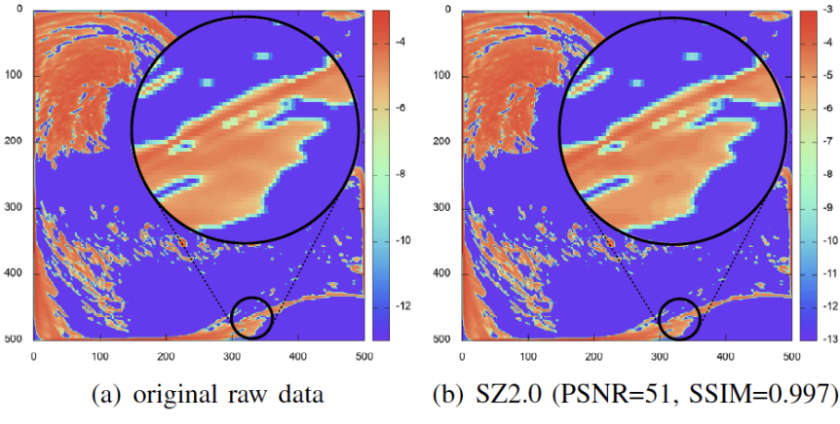
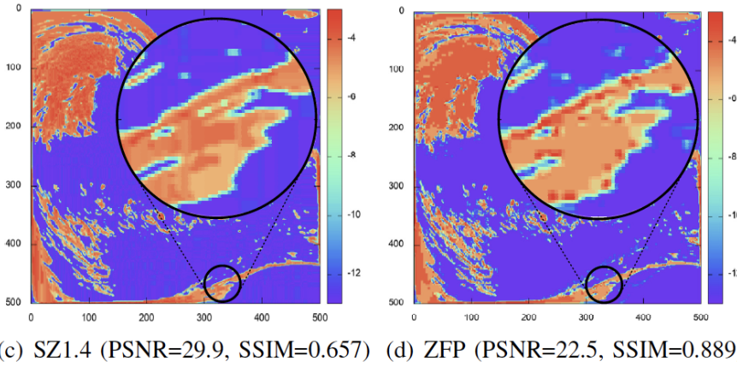
Lossy compression requirements
Reduce data accuracy to reach higher compression ratio
Tradeoff between data size and data accuracy
Different metrics exists to quantify lossy compression effect
Quantitative - error bounds, PSNR, SSIM
Visualization - critical points, merge trees,...
Hurricane CLOUDf: slice 50, CR=66.1
Image source: https://szcompressor.org/tabs/performance/
Notes:
Here is an example of Hurricane data using different lossy compressors particularly SZ and ZFP and their quantitative metrics. SZ and ZFP are two main lossy compressors for floating point data built by ANL and Lawrence livermore national labs respectively.

Slide 13
Quantitative assessment of lossy compressor errors
Error metrics (amount of error)
Error bounds - point wise metrics
RMSE
PSNR
Rate distortion
}
Statistical metrics
Hurricane CLOUDf: slice 50, CR=66.1
Image source: https://szcompressor.org/tabs/performance/
Notes:
Quantitative assessment in lossy compressors is done by defining the point-wise error bound and calculating the statistical metrics like RMSE, PSNR and rate distortion. In this example here we can see different compressors produce different values of PSNR and SSIM. These values help in measuring the reconstruction quality of the data. These values are highly dependent on the point-wise error bound that we define while performing the compression.
So how can we define the point-wise error bound.

Slide 14
Error bounds calculation
Lossy compressors (SZ¹, ZFP²) provides point wise error controls
Two main types of error bounds
Notes:
Well the point wise error bound can be defined in two ways:

Slide 15
Error bounds calculation
Lossy compressors (SZ¹, ZFP²) provides point wise error controls
Two main types of error bounds
Absolute error bound
E_{a} = | V - V’ |
Relative error bound
E_{r} = | V – V’ | V
where, E: error bound, V: initial dataset, V’: decompressed dataset
[1] https://szcompressor.org/
[2] https://computing.llnl.gov/projects/zfp
Notes:
1 is absolute error bound and other is relative error bounds. The main idea of defining the pointwise error bound is how far decompressed data can deviate from the original data

Slide 16
Lossy compression error - effect on data
Ideally, we can formalize the compression error and propagate them in the simulation equations
In reality, it is very difficult
Lack a profound understanding of lossy compression errors effects
Notes:
Now, lets switch gears and talk about some of the problems in the lossy compression and as discussed in the previous presentation what are the fears of lossy compression but from a slightly different angle. So far, we’ve looked at how compressors like SZ and ZFP define strict pointwise error guarantees — absolute or relative — ensuring that reconstructed values don’t deviate from the originals by more than a user-defined bound. But the big question is — do these guarantees always hold in practice?

Slide 17
Error bound - Floating point arithmetics
Floating-point values cannot precisely represents all numbers
Values that cannot be represented are rounded to a representable value
Notes:
Well the answer is no.Even tiny rounding effects in floating-point arithmetic can sometimes push values across those mathematical boundaries. And , in reality, floating-point numbers can’t represent every possible real value.

Slide 18
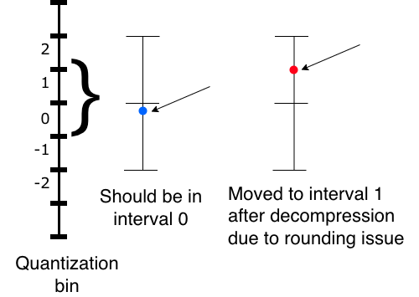
Error bound - Floating point arithmetics
Floating-point values cannot precisely represents all numbers
Values that cannot be represented are rounded to a representable value
Example:
ABS error: assigns value to the nearest bin
Rounding near bin borders may misplace values to the
adjacent bin
Notes:
This is because when we quantize or round, especially near bin edges, we can unintentionally violate the very error bounds we’re trying to enforce and that’s where many subtle correctness issues begin.

Slide 19
Error bound - Floating point arithmetics
Floating-point values cannot precisely represents all numbers
Values that cannot be represented are rounded to a representable value
Example:
ABS error: assigns value to the nearest bin
Rounding near bin borders may misplace values to the
adjacent bin
INF/ NaN : propagate during computation
Notes:
We also face undefined behaviors like NaNs, Infs. If the original data contains Nans and Infs these values can propagate through different stages of lossy compression pipeline and results in high error in the reconstructed value.

Slide 20
Error bound - Floating point arithmetics
Floating-point values cannot precisely represents all numbers
Values that cannot be represented are rounded to a representable value
Example:
ABS error: assigns value to the nearest bin
Rounding near bin borders may misplace values to the
adjacent bin
INF/ NaN : propagate during computation
Denormals: lower precision, highly sensitive to
rounding
Notes:
Similarly, denormals are highly sensitive to rounding and these can propagate unpredictably through the pipeline

Slide 21
Our solution
Goal: Ensure no error-bound violation, no undefined floating-point behavior during compression or reconstruction
Notes:
So in this work, one of our goal is to eliminate these corner-case violations i.e. no error bound violation, and no undefined floating point behavior during the compression and reconstruction pipeline.

Slide 22
Our solution
Goal: Ensure no error-bound violation, no undefined floating-point behavior during compression or reconstruction
Specification-level guarantees:
Define contracts:
| V - V’ | ≤ E for all finite V
Quantization must be monotonic, bounded and terminating
Notes:
For this we propose and define formal contracts—pre- and post-conditions—ensuring that the difference between the original and reconstructed data is less than or equal to defined error bound,
and that quantization remains monotonic, bounded, and terminating.

Slide 23

Our solution
Goal: Ensure no error-bound violation, no undefined floating-point behavior during compression or reconstruction
Specification-level guarantees:
Define contracts:
| V - V’ | ≤ E for all finite V
Quantization must be monotonic, bounded and terminating
Use Verus¹ and express pre/postconditions and invariants for quantization kernels
Verus is a Rust based verification language
[1] https://github.com/verus-lang/verus
Notes:
We encode these contracts using Verus, a Rust-based verification language that reasons about memory safety and arithmetic correctness. This gives us specification-level guarantees that the reconstructed values never violate user-defined bounds.

Slide 24
Race condition elimination
Why race condition matters?
Parallel compressors (OpenMP/CUDA) are fast but risk data races in shared states
Race conditions → Non-deterministic behavior → break correctness guarantees
Notes:
The next problem that can happen in lossy compression is race conditions. Most modern compressors rely on OpenMP or CUDA parallelism. Parallelism is important to produce faster scientific analysis. But uncontrolled shared states can lead to data races, producing nondeterministic results—even with the same inputs. This can break the correctness guarantees of our system.

Slide 25
Race condition elimination
Why race condition matters?
Parallel compressors (OpenMP/CUDA) are fast but risk data races in shared states
Race conditions → Non-deterministic behavior → break correctness guarantees
How using Verus is helpful
Ownership and borrowing models
Each thread operates on disjoint memory segments
Permission based reasoning
No two threads write in the same memory cell simultaneously
Notes:
Verus helps eliminate this by enforcing the ownership and borrowing model where each thread operates on disjoint memory—and by permission-based reasoning, which statically prevents two threads from writing to the same cell.
This removes race conditions by construction in Verus.

Slide 26
Visualization - Topology based quality metrics
Topological descriptors
Notes:
Next problem we want to tackle in lossy compression is in terms of visualization
So beyond numerical accuracy, topology tells us whether the structure of the data is preserved or not.
There are different types of topological descriptors.

Slide 27
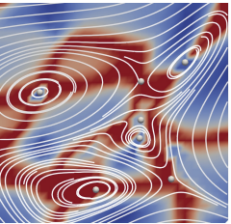
Visualization - Topology based quality metrics
Topological descriptors
Critical points in vector or scalar fields
Streamlines and critical points
Image source: X. Liang, S. Di, F. Cappello, M. Raj, C. Liu, K. Ono, Z. Chen, T. Peterka,and H. Guo, “Toward feature-preserving vector field compression,”
IEEE Transactions on Visualization and Computer Graphics, 2022.
Notes:
First is critical points. Critical points such as maxima, minima, and saddles—capture physical features such as vortex cores or pressure extrema. These are the points where the derivative of a function is zero or undefined. These helps to quantify and describe the structure of the system. For example the white dots in the figure are critical points of the data.

Slide 28

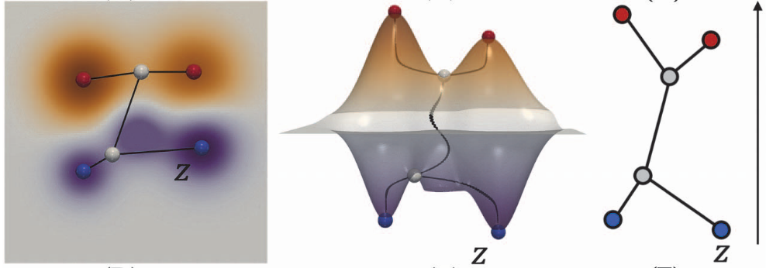
Visualization - Topology based quality metrics
Topological descriptors
Critical points in vector or scalar fields
Contour trees
Scalar field f graph of f contour tree of f
Image source: Yan et al. “TopoSZ: Preserving Topology in Error-Bounded Lossy Compression, 2023”
Notes:
Next is contour trees. Contour trees records the connectivity of isosurfaces (contours) of a scalar field as their isovalue changes. For example in the graph here, where f is the height function, we can create the contour trees by connecting the critical points at different isosurfaces.

Slide 29
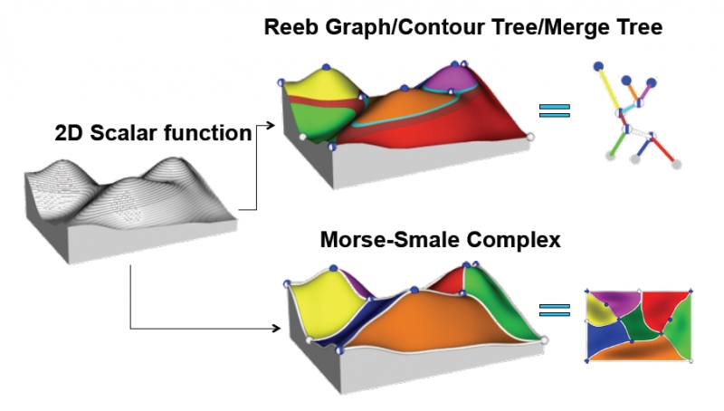
Visualization - Topology based quality metrics
Topological descriptors
Critical points in vector or scalar fields
Contour trees
Merge trees and Morse-smale complex
Image source: Liu et al. “Visualizing High-Dimensional Data: Advances in the Past Decade.” IEEE TVCG, 23(3):1249-1268, 2017.
Notes:
Other Descriptors like merge trees, and Morse-Smale complexes, help summarize how scalar fields evolve. So here is an example of how merge trees and morse-smale complex looks like.

Slide 30
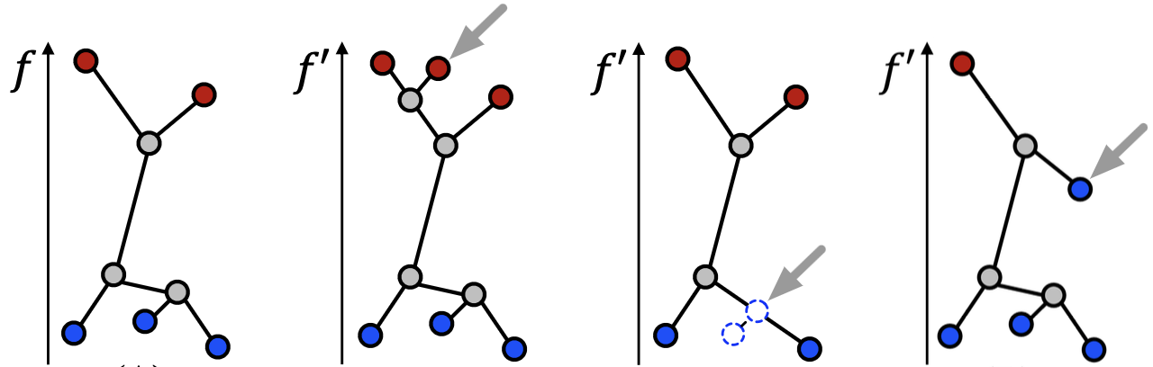

False cases
Original data
original contour tree
Compressed data
False Positive (FP)
False Negative (FN)
False Type (FT)
Decompressed data
contour tree constructed by decompressed data
Image source: Yan et al. “TopoSZ: Preserving Topology in Error-Bounded Lossy Compression, 2023”
Notes:
However, theres is a problem that can occur in topological descriptors because of the loss of information. Basically, lossy compression can introduce false positives, false negatives, or false types in these structures.” FP refers to when a new feature is introduced in you descriptor when it was not avaialanle in original data. Similarly FN is loss of features in the reconstructed data and FT is a new type of feature that got introduced in reconstructed data when it was not present in original data.

Slide 31
Solution
Topology community is well aware of the problem
Different solutions exists:
M. Ainsworth, O. Tugluk, B. Whitney, and S. Klasky, “Multilevel techniques for compression and reduction of scientific data—the multivariate case,” SIAM Journal on Scientific Computing, vol. 41, no. 2, pp. A1278– A1303, 2019.
X. Liang, S. Di, F. Cappello, M. Raj, C. Liu, K. Ono, Z. Chen, T. Peterka,and H. Guo, “Toward feature-preserving vector field compression,” IEEE Transactions on Visualization and Computer Graphics, 2022.
H. Guo, D. Lenz, J. Xu, X. Liang, W. He, I. R. Grindeanu, H.-W. Shen, T. Peterka, T. Munson, and I. Foster, “Ftk: A simplicial spacetime meshing framework for robust and scalable feature tracking,” IEEE transactions on visualization and computer graphics, vol. 27, no. 8, pp. 3463–3480, 2021
Notes:
Many methods attempt to fix this, where they remove the false cases by saving extra information while compressing and then applying specialized techniques to retrieve the information correctly. But most of these methods are iterative and computationally heavy. Prior work—such as TopoSZ and TopoQZ tackle this issue. But these methods are bottlenecked by the topological descriptor creation during the compression pipeline there by making the entire process computationally and memory expensive

Slide 32
Solution
Topology community is well aware of the problem
Different solutions exists:
M. Ainsworth, O. Tugluk, B. Whitney, and S. Klasky, “Multilevel techniques for compression and reduction of scientific data—the multivariate case,” SIAM Journal on Scientific Computing, vol. 41, no. 2, pp. A1278– A1303, 2019.
X. Liang, S. Di, F. Cappello, M. Raj, C. Liu, K. Ono, Z. Chen, T. Peterka,and H. Guo, “Toward feature-preserving vector field compression,” IEEE Transactions on Visualization and Computer Graphics, 2022.
H. Guo, D. Lenz, J. Xu, X. Liang, W. He, I. R. Grindeanu, H.-W. Shen, T. Peterka, T. Munson, and I. Foster, “Ftk: A simplicial spacetime meshing framework for robust and scalable feature tracking,” IEEE transactions on visualization and computer graphics, vol. 27, no. 8, pp. 3463–3480, 2021
But all these solutions have multiple iterations or are bottlenecked by the topological descriptor construction
Notes:
Since one of the main advantage of lossy compression is speed and we do end up losing that in some of these prior work we are interested in building a compression pipeline that is not only fast but can also preserve the topological information.

Slide 33

Our solution
Build a single pass solution to preserve
Critical points types
Critical points location
Merge tree structure
Notes:
Hence We address this issue with a faster, single-pass approach. Our single-pass method directly preserves critical point types, locations, and there by also preserve merge-tree structure during compression. This work is in collaboration with ANL.

Slide 34
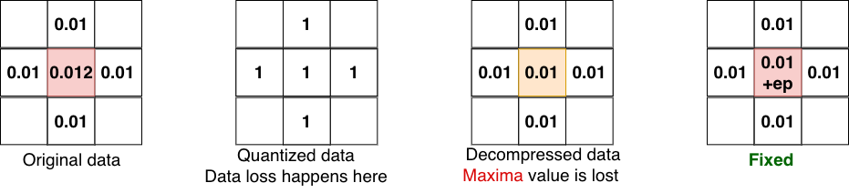
Our solution
Build a single pass solution to preserve
Critical points types
Critical points location
Merge tree structure
Use stencil based method to retrieve the critical point information
Notes:
For this We use stencil-based neighborhood analysis to detect these features and store minimal metadata to reconstruct the topology accurately. Here is an example of maxima point lost during compression and then applying a simple stencil to retrieve the maxima back. The mechanism for maxima stencil is very simple. We take the maximum value of the neighboring points and add a machine epsilon to retrieve the final maxima back.

Slide 35
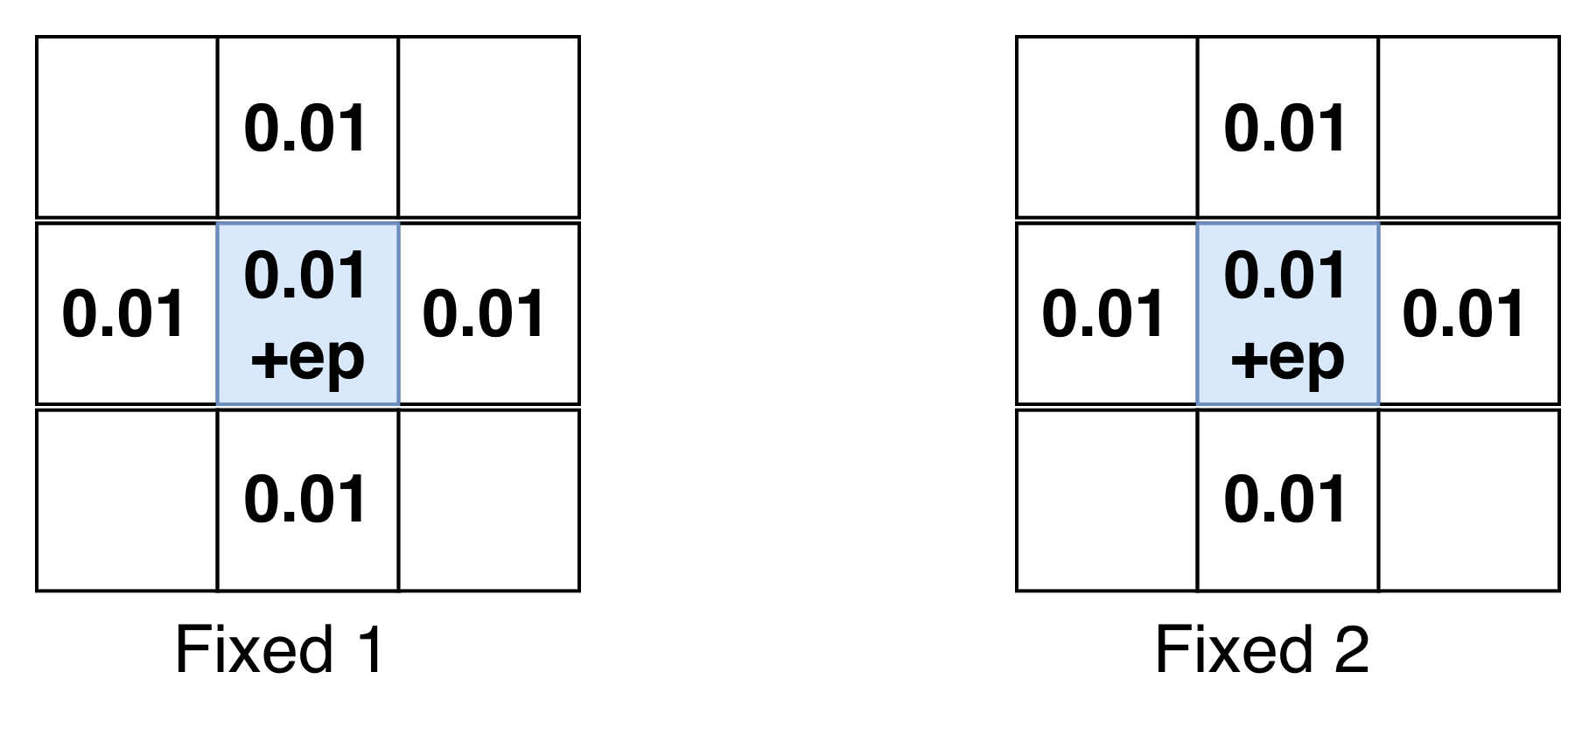
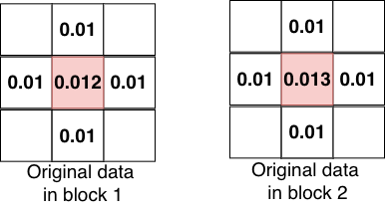
Our solution
Build a single pass solution to preserve
Critical points types
Critical points location
Merge tree structure
Use stencil based method to retrieve the critical point information
Save the positions of critical points to retrieve merge tree structure
Notes:
This avoids costly iterative reconstruction. We also save the relative positions of critical point so that we can retrieve the merge tree structure. So here is an example of how the reconstructed data will look like if we apply just the previous stencil method that I discussed before.

Slide 36
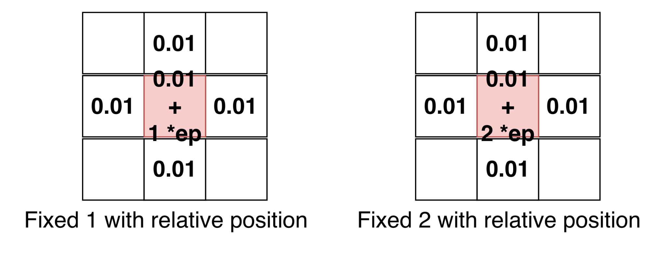
Our solution
Build a single pass solution to preserve
Critical points types
Critical points location
Merge tree structure
Use stencil based method to retrieve the critical point information
Save the positions of critical points to retrieve merge tree structure
Notes:
But rather we save the relative position of each value in the quantization bin to retrieve the correct output for the decompressed result. This position helps us in preserving the overall merge tree structure.

Slide 37
Takeaways
Problems in lossy compression exists in terms of
Error bounds
Floating point behavior
Race conditions
Topological descriptor
Notes:
To wrap up, let’s revisit why formal guarantees matter in lossy compression. In practice, we face four major sources of uncertainty:
Error bounds that can be violated due to rounding,
Floating-point behavior that leads to non-deterministic results
Race conditions in parallel implementations, and
Topological distortions that alter the scientific meaning of the data.
Each of these can independently break correctness — and together, they make reliable lossy compression extremely challenging.

Slide 38
Takeaways
Problems in lossy compression exists in terms of
Error bounds
Floating point behavior
Race conditions
Topological descriptor
Our solution
Using verified Verus kernels – ensures correct and deterministic reconstructed results
Notes:
Our first line of defense is formal verification using Verus, a Rust-based verification framework.
By expressing preconditions and postconditions in the compression kernel, we can mathematically prove that
Error bound always holds — for all valid inputs.
This ensures that decompression is both correct and deterministic, not just empirically accurate.”

Slide 39
Takeaways
Problems in lossy compression exists in terms of
Error bounds
Floating point behavior
Race conditions
Topological descriptor
Our solution
Using verified Verus kernels – ensures correct and deterministic reconstructed results
Using Verus automatically remove race condition problem
Notes:
With Verus, we also eliminate race conditions through its ownership and permission-based reasoning model.

Slide 40
Takeaways
Problems in lossy compression exists in terms of
Error bounds
Floating point behavior
Race conditions
Topological descriptor
Our solution
Using verified Verus kernels – ensures correct and deterministic reconstructed results
Using Verus automatically remove race condition problem
Single-pass topology preservation is fast and reliable
Notes:
Finally, we address the structural integrity of scientific data.
Our single-pass topology preservation method captures critical points — maxima, minima, and saddles — directly during compression, along with their connectivity in the merge tree.

Slide 41
Takeaways
Problems in lossy compression exists in terms of
Error bounds
Floating point behavior
Race conditions
Topological descriptor
Our solution
Using verified Verus kernels – ensures correct and deterministic reconstructed results
Using Verus automatically remove race condition problem
Single-pass topology preservation is fast and reliable
Together they enable formally correct, deterministic and efficient lossy compression for scientific workflows
Notes:
Together, these components will form a comprehensive correct framework for lossy compressors like SZ and ZFP

Slide 42
Thank you!

