Slide 1


Assessing the quality of zarr datasets from km scale ESM simulations
Kameswar Rao Modali¹, Karsten Peters von Gehlen¹, Fabian Wachsmann¹, Janos Zimmermann¹,Dogus Kaan Bilir¹, Florian Ziemen¹, Karl-Hermann Wieners², Lukas Kluft², Siddhant Tibrewal²
2nd Workshop on Correctness and Reproducibility for Earth System Software
NCAR and virtual, 6-7 November 2025
¹
²

Slide 2
Moore’s Law
10¹⁸
^{Exa}
Source: OurWorldInData.org, Karl Rupp,Microprocessor Trend Data (2022)

Slide 3



What do we expect from ESMs capable of leveraging Exascale computing power?
Some parameterizations become obsolete -> more “realism”
What kind of simulations can be targeted with such ESMs?
Possibility to compute and evaluate kilometer-scale climate trajectories.

Slide 4
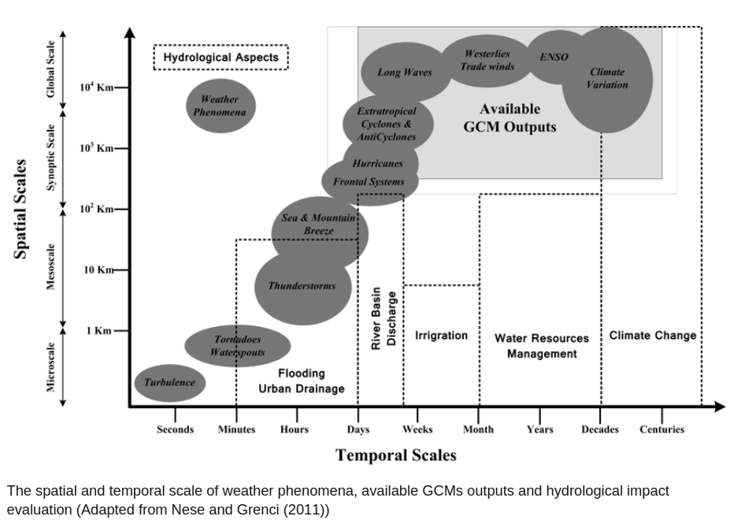

Slide 5

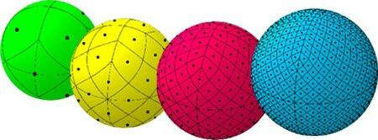
Of course, new approaches come with challenges…
How do we cater to the gamut of length and time scales of scientific pursuits?
How do we enable efficient data access, analysis and evaluation?
Combination of HEALPix grid and zarr-formatted data

Slide 6
Hierarchical equal area iso-latitude pixelization - HEALPix (Gorski et al. 2004)
Hierarchical tessellation of sphere into curvilinear quadrilaterals - lowest resolution partition has 12 base pixels
Resolution of the tessellation increases by division of each pixel into four new ones.
Areas of all pixels at a given resolution are identical.
Pixels are distributed on lines of constant latitude.
Image source: wikipedia
Mapping km-scale model output to HEALPix enables efficient analysis and evaluation of global quantities as well as feature analysis at maximum resolution.

Slide 7
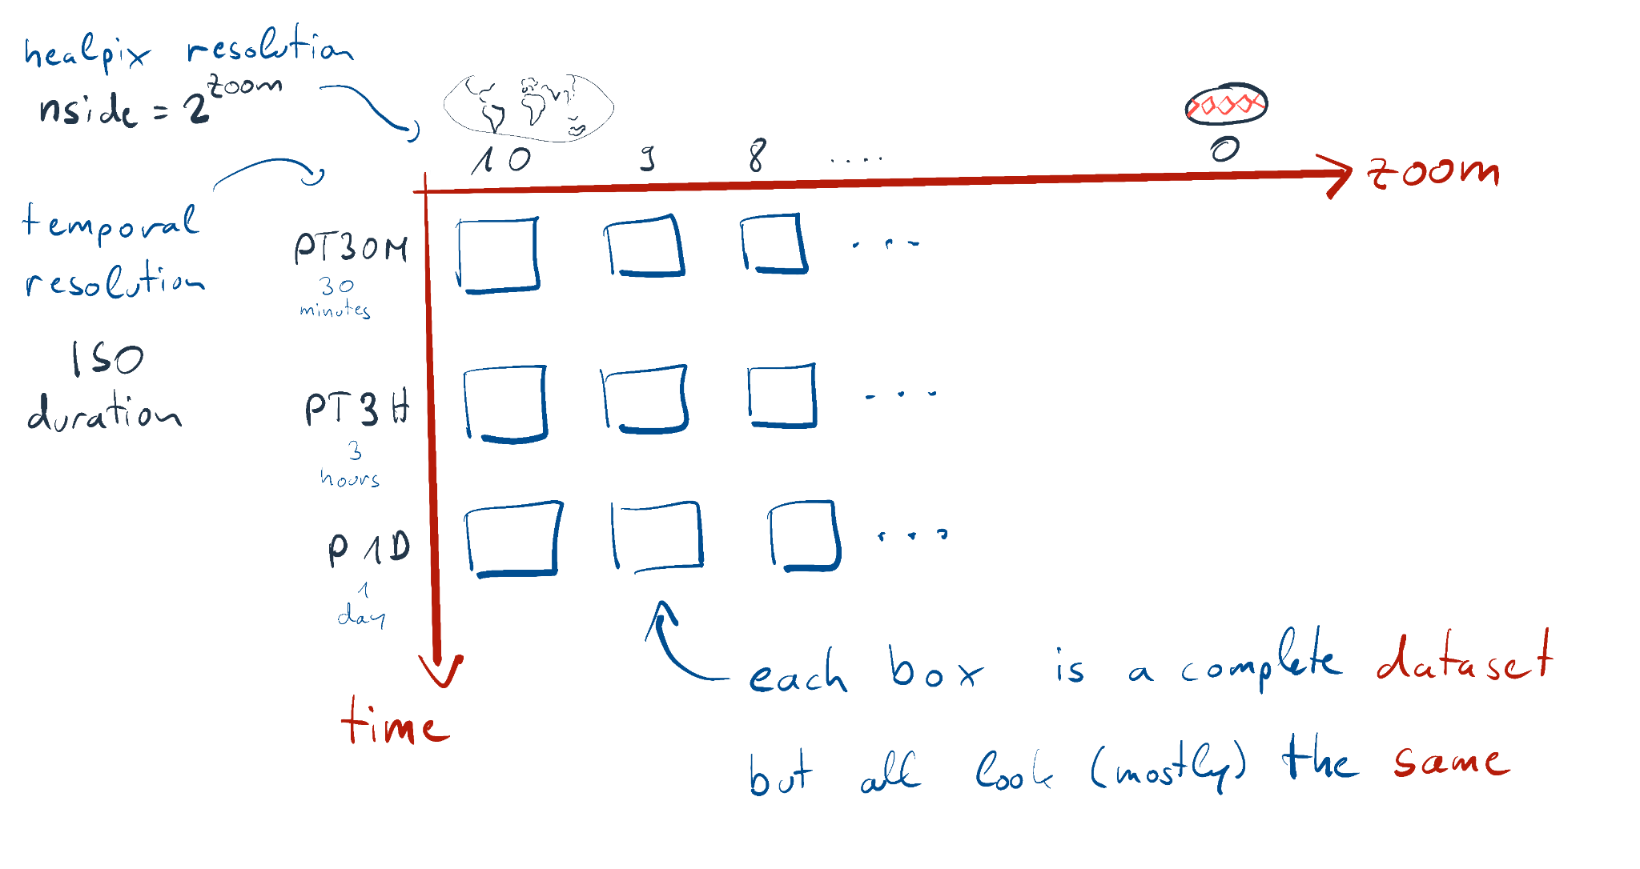
HR ESM data on HEALPix, stored in zarr-format
The output is stored as combination of multiple resolutions and chunks; example from the ICON model:
https://zarr.readthedocs.io/en/stable/
one dataset per zoom level
(0-10)
and temporal output
30 minutes
3 hours
1 day
source: easy.gems.dkrz.de

Slide 8
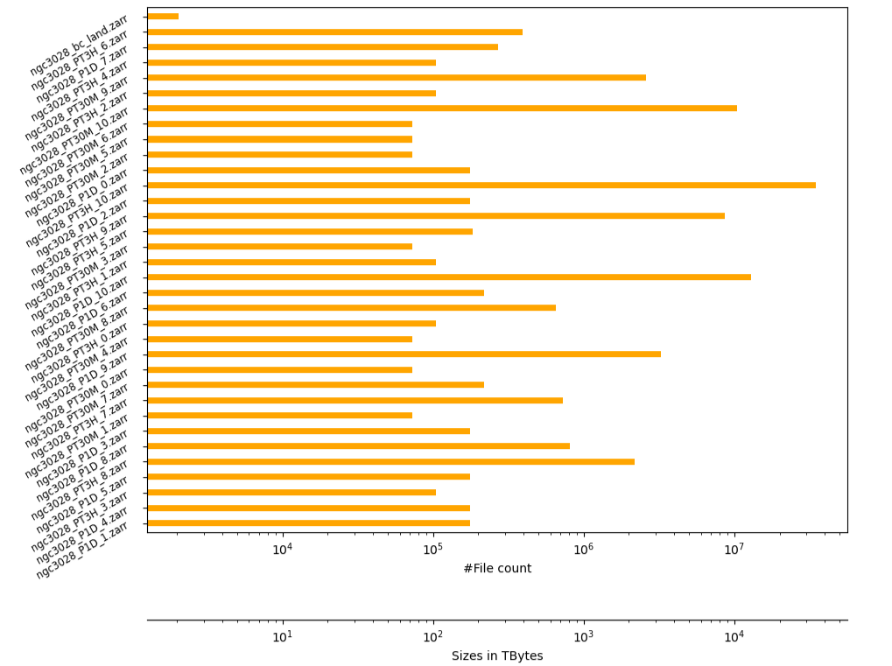
How does it work in the context of ICON model output?
up to 10⁷ files/chunks per dataset
up to hundreds of Tb per dataset
Technical challenge!!

Slide 9
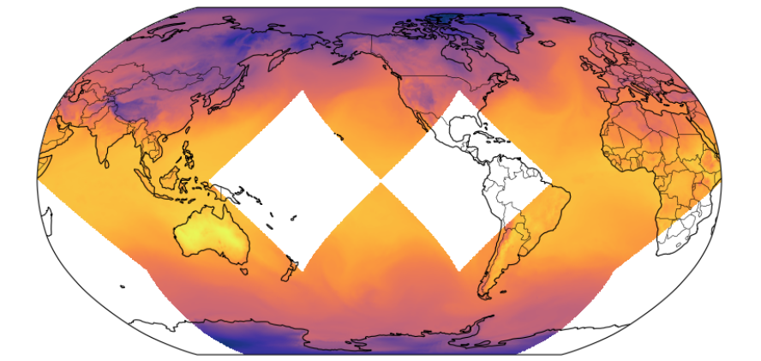
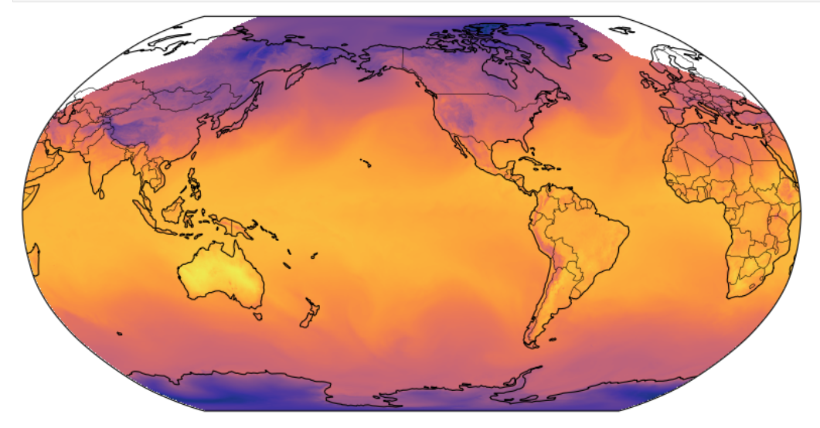
How to ascertain the data integrity?
Data is produced and moved across storage tiers (HDD -> S3 -> tape) which could result in missing chunks
Effects could be
wrong chunk count,
uninitialized chunks,
missing chunks Vs zoom levels
zoom 7
Single chunk missing
zoom 9
Single chunk missing
Notes:
Data is produced and moved across storage tiers, which could result in missing chunks for example.
chunk count, uninitialized chunks, missing chunks Vs zoom levels , fault tolerant

Slide 10
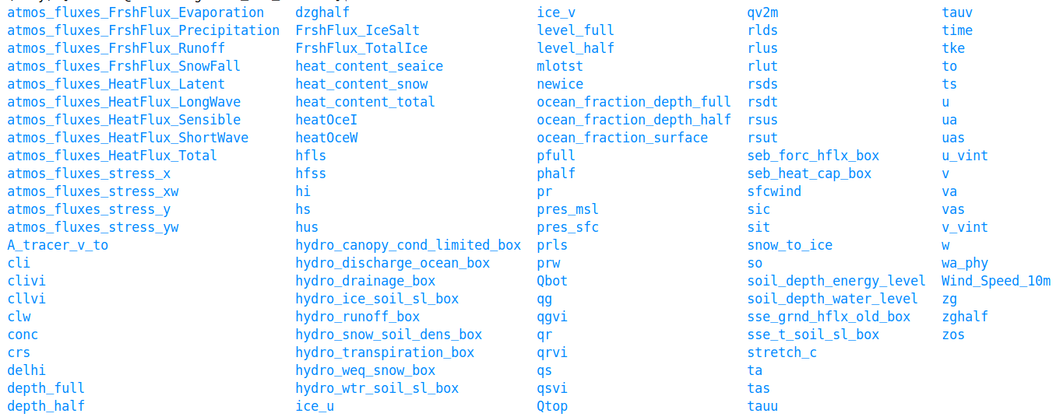
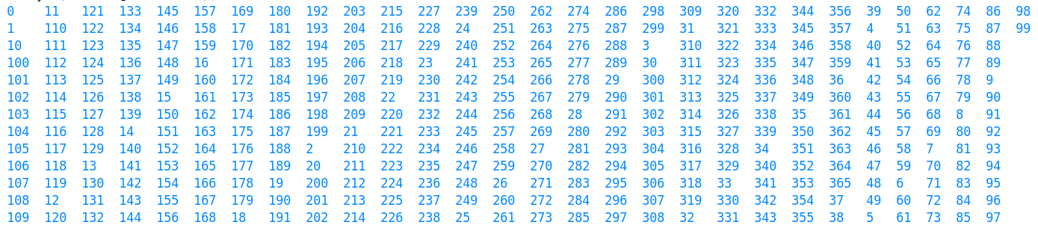
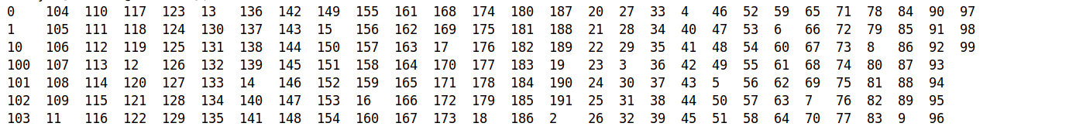
How to ascertain the data integrity?
Typical Zarr store
The names of chunks are numbers!!!
Notes:
Enumerating the list of chunk IDs and checking , as the chunks are named as monotonically increasing integers in zarr v2.0 hierarchical structure

Slide 11
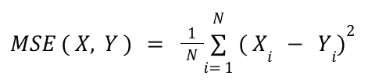
How to ascertain the data quality?
Mean Squared Error
Mean squared error
Pressure levels
t=0
t + t
Time

Slide 12
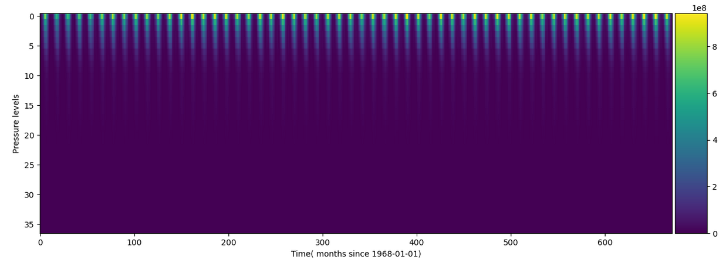
How to ascertain the data quality?
Mean Squared Error ( MSE )
ERA5 Geopotential(mon) 1968-2020 250 Km² 37 pressure levels

Slide 13
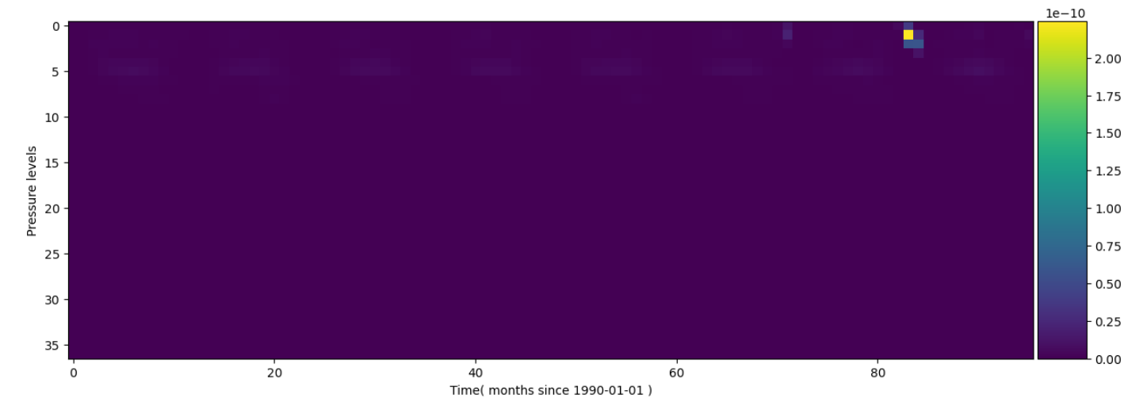
How to ascertain the data quality?
Mean Squared Error ( MSE )
ERA5 Ozone mixing (mon) 1990-1997 250 Km² 37 pressure levels
It turns out that some issue with measuring instrument(TOMS) in 1995…
https://www.theozonehole.org/ozone1995.htm

Slide 14
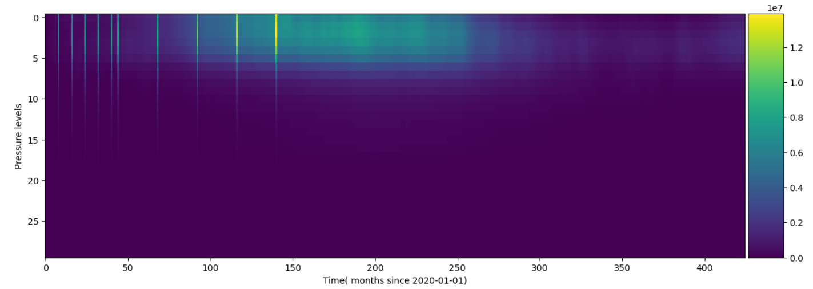
How to ascertain the data quality?
Mean Squared Error ( MSE )
ICON Geopotential(P1D)
It turns out that those abnormal streaks are due to some issue in computing daily values from model time step…

Slide 15

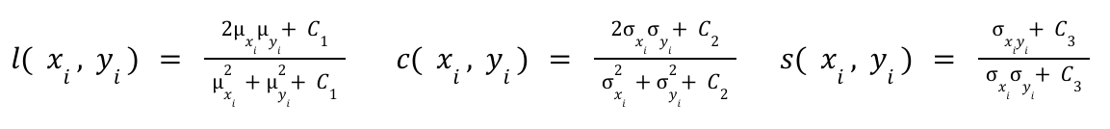
How to ascertain the data quality?
Structural Similarity Index Measure (SSIM)
= f ( luminance, contrast, structure )
Z. Wang et al 2004

Slide 16
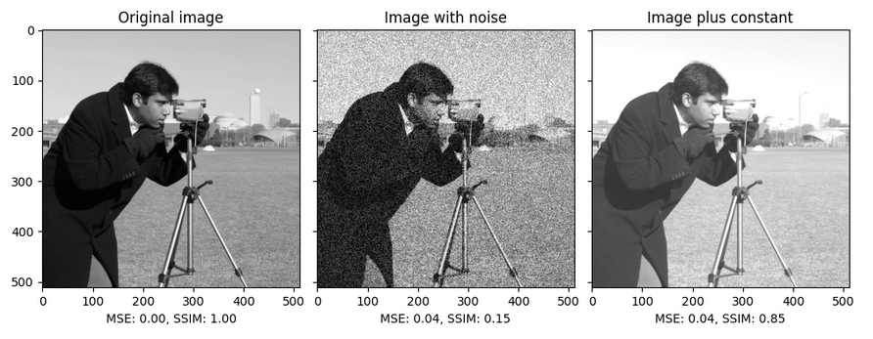
How to ascertain the data quality?
Structural Similarity Index Measure (SSIM)
Source: https://scikit-image.org/
Evaluation of entire images for overall similarity -> global ESM simulation fields?
However, difficult to realize for high-resolution climate simulation data (too many pixels)

Slide 17

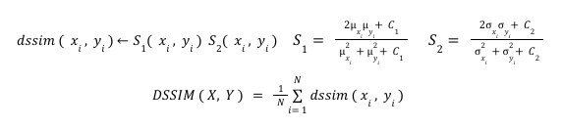
How to ascertain the data quality?
Data Structural Similarity Index Measure (DSSIM) (Baker et al., 2024)
Applicable to regular grids; HR model output is often unstructured, e.g. HEALPiX

Slide 18
How to ascertain the data quality?
Data Structural Similarity Index Measure (DSSIM)
Animation of kernel for various grid cell locations
Adapted to HEALPix grid using ‘healpix-convolution’ package for constructing the gaussian kernel
https://healpix-convolution.readthedocs.io/en/latest/index.html
Notes:
IFREMER French institute for ocean science

Slide 19
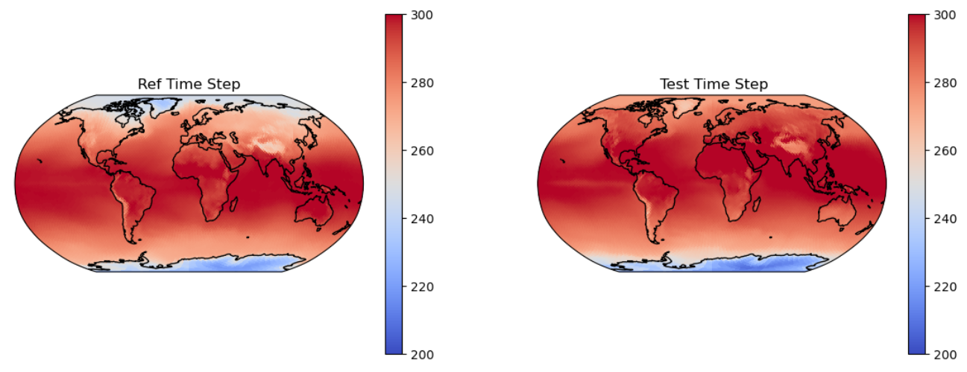
How to ascertain the data quality?
Data Structural Similarity Index Measure (DSSIM)
!!!DSSIM = 0.56!!!

Slide 20
Summary
Km-scale global (physical) ESM simulation data require novel data layout and data formats to allow processing
Combination of cloud native formats like Zarr (in small chunks) and HEALPix require adaptation of techniques to enable ensuring data integrity and data quality .
Data integrity (erroneous chunks) can be verified using simple method
Adapted DSSIM to HEALPix grid which enables to assess data quality almost at the level of visual inspection.
Outlook
Publication of code for community reuse
Possibility to incorporate into HR ESM workflows

Slide 21
THANK YOU

