Slide 1
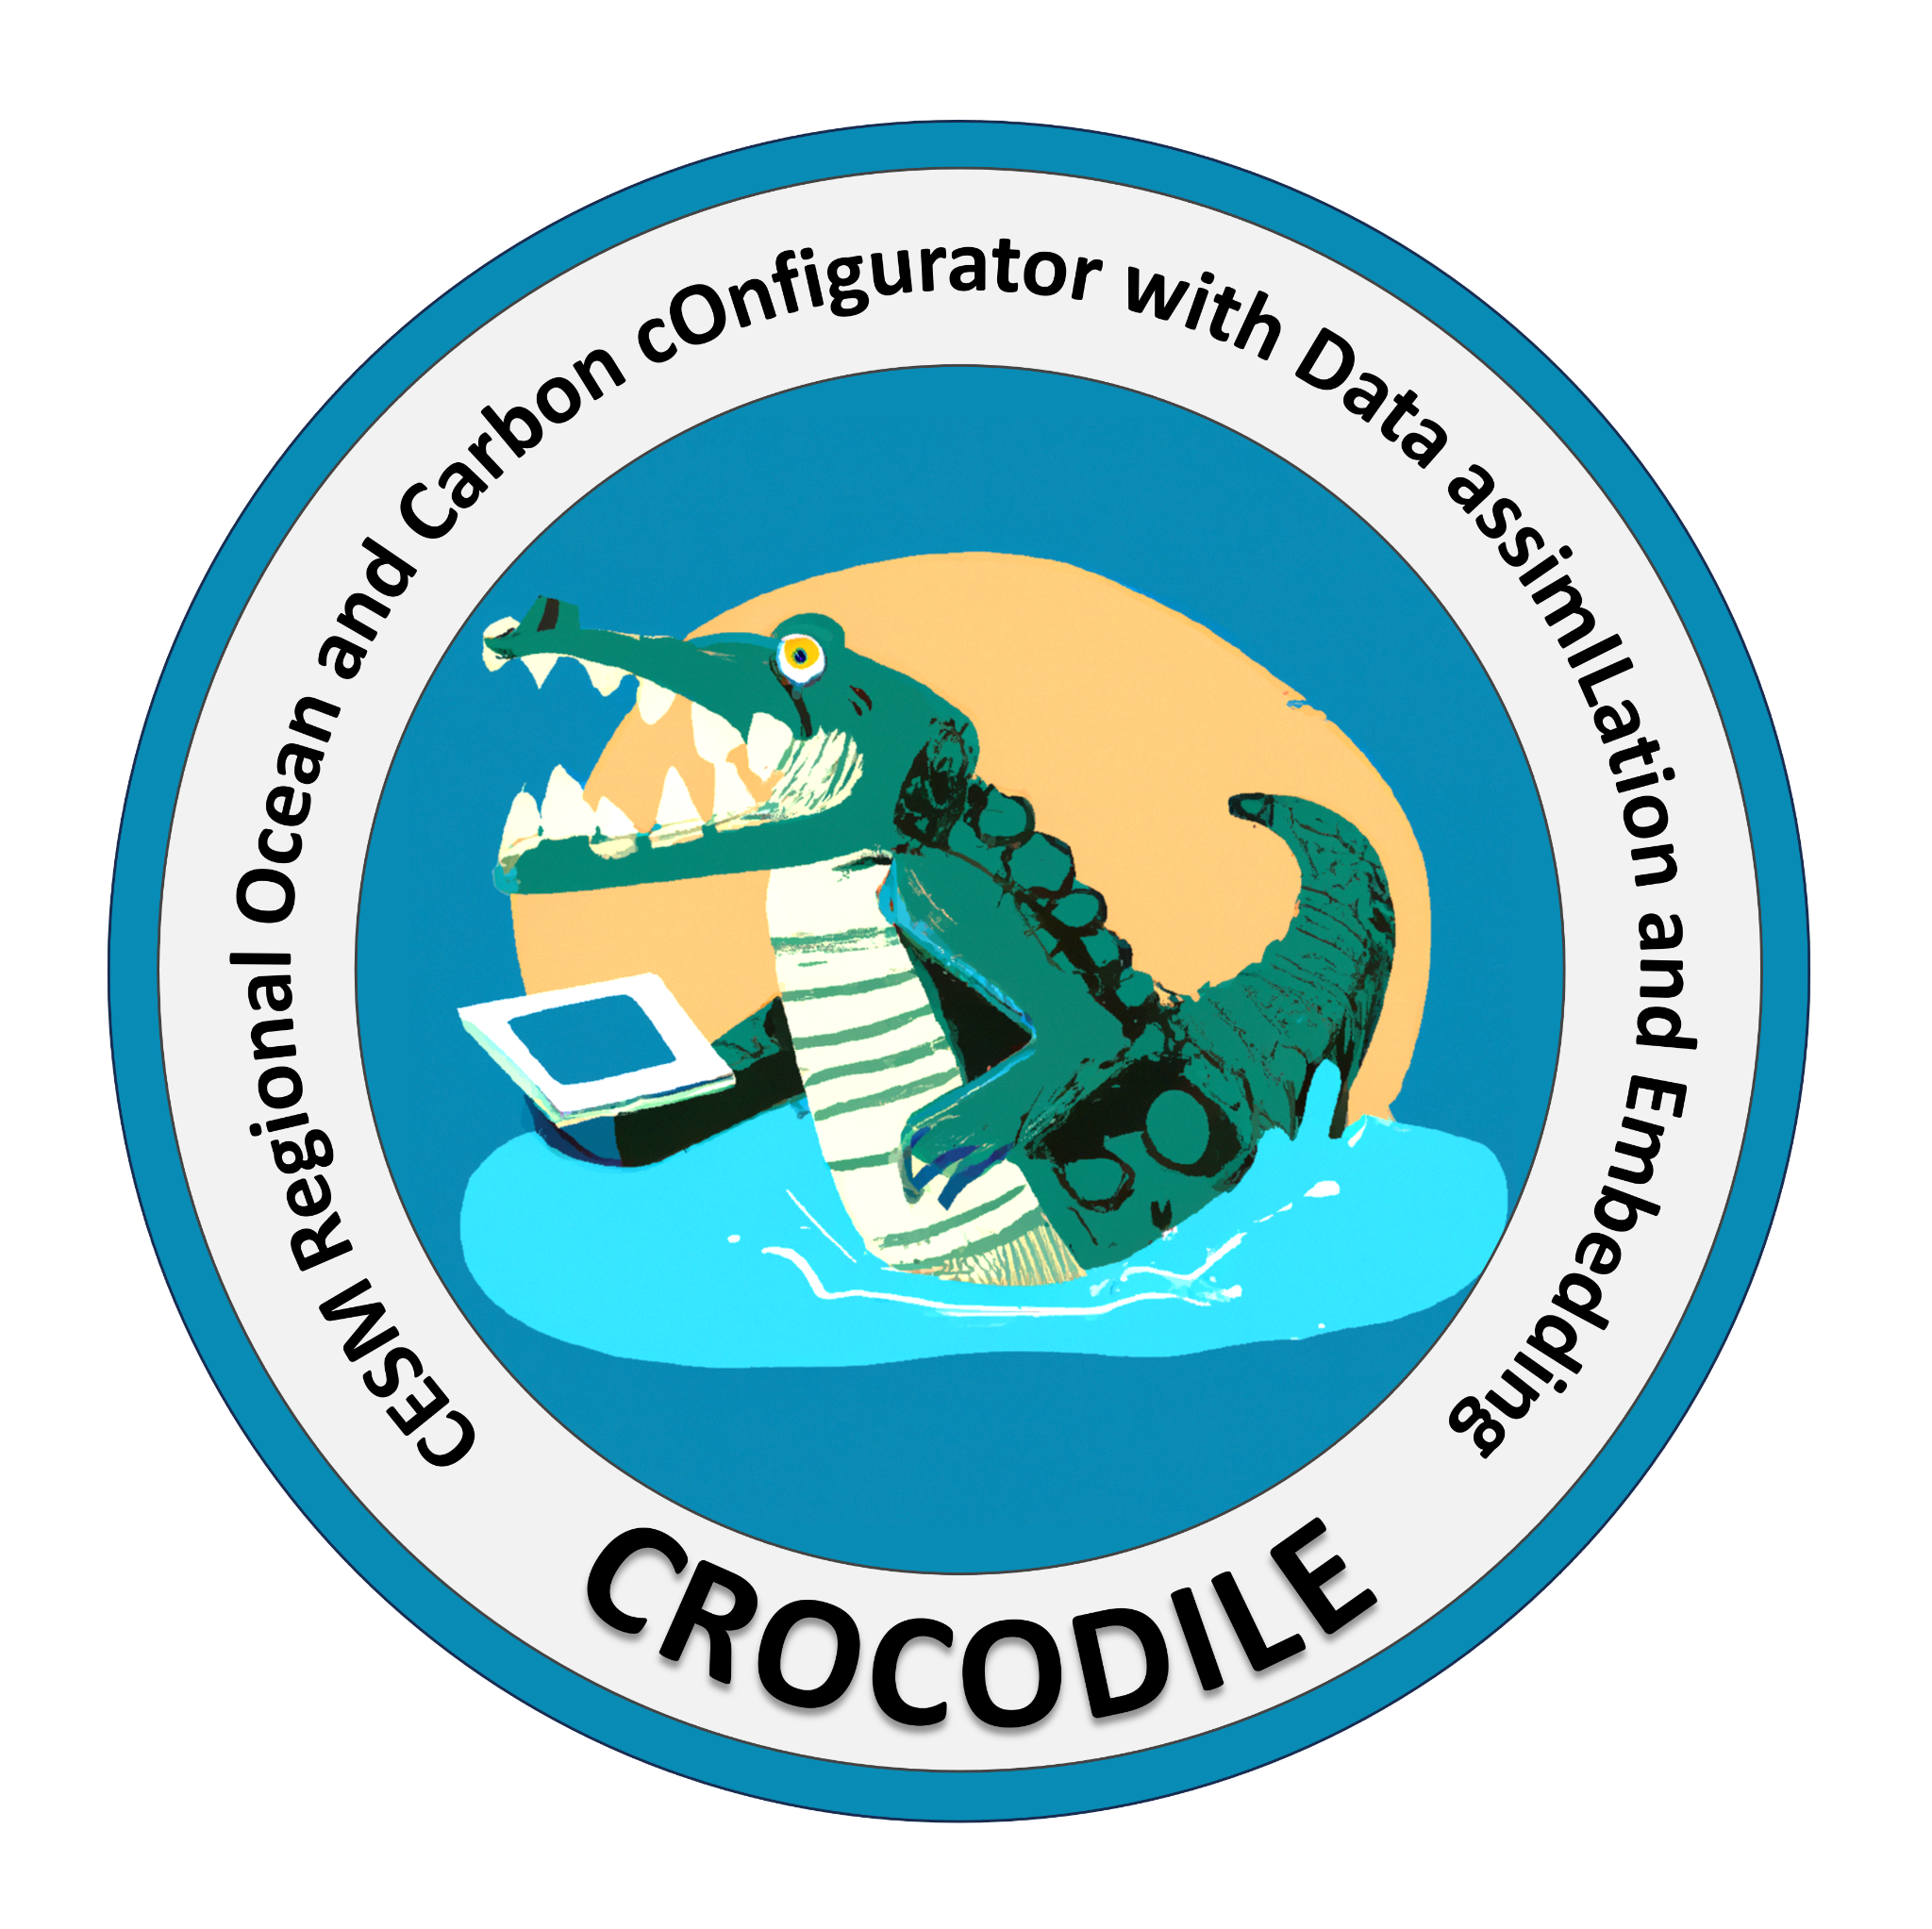
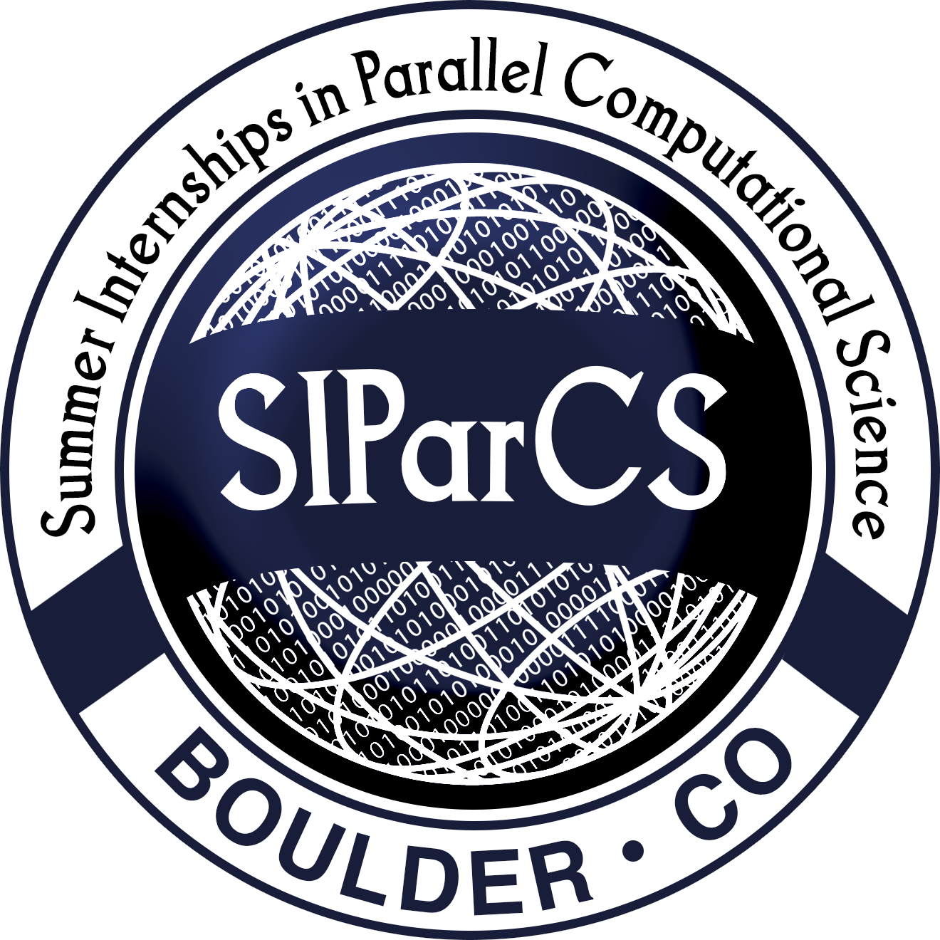
Enhancing Scientific Reproducibility in CrocoDash for Regional Ocean Modeling
Andrew Kwong
Mentors: Manish Venumuddula, Alper Altuntas, Dan Amrhein
Summer Internships in Parallel Computational Science (SIParCS)
November 7, 2025

Slide 2
BACKGROUND
Regional ocean models are powerful tools.
It can be time-consuming to set these models up.
Months/Weeks → Days/Hours
Part 1: Introduction
Notes:
Regional ocean models are powerful tools:
Allow us to physical and biogeochemical processes at finer spatial scales, which are otherwise unresolved in global climate models.
In our case: “A model is a numerical representation of the physical processes that govern the Earth system, using equations, input data, and numerical methods to simulate how this system evolves over space and time.
Model setup challenges:
It can take several months to set up one’s desired regional ocean model with MOM6.
We want to pursue rapid prototyping of regional ocean models so we can answer more important scientific questions.
Introducing CROCODILE
By accelerating this process and lowering the technical overhead, we can build a community centered around open science, aimed at understanding the imprints of climate change.
Outline basic features of CrocoDash and its workflow:
What does this look like? It involves generating a domain (area you want to study), creating a “case” in CESM, preparing ocean forcing data (so initial conditions and open boundary conditions), and finally building the case.
We take these steps and unify them into one cohesive workflow, priming users for rapid development of models.

Slide 3
PROJECT OBJECTIVE
Enhance scientific reproducibility and increase accessibility in the CrocoDash workflow.
Goal: Fully reproducible end-to-end workflow to create regional Modular Ocean Model version 6 (MOM6) cases!
CrocoDash
Case: A specific instance of a model simulation in the Community Earth System Model (CESM).
Domain Generation
Case Creation
Domain: Specific region being simulated, including a horizontal grid, vertical grid, and topography.
Ocean Forcing Data Preparation
Forcings: Initial conditions (ICs), open boundary conditions (OBCs), tides, and chlorophyll.
Build and Run Case
Part 1: Introduction
Notes:
And thus our Project objective!
Our goal is to enhance scientific reproducibility and increase accessibility in the CrocoDash workflow.
What it means to be reproducible:
Repeatability: A researcher can independently recreate the same exact model setup, run, and results under the same inputs and assumptions.
Our contributions focus on the model setup being repeatable!
Traceability: Each transformation to the model build should be logged and versioned! This enables provenance tracking.
Transparency: Changes are made known to the user setting up the model and to those who might want to use or replicate that model down the line.
TopoEditor (AFTER)
And so, looking into what reproducible looks like, we can look at the TopoEditor.
Showcase the different features added that contribute to this reproducibility
Ultimately, it was from here to increase the scope of adding reproducible features from the (existing) TopoEditor to beyond… here’s what I did

Slide 4
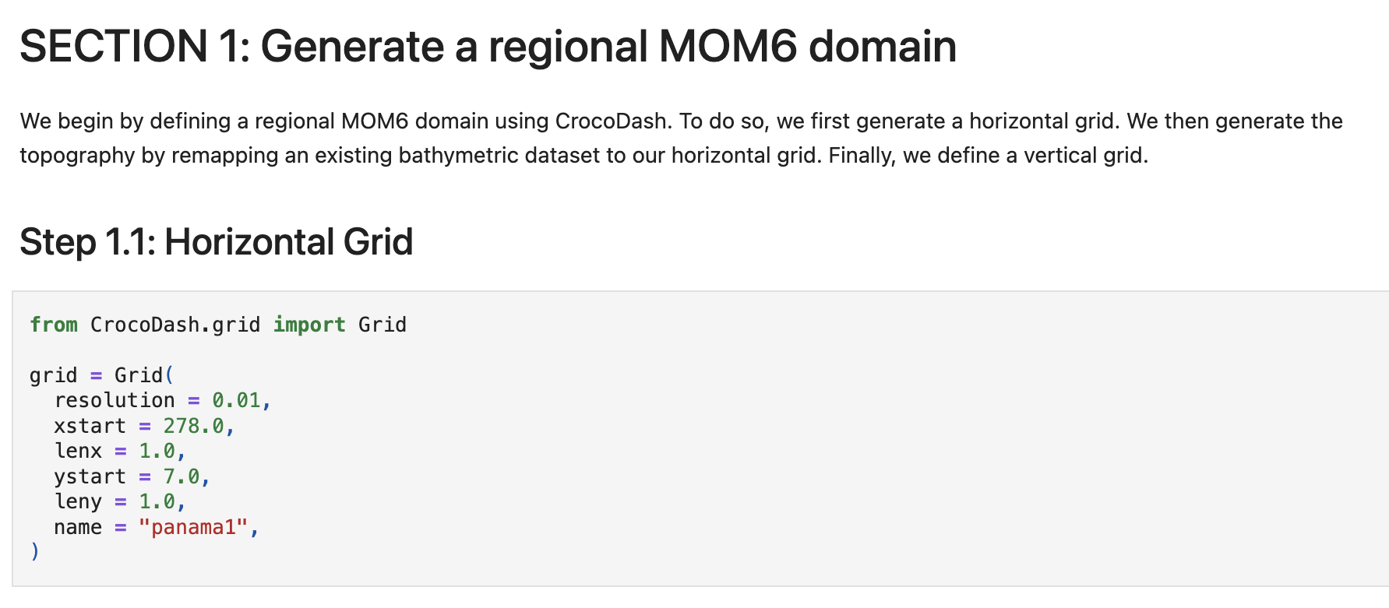
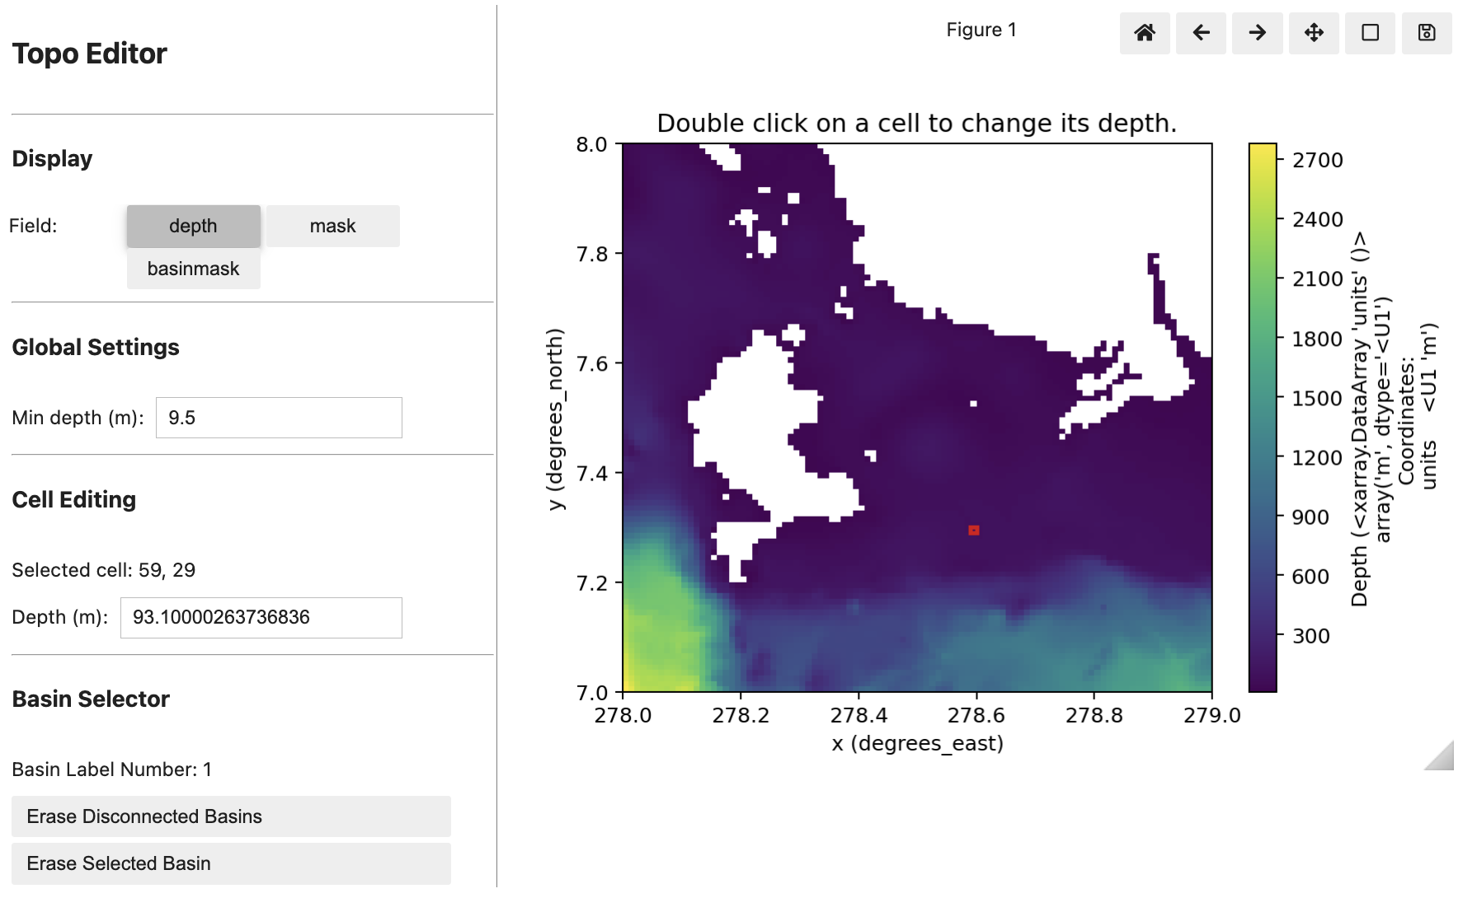
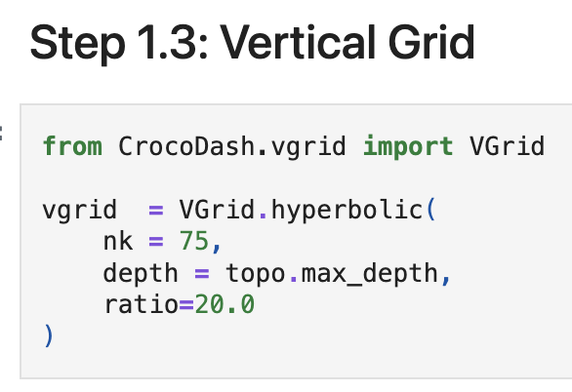
MOTIVATION
Model setups are now more user-friendly and streamlined in this workflow but…
There is a lack of reproducible features in CrocoDash!
How do we make this workflow reproducible?
Part 1: Introduction
Notes:
CrocoDash in its original state
Model setups are now more user-friendly and streamlined in this workflow.
It is now much easier and faster to create model configurations over domains – in most cases, the setup time has decreased from weeks or even months to just hours.
With that said…
Reproducibility
There is a lack of reproducible features in CrocoDash!
How can users be able to save their configurations or keep track of their progress as they set up their regional ocean models?
Introduce object configurators – used for generating domain.
Use the TopoEditor as an example.
It can take hours to make fine edits and save a desired topography.
No way to save/track progress across sessions – essentially lose all progress if you end the Jupyter notebook session!
Show Grid and VGrid and how it is still unintuitive and potentially time-consuming
We want open science, where we can experiment and validate with ease.

Slide 5
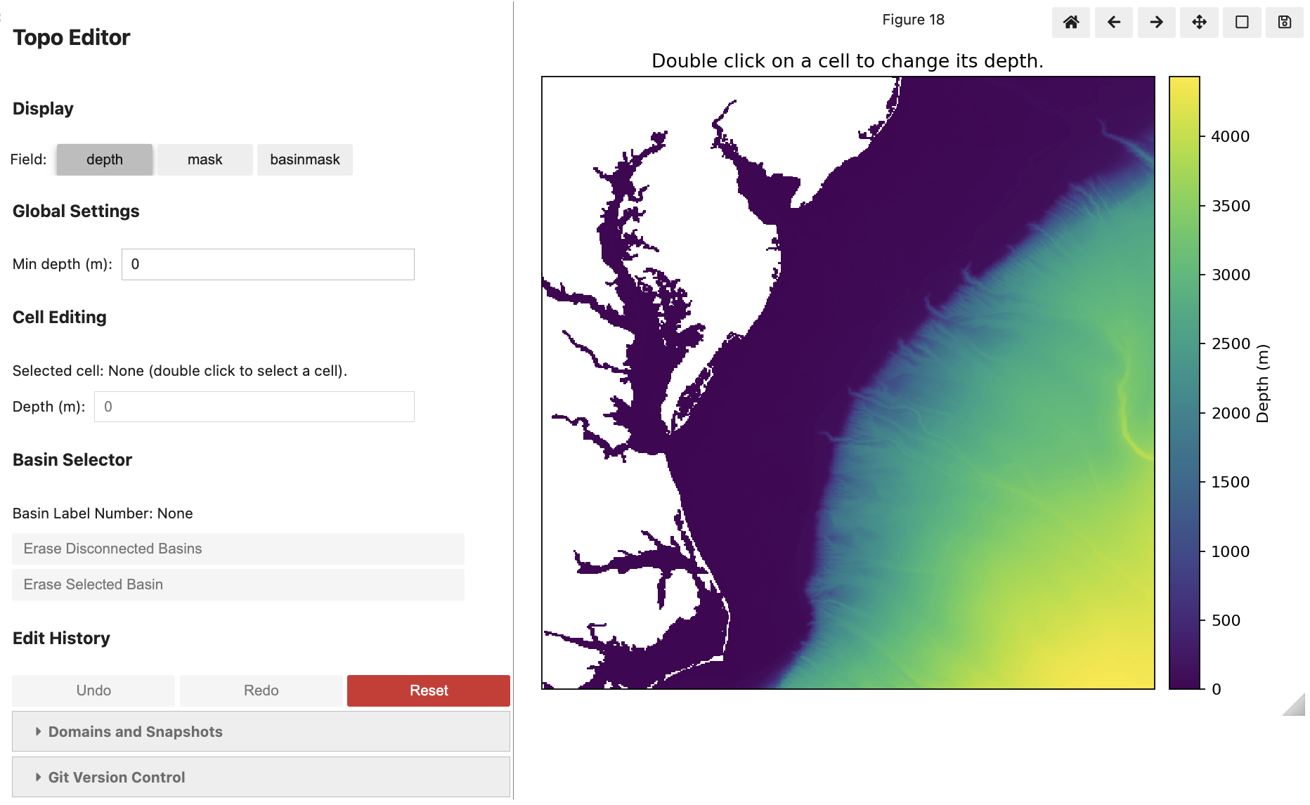

SCIENTIFIC REPRODUCIBILITY
Reproducibility = Repeatability + Traceability + Transparency
Editing topography is important for model tuning but tedious!
History
Version control
Shareability
Part 2: Procedures
Notes:
“While Earth's seafloor is well-mapped, regional ocean models often require modifying topography to ensure numerical stability and realistic circulation at a given grid resolution. Features like narrow straits, steep slopes, or shallow basins may need to be smoothed, deepened, or reshaped to avoid instabilities or spurious flows. This process is part of model tuning — getting a simulation to behave realistically isn't just about correct equations and boundary conditions; it requires careful iteration. The Topo Editor makes this process transparent, reversible, and reproducible, so users no longer need to “cross their fingers” and hope the case runs — they can see, control, and refine each step with confidence.”

Slide 6
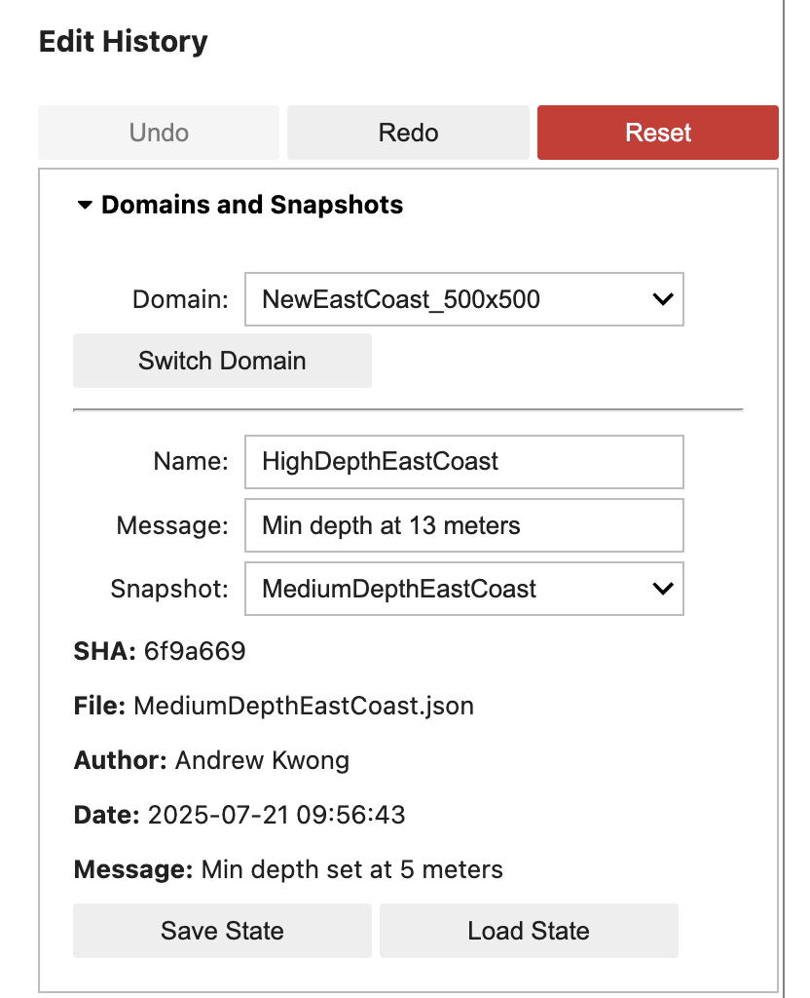
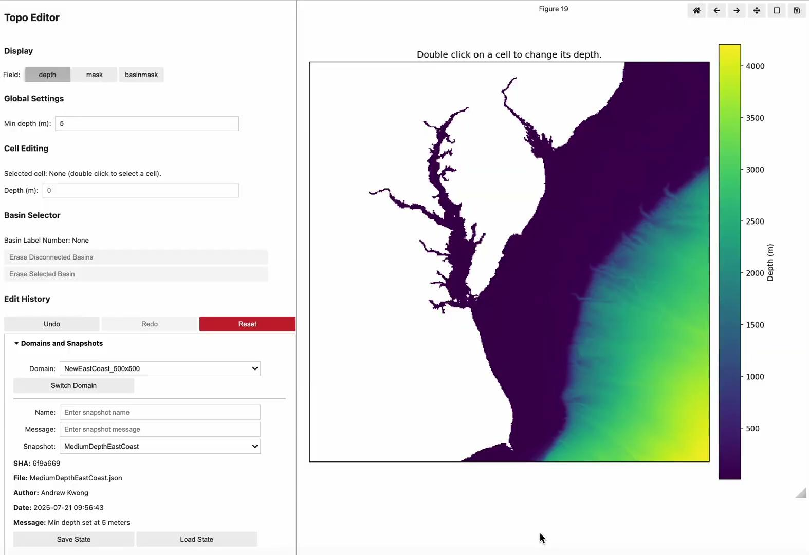
HISTORY AND PROVENANCE
Topo Editor Edit History Section
Users now able to save and load snapshots across sessions, with a history log of modifications.
Part 2: Procedures
Notes:
Initial focus on the object configurators in the CrocoDash workflow
Makes sense as they are user-facing and there is a great deal of interactivity
First thing you might notice is that there is not the functionality to undo, redo, and reset changes.
TopoEditor improvements
On top of these new edit features, one can snapshot their changes by saving state, or they can load a previous state from a history.
If a user loads in a previous state using load state, the undo and redo histories are restored from the previous session.
.json files used to restore topography changes in the Topo Editor
SHA (hmm) → leads into the next slide on version control integration and the use of Git

Slide 7
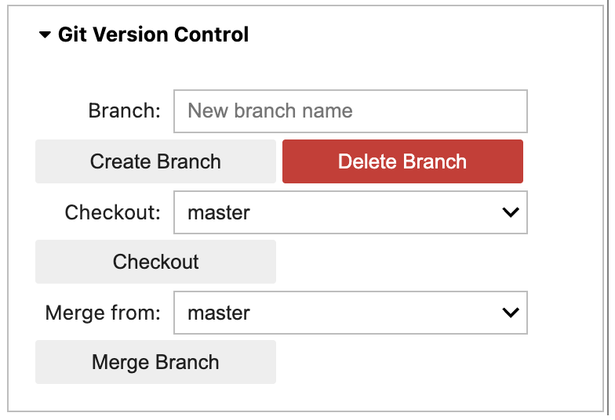
VERSION CONTROL INTEGRATION
With a history to log changes over time, how do we integrate version control?
We use Git to handle commits, branches, and checkouts in the Topo Editor.
This promotes data provenance and traceability!
Users can share Topo and Grid configurations through repositories.
Topo Editor Version Control Section
Part 2: Procedures
Notes:
Saving and Loading
This is actually using Git commits under the hood!
Git for version control!
Thus, our method of handling version control is via Git.
We can commit changes; create, delete, and merge branches; and perform checkouts in the Topo Editor.
We use Git because it is well-developed software widely used by the scientific community.
This further promotes open science and a collaborative modeling environment.
It also promotes data provenance and traceability.
Users can therefore share and use Topo objects from repositories (as well as horizontal Grids since they are always connected to Topos), but what does this look like across the CrocoDash workflow?
What is the sense of structure and what users might be sharing?

Slide 8
STRUCTURE AND SHAREABILITY
Topos are located in Git repositories.
Generate Grid
Grid
Grid Creator
Generate VGrid
Generate Topo
VGrid Creator
VGrid
Topo
Topo Editor
Case
Grids and VGrids are libraries local to the user.
Part 2: Procedures
Notes:
Structure
Go through from the top (aided by transitions)
Grid generation creates a Grid object
You can edit said Grid, which will create a NEW Grid object each time you make a change and save the Grid
Grid Libraries! → contains .json and .nc files
You generate a Topo from a Grid
This Topo object can now be modified/mutated using the Topo Editor → contains .json and .nc files (both Grid and Topo)
The VGrid is separated generated
You can edit said VGrid, which will create a NEW VGrid object each time you make a change and save the VGrid
VGrid Libraries! → contains .json and .nc files
A Grid, Topo, and VGrid object are used to create a Case object!
** and then we configure and process forcings from ocean data so that a case can be built and run…
Reiterate the points that each Topo of a unique Grid are their own Git repositories, and Grids/VGrids are libraries local to the user.
So what does do these configurators look like all together?

Slide 9
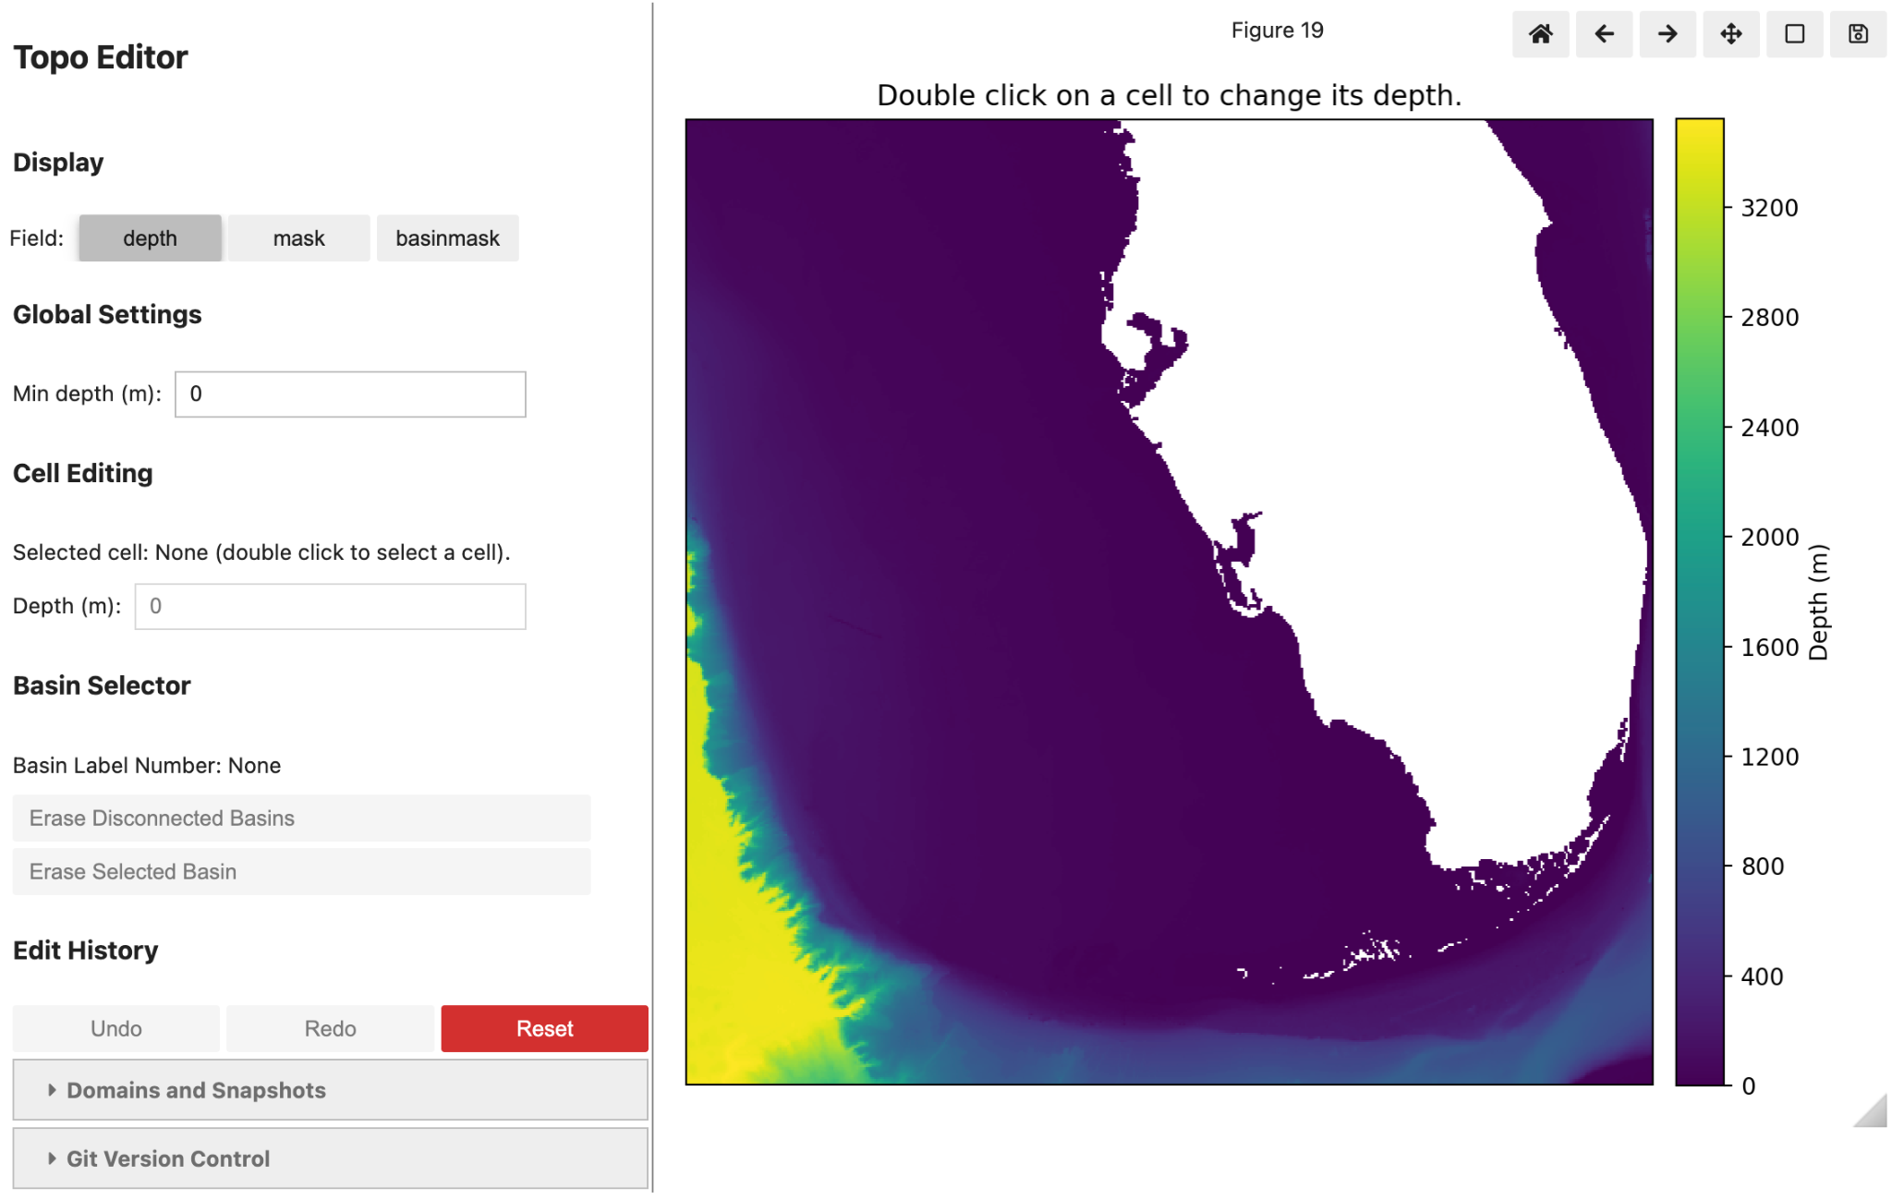
OBJECT CONFIGURATORS
Grid Creator
Topo Editor
VGrid Creator
Part 2: Procedures
Notes:
Now that we have gone through the three core parts of adding reproducibility into these object configurators, namely history & provenance, version control, and shareability, what do they all look like?
You have already seen the Topo Editor (--> transition)
*** EMPHASIZE REPRODUCIBILITY
Grid Editor
Note the lack of snapshots (we are not tracking changes in Grids over time since they are all unique objects, unlike Topo.
We are instantiating a new Grid object each time we change and save a Grid.
With a Topo object, modifications can be tracked by looking at the bathymetry data.
Still VERY useful and increases accessibility and efficiency in the workflow!
VGrid Editor (this one is the most simple)
Very similar to the Grid Editor, except you are now changing the vertical grid profile.

Slide 10
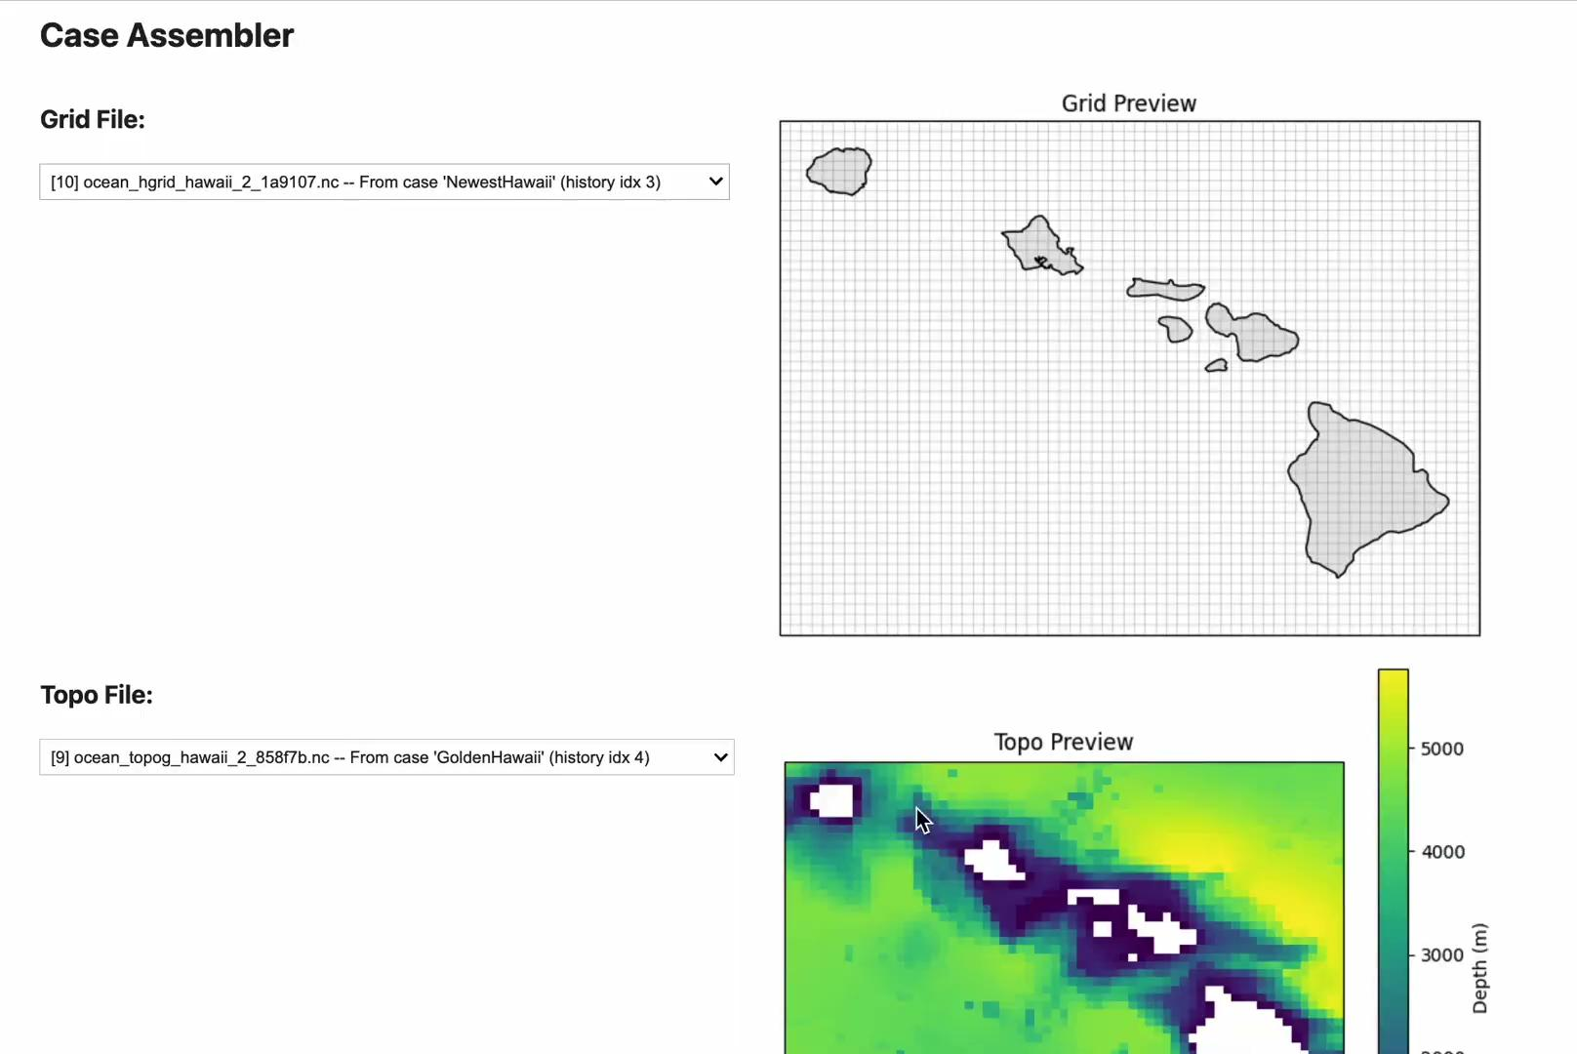
END-TO-END WORKFLOW
Case Assembler
Final step: Add reproducibility to the preparation of forcing data.
Case history configurations are saved to a .json file.
We have everything we need to build and run a Case from history!
Part 3: Outcomes
Notes:
Walk through the Case Assembler
(when it gets to the part where I select the forcing config) Final step: Ocean Forcing Data
With reproducibility added to the generation of a domain, as well as case creation, our final step involves adding reproducibility to the preparation of forcing data.
Forcing data: Atmospheric and freshwater inputs used to drive ocean models – simulating ocean circulation and other processes.
In the setup of a regional ocean model, this involves having some forcing configuration.
Includes ICs, OBCs, tides (and soon to be chlorophyll).
Solution to Forcing Data
We save a history of case forcing configurations in a .json file.
Serves as a snapshot of the full forcing configuration – users no longer have to worry about trying to create any previous forcing configuration they used from scratch!
All ingredients are ready!
Domain
Case is created
Forcing configurations
All reproducible and saved to some sort of history!
Here’s what it looks like after configuring and processing the forcings – they’re written to a configuration file called user_nl_mom
The case is ready to be built and run! We have a ready-to-go regional ocean model!

Slide 11
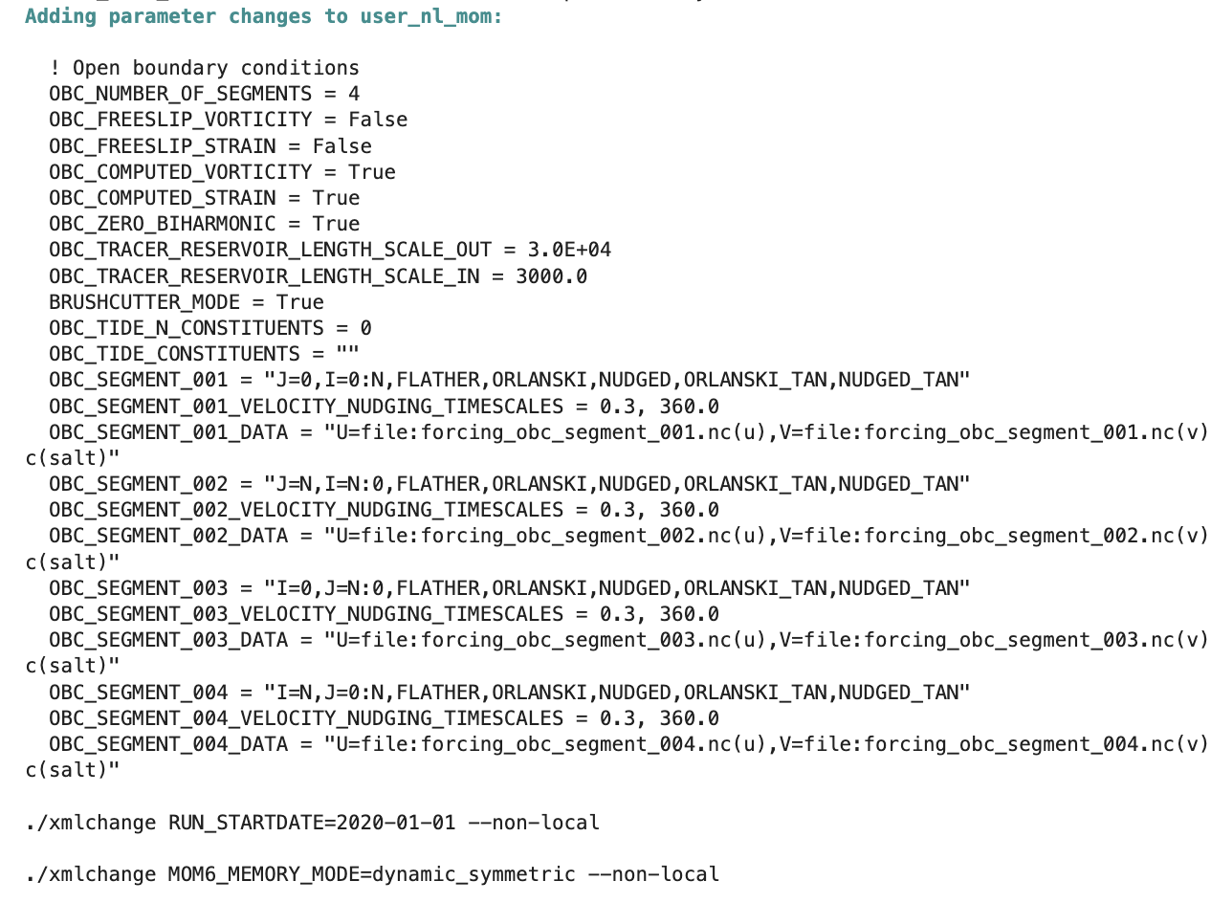
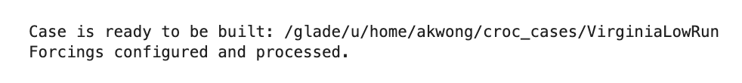
END-TO-END WORKFLOW
Final step: Add reproducibility to the preparation of forcing data.
Case history configurations are saved to a .json file.
We have everything we need to build and run a Case from history!
Part 3: Outcomes
Notes:
Walk through the Case Assembler
(when it gets to the part where I select the forcing config) Final step: Ocean Forcing Data
With reproducibility added to the generation of a domain, as well as case creation, our final step involves adding reproducibility to the preparation of forcing data.
Forcing data: Atmospheric and freshwater inputs used to drive ocean models – simulating ocean circulation and other processes.
In the setup of a regional ocean model, this involves having some forcing configuration.
Includes ICs, OBCs, tides (and soon to be chlorophyll).
Solution to Forcing Data
We save a history of case forcing configurations in a .json file.
Serves as a snapshot of the full forcing configuration – users no longer have to worry about trying to create any previous forcing configuration they used from scratch!
All ingredients are ready!
Domain
Case is created
Forcing configurations
All reproducible and saved to some sort of history!
Here’s what it looks like after configuring and processing the forcings – they’re written to a configuration file called user_nl_mom
The case is ready to be built and run! We have a ready-to-go regional ocean model!

Slide 12
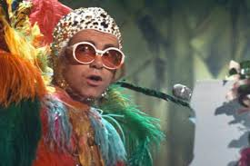
CONCLUSIONS
Reproducibility requires intention and infrastructure.Refactoring enables reliability and extensibility.
Building new features requires maintenance of one’s footprint.
Essential for long-term scientific software.
Reproducibility isn’t just good practice, it’s good science.
By tracking what we do, we preserve why results matter.
This work ensures that ocean models from CrocoDash are not just functional, but transparent and shareable.
A
Modular design enables reusable modeling.
Good science begins with reproducibility.
Our work integrating modular configurators, version-controlled editing, and reproducible tools lays the foundation for rapid, reproducible Earth system modeling.
Part 4: Conclusions
Notes:
Reproducibility is built, not assumed.
Scientific reproducibility is more than just a post-processing step of a workflow. It’s even more than just having a history and log of actions and changes a user has made.
It includes modular, testable code and features that promote workflow provenance, traceability, and shareability.
Reproducibility is now a core feature of CrocoDash, not an afterthought.
Refactoring enables reliability and extensibility.
It’s easy to go fast and develop features at a rapid pace, but in the context of production and working on large teams, it’s essential to not overextend.
To not overextend means keeping an eye on your footprint – your code footprint that is.
Refactoring is the means by which we can maintain these features in the long run.
Reproducibility isn’t just good practice, it’s good science.
Open science is more important than ever.
Sharing transparent workflows can allow us to tackle scientific questions and understand our ways of tackling them.

Slide 13
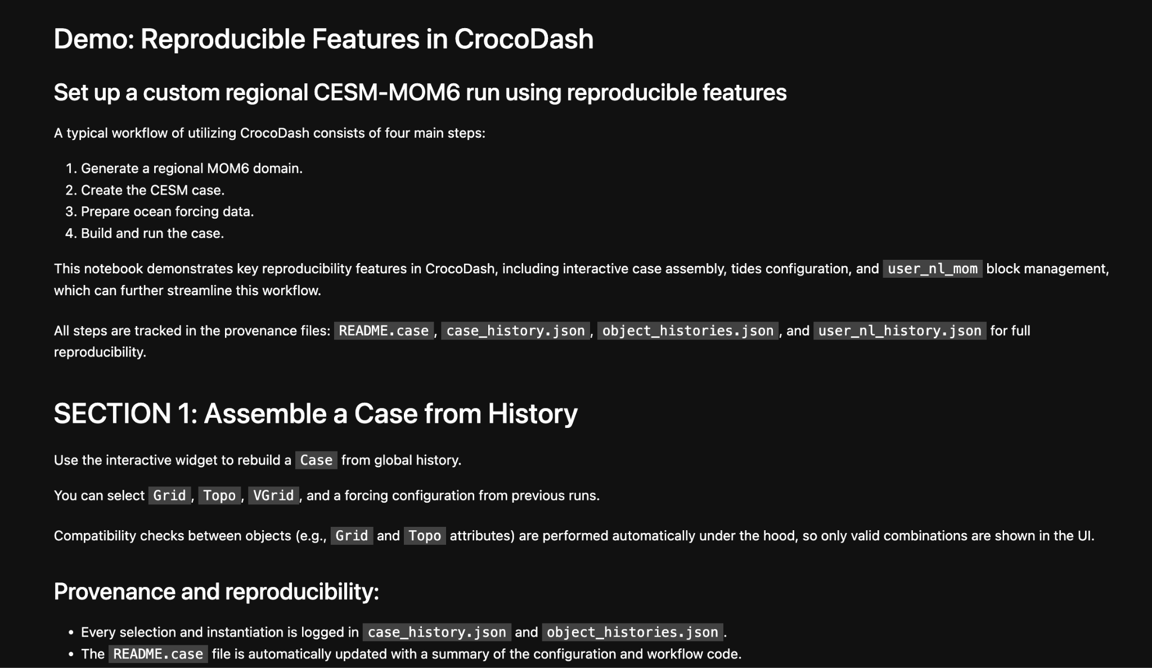
ADDITIONAL WORK
Documentation
Testing
Write unit tests for key components in the editors and in the Case Assembler.
Develop a continuous integration (CI) pipeline for automated testing.
Extending Features
Handle for other grid and edit types.
Add to the reproducibility suite as CrocoDash grows (e.g., chlorophyll, BGC, DROF)!
Creation of Jupyter notebooks focused on scientific reproducibility for regional MOM6 cases.
Part 4: Conclusions
Notes:
Documentation
Jupyter notebook development for documentation and user knowledge
Create scientifically relevant use-cases for reproducibility
Showcase each component (object configurators, Case Assembler, and more)
Testing
Write unit tests for key components in the configurators as well as in Case Assembler
Extending Features
Extend features to support curvilinear grids and other modifications and changes that can be made to Cases

Slide 14

ACKNOWLEDGMENTS
Thank you to my mentors:
Dan Amrhein, Manish Venumuddula, Alper Altuntas
Thank you to the internship organizers:
Virginia Do, Jessica Wang, Prashansa Agrawal
Thank you to the organizations that support us:
This material is based upon work supported by the U.S. National Science Foundation National Center for Atmospheric Research, which is a major facility sponsored by the U.S. National Science Foundation under Cooperative Agreement No. 1755088. Any opinions, findings, and conclusions or recommendations expressed in this material are those of the author(s) and do not necessarily reflect the views of the U.S. National Science Foundation.
Part 4: Conclusions

Slide 15
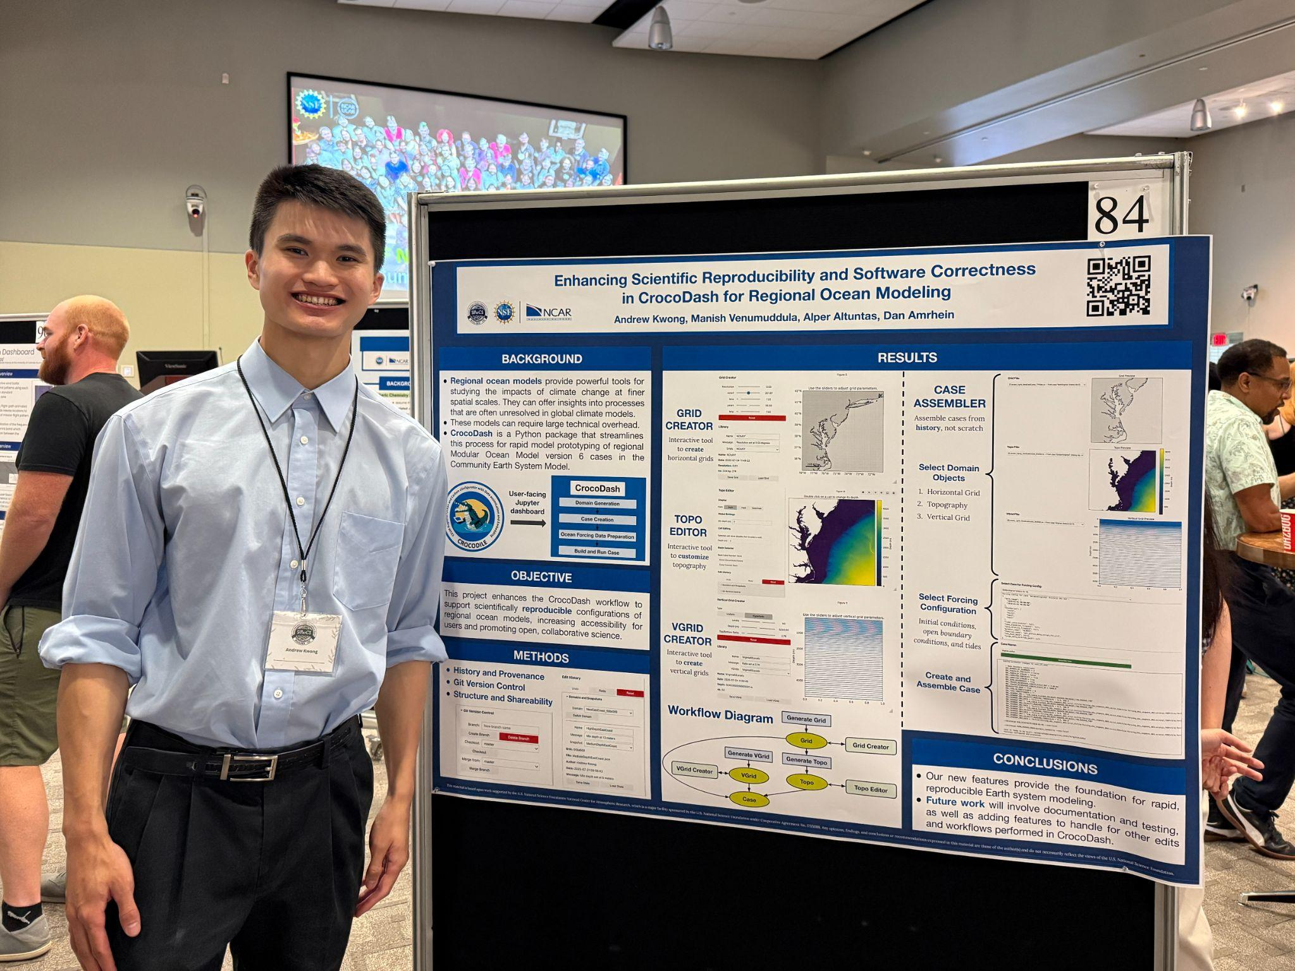
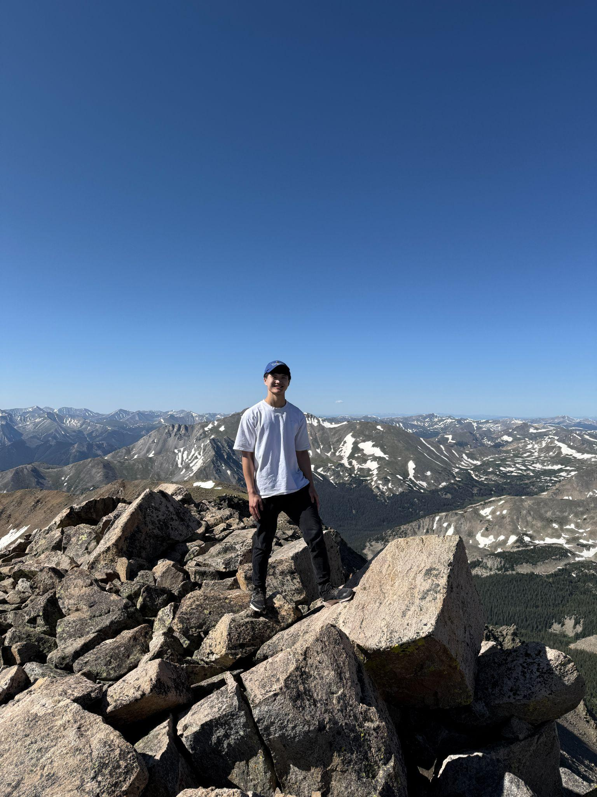
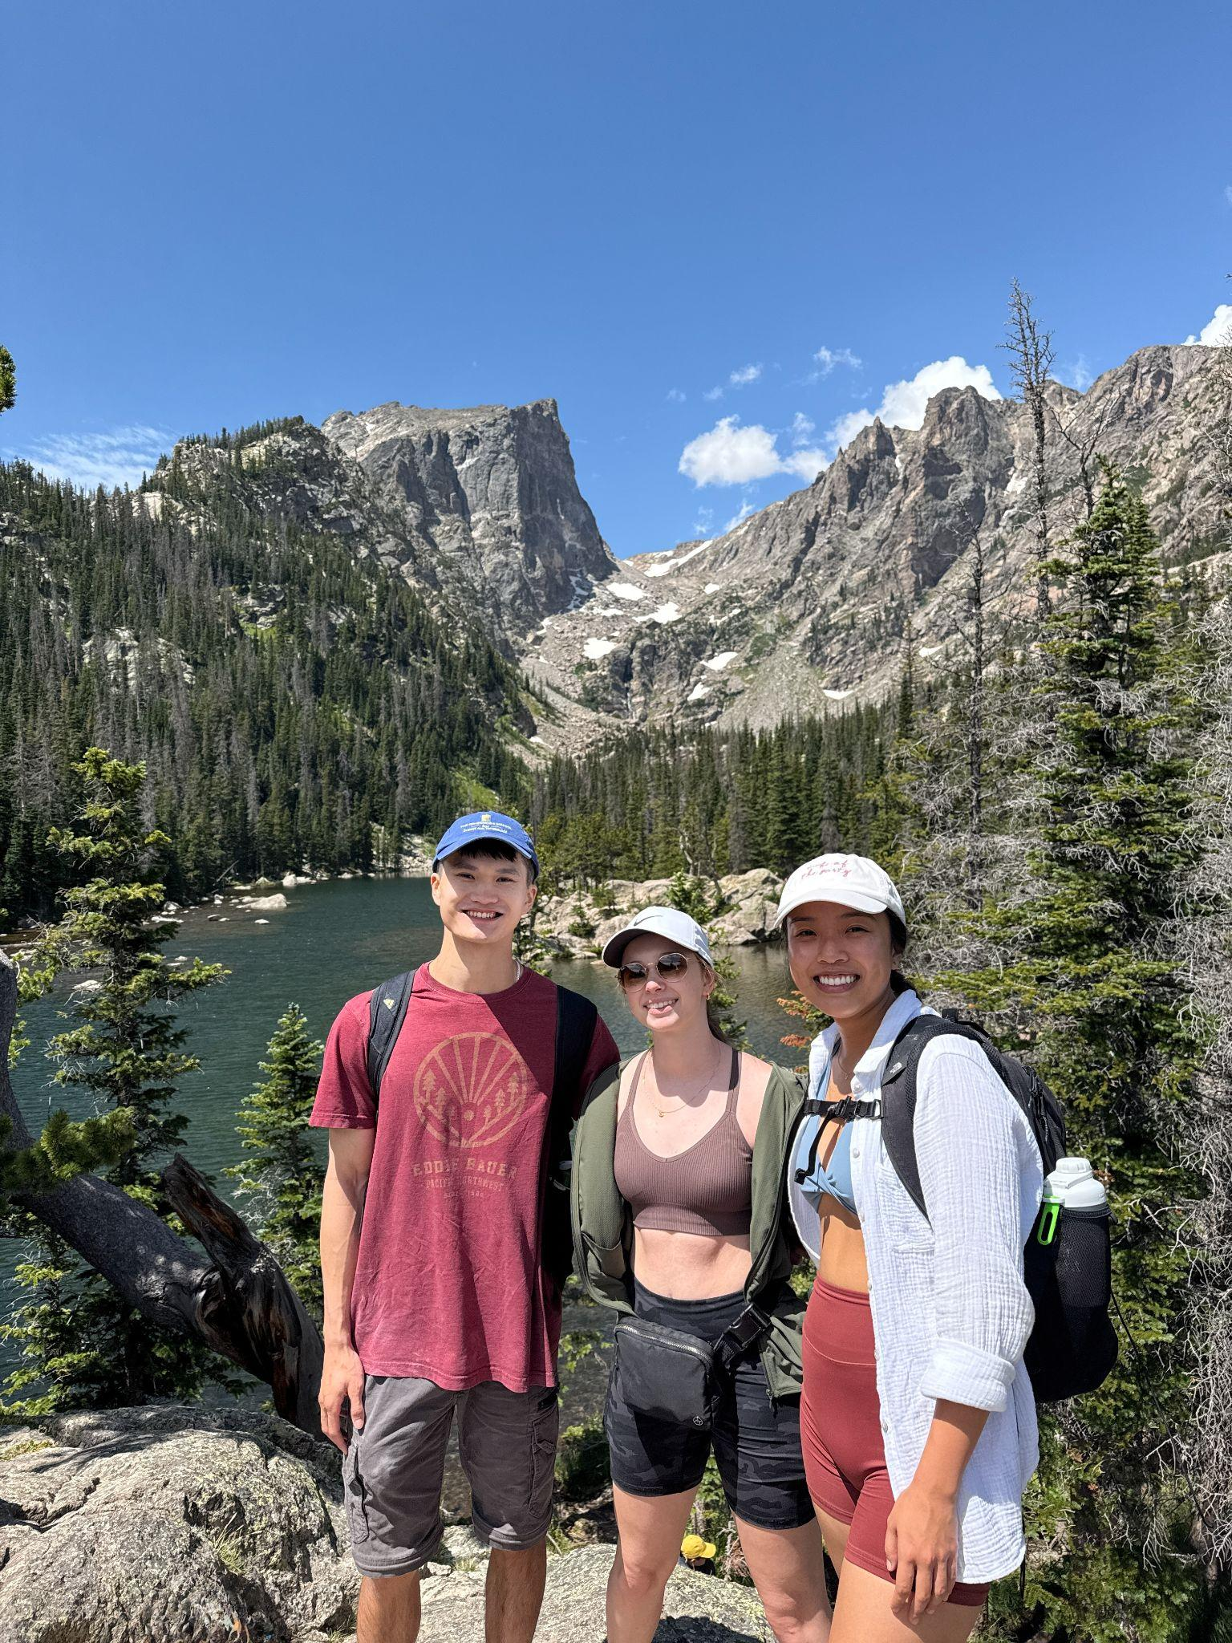
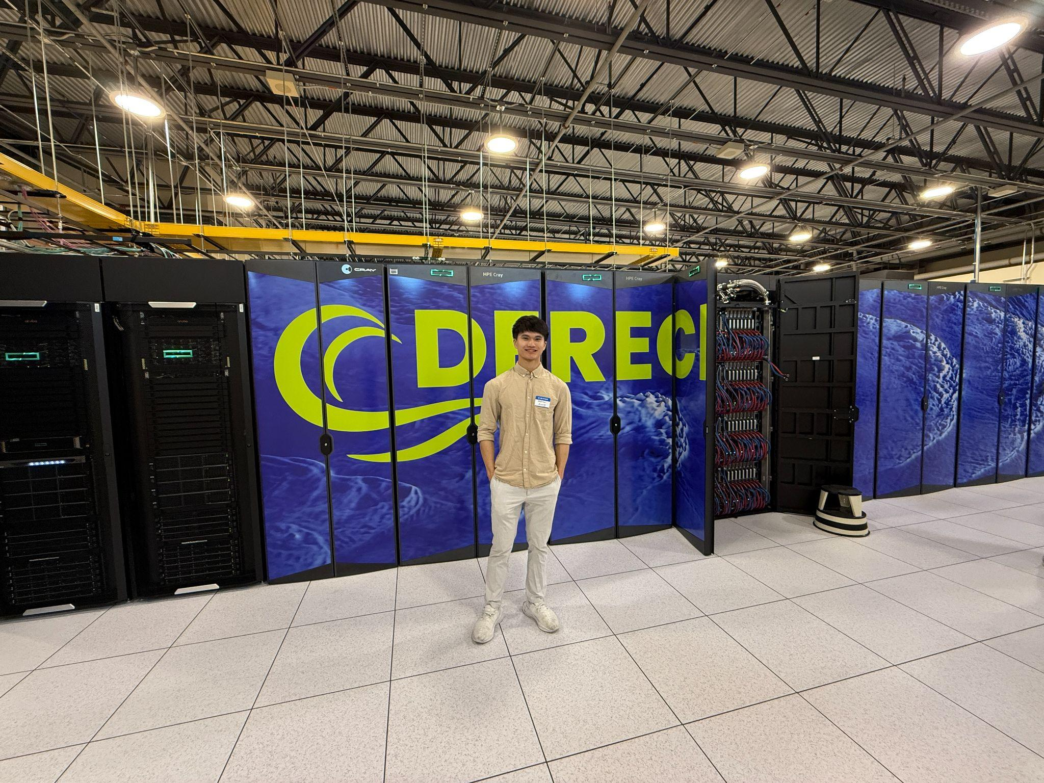
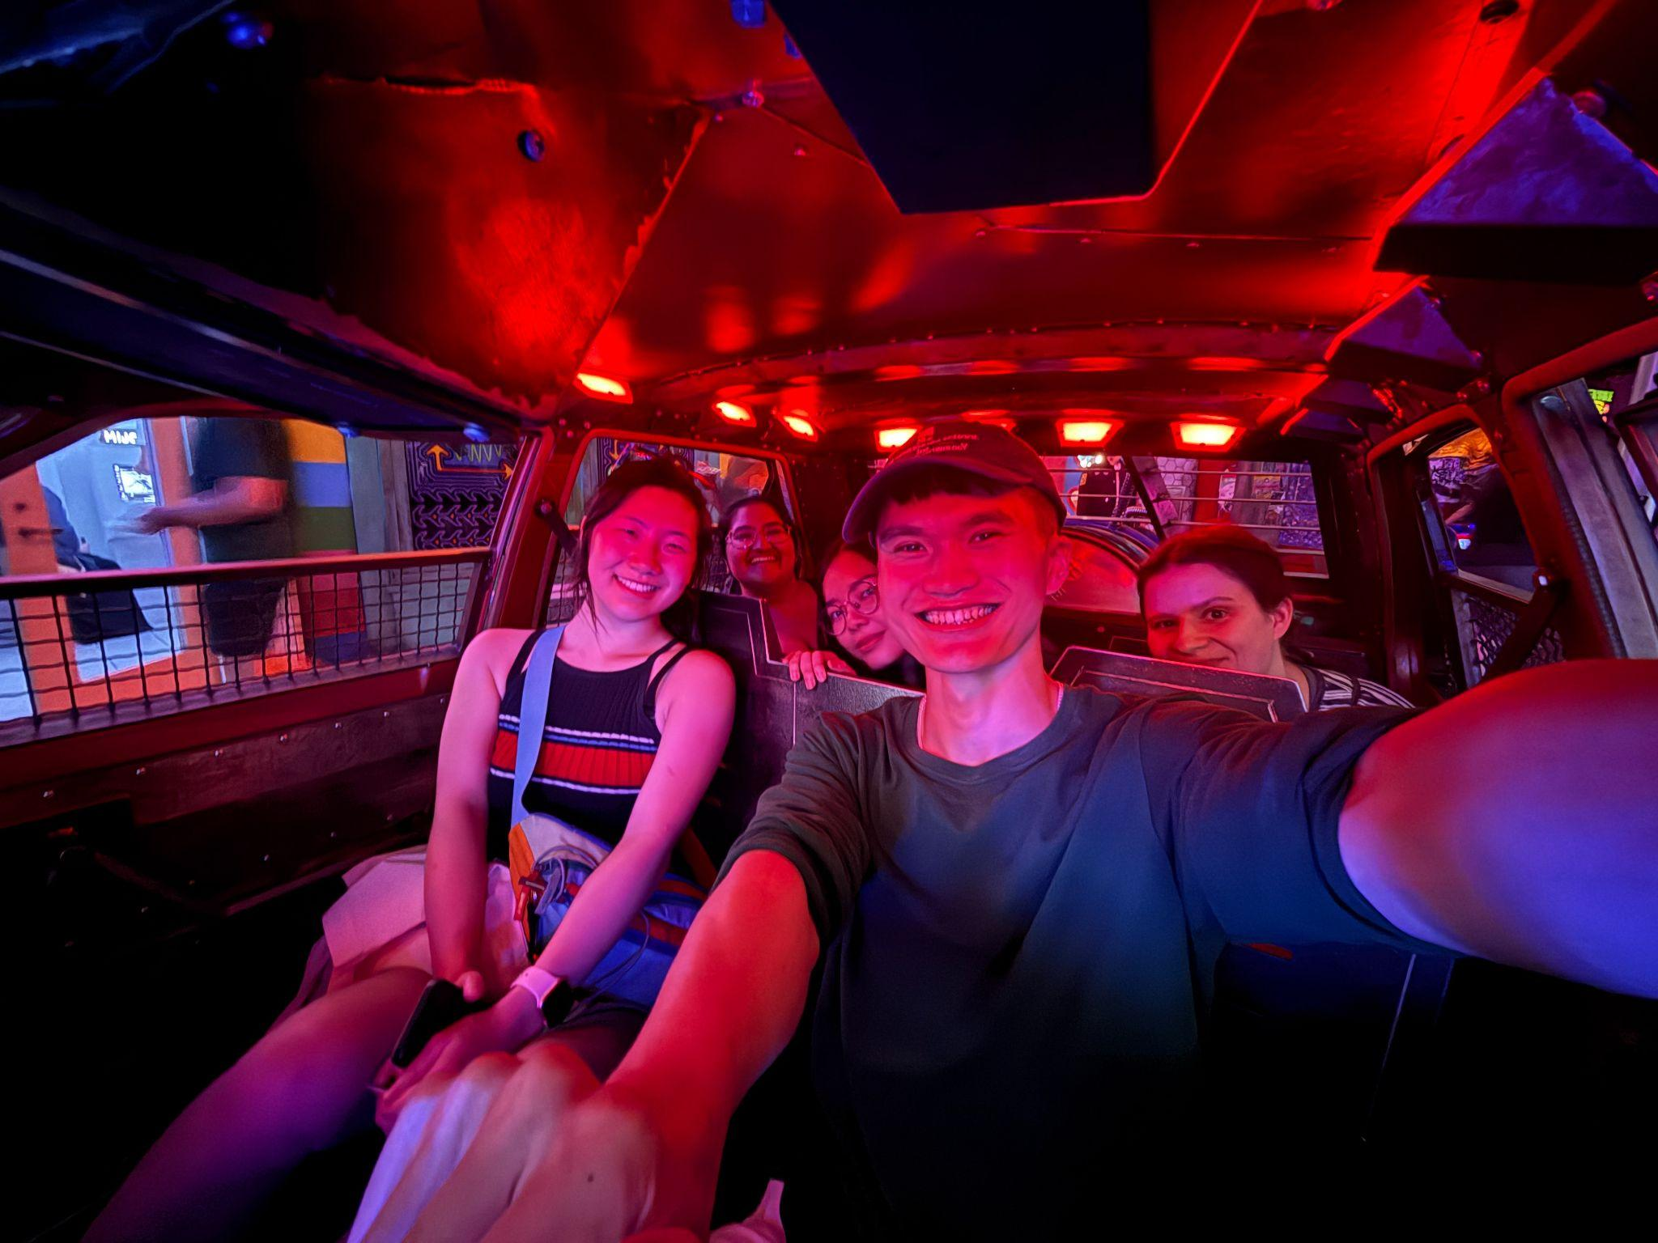
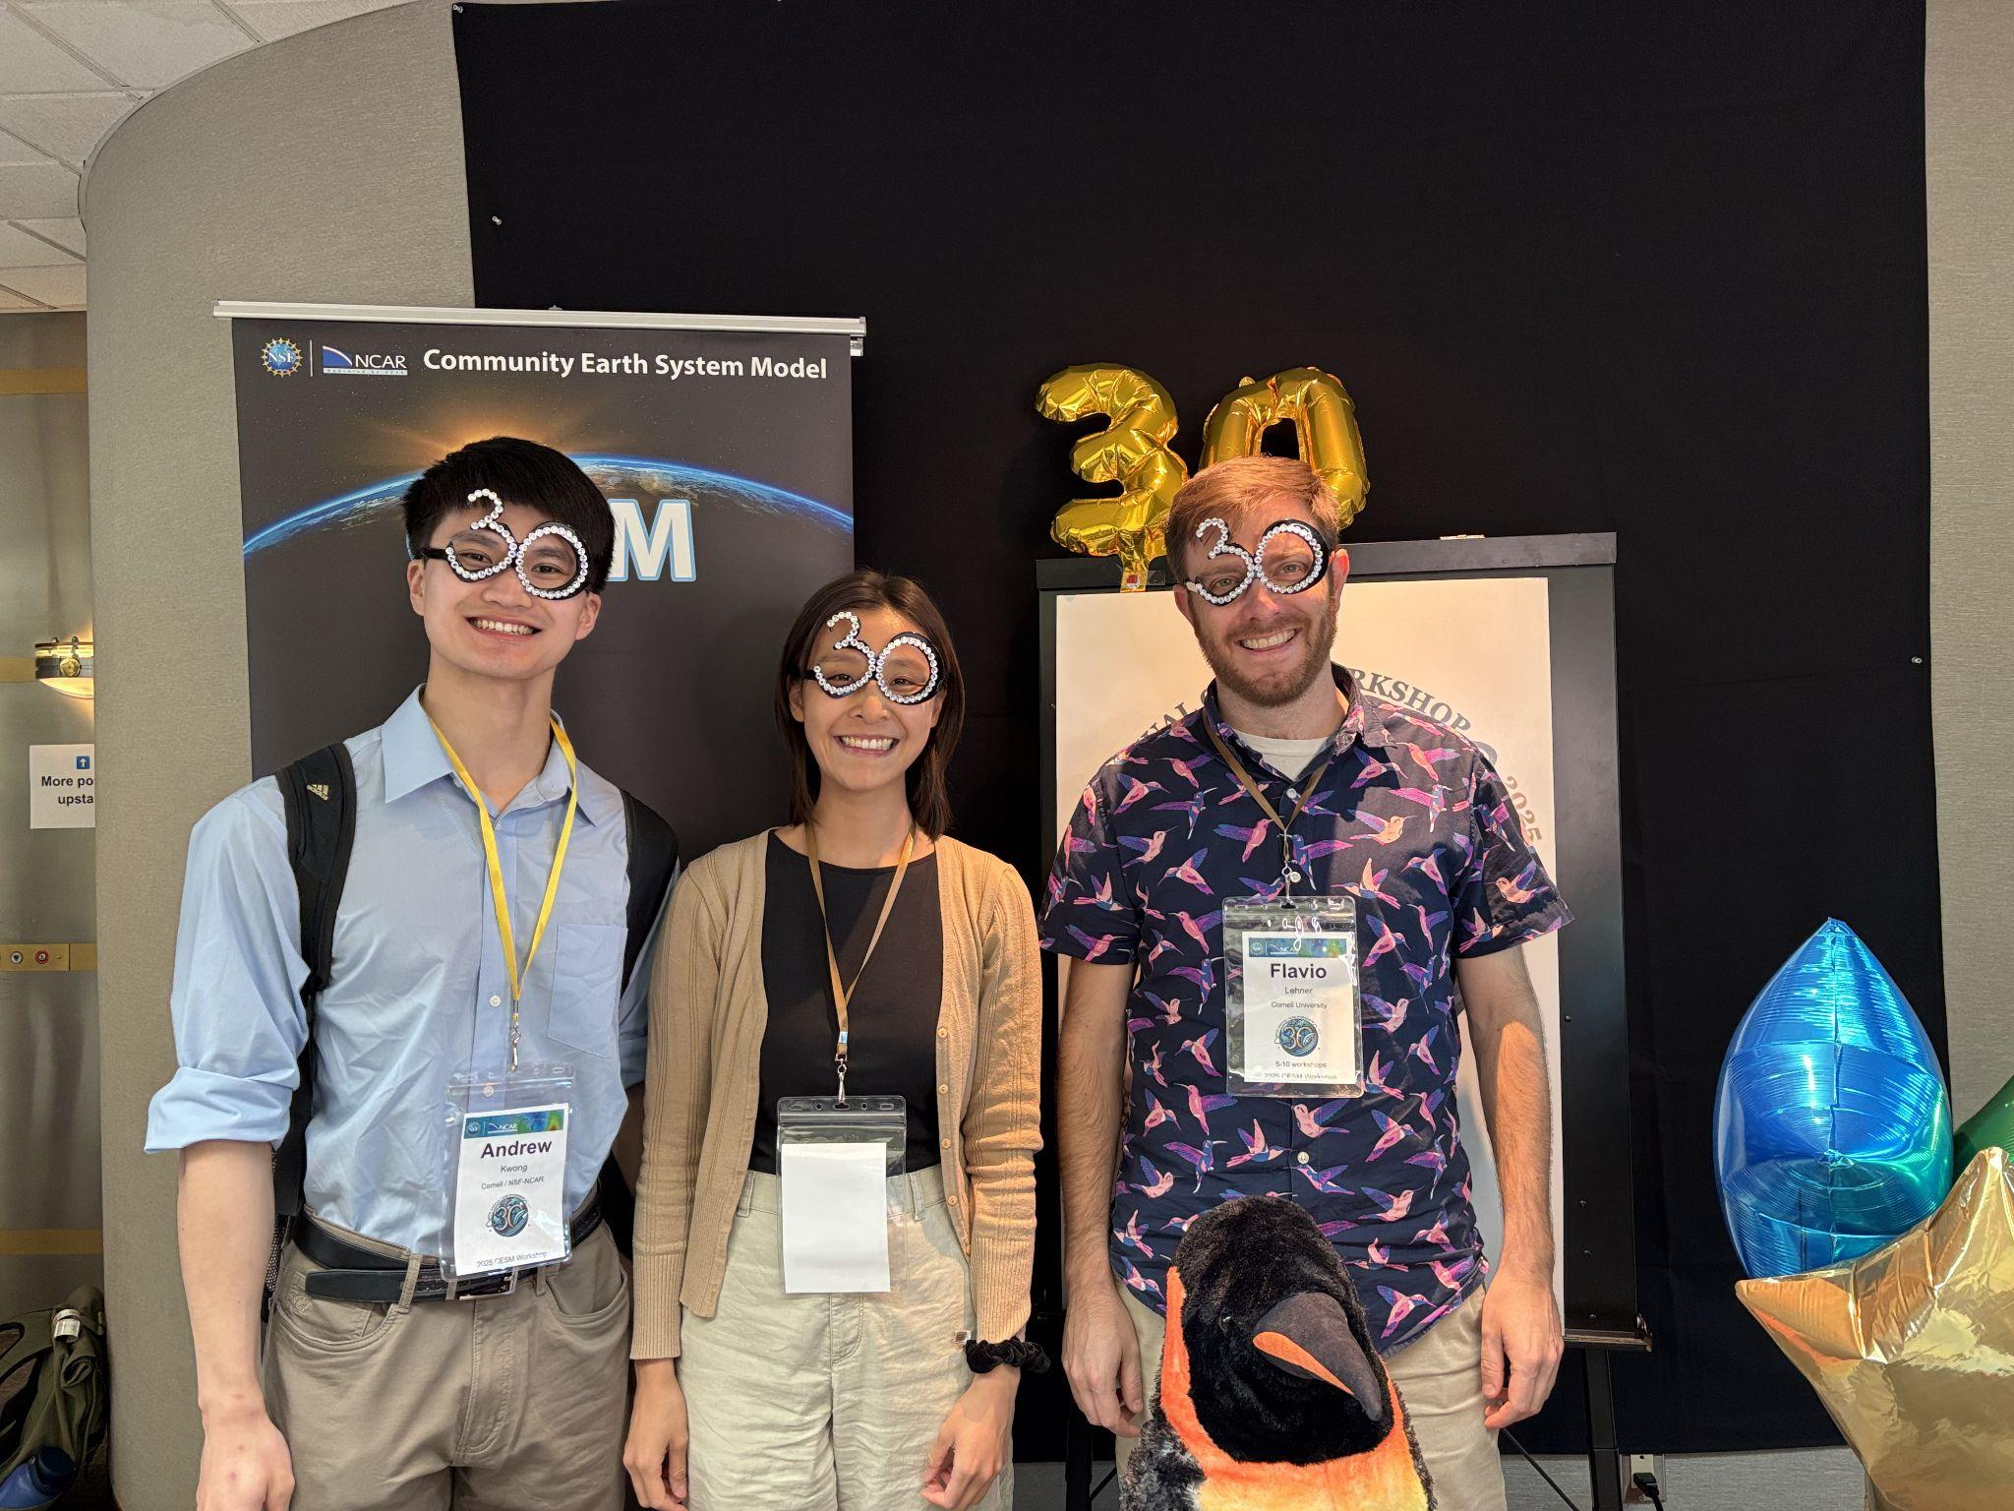
ABOUT SIPARCS
Part 4: Conclusions

