Slide 1
Characterizing and Correcting Non-Standard Arithmetic in GPUs
for Scientific Computing
Paul Jiang, Benjamin Valpey, Ganesh Gopalakrishnan

Slide 2
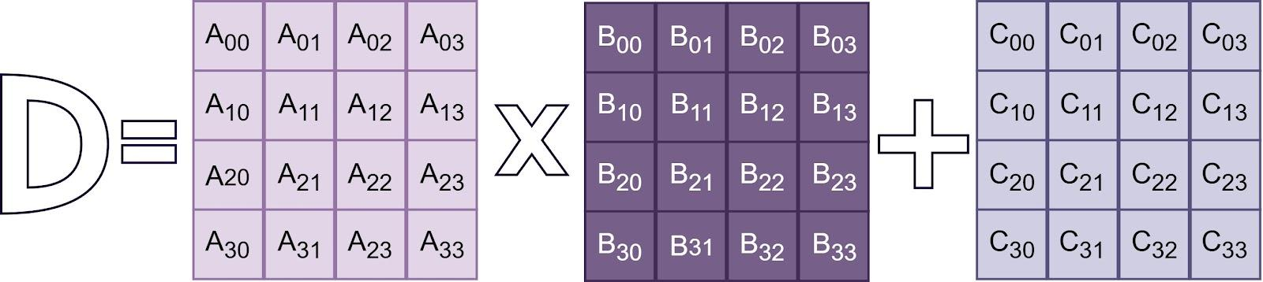
Motivation
Modern computing relies on hardware accelerators for high performance
GPUs have embraced these specialized units, commonly known as Tensor Cores, to accelerate matrix operations of the form:
Until recently, the precise semantics of these units were proprietary and effectively a “black box”

Slide 3
Motivation
Through recent work by Fasi¹, Li², Mantas³, and Valpey⁴ that we now understand how these hardwares function
However, sometimes simply understanding the semantics is not enough
Early work from Fasi and Mantas demonstrated a phenomenon emergent from the non-standard behavior of Tensor Core accumulation: non-monotonicity
Non-monotonicity can violate basic assumptions in numerically sensitive code, affecting convergence, error bounds, and stability
[1] Massimiliano Fasi, Nicholas J Higham, Mantas Mikaitis, and Srikara Pranesh. Numerical Behavior of NVIDIA Tensor Cores. PeerJ Computer Science, 7:e330, 2021.
[2] Xinyi Li, Ang Li, Bo Fang, Katarzyna Swirydowicz, Ignacio Laguna, and Ganesh Gopalakrishnan. FTTN: Feature-Targeted Testing for Numerical Properties of nvidia & AMD Matrix Accelerators. In 2024 IEEE/ACM 24th International Symposium on Cluster, Cloud and Internet Computing (CCGrid). IEEE, 2024.
[3] Mantas Mikaitis. Monotonicity of multi-term floating-point adders. IEEE Transactions on Computers, 73(6):1531–1543, 2024.
[4] Benjamin Valpey, Xinyi Li, Sreepathi Pai, and Ganesh Gopalakrishnan. An SMT Formalization of Mixed-Precision Matrix Multiplication: Modeling Three Generations of Tensor Cores. In NASA Formal Methods Symposium, pages 360–379, Cham, Jun 2025. Springer Nature Switzerland.

Slide 4
Motivation
Consider an addition of 3 terms:
1 + 2 + 8
...and a second addition where addends are larger:
1 + 2 + 9
Non-monotonicity occurs when increasing an operand decreases result’s magnitude
i.e. it is possible for (1 + 2 + 9) < (1 + 2 + 8) to be true

Slide 5
Motivation
TC results are “good enough” for machine learning
TC often not “good enough” for scientific computing

Slide 6
Motivation
The internal arithmetic of these accelerators evolves with each generation
Important to formalize the precise conditions for non-monotonicity in tensor cores in an effort to
Understand input ranges that may trigger this behavior
Inform hardware designs in future generations such that these dangerous emergent phenomenon like are guarded against

Slide 7

Preliminaries
Floating point values consist of a sign (s), exponent (e), and an m-bit mantissa. The term 1.m is known as the significand
Commonly expressed as
ulp (unit in the last place) – the value of the mantisa’s least significant bit
sign | exp | impl | mant
0 | 20 | 1 | 01101 ← ulp

Slide 8
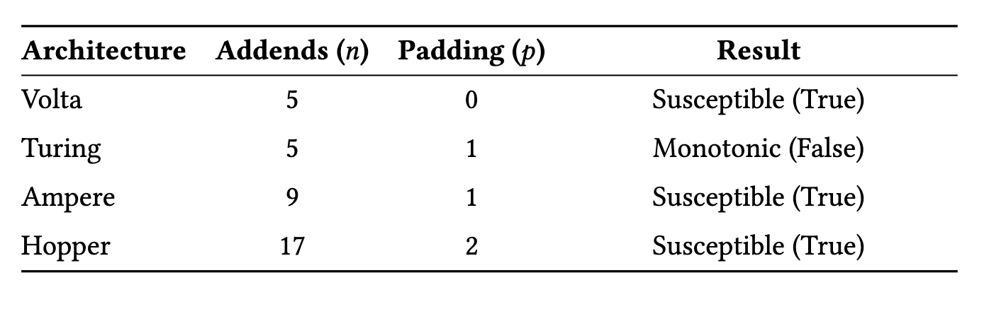
Preliminaries
Tensor cores generally vary generation by generation in two ways:
1. n : number of terms added in one block
2. p : the number of extra ‘padding’ bits appended to the end of the mantissa

Slide 9
Preliminaries
A tensor core performs its operations in 4 primary steps:
A[i,k] · B[k,j] are computed exactly and held in FP32
Because exact, can simplify A[i,k] · B[k,j] terms to be T₁… T_{i}
A max exponent is determined from all T₁… T_{i} and the C term and all terms are right-shifted to align to this exponent
The aligned significands are summed at once in an extended significand with p extra bits of padding precision
Results are normalized and bits beyond mantissa are truncated and lost

Slide 10
Preliminaries (n = 4, p = 1)
sign | exp | impl | mant | padding | lost
0 | 20 | 1 | 01101 | 0 |
0 | 18 | 1 | 01110 | 0 |
0 | 16 | 1 | 11100 | 0 |
0 | 17 | 1 | 01111 | 0 |

Slide 11
Preliminaries (n = 4, p = 1)
sign | exp | impl | mant | padding | lost
0 | 20 | 1 | 01101 | 0 |
0 | 18 | 1 | 01110 | 0 |
0 | 16 | 1 | 11100 | 0 |
0 | 17 | 1 | 01111 | 0 |

Slide 12
Preliminaries (n = 4, p = 1)
sign | exp | impl | mant | padding | lost
0 | 20 | 1 | 01101 | 0 |
0 | 20 | 0 | 01011 | 1 | 0
0 | 20 | 0 | 00011 | 1 | 100
0 | 20 | 0 | 00101 | 1 | 11

Slide 13
Preliminaries (n = 4, p = 1)
sign | exp | impl | mant | padding | lost
0 | 20 | 1 | 01101 | 0 |
0 | 20 | 0 | 01011 | 1 | 0
0 | 20 | 0 | 00011 | 1 | 100
0 | 20 | 0 | 00101 | 1 | 11

Slide 14
Preliminaries (n = 4, p = 1)
sign | exp | impl | mant | padding | lost
0 | 20 | 1 | 01101 | 0 |
0 | 20 | 0 | 01011 | 1 |
0 | 20 | 0 | 00011 | 1 |
0 | 20 | 0 | 00101 | 1 |

Slide 15
Preliminaries (n = 4, p = 1)
sign | exp | impl | mant | padding | lost
0 | 20 | 1 | 01101 | 0 |
0 | 20 | 0 | 01011 | 1 |
0 | 20 | 0 | 00011 | 1 |
0 | 20 | 0 | 00101 | 1 |
SUM —------------------------------------------------

Slide 16
Preliminaries (n = 4, p = 1)
sign | exp | impl | mant | padding | lost
0 | 20 | 1 | 01101 | 0 |
0 | 20 | 0 | 01011 | 1 |
0 | 20 | 0 | 00011 | 1 |
0 | 20 | 0 | 00101 | 1 |
SUM —------------------------------------------------
0 | 20 | 10 | 00001 | 1 |

Slide 17
Preliminaries (n = 4, p = 1)
sign | exp | impl | mant | padding | lost
0 | 20 | 1 | 01101 | 0 |
0 | 20 | 0 | 01011 | 1 |
0 | 20 | 0 | 00011 | 1 |
0 | 20 | 0 | 00101 | 1 |
SUM —------------------------------------------------
0 | 21 | 1 | 00000 | 1 | 1

Slide 18
Preliminaries (n = 4, p = 1)
sign | exp | impl | mant | padding | lost
0 | 20 | 1 | 01101 | 0 |
0 | 20 | 0 | 01011 | 1 |
0 | 20 | 0 | 00011 | 1 |
0 | 20 | 0 | 00101 | 1 |
SUM —------------------------------------------------
0 | 21 | 1 | 00000 | 1 | 1

Slide 19
Preliminaries (n = 4, p = 1)
sign | exp | impl | mant | padding | lost
0 | 20 | 1 | 01101 | 0 |
0 | 20 | 0 | 01011 | 1 |
0 | 20 | 0 | 00011 | 1 |
0 | 20 | 0 | 00101 | 1 |
SUM —------------------------------------------------
0 | 21 | 1 | 00000 | |

Slide 20
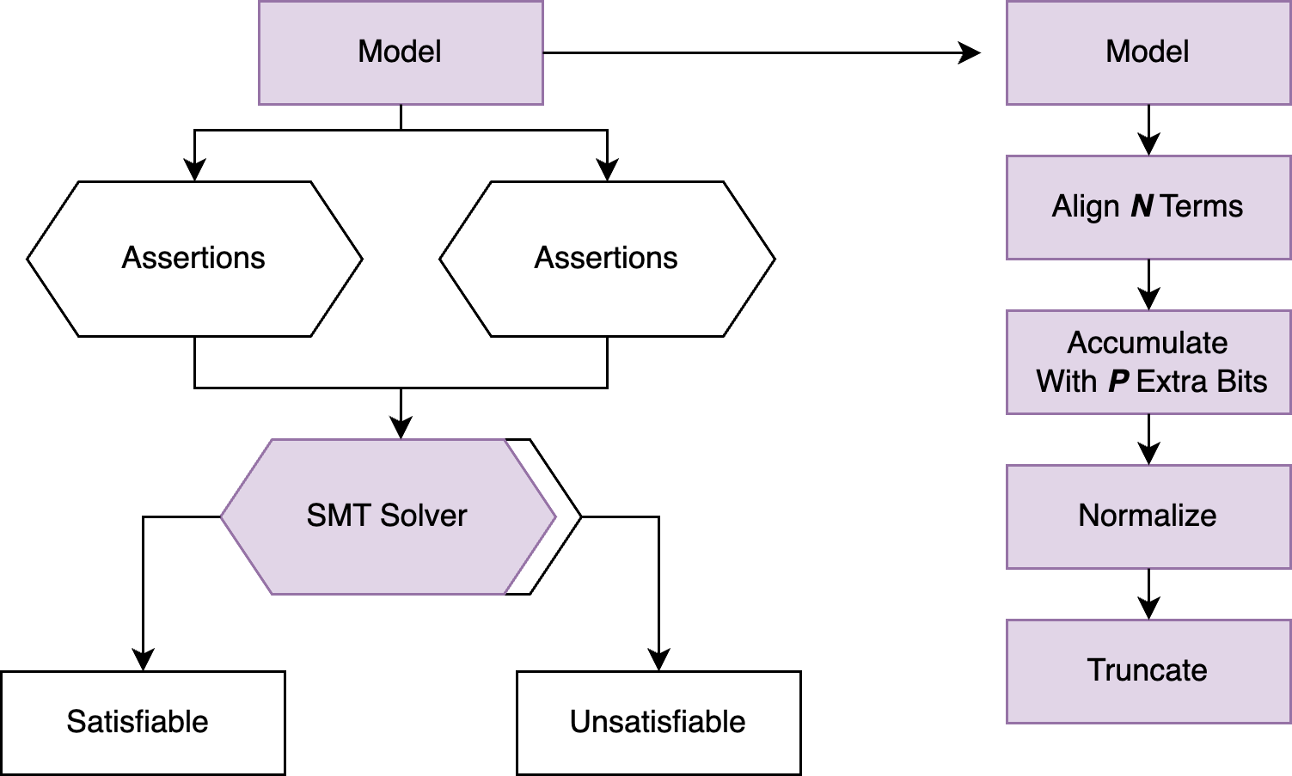
Non-monotonicity
Now that we know how these units work, let's try to investigate a case of non-monotonicity…

Slide 21
Non-Monotonicity (n = 4, p = 0)
sign | exp | impl | mant | lost
0 | 24 | 1 | 00000 | 0
0 | 18 | 1 | 00000 | 0
0 | 18 | 1 | 00000 | 0
0 | 18 | 1 | 00000 | 0

Slide 22
Non-Monotonicity (n = 4, p = 0)
sign | exp | impl | mant | lost
0 | 24 | 1 | 00000 |
0 | 18 | 1 | 00000 |
0 | 18 | 1 | 00000 |
0 | 18 | 1 | 00000 |

Slide 23
Non-Monotonicity (n = 4, p = 0)
sign | exp | impl | mant | lost
0 | 24 | 1 | 00000 | 0
0 | 24 | 0 | 00000 | 1
0 | 24 | 0 | 00000 | 1
0 | 24 | 0 | 00000 | 1

Slide 24
Non-Monotonicity (n = 4, p = 0)
sign | exp | impl | mant | lost
0 | 24 | 1 | 00000 | 0
0 | 24 | 0 | 00000 | 1
0 | 24 | 0 | 00000 | 1
0 | 24 | 0 | 00000 | 1

Slide 25
Non-Monotonicity (n = 4, p = 0)
sign | exp | impl | mant | lost
0 | 24 | 1 | 00000 |
0 | 24 | 0 | 00000 |
0 | 24 | 0 | 00000 |
0 | 24 | 0 | 00000 |
SUM —------------------------------------------------

Slide 26
Non-Monotonicity (n = 4, p = 0)
sign | exp | impl | mant | lost
0 | 24 | 1 | 00000 |
0 | 24 | 0 | 00000 |
0 | 24 | 0 | 00000 |
0 | 24 | 0 | 00000 |
SUM —------------------------------------------------
0 | 24 | 1 | 00000 |

Slide 27
Non-Monotonicity (n = 4, p = 0)
sign | exp | impl | mant | lost
0 | 23 | 1 | 11111 | 0
0 | 18 | 1 | 00000 | 0
0 | 18 | 1 | 00000 | 0
0 | 18 | 1 | 00000 | 0

Slide 28
Non-Monotonicity (n = 4, p = 0)
sign | exp | impl | mant | lost
0 | 23 | 1 | 11111 | 0
0 | 18 | 1 | 00000 | 0
0 | 18 | 1 | 00000 | 0
0 | 18 | 1 | 00000 | 0

Slide 29
Non-Monotonicity (n = 4, p = 0)
sign | exp | impl | mant | lost
0 | 23 | 1 | 11111 | 0
0 | 23 | 0 | 00001 | 0
0 | 23 | 0 | 00001 | 0
0 | 23 | 0 | 00001 | 0

Slide 30
Non-Monotonicity (n = 4, p = 0)
sign | exp | impl | mant | lost
0 | 23 | 1 | 11111 | 0
0 | 23 | 0 | 00001 | 0
0 | 23 | 0 | 00001 | 0
0 | 23 | 0 | 00001 | 0
SUM —------------------------------------------------

Slide 31
Non-Monotonicity (n = 4, p = 0)
sign | exp | impl | mant | lost
0 | 23 | 1 | 11111 | 0
0 | 23 | 0 | 00001 | 0
0 | 23 | 0 | 00001 | 0
0 | 23 | 0 | 00001 | 0
SUM —------------------------------------------------
0 | 23 | 10 | 00010 | 0

Slide 32
Non-Monotonicity (n = 4, p = 0)
sign | exp | impl | mant | lost
0 | 23 | 1 | 11111 | 0
0 | 23 | 0 | 00001 | 0
0 | 23 | 0 | 00001 | 0
0 | 23 | 0 | 00001 | 0
SUM —------------------------------------------------
0 | 24 | 1 | 00001 | 0

Slide 33
Non-Monotonicity
Non-monotonicity described by literature to be resultant from a class of tensor core-like adders computing n-term sums without the normalization of intermediate quantities

Slide 34
Non-Monotonicity
Non-monotonicity described by literature to be resultant from a class of tensor core-like adders computing n-term sums without the normalization of intermediate quantities
Is there a space within this class that is guaranteed to be safe from non-monotonicity?
Lack of intermediate normalization is much of what makes TC efficient
→ Can we keep this general schema while still correcting for its problematic behavior?

Slide 35
Non-Monotonicity
INTUITION: We can see from the example when given a large term and n - 1 small terms
When the large term’s exponent decreases, the smaller terms re-enter the representable range of the large term and into the accumulator

Slide 36
Non-Monotonicity
Non-monotonic behavior occurs in a Tensor Core accumulator if the sum of the smaller terms that “flow back” into the accumulator is greater than the decrease in the large term, without loss of generality: T1 − T1’

Slide 37
Non-Monotonicity
Non-monotonic behavior occurs in a Tensor Core accumulator if the sum of the smaller terms that “flow back” into the accumulator is greater than the decrease in the large term, without loss of generality: T1 − T1’
INTUITION: A Tensor Core accumulator is m + p bits wide. These p bits are appended onto the lower end of the mantissa. This means for smaller terms to “flow in and out” of the large term, they must fall below the padding bits too
Lets try!

Slide 38
Non-Monotonicity (n = 4, p = 1)
sign | exp | impl | mant | padding | lost
0 | 24 | 1 | 00000 | 0 |
0 | 18 | 1 | 00000 | 0 |
0 | 18 | 1 | 00000 | 0 |
0 | 18 | 1 | 00000 | 0 |

Slide 39
Non-Monotonicity (n = 4, p = 1)
sign | exp | impl | mant | padding | lost
0 | 24 | 1 | 00000 | 0 |
0 | 24 | 0 | 00000 | 1 |
0 | 24 | 0 | 00000 | 1 |
0 | 24 | 0 | 00000 | 1 |

Slide 40
Non-Monotonicity (n = 4, p = 1)
sign | exp | impl | mant | padding | lost
0 | 24 | 1 | 00000 | 0 |
0 | 24 | 0 | 00000 | 1 |
0 | 24 | 0 | 00000 | 1 |
0 | 24 | 0 | 00000 | 1 |
SUM —------------------------------------------------

Slide 41
Non-Monotonicity (n = 4, p = 1)
sign | exp | impl | mant | padding | lost
0 | 24 | 1 | 00000 | 0 |
0 | 24 | 0 | 00000 | 1 |
0 | 24 | 0 | 00000 | 1 |
0 | 24 | 0 | 00000 | 1 |
SUM —------------------------------------------------
0 | 24 | 1 | 00001 | 1 |

Slide 42
Non-Monotonicity (n = 4, p = 1)
sign | exp | impl | mant | padding | lost
0 | 24 | 1 | 00000 | 0 |
0 | 24 | 0 | 00000 | 1 |
0 | 24 | 0 | 00000 | 1 |
0 | 24 | 0 | 00000 | 1 |
SUM —------------------------------------------------
0 | 24 | 1 | 00001 | 1 |

Slide 43
Non-Monotonicity (n = 4, p = 1)
sign | exp | impl | mant | padding | lost
0 | 24 | 1 | 00000 | 0 |
0 | 24 | 0 | 00000 | 1 |
0 | 24 | 0 | 00000 | 1 |
0 | 24 | 0 | 00000 | 1 |
SUM —------------------------------------------------
0 | 24 | 1 | 00001 | |

Slide 44
Non-Monotonicity (n = 4, p = 1)
sign | exp | impl | mant | padding | lost
0 | 23 | 1 | 11111 | 0 |
0 | 18 | 1 | 00000 | 0 |
0 | 18 | 1 | 00000 | 0 |
0 | 18 | 1 | 00000 | 0 |

Slide 45
Non-Monotonicity (n = 4, p = 1)
sign | exp | impl | mant | padding | lost
0 | 23 | 1 | 11111 | 0 |
0 | 18 | 1 | 00000 | 0 |
0 | 18 | 1 | 00000 | 0 |
0 | 18 | 1 | 00000 | 0 |

Slide 46
Non-Monotonicity (n = 4, p = 1)
sign | exp | impl | mant | padding | lost
0 | 23 | 1 | 11111 | 0 |
0 | 23 | 0 | 00001 | 0 |
0 | 23 | 0 | 00001 | 0 |
0 | 23 | 0 | 00001 | 0 |

Slide 47
Non-Monotonicity (n = 4, p = 1)
sign | exp | impl | mant | padding | lost
0 | 23 | 1 | 11111 | 0 |
0 | 23 | 0 | 00001 | 0 |
0 | 23 | 0 | 00001 | 0 |
0 | 23 | 0 | 00001 | 0 |
SUM —------------------------------------------------

Slide 48
Non-Monotonicity (n = 4, p = 1)
sign | exp | impl | mant | padding | lost
0 | 23 | 1 | 11111 | 0 |
0 | 23 | 0 | 00001 | 0 |
0 | 23 | 0 | 00001 | 0 |
0 | 23 | 0 | 00001 | 0 |
SUM —------------------------------------------------
0 | 23 | 10 | 00010 | 0 |

Slide 49
Non-Monotonicity (n = 4, p = 1)
sign | exp | impl | mant | padding | lost
0 | 23 | 1 | 11111 | 0 |
0 | 23 | 0 | 00001 | 0 |
0 | 23 | 0 | 00001 | 0 |
0 | 23 | 0 | 00001 | 0 |
SUM —------------------------------------------------
0 | 23 | 1 | 00001 | 0 |

Slide 50
Non-Monotonicity (n = 4, p = 1)
sign | exp | impl | mant | padding | lost
0 | 23 | 1 | 11111 | 0 |
0 | 23 | 0 | 00001 | 0 |
0 | 23 | 0 | 00001 | 0 |
0 | 23 | 0 | 00001 | 0 |
SUM —------------------------------------------------
0 | 23 | 1 | 00001 |

Slide 51
Non-Monotonicity
No longer non-monotonic for this one example
But this is just for one example, is there a way to know for all cases?

Slide 52
SMT
SMT Solvers can be powerful
in modeling arithmetic schemes
We can encode each operation
that the tensor core performs
as constraints on bit-vectors

Slide 53
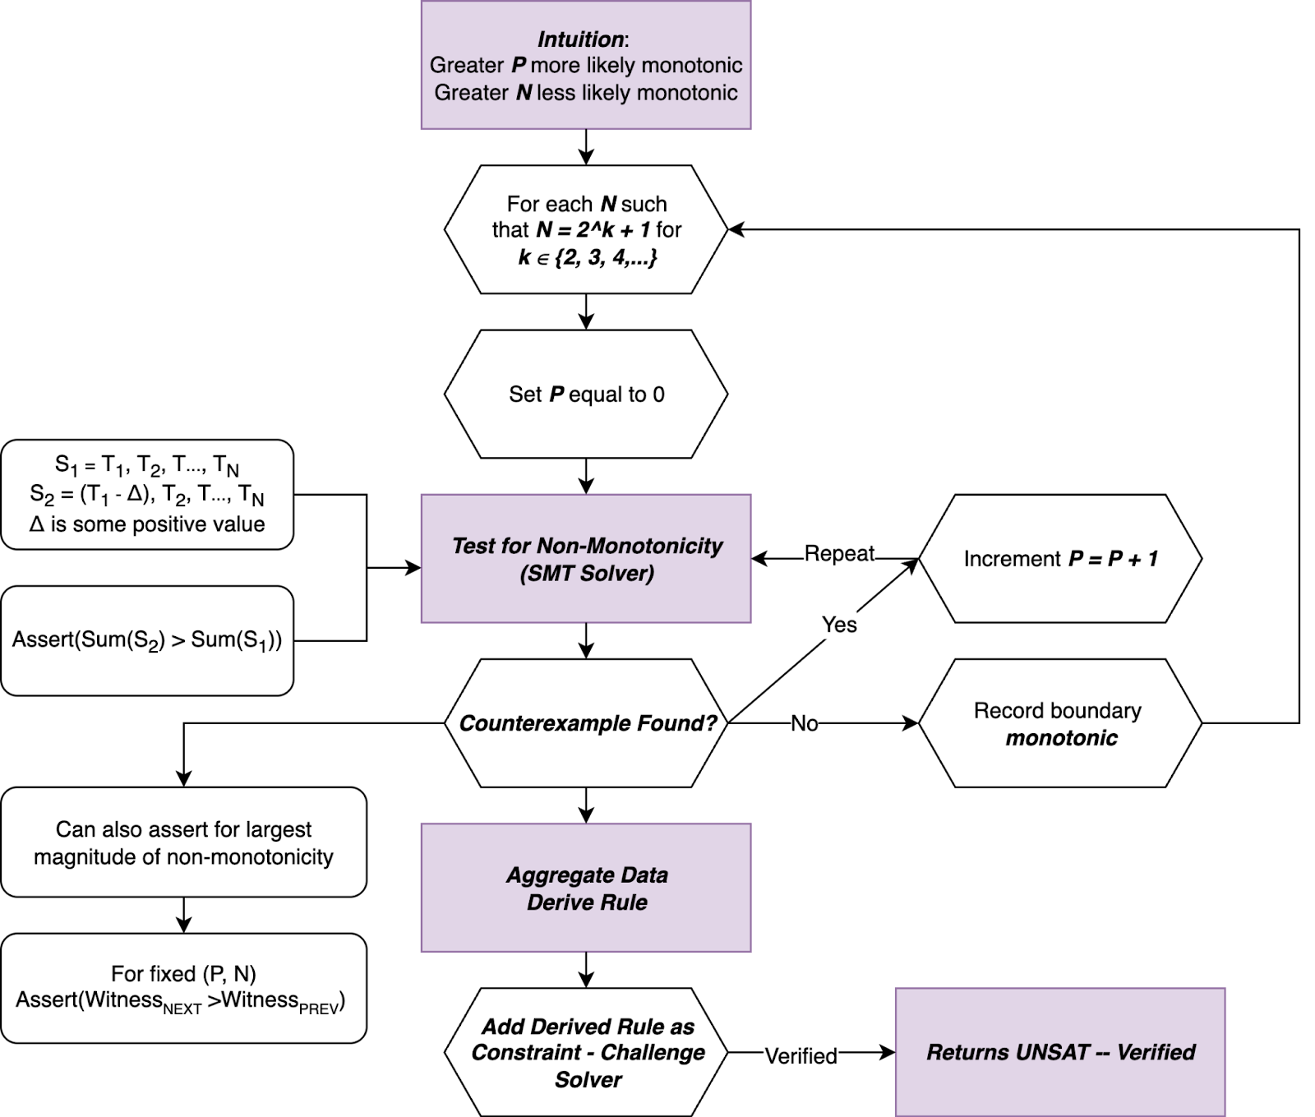
Process

Slide 54
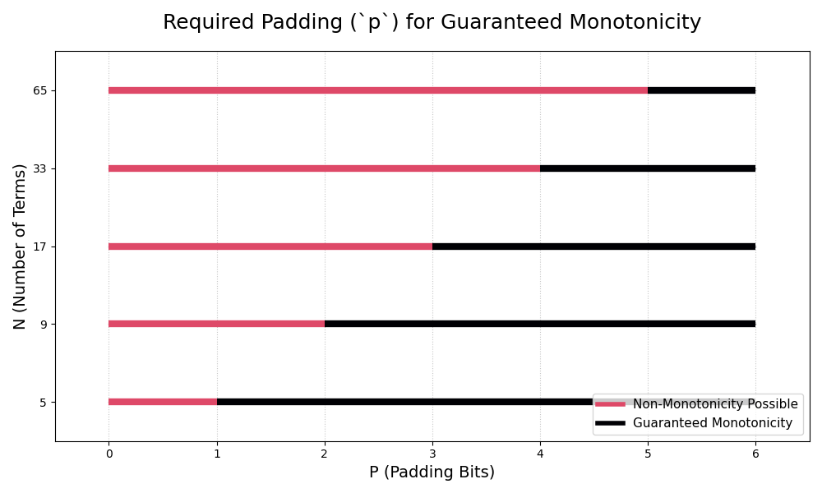
Results

Slide 55
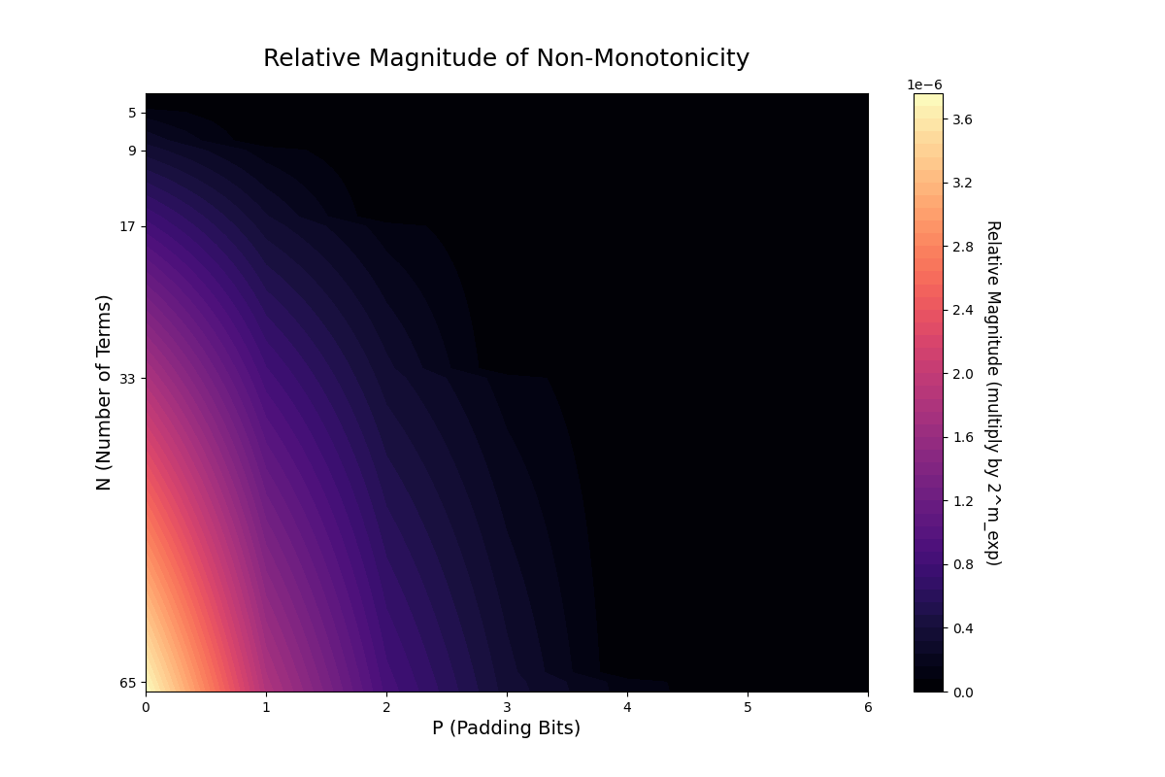
Results

Slide 56
Results

Slide 57
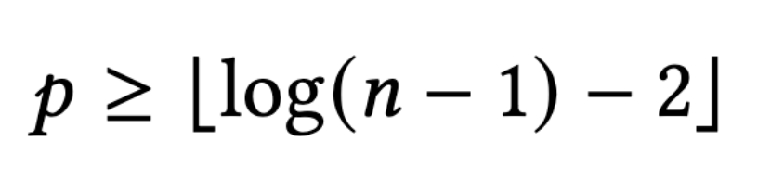
Results

Slide 58
Takeaways
YES! There is a space of hardware configurations that fall within this class of Tensor Core-like adders that also does not allow for non-monotonicity
The existing Turing architecture falls under this classification
We have only discussed non-monotonicity here
What about the larger bounds of general error that come inherent to TC
Can we correct for these too?
→ Come talk with me, we can discuss :)

Slide 59
Thank You :)

Slide 60


