Slide 1

A Tutorial for the DDS JavaScript Search API
JSHTML v1.1

Slide 2

Overview of the DDS JavaScript Search Service
Example web pages that have been built using the service
Look at how to create a web page using the service
Summary of available service commands
JavaScript Search Service Tutorial

Slide 3
Lets web developers place DDS search into web pages with JavaScript
Development of the custom page can be done using a text editor or tools like Dreamweaver
Uses JavaScript, CSS and HTML – Web standards that are supported by all major browsers
  Users do not need to install plug-ins or other special software in order to view the page
  Compatible with all 5.5 and later browsers
Can be deployed to any static web server
  Does not require CGI or other application servers like Tomcat
Available only for resources that reside in the ADN framework
  For other formats, use the DDS Search Service with JSON output instead
JavaScript Search Service Tutorial

Slide 4

The service API enables developers to customize their page for a specific audience
Developers can:
  Customize which search options are displayed in the page
  Create custom menus for any topic or domain
  Make SmartLinks and SmartLinkDropLists that return specific DDS resources when clicked or selected
  Customize the way the search results are displayed in the page
  Tailor the fonts, colors and other HTML elements that are returned by the service to match a particular web page design
JavaScript Search Service Tutorial

Slide 5
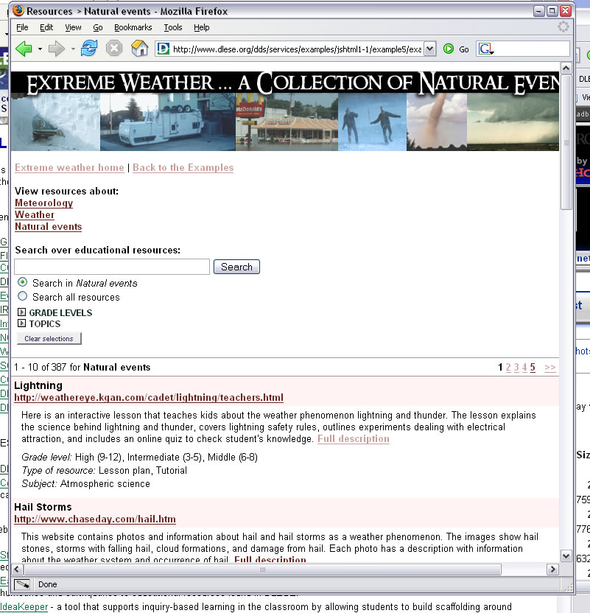
Title reflects the user’s actions
CSS controls the fonts, sizes and colors in the page
SmartLinks that bring up resources for specific topics
A search box to enter text
Ability to search within the SmartLink results
Links to page through results
User’s search actions are reflected
Standard and custom menus to limit searches by category or topic
Search results - can be customized

Slide 6

Similar to a web service client/server architecture
HTML Page on Web Server
(Client)
HTML page sits on a static web server
Contains HTML and CSS plus JavaScript commands that render the search service content
All HTTP parameters are proxied through to the JavaScript service
2. HTTP JavaScript
request is proxied to the service
1. User performs a search – HTTP request
JavaScript Service
(Server)
Accepts JavaScript service commands and user’s search request encoded in HTTP parameters
Returns HTML inside a JavaScript write() function
HTML includes forms (search box, menus, etc.), search results and other custom-tailored content
Web Site Visitor
Accesses the page from their web browser
3. HTML in the web page is returned directly to the browser
4. HTML from the search service is wrapped in a JavaScript write() function and returned to the browser
JavaScript Search Service Tutorial

Slide 7

JavaScript Search Service Tutorial

Slide 8
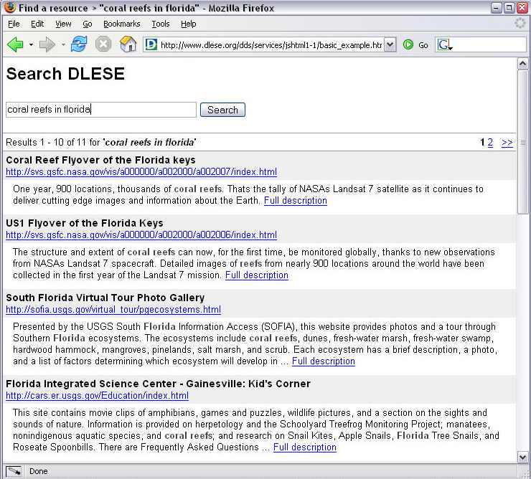
Search box
Simple search results

Slide 9
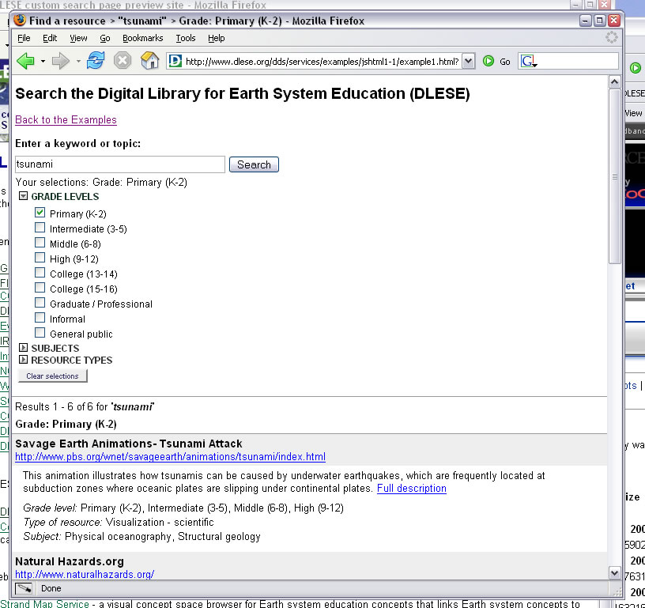
Search box
Standard menus include:
Grade Levels
Subjects
Resource Types
Content Standards
Collections

Slide 10
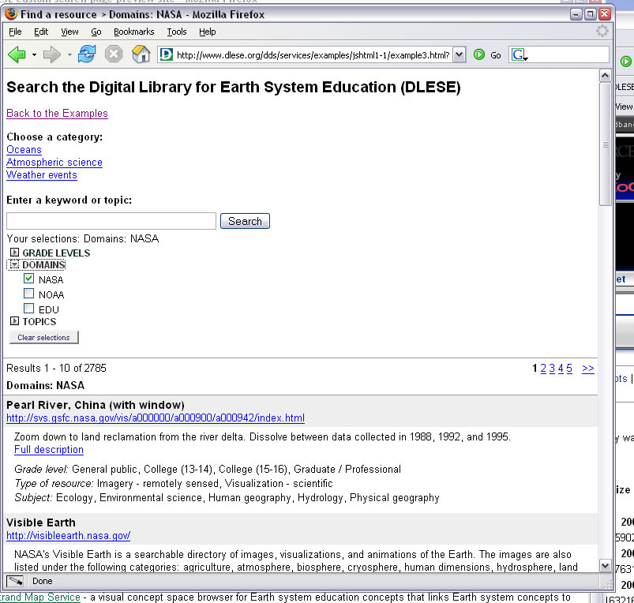
SmartLinks
Search Box
Custom menus can be mapped to any topic or category. For example subjects, locations (states, regions), web site domains, many others

Slide 11
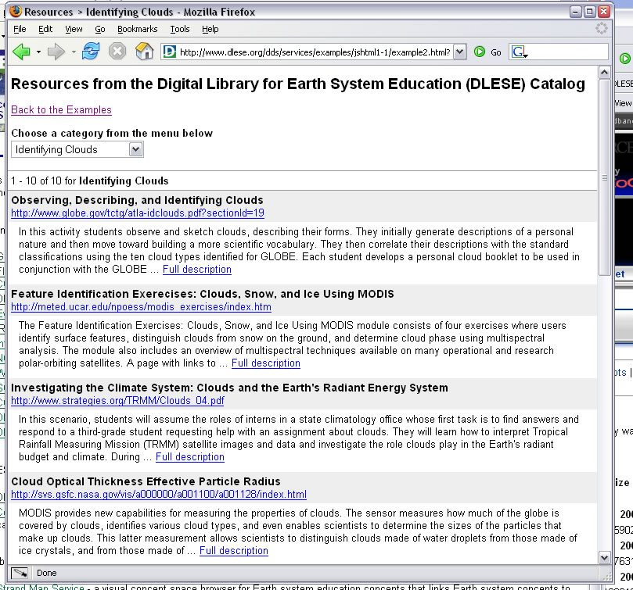

SmartLinkDropList
When user selects a topic from the menu a search is issued and the results are displayed in the page

Slide 12

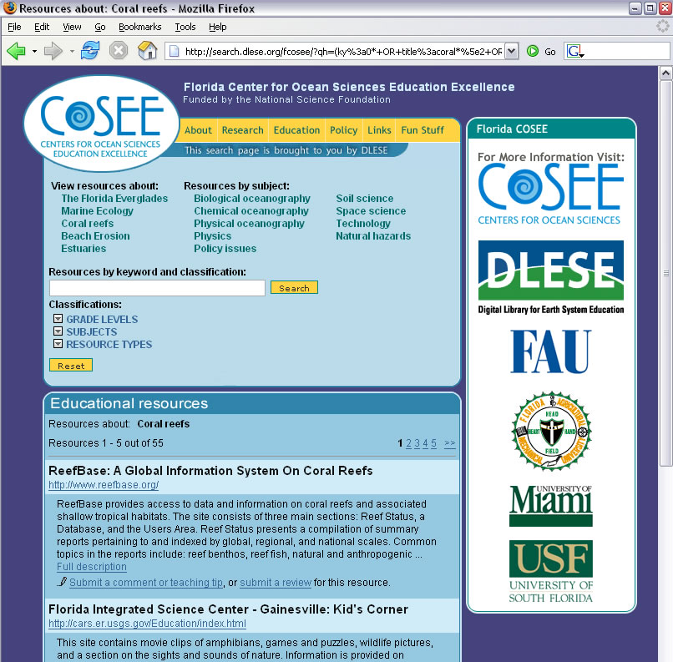
SmartLinks
When the user clicks a SmartLink, a search is issued and the results are displayed in the page

Slide 13

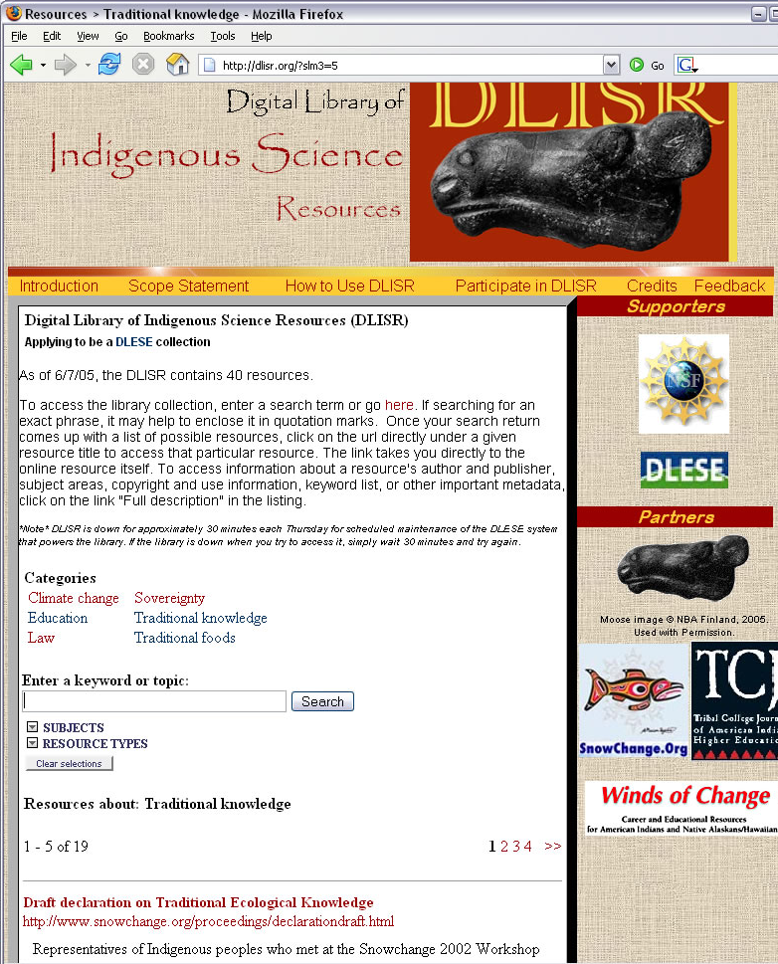

Slide 14

JavaScript Search Service Tutorial

Slide 15
Three options:
  Start with one of the example search pages and use it as a template for your custom page:
  http://www.dlese.org/dds/services/examples/jshtml1-1/
  Insert example code provided in the documentation into an existing web page:
  http://www.dlese.org/dds/services/jshtml1-1/javascript_service_documentation.jsp
  Edit and modify the code directly in your web page. This is covered next in this tutorial.
JavaScript Search Service Tutorial

Slide 16
In your HTML page:
  Source the serviceURL JavaScript library, which enables use of the the service commands (required)
  Include an inline script element that contains one of the two required commands plus any optional commands. Place this where you would like the DLESE search to be rendered in your page (required)
  Insert HTML for SmartLinks or SmartLinkDropMenus (optional)
  Source the suggested CSS style sheet and other CSS styles (optional)
JavaScript Search Service Tutorial

Slide 17

1. Use standard HTML for the overall page design
<html>
<head>
<title>Example custom DLESE search page</title>
<LINK REL="stylesheet" TYPE="text/css"
HREF="http://www.dlese.org/dds/services/jshtml1-1/suggested_styles.css">
<style type="text/css">
BODY { font-family: Arial, sans-serif; }
TD { font-size:10pt; }
</style>
</head>
<body>
<h1>Example custom search page</h1>
<a href='JavaScript:SmartLink("tsunamis","Tsunamis")'>Tsunamis</a>
<SCRIPT TYPE="text/javascript"
SRC="http://www.dlese.org/dds/services/jshtml1-1/javascript_search_service.js"></SCRIPT>
<SCRIPT TYPE="text/javascript">
ShowElement("searchBox");
RenderPage();
</SCRIPT>
</body>
</html>
5. The Suggested CSS may be applied to the page (optional)
6. CSS may applied to the TD element to control the way the content from the service is rendered (optional)
4. A SmartLink command may be used in the <a> tag to show resources for a given query when clicked (optional)
2. Source the serviceURL JavaScript library, which enables use of the service commands (required)
3. Insert an inline <script> element and include one of the two required commands plus any optional commands. This is inserted at the point in the HTML at which the service output is rendered (required)
JavaScript Search Service Tutorial

Slide 18

JavaScript Search Service Tutorial

Slide 19

Display commands
  Are used to insert and control the search options that are visible in your page and how the search results are displayed
SmartLink commands
  Are used to make dynamic links and drop menus in your page that return specific resources when clicked or selected
Logic commands
  Are used to control global behaviors for your page
Required commands
  Are used to render the dynamic content in your page - one of these two commands must be included in your page
JavaScript Search Service Tutorial

Slide 20

JavaScript Search Service Tutorial

Slide 21

Sample: ShowElement("searchBox");
Instructs the service to display a particular HTML element in your page
Search-related elements that available with this command include a search box, standard menus for grade levels, subjects, content standards, resource types or collections and an option to search within SmartLink results
Search results can be configured with this command to show grade levels, subjects, resource types, collections, annotations and accession date
May be repeated as many times as needed to insert as many elements you want
The order in which these appear in your inline <script> has no effect on how the elements appear in your page
JavaScript Search Service Tutorial

Slide 22

Sample: HideElement(“pager");
Instructs the service to hide a particular HTML element that normally would be displayed
Allows you to disable display of the links to page through the results, disable the rewriting of the title of the page or disable the display of the DLESE logo
May be repeated as many times as needed to disable each of the given items
JavaScript Search Service Tutorial

Slide 23

Sample: CustomMenuItem("Topics","Biology","su:03");
Allows you to create custom menus for your page
May be repeated as many times as needed to insert as many menus as you would like
The order in which these appear in your inline <script> controls how the menus are ordered in your page
Each menu item is mapped to any search query you choose
JavaScript Search Service Tutorial

Slide 24

MaxResultsPerPage - Instructs the service to display a given maximum number of results per page of results
Sample: MaxResultsPerPage("5");
MaxLinkLength - Instructs the service to truncate the links displayed in the page to a given length
Sample: MaxLinkLength("50");
MaxDescriptionLength - Instructs the service to truncate the description displayed in the search results to a given length
Sample: MaxDescriptionLength("200");
JavaScript Search Service Tutorial

Slide 25

Unlike all the other commands, these two commands are used within standard HTML tags (the <a> tag and the <select> tag) rather than within the inline <script> tag
JavaScript Search Service Tutorial

Slide 26

Sample:
<a href='JavaScript:SmartLink("oceans","Oceans")'>Oceans</a>
Allows you to create one or more custom links for your page that is mapped to one or more search queries
When the user clicks on a SmartLink, the given query is executed and the search results are displayed in your page
Allows you to make a group of resources available to your site visitors with a single click
JavaScript Search Service Tutorial

Slide 27

Sample:
<select id="smartLinkDropList" onchange="JavaScript:SmartLinkDropList()">
<option value="">-- Select a category --</option>
<option value="tsunamis">Tsunamis</option>
<option value="earthquakes">Earthquakes</option>
</select>
Allows you to create a drop list containing one or more custom selections for your page that is mapped to one or more search queries
When the user selects an item in the SmartLinkDropList, the given query is executed and the search results are displayed in your page
Allows you to make groups of resources available to your site visitors from a single drop menu
JavaScript Search Service Tutorial

Slide 28

SearchConstraint - Instructs the service to constrain all searches in the page to a given sub-set of resources based on the search query you define
Sample: SearchConstraint("su:08");
SearchBoost - Instructs the service to boost the ranking of results in the page that match the criteria you define using a search query
Sample: SearchBoost(“florida");
SortBy - Instructs the service to apply a given sort order to the results that are displayed. Results can be ordered alphabetically by title, by date they were cataloged or by most relevant to the user’s search query (default)
Sample: SortBy(“title");
RedirectSearchTo - Instructs the service to redirect the user's search request to a second page where the result will be displayed
Sample: RedirectSearchTo(“search-page2.html");
SuppressErrors - Instructs the service to suppress any developer errors that may be returned by the service
Sample: SuppressErrors( );
JavaScript Search Service Tutorial

Slide 29

RenderPage - Instructs the service to render the page
Sample: RenderPage( );
RenderSearchResults - Instructs the service to perform a search based on a query you define and render the results automatically in the page
Sample: RenderSearchResults(“tsunamis");
JavaScript Search Service Tutorial

Slide 30
Embedded search queries are used in the commands to return a given sub-set of library resources
Embedded search queries are used in the following commands: CustomMenuItem, SmartLink, SmartLinkDropList, SearchConstraint, SearchBoost, RenderSearchResults
In the CustomMenuItem, SearchConstraint, SmartLink, SmartLinkDropList commands, the embedded query can also be used to limit the user’s search to the given sub-set of library resources
Example - The query for resources in the area of atmospheric science is: su:01 or subject:”Atmospheric science”
  When used in RenderSearchResults or the SmartLink commands, this query returns all atmospheric science resources
  When used in CustomMenuItem, SearchConstraint, or the SmartLink commands with the search in option enabled, this query limits searches to only those resources that are within atmospheric science
See documentation for details about creating queries
JavaScript Search Service Tutorial

Slide 31

CSS may be used to control the fonts, sizes and colors in the service output
JavaScript Search Service Tutorial

Slide 32
Suggested CSS – A style sheet that contains suggested styles for use with the service
  Once sourced, individual styles may be redefined later in the page
All service output is within a TD element
  Apply styles to the TD element to control the way the service output is rendered
The class stdTable is assigned to all TD elements in the service output
  Apply styles to TD.stdTable to control the way the service output is rendered independently from other TD content in your page
JavaScript Search Service Tutorial

Slide 33
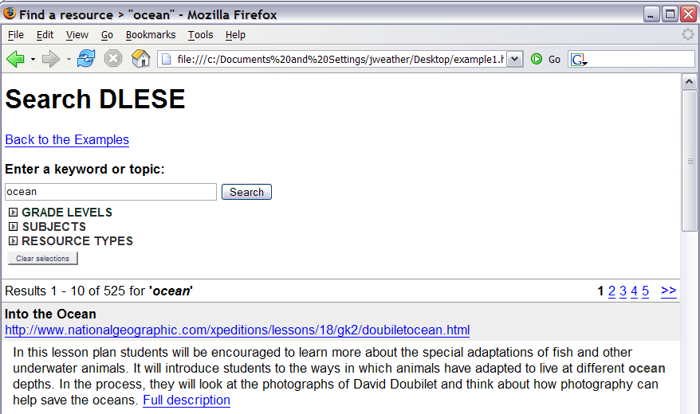
<head>
<LINK REL="stylesheet" TYPE="text/css"
HREF="http://www.dlese.org/dds/services/jshtml1-1/suggested_styles.css">
<style type="text/css">
BODY { font-family: Arial, sans-serif; }
TD { font-size:10pt; }
</style>
</head>
CSS applied to the BODY effects the entire page
CSS applied to the TD element effects the service output
JavaScript Search Service Tutorial

Slide 34
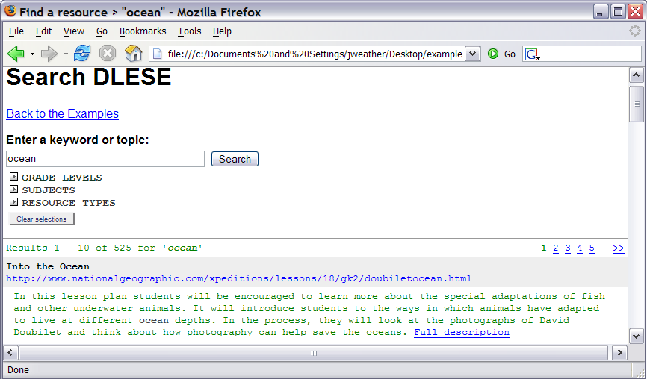
<head>
<LINK REL="stylesheet" TYPE="text/css"
HREF="http://www.dlese.org/dds/services/jshtml1-1/suggested_styles.css">
<style type="text/css">
BODY { font-family: Arial, sans-serif; }
TD { font-size:10pt; font-family: Monospace; color: green; }
</style>
</head>
CSS applied to the BODY effects the entire page
CSS applied to the TD element effects the service output
JavaScript Search Service Tutorial

Slide 35
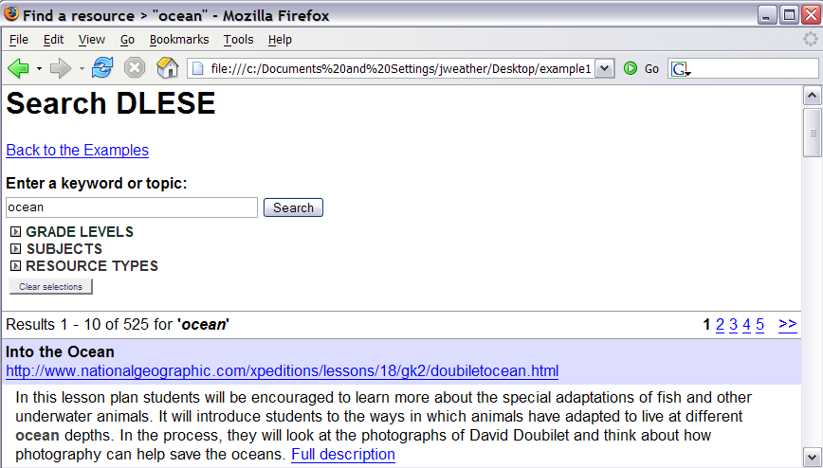
<head>
<LINK REL="stylesheet" TYPE="text/css"
HREF="http://www.dlese.org/dds/services/jshtml1-1/suggested_styles.css">
<style type="text/css">
BODY { font-family: Arial, sans-serif; }
TD { font-size:10pt; }
TR.resourceTitle { background-color:#ddddff; }
</style>
</head>
CSS applied to the TR.resourceTitle background-color controls the color behind the title of the resources in the search results
JavaScript Search Service Tutorial

Slide 36

As you develop, open your page in your browser to see how the dynamic content is displayed
Test your page in different browsers to verify they are rendering as you intended
As you edit the commands in your page, you will need to 'force' the browser to refresh itself in order to see the changes
There are some issues when developing using Internet Explorer (which do not occur once your page is deployed to a web server). Firefox or Netscape are recommended for developing your pages
Use the JavaScript debugging features of your browser to look for JavaScript errors
JavaScript Search Service Tutorial

Slide 37
See:
http://www.dlese.org/dds/services/jshtml1-1/javascript_service_documentation.jsp
For questions and comments, please send e-mail to support@dlese.org
JavaScript Search Service Tutorial

