Slide 1
Summer 2011 Undergraduate Engineering Internship Presentation
Monica Jacobs

Slide 2
My Computer Science Background
Python
Java
Some C
Html
php
mySQL

Slide 3

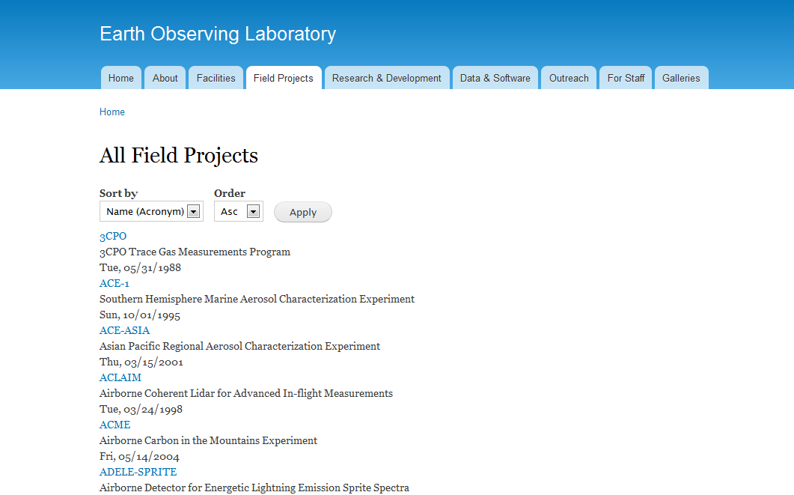
New Drupal Site
Originally hired for project that was delayed
Helped design organizational structure for field projects
Not particularly
technical
  Views
  Content Type
http://www.cloudave.com/wordpress/wp-content/uploads/2011/01/Drupal-Logo.png

Slide 4
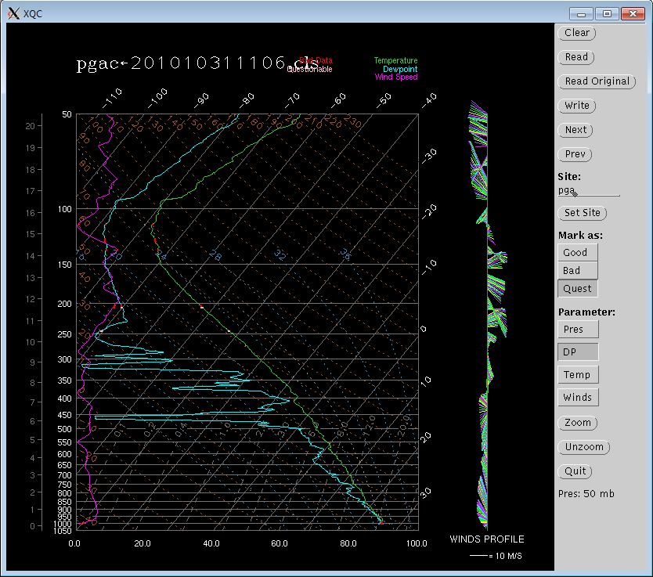
XQC Software
Sounding quality control tool
Written in C
Solaris only
  xview
Good/Bad/Questionable data markers
Parameters
Zoom
XQC2

Slide 5
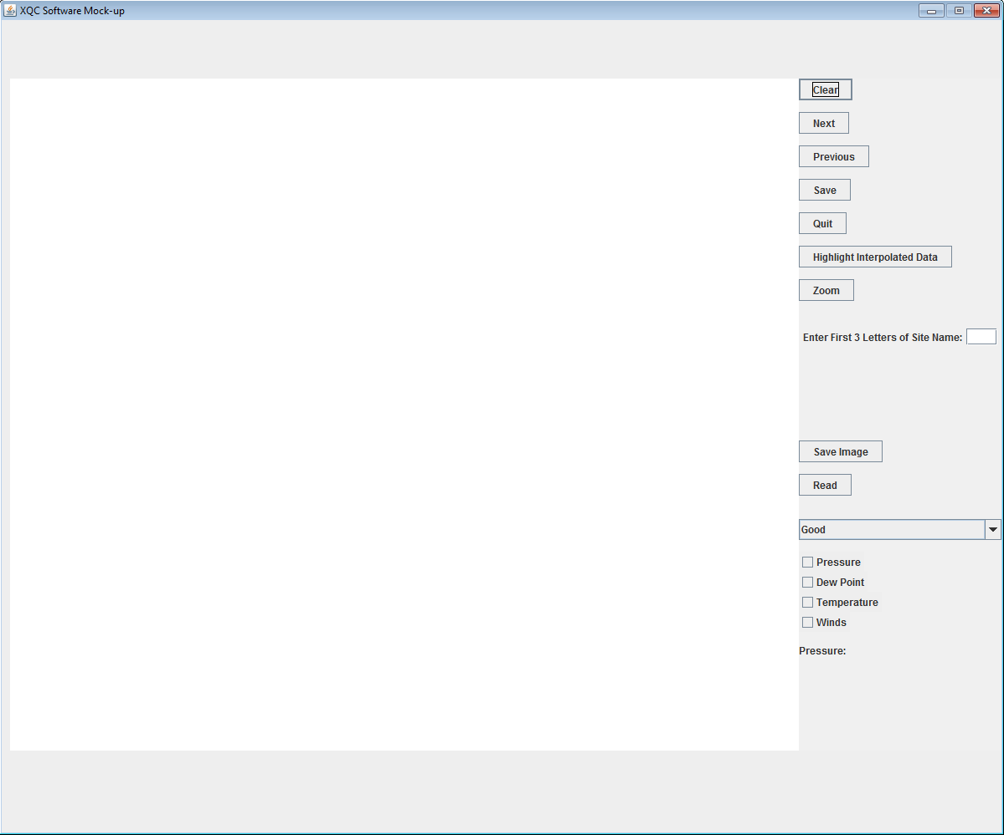
XQC Recommendation
Future Requirements:
  Cross-platform compatible
  Drag-and-Drop Zoom
  Save skew-T
  View a plot of ascent rate
  Overlay multiple soundings
Java
Report and Mock-up

Slide 6
Sounding Comparison Tool (SCT)-
Key Features
Compare Data from 5 Soundings on Plots
X-Axis Variables: Temperature, Relative Humidity, Wind Speed, Wind Direction, Ascension Rate, Longitude, Latitude, U Wind and V Wind
Y-Axis Variables: Pressure, Time and Altitude
Zoom feature

Slide 7
More SCT Mandatory Requirements
Windows-style file selection
Quit Button
Select new files and create new plots w/o exiting
Legend for each plot to differentiate between soundings
Proper scaling
Pressure plots with y-axis reversed
Error handling and graceful death

Slide 8
Some SCT Desired Requirements
Option to reverse Y-axis for dropsondes when plotting Time
Drag and Drop Zoom
View Skew-T Log P graphs too

Slide 9
Language and Tools
Java
Gnuplot
Javaplot
Gifs and Scripts
  Template File
Bash Shell

Slide 10
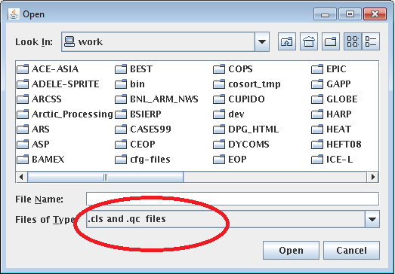
Selecting Files
NCAR EOL Sounding Composite Format
Filter for .cls and .qc files

Slide 11
Generating and Displaying the Plots
Data files rewritten with consistent missing value
Gnuplot template file read
Gnuplot scripts generated for new data files
New scripts run
.gif files created of plots
Image files displayed in Java interface
When “Plot” button selected, indicates all files opened
Different variables have different missing data markers
  Gnuplot is inflexible
  .sct files
Not particularly efficient, but no additional installations on network

Slide 12
Removing Files
.gif, .sct and gnuplot scripts generated
Bash script called with “Clear” or “Quit” buttons
  SCT doesn’t have to be run through Bash
Specific .gifs and scripts removed
All .sct files deleted

Slide 13
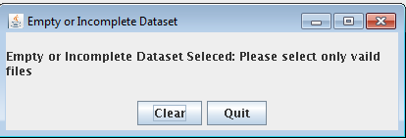
Error Handling
All errors handled
User-relevant errors get a pop-up message
Most common error is that gnuplot does not generate plots
  This occurs with an incomplete or empty file

Slide 14
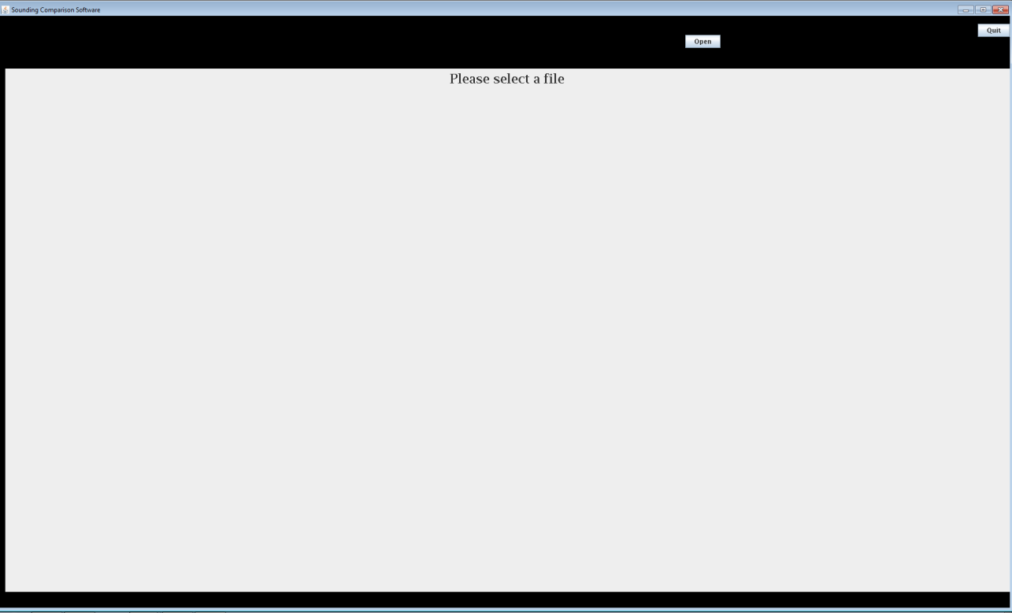
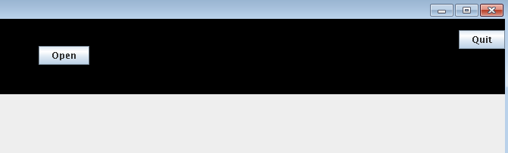
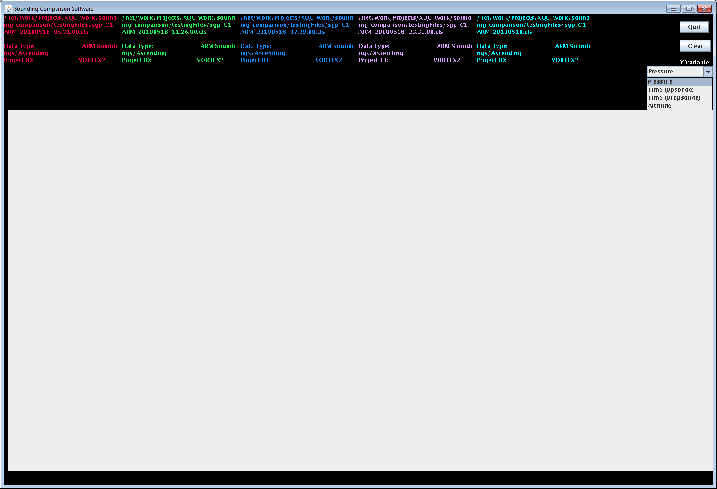
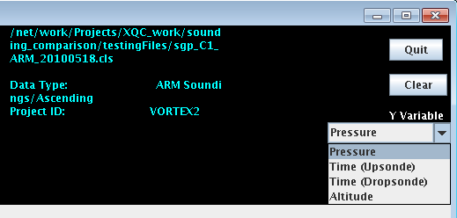
Startup and File Selection

Slide 15
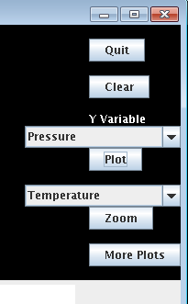
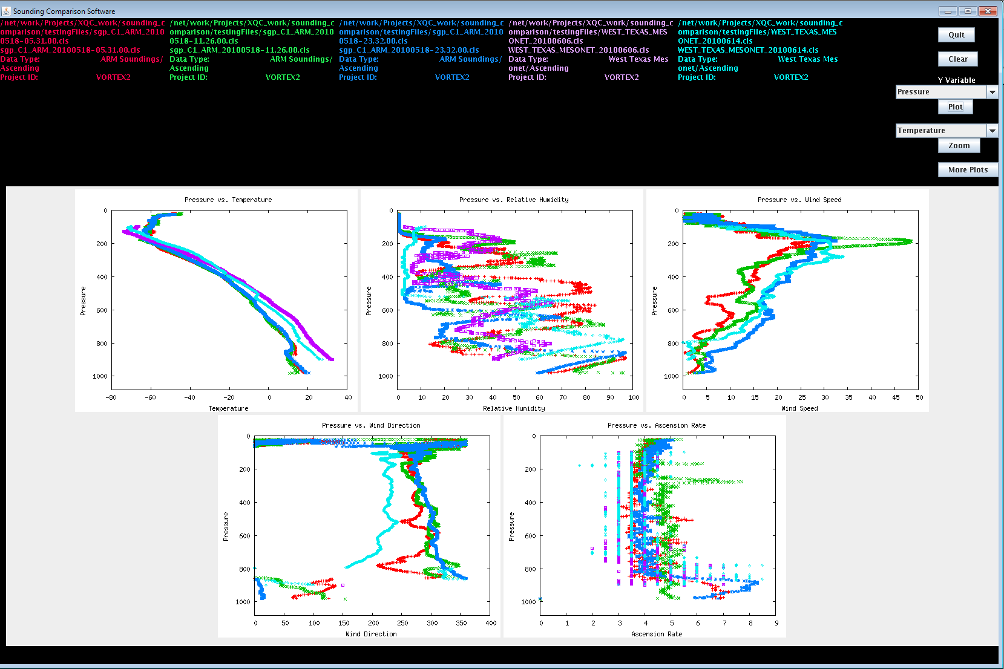
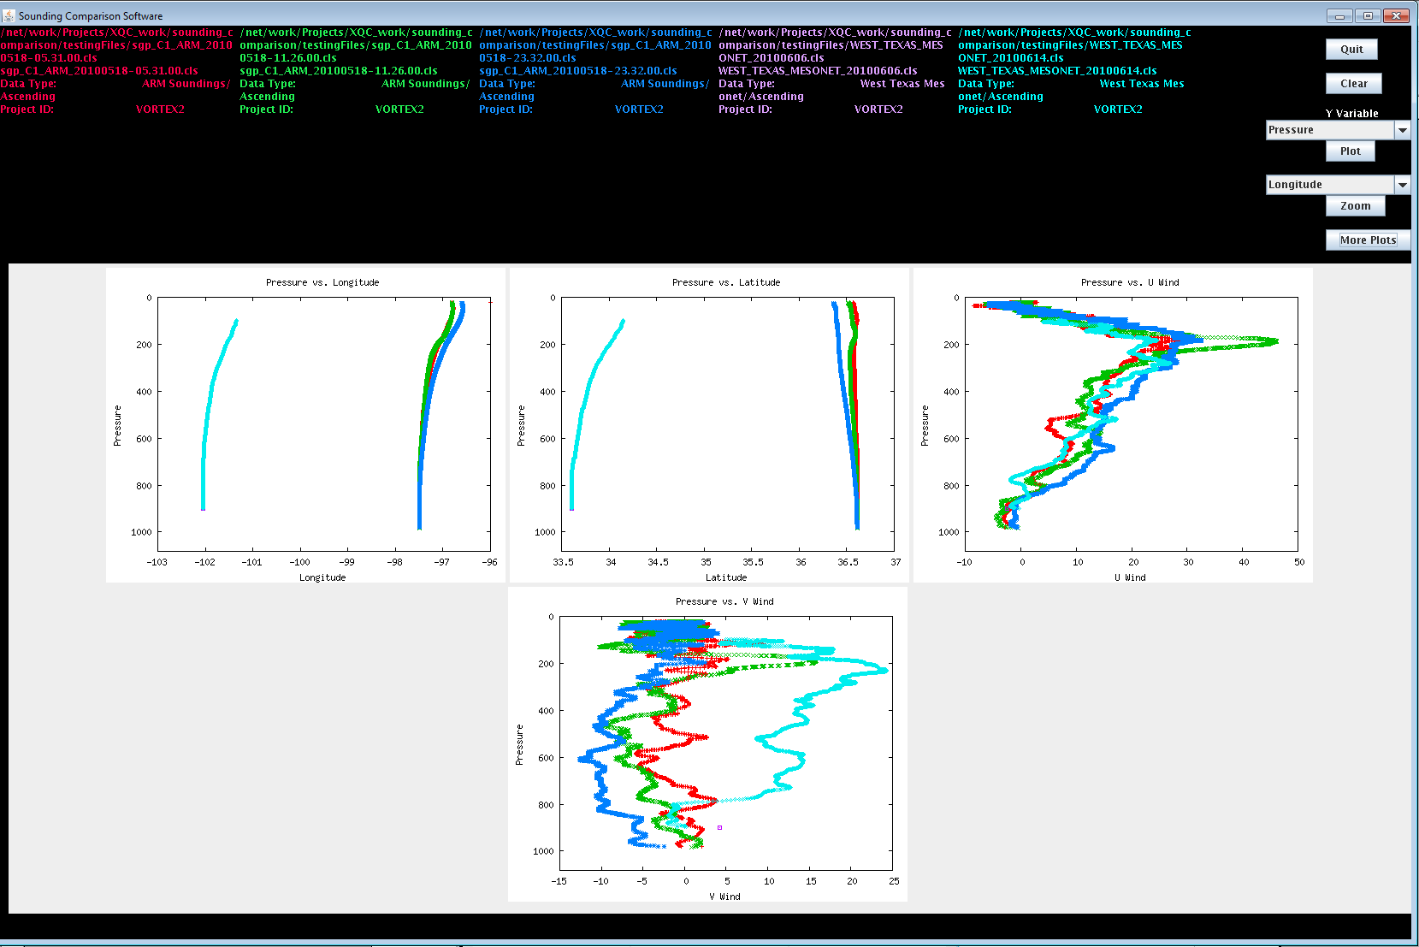
Plot Views

Slide 16
Software Uses: Quality Control
Can compare data from consecutive soundings
Spot data that doesn’t make sense or is different

Slide 17
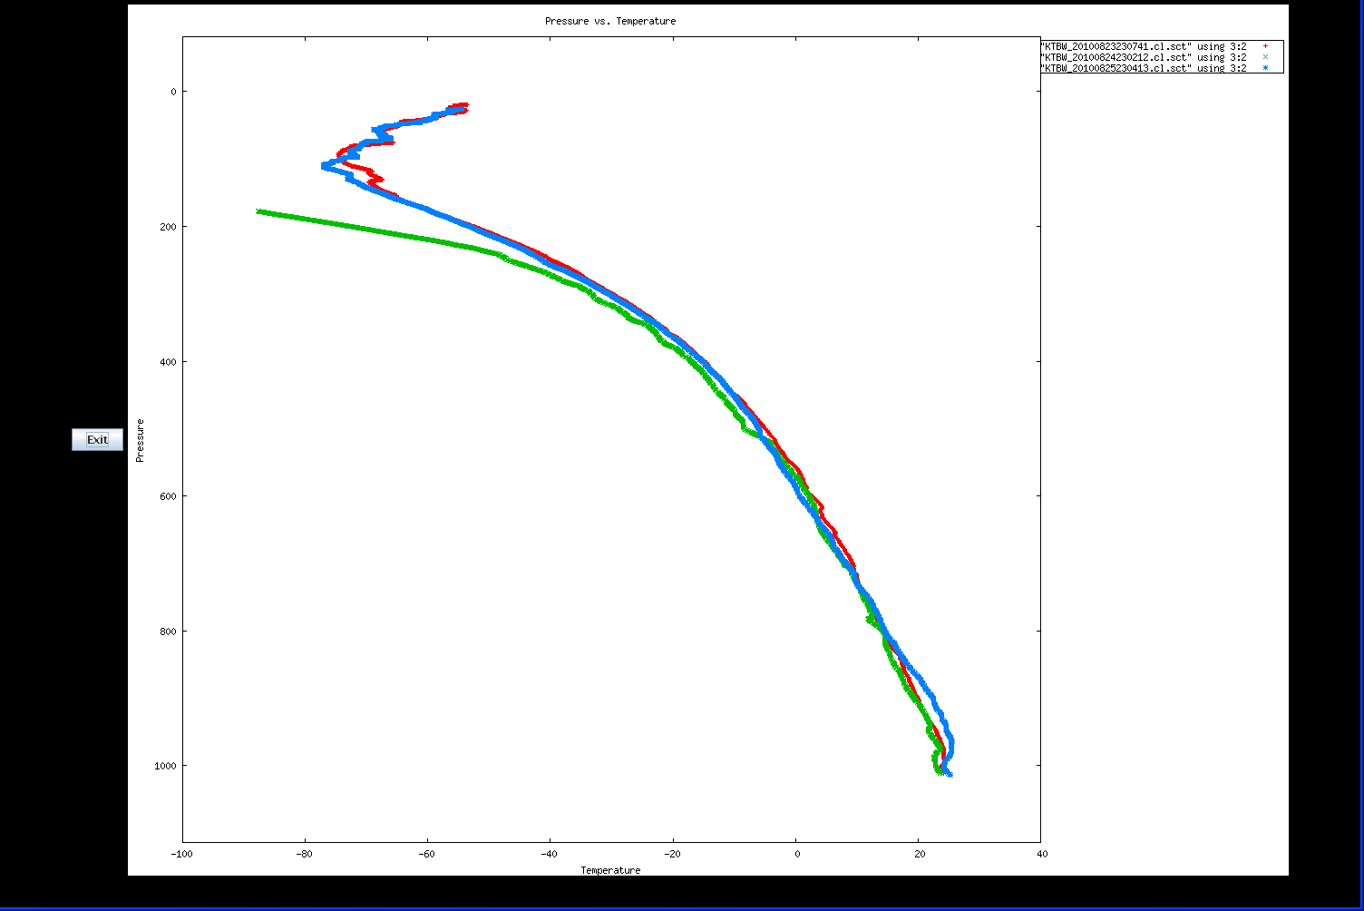
PREDICT NWS Tampa Bay, FL Radiosonde Temperature Data

Slide 18
Software Uses: Scientific Analysis
Allows data to be compared and changes noted
Variety of variables for flexibility in analysis
  27 different variable combinations

Slide 19
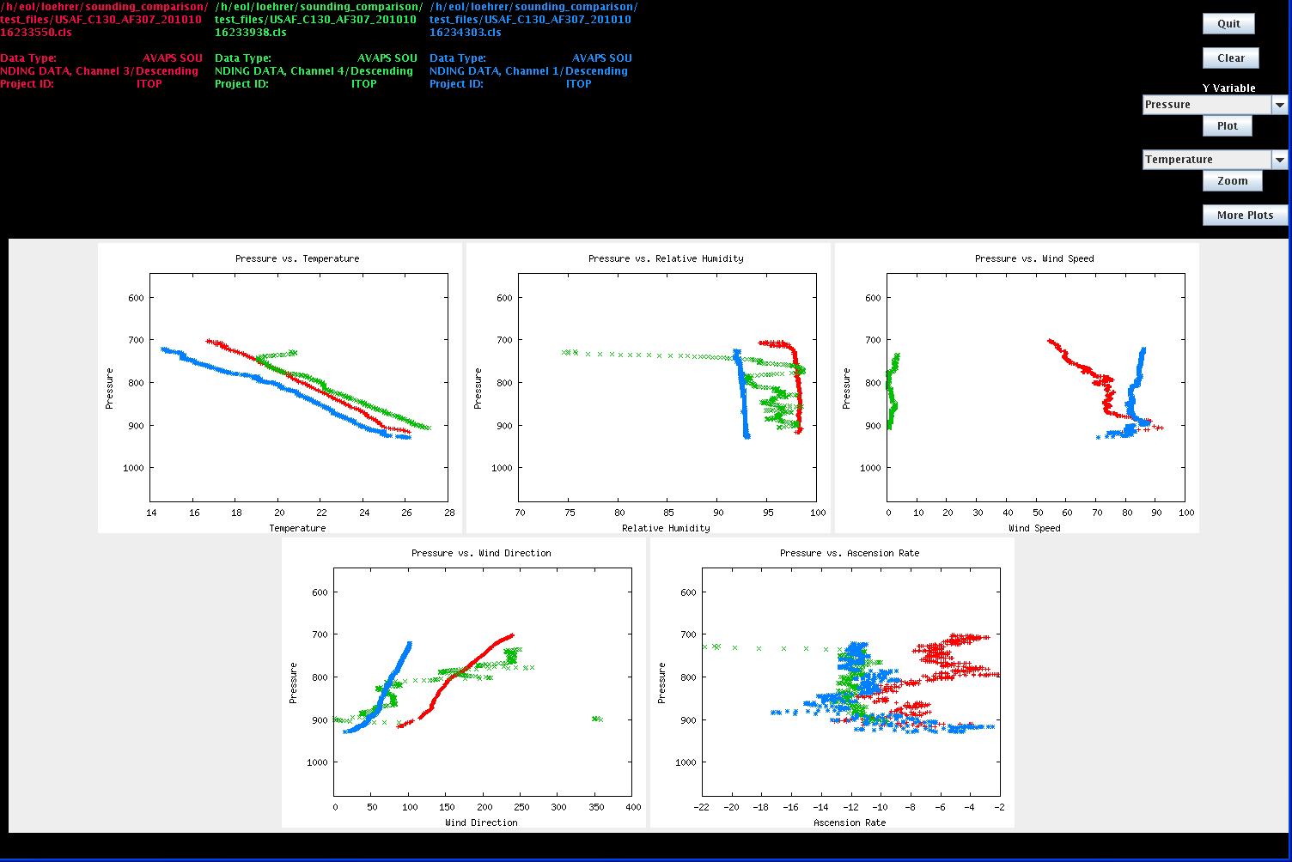
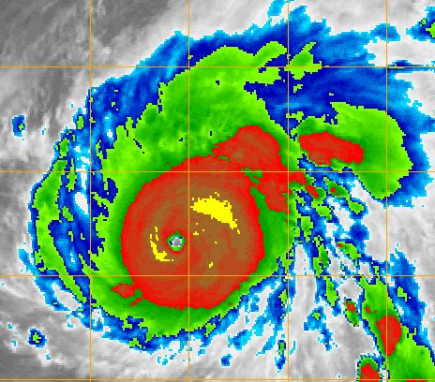
ITOP_2010 USAF C-130 Dropsonde Pass Through Eye of Supertyphoon Megi

Slide 20
Future Improvements
Drag and Drop Zoom
  Easiest to use something other than gnuplot
Skew-T
Improved efficiency
  Javaplot or entirely different plotting tool

Slide 21
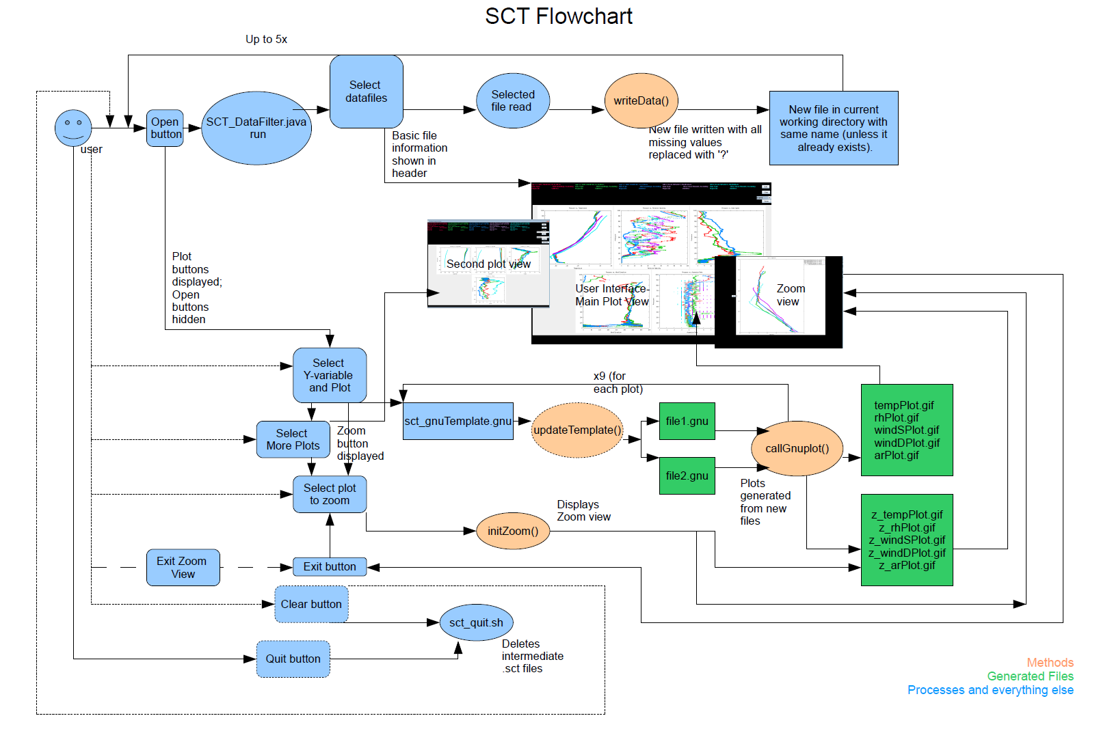
Documentation
Howto SCT
SCT Report
Regression Testing Suite with Howto
Flowchart
Version Control (SVN)

Slide 22
Thanks for your time!
Questions?

