Slide 1
MTP Status
Aug 26, 2015

Slide 2
Reverse engineering
Have the basic algorithm to get from counts to Brightness temperature
Still a question of how best to implement gain equation, more conversation with JPL is needed
Have a basic solution that will allow us to move forward

Slide 3
Reverse engineering
Have the basic algorithm to get from Brightness temperature to Profile Temperature
Still need MRI (quality indicator)
Still need altitude (believe it’s simple)

Slide 4
Development
Data Model is defined
MTP Bin output data has been put into model for CSET data
Platinum wire to temperature algorithm has been verified (Tsynth)
Basic temperature profile plot has been added to aeros

Slide 5
Development next steps
Write code to pull in template and retrieval coefficient information from pre-CSET templates
Add it to copies of the netCDF files according to the data model
Write code to convert counts to brightness temperatures
Compare with MTPbin data (next slide)
Getting “close enough” results?

Slide 6
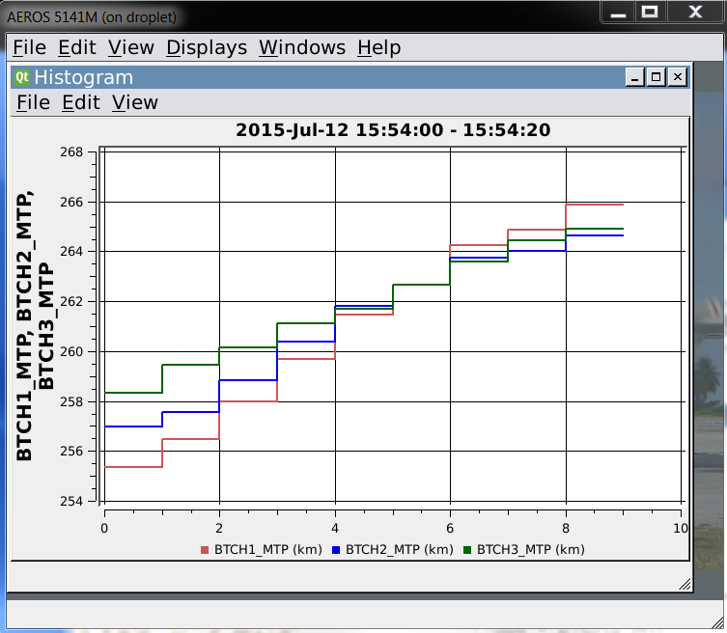
MTPBin Brightness temps example

Slide 7
Development next steps
Write code to select template(s)/retrieval coefficients for Brightness temperatures and the altitude levels for them
Validate against MTPBin data from CSET (see next slide)

Slide 8
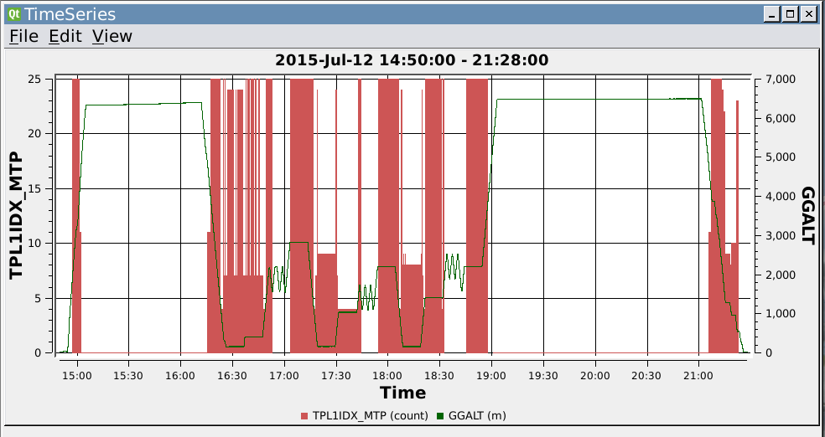
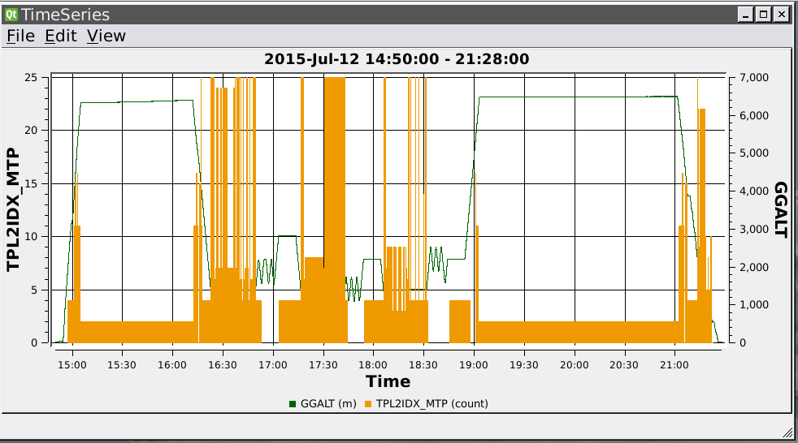

Slide 9
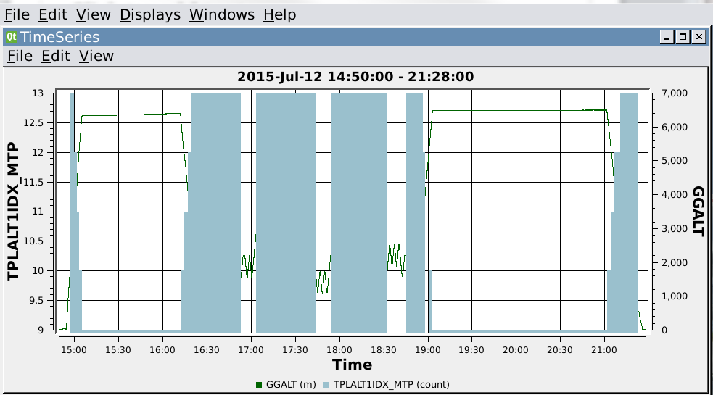
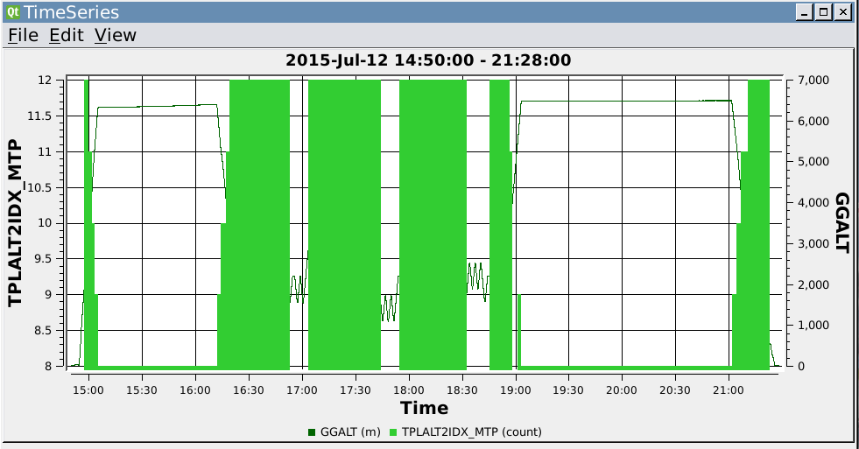

Slide 10
Development next steps
Reverse Engineer altitude value for profile temperature pairings from MTPBin
Write code to generate MTP Profile temperature and altitude components
Validate
Assuming all coding is comparing well
Update aeros displays and add new displays as previously discussed

